Slide 1
Acute and chronic pain
Dr. Štoudek, Dr. Křikava

Slide 2

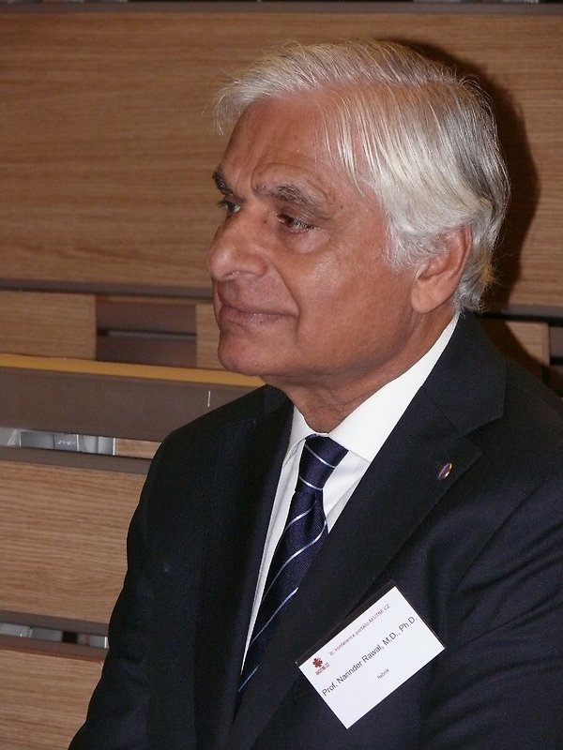
Prof. Henrik Kehlet
Prof. Narinder Rawal
Acute Pain Service

Slide 3
Definition - Merskey 1967, WHO, IASP
An unpleasant sensory or emotional experience associated with actual or potential tissue damage or described in terms of such damage
„Pain is, what patient feels, when he says, that he feels pain “
Margo Mc. Caffery

Slide 4
Difficult to apply definition
Small children
Verbal handicapped adults
Mentally disabled
Patients with dementia
Patients suffering from alexithymia

Slide 5
Pain
= subjective experience
Could be affected:
  Age
  Gender
  Cultural habits
  Previous experience

Slide 6
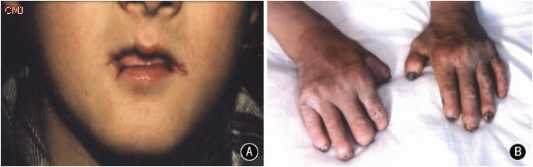
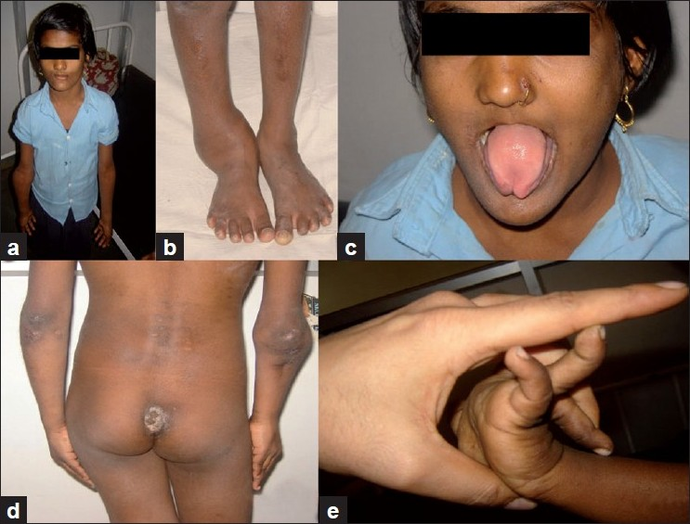
Congenital loss of feeling of pain

Slide 7
Patophysiology of pain
Nociceptors, polymodal nocisensors
C fibre nociceptors
A fibre nociceptors
Posterior horns of spinal cord
Tractus spinothalamicus, spino-bulbo thalamicus, spinoreticularis
Brain pain centers (gyrus precentralis….)
Supressive mechanisms (GABA, opioids..)

Slide 8
Classification of pain
Acute pain x chronic pain
Nociceptive pain x neuropathic pain
Psychogenic pain
Malignant pain x non-malignant pain
  Pain caused by cancer (infiltration of bone, viscera…)
  Pain as sequelae of cancer treatment (post-surgical, post chemotherapy, post radiotherapy…)

Slide 9
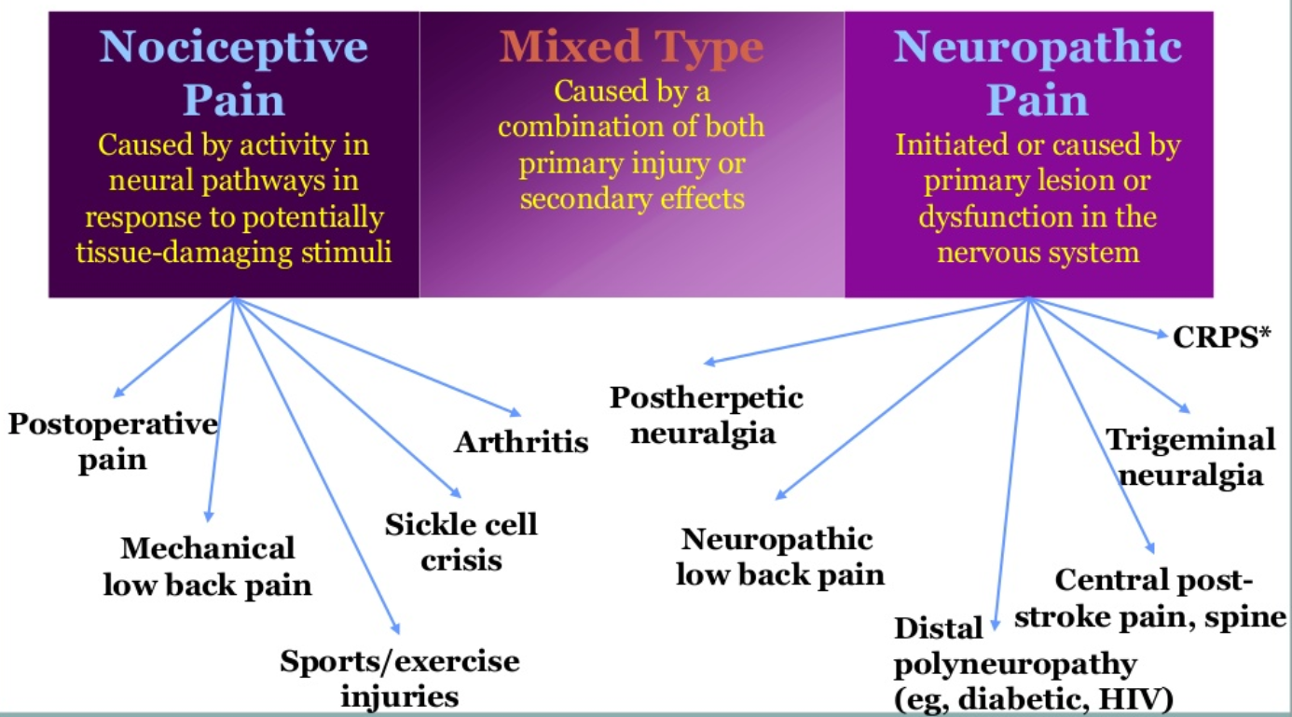
Classification of pain

Slide 10
Acute pain
Useful pain, physiologic pain
AP is symptom of disease
Fulfill basic role of pain – protect organism against injury, disease …
Short duration – hours, days.. Max. 3 months
Duration of acute pain is adequate to causality of this pain
Sharp, itching, localized pain,
Localization is the same as causality
Stimulation of sympathetic syst.
Main risk of AP is its chronification

Slide 11
Chronic pain
CHP is syndrome, disease
Long duration – more than 3 months
Usually connected with depression
Parasympathetic stimulation
Constipation
Social isolation

Slide 12
Somatic pain
Cause: stimulation of nociceptors
Types:
  Somatic (muscles, skin, joints)
  Visceral (internal organs)
Character:somatic pain is good localized, sharp
  Visceral: dull and difficult for localization, sometimes reffered pain

Slide 13
Neuropathic pain
cause: dysfunction of nerve systems (peripheral, central, vegetative)
types:
  peripheral (peripheral nerves, nerve roots),Trigeminal neuralgia, post herpetic neuralgia
  central (brain, spine) central post stroke pain
Character: stable pain, paroxysmal pain with intensive pain atacks, alodynia) trigeminal neuralgia, postherpetic neuralgia

Slide 14
Other types of pain
Mixed pain:
  Pain contained nociceptive and neuropathic type of pain (FBSS)
Psychogenic pain

Slide 15
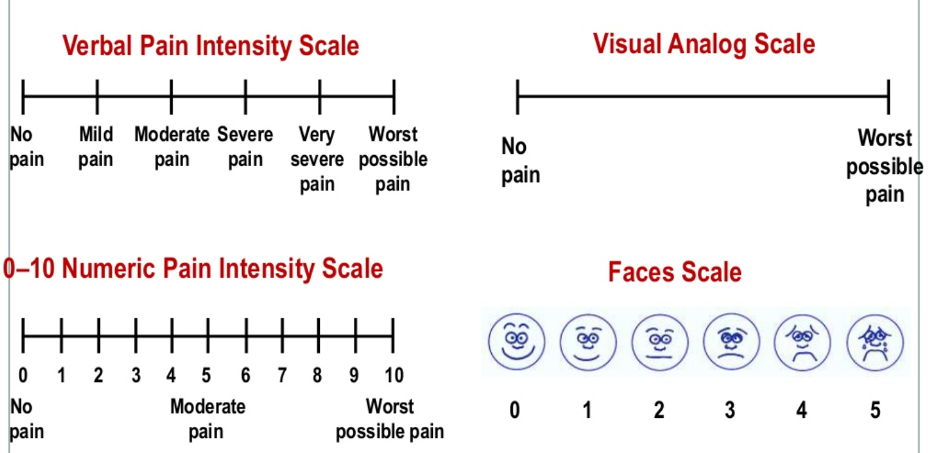
Pain measurement

Slide 16
Possibilities of pain treatment
Pharmacotherapy
Physical treatment and rehabilitation
Psychotherapy
Invasive pain treatment methods
„Alternative“ treatment approaches (homeopathy, acupuncture ….)

Slide 17
Acute vs. Chronic Pain Management
Acute Pain
Chronic Pain
Most often treated with:
  NSAIDS
  Opioids
  Local anesthetics
  Splinting
  Positioning changes
  Ice
Most often treated with:
  Anti-seizure medications
  Anti-depressant medications
  NSAIDS
  Implantable devices
  Psychological therapy
  Acupuncture
When everything else fails and benefits outweigh risks
  Opioids

Slide 18
Acute Pain Service
Provides 7 days per week, 24 hour consultative services every day of the year.
Staffed by anaesthesiologists, nurse practitioners
Manages IV PCA (patient controlled analgesia), epidural catheters, nerve block catheters.

Slide 19
Center for Pain Management
The Pain Center is located in the Ambulatory Care Pavilion
Treatments offered
  Comprehensive evaluations
  Epidural steroid injections
  Spinal injections
  Nerve blocks
  Psychological evaluation and treatment
  Opioid risk evaluation

Slide 20
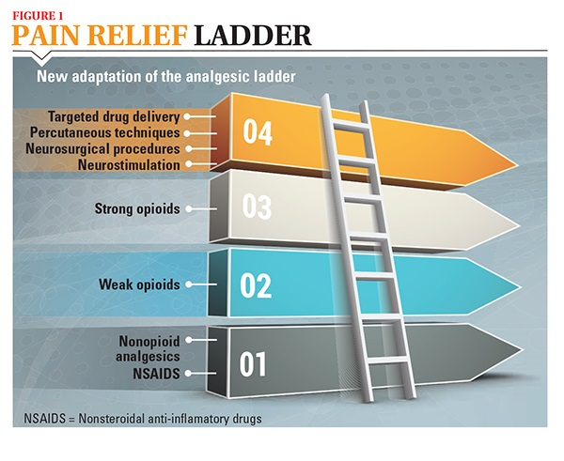
WHO ladder of pain treatment

Slide 21
WHO 3 steps analgesics ladder
For mild pain, use non-opioid first
When pain persist or increases, add an opioid
If pain becomes more severe, increase the opioid potency or dose
Schedule doses on around-the-clock basis, with additional PRN doses-rescues

Slide 22
Adjuvant analgesics
Anticonvulsants
Antidepressants
Corticosteroids
Neuroleptics
Anxiolytics
Muscle relaxants
Anesthetics
antispasmodics

Slide 23
Analgetic of the I step
Analgetic – antipyretic:
  Paracetamol (acetaminophen)
  NSA (non steroid antiphlogistic):
    non selective COX inhibitors (ibuprofen, diclofenac, naproxen, indometacin)
    COX II preference inhibitors (nimesulid, meloxicam)
    COX II selective inhibitors (celecoxib, parecoxib (Dynastat), valdecoxib)
    (Arcoxia)

Slide 24
Analgetic of the II step
Weak opioids:
  Codeine ( max. 240 mg/d)
  Tramadol (max. 400 - 600 mg/d; µ agonist, norepinephrine and serotonin reuptake inhibitor)
  Hydrocodone (DHC) max 240mg/d
  Oxycodone in combination with nonopioid
  Tapentadol (µ agonist, norepinephrine reuptake inhibitor)

Slide 25
Analgetic of the III step
Morphin SR
Fentanyl
Oxycodone
Morphin IR
Buprenorphine
Hydromorfone
Methadone

Slide 26
The most frequent mistakes in chronic pain treatment
Doctors don´t use advantageous combinations of different analgesics groups (opioids + NSA, NSA + paracetamol)
In case of increasing analgesics combinations (step up on the WHO leader) change non opioid remedy to weak opioid – instead to add weak opioid
Dosage of drug inappropriate to pharmacokinetics of drug (usual slow release (SR) preparates last for 12 hours)
Insufficient dosage of opioid, they are untimely changed
Combinations of different NSA (indomethacin supp + ibuprofen)
Untimely cancelling treatment due to AE, opioids related AE disappear during 2 weeks (exclude constipation) Occurrence of AE is reason for its treatment – no cancelling

Slide 27
Invasive Pain treatment - indications
In case of lack of effect of pharmacotherapy
Pharmacotherapy with severe adverse event
Supplement of Pharmacotherapy

Slide 28
Types of blockades
Reversible x irreversible
Vegetative x somatic
single x repeated x continual
Diagnostic x prognostic x therapeutic

Slide 29
Division of blockades due to localisation
Local application of LA (reflexive blockades, trigger points, tender points, painful scars, intraarticular applications (SI? …)
Peripheral nerve blockades (axillar, and intercostal nerve block)
Paravertebral blocks
Central (spinal) block (epidural, subarachnoid)

Slide 30
Epidural application of steroids

Slide 31
Indication
Acute (days) and subacute (weeks up to 3-6 months) radicular pain (pain irradiating do leg) and caused by intervertebral disc herniation.
CT exam.
Patient is not indicated to back surgery

Slide 32
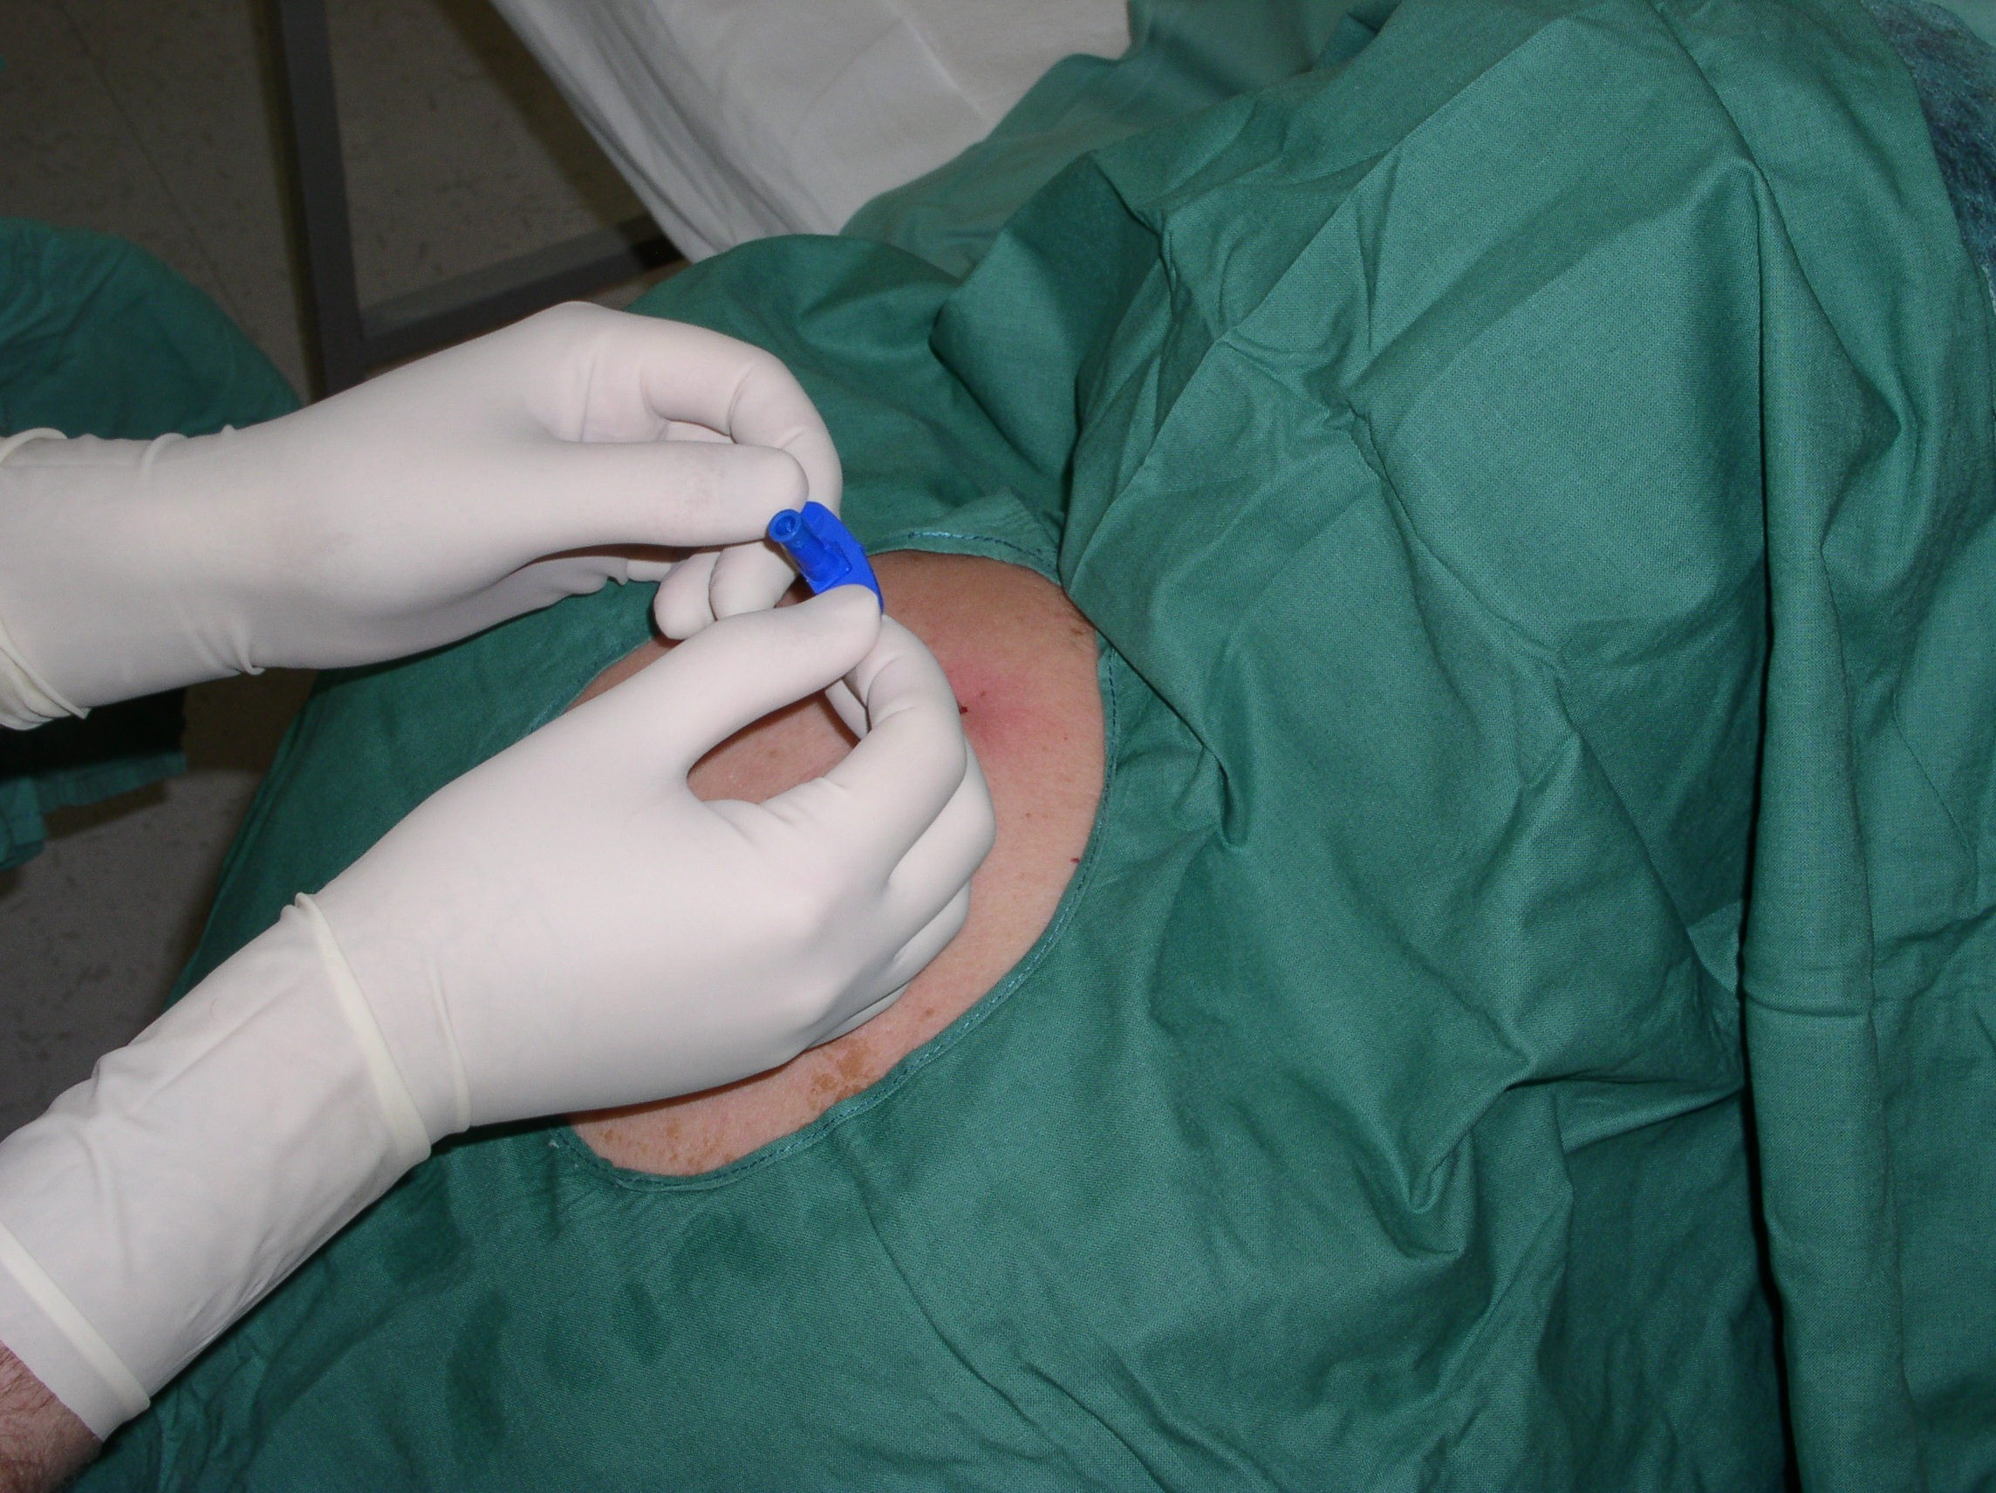

Slide 33
Recommendation after a application
2 weeks of resting regime
First improvement of pain during 2-3 weeks
4 weeks next visit in pain amb.
From 6 th moth after appl. Started rehabilitation
Recommended daily exercising (15-20 min) - improve body muscle unbalance

Slide 34
Subarachnoidal analgesia
Single shot – before surgery – 24 hours post surgery analgesia
  LA + morphin spinal 0,2-0,3 mg
Subarachnoidal catheters
  Spinocath
Subarachnoidal ports

Slide 35
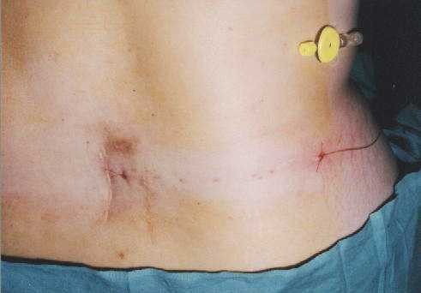

Slide 36
Subarachnoidal ports
Treatment of chronic pain – moths, years (FBSS, Cancer)
Patient or his family training of applications
To Be prepare to solve complications of this treatment method (CNS infections, local infections, technical complications, withdrawal syndrome)

Slide 37
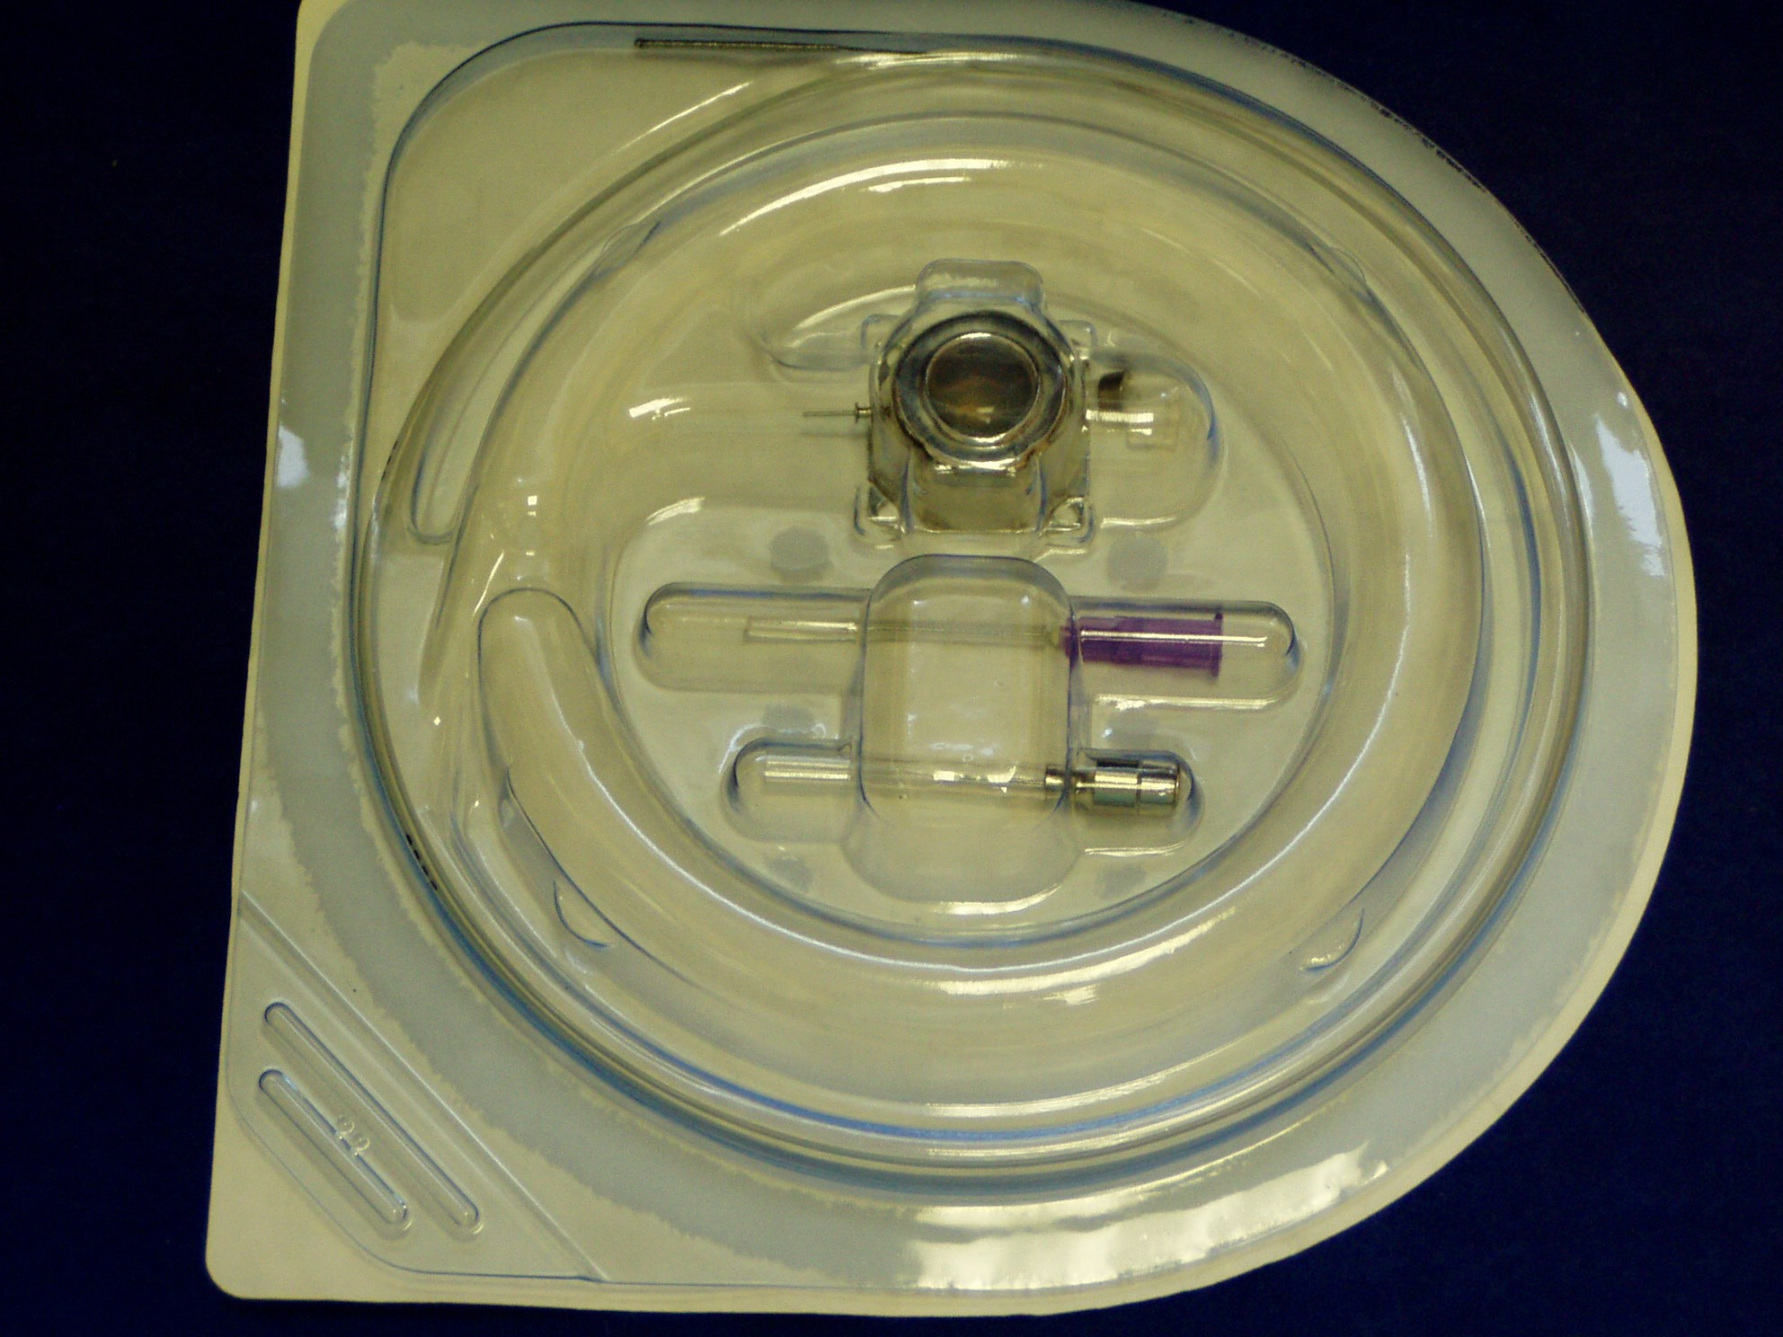

Slide 38
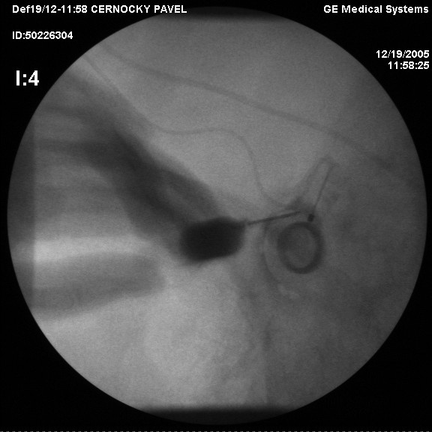

Slide 39
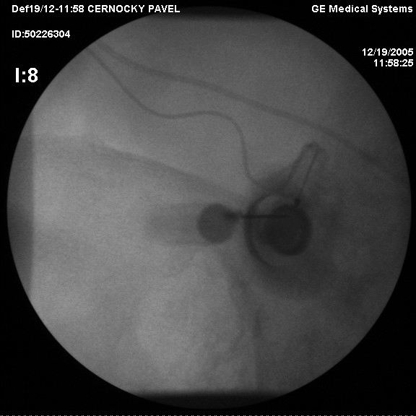

Slide 40
Neuromodulation

Slide 41
Neuromodulations centres in CZ
FN Homolka
FN Motol
ÚVN Praha
FN Olomouc
FN Brno
FN u sv. Anny v Brně

Slide 42
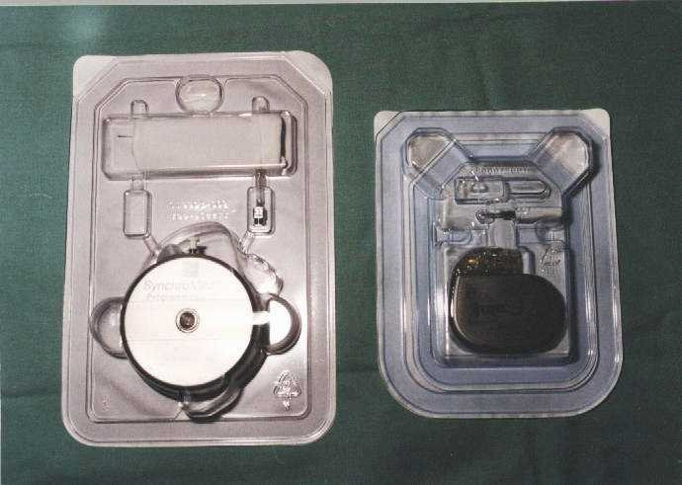

Slide 43
Necessary pre-implantation examinations
Neurologic
Psychologic!!!!
Psychiatric
Immunology
Orthopaedic or neurosurgery
Summary of health condition from GP
Algeziology exam
Positive result of test period

Slide 44
Indication
SCS – spinal cord stimulation
Predominant neuropathic lower limb pain
Subarachnoid pumps
Predominant low back pain

Slide 45
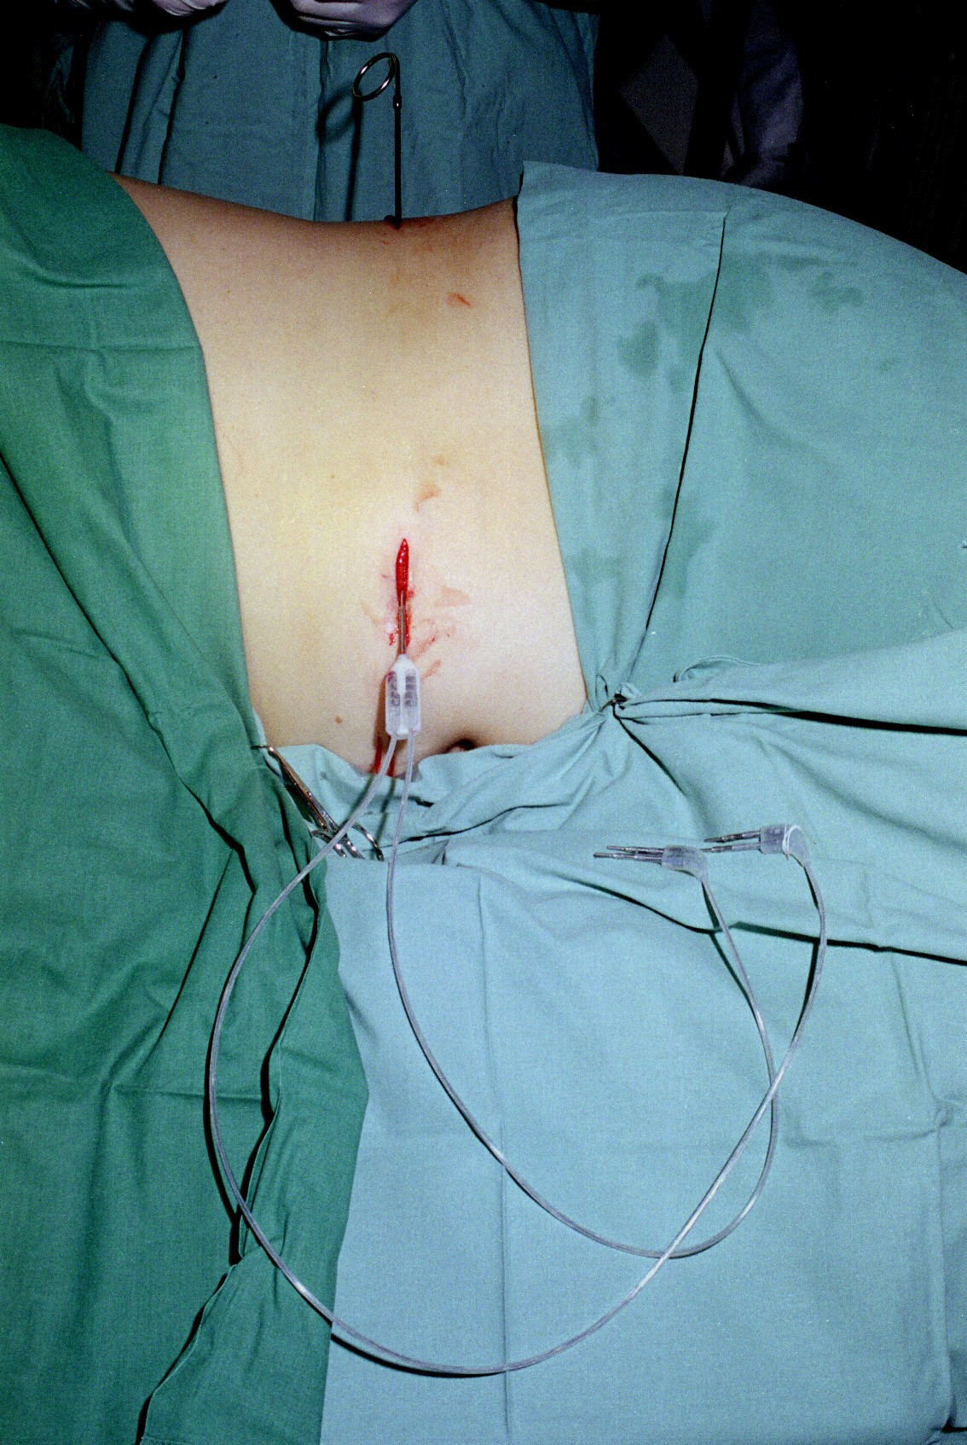

Slide 46
Subarachnoidal programmable pump – test period
Insertion of subarachnoid catheter
Connecting of external programmable pump
Setting of adequate mode for application
1 week in patient, 1 week out patient (better simulation of normal daily life of pat.)

Slide 47
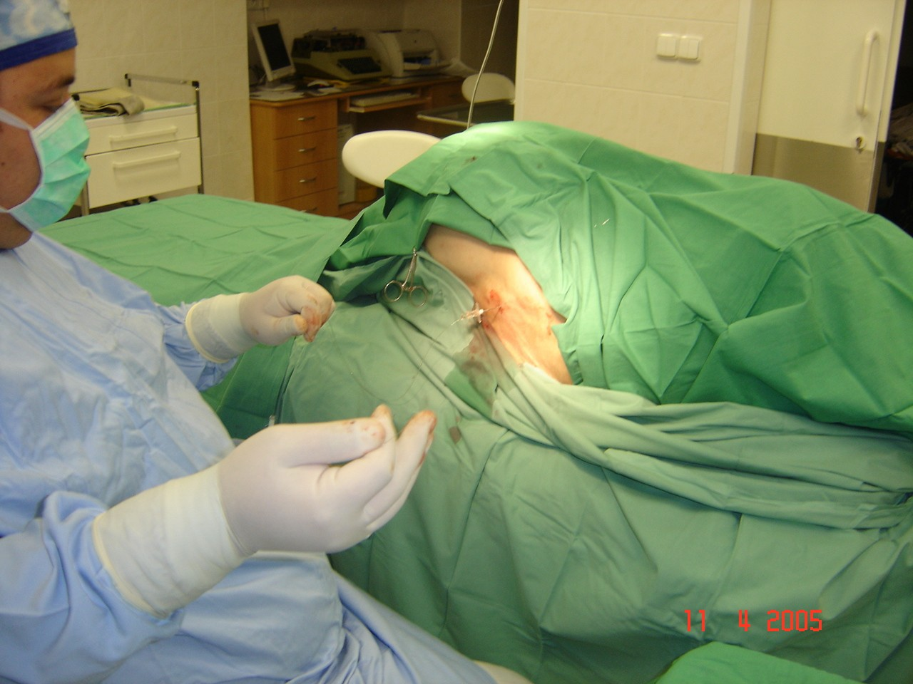

Slide 48
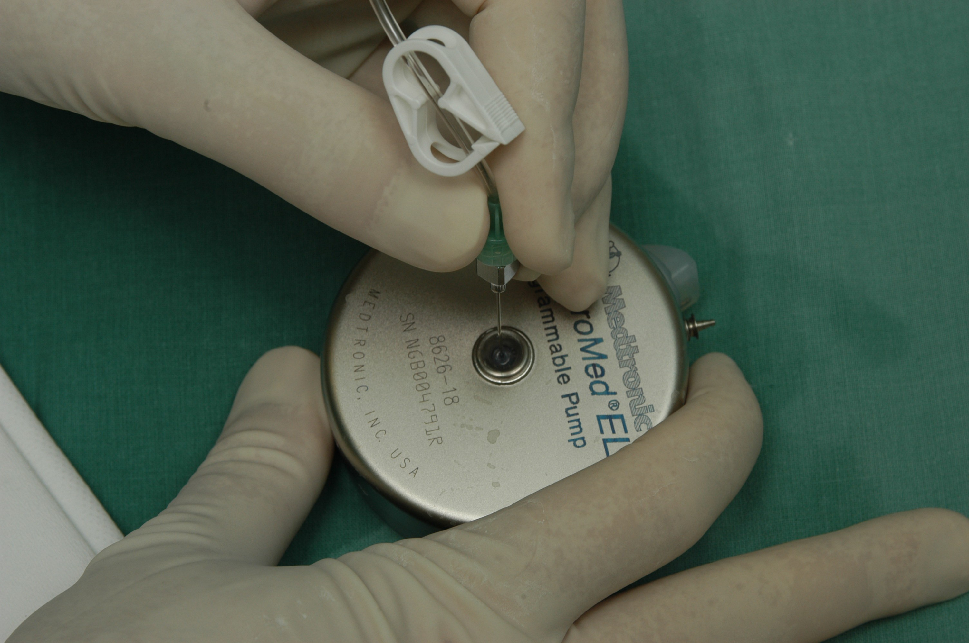

Slide 49
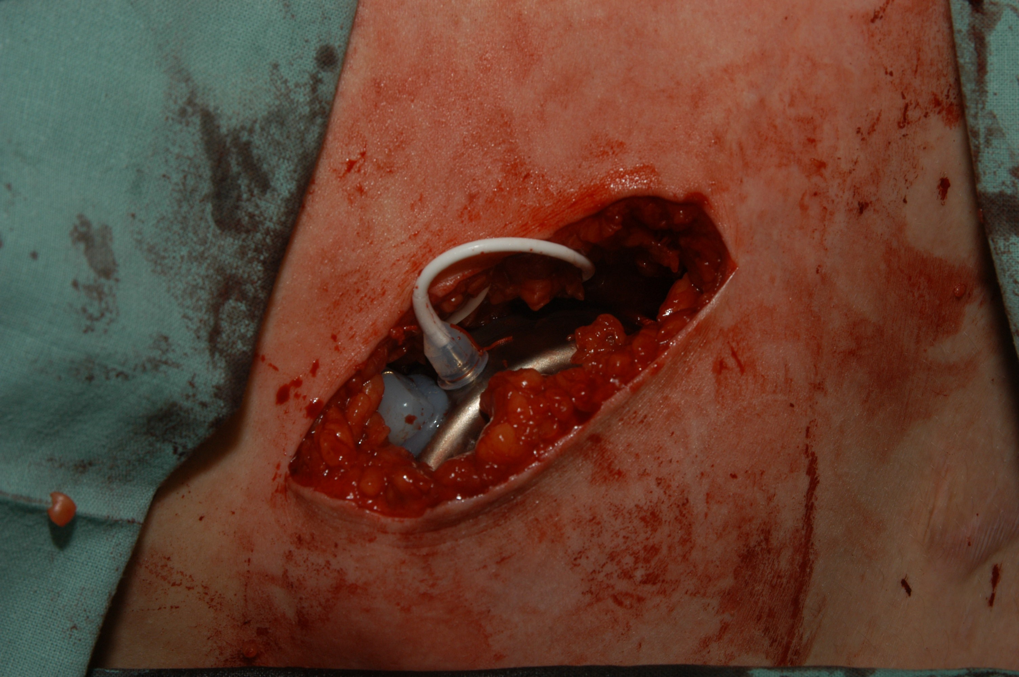

Slide 50
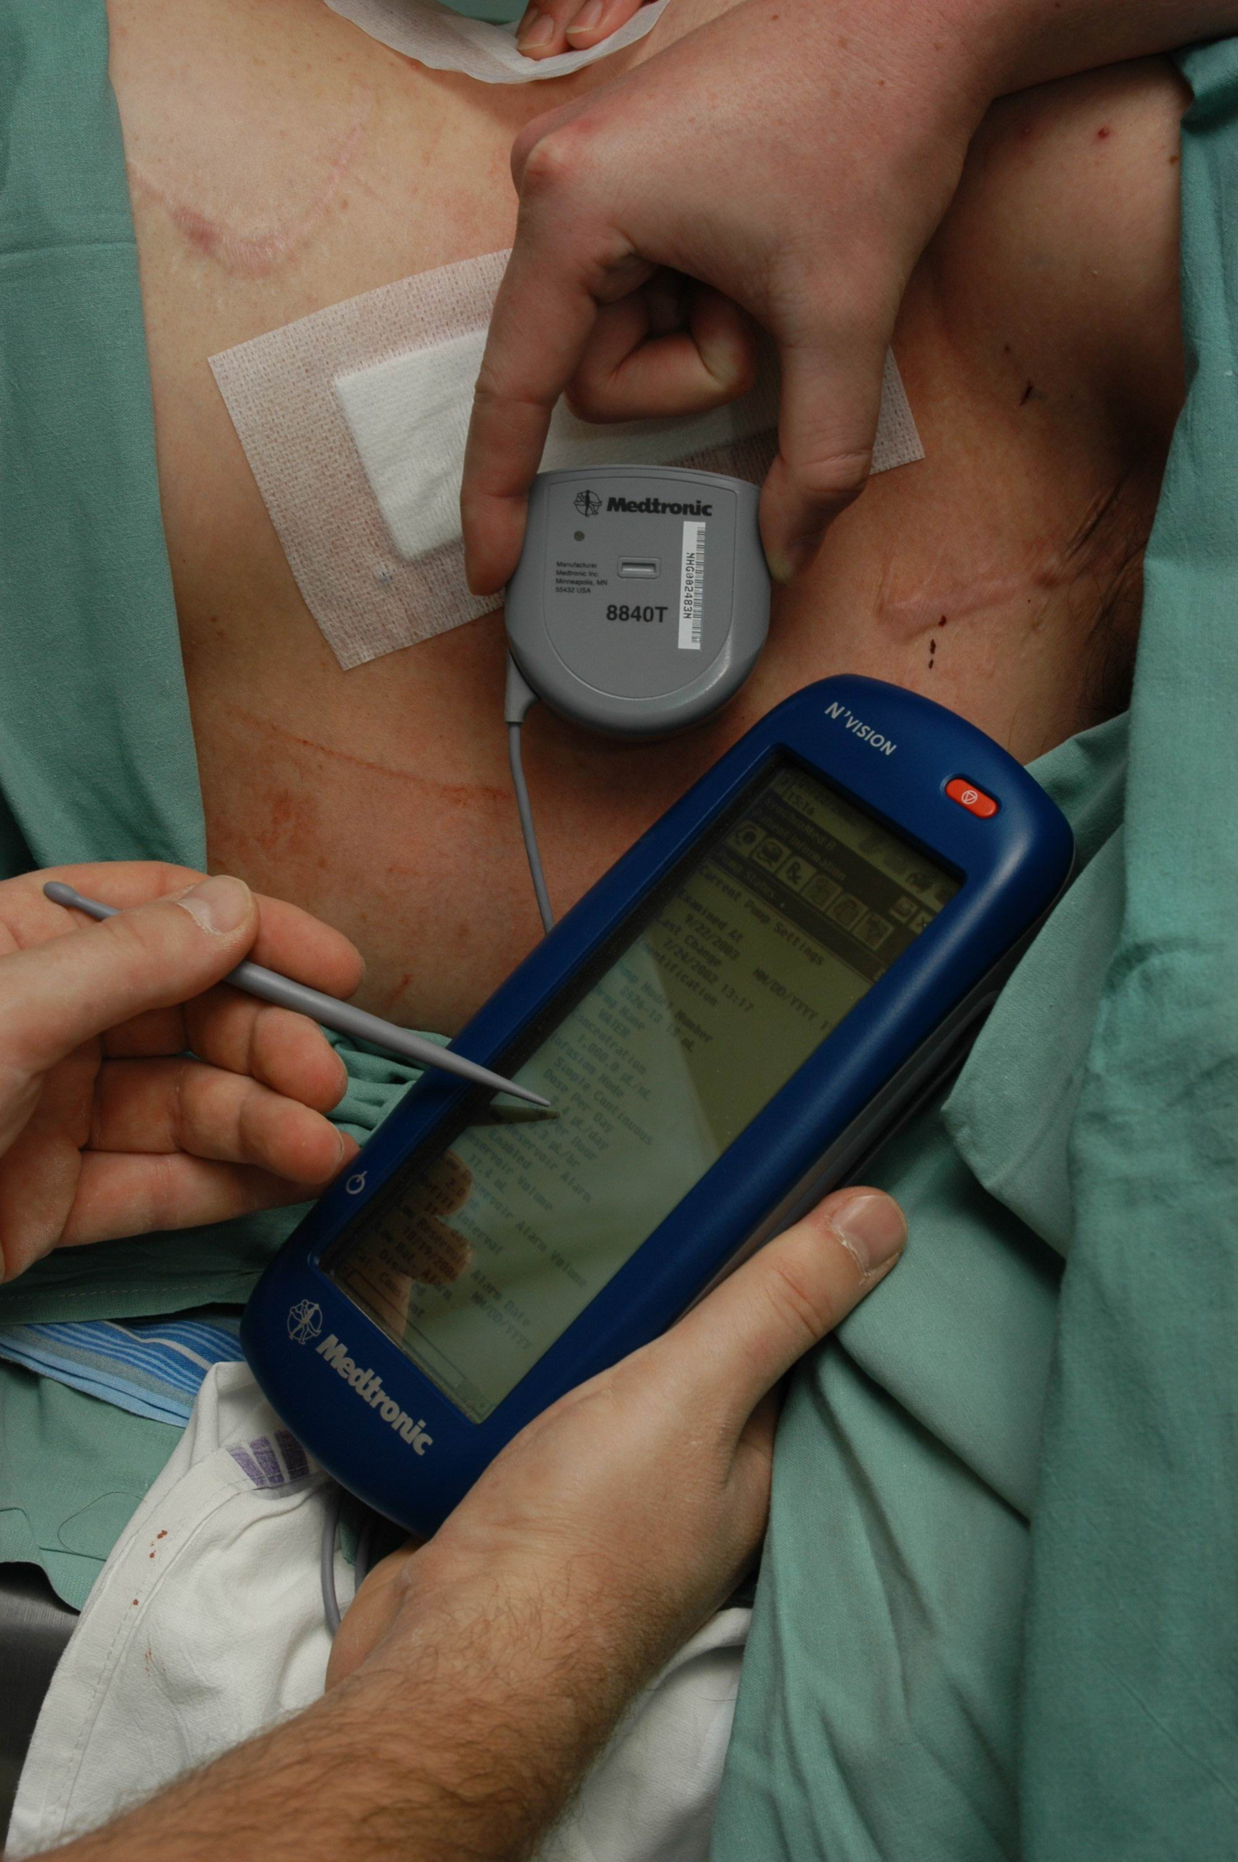

Slide 51
Sympathetic blocks

Slide 52
Sympathetic blocks
Reversible
Lokální anaesthetic
Ireversible
Etanol 50–80%
Fenol 6-8%

Slide 53
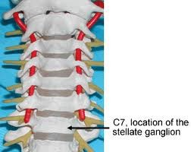
Ganglion stellatum – cervical sympathetic syst.
Upper cervical ganglion (C2-C3)
Middle cervical ganglion (C4-C6)
Lower cervical ganglion, ggl. Stellatum (C7 -Th1)

Slide 54
Indication
CRPS I. a II. Type (after surgery or injury, prolonged healing and oedema, followed with muscle atrophy and articulation freezing
Post herpetic neuralgia
Phantom pain
Morbus Paget
Post radiation neuritis
Raynaud's disease

Slide 55
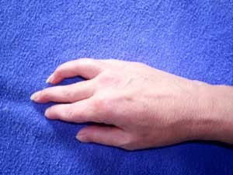
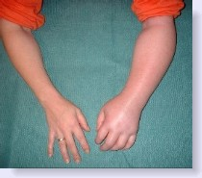
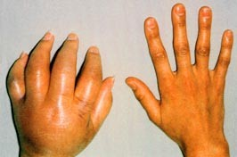

Slide 56
Therapy
Series of 10 blocks, Marcaine 0,25% 10 - 15ml
Possibility of blockades of other nerves in this region (n. glossopharyngeus, n. recurrent – gulping disorder, huskiness)
Presence of Horner´s trias

Slide 57
Neurolysis of ggl. coeliacum
Epigastrial pain
  (painful attacks in case of chronic pancreatitis, cancer of pancreas – very painful type of cancer
Blockade under CT control

Slide 58
Thank you for your attention

