Slide 1


TACHYCARDIA
&
BRADYCARDIA
ALGORITHMS
Jan Hruda
ARK FN u sv. Anny

Slide 2

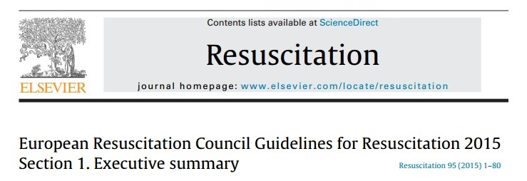


www.erc.edu

Slide 3
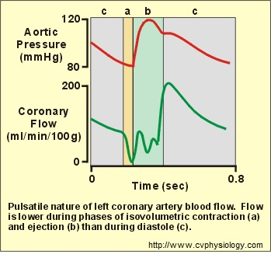
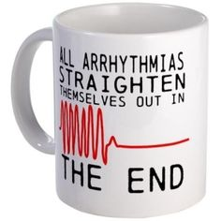
ARRHYTMIA
Consequences:
cardiac failure
myocardial ischaemia
(pre-)syncope
cardiogenic shock
circulatory failure/arrest
= require immediate treatment
= guidelines knowledge crucial

Slide 4
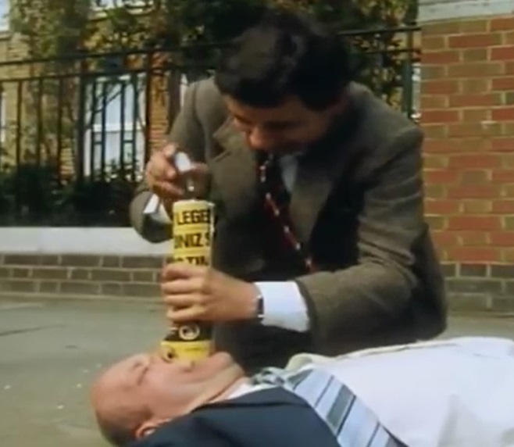
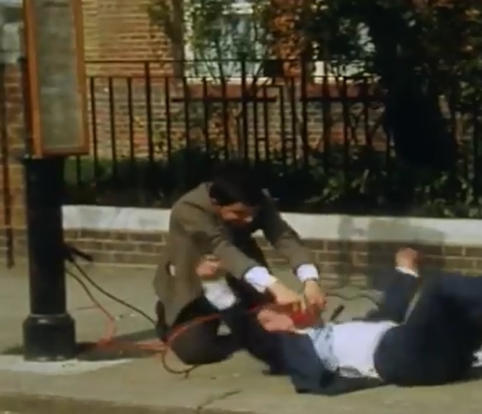

ARRHYTMIA
PHARMACOTHERAPY
ELECTROTHERAPY
antiarrhythmics
parasympatholytics
sympathomimetics
cardioversion
(defibrillation)
pacing

Slide 5
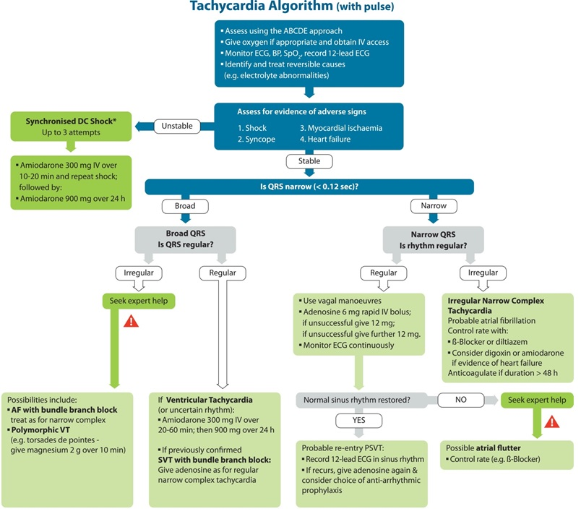
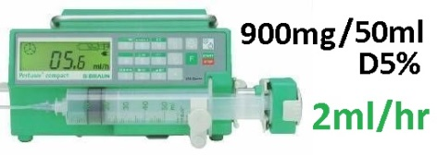
sedation
Do not administer amiodarone as a quick bolus = ↓BP

Slide 6

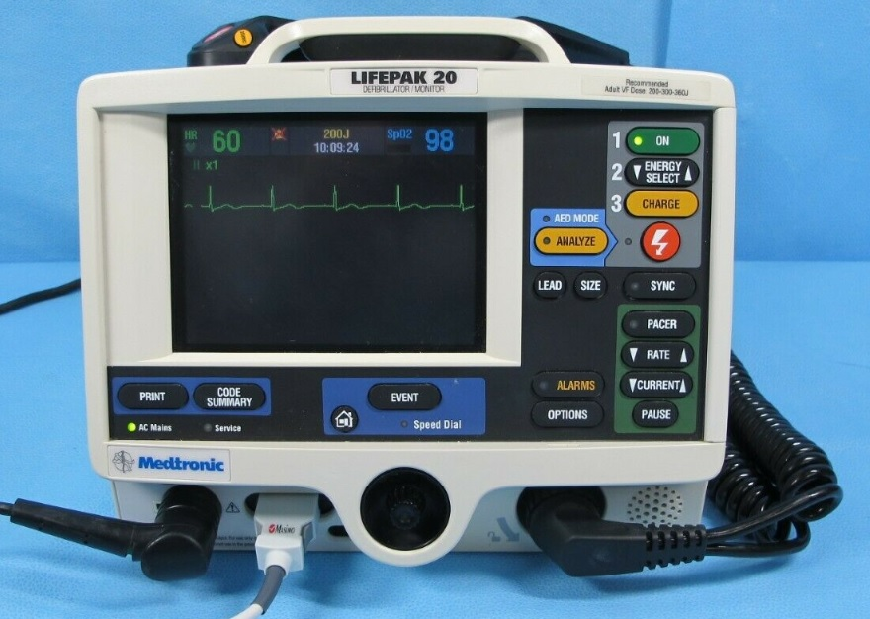
!
SYNCHRONISED
SYNC button
ECG cable
synchronization
PADS cable

Slide 7
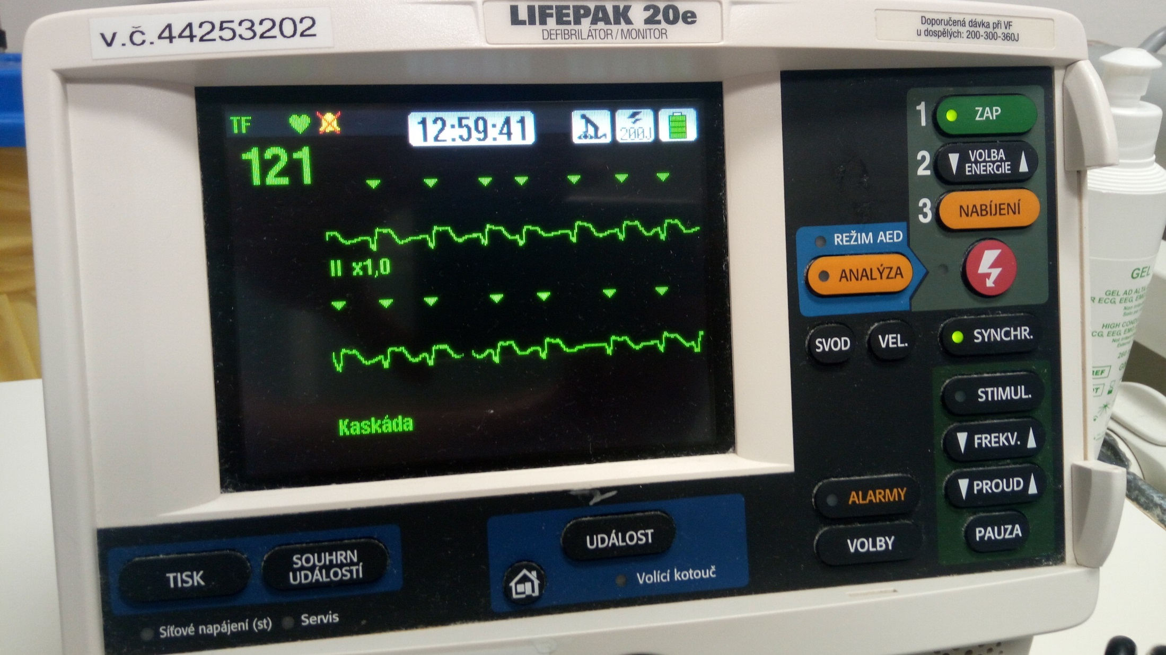
!
Always check QRS detection by the monitor/defibrillator
SYNCHRONISED
QRS detection
SYNC button lit

Slide 8

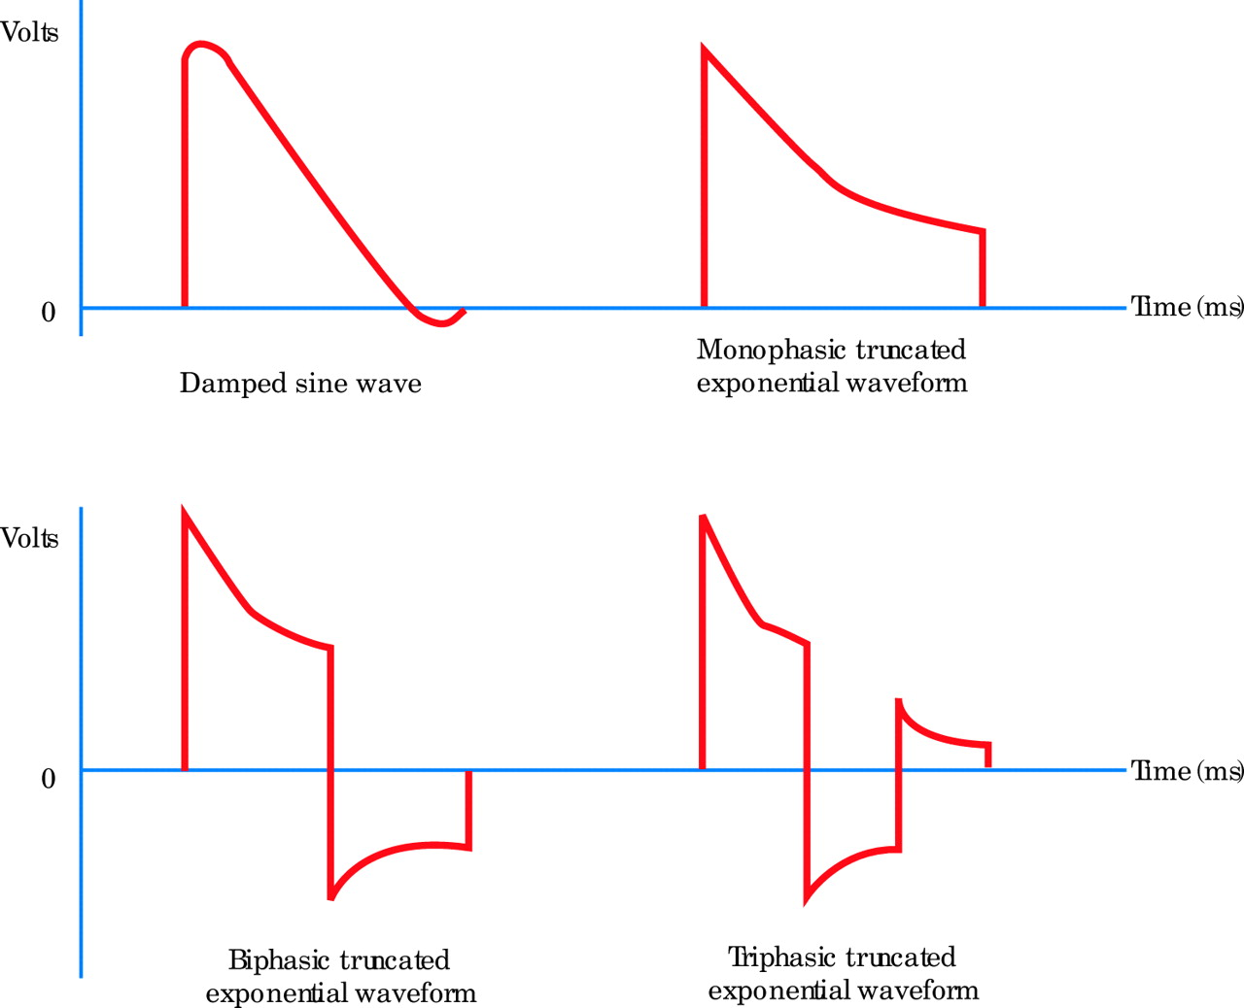

Slide 9
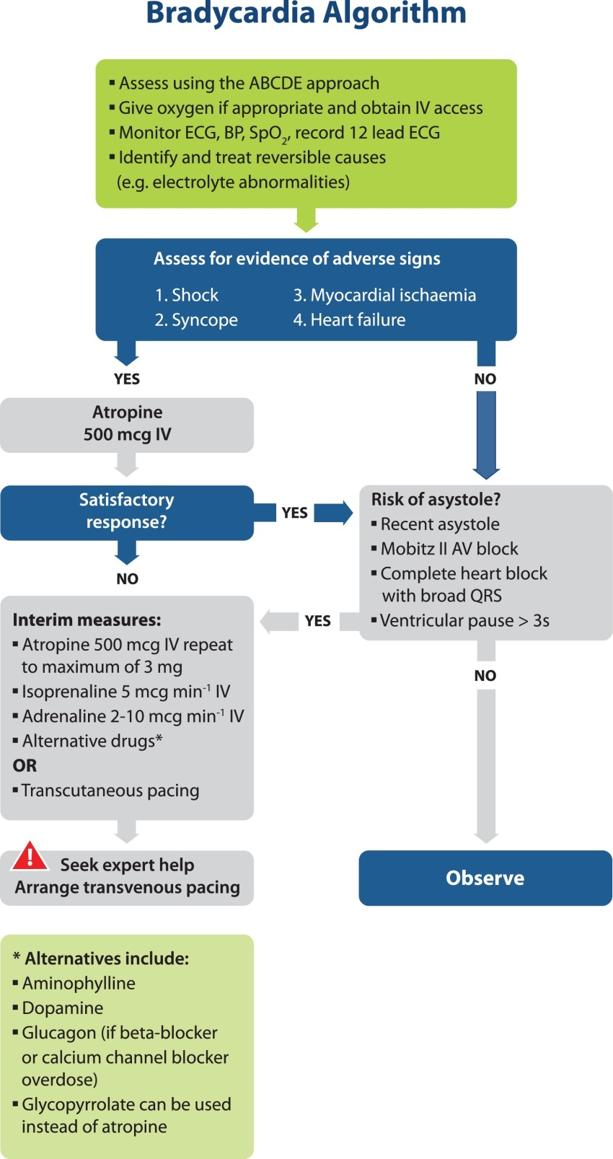
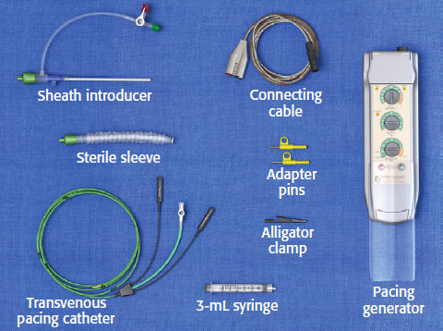
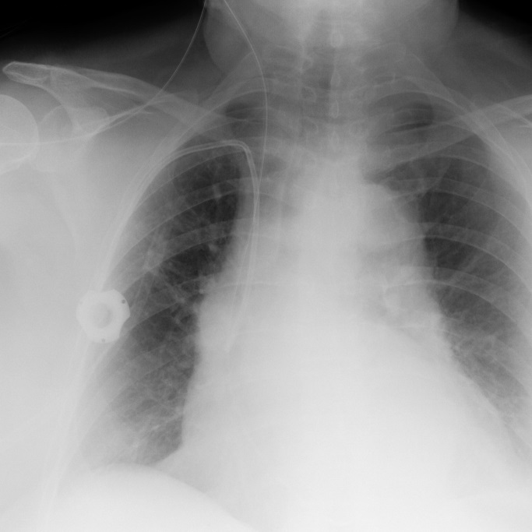
https://coreem.net

Slide 10
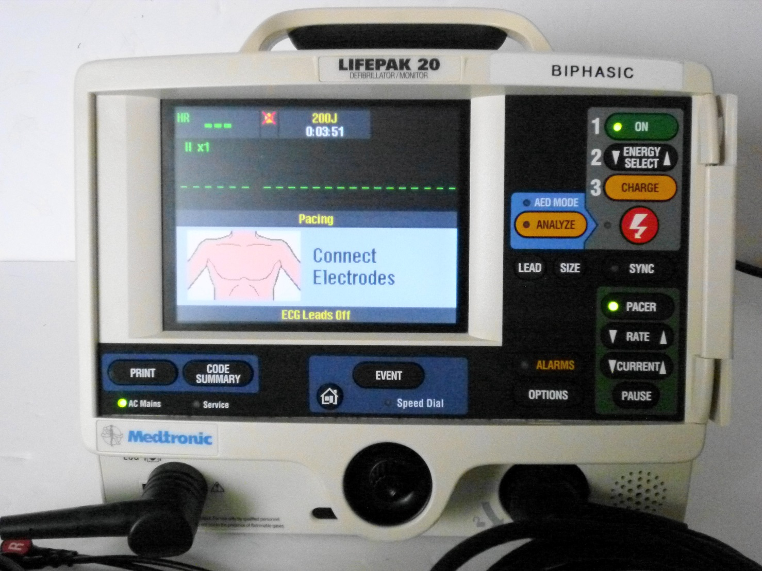
PACER button

Slide 11
MUST
READ
!
Thank you

