Slide 1
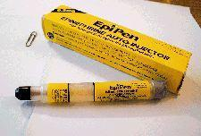
Anaphylaxis
Pavel Štětka MD
ARK FNUSA Brno

Slide 2
Anaphylaxis is a serious allergic reaction that is rapid in onset and may cause death
The rate of occurrence is increasing in industrialized countries
Anaphylaxis is not always recognized as such because it can mimic other conditions and is variable in its presentation.

Slide 3
Anaphylaxis can be classified as
1.Immunologic anaphylaxis …includes both IgE-mediated and IgG-mediated reactions (which have not been identified in humans), as well as immune complex/complement-mediated mechanisms
2.Non-immunologic anaphylaxis ………is caused by agents or events that induce sudden, massive mast cell or basophil degranulation, without the involvement of antibodies.

Slide 4
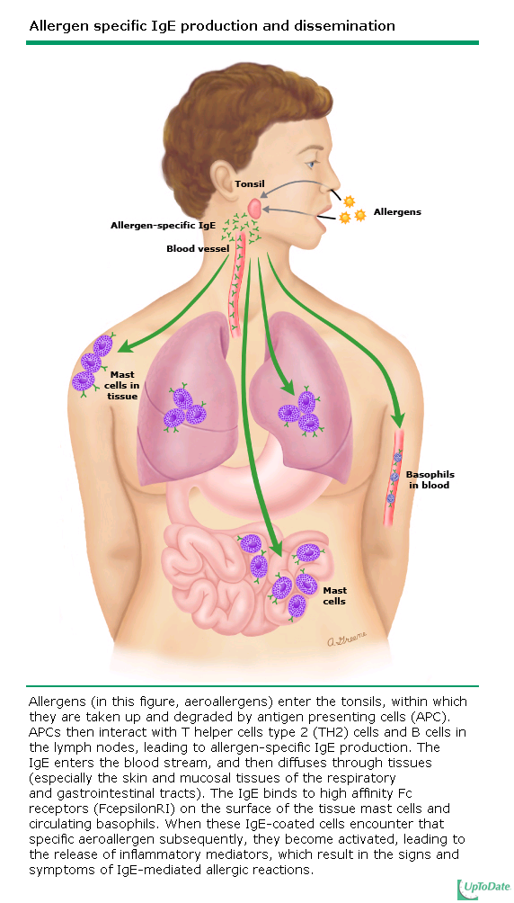

Slide 5
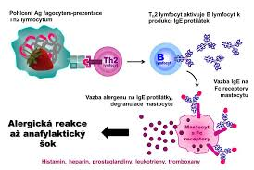

Slide 6
1. Immunologic anaphylaxis
In IgE-mediated anaphylaxis, the activation of mast cells, basophils, and eosinophils results in the release of preformed inflammatory mediators-- including histamine, tryptase, chymase, heparin, histamine-releasing factor, and PAF
Cellular activation also stimulates the production of lipid-derived mediators such as prostaglandins and leukotrienes.

Slide 7
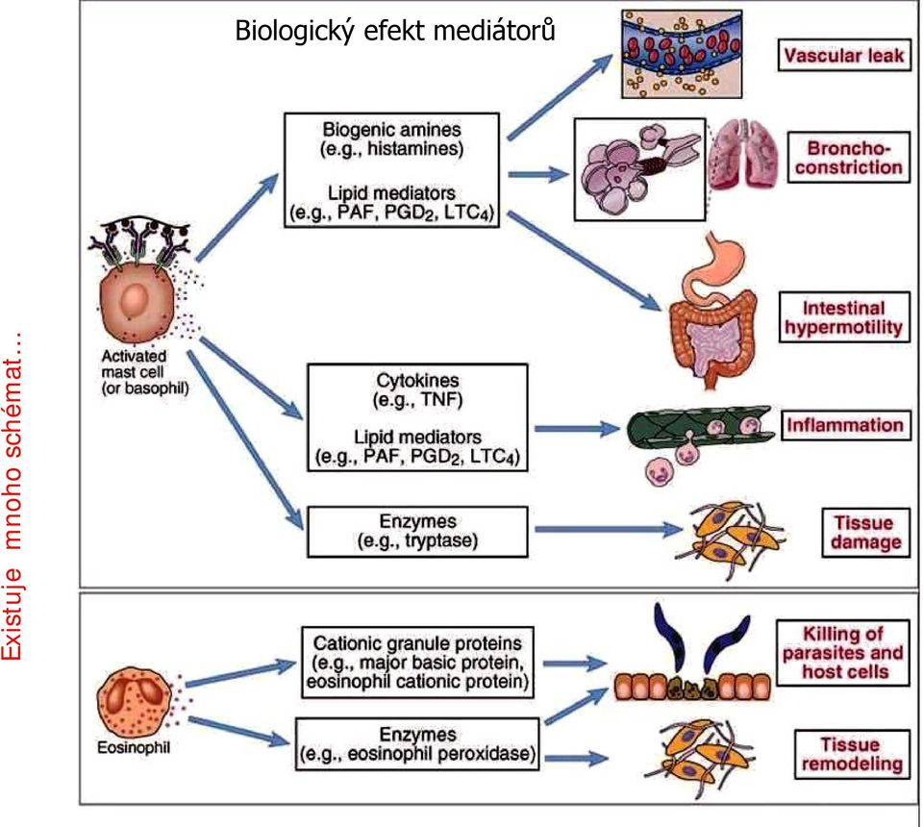

Slide 8
Mediators …..responsible for the main pathoph. picture of anaphylaxis
Vasodilation
Increasing permeability
Myocardial depression

Slide 9
2.Non-immunologic anaphylaxis
Complement-propofol
direct mast cells-vankomycin, meperidine…

Slide 10
In humans, the predominant shock organs are the heart, lung, and vasculature, and fatalities are divided between circulatory collapse and respiratory arrest
Anaphylaxis is associated with myocardial depression, arrhythmias, and myocardial ischemia. Contributing factors include direct mediator effects on the myocardium, exacerbation of preexisting myocardial insufficiency by the hemodynamic stress of anaphylaxis, and exogenous or endogenous epinephrine.

Slide 11
Anaphylaxis may affect any part of the respiratory tract, causing bronchospasm and mucus plugging in the smaller airways, and laryngeal edema and asphyxiation in the upper airway. Asphyxiation typically occurs rapidly after allergen exposure, with death occurring within one hour in many cases. Severe bronchospasm during anaphylaxis characteristically develops in individuals with preexisting asthma.

Slide 12
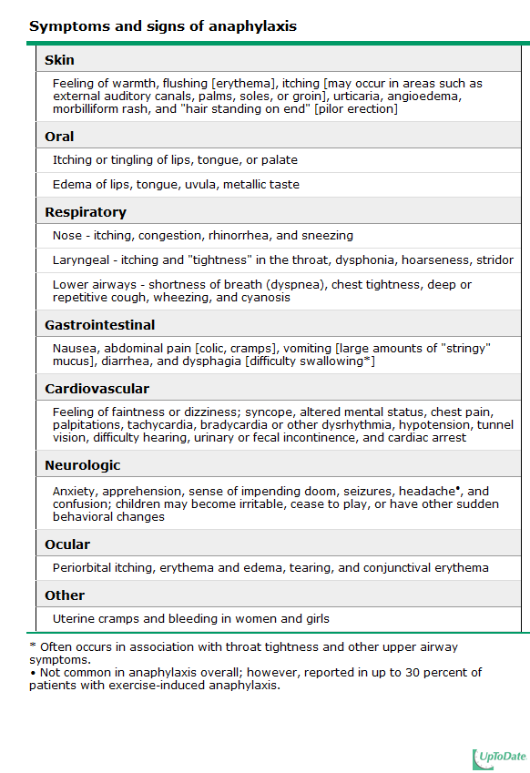
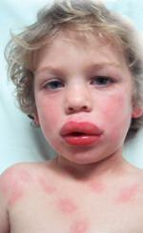

Slide 13
The diagnosis of anaphylaxis is based primarily upon clinical symptoms and signs, as well as a detailed description of the acute episode, including antecedent activities and events occurring within the preceding minutes to hours.
There are three clinical criteria for the diagnosis of anaphylaxis, which reflect the different ways in which anaphylaxis may present Anaphylaxis is highly likely when any ONE of the three criteria is fulfilled

Slide 14
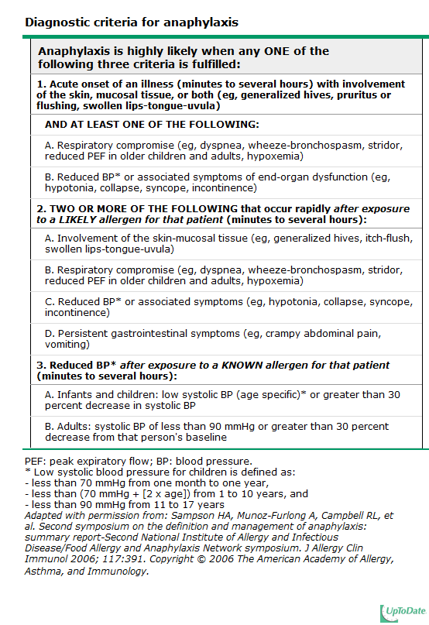

Slide 15
Recognition is not always easy, because anaphylaxis can mimic many other disorders and can be variable in its presentation. Anaphylaxis may present with various combinations of as many as 40 potential symptoms and signs
Patients and healthcare professionals commonly fail to recognize and diagnose anaphylaxis in its early stages, when it is most responsive to treatment. In particular, there is a reluctance to diagnose anaphylaxis in the absence of hypotension, even though this sign is not required for the diagnosis and occurs late or not at all in a food-induced anaphylactic episode

Slide 16
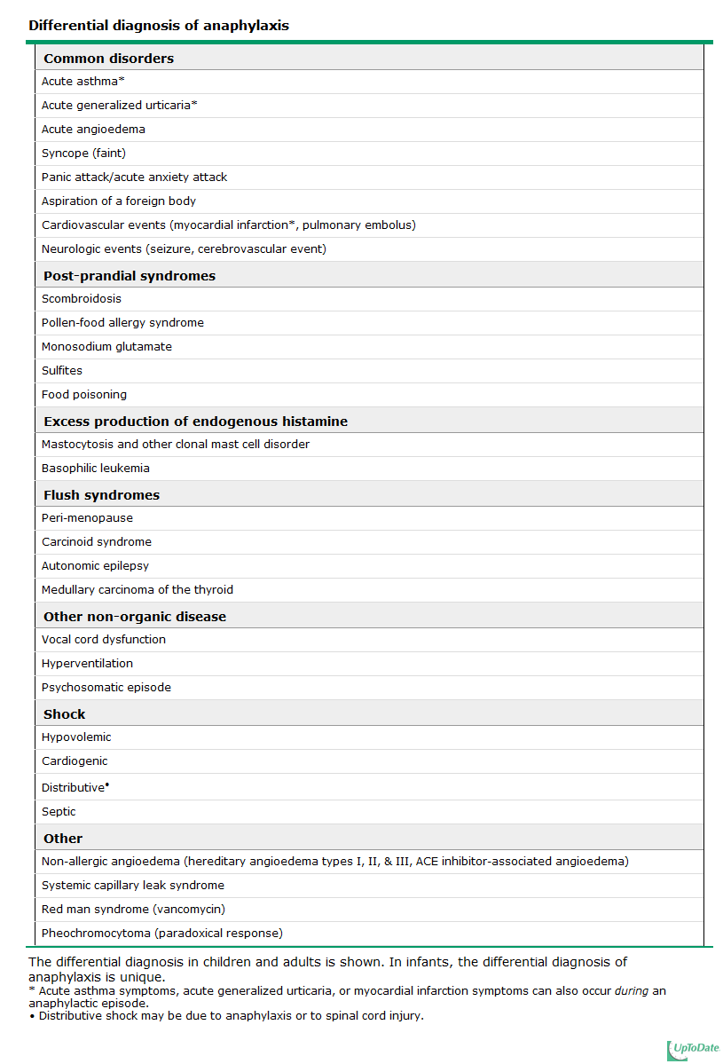

Slide 17
Anaphylaxis most often results from an IgE-mediated allergic reaction.
Common triggers include foods, insect stings, and medications. There is a rapidly expanding list of novel and/or unusual triggers
The clinical diagnosis of anaphylaxis may or may not be confirmed by measurement of elevated concentrations of plasma histamine or serum or plasma total tryptase. Elevations in these mediators are transient

Slide 18
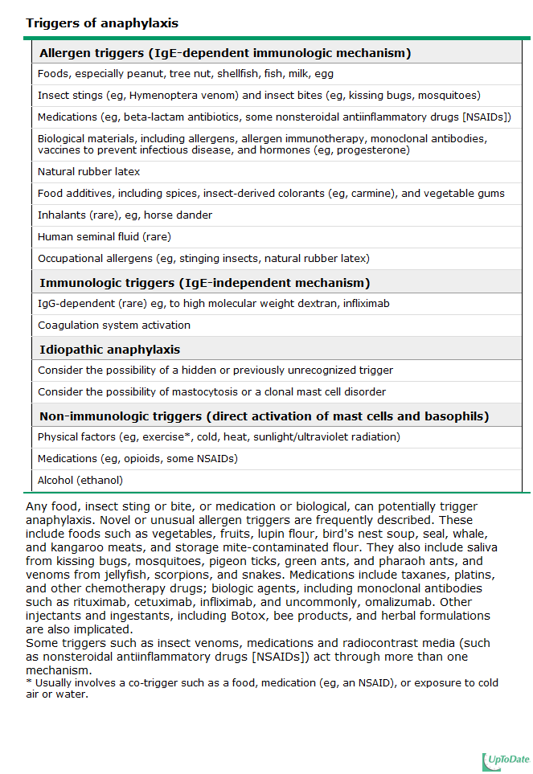

Slide 19
Prompt recognition and treatment are critical in anaphylaxis. In fatal anaphylaxis, median times to cardiorespiratory arrest are 5 minutes in iatrogenic anaphylaxis, 15 minutes in stinging insect venom-induced anaphylaxis, and 30 minutes in food-induced anaphylaxis.
Initial management is summarized in a rapid overview table

Slide 20
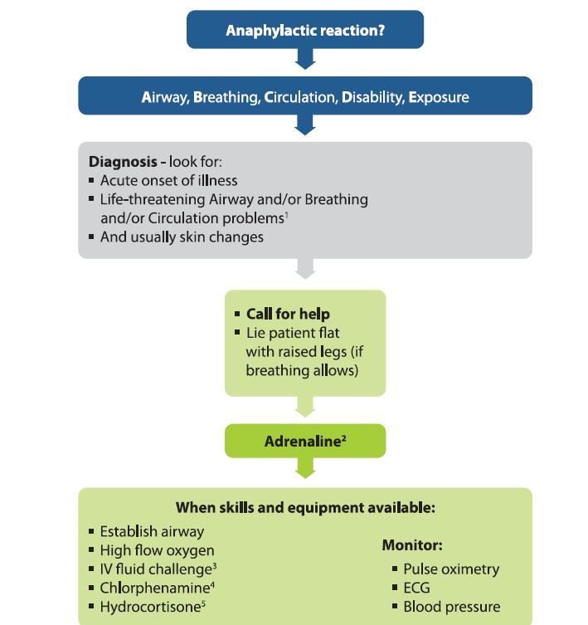

Slide 21
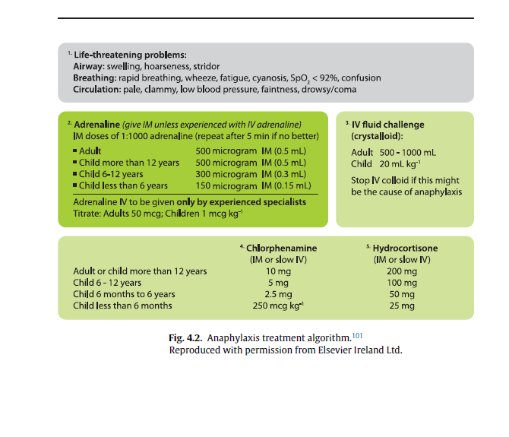

Slide 22
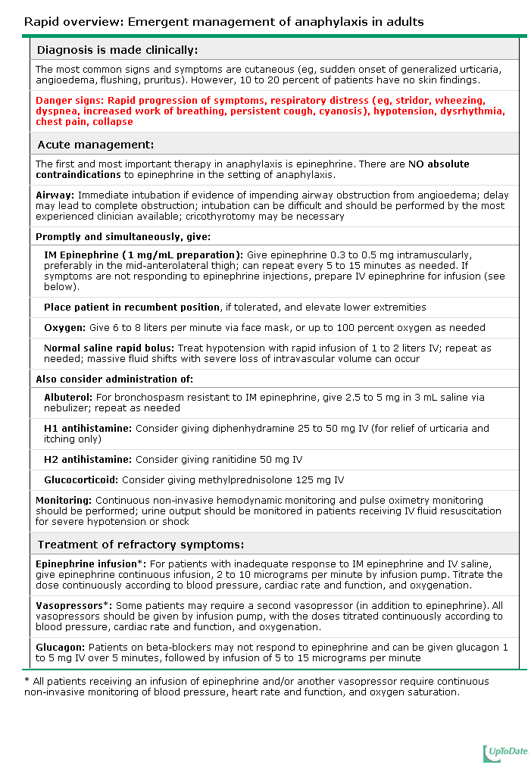
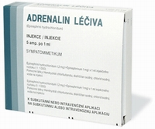
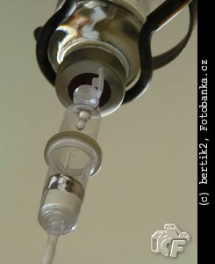

Slide 23
Epinephrine is lifesaving in anaphylaxis. It should be injected as early as possible in the episode in order to prevent progression of symptoms and signs. There are no absolute contraindications to its use, and it is the treatment of choice for anaphylaxis of any severity. We recommend epinephrine for patients with apparently mild symptoms and signs (eg, a few hives and mild wheezing) (Grade 1B) and for patients with moderate to severe symptoms and signs (Grade 1A).

Slide 24
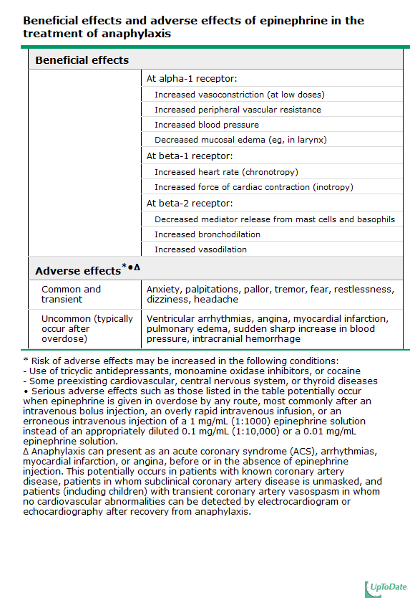

Slide 25
The route of epinephrine administration depends upon the presenting symptoms. For patients who are not profoundly hypotensive or in shock or cardiorespiratory arrest, intramuscular (IM) injection into the mid-anterolateral thigh as the initial route of administration is advised

Slide 26
For adults, the dose of epinephrine is 0.3 mg to 0.5 mg, injected intramuscularly into the mid-anterolateral thigh. This treatment may be repeated at 5 to 15 minute intervals.
For infants and children, the dose of epinephrine is 0.01 mg per kilogram up to 0.5 mg per dose, injected intramuscularly into the mid-anterolateral thigh. This treatment may be repeated at 5 to 15 minute intervals.

Slide 27
Intravenous epinephrine is indicated for patients with profound hypotension or symptoms and signs suggestive of impending shock (dizziness, incontinence of urine or stool) or those who do not respond to an initial intramuscular injection of epinephrine and fluid resuscitation. For these patients we suggest that epinephrine be administered by continuous slow intravenous infusion rather than by intermittent IV bolus

Slide 28
Massive fluid shifts can occur in anaphylaxis, and all patients with orthostasis, hypotension, or incomplete response to epinephrine should receive large volume fluid resuscitation with normal saline. Normotensive patients should receive normal crystaloid to maintain venous access in case their status deteriorates
Supplemental oxygen should be administered.

Slide 29
Glukagon for patient taking beta-blockers-- –inotropic and chronotropic effects that are not mediated through beta-receptors
H1 antihistamines- to relieving itching and hives-prometazin, cetirizine
H2 antihistamines-no evidence
Bronchilators inhaled, only adjunjctive to epinephrine
Glucocorticoids- to prevent biphasic or protracted reactions-occur in23%

Slide 30
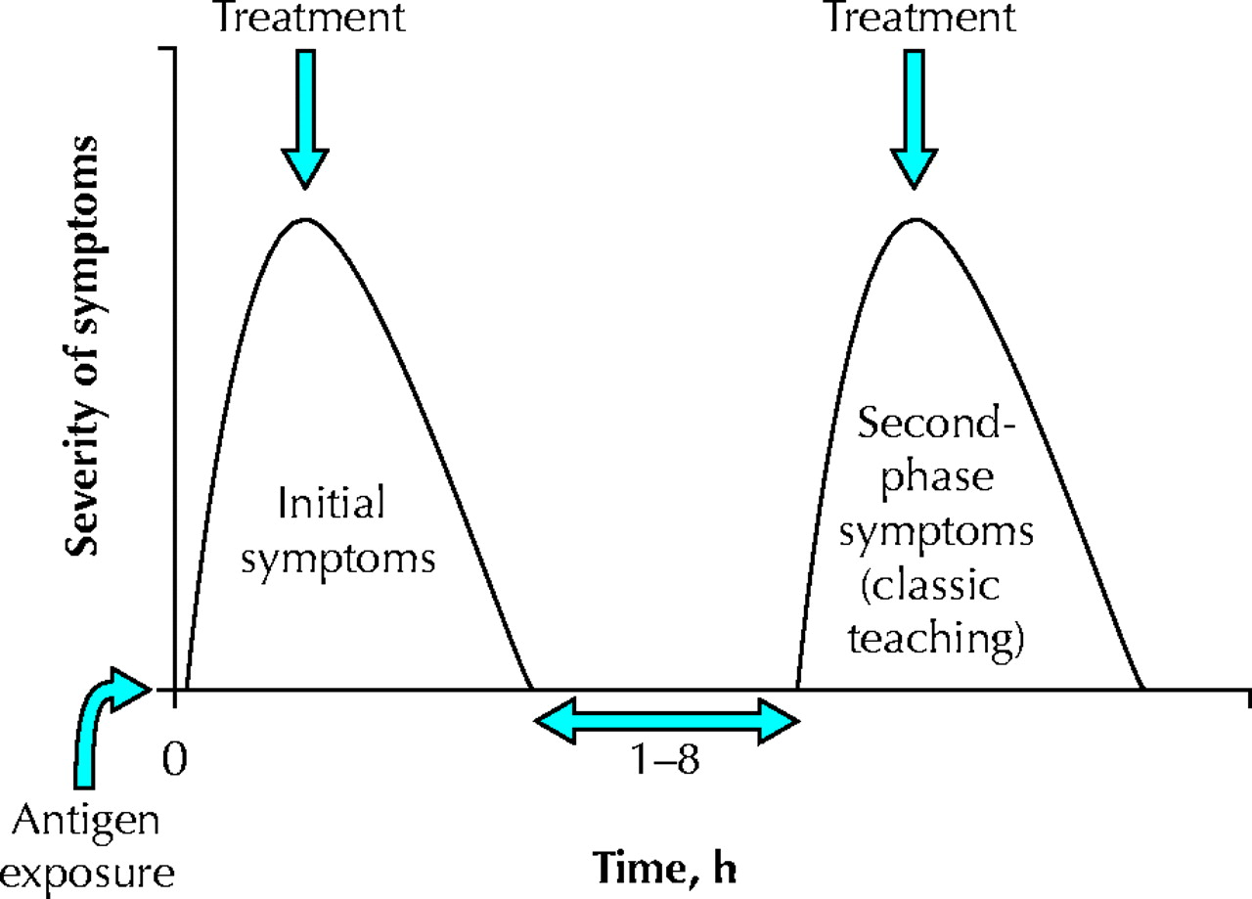

Fig. 1: Schematic representation of a biphasic anaphylactic reaction.
Schematic representation of a biphasic anaphylactic reaction. The second-phase reaction has been described as occurring between 1 and 8 hours after the initial reaction, but new evidence suggests that this second phase may occur up to 38 hours (mean 10 hours) after the initial reaction. About one-third of the second-phase reactions are more severe, one-third are as severe and one-third are less severe.
©2003 by Canadian Medical Association
Notes:
Fig. 1: Schematic representation of a biphasic anaphylactic reaction. The second-phase reaction has been described as occurring between 1 and 8 hours after the initial reaction, but new evidence suggests that this second phase may occur up to 38 hours (mean 10 hours) after the initial reaction. About one-third of the second-phase reactions are more severe, one-third are as severe and one-third are less severe.

Slide 31
Patients successfully treated for anaphylaxis should be discharged with a personalized written anaphylaxis emergency action plan , an epinephrine autoinjector, written information about anaphylaxis and its treatment, and a plan for further evaluation

Slide 32
It is critical that patients be evaluated further to confirm the trigger, as specific avoidance measures are useful in reducing the risk of recurrence. Additionally, for some allergens, immunomodulation is also available to reduce the risk

Slide 33
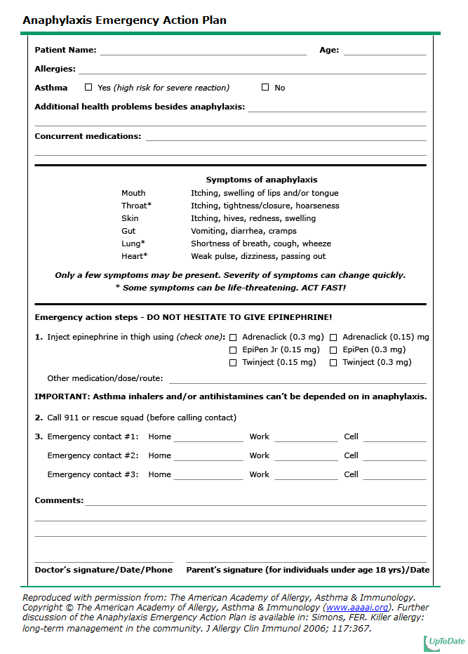

Slide 34
Alergen= trigger
Sensibilisation
Second exposition of alergen-mast cells, basofils
Release of mediators
Clinical signs-cardiovascular, respiratory, skin,GIT symptoms
Dg. and therapy -epinephrin

Slide 35
