Slide 1
Respiratory system.
Compendium.

Slide 2
Questions for the oral exam
A22: Hypoxia and ischemia
A25: Lung ventilation, volumes, measurement
A26: Dead space, measurement
A27: Resistance of airways, measurement
A28: Maximal respiratory flow - volume curve (spirogram)
A45: Alveolar surface tension. Surfactant
A46: Compliance of lungs. Respiratory work. Pneumothorax
A47: Composition of atmospheric and alveolar air. Gas exchange in lungs and tissues
A48: Transport of O₂. Oxygen - haemoglobin dissociation curve. Transport of CO₂
A49: Regulation of ventilation
A50: Respiratory responses to irritants

Slide 3
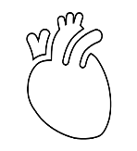
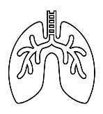
A22: Hypoxia and ischemia
Hypoxia is a general name for a lack of oxygen in the body or individual tissues
Ischemia, meaning insufficient blood flow to a tissue, can also result in hypoxia
The most common types of hypoxia:
  Hypoxic
  Transport (anemic)
  Ischemic (stagnation)
  Histotoxic
  O₂
  O₂
  O₂
  ERY
  ERY
  O₂
  ERY: ♀ 3.4 – 4.4 * 10¹²/l
  ♂ 4.5 – 5.5 * 10¹²/l
  pO₂: 21kPa

Slide 4


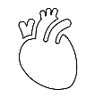
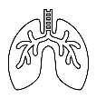


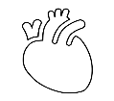
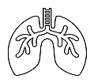
A22: Hypoxia and ischemia
Hypoxic:
  physiological: stay at higher altitudes
  ↓ pO₂; N Ery
  pathological: hypoventilation during lung or neuromuscular diseases
  ↓ ventilation; N pO₂; N Ery
Transport (anemic):
  reduced transport capacity of blood for oxygen (anemia, blood loss)
  N pO₂; ↓ Ery/Hb
Ischemic (stagnation):
  restricted blood flow to tissue (heart failure, obstruction of an artery)
  N pO₂; N Ery
Histotoxic
  cells are unable to utilize oxygen (cyanide poisoning)
  N pO₂; N Ery

Slide 5
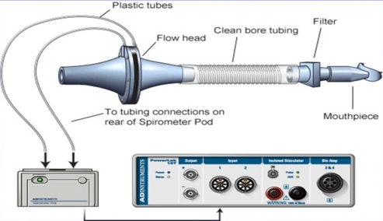
A25: Lung ventilation, volumes, measurement
Ventilation, or breathing, is the movement of air through the conducting passages between the atmosphere and the lungs
Principle: determination the air flow velocity from the measured pressure differences between the inner and outer spirometer membranes, the volumes being calculated (PowerLab spirometry)

Slide 6
A25: Lung ventilation, volumes, measurement
V [l]
IRV (2,5 l)
Vt (0,5 l)
ERV (1,5 l)
RV (1,5 l)
Tidal volume (TV) – the volume of air that enters the lungs during each inspiration (or the volume that is exhaled during every expiration).
Inspiratory reserve volume (IRV) – the maximal amount of additional air that can be drawn into the lungs by determined effort after a normal inspiration at rest.
Expiratory reserve volume (ERV) – the additional amount of air that can be exhaled from the lungs by determined effort after a normal expiration.
Residual volume (RV) – the volume of air still remaining in the lungs after the most forcible expiration possible.

Slide 7
A25: Lung ventilation, volumes, measurement
V [l]
IRV (2,5 l)
Vt (0,5 l)
ERV (1,5 l)
RV (1,5 l)
Lung capacity:
VC = VT + IRV + ERV
TLC = VC + RV
FRC = ERV + RV
IC = IRV + VT
EC = ERV + VT
Dynamic lung volumes:
VE
MMV

Slide 8
A25: Lung ventilation, volumes, measurement
Dynamic lung volumes
V [l]
FVC – the maximum volume of air that can be exhaled after maximum inhale
FEV₁ – the volume of air exhaled with the greatest effort in 1 second after maximum inhale
FEV₁/FVC (%) – Tiffeneau index – around 0,8 (80 %)
FEV₁
FVC
RV
1 s
Time [s]

Slide 9
A25: Lung ventilation, volumes, measurement
V [l]
V [l]
FVC > FVC
FEV₁
FEV₁
1 s
Time [s]
1 s
Time [s]
Obstruction lung disease
(FVC=N; FEV₁=↓)
tracheal stenosis
astma bronchiale
CHOPN
tumor
Restrictive lung disease
(FVC=↓; FEV₁=N)
Pulmonary etiology
pulmonary fibrosis
lung resection
pulmonary edema
pneumonia
Extrapulmonary etiology
ascites
kyphoscoliosis
burns
high diaphragm condition

Slide 10
FUNCTIONAL INVESTIGATION OF THE LUNGS
TIMED VITAL CAPACITY (FEV₁ - forced expiratory volume per 1 s)
V [l]
V [l]
Healthy people Obstruction disease
FVC physiology values FVC physiology values
FEV1=80% FEV1 lower than 70%
Restriction disease
FVC lower than physiology values
FEV1 – as physiology value
0
1
2
FEV₁
3
FVC
V [l]
4
0
5
1
1 s
Čas [s]
2
RV
3
1 s
Čas [s]
4
5
1 s
Čas [s]
PULMONARY MINUTE VENTILATION RMV (respiratory minute volume) at rest (0.5 l x 12 breathes/min = 6 l/min)
MAXIMAL VOLUNTARY VENTILATION (MVV) (125-170 l/min)
PEAK EXPIRATORY FLOW RATE (PEFR) (~10 l/s)
10

Slide 11
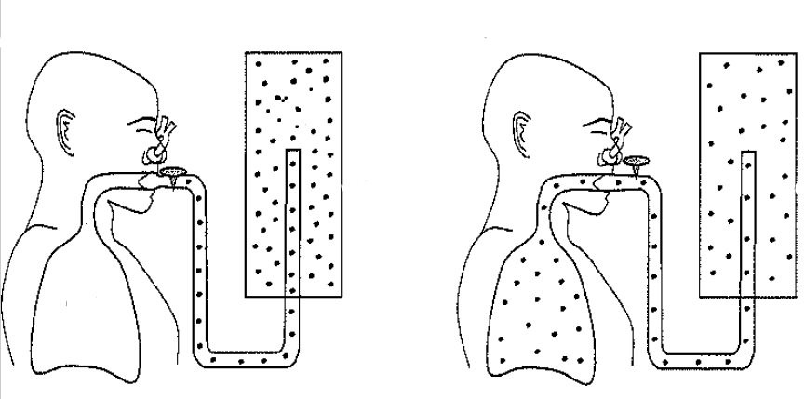
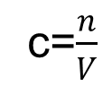
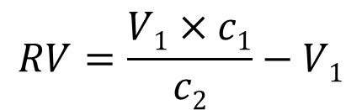
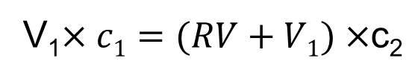
A25: Lung ventilation, volumes, measurement
Helium dilution method – residual volume
V₁
c₁
c=$\frac{n}{V}$
V₂=RV+V₁
c₂
V₁$×c1=(RV+V1)×$c₂
$$RV=\frac{V1×c1}{c2}−V1$$

Slide 12
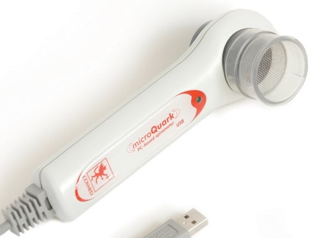
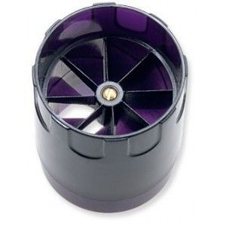
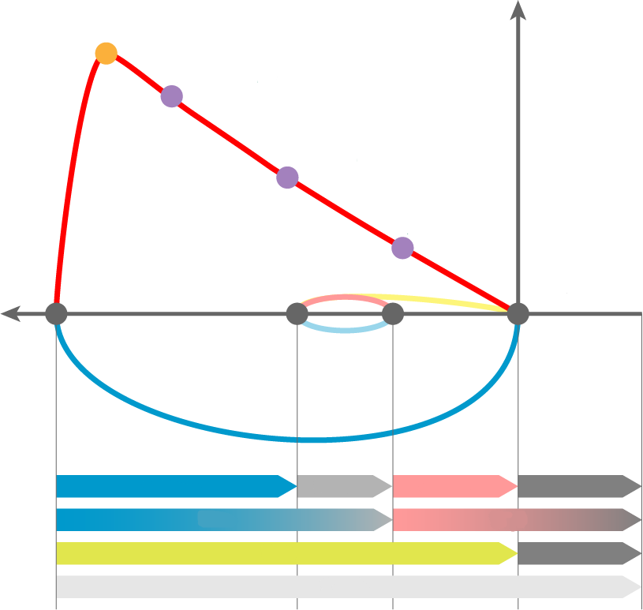
A28: Maximal respiratory flow - volume curve (spirogram)
Principle: the measurement of the air flow velocity according to the speed of the turbine and the volumes are calculated (Cosmed).
PEF
PEF – peek expiratory flow; the highest speed of air flow at peak of exhale
MEF – maximum expiratory flow rates at different FVC levels, which is still to be exhaled (75 %, 50 % and 25 % of FVC)
MEF_{25%}
MEF_{50%}
MEF_{75%}
IRV
Vt
ERV
RV
IRC
FRC
VC
RV
TLC

Slide 13
DEAD SPACE
TOTAL GAS VOLUME NOT EQUILIBRATED WITH BLOOD (without exchange of gasses)
ANATOMICAL dead space - volume of air passages
FUNCTIONAL (total) dead space
ANATOMICAL dead space + total VOLUME of ALVEOLI without functional capillary bed
IN HEALTHY INDIVIDUALS
both spaces are practically identical
6

Slide 14
V_{T} tidal volume ~ 500 ml
V_{T} = V_{A} + V_{D}
V_{A} part of tidal volume entering alveoli ~ 350 ml
V_{D} part of tidal volume remaining in the dead space ~ 150 ml
f = 12/min
·
V_{A}
= V_{A} x f
∙
V
= V_{T} x f
ALVEOLAR VENTILATION
PULMONARY MINUTE VENTILATION
4.2 l/min
·
V_{D}
= V_{D} x f
6 l/min
DEAD SPACE VENTILATION
1.8 l/min
5

Slide 15
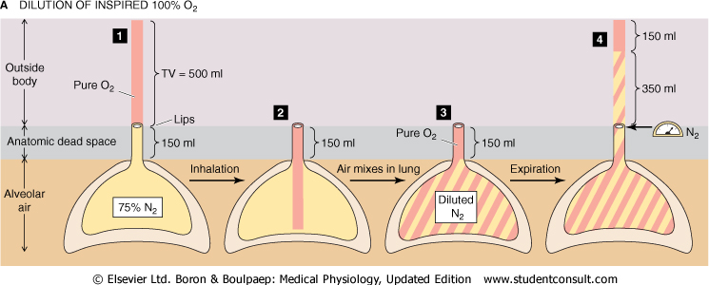
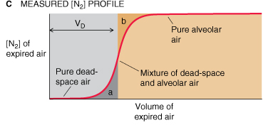
DEAD SPACE – nitrogen test (force inspiration of pure O2, follow slowly expiration with monitoring of concentration of nitrogen)

Slide 16
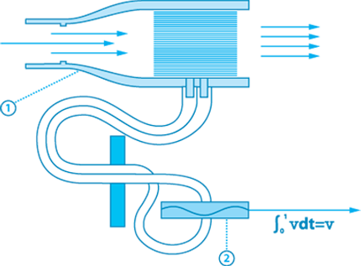
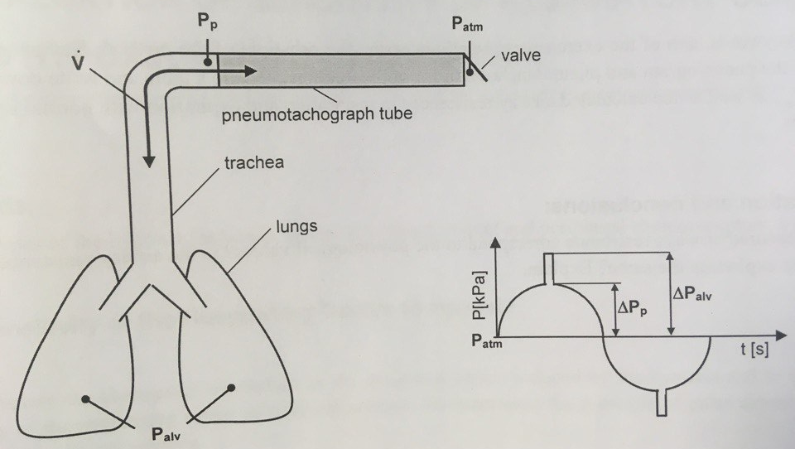
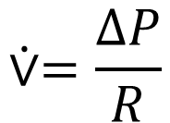
A27: Resistance of airways, measurement
Pneumotachograph:
tubes of the same diameter, parallel arranged
measures the differences in air pressure at the beginning and end of the pneumotachograph in proportion to the velocity of the inhaled or exhaled air
$$⩒=\frac{ΔP}{R}$$

Slide 17
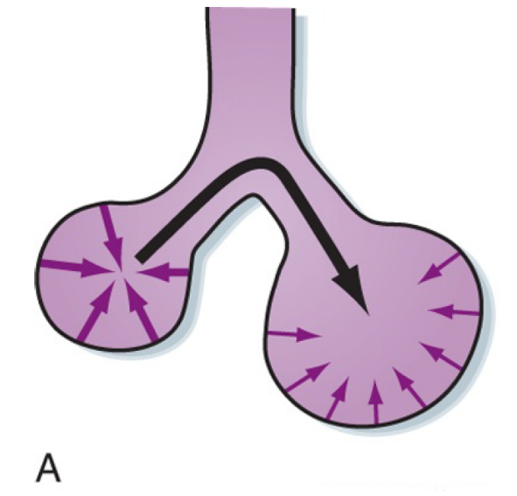

A45: Alveolar surface tension. Surfactant
pneumocytes typ II
reduces the surface tension depending on the size of the alveolus
increases lung compliance, reduces breathing work
The Laplace law (in constant tension):
the alveolus with bigger radius has lower pressure
→ the air would move from a smaller alveolus to a bigger one
→ collapse of smaller alveoli
2
T
P
=
r

Slide 18
LAW OF LAPLACE
spherical structures
2
T
P
=
r
P
r
P₁
?
P₂
T
P₁ > P₂
P pressure
r radius
T surface tension
PATHOLOGY
COLLAPSE OF ALVEOLI - ATELECTASIS
EXPANSION OF ALVEOLI
16

Slide 19
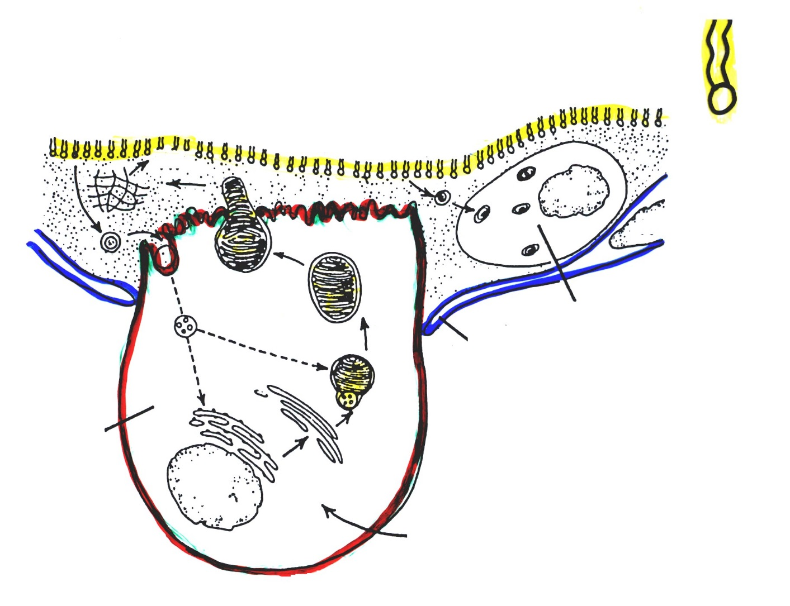
SURFACTANT
SURFACE TENSION LOWERING AGENT
EFFECT MAINLY IN THE EXPIRED POSITION
PHOSPHOLIPID
dipalmitoyl fosfatidyl cholin
ALVEOLAR EPITHELIAL CELLS
exocytosis of lamellar bodies
surfactant cycle
surfactant
macrofage
TYPE II
specialized granular epithelial cells
PRODUCTION OF SURFACTANT
TYPE I
thin epithelial cells
DIFFUSION OF GASSES
fatty acids, choline, glycerol, amino acids, etc.)
17a

Slide 20
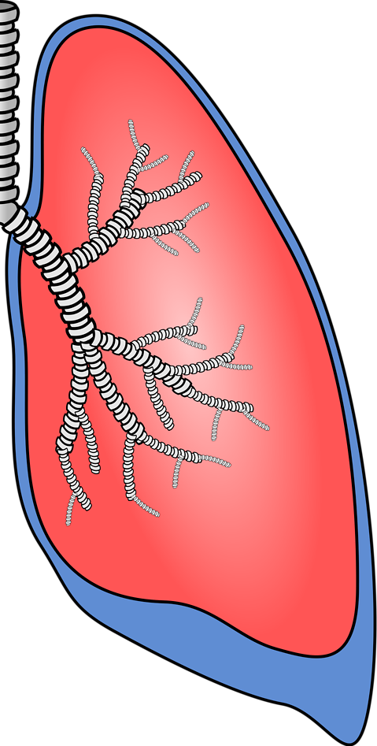
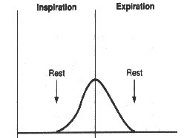
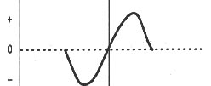
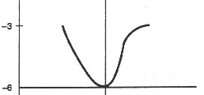
A46: Compliance of lungs. Respiratory work. Pneumothorax
visceral pleura
parietal pleura
alveolar pressure
pleural pressure
pleural fluid

Slide 21
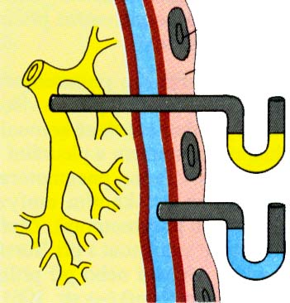
PLEURA
pulmonalis
parietalis
+0.1 kPa
-0.1 kPa
-0.3/-0.5 kPa
-0.6/-0.8 kPa

Slide 22
A46: Compliance of lungs. Respiratory work. Pneumothorax
According to etiology:
  traumatic pneumothorax (due to an injury) occurs if the chest wall is perforated or during an injury of the esophagus, bronchi, and during rib fractures.
  spontaneous pneumothorax
  primary idiopathic pneumothorax (without any known cause) may occur in tall healthy young men with an incidence of pneumothoraxes in the family,
  secondary pneumothorax arises as a consequence of lung diseases (such as COPD or cystic fibrosis),
  iatrogenic pneumothorax (due to medical procedures) occurs during invasive medical examinations such as transparietal aspiration biopsy, subclavian vein catheterization, or mechanical ventilation with positive pressure.
  artificially induced (deliberate) pneumothorax is used during thoracoscopy, an endoscopic examination the thoracic cavity.
According to the communication of the pleural space with its surroundings
  open pneumothorax (when the hole in the pleural space remains open, the air in the pleural cavity moves back and forth with each breath of the patient)
  closed pneumothorax (when a small opening through which air enters the pleural cavity closes)
  valvular pneumothorax (the tissue of the lungs or the chest wall covers the hole in such a way that a valve emerges, this valve allows air to flow inside during inspiration, but it prevents the air from leaving the pleural cavity during exhalation).

Slide 23
A46: Compliance of lungs. Respiratory work. Pneumothorax
Respiratory system resistance
Elastic resistance:
  elastic fibers
  alveolar surface tension
Nonelastic resistance:
  viskose resistance
  airway resistance
Respiratory work:
Elastic
Viskose
Work of airway resistance

Slide 24
FORCES PARTICIPATING IN RESPIRATION
ACTIVE FORCES performed by respiratory muscles
PASSIVE FORCES represented by:
lungs elasticity
chest elasticity
QUIET RESPIRATION
INSPIRATION - active forces of inspiratory muscles prevail
EXPIRATION - only passive (elastic) forces are in action
12

Slide 25
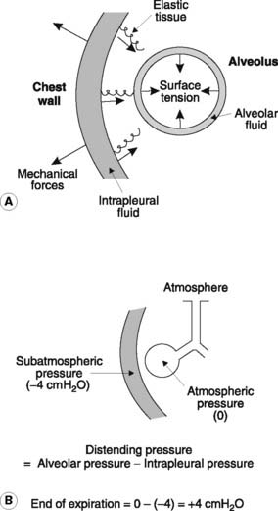
Forces acting on the lung
elasticity of lung (elastic recoil) (collapsing force)
Lung surface tension (collapsing force)
Chest wall recoil (opening force)
Intrapleural pressure-IPP (opening force)

Slide 26
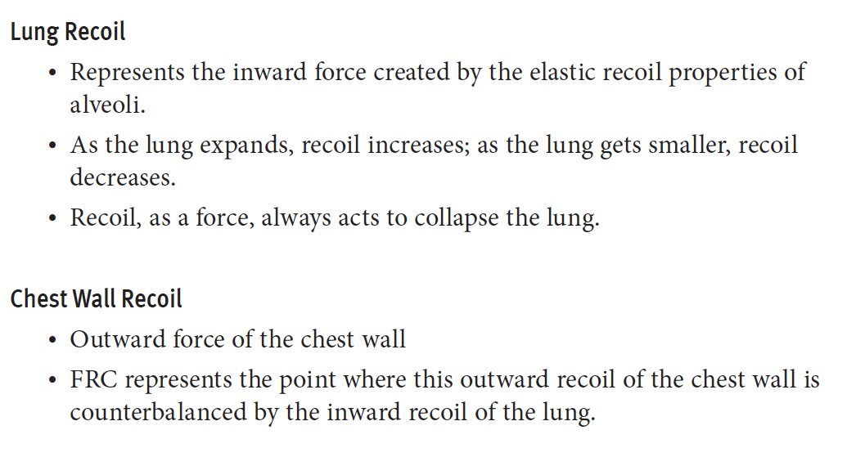
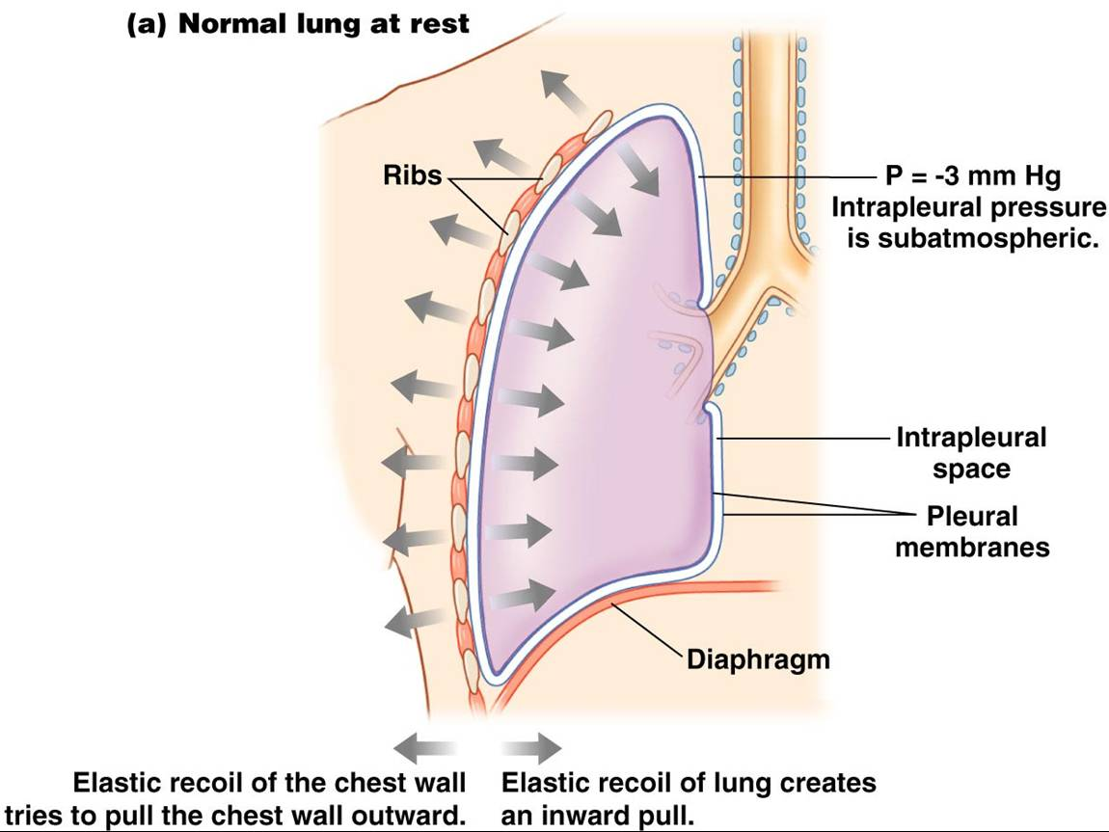
Lung recoil and chest wall recoil

Slide 27
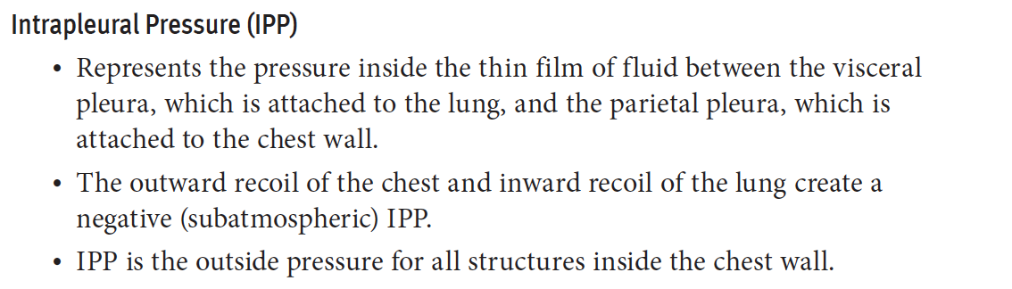
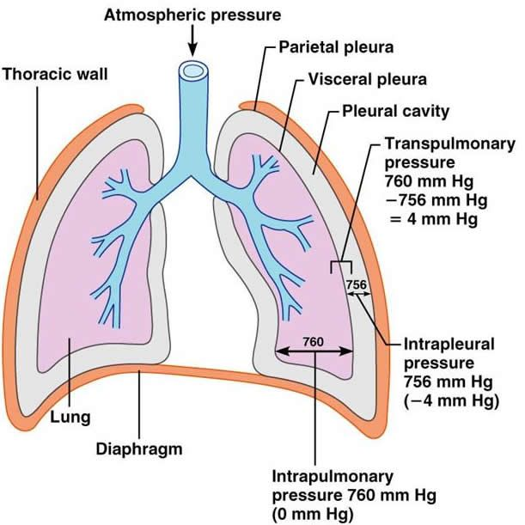
Intrapleural pressure

Slide 28
Major forces acting on the lung
Important points
Intrapleural pressure > Lung recoil → Lung Expands
Intapleural pressure < lung recoil → lung collapse
Intrapleural pressure = Lung recoil → lung size constant

Slide 29
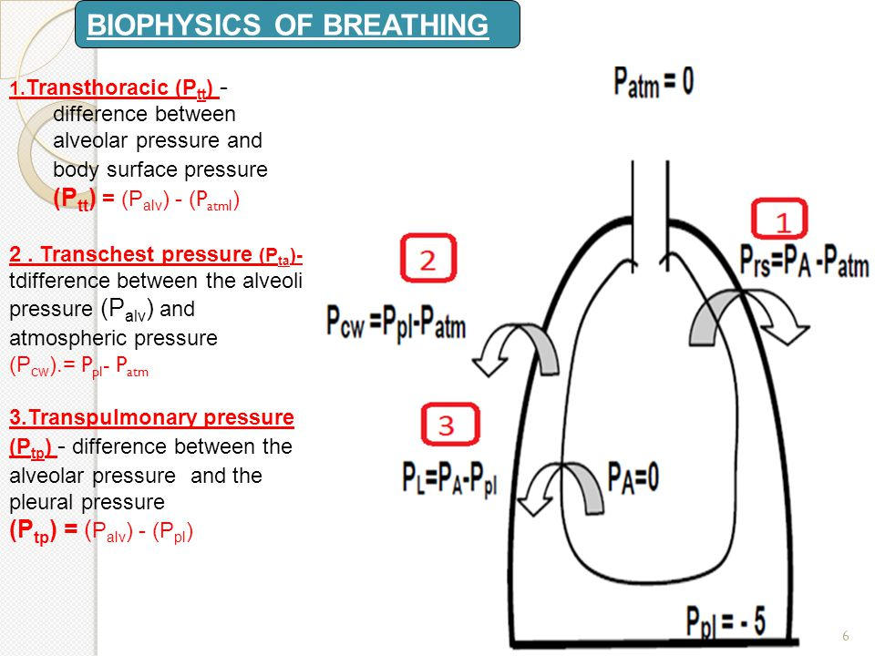
Transmural pressure

Slide 30
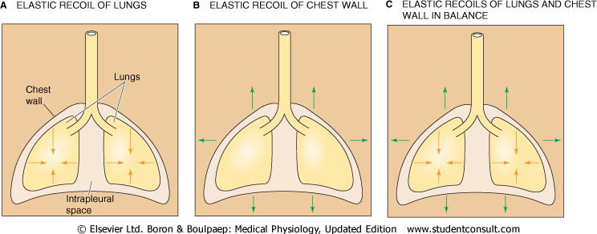
A46: Compliance of lungs. Respiratory work. Pneumothorax
V (l)
TLC
Vt
Pt: P_{atm} and P_{pl}
Pt: P_{alv} and P_{pl}
RV
Pt (kPa)
Pt: P_{atm} and P_{alv}

Slide 31
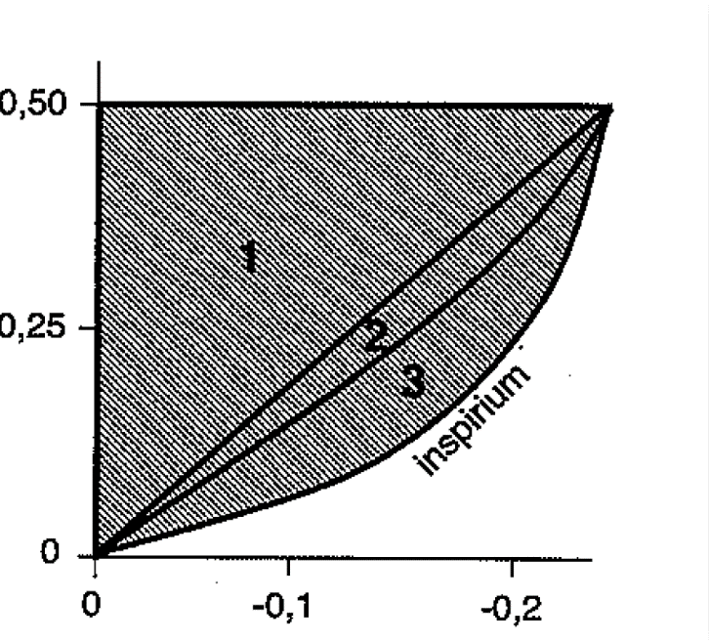
A46: Compliance of lungs. Respiratory work. Pneumothorax
V (l)
TLC
V (l)
Vt
Pt (kPa)
Respiratory work:
1 – elastic
2 – viscos
3 – airway resistance
RV
Pt (kPa)

Slide 32
A47: Composition of atmospheric and alveolar air. Gas exchange in lungs and tissues.
O₂ 20.95 % F_{O2} ≅ 0,21
N₂ 78.09 % F_{N2} ≅ 0,78
CO₂ 0.03 % F_{CO2} ≅ 0,0004
COMPOSITION OF DRY ATMOSPHERIC AIR
BAROMETRIC PRESSURE IN SEA LEVEL
1 atmosphere = 760 mm Hg
PARTIAL PRESSURE OF DRY AIR IN SEA LEVEL
P_{O2} = 760 x 0,21 = ~160 mm Hg
P_{N2} = 760 x 0,78 = ~593 mm Hg
P_{CO2} = 760 x 0,0004 = ~ 0,3 mm Hg
1 kPa = 7,5 mm Hg (torr)

Slide 33
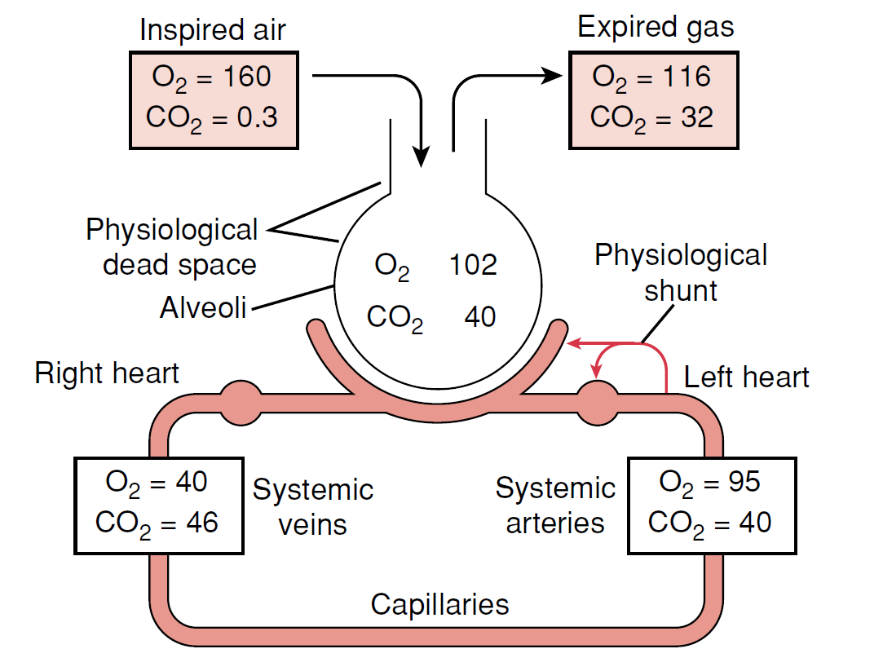
A47: Composition of atmospheric and alveolar air. Gas exchange in lungs and tissues.

Slide 34
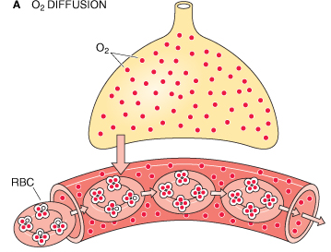
A48: Transport of O2. Oxygen - haemoglobin dissociation curve. Transport of CO2
O₂ is transported in two forms :
physically dissolved(1%)
in chemical bond with Hb (99%)
Fetal hemoglobin(2α, 2γ)
Methemoglobin (Fe³⁺)
Carboxyhemoglobin (CO)
Carbaminohemoglobin (CO₂)
Oxyhemoglobin (O₂)
Deoxyhemoglobin (without any gases)

Slide 35
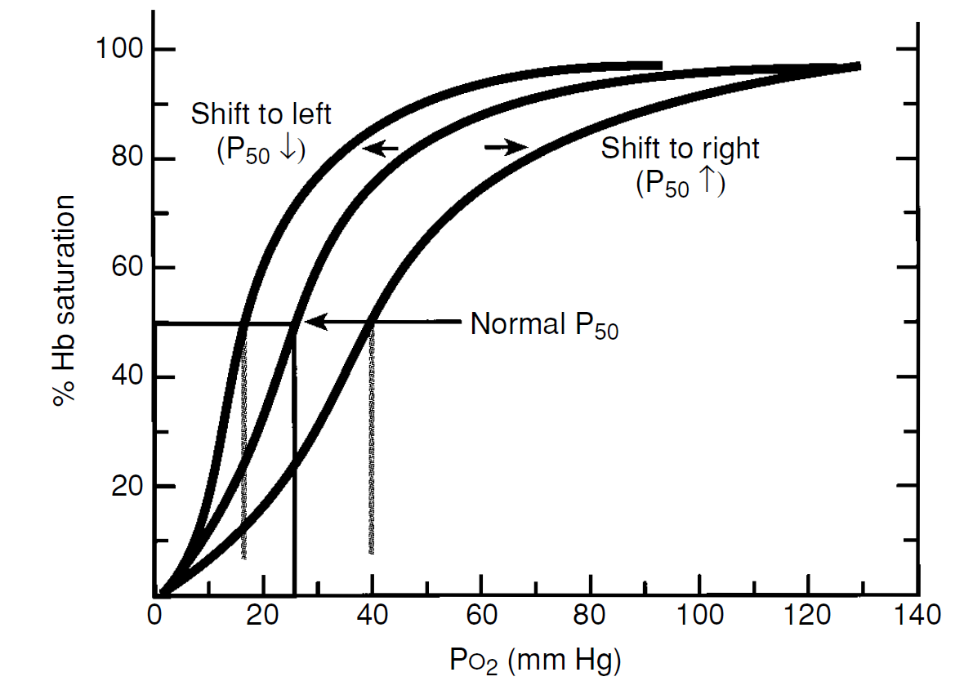
A48: Transport of O2. Oxygen - haemoglobin dissociation curve. Transport of CO2
Dissociation curve of Hb is influenced by:
pH of blood
pCO₂ of blood
Temperature
Concentration of 2,3 - BPG

Slide 36
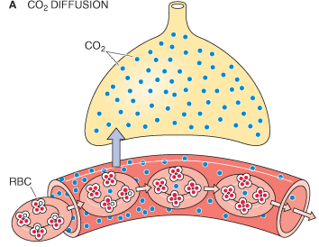
A48: Transport of O2. Oxygen - haemoglobin dissociation curve. Transport of CO2
CO₂ is transported in next forms :
physically dissolved(5 %)
in the form of bicarbonate anions (85%)
in chemical bond with Hb (10%)
CO₂
H⁺ + Hb
KAH
CO₂ + H₂O H₂CO₃
HCO₃⁻
CO₂
Cl⁻
Hb
H⁺ + HCO₃ ⁻
H₂CO₃
KAH
CO₂ + H₂O
Cl⁻

Slide 37
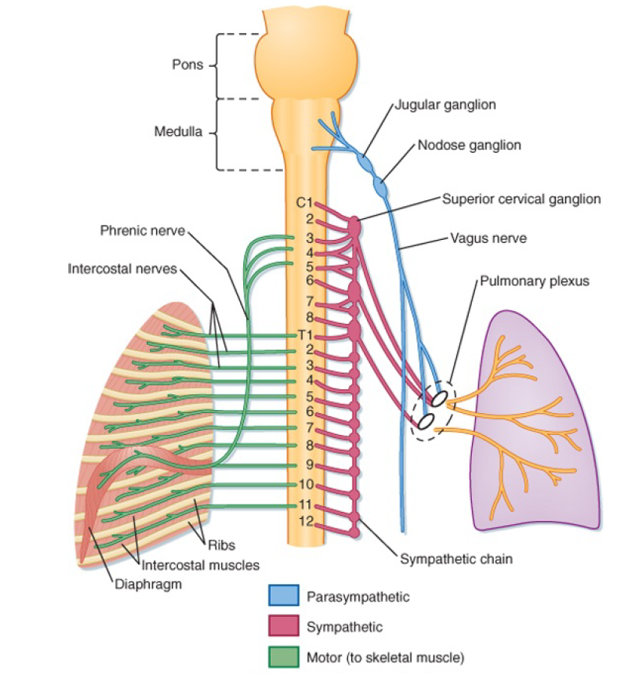
A49: Regulation of ventilation

Slide 38
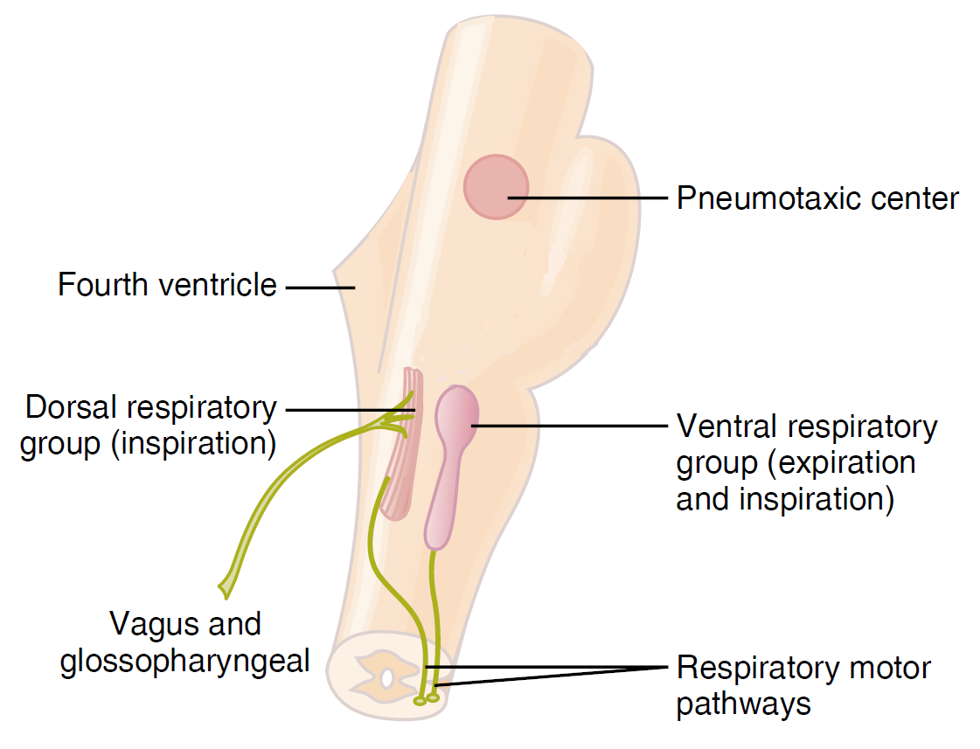
A49: Regulation of ventilation

Slide 39
They can be divided into three main groups:
  dorsal respiratory group – placed bilaterally on the dorsal side of the medulla oblongata, only inspiratory neurons, sending axons to motoneurons of inspiratory muscles (diaphragm, external intercostal muscles; their activation=inspiration, their relaxation=expiration; participates on inspiration at rest and forced inspiration
  ventral respiratory group - located on the ventrolateral part of the medulla oblongata, the upper part: neurons whose axons of motor neurons activate the main and auxiliary inspiratory muscles; the lower part: expiratory neurons which innervate expiratory muscles (internal intercostal muscles). Neurons in this group operate only during forced inspiration and forced expiration.
  Pontine respiratory group - pneumotaxic center - dorsally placed on top of the pont, contributes to the frequency and depth of breathing; affects the activity of respiratory neurons in the medulla oblongata.

Slide 40
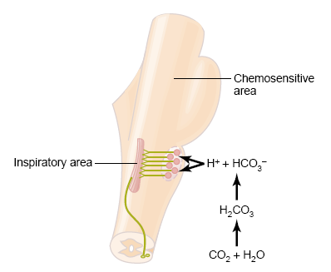
Chemical factors affecting the respiratory center:
Central chemoreceptors
on the front side of the medulla
sensitive only to increase of arterial pCO₂ (by increasing H⁺
^{(intracerebral fluid})
^{Notice:}
central chemoreceptor are stimulated by other types of acidosis (lactate acidosis, ketoacidosis)

Slide 41
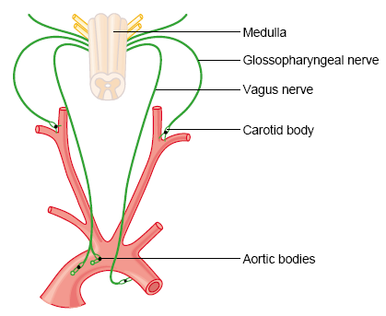
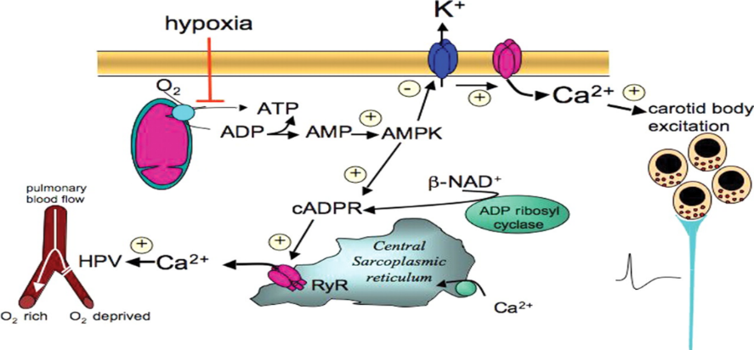
Peripheral chemoreceptors
– located in the aortic and carotid bodies
-primarily sensitive to decrease in arterial pO₂, particularly to decrease of O₂ under 10-13 kPa in the arterial blood.
They convey their sensory information to the medulla via the vagus nerve and glossopharyngeal nerve.
Mechanism of action: Decreased ATP production in mitochondria leads to depolarization of receptors membrane and to excitation of chemoreceptor
http://www.medicine.mcgill.ca/physio/resp-web/sect8.htm,

Slide 42
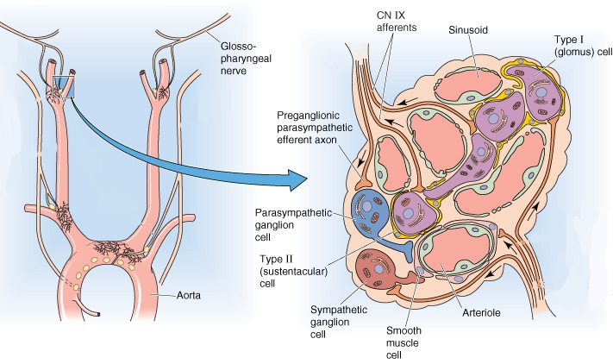
A49: Regulation of ventilation

Slide 43
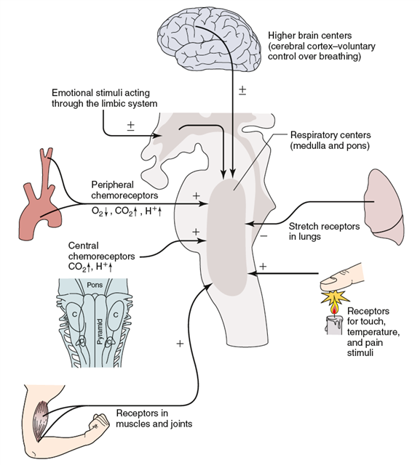
A49: Regulation of ventilation

Slide 44
A50: Respiratory responses to irritants
The lungs are protected from damage by:
  presence of hair (vibrissae) in the nasal cavity (traps dust particles)
  presence of ciliary epithelium covered with mucus (cilia moving mucus in one direction - into the pharynx)
  pulmonary alveolar macrophages
  presence of antibodies in bronchial secretion (IgA)
Reflexes:
  Herring-Breuer reflexes (inflation/deflation)
  Sneeze reflex
  Cough reflex
  Hiccup
  Yawn

Slide 45
A50: Respiratory responses to irritants
Cough Reflex | Sneeze Reflex | Hiccup
Cough is an expulsive reflex that protects the lungs and respiratory passage from foreign bodies. Causes of cough: Irritants-smokes, fumes, dusts, etc. Diseased conditions like COPD, tumors of thorax, etc. Pathway for cough reflex: Receptors in nose, paranasal sinuses, pharynx, trachea, pleura, diaphragm, perichondrium, stomach, ex.auditory canal and tymphanic membrane V,IX,X cranial nerves and phrenic nerves medulla X cranial nerve, phrenic nerve, spinal motor nerve primary and accessory respiratory muscles | Sneeze is defined as the involuntary expulsion of air containing irritants from nose. Causes of sneeze: Irritation of nasal mucosa Excess fluid in airway Pathway for sneeze reflex: Olfactory receptors or V cranial nerve endings I and V cranial nerve medulla – nucleus solitarious and reticular formation V, VII, IX, X cranial nerves and intercostal muscles pharyngeal, tracheal and respiratory muscles | Hiccup is spasmodic contraction of the diaphragm which causes a sudden intake of breath that is involuntarily cut off by closure of the glottis, thus producing a characteristic sound. Causes of hiccup: Eating too fast or too much Strokes, brain tumors, damage to the vagus or phrenic nerve Anxiety and stress Pathway for sneeze reflex: Phrenic, vagus, and sympathetic nerves Midbrain Motor fibers of phrenic nerve and accessory nerves Diaphragm and intercostal muscles

Slide 46
A50: Respiratory responses to irritants
Herring-Breuer reflexes (inflation/deflation)
a. keeps the lungs from over-inflating with inspired air
  pulmonary stretch R – vagus nerve – medulla – inhibition of inspiration and initiation of expiration
b. serves to shorten exhalation when the lung is deflated
  pulmonary stretch R – vagus nerve – the pontine center

Slide 47
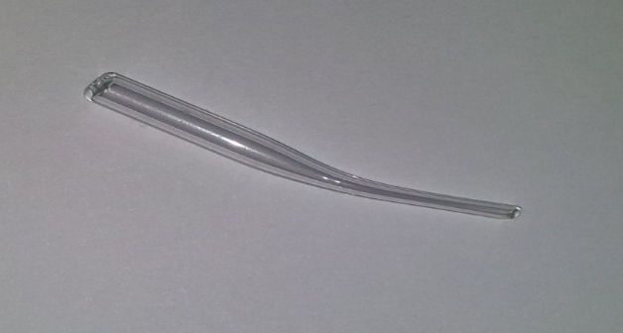
Hering – Breuer ´s reflex in animal experimentH
ENDOTRACHEAL CANNULA
TRACHEA
A. CAROTIS
N. VAGUS
47
Upraveno dle: Poopesko Peter a kol. (1990)

Slide 48
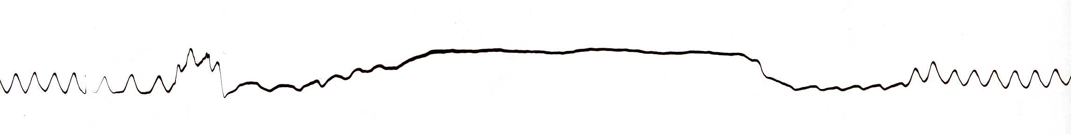
HERING-BREUER REFLEX
Reflex STOP BREATHING
Artefakts
Artefakts
48

Slide 49
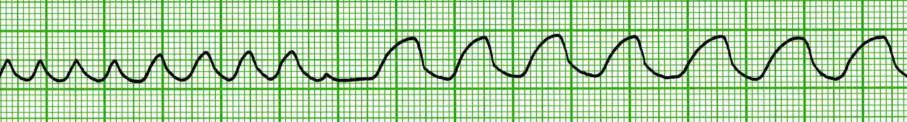
Changes of breathing after VAGOTOMY
inspirium
exspirium
One-side VAGOTOMY
Both-side VAGOTOMY
49

