Slide 1
Devices on chest X-ray
Tomáš Rohan, Radim Gerstberger, Monika Poláčková

Slide 2
Learning Outcomes
The student will become familiar with catheters and devices that can be described on a chest x-ray
The student will learn the correct position of the central venous catheter on a chest X-ray

Slide 3
Content of the lecture
Central venous access (CVC, PICC, port catheters)
Pacemaker electrodes (PM, ICD) and other cardiovascular devices
Tracheal tube and tracheostomy
Nazogastric and nasoeneteric tubes

Slide 4
Content of the lecture
Central venous access (CVC, PICC, port catheters)
Pacemaker electrodes (PM, ICD) and other cardiovascular devices
Tracheal tube and tracheostomy
Nazogastric and nasoeneteric tubes

Slide 5
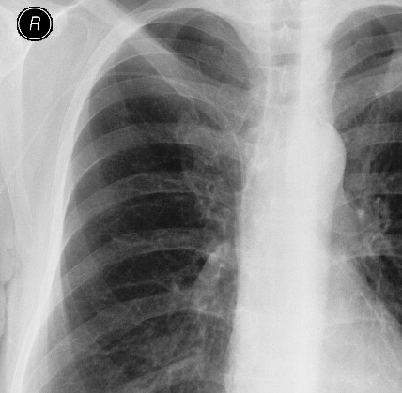
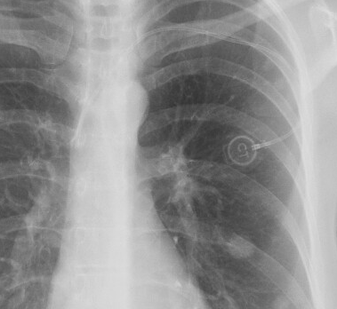
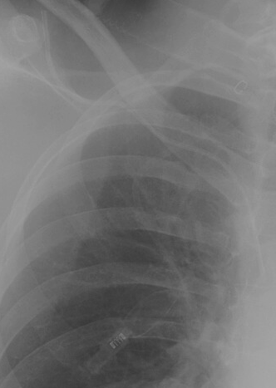
CVC, PICC, port catheters
PICC
Port catheter
CVC
What to focus on?
Pneumothorax
Position of the tip
Course (kinked, twisted,...)
Integrity failure
Change over time on the control X-ray

Slide 6
Optimal position of CVC

Slide 7
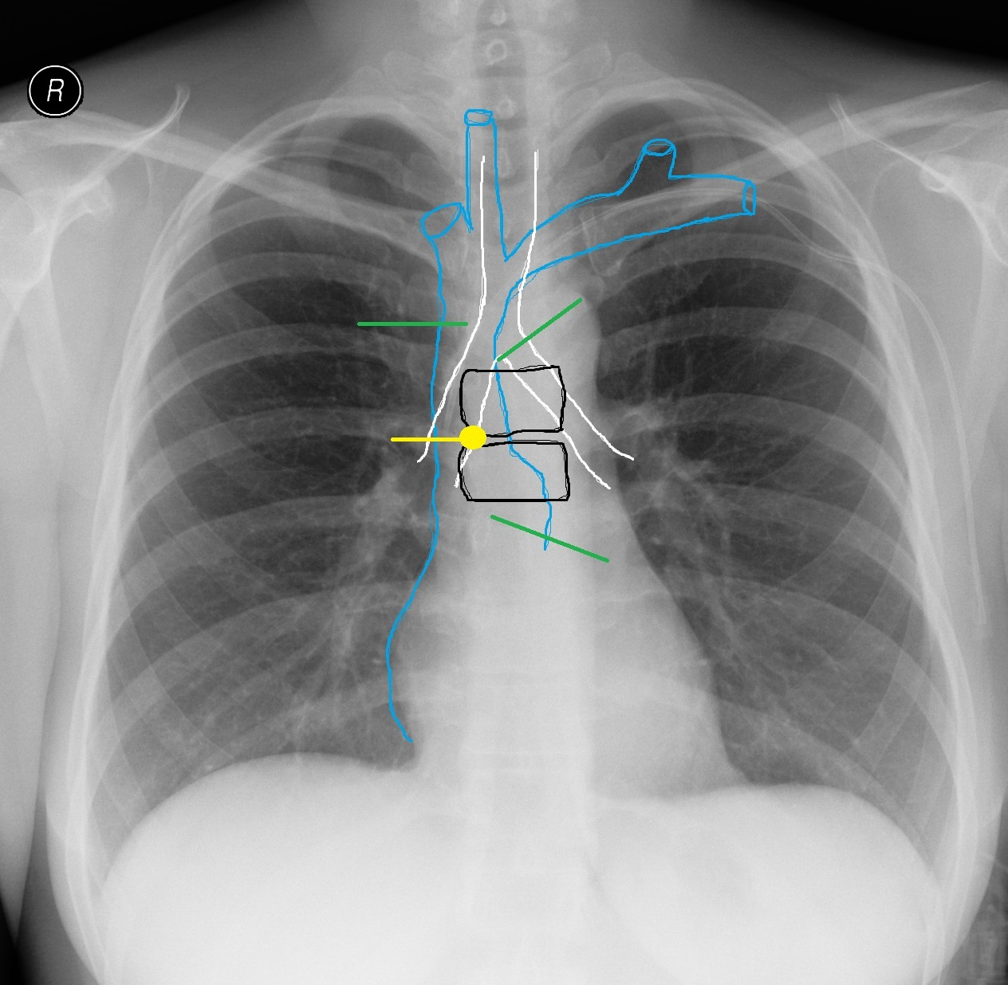
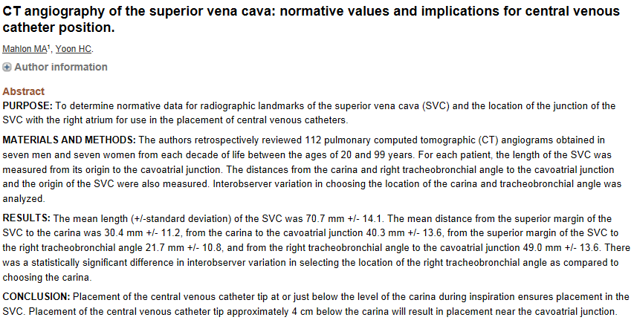
Superior vena cava
carina tracheae
Optimal position for CVC
4cm
Right atrium (RA)
Cavoatrial junction (4cm below carina)
Optimal position for PICC, port catheters
Mahlon, M.A.; Yoon, H.-C. CT Angiography of the Superior Vena Cava: Normative Values and Implications for Central Venous Catheter Position. J Vasc Interv Radiol 2007, 18, 1106–1110, doi:10.1016/j.jvir.2007.06.002.
Notes:
malpozice
- špička katétru není v optimální poloze pro používání, tedy není v dist. třetině VCS, kavoatriálním ústí
primární malpozice: ihned po implantaci, stočení do VJI, kontralaterální v. subclavia, proximální část VCS, stočení katétru v průběhu žíly
sekundární malpozice (dislokace): povytažení, stočení do VJI, smyčka v cévě (při zvýšeném nitrohrudním tlaku-kašel, zvracení)
malpozice je hlavní rizikový faktor pro rozvoj malfunkce (trombóza, mechanická obstrukce při naléhání špičky katétru na stěnu cévy)

Slide 8
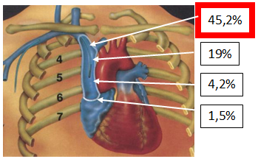
Complications of CVC
malposition (the tip of the catheter is not in optimal position – not in distal third of SVC or in cavoatrial junction)
- primary
- secondary
thrombosis, mechanical obstruction
arrhythmias
Caers, J., Fontaine, C., Vinh-Hung, V. et al. Catheter tip position as a risk factor for thrombosis associated with the use of subcutaneous infusion ports. Support Care Cancer 13, 325–331 (2005). https://doi.org/10.1007/s00520-004-0723-1

Slide 9
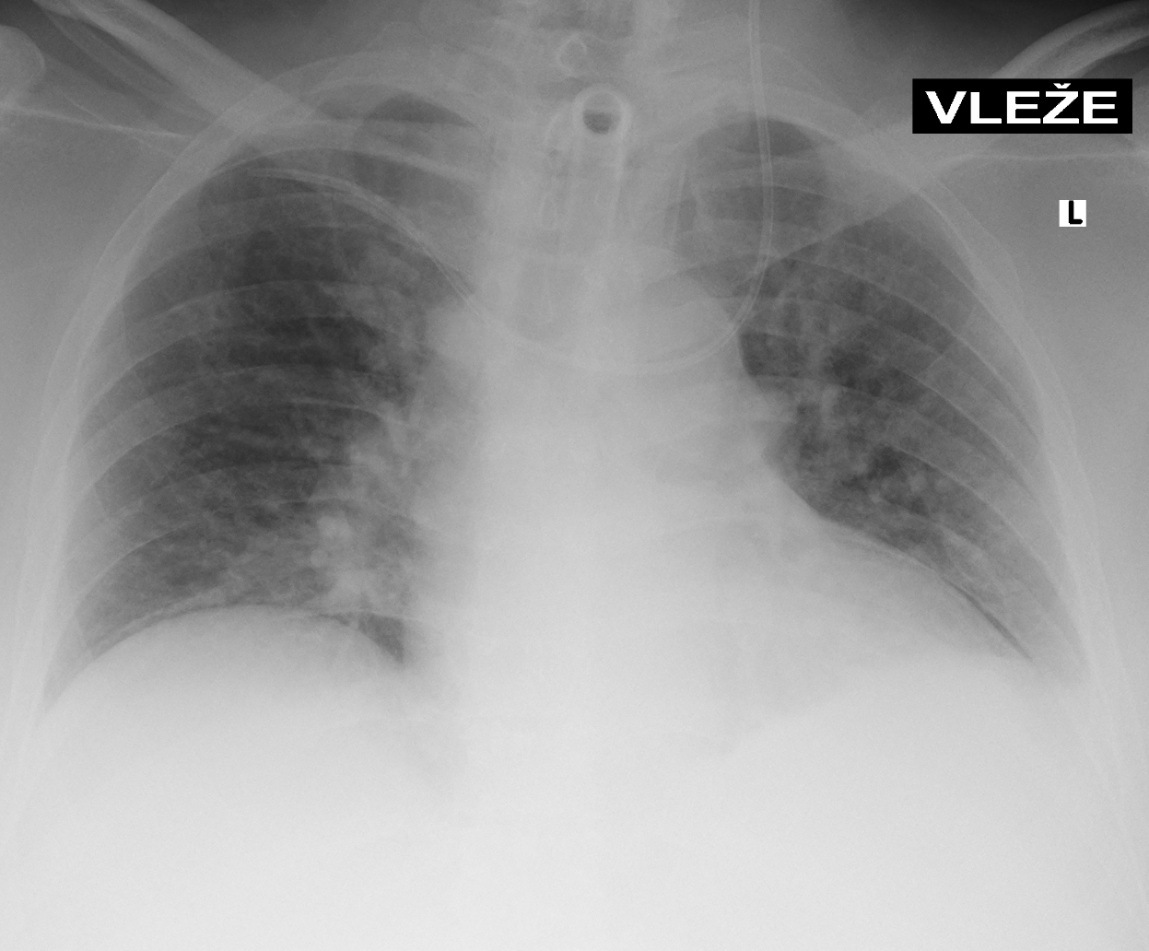
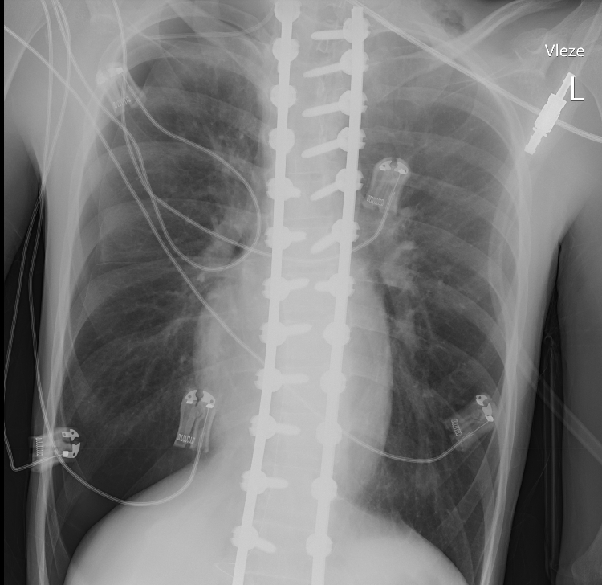
Complications of CVC

Slide 10
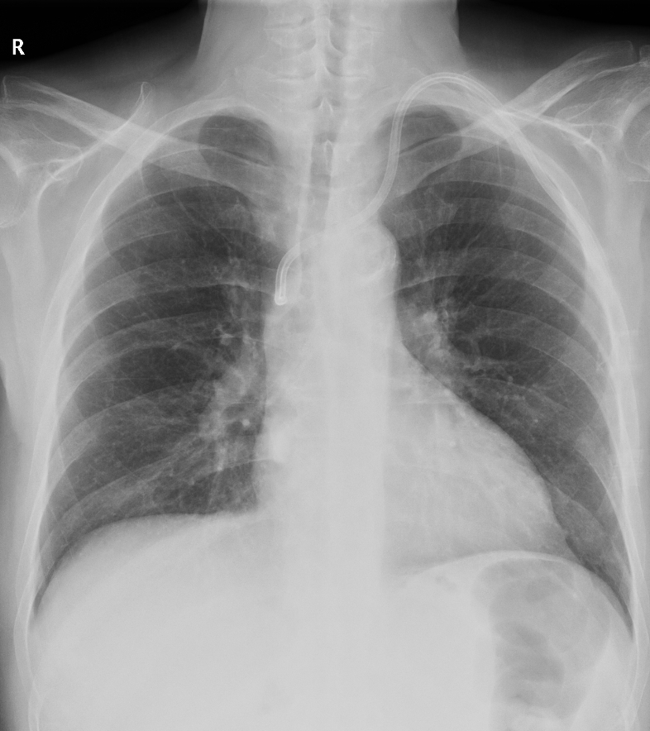
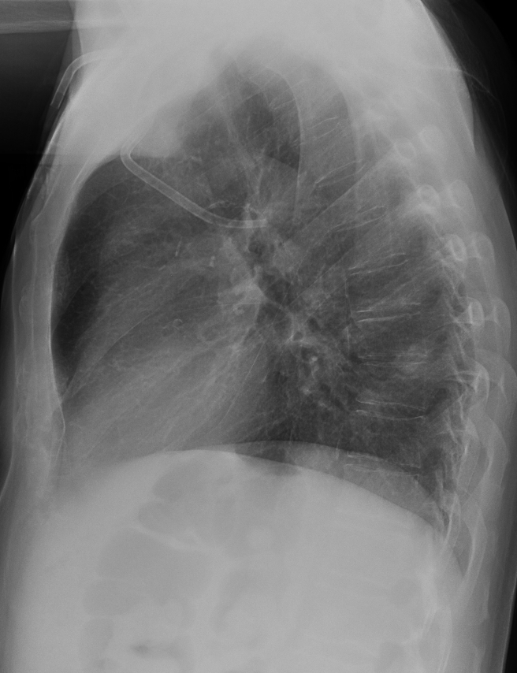
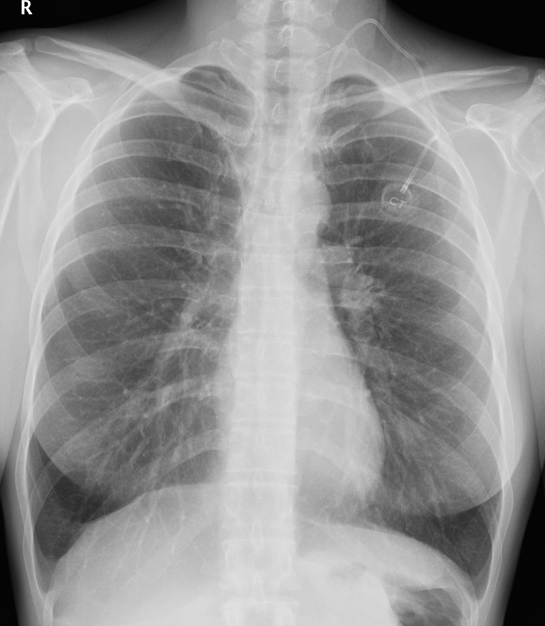
Complications of CVC

Slide 11
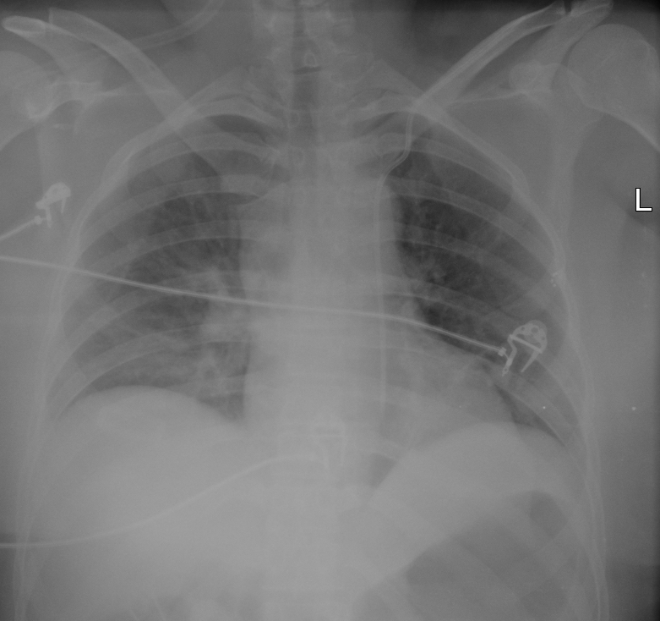
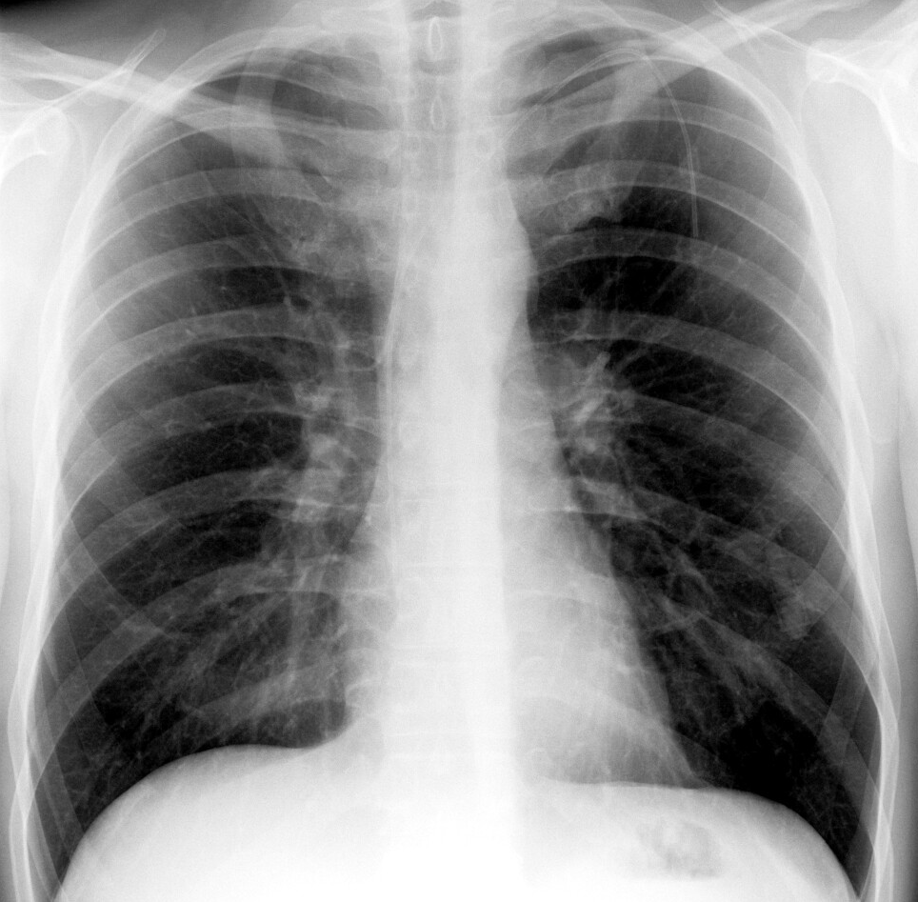
Complications of CVC
9cm

Slide 12
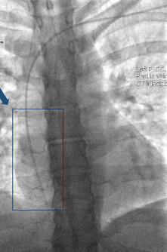
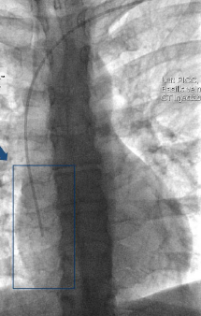
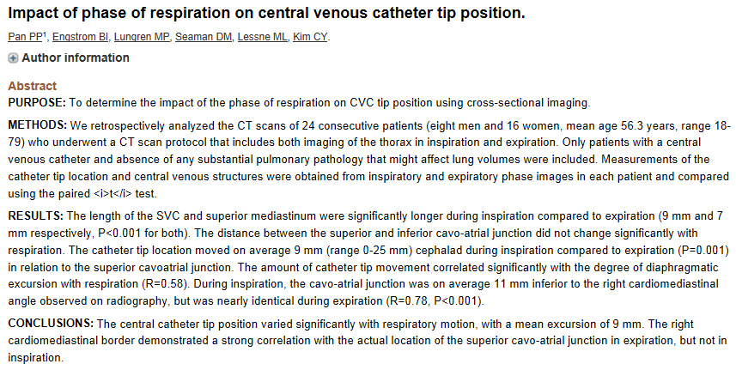
CVC tip position
NO
Is there a difference between upright and supine postibion?
Is there a difference between inspiration and expiration?
YES 9mm
Pan, P.P.; Engstrom, B.I.; Lungren, M.P.; Seaman, D.M.; Lessne, M.L.; Kim, C.Y. Impact of Phase of Respiration on Central Venous Catheter Tip Position. J Vasc Access 2013, 14, 383–387, doi:10.5301/jva.5000135.

Slide 13
Content of the lecture
Central venous access (CVC, PICC, port catheters)
Pacemaker electrodes (PM, ICD) and other cardiovascular devices
Tracheal tube and tracheostomy
Nazogastric and nasoeneteric tubes

Slide 14
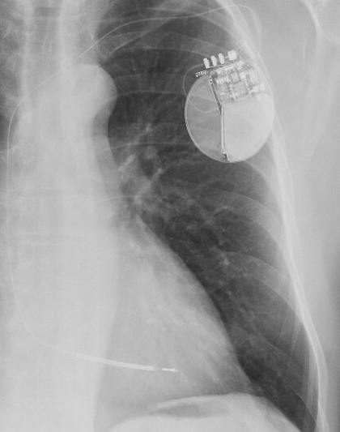
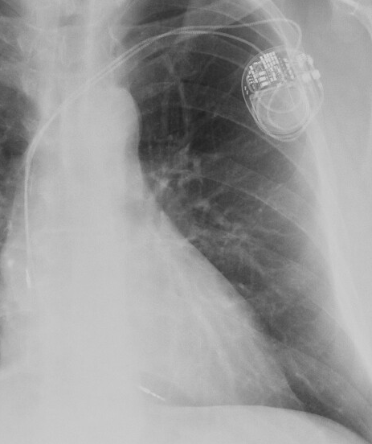
Pacemaker electrodes
ICD
PM
What to focus on?
Pneumothorax
Position of the tip
Course (kinked, twisted,...)
Integrity failure
Change over time on the control X-ray
Notes:
ICD - implantable cardioverter defibrillator

Slide 15
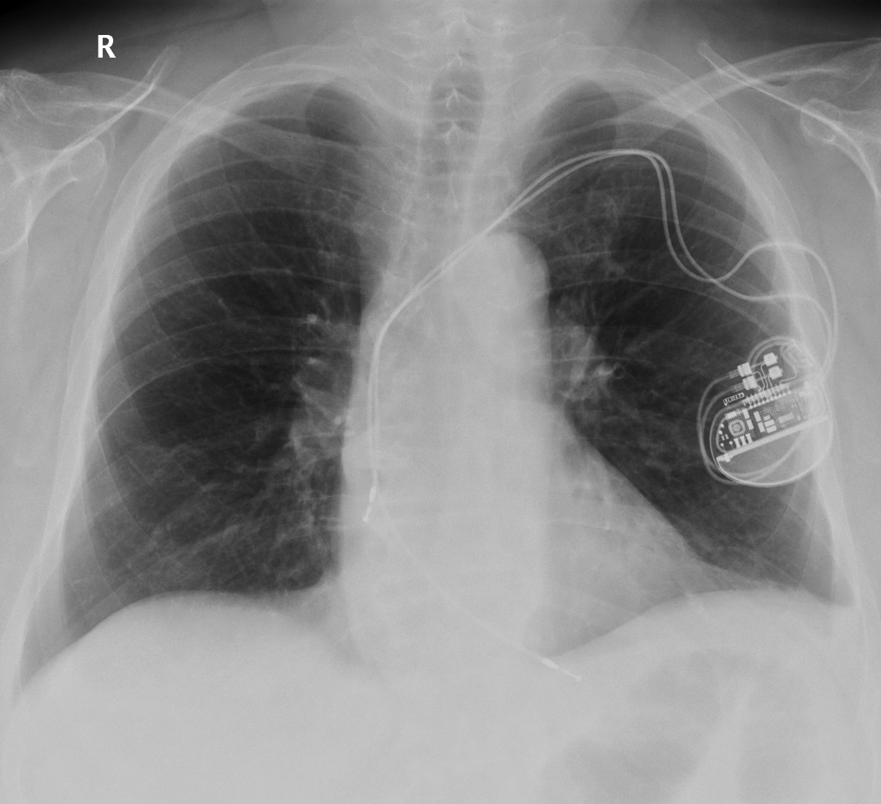
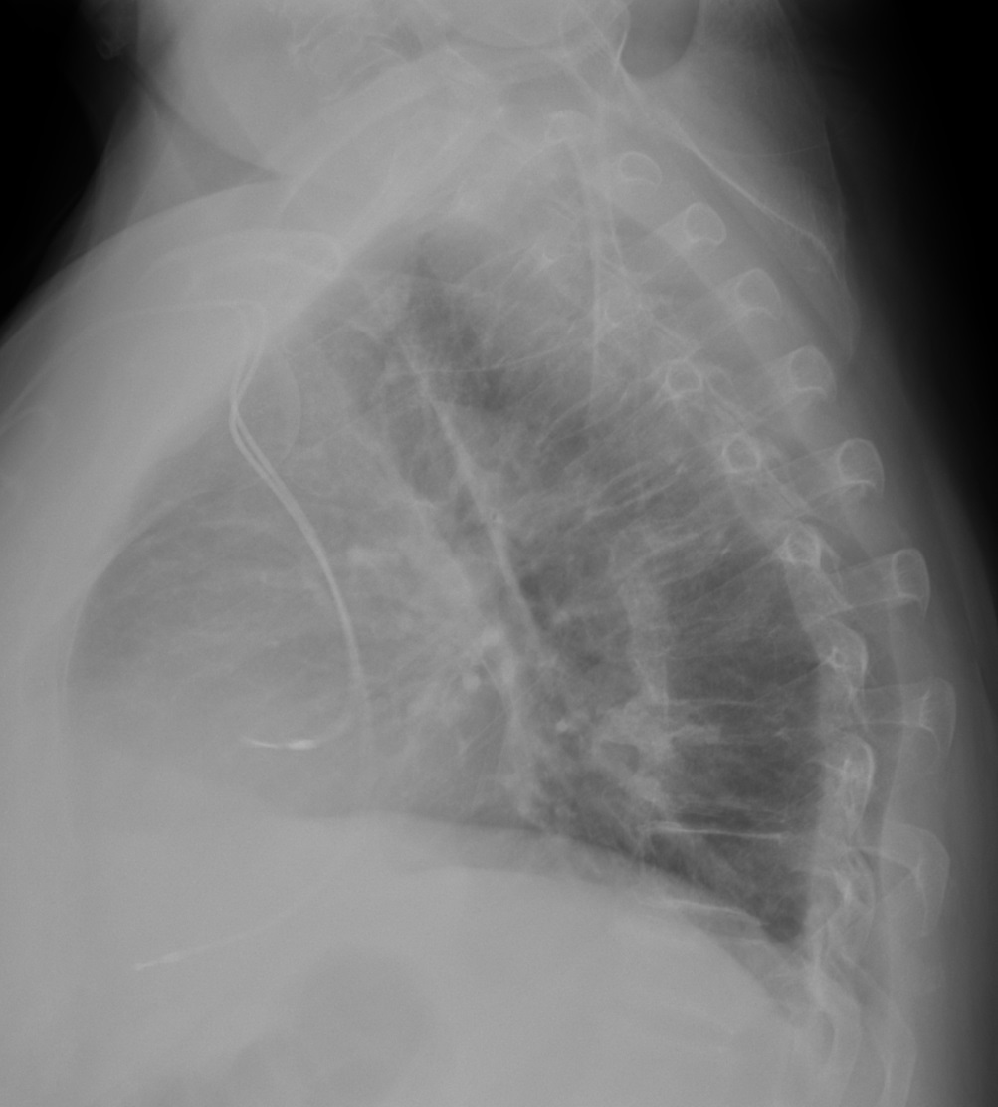
Correct position - pacemaker
RA electrode
RA electrode
RV electrode
RV electrode
Notes:
RA – right atrium
RV – right ventricle

Slide 16
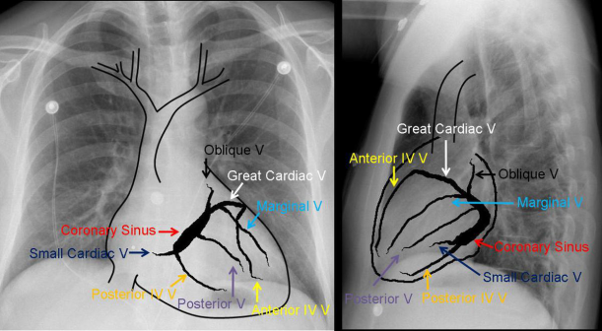
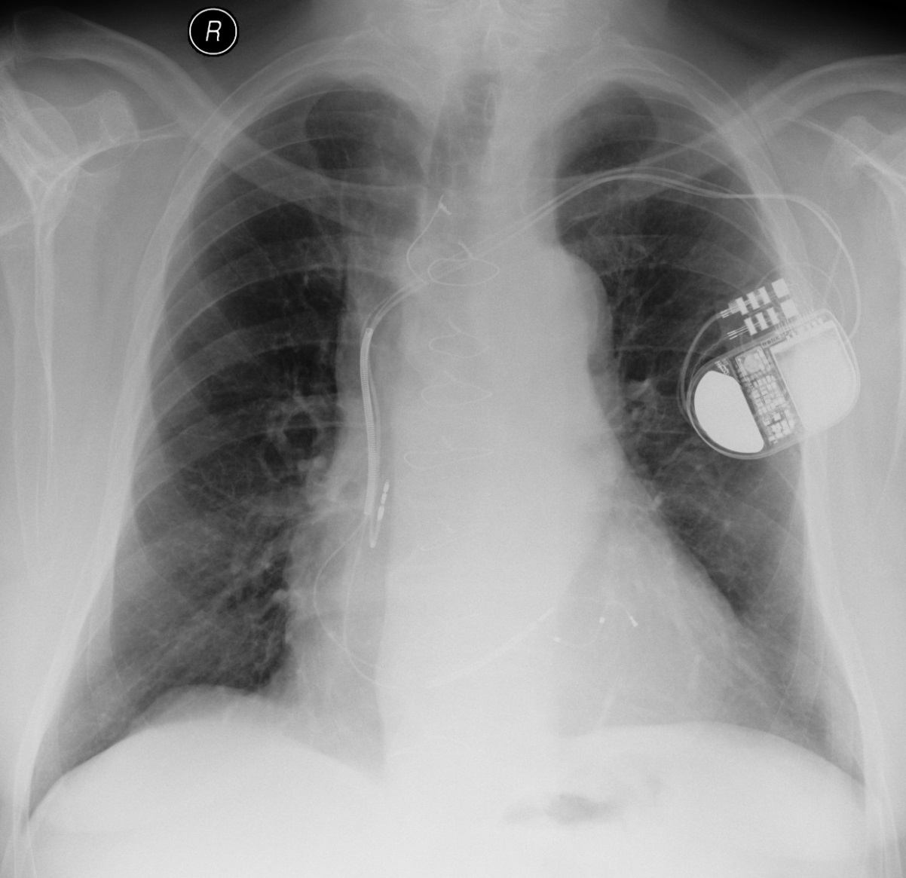
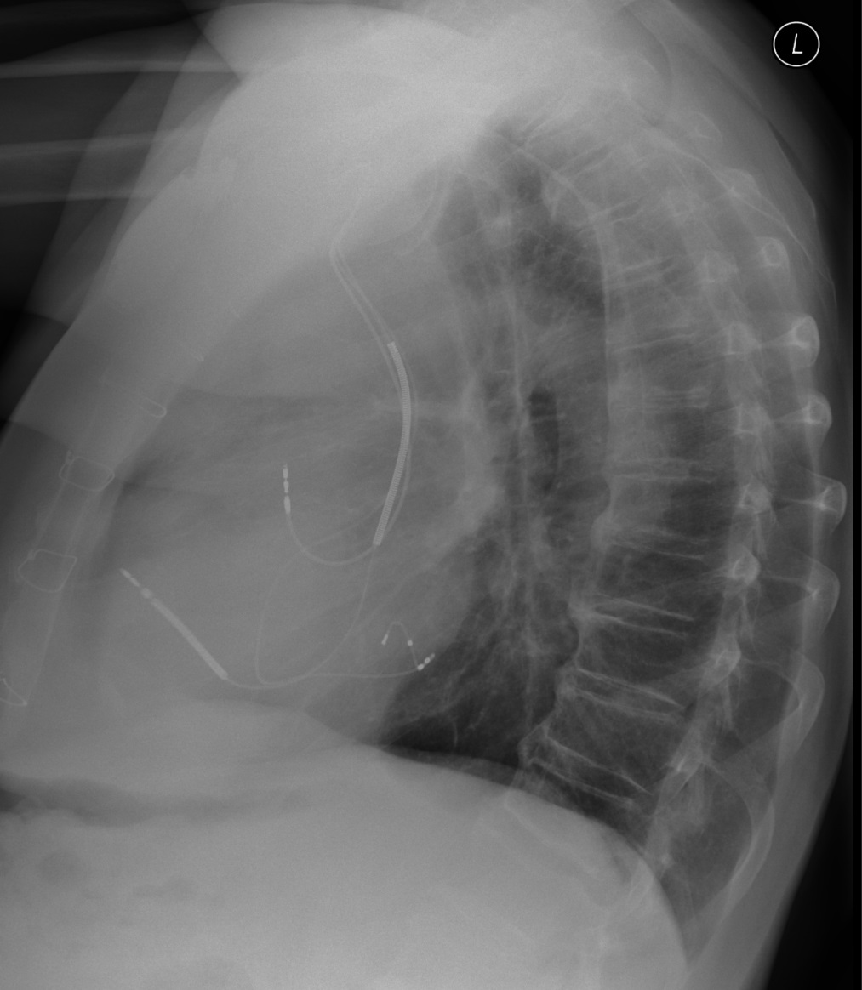
Correct position - ICD
RA electrode
RA electrode
Mv electrode
Mv electrode
RV electrode
RV electrode
Gutierrez, F.; Rossini, S.A.; Bhalla, S.; Cummings, K.; Capiel, C. Cardiac Pacemakers: What the Radiologist Needs to Know Available online: https://epos.myesr.org/poster/esr/ecr2010/C-0741 (accessed on 7 October 2021).
Notes:
Mv – marginal vein

Slide 17
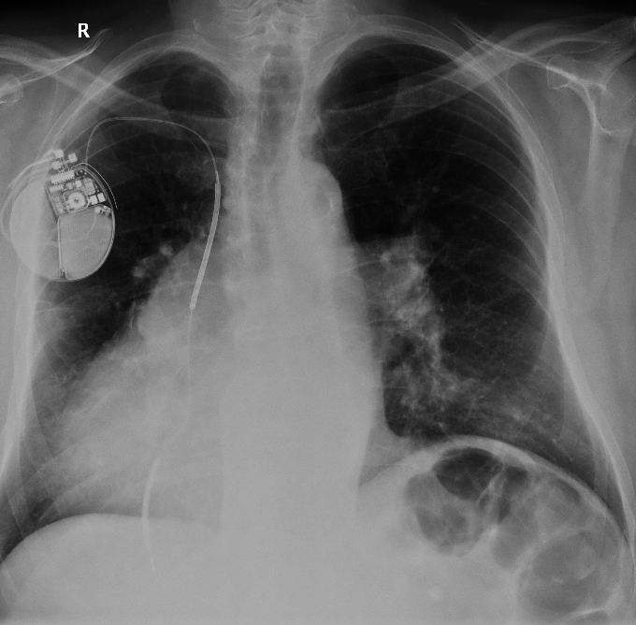
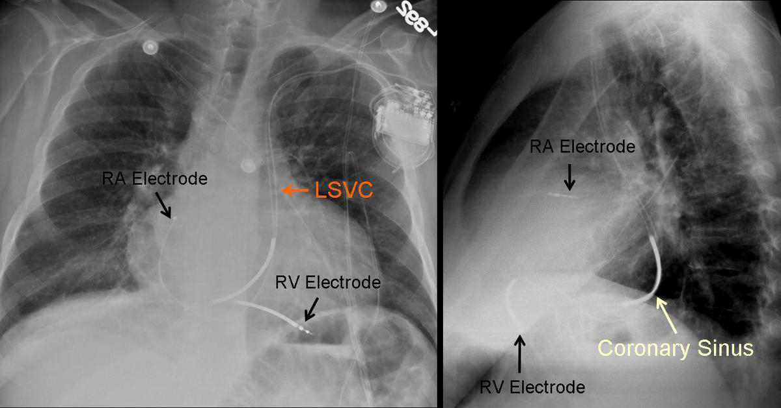
Variability of pacemaker/ICD electrodes
Situs inversus
Left superior vena cava (LSVC)
Gutierrez, F.; Rossini, S.A.; Bhalla, S.; Cummings, K.; Capiel, C. Cardiac Pacemakers: What the Radiologist Needs to Know Available online: https://epos.myesr.org/poster/esr/ecr2010/C-0741 (accessed on 7 October 2021).
Notes:
LSCV - Left superior vena cava

Slide 18
Other types of pacemakers/ICD

Slide 19
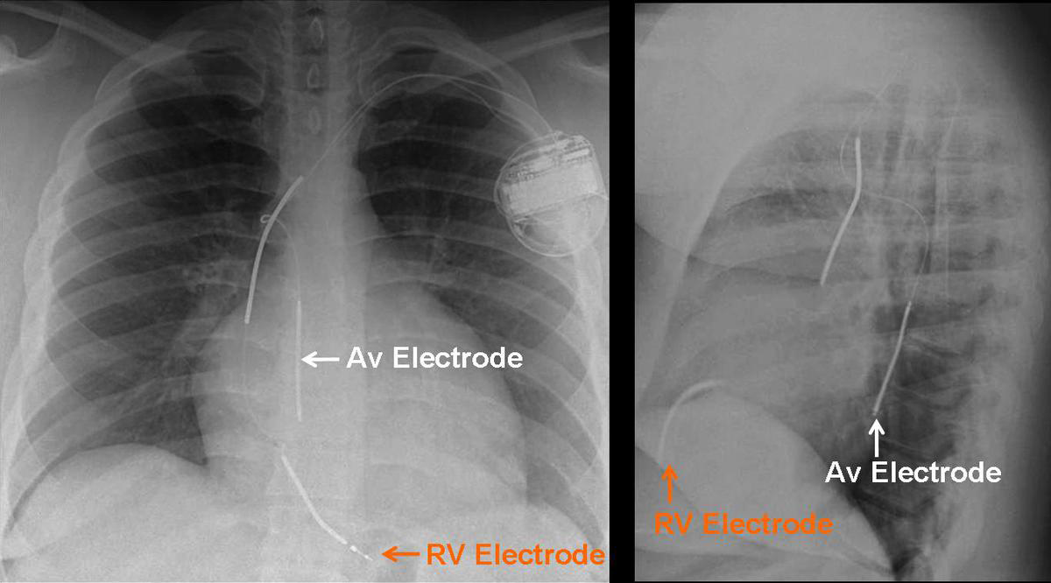
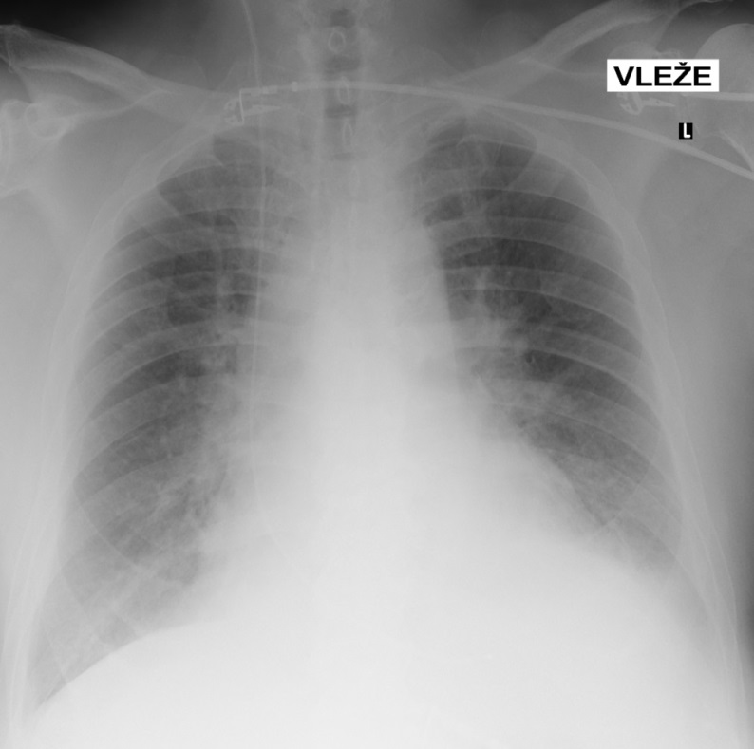
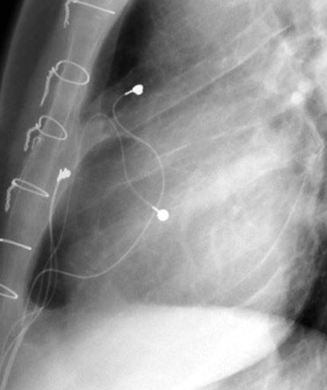
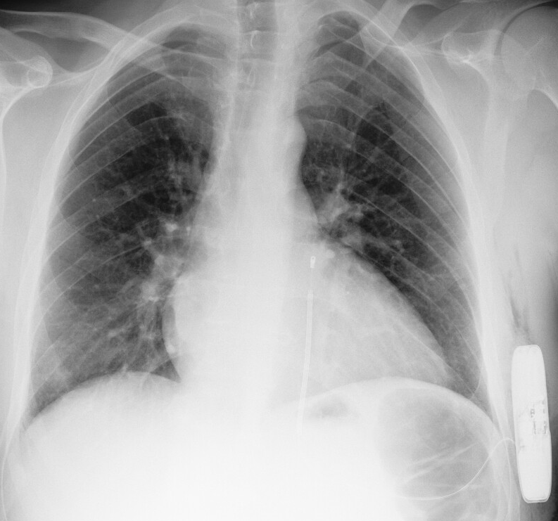
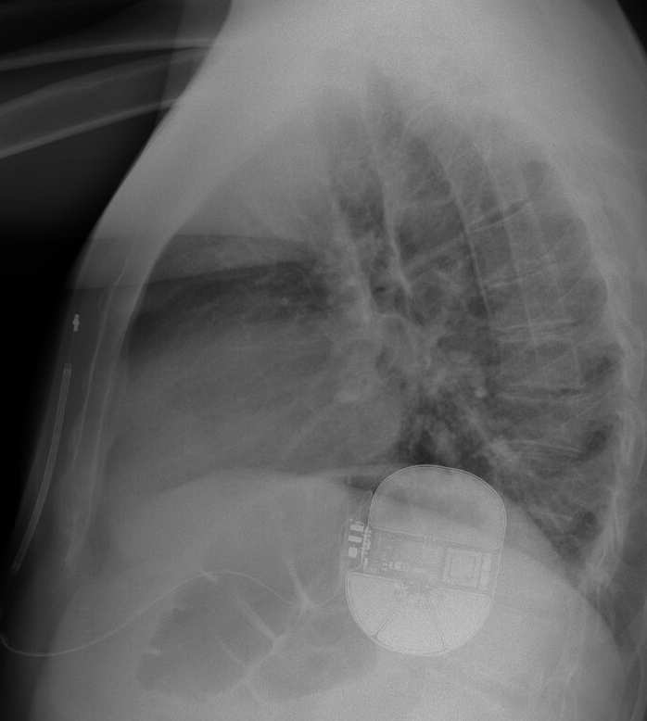
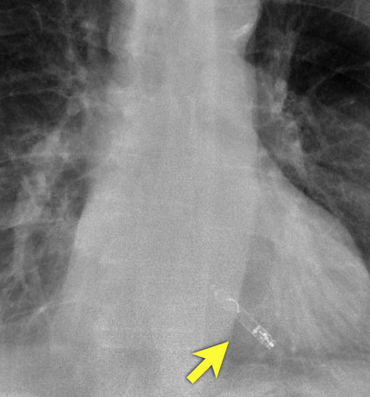
ICD with electrode in RV and azygos vein
Temporary electrode for stimulation
Epicardial pacing
Subcutaneous ICD
Leadless PM
Gutierrez, F.; Rossini, S.A.; Bhalla, S.; Cummings, K.; Capiel, C. Cardiac Pacemakers: What the Radiologist Needs to Know Available online: https://epos.myesr.org/poster/esr/ecr2010/C-0741 (accessed on 7 October 2021).
Cardiovascular devices on Chest X-Ray, Radiology Assistant. Available online: https://radiologyassistant.nl/cardiovascular/devices/cardiovascular-devices (accessed on 7 October 2021).
Notes:
AV – azygos vein

Slide 20
Complications of pacemaker/ICD electrodes

Slide 21
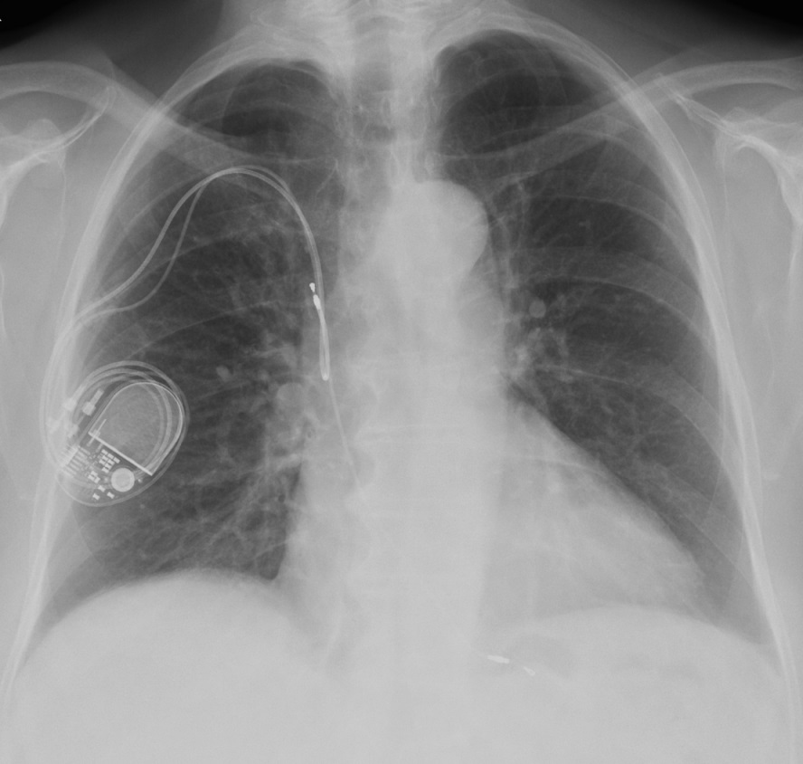
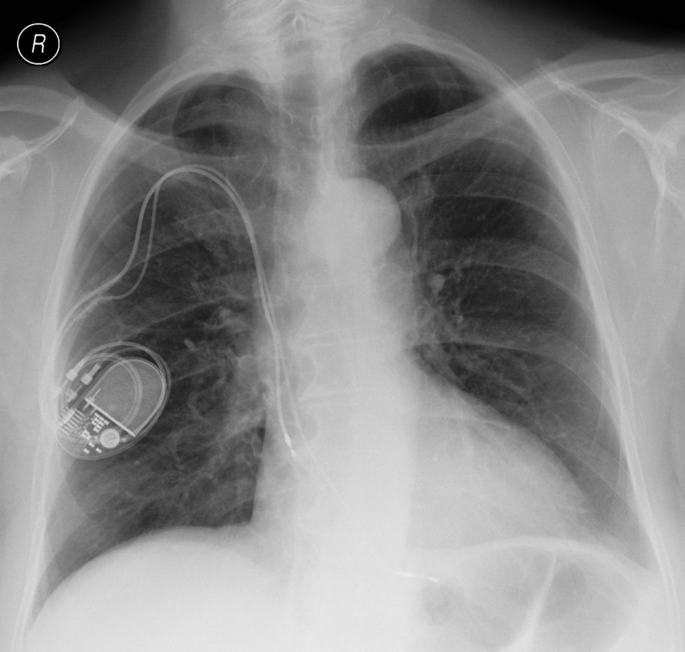
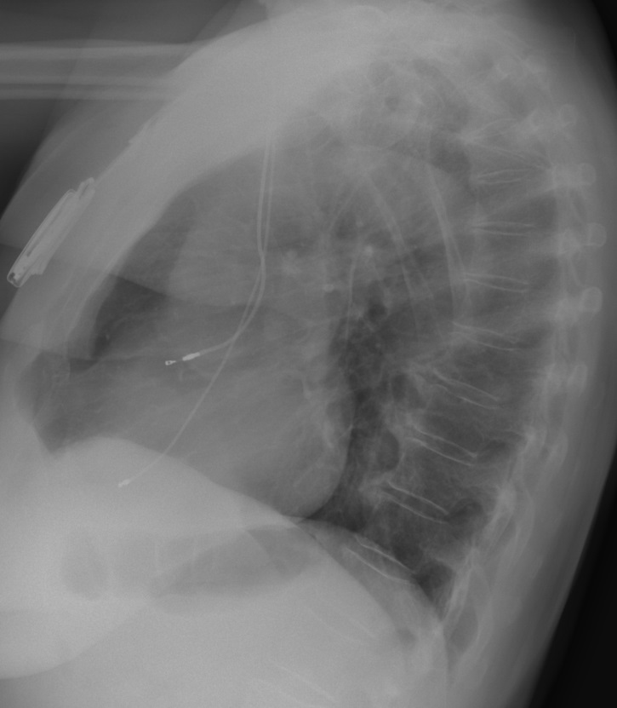
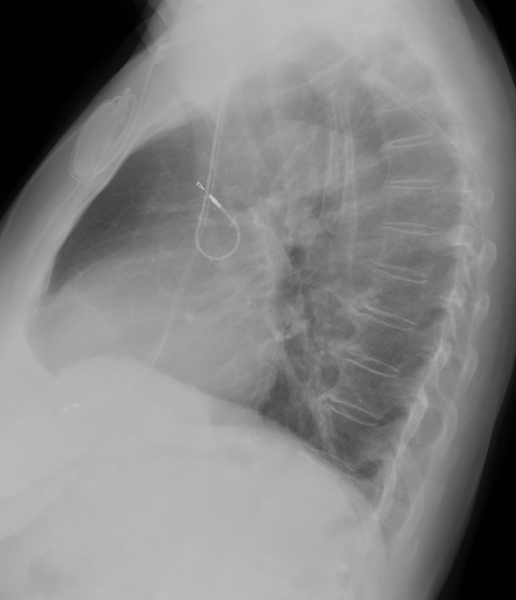
1 month after implantation
Dislocation
Immediately after implantation

Slide 22
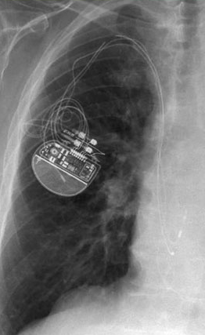
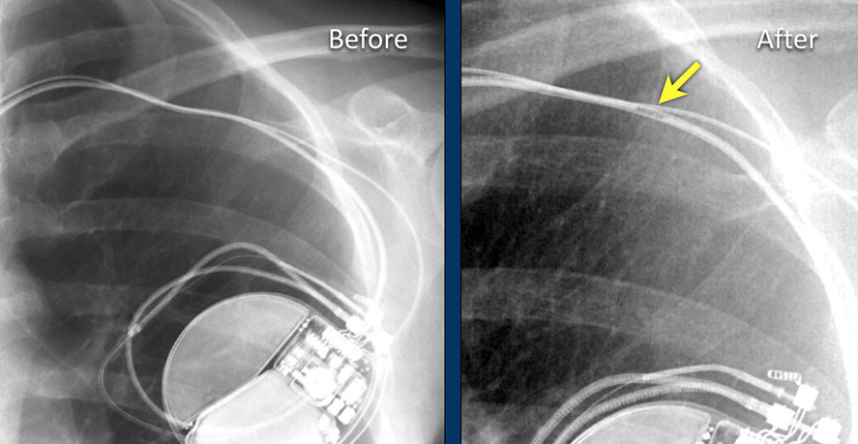
Fracture of electrodes
Gutierrez, F.; Rossini, S.A.; Bhalla, S.; Cummings, K.; Capiel, C. Cardiac Pacemakers: What the Radiologist Needs to Know Available online: https://epos.myesr.org/poster/esr/ecr2010/C-0741 (accessed on 7 October 2021).
Cardiovascular devices on Chest X-Ray, Radiology Assistant. Available online: https://radiologyassistant.nl/cardiovascular/devices/cardiovascular-devices (accessed on 7 October 2021).
Notes:
V anamn. Záškuby bránice

Slide 23
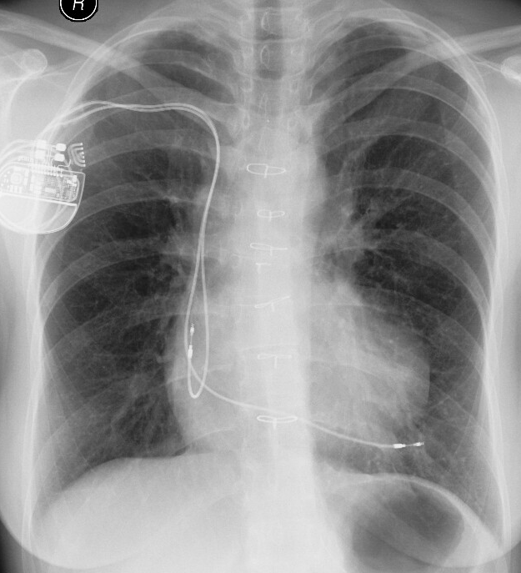
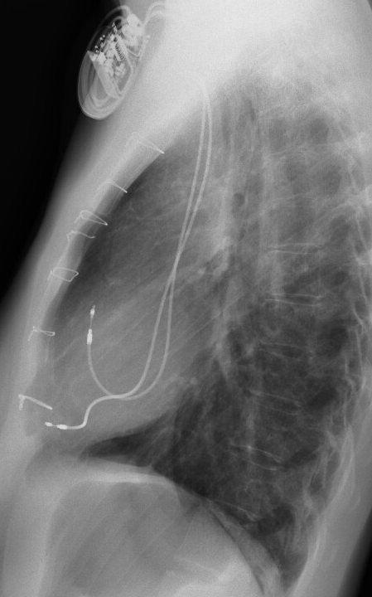
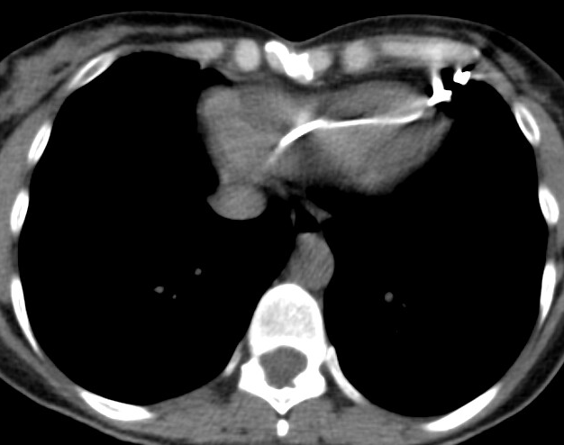
Perforation of right ventricle
Gutierrez, F.; Rossini, S.A.; Bhalla, S.; Cummings, K.; Capiel, C. Cardiac Pacemakers: What the Radiologist Needs to Know Available online: https://epos.myesr.org/poster/esr/ecr2010/C-0741 (accessed on 7 October 2021).
Cardiovascular devices on Chest X-Ray, Radiology Assistant. Available online: https://radiologyassistant.nl/cardiovascular/devices/cardiovascular-devices (accessed on 7 October 2021).
Notes:
V anamn. Záškuby bránice

Slide 24
Prosthetic heart valves

Slide 25
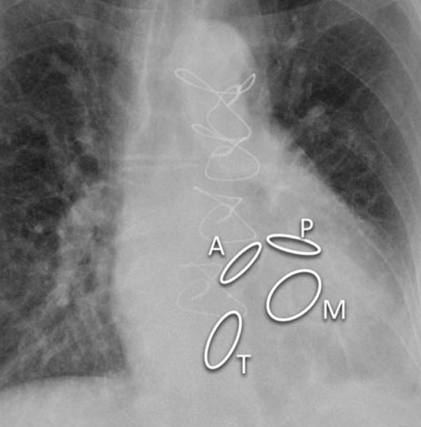
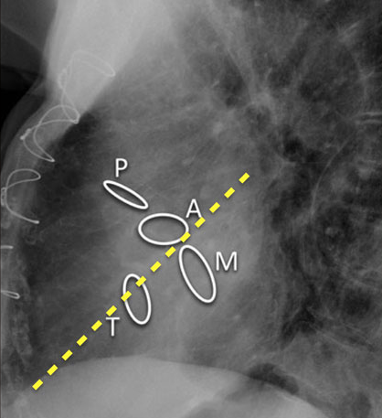
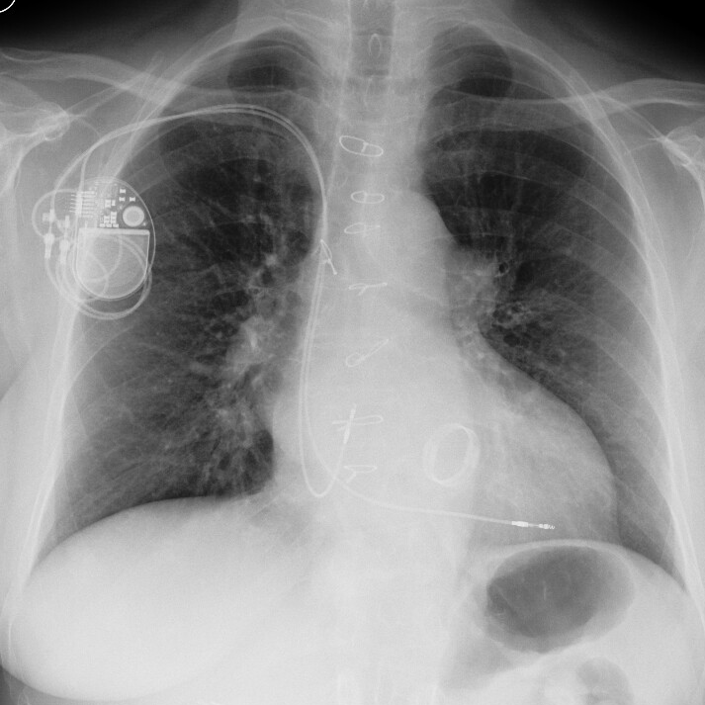
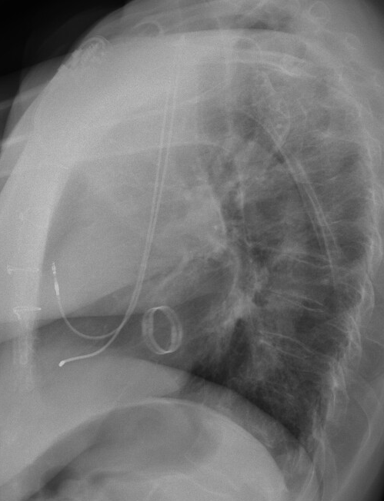
Cardiovascular devices on Chest X-Ray, Radiology Assistant. Available online: https://radiologyassistant.nl/cardiovascular/devices/cardiovascular-devices (accessed on 7 October 2021).

Slide 26
Other cardiovascular devices on X-ray

Slide 27
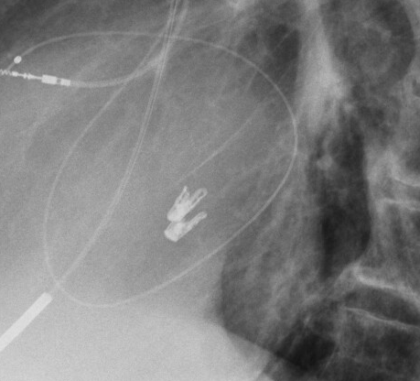
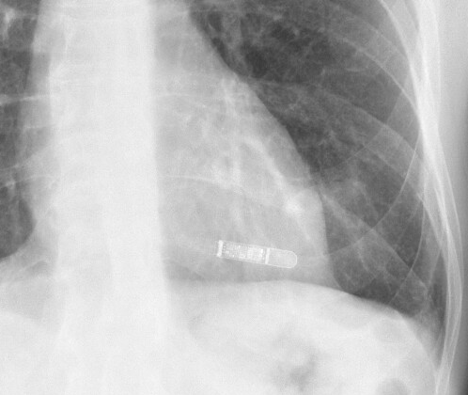
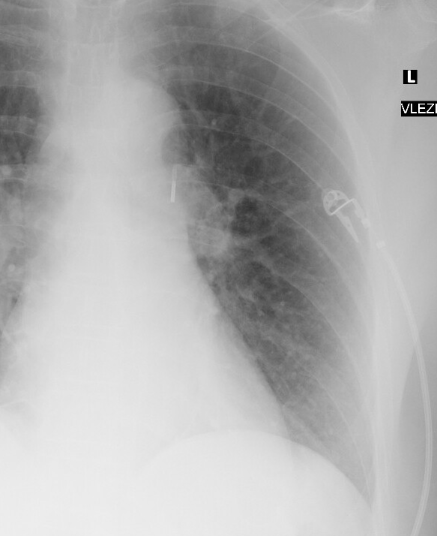
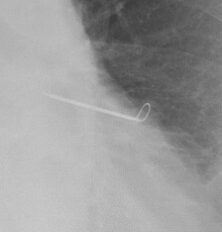
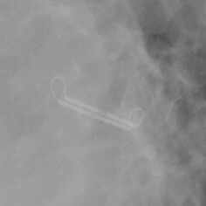
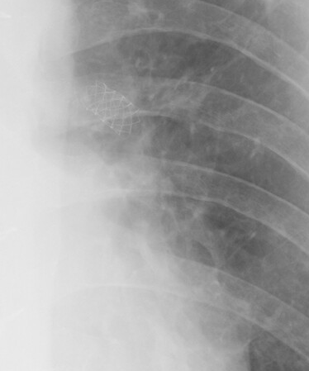


Mitral clip
ILR
(implantable loop recorder)
Intra-Aortic Balloon Counterpulsation
Atriclip
Vascular stent
Occluder
Coronary stent
Cardiovascular devices on Chest X-Ray, Radiology Assistant. Available online: https://radiologyassistant.nl/cardiovascular/devices/cardiovascular-devices (accessed on 7 October 2021).

Slide 28
Content of the lecture
Central venous access (CVC, PICC, port catheters)
Pacemaker electrodes (PM, ICD) and other cardiovascular devices
Tracheal tube and tracheostomy
Nazogastric and nasoeneteric tubes

Slide 29


Correct position
Tracheal tube
Tracheostomy

Slide 30

Tracheal tube - malposition

Slide 31
Content of the lecture
Central venous access (CVC, PICC, port catheters)
Pacemaker electrodes (PM, ICD) and other cardiovascular devices
Tracheal tube and tracheostomy
Nazogastric and nasoeneteric tubes

Slide 32


Nazogastric and nazojejunal tube – correct position

Slide 33
Nasogastric or nasojejunal tubes - malposition

Slide 34




Slide 35
Take home message
The importance of X-ray in assessing the position and complications of catheters and tubes
Optimal position of central venous catheters

