Slide 1
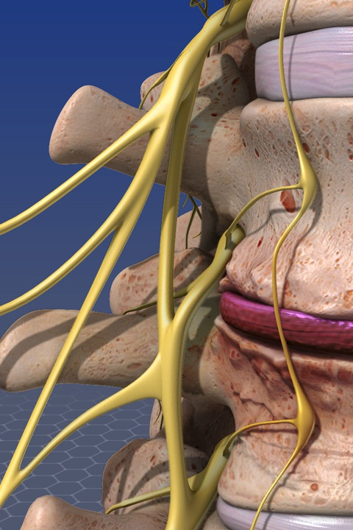
Spondylodiscitis
Aetiology, diagnostics, therapy

Slide 2
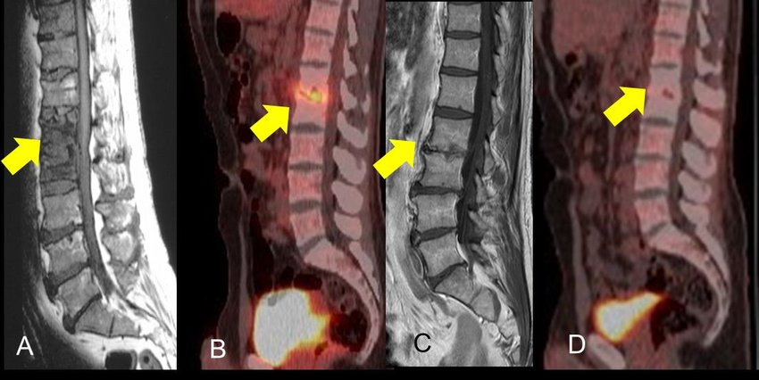


MOTTO
“Discitis from the infectologist’s and orthopaedist’s point of view”
“Multidisciplinary issue = multidisciplinary approach”

Slide 3

PRESENTATION PLAN
Definition
Epidemiology
Aetiopathogenesis
Clinical symptoms
Diagnostics
Imaging methods
Treatment
Case studies
Discussion

Slide 4
Definition
Various infections of the spine and adjacent structures, incl. soft tissues
It includes discitis, epidural abscess and vertebral osteomyelitis
MRI scans of the spine are the foundation of diagnostics
Treatment can be:
Conservative = long-term targeted antibiotics
Surgical = decompression, possible stabilisation of the spine and long-term ATB
The approach is always individual, and depends particularly on:
The patient's general condition
The extent and chronicity of the infection
The inflammation’s localisation in the spine
Identification of the pathogen and its susceptibility to antimicrobial agents

Slide 5
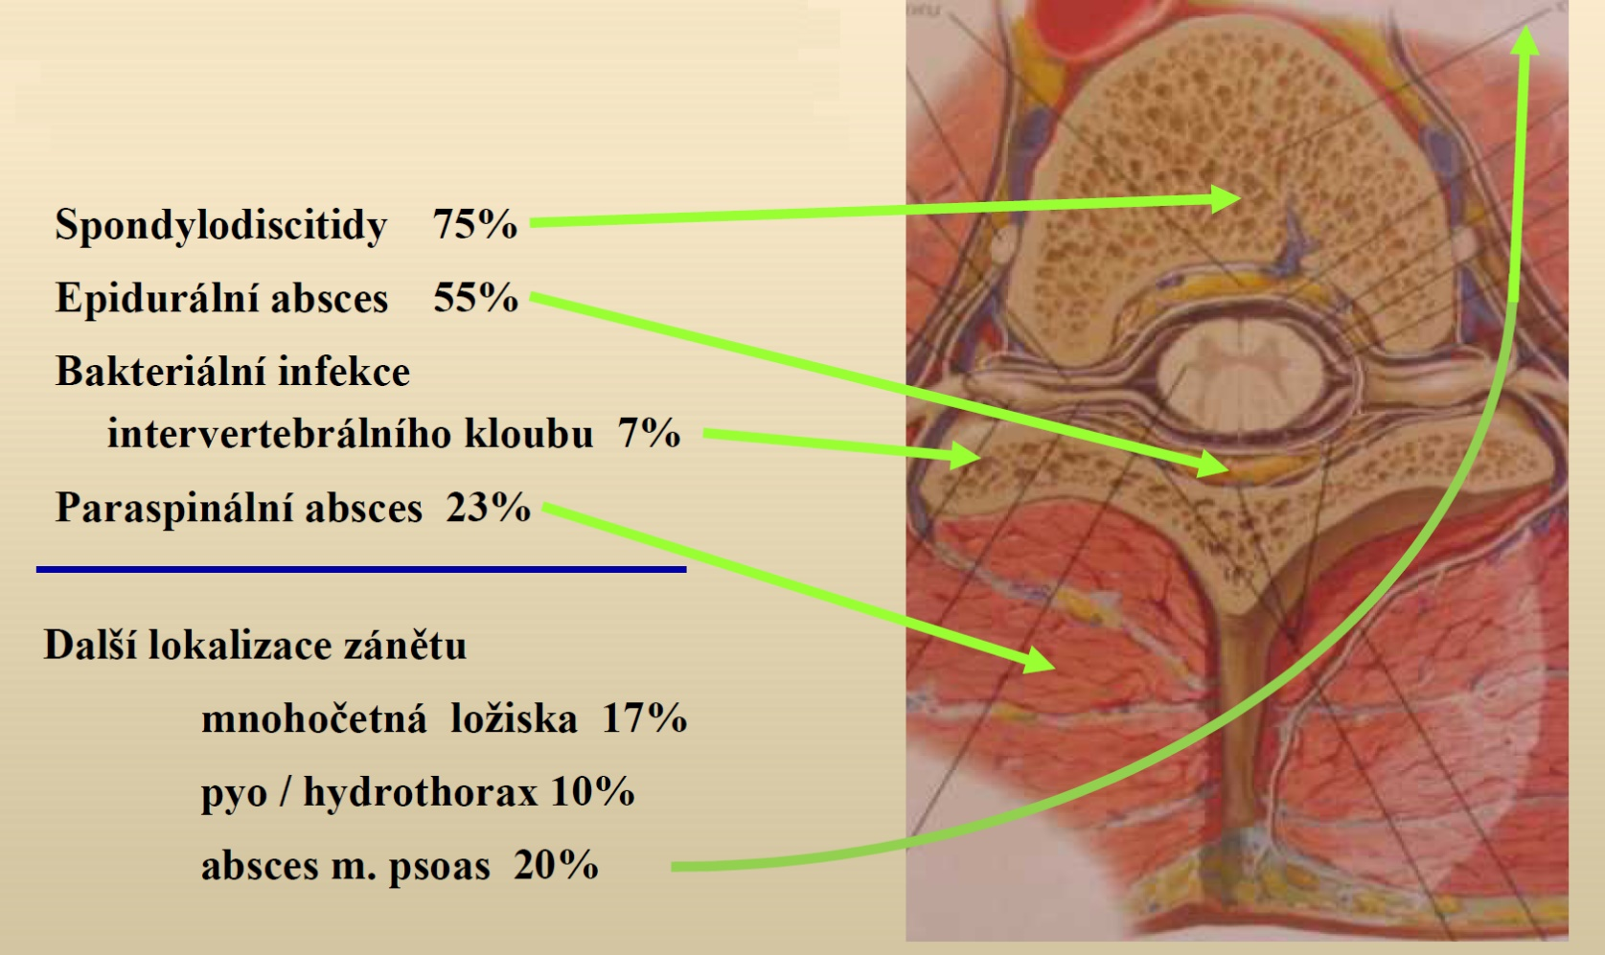
Anatomy – the localisation of the inflammatory process
By permission of: MUDr. V. Chmelík et al., České Budějovice Hospital, 2017

Slide 6
Epidemiology I
Incidence range
0.2– 3.7/ 100,000 per year
3– 5% of all bone and joint infections, rising incidence
Bi-modal age distribution:
First peak under 20 years
Second peak 50 to 70 years
Males affected more frequently than females
(1.5–2:1 ratio)
30 to 50% associated with neurological deficit
Mortality < 5%

Slide 7
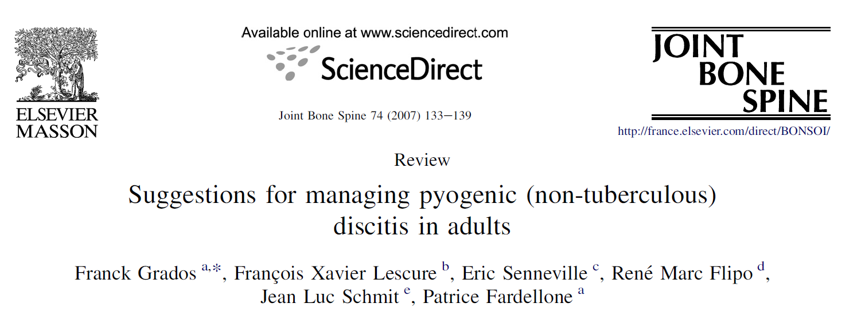
Epidemiology II
Anatomical localisation: 50% LS, 40% Th, 10% C spine
Risk factors:
  The elderly
  Type 1 and 2 DM
  Malignancies
  Chronic renal failure, liver cirrhosis
  Chronic cardiac failure, malnutrition
  Severe obesity
  HIV infection, alcohol abuse, narcotics
  Trauma, smoking

Slide 8
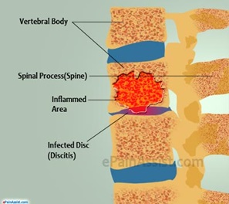
Pathogenesis
Pathophysiology
Pathogenic microbes
Inoculation – hematogenic – iatrogenic – per continuitatem
Neurogenic deficit
Other complications

Slide 9
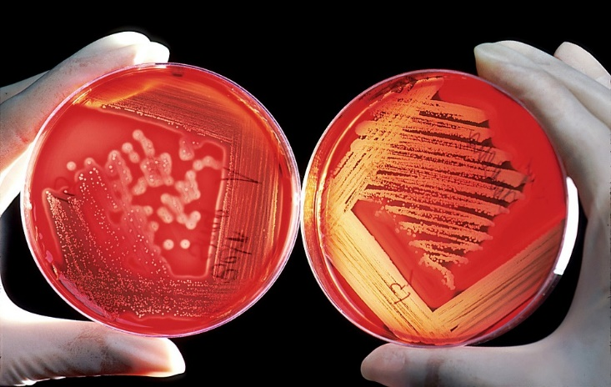
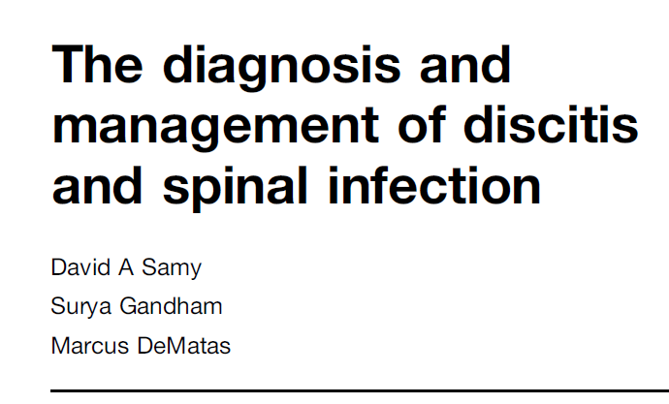
Pathogens
Aetiology is usually monobacterial, successfully identified only in ca two thirds of cases!
Staphylococcus aureus (ca 50% of discitis cases), including MRSA strains
Enterobacteria (E. coli, Proteus, Klebsiella, Enterobacter...), incl. ESBL+
Mycobacterium tuberculosis (specific aetiology, developing countries)
Brucellosis (B. melitensis, B. abortus, the Mediterranean, Middle East)
Mycotic (in immunocompromised patients, ca 2%)

Slide 10
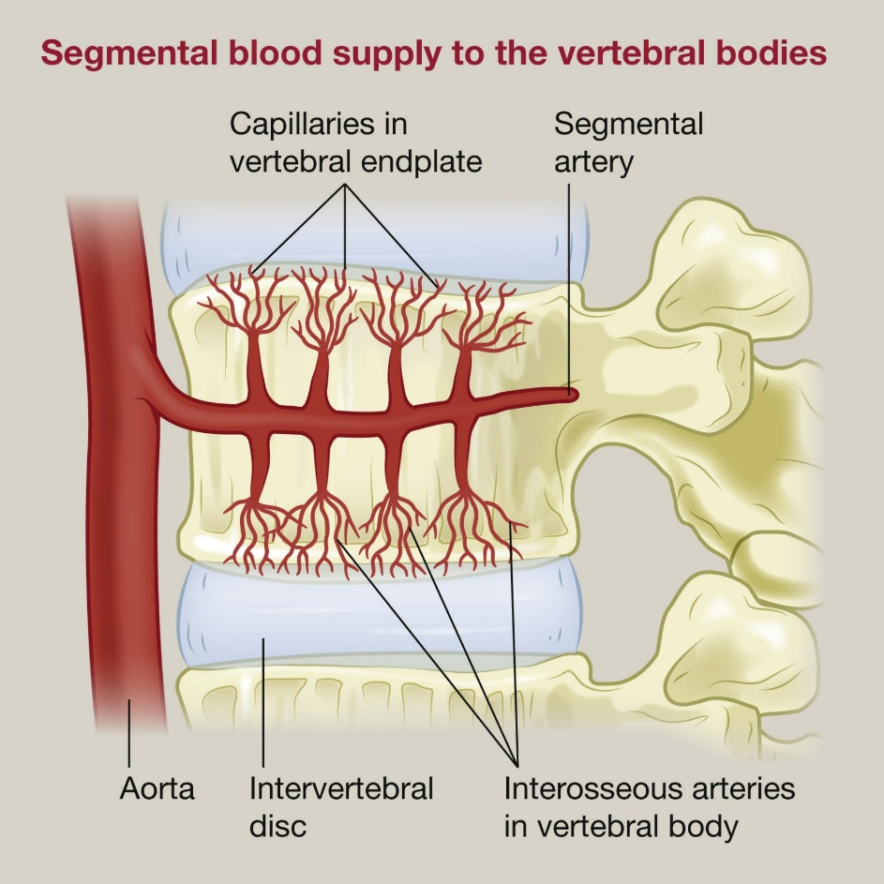
Pathogenesis
The terminal vessels of spinal arteries end in vertebral bodies → septic emboli cause extensive bone infarctions → bone tissue defects, compressive fractures → instability of the spine, spread of infection to adjacent discs → destruction
The infection spreads from the osteonecrotic lesions further into the paravertebral soft tissues and the epidural space of the spinal canal → abscesses, epidural empyema

Slide 11
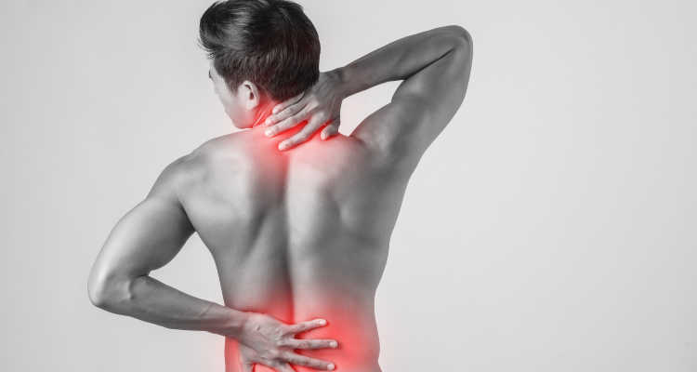
Clinical symptoms
Back pain
General symptoms
Neurological symptoms
Laboratory markers

Slide 12
Clinical symptoms
Back pain
Usually the dominant symptom, often at rest, at night, poorly responding to analgesics
May be conjoined with chronic pain in patients with VAS (!)
Epidural empyema = intensive or immobilising algia

Slide 13
Clinical symptoms
General symptoms of infection
Fever, chills, shivers (rather mild symptoms, septic condition is rare)
Frequent subfebrile temperatures, night sweats, lack of appetite, weight loss, general weakness

Slide 14
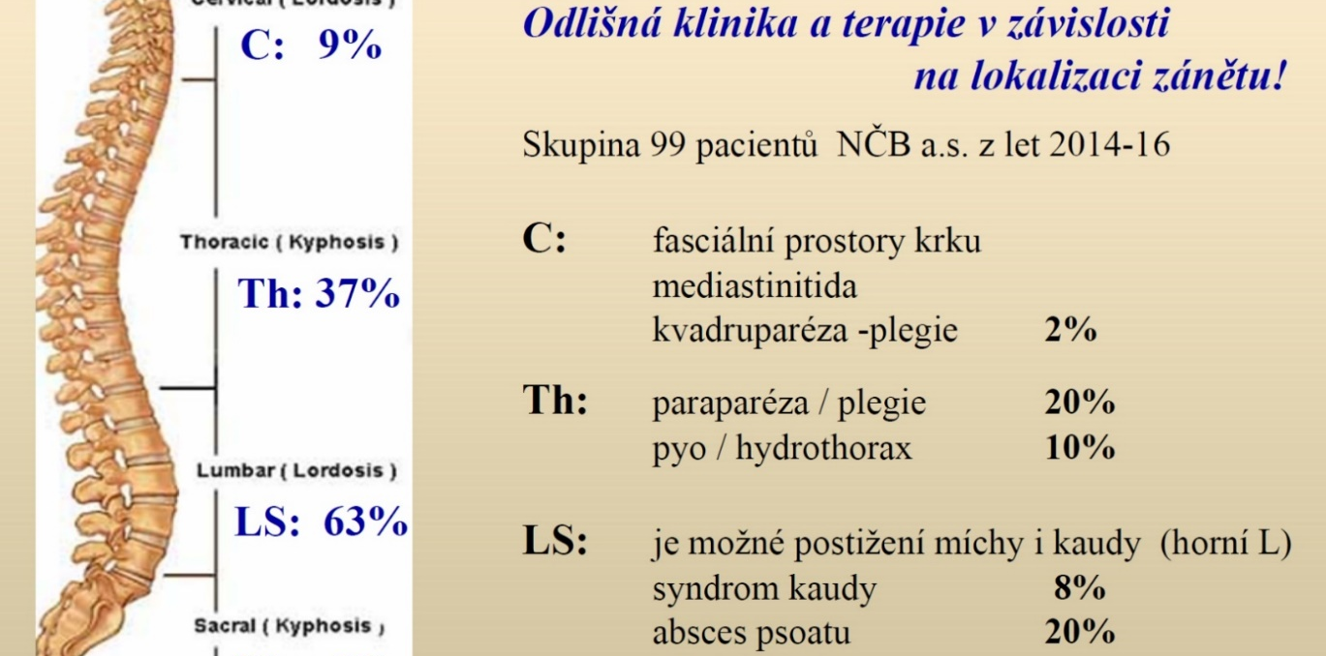
Clinical symptoms – neurology
Radiculopathy, myelopathy secondary to compression of nerve structures
Clinical image ranging from algoparesthesia, paraparesis and paraplegia to the cauda equina syndrome
Symptoms depend on the localisation of the inflammatory process:
By permission of: MUDr. V. Chmelík et al., České Budějovice Hospital, 2017.

Slide 15

Clinical symptoms
Laboratory findings
Elevated acute phase reactants (CRP 100–200),
FW typically over 100/min, low procalcitonin
Leukocytosis, thrombocytosis x thrombocytopenia, anaemia (microcytic, protracted course)
Often rapid CRP decrease (down to normal) after ATB therapy (FW elevation persists longer!)
CAVE: “cold infection” (!)

Slide 16
Diagnostics
Spondylodiscitis is rare, but it does occur!
Persisting back pain at rest, often when lying down and at night
“Red flags” febrile and subfebrile temperatures, APR elevation, age below 20 and over 55 years, history of a spinal trauma or surgery, weight loss, fatigue, a new neurological deficit
Spine imaging examination always as soon as possible

Slide 17
Diagnostics
Microbiology → key for infectious agent determination
Haemocultivation (positive in ca 60% of discitis cases)
Cultivation from a potential lesion (urine, pus...)
Targeted biopsy
Imaging methods → key for diagnostics

Slide 18
Imaging methods
X-ray → poor sensitivity, vertebral osteomyelitis finding with 2–3 weeks latency, poor specificity (tumors, pathological fractures...)
CT → easier accomplished than MRI, faster, but poorer imaging
MRI → gold standard, higher sensitivity and specificity, captures intervertebral discs, soft tissues, dg of myelopathy, nerve structures compression
PET/MRI, SPECT/CT → radionuclide methods, morphology + functional diagnostics combination, search for infection origin in FOU, detection of tumors and metastases

Slide 19
Imaging methods
Simple X-ray image of the spine
Computed tomography (CT)
Magnetic resonance imaging (MRI)
Scintigraphy, PET/MRI

Slide 20
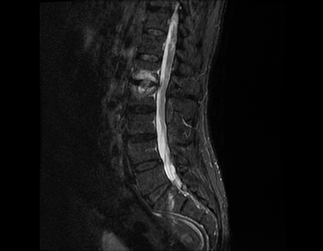
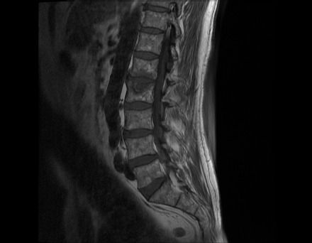
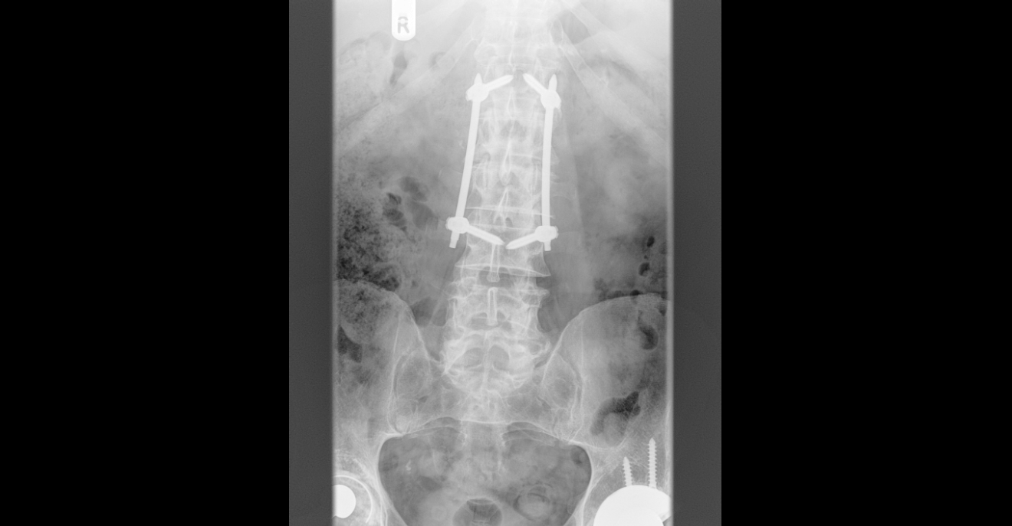
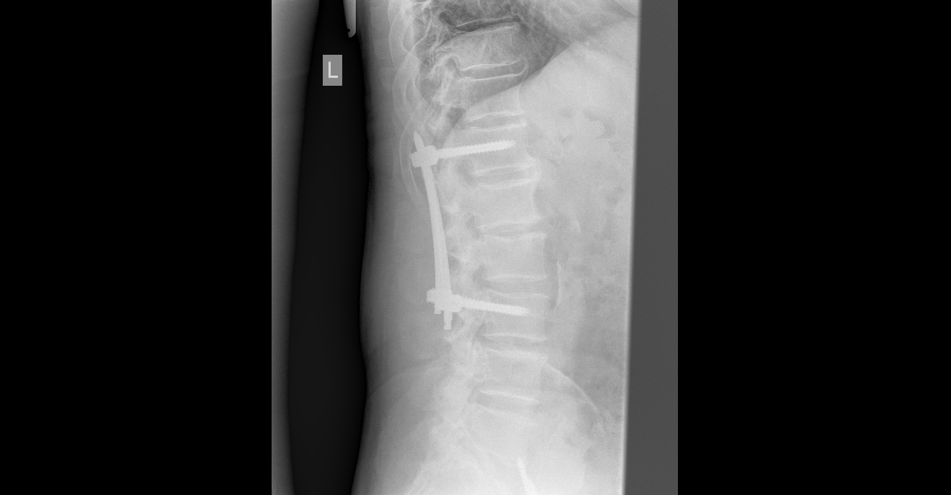

Slide 21
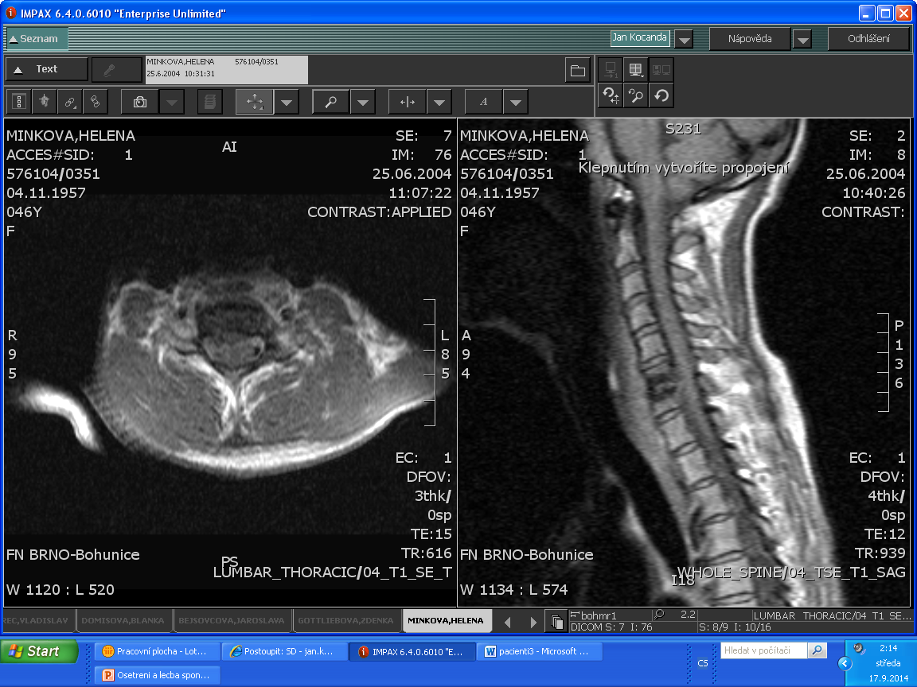
C

Slide 22
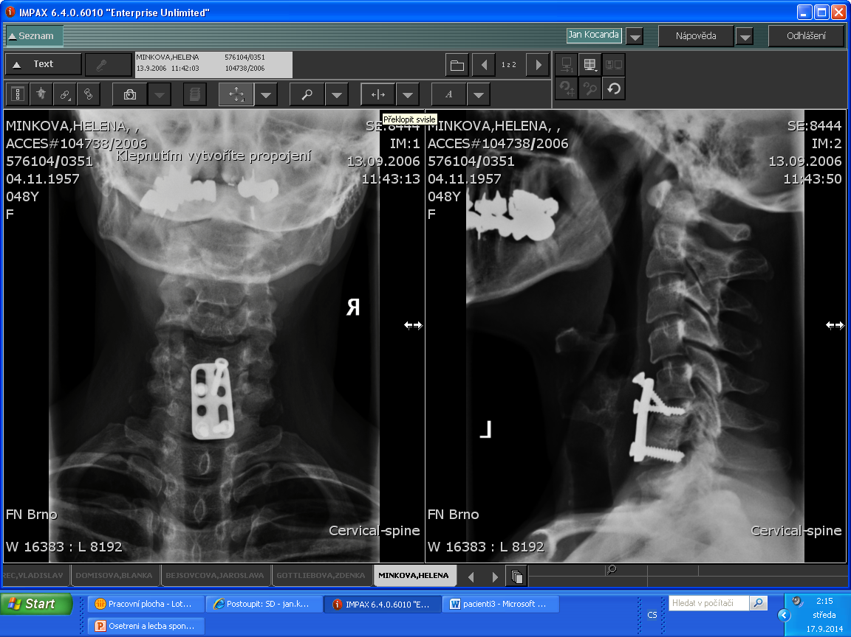

Slide 23
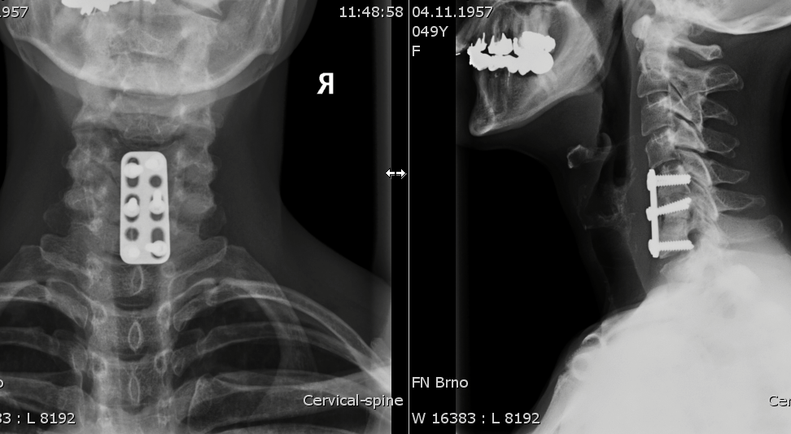

Slide 24
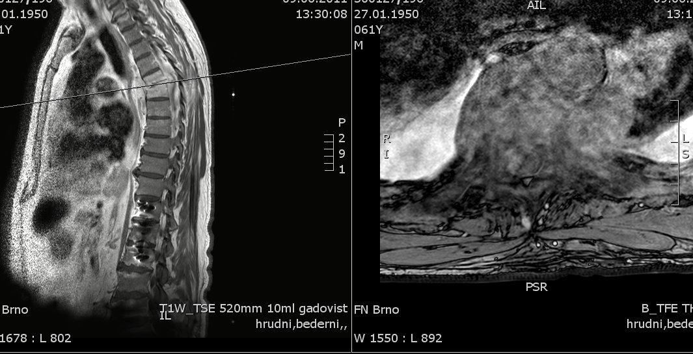
Th

Slide 25
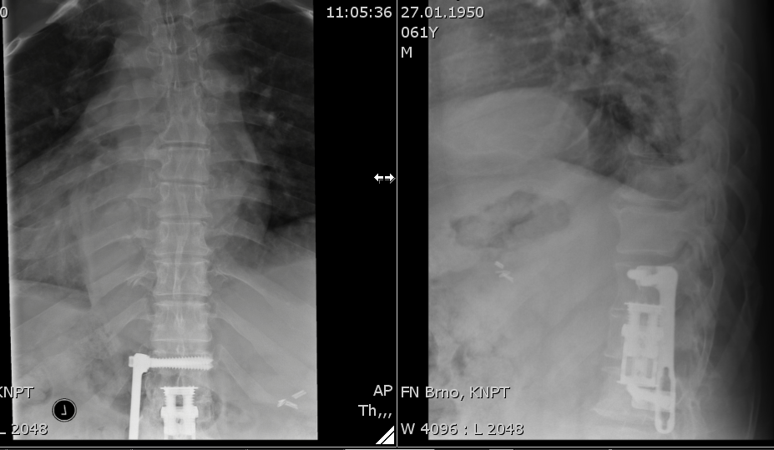

Slide 26
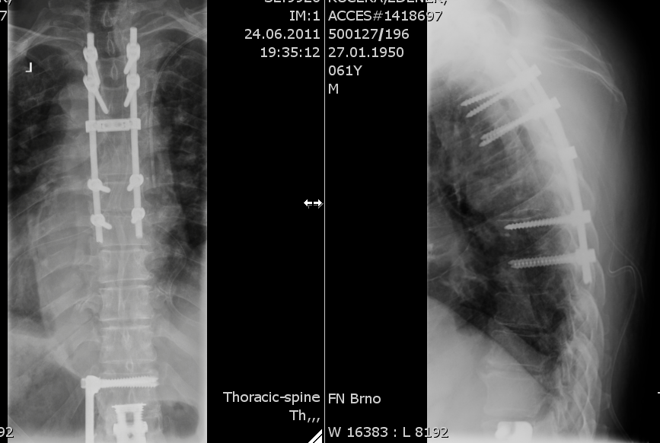

Slide 27
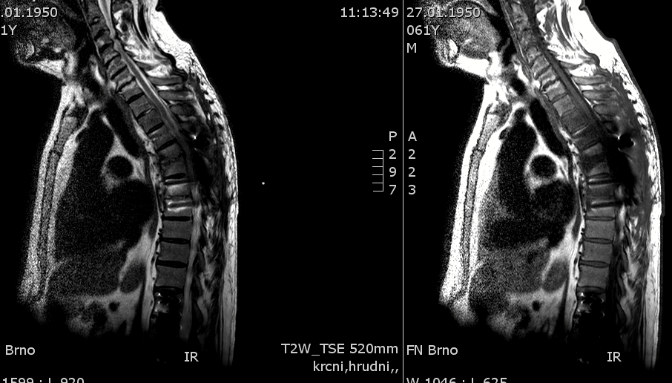
St.p. dors. stabilizaci Th3-8 pro spondylodiscitis v et. Th5/6; nová spondylodiscitis v et. Th2/3

Slide 28
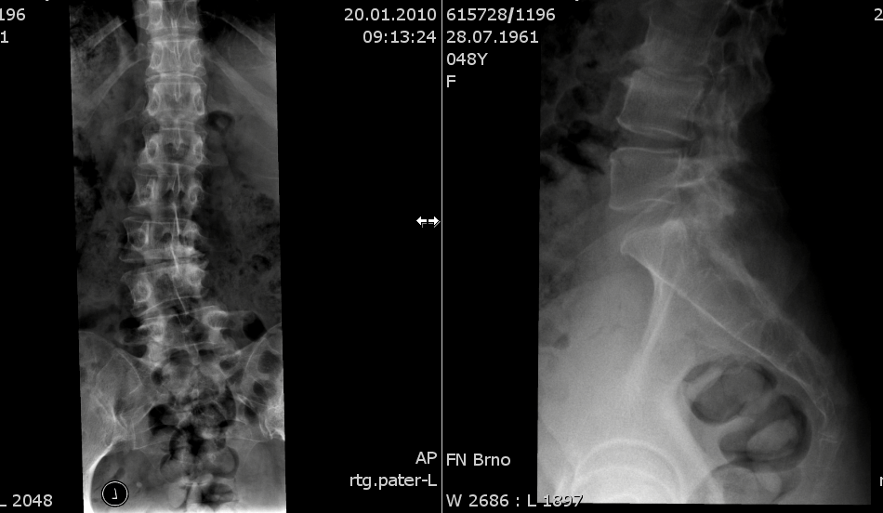
L

Slide 29
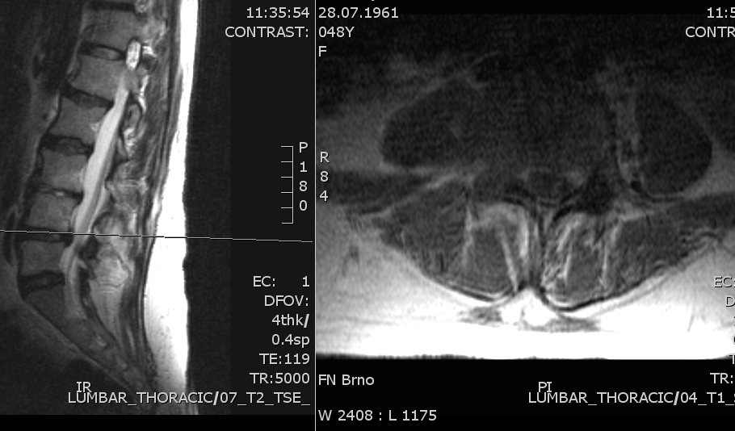

Slide 30
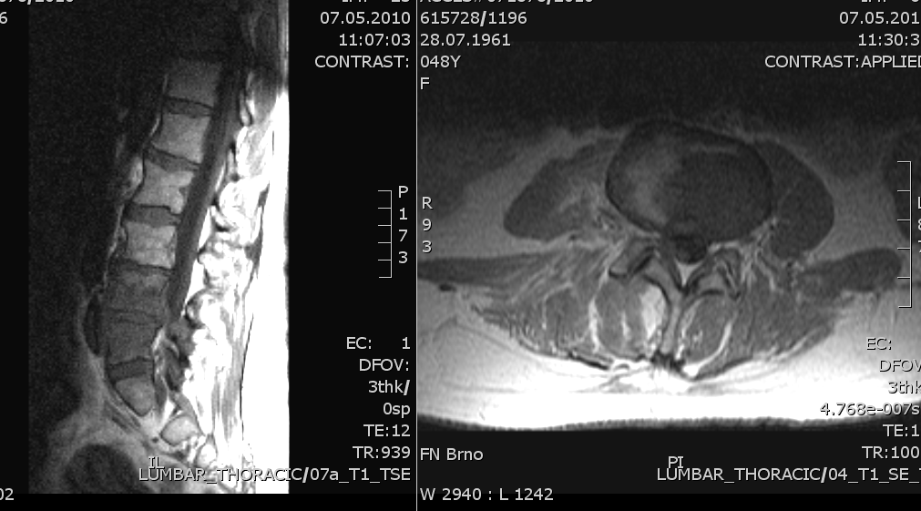

Slide 31
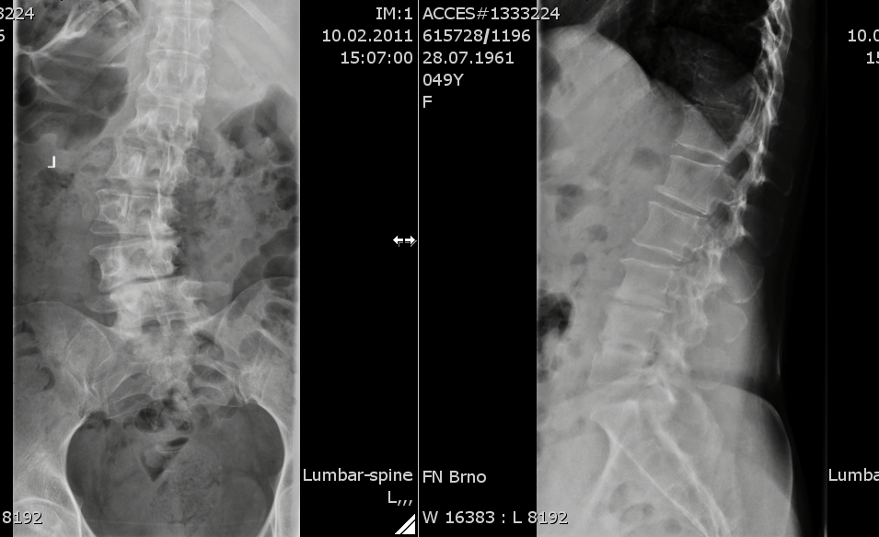

Slide 32
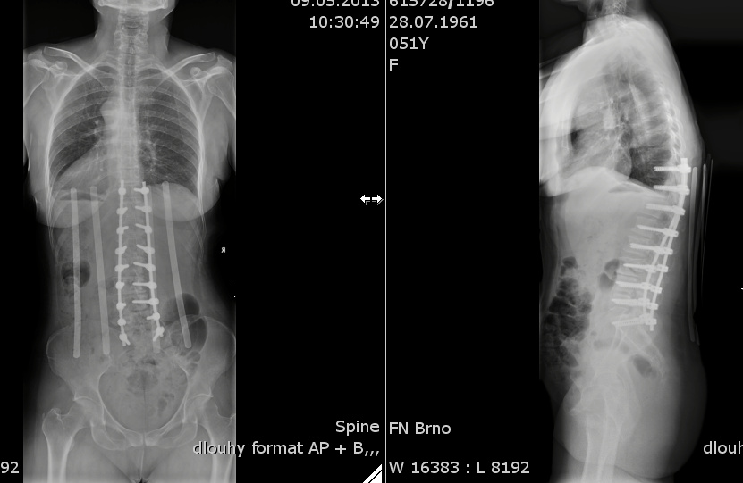

Slide 33
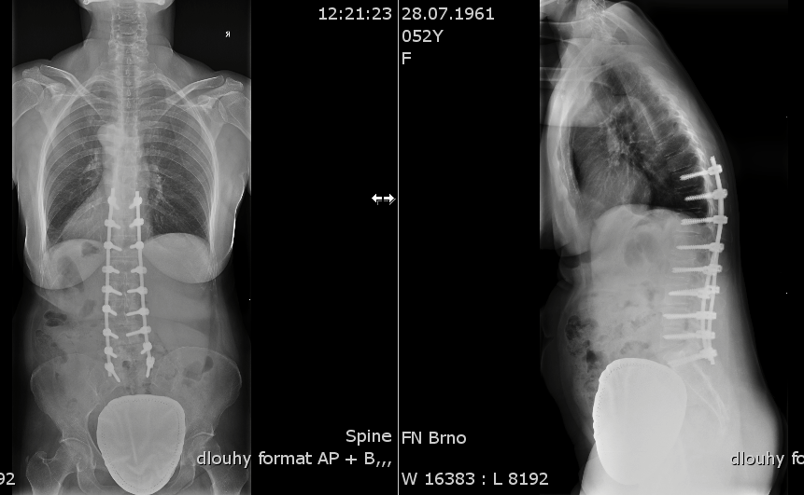

Slide 34
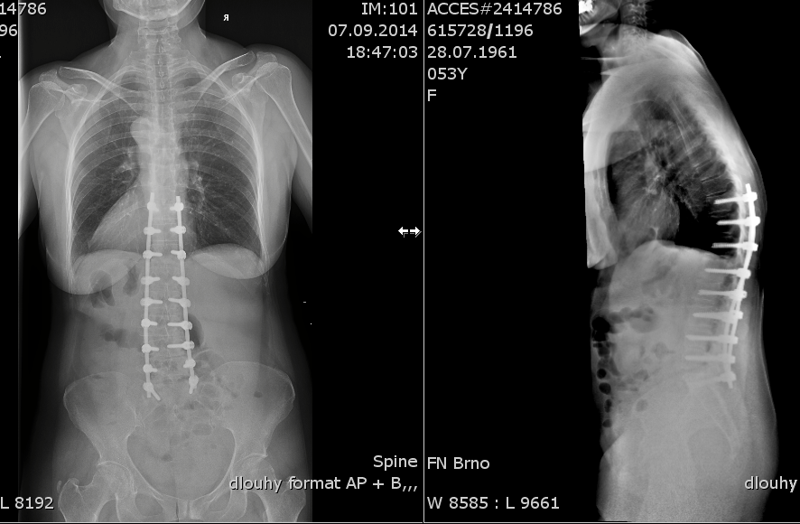

Slide 35
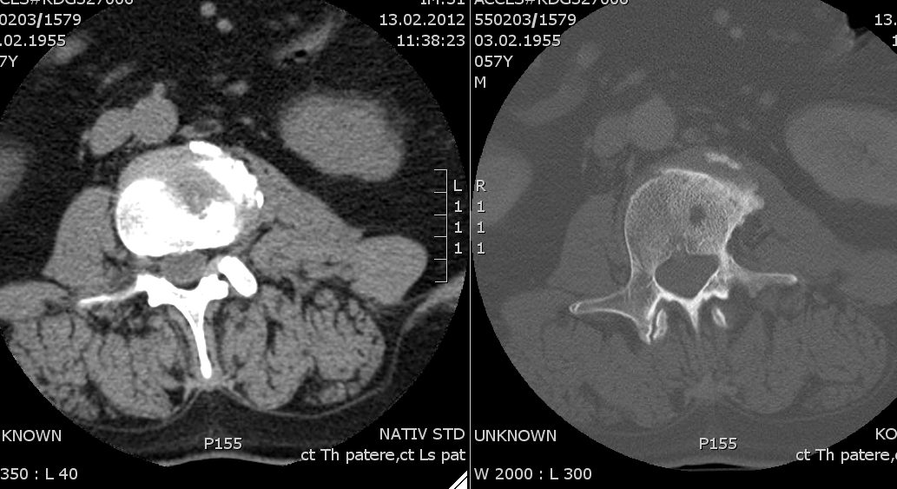
pč 2

Slide 36
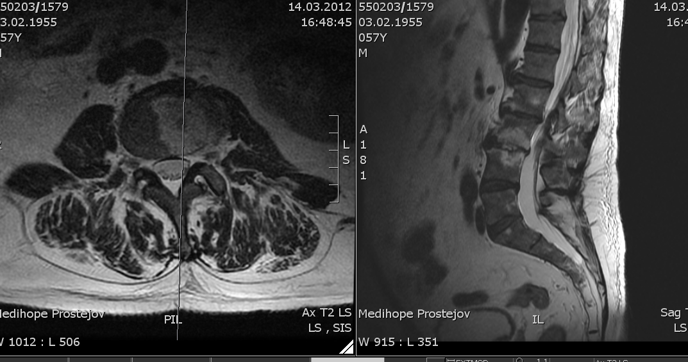

Slide 37
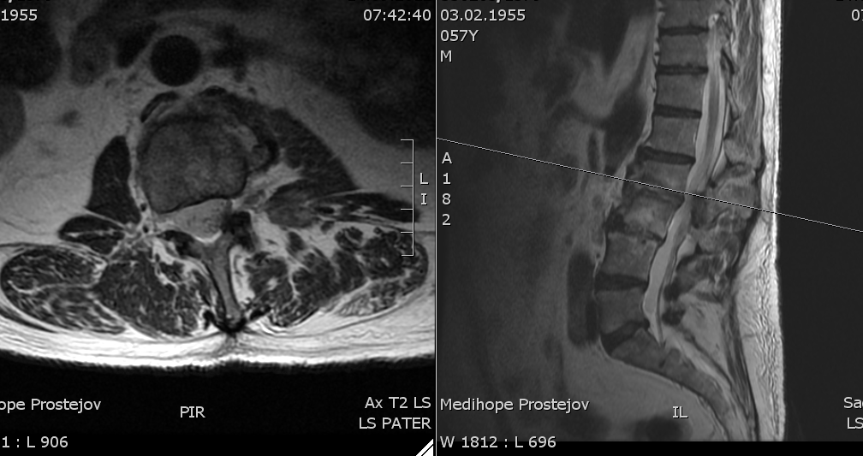

Slide 38
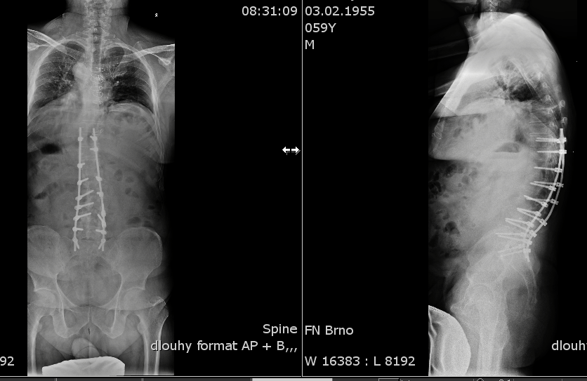

Slide 39
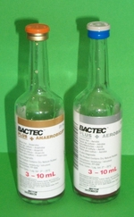
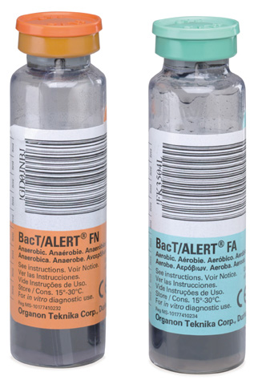
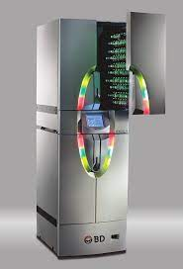
Diagnostics – haemocultivation
Haemocultivation sampling always before ATB initiation (risk of sterilisation of the cultures)
Vessel selection: aerobic (P. aeruginosa, Candida), anaerobic: strict anaerobes, viridising streptococci
1 pair (concurrent collection) = 1 haemoculture (!)
1 HMC is not enough, ideally 2 to 3 sets, sequential collection, increase of temperature / shivers
In patients with CVC, at least one HMC from the catheter, other from periphery
Vessel can be used also for CSF, centesis fluid, pus, exudate…

Slide 40
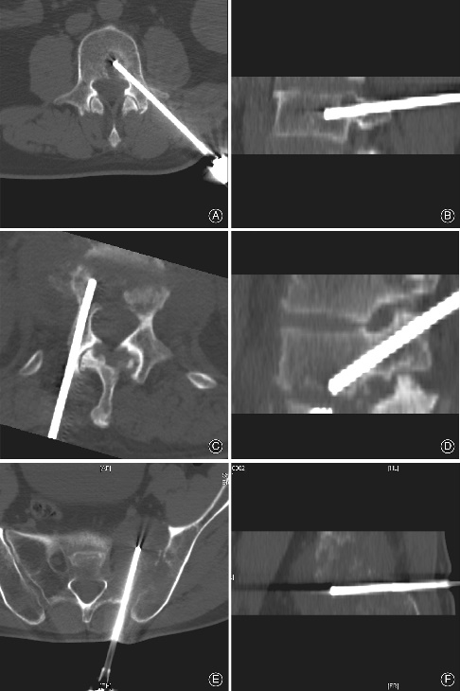
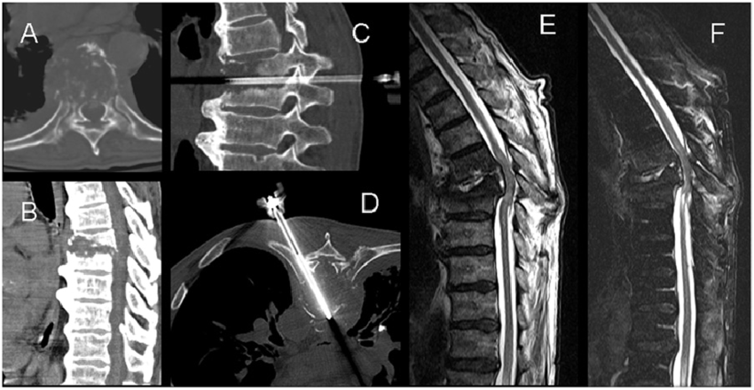
Diagnostics – biopsy
Vertebral biopsy → targeted tissue collection from the lesion
  For histology, cultivation, PCR diagnostics (bacteria, fungi)
Percutaneous CT-guided biopsy
Open (surgical) biopsy
Indication:
  Finding infectious agent when empirical ATB therapy fails
  Ruling out neoplastic aetiology in differential diagnostics

Slide 41
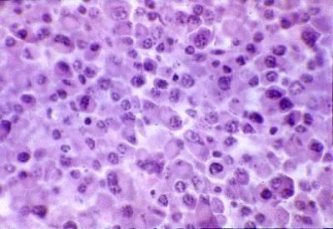
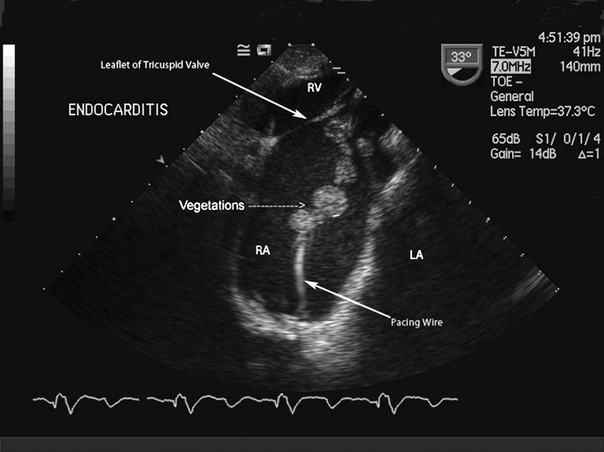
Differential diagnostics
Erosive osteochondrosis
Compressive vertebral fracture
Neoplastic destruction
Plasmocytoma
Ankylosing spondylarthritis...
Test to find the lesion = origin (always with S. aureus bacteraemia):
  Echocardiography (ideally transaesophageal ECHO)
  US of the abdomen and intestines
  X-ray of the chest
  CT/MRI of the brain (abscess)
  Ocular fundus examination
  US of soft tissues/CT
Vertebral plasmocytoma, Atlas of Pathology, University Hospital in Motol

Slide 42
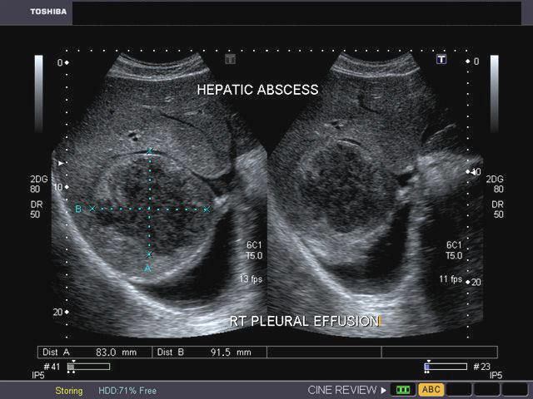
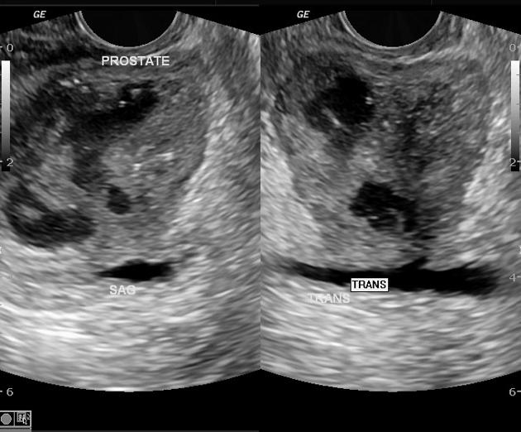
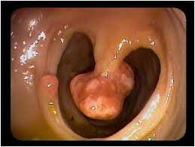
Differential diagnostics
Proof of G- aetiology (enterobacteria) → search for origin in GIT and UT
  US or CT of the abdomen
  GFS, colonoscopy
  CT IVU, cystoscopy, TRUS...

Slide 43
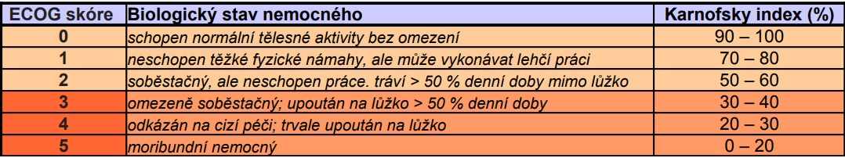
Treatment
Always individual and multidisciplinary approach (!)
We must consider:
  Neurological deficit
  The extent of involvement
  Biomechanical instability of the spine
  Conservative treatment failure
  Always also comorbidities, surgery risks, patient’s functional status
Conservative
x
Surgical

Slide 44
ATB therapy
Bactericidal ATB of the blood component, initially empirical, then targeted to the cultivated agent and its ATB susceptibility (MRSA, ESBL, MBL strains...)
Always long-term, parenteral for the first 2–4 weeks, oral after stabilisation
12 weeks is the gold standard, recent tendency to shorten ATB period
On-going clinical check, inflammatory parameters, imaging examinations (MRI after a time, gradual regression)
Consider ATB toxicity risks, induction of Clostridium colitis, allergies...

Slide 45
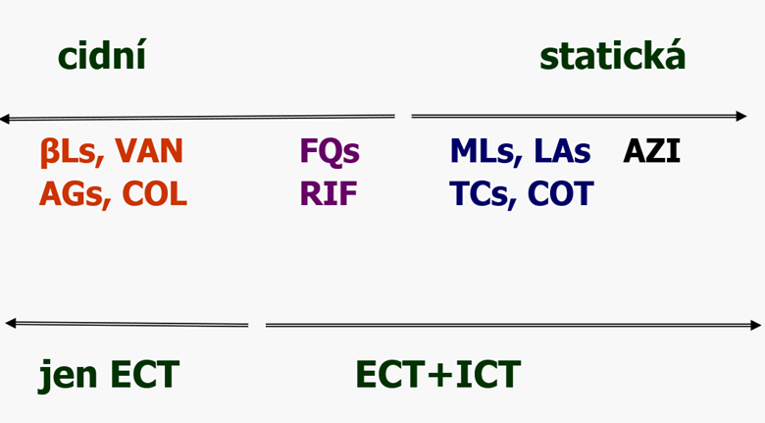

ATB therapy
Targeted according to haemocultivations | Empirical ATB therapy
Staphylococci: Oxacillin IV 16–20 g/day Vancomycin IV (MRSA) 30 mg/kg/day Linezolide IV | Initial parenteral: Oxacillin (vancomycin) + gentamicin, rifampicin Carbapenems (meropenem) Vancomycin + 3rd or 4th generation cephalosporin (or fluoroquinolone)
Enterobacteria, G- bacilli 3rd or 4th generation cephalosporins Combination with aminoglycosides Monotherapy with carbapenems | Following oral: Cotrimoxazole + rifampicin (affects biofilm) Doxycycline Clindamycin, cefuroxime axetil, linezolide...
Streptococci: G-PNC, cephalosporins...

Slide 46
Conservative treatment
Initial therapy usually during hospitalisation, then outpatient follow-up (INF + ORT)
Sufficient analgetisation
- Paracetamol + tramadol
- Opiate patches
- Co-analgesics
- Via outpatient pain treatment
Comprehensive care for internal environment, TED prophylaxis, adequate nutrition, probiotics...
Initially typically resting regimen, gradually RHB, spinal immobilisation (Jewett brace, lumbar brace, cervical collar...)

Slide 47
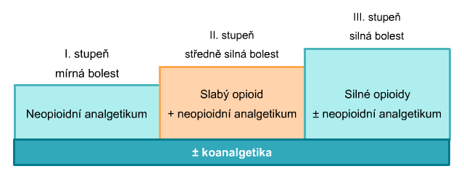
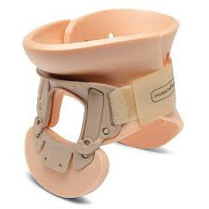
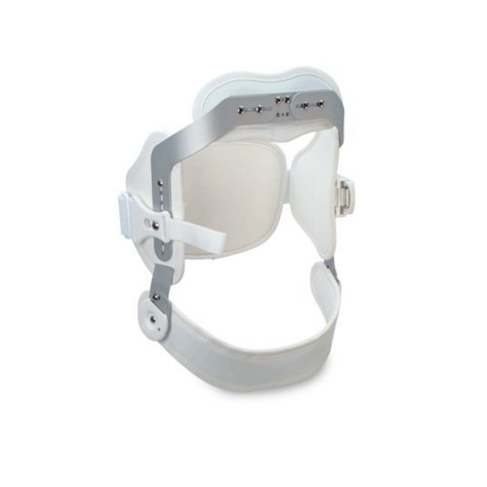
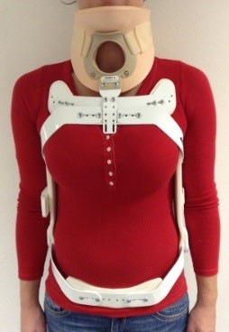
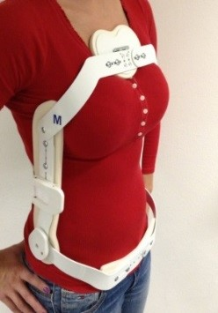
Conservative treatment
ATB therapy
Analgesia
Braces
Targeted RHB

Slide 48
Surgical treatment
Traditional open procedures:
Posterior/anterior/lateral stabilisation and decompression
Auto/allografts
Instrumentation
MISS:
Percutaneous drainage of the abscess, transpedicular biopsy and drainage
Percutaneous transpedicular stabilisation w/out debridement, decompression
Frontal minimally invasive approach and debridement, spondylodesis w/out instrumentation (mini-open or endoscopic)
Combination of procedures

Slide 49
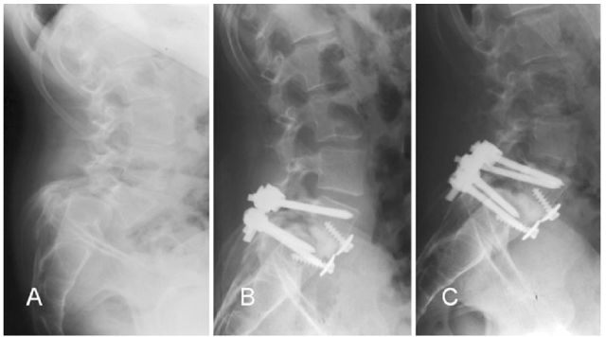


Magerl fixator

Slide 50
Case study 1
Medical history:
Male, 74 years, retired, history of internal jugular vein thrombosis with CVC
status post left-sided hemicolectomy + cholecystectomy due to colorectal adenocarcinoma in 1998; also status post stercoral peritonitis with bowel perforation and septic shock development, jejunostomy performed in 2016
Short bowel syndrome, long-term supplemental PE nutrition via PICC
Present complaint:
3/2019 hospitalised at Internal Medicine Dept., catheter sepsis, oxacilline-resistant S. epidermidis aetiology, ATB combination ceftriaxon + clindamycin, PICC kept, discharged home
6/2019 new hospitalisation at the Neurology Dept. for lumbar spine pain (chronic, recently worsening), propagating into his left side and abdomen, at home sometimes chills, subfebrile temperatures, resolving with paracetamol
LMWH chronic prophylaxis

Slide 51
Case study 1
Laboratory on admission:
WBC 7.7 x 10⁹/L, PLT 147 x 10⁹/L, Hb 91 g/L, CRP 72 mg/L, PCT 0.1 ng/L
Haemocultivation: G+ cocci, oxacillin-resistant S. epidermidis
Suspected lesion is the PICC (in place for 2 years), empirical ATB vancomycin IV
ECHO without a proof of IE, abdominal US without a pathological finding, heart + lungs X-ray without infiltration
MRI of Th-L spine – image of Th10 and 11 spondylodiscitis with epidural perivertebral infiltration on the left, no proof of abscess
ATB therapy escalated to vancomycin + clindamycin IV
PICC kept in situ (!)

Slide 52
Case study 1
Vancomycin discontinued after 14 days, oral clindamycin maintained
Fevers recur 6 days after vancomycin discontinuation, lab. CRP 50
ATB therapy changed to clindamycin + levofloxacin
Search for lesions resumed: X-ray of the heart + lungs, paranasal sinuses, MRI of the brain and C spine, ORL and stomatological examination – no infectious lesion.
Follow-up MRI of the spine after 1 month:
Progression of Th10/11 spondylodiscitis, vertebral bodies completely involved, progression of perivertebral infiltration on the right with a small abscess ca 4 mm

Slide 53


Case study 1
Progression of Th10/11 spondylodiscitis, vertebral bodies completely involved, progression of perivertebral infiltration on the right

Slide 54




Case study 1
8/2019 transfer from regional Neurology to the Clinic of Infectious Diseases
PICC extraction (after > 5 weeks of ATB treatment, a replacement introduced through the left cephalic vein)
Continuing clindamycin + levofloxacin ATB therapy

Slide 55
Case study 1
Five days after PICC replacement, the patient is febrile again, elevated CRP, low procalcitonin
On day 6 swelling of the upper left limb – according to US, a complete thrombosis of v. cephalica, spreading to v. axillaris, thrombosis of v. subclavia, including vasculature in the subclavicular region.
The thrombotised PICC extracted, a tunneled Hickman catheter introduced via the left internal jugular vein at the angiography suite, ATB escalated to meropenem + fluconazole, LMWH
Follow-up MRI of the spine after 9 weeks of ATB treatment – status post spondylodiscitis Th 10/11, no epidural abscess, inflammatory changes regression
ATB therapy 1 more month oral levofloxacin, total of 10 weeks hospitalisation
Patient is further afebrile, without a neurological deficit, CRP below 5
MUDr. Roman Stebel, Ph.D., MUDr. Jan Kocanda

Slide 56
Case study 1 – summary
Complications in 11/2019 – primary attack of enterocolitis caused by C. difficile
ATB history:
Ceftriaxon, clindamycin, vancomycin, levofloxacin, meropenem, fluconazole
Early extraction of a foreign body as the source of bacteraemia
Rationalisation of ATB therapy, a candidate for an OPAT regimen therapy (dalbavancin – ideal choice for oxacillin-resistant staphylococci)

Slide 57
OPAT (Outpatient Parenteral Antimicrobial Therapy)
Continuing ATB therapy is usually necessary after discharge from hospitalisation
A suitable oral drug exists → always prefer oral ATB
No oral drug (agent + susceptibility, allergy...) → continue hospitalisation
...or OPAT!
ATB regimens suitable for outpatient parenteral therapy of skeletal infections:
Amikacin, gentamicin 1x daily IV (multiresist. Pseudomonas aeruginosa)
Ertepenem 1x daily IV (ESBL strains of enterobacteria)
Teicoplanin 3x weekly IV (G+ cocci)
Dalbavancin 1x weekly IV (MRSA, coagulase-negative staphylococci)
  → Lipoglycolpeptide ATB, biological half-life ca 180 hours
  → Lipophilic chain – good tissue penetration
  → Inhibits growth and multiplication of G+ bacteria 10x stronger than vancomycin

Slide 58

OPAT
OPAT advantages:
Shortened hospitalisation
Reduced risk of nosocomial infections and other complications
Earlier restoration of mobility, return to regular activities, earlier RHB
OPAT disadvantages:
Who, where and how will apply it?
The economical paradox – shortened hospitalisation according to DRG is often a disadvantage
ATB suitable for OPAT (dalbavancin) is expensive, approval by physician reviewer
Supervision concerning development of complications, recurrent disease...
Secured venous access (peripheral x central x PICC x midline catheter)

Slide 59
Discussion
Diagnostic delay (the interval from onset of complaint to determination of the correct diagnosis) is 10 weeks on average (2 to 6 months)!
Mortality and the presence of permanent neurological consequences both correlate with the delay in establishing the correct diagnosis
50% of patients are over 50 years old
Fever is present in 50% of cases
Physiological peripheral blood leukocyte count is present in 50% of cases
Staphylococcus aureus is the aetiological agent in over 50% of cases
Lumbar spine is involved in 50% of cases
The primary lesion is not found in 50% of cases
The symptoms last over 3 months in 50% of patients
The 50% rule

Slide 60

stebel.roman@fnbrno.cz
kocanda.jan@fnbrno.cz

