Slide 1
Cell Death
There are many ways for a cell to die…

Slide 2
Introduction to cell death
Life or death of individual cells determines health and disease in multi-celled organisms.
Cell death is crucial for organogenesis in utero and successful control of host cell populations in healthy tissues but can also play a part in disease that occurs in response to toxic insults or microbial infection.

Slide 3
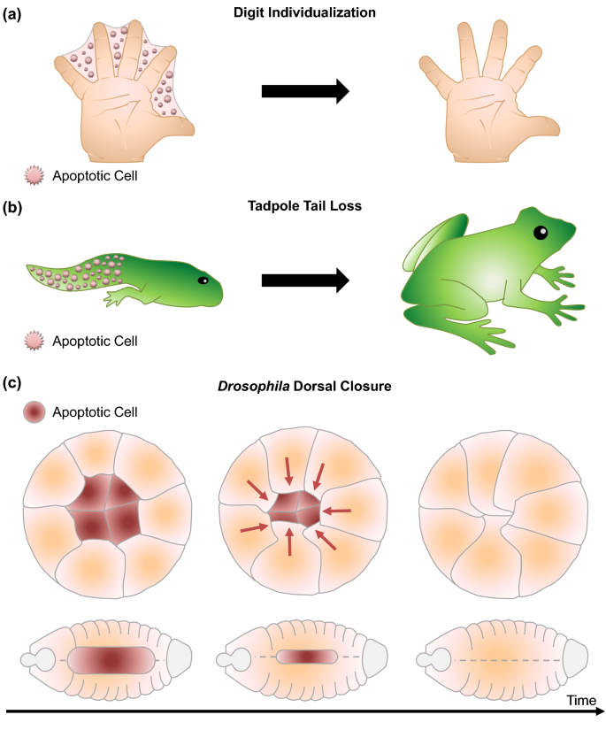
Introduction to cell death
Cell death is an important process in the body as it promotes the removal of unwanted cells.
Failure of cells to die, or cells dying when they shouldn’t, can lead to or exacerbate many diseases.

Slide 4
Why do cells die?
Cell death is an important process in the body. It removes cells in situations including:
when cells are not needed, such as during certain stages of development
to create a structure in the body, for example, the outer layer of the skin is made of dead cells
to remove excess cells, such as white blood cells after an infection has been cleared
if cells are damaged (such as by radiation or toxins ) or malignant
when cells are infected by viruses

Slide 5
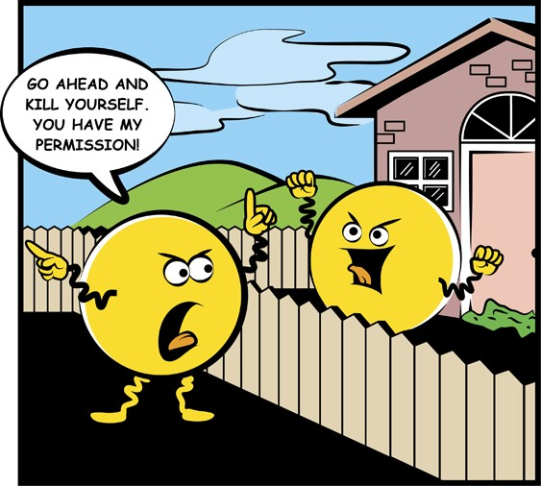
How do cells die?
Cells can die because they are damaged, but most cells die by killing themselves.
There are several distinct ways in which a cell can die. Some occur by an organised, ‘programmed’ process.
Some cell death processes leave no trace of the dead cell, whereas others activate the immune system with substances from the dead cell.
Derry, W. Chewing the fat about death with the neighbours. Cell Death Differ 23, 1097–1098 (2016). https://doi.org/10.1038/cdd.2016.49

Slide 6
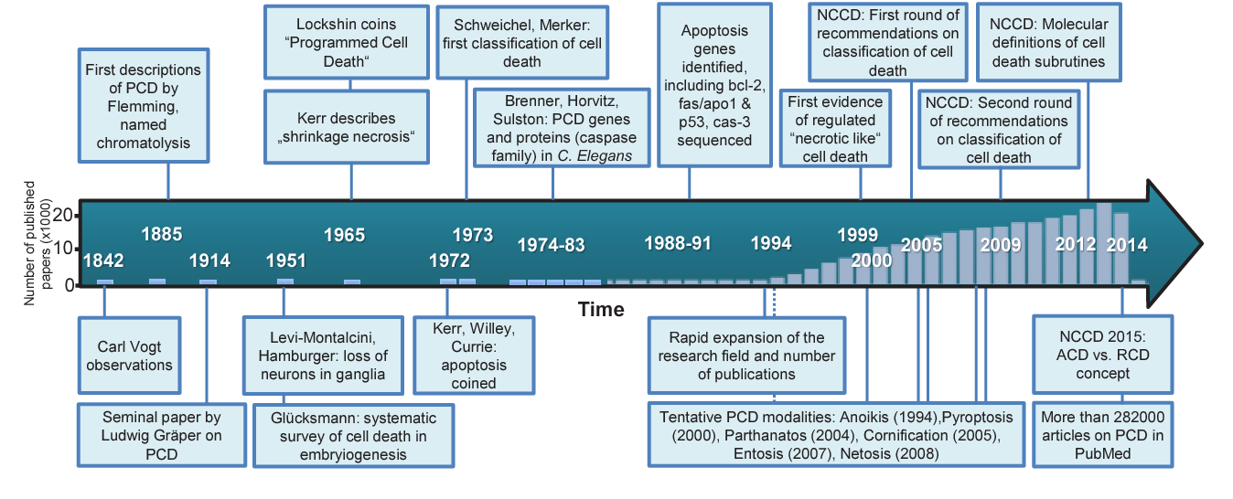
How do cells die?

Slide 7
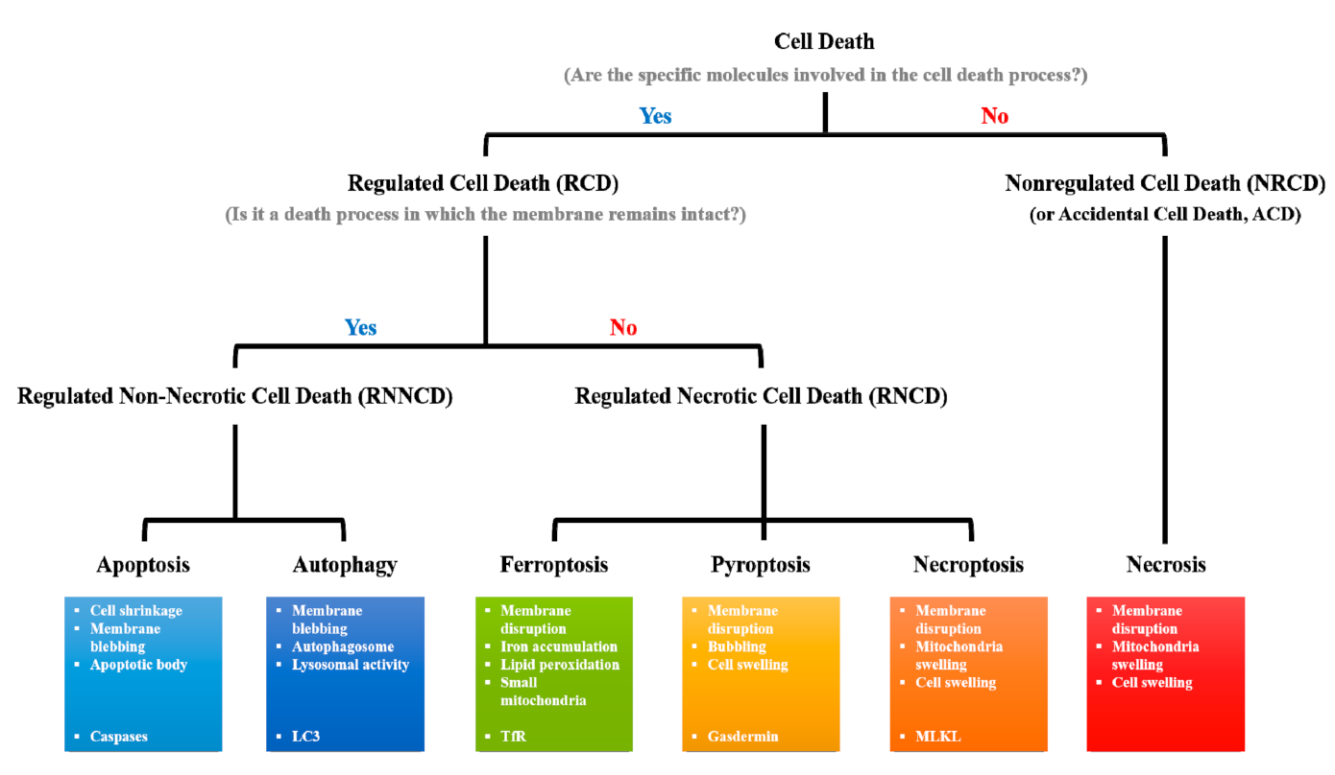
How do cells die?

Slide 8
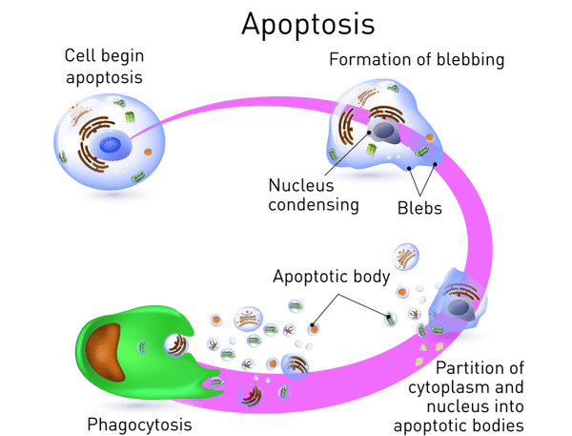
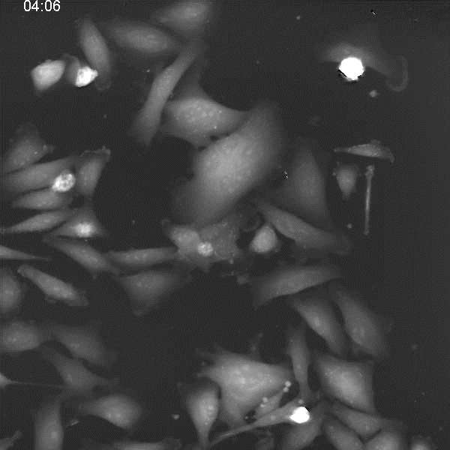
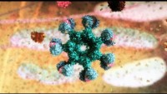
Apoptosis
Apoptosis is a form of cell death that prevents immune activation.
The cell activates proteins called caspases that are normally dormant.
These caspases dismantle the cell from within. The apoptotic cell breaks into small packages that can be engulfed by other cells. This prevents the cell contents leaking out of the dying cell and allows the components to be recycled.
https://www.google.com/search?q=wehi+edu+apoptosis&oq=wehi+edu+apoptosis&gs_lcrp=EgZjaHJvbWUyBggAEEUYOTIICAEQABgWGB7SAQgzMDgwajBqN6gCALACAA&sourceid=chrome&ie=UTF-8#fpstate=ive&vld=cid:55d455b1,vid:DR80Huxp4y8,st:0

Slide 9
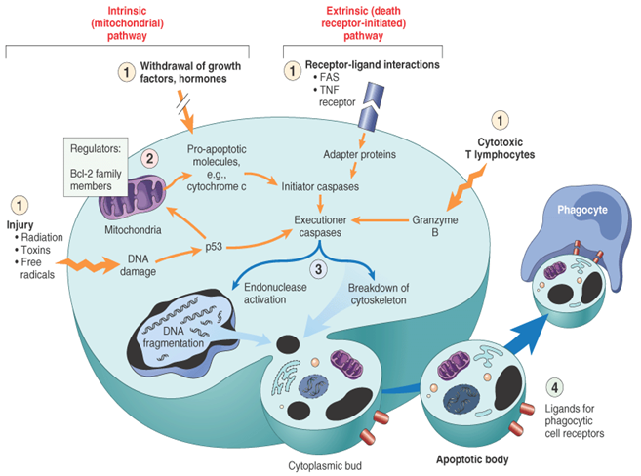
Apoptosis
Caspases: these enzymes are switched on in apoptotic cells, and digest other proteins to bring about cell death. Some caspases have roles in processes other than cell death.
Bcl-2 family proteins: these proteins interact with each other to determine whether a cell undergoes apoptosis or stays alive. Some Bcl-2 family proteins promote survival, and block apoptosis. Others are ‘pro-death’, and trigger apoptosis.
Death receptors: these are proteins on the surface of the cell. When they are bound by certain cytokines (hormone-like signalling proteins), they cause changes in the cell that can lead to cell death.

Slide 10
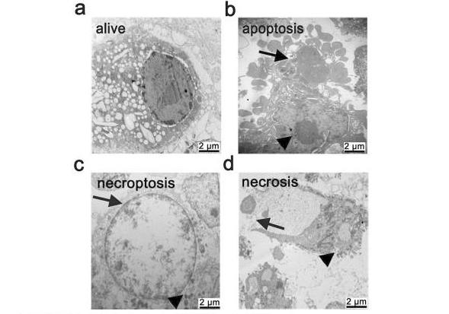
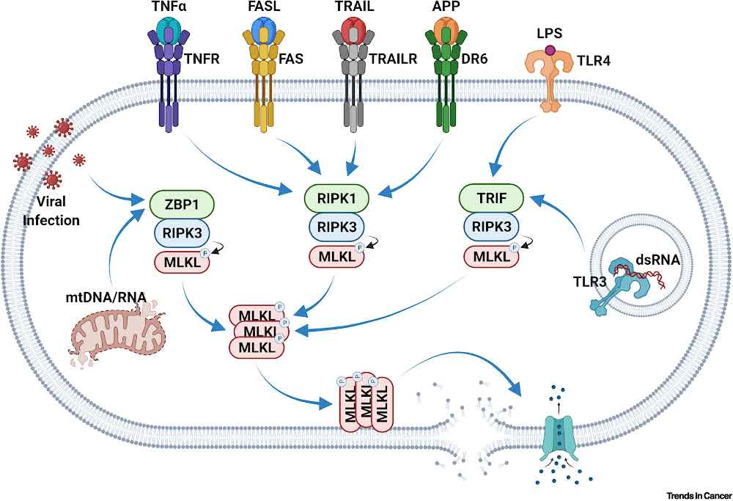
Necroptosis
Necroptosis is a form of programmed necrosis that is mediated by various cytokines and pattern recognition receptors (PRRs). Cells dying by necroptosis show necrotic phenotypes, including swelling and membrane rupture, and release damage-associated molecular patterns (DAMPs), inflammatory cytokines, and chemokines, thereby mediating extreme inflammatory responses.

Slide 11
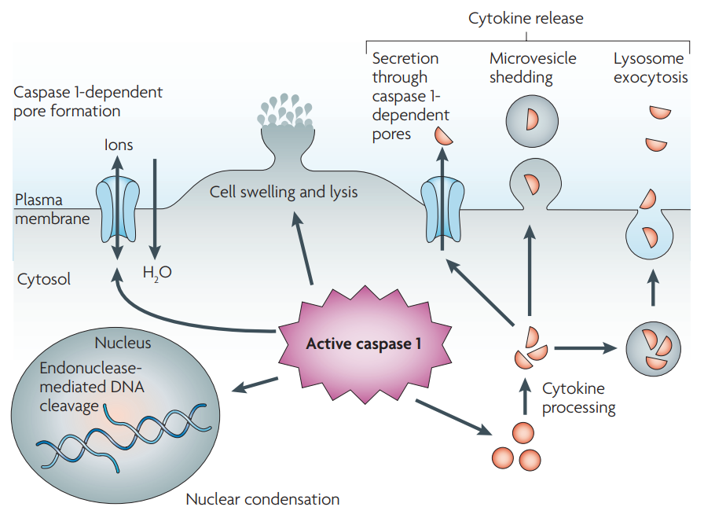
Pyroptosis
Pyroptosis is characterized by caspase 1-dependent formation of plasma-membrane pores, which leads to pathological ion fluxes that ultimately result in cellular lysis and release of inflammatory intracellular contents.
Microorganism- and host-derived 'danger' signals stimulate formation of a multiprotein complex, termed the inflammasome, which leads to processing and activation of caspase 1. Active caspase 1 causes pyroptosis and is responsible for proteolytic maturation of the inflammatory cytokines interleukin-1β (IL-1β) and IL-18.
Bergsbaken, T., Fink, S. & Cookson, B. Pyroptosis: host cell death and inflammation. Nat Rev Microbiol 7, 99–109 (2009). https://doi.org/10.1038/nrmicro2070

Slide 12
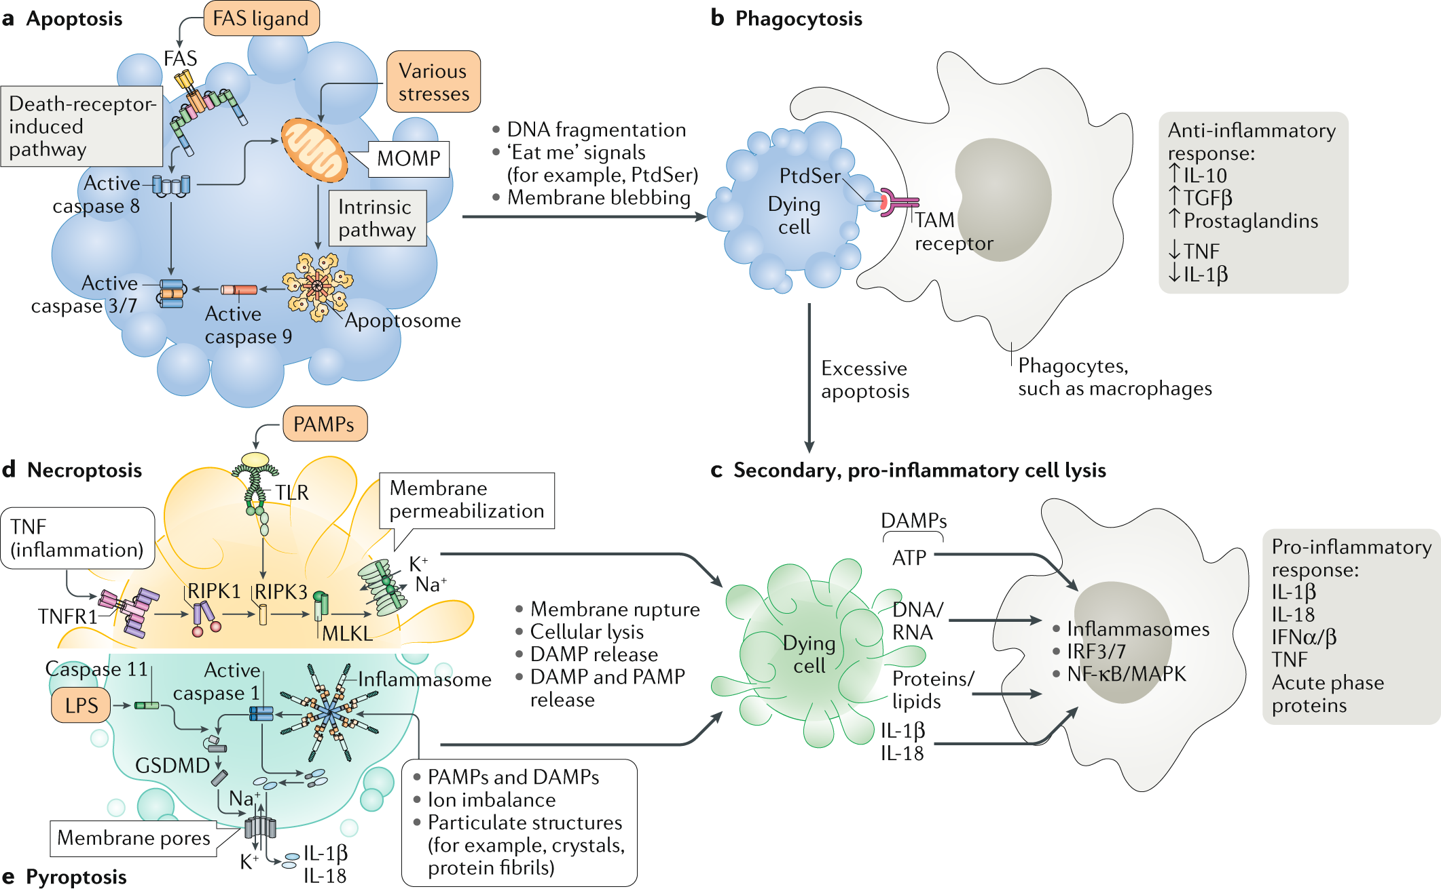
Apoptosis vs. lytic cell death
Non-lytic cell death, apoptosis (the integrity of plasma membrane is sustained).
Plasma membrane rupture (PMR) is the final cataclysmic event in lytic cell death (regulated or accidental necrosis).
PMR releases intracellular molecules known as damage-associated molecular patterns (DAMPs) that propagate the inflammatory response.

Slide 13
Cell death proteins
Many proteins have been discovered that control whether a cell dies by the processes of apoptosis, necroptosis or pyroptosis.
Some key cell death control proteins include:
Caspases: these enzymes are switched on in apoptotic cells, and digest other proteins to bring about cell death. Some caspases have roles in processes other than cell death.
Bcl-2 family proteins: these proteins interact with each other to determine whether a cell undergoes apoptosis or stays alive. Some Bcl-2 family proteins promote survival, and block apoptosis. Others are ‘pro-death’, and trigger apoptosis.
Death receptors: these are proteins on the surface of the cell. When they are bound by certain cytokines (hormone-like signalling proteins), they cause changes in the cell that can lead to cell death.
RIP kinases: two proteins called ‘RIP1 kinase’ and ‘RIP3 kinase’ trigger necroptosis.
IAPs: or ‘inhibitor of apoptosis proteins’ can prevent cell death. They can do this by blocking several cell death proteins including caspases and RIP1 kinase.
SMAC/Diablo: is an inhibitor of IAPs. In healthy cells, SMAC is stored away from IAPs, in parts of the cell called mitochondria. When cell death is triggered, SMAC can leak out and block IAPs function. Thus, the release of SMAC out of mitochondria can promote cell death.

Slide 14
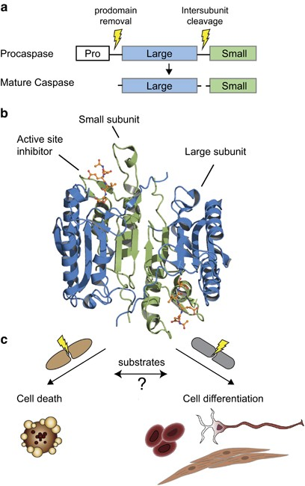
Caspases
The human caspase family regulates crucial biological functions, such as cell death in apoptosis and pyroptosis, as well as non-cell death functions in inflammation, dendrite trimming, and cell differentiation.
Caspases are a family of cysteine proteases whose functions are inextricably linked with the process of programmed cell death, or apoptosis, in all metazoans, including C. elegans, Drosophila, mouse and humans.
Caspases are expressed in cells as inactive zymogens also known as procaspases.

Slide 15
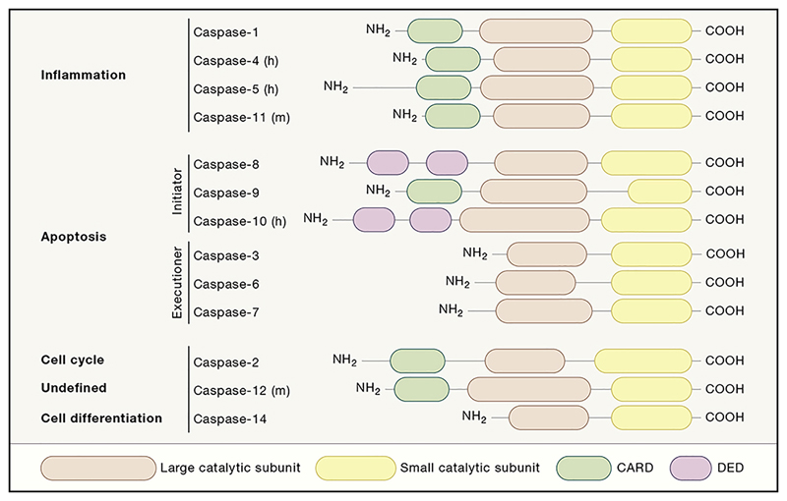
Caspases
The human caspase family is divided into three main groups, primarily based on sequence similarity and biological function.
Group I comprises the inflammatory caspases-1, -4, and -5 (caspase-11 in mouse). Within this group, caspase-1 is the enzyme that has been best characterized and well known for processing of IL-1β involved in inflammation.
Group II is formed by the apoptotic effector caspases-3, -6, and -7 that share a similar short pro-domain, and are classically described as the ‘executors of apoptosis’.
Finally, group III includes the human initiator caspases-8, -9, and -10
Only subsets of the human population detectably express caspase-12.
Highly specific role proposed for caspase-14 is the differentiation process of human keratinocytes.
Julien, O., Wells, J. Caspases and their substrates. Cell Death Differ 24, 1380–1389 (2017). https://doi.org/10.1038/cdd.2017.44

Slide 16
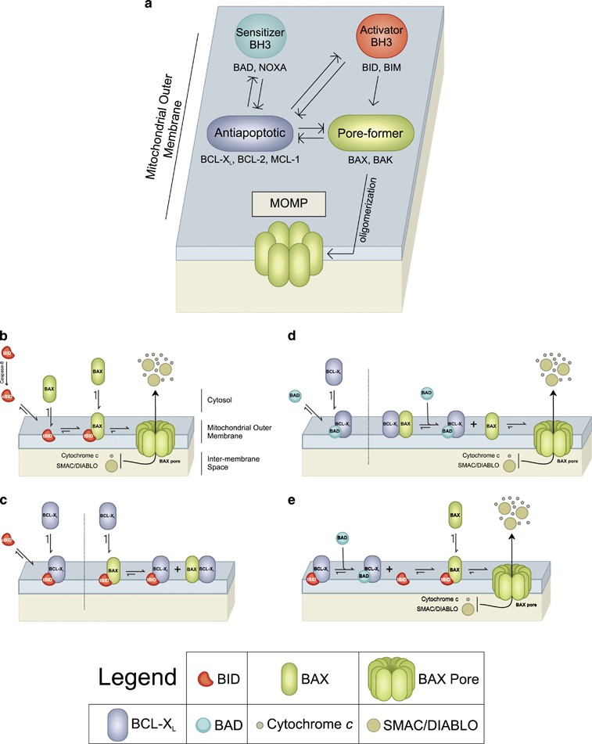
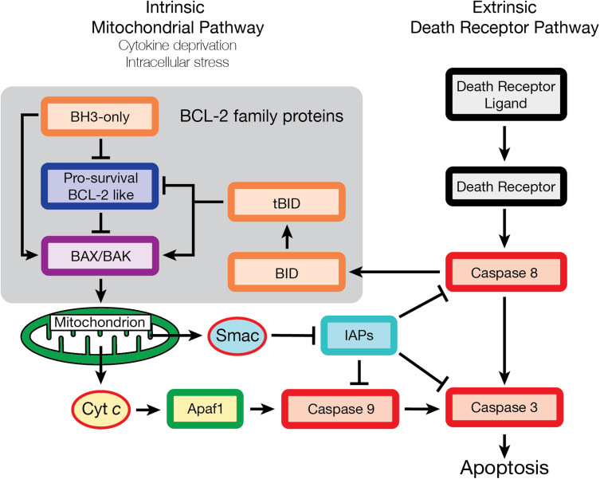
Bcl-2 family proteins
The BCL-2 family of proteins controls cell death primarily by direct binding interactions that regulate mitochondrial outer membrane permeabilization (MOMP) leading to the irreversible release of intermembrane space proteins, subsequent caspase activation and apoptosis.

Slide 17
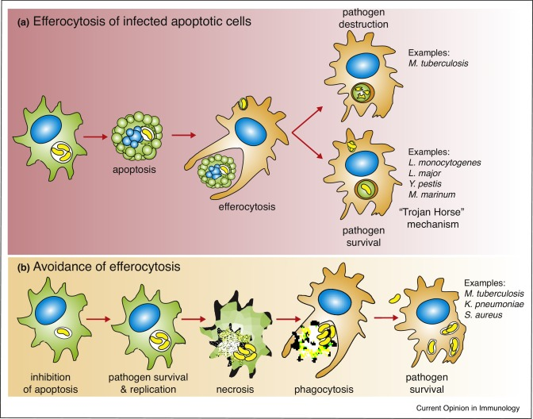
How does cell death impact health?
Many diseases are associated with abnormal cell death. Some examples of this are:
cancer: cancer cells often resist cell death, even after anti-cancer treatment.
autoimmunity e.g. Lupus, type 1 diabetes: immune cells that attack the body’s own tissues normally die. If this cell death does not occur it can cause diseases such as lupus or type 1 diabetes.
viral infection: viruses need to keep a cell alive in order to reproduce. Cell death can therefore prevent viral replication.
heart attack: many cells, including those in the heart and brain, trigger their apoptosis machinery when they lose their blood supply.

Slide 18
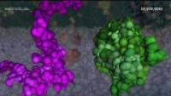
New medicines targeting cell death
Understanding how proteins such as the Bcl-2 family control cell death has led to the development of new drugs to block their function. These have the potential to cause the death of cancer cells, or the immune cells that cause autoimmune disease.
One set of drugs, called ‘BH3 mimetics’ trigger apoptotic cell death. They do so by preventing the action of ‘pro-survival’ Bcl-2 family proteins. Unless blocked, these pro-survival proteins help cancer cells stay alive, even after anti-cancer treatments such as chemotherapy.
Clinical trials are underway to determine whether BH3 mimetics can be used to treat certain cancers. BH3-mimetics might also potentially help treat autoimmune diseases by killing disease-causing white blood cells.
SMAC-mimetics are agents that, like the SMAC protein, enhance cell death. They do this by stopping IAPs from blocking cell death. They might also be able to help cells die so that chronic viral infections can be cleared.
There is also considerable interest in agents that can prevent cell death. These could have applications for treating conditions in which there is unwanted cell death, such as stroke, heart attack or neurodegenerative disorders
https://www.youtube.com/watch?v=tzwaPWElklo&ab_channel=WEHImovies

Slide 19
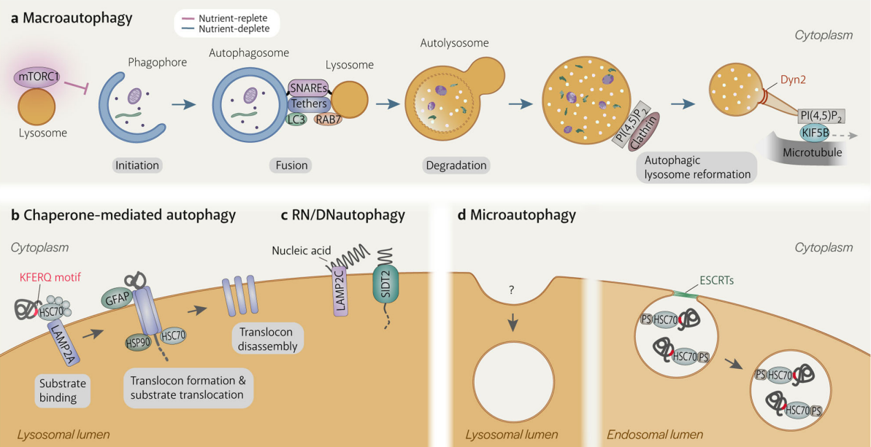
Autophagy
Autophagy is a fundamental cellular process that eliminates molecules and subcellular elements, including nucleic acids, proteins, lipids and organelles, via lysosome-mediated degradation to promote homeostasis, differentiation, development and survival.
The most well-studied form of autophagy is macroautophagy, which delivers cytoplasmic material to lysosomes via the double-membraned autophagosome. Other forms of autophagy, namely chaperone-mediated autophagy and microautophagy, occur directly on the lysosome.
Compromised autophagy is a hallmark of aging.
Yim, W.WY., Mizushima, N. Lysosome biology in autophagy. Cell Discov 6, 6 (2020). https://doi.org/10.1038/s41421-020-0141-7
Aman, Y., Schmauck-Medina, T., Hansen, M. et al. Autophagy in healthy aging and disease. Nat Aging 1, 634–650 (2021). https://doi.org/10.1038/s43587-021-00098-4

Slide 20
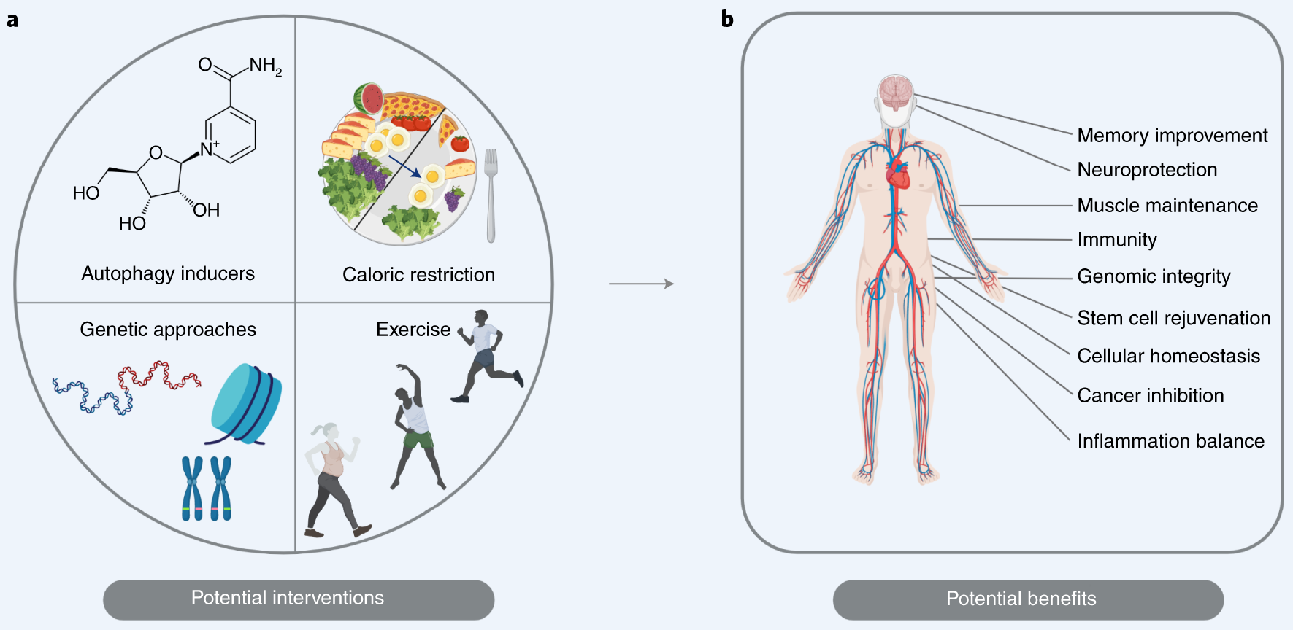
Autophagy in healthy aging and disease
Exposing individuals to autophagy inducers, dietary restriction and exercise late in life could boost autophagy and result in benefits to tissue function

