Slide 1
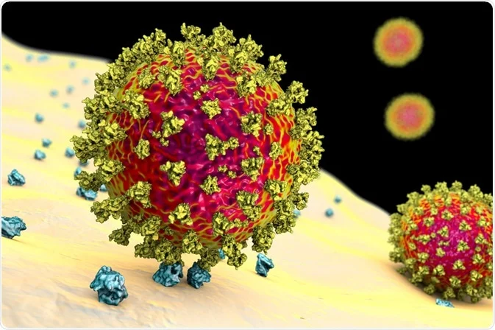
SARS-CoV-2 pathophysiology

Slide 2
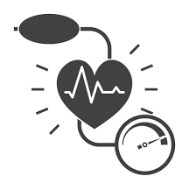
Renin-angiotensin-aldosteron systém (RAS)
    Receptor ACE2
    Pathologic regualation of RAS and covid 19

Slide 3

Renin-angiotensin-aldosteron systém (RAS)
    Receptor ACE2
    Pathologic regualation of RAS and covid 19
Non-specific (innate) immunity a mutagenesis
    Mechanisms of innate immunity
    Mutations raised by host cell

Slide 4

Renin-angiotensin-aldosteron systém (RAS)
    Receptor ACE2
    Pathologic regualation of RAS and covid 19
Non-specific (innate) immunity a mutagenesis
    Mechanisms of innate immunity
    Mutations raised by host cell
Specific immune reaction and complement activation
    Antibody response
    Inflamation

Slide 5

Renin-angiotensin-aldosteron systém (RAS)
    Receptor ACE2
    Pathologic regualation of RAS and covid 19
Non-specific (innate) immunity a mutagenesis
    Mechanisms of innate immunity
    Mutations raised by host cell
Specific immune reaction and complement activation
    Antibody response
    Inflamation
Mechanisms of endothelial injury
    Cytokine storm, ARDS

Slide 6
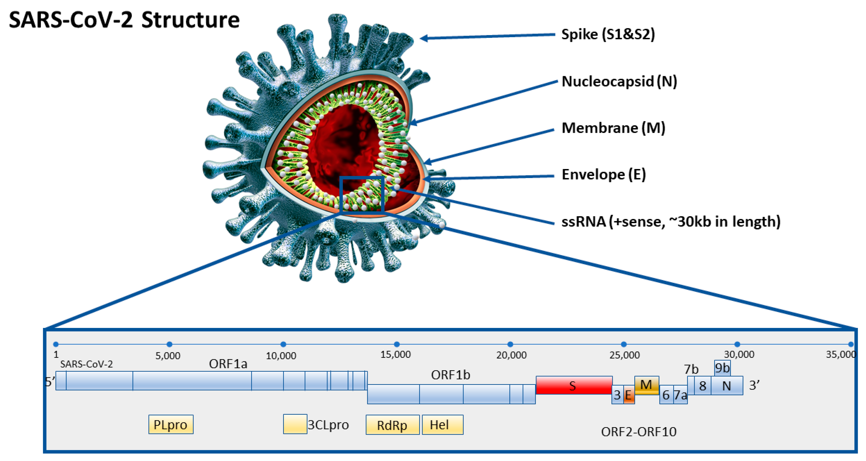

Slide 7
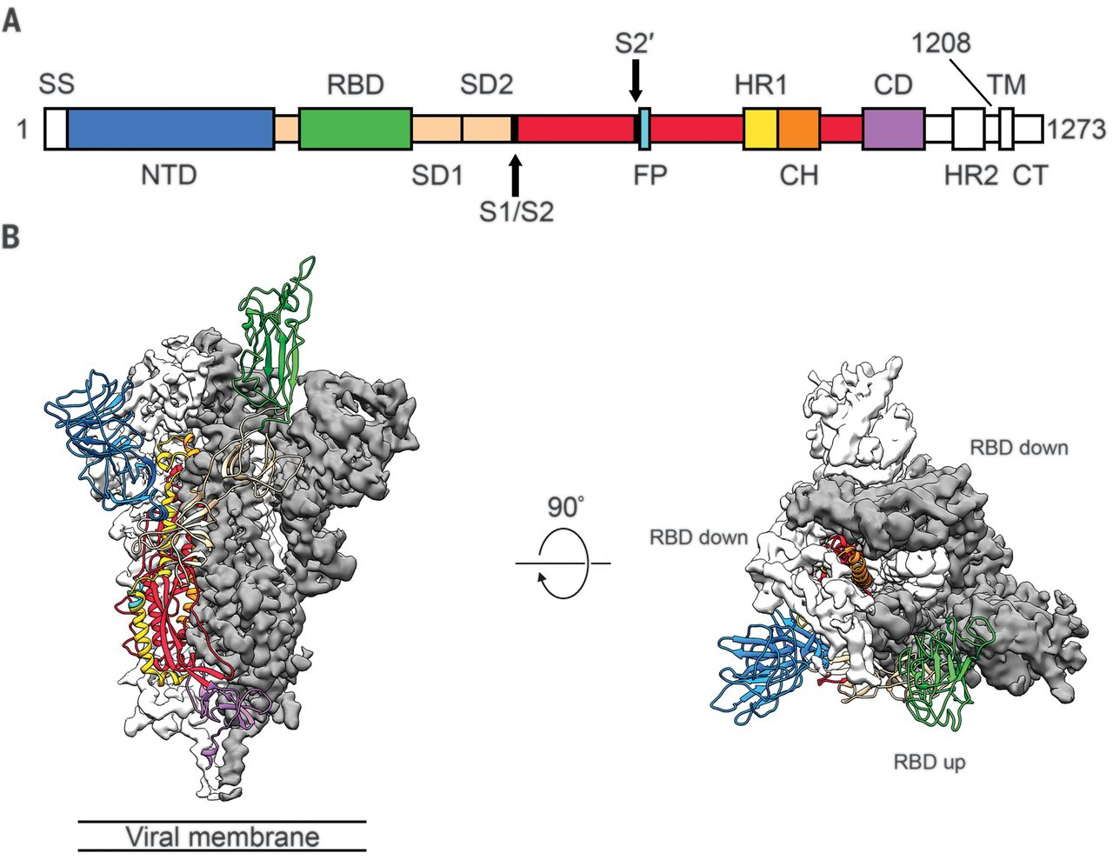
S-protein structure

Slide 8
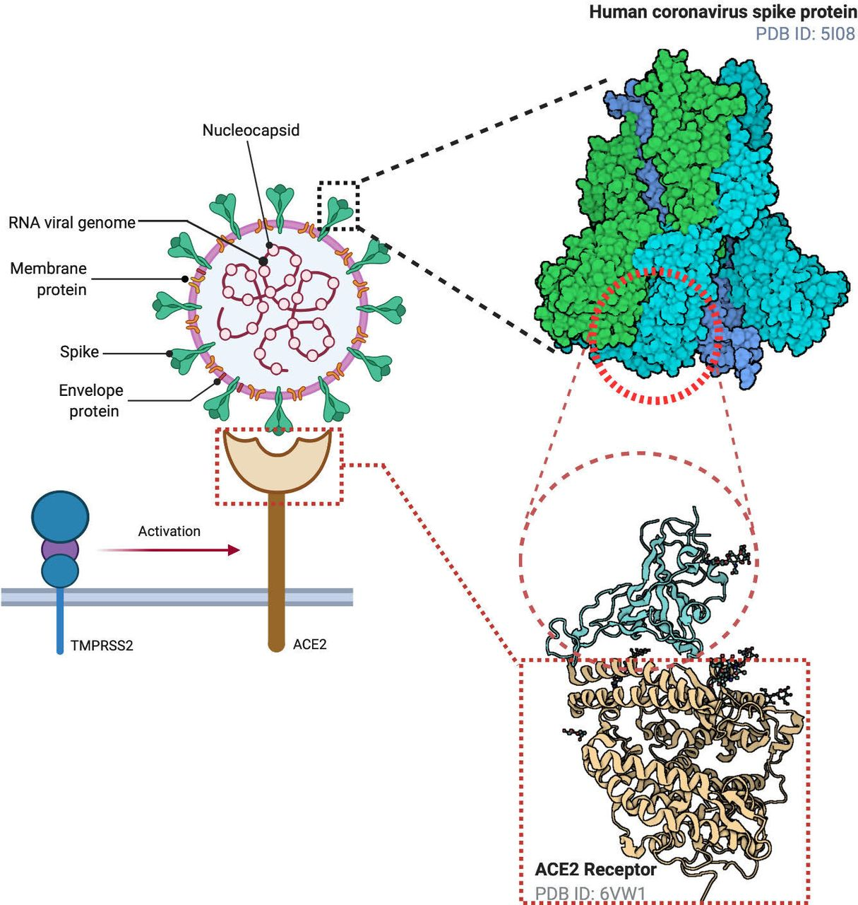
S-protein structure and interaction wih ACE2

Slide 9
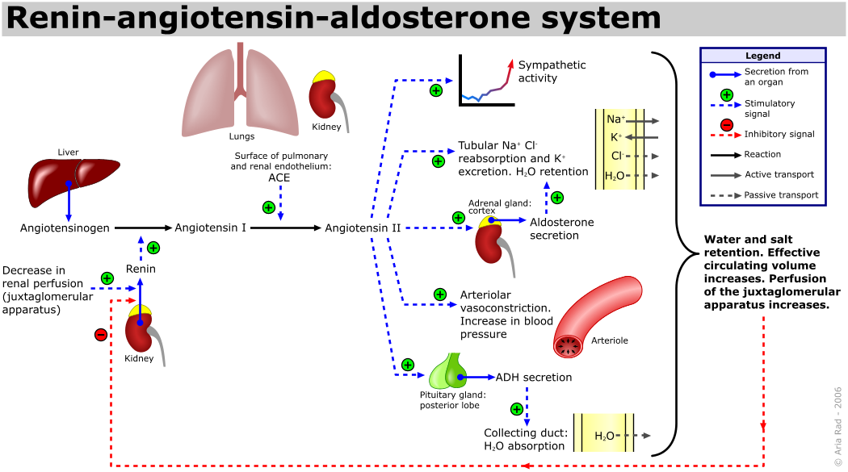

Slide 10
The role of RAS in SARS-Cov-2 infection
Angiotensinogen
Renin
Ang I
Angiotensin I
10-amino-acids

Slide 11
The role of RAS in SARS-Cov-2 infection
Angiotensinogen
Renin
Ang I
Angiotensin I
10-amino-acids
Angiotensin II
8-amino-acids
Angiotensin-converting enzyme 1
Ang II
ACE 1
AT₁R
Angiotensin II receptor type 1
Thrombocyte activation
Coagulation
Inflamation
Mesenchymal proliferation
Increased permeability
Vasoconstriction
Endothelial disfunction
Lung edema,

Slide 12
The role of RAS in SARS-Cov-2 infection
Angiotensinogen
Renin
Ang I
Angiotensin I
10-amino-acids
Angiotensin II
8-amino-acids
Angiotensin-converting enzyme 1
Ang II
Ang II
ACE 1
AT₁R
AT₂R
Angiotensin II receptor type 2
Angiotensin II receptor type 1
Thrombocyte activation
Coagulation
Inflamation
Mesenchymal proliferation
Increased permeability
Vasoconstriction
Endothelial disfunction
Lung edema,

Slide 13
The role of RAS in SARS-Cov-2 infection
Angiotensinogen
Renin
Ang I
Angiotensin I
10-amino-acids
Ang 1-9
Angiotensin II
8-amino-acids
angiotensin 1-7
Angiotensin-converting enzyme 1
Ang II
Ang II
Ang 1-7
ACE 1
ACE 2
AT₁R
AT₂R
Angiotensin II receptor type 2
Angiotensin-converting
enzyme 2
Angiotensin II receptor type 1
Thrombocyte activation
Coagulation
Inflamation
Mesenchymal proliferation
Increased permeability
Vasoconstriction
Endothelial disfunction
Lung edema,

Slide 14
The role of RAS in SARS-Cov-2 infection
Angiotensinogen
Renin
Ang I
Angiotensin I
10-amino-acids
Ang 1-9
Angiotensin II
8-amino-acids
angiotensin 1-7
Alamandine =
Decarboxylated Ang 1-7
Angiotensin-converting enzyme 1
Ang II
Ang II
Ang 1-7
Ala 1-7
ACE 1
ACE 2
Ang 1-7
AT₁R
AT₂R
MAS-R
MrgD
Angiotensin II receptor type 2
Angiotensin-converting
enzyme 2
MrgD- Mas-related G protein-coupled receptor D
Angiotensin II receptor type 1
Mas-receptor
Thrombocyte activation
Coagulation
Inflamation
Mesenchymal proliferation
Increased permeability
Vasoconstriction
Endothelial disfunction
Lung edema,

Slide 15
The role of RAS in SARS-Cov-2 infection
Angiotensinogen
Renin
Ang I
Angiotensin I
10-amino-acids
Ang 1-9
Angiotensin II
8-amino-acids
angiotensin 1-7
Alamandine =
Decarboxylated Ang 1-7
Angiotensin-converting enzyme 1
Ang II
Ang II
Ang 1-7
Ala 1-7
ACE 1
ACE 2
Ang 1-7
AT₁R
AT₂R
MAS-R
MrgD
Angiotensin II receptor type 2
Angiotensin-converting
enzyme 2
MrgD- Mas-related G protein-coupled receptor D
Angiotensin II receptor type 1
Mas-receptor
Thrombocyte activation
Coagulation
Inflamation
Mesenchymal proliferation
Increased permeability
Vasoconstriction
Endothelial disfunction
Lung edema,
NO production
Vasodilatation
Endothelia protection
Anti oxidative stress
Anti-fibrosis

Slide 16
The role of RAS in SARS-Cov-2 infection
HMWK
Bradyk
Bradyk
Bradyk
Kalikrein
ACE 1
ACE 2
Angiotensinogen
BK1R
BK2R
Renin
BK is hydrolyzed by ACE into des-Arg9 BK and inactive products.
ACE2 breaks down des-Arg9-BK into inactive peptides.
BK and des-Arg9-BK interact with two bradykinin receptors (BK1R and BK2R)
Vasidilation, NO
Inflamation
Cytokine
Endothelial dysfunction
Ang I
Angiotensin I
10-amino-acids
Ang 1-9
Angiotensin II
8-amino-acids
angiotensin 1-7
Alamandine =
Decarboxylated Ang 1-7
Angiotensin-converting enzyme 1
Ang II
Ang II
Ang 1-7
Ala 1-7
ACE 1
ACE 2
Ang 1-7
AT₁R
AT₂R
MAS-R
MrgD
Angiotensin II receptor type 2
Angiotensin-converting
enzyme 2
MrgD- Mas-related G protein-coupled receptor D
Angiotensin II receptor type 1
Mas-receptor
Thrombocyte activation
Coagulation
Inflamation
Mesenchymal proliferation
Increased permeability
Vasoconstriction
Endothelial disfunction
Lung edema,
NO production
Vasodilatation
Endothelia protection
Anti oxidative stress
Anti-fibrosis

Slide 17
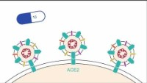
The role of RAS in SARS-Cov-2 infection
ACE inhibitors:
Captopril
Enalapril
Fosinopril
Lisinopril
Angiotensinogen
Renin
AT1R inhibitors:
Valsartan
Telmisartan
Losartan
Olmesartan
Ang I
Angiotensin I
10-amino-acids
Ang 1-9
Angiotensin II
8-amino-acids
angiotensin 1-7
Alamandine =
Decarboxylated Ang 1-7
Angiotensin-converting enzyme 1
Ang II
Ang II
Ang 1-7
Ala 1-7
ACE 1
ACE 2
Ang 1-7
AT₁R
AT₂R
MAS-R
MrgD
Angiotensin II receptor type 2
Angiotensin-converting
enzyme 2
MrgD- Mas-related G protein-coupled receptor D
Angiotensin II receptor type 1
Mas-receptor
Thrombocyte activation
Coagulation
Inflamation
Mesenchymal proliferation
Increased permeability
Vasoconstriction
Endothelial disfunction
Lung edema,
NO production
Vasodilatation
Endothelia protection
Anti oxidative stress
Anti-fibrosis

Slide 18
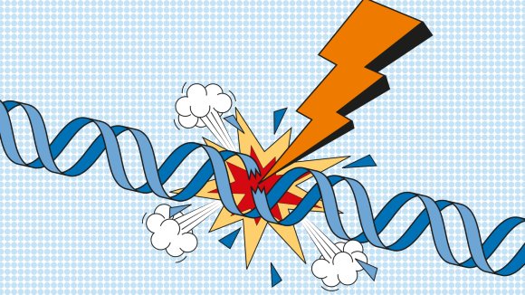
Mechanisms of innate immunity
(fast but non-specific response)
Detection of pathogenic microorganisms
  Membrane receptors
  Intracellular receptors of foreign nucleic acids
  Cytokine signalling
Intracellular signalling pathways
Activation of transcription / gene expression
  Expression of cytokines
  Activation of specific immune response
  Elimination of microorganisms
  Use of gene

Slide 19
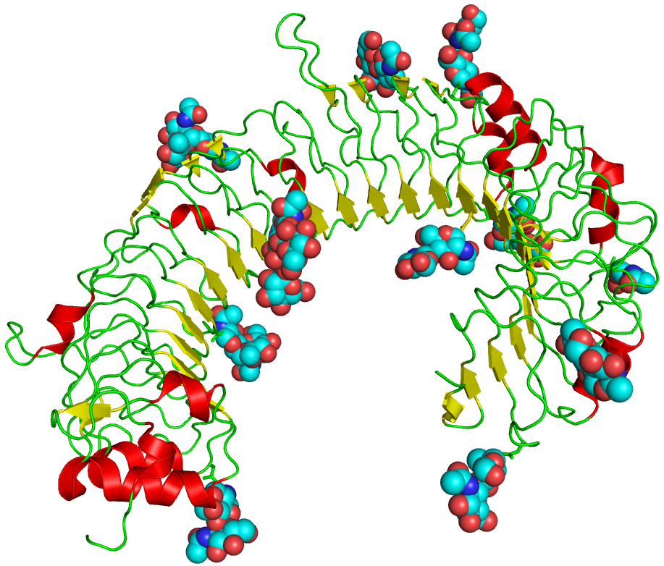

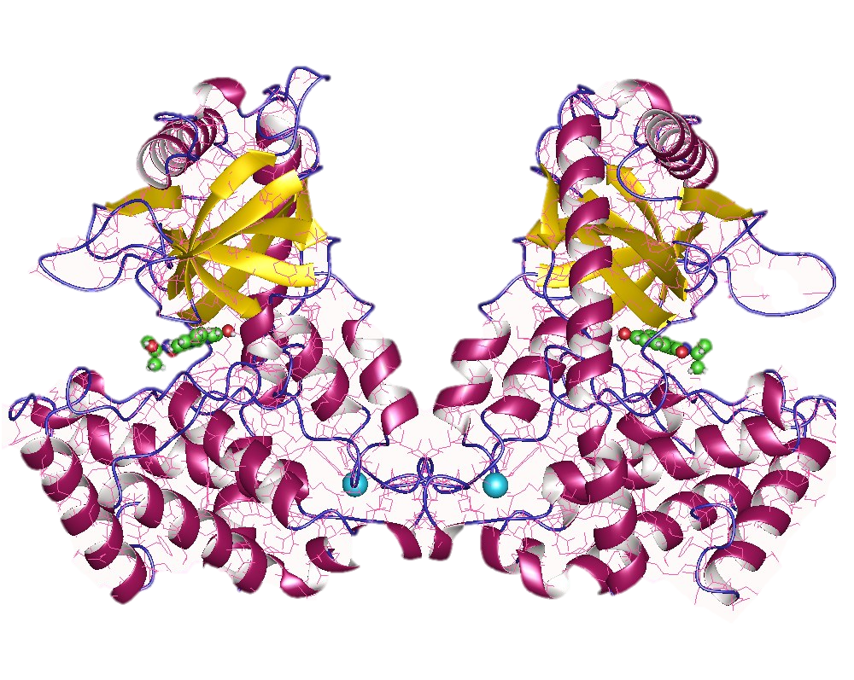
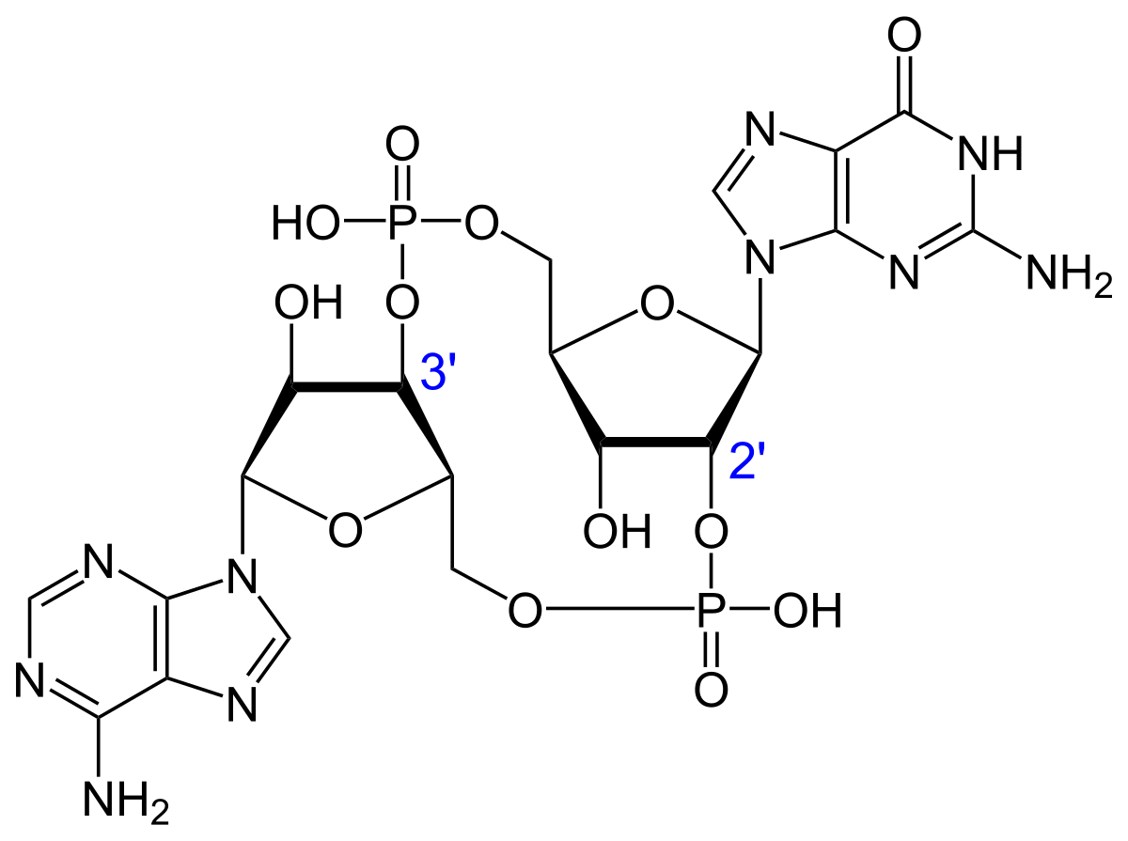


Mechanisms of innate immunity
TLR
TLR
IFN
Toll-like receptors
(TLRs)
IFNAR
Activated by extracellular signals from pathogens:
Polysacharides, RNA, DNA, proteins, lipopeptides, endotoxins,..
Interferone receptors
Cyclic GMP-AMP synthase
Cytoplasmic sensor of DNA
cGAS
cGAMP
Stimulator of interferon genes
Cyclic guanosine monophosphate–adenosine monophosphate
ER
STING
ATP+GTP
IRGs – interferone regulated genes
Cytokines
Host-directed editing enzymes:
APOBEC, ADAR, AID..
IRFs
STAT
NF-κB
GAS ISRE
gamma-activated sequences, IFN-stimulated response elements

Slide 20
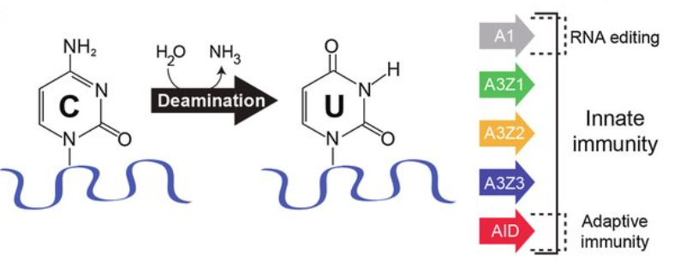
APOBEC family members
APOBEC ("apolipoprotein B mRNA editing enzyme, catalytic polypeptide-like") is a family of evolutionarily conserved cytidine deaminases.
Discovered due to their ability to eliminate HIV infection
When misregulated, are a major source of mutation in numerous cancer types.
AID is a part of adaptive immunity; it is responsible for hypermutation of variable immunoglobulin regions in lymphocytes
APOBEC1
APOBEC2
APOBEC3A
APOBEC3B
APOBEC3C
APOBEC3D
APOBEC3F
APOBEC3G
APOBEC3H
APOBEC4
AID (activation induced deaminase)

Slide 21
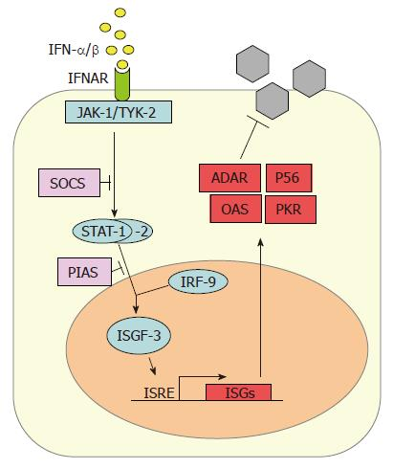
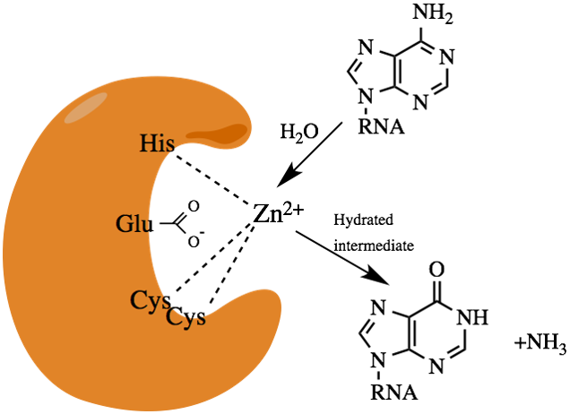
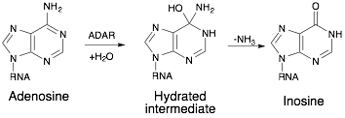
ADAR - adenosine deaminase acting on RNA
responsible for binding to double stranded RNA (dsRNA) and converting adenosine (A) to inosine (I) by deamination. ADAR protein is a RNA-binding protein, which functions in RNA-editing through post-transcriptional modification of mRNA transcripts by changing the nucleotide content of the RNA
Dysregulation associated with: Aicardi–Goutières syndrome and Bilateral Striatal Necrosis/Dystonia, cancer (HCC)
Mechanism of action:
Deamination of adenosine to inosine
Destabilize RNA
Mismatch pairing when replicated

Slide 22
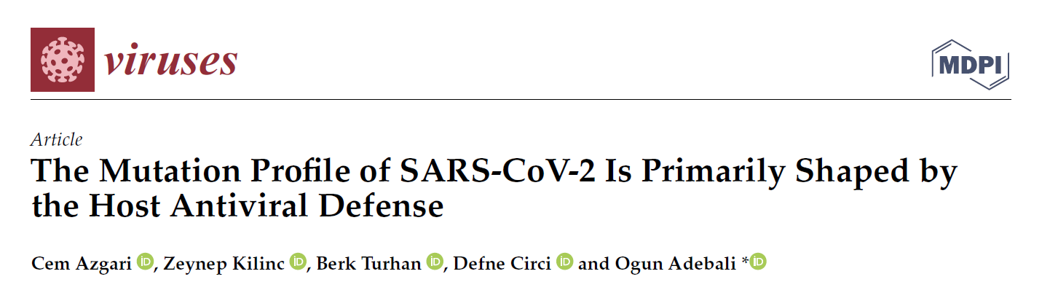
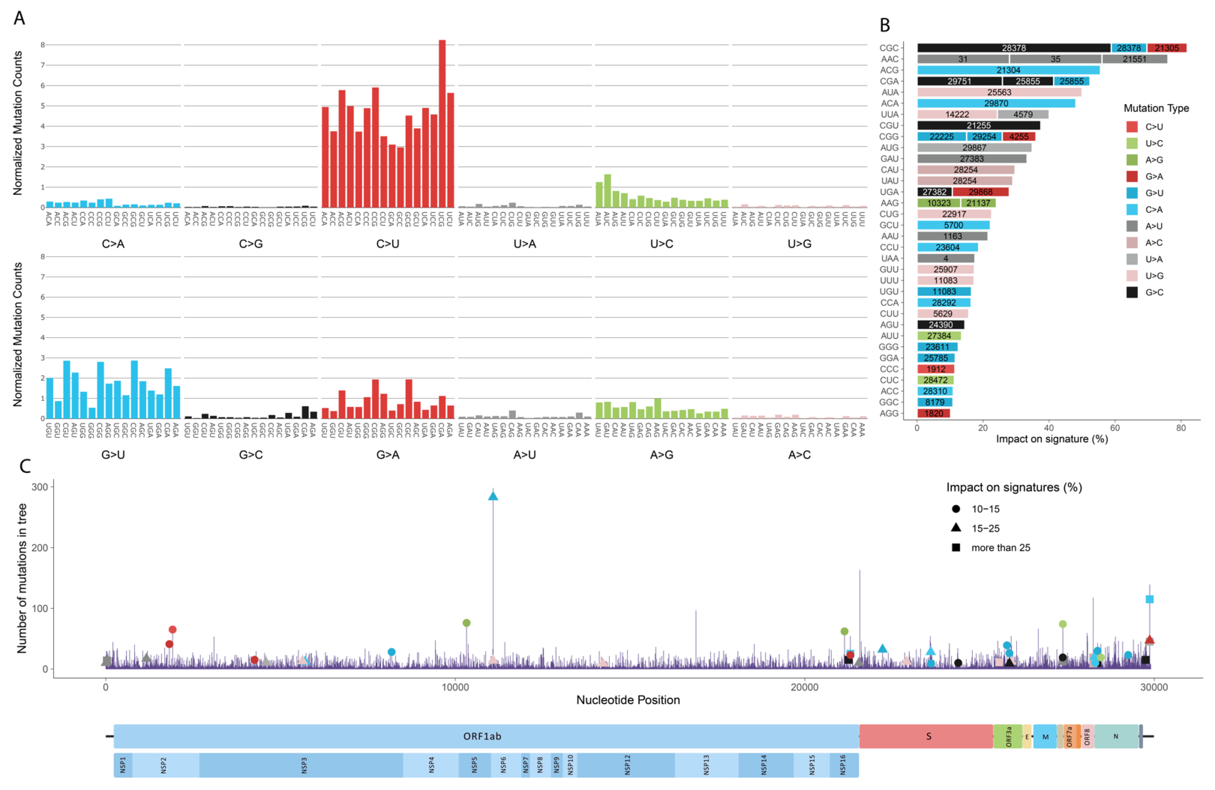
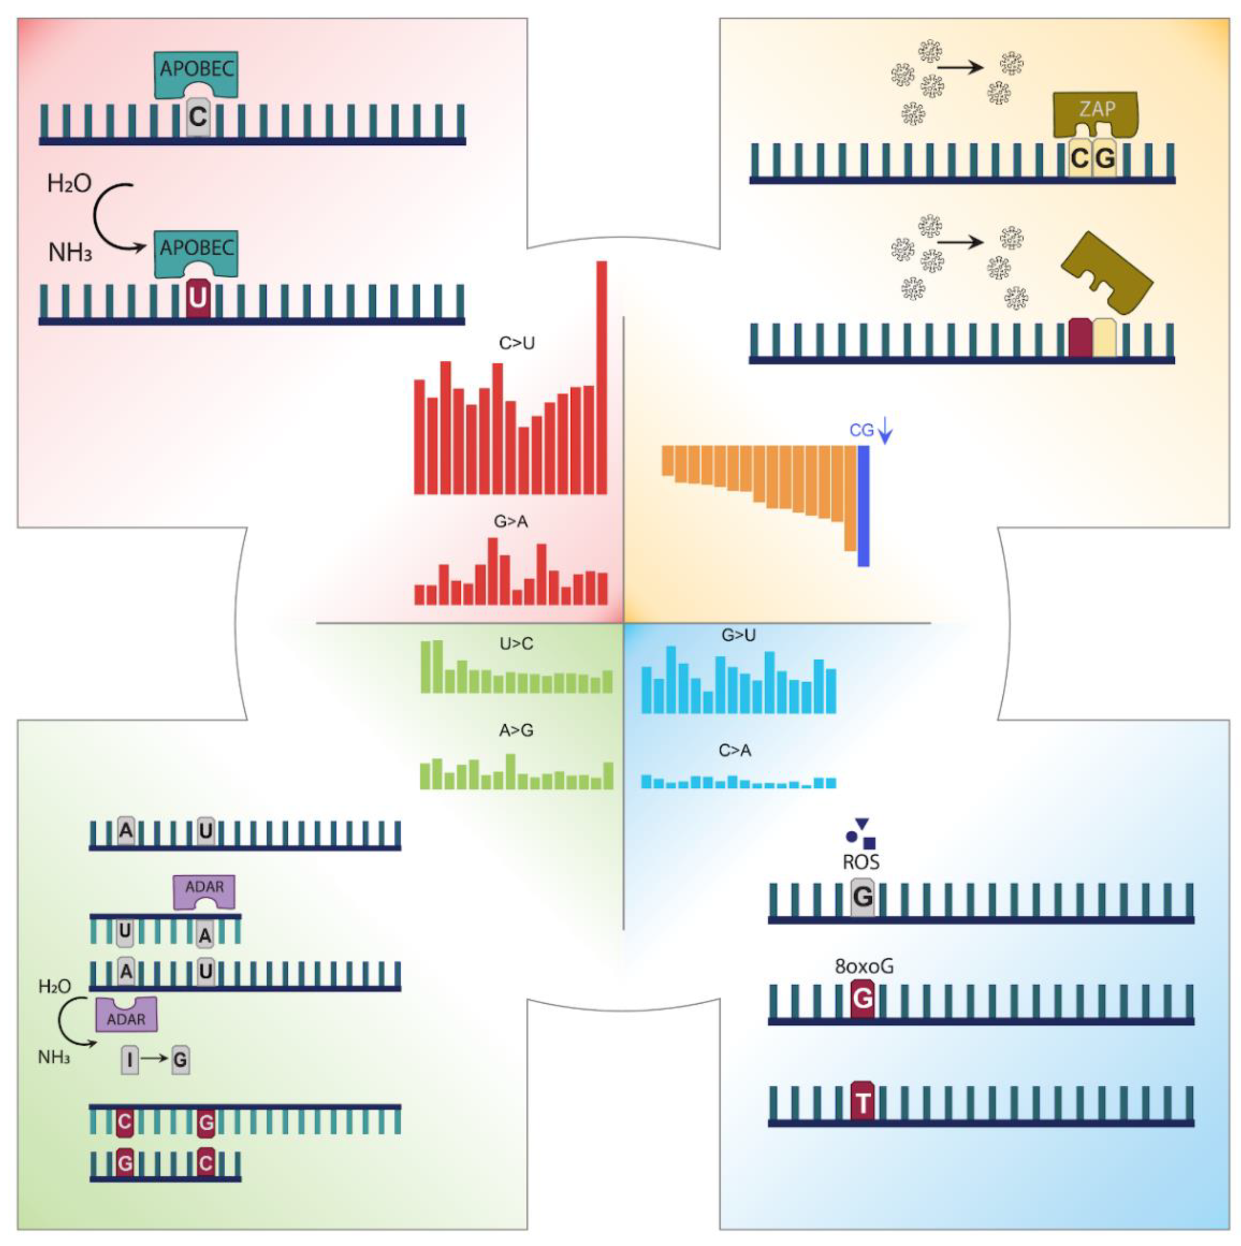
The results suggest that the heterogeneous mutation patterns are mainly reflections of host (i) antiviral mechanisms that are achieved through APOBEC, ADAR, and ZAP proteins, and (ii) probable adaptation against reactive oxygen species.

Slide 23
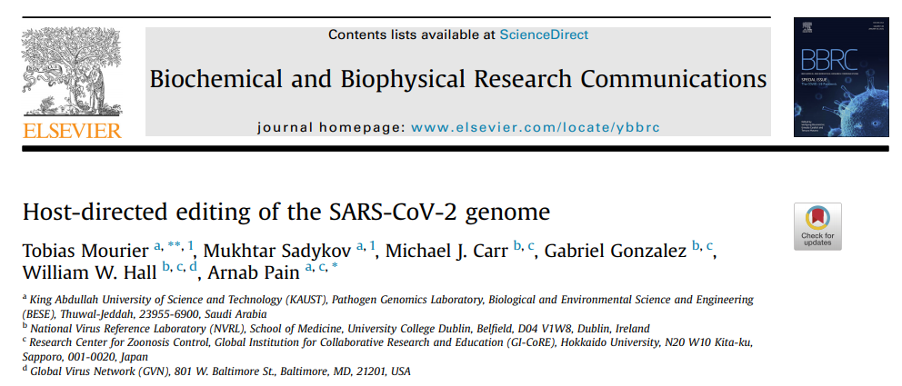
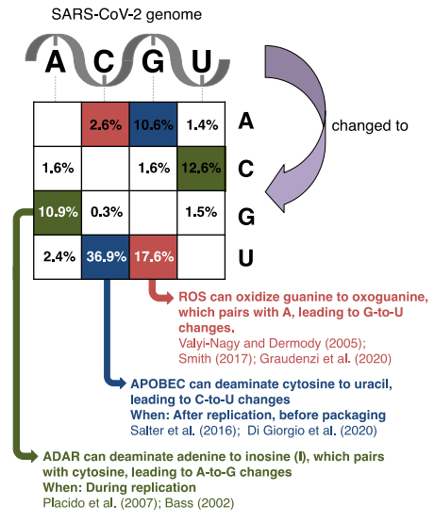

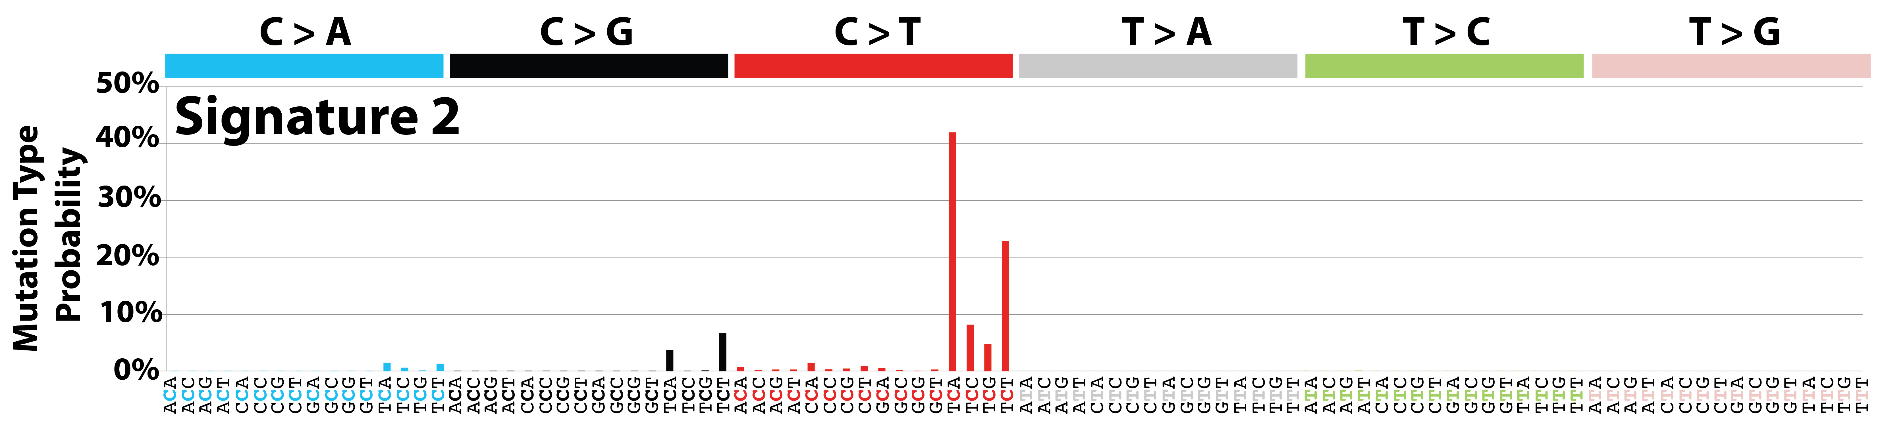
Signatures of Mutational Processes in Human Cancer
Signature 2 has been attributed to activity of the AID/APOBEC family of cytidine deaminases.

Slide 24
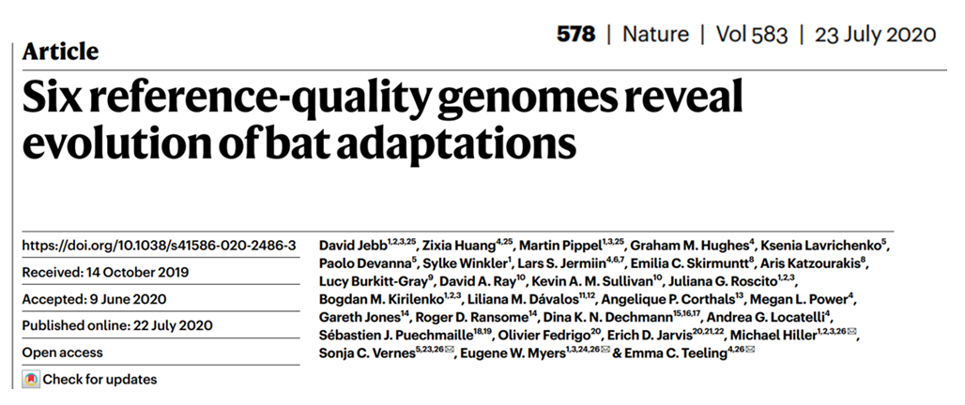
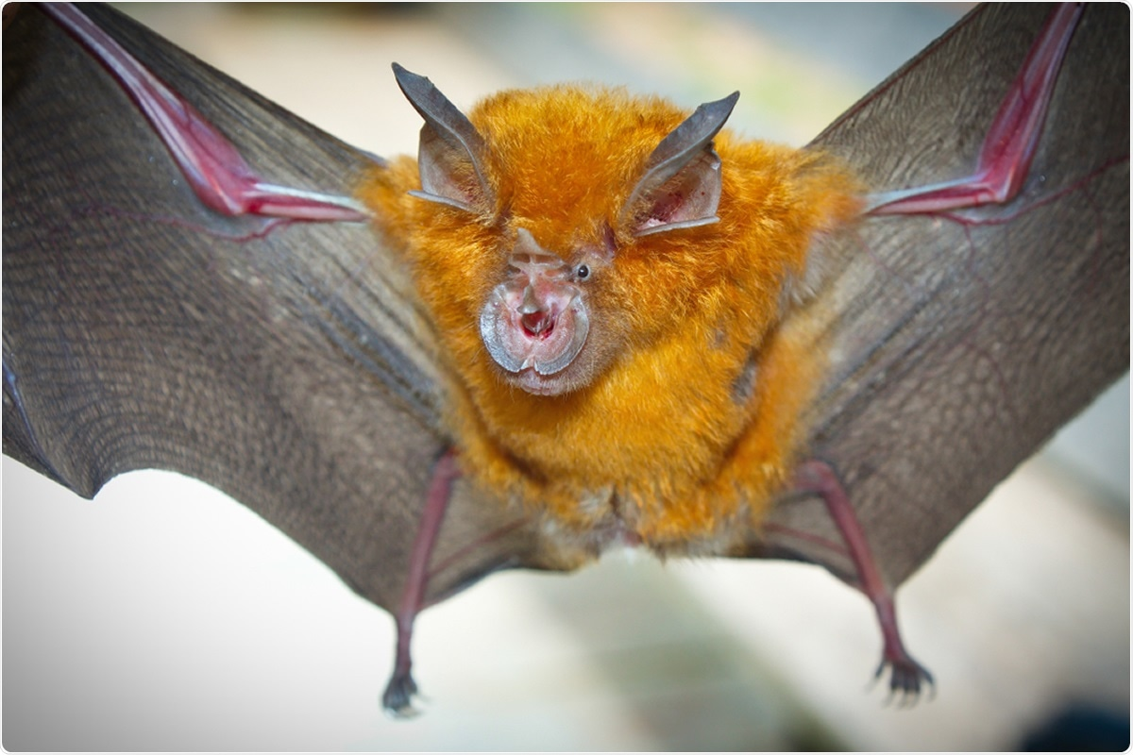
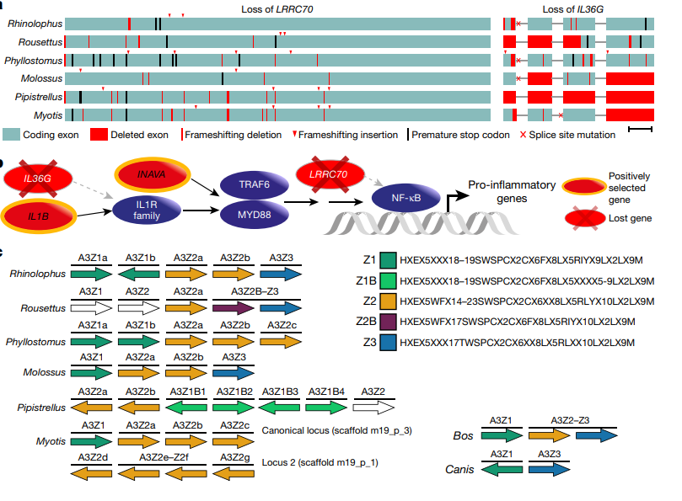
Loss of genes in NF-κB signalling pathway
Expansion of the APOBEC3 gene locus

Slide 25
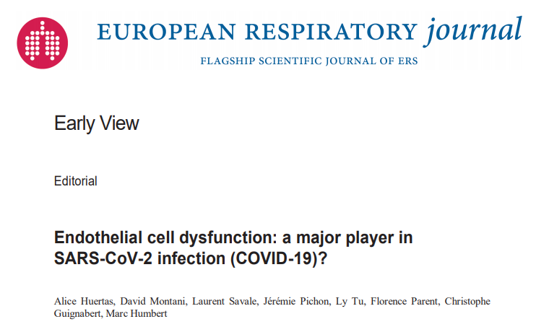
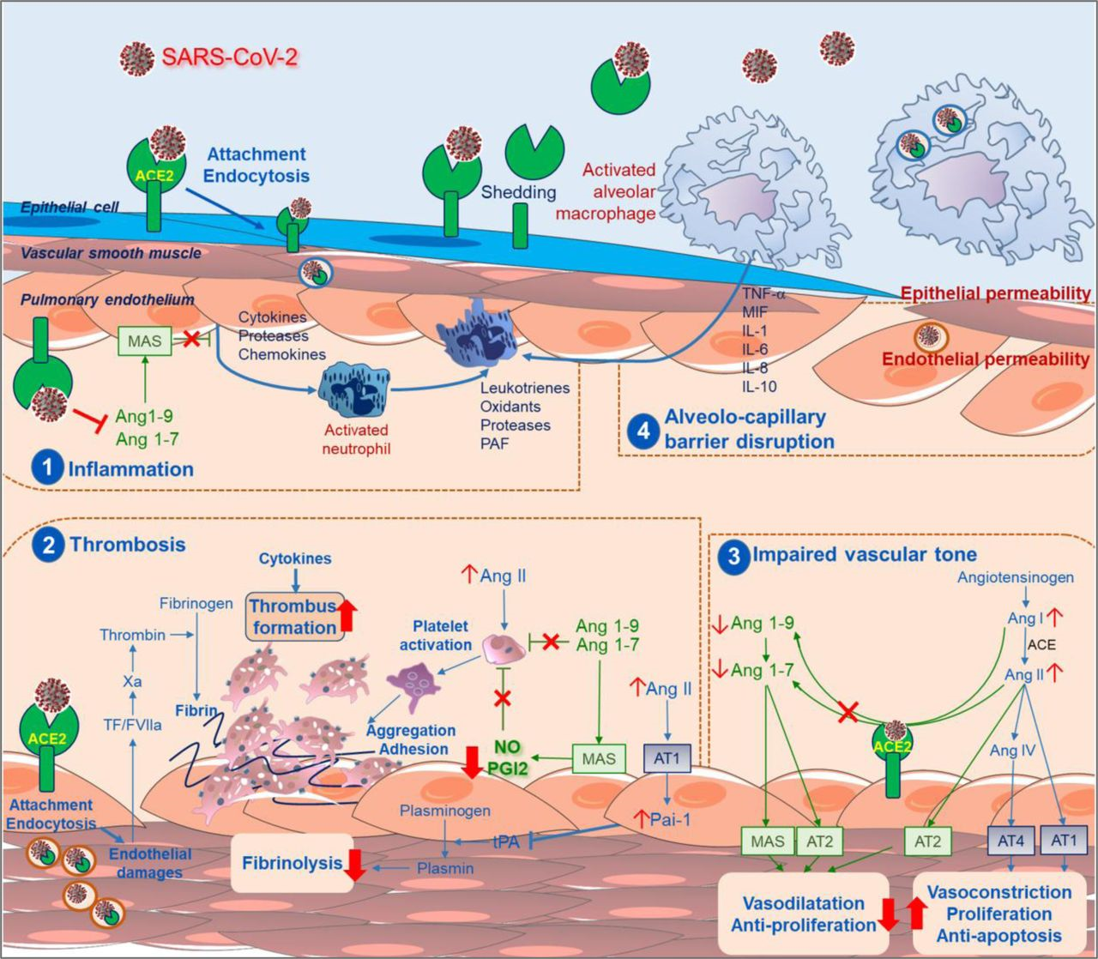
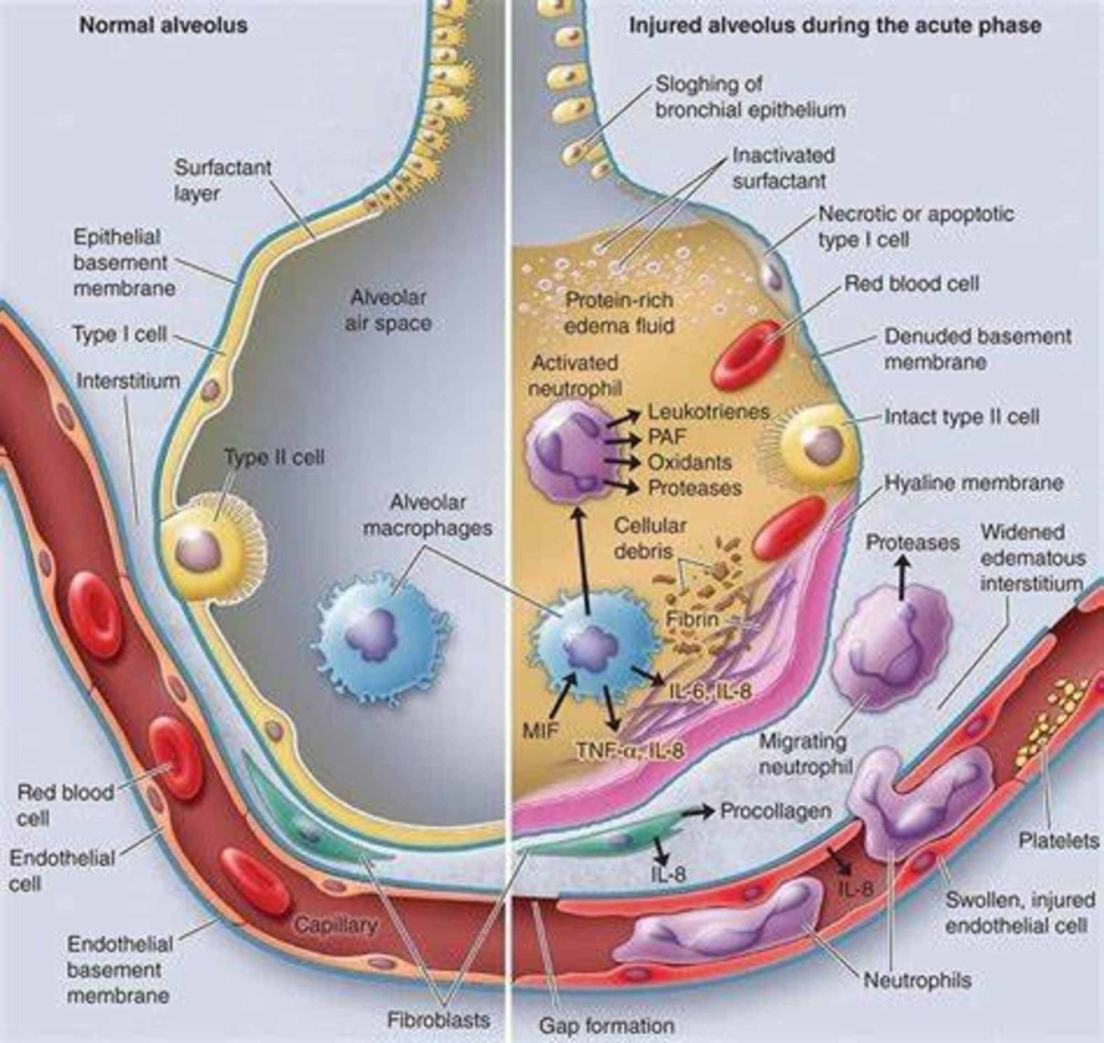

Slide 26
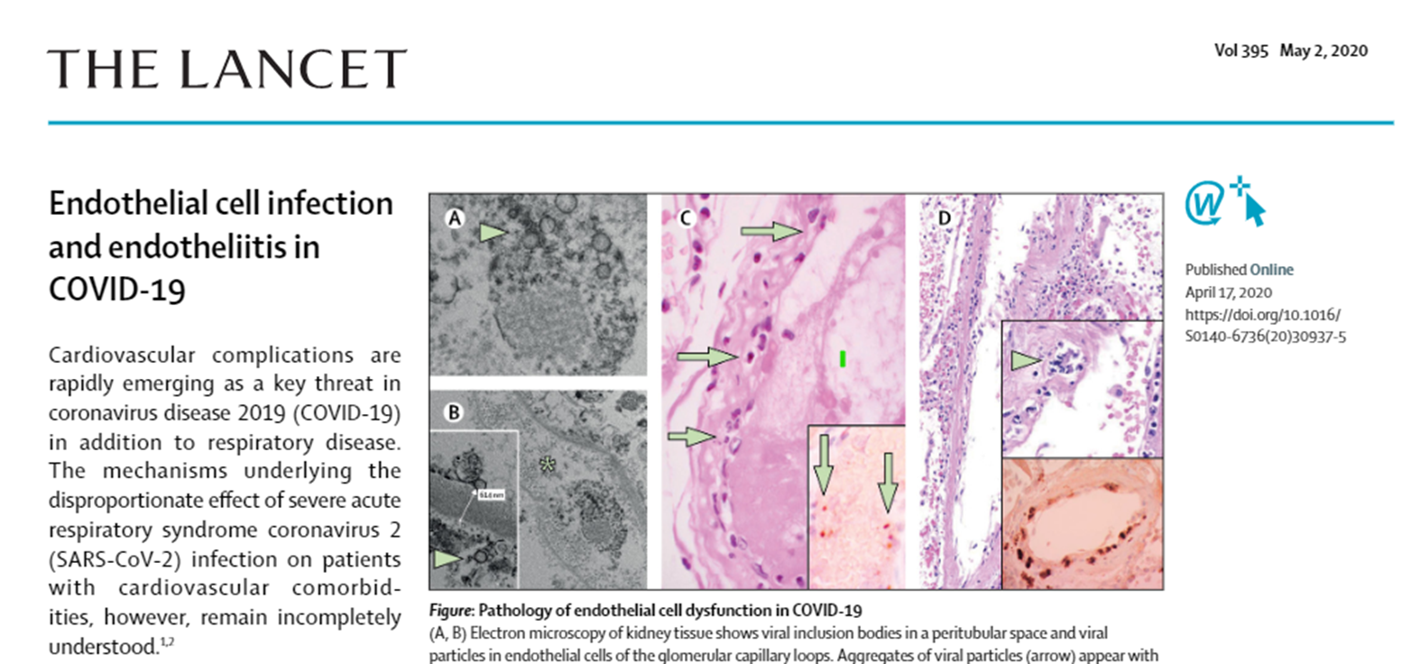
Mechanisms of endothelial damage by SARS-CoV2
viral mRNA

Slide 27
Mechanisms of endothelial damage by SARS-CoV2
Ang I
S-protein
Ang II
Ang 1-7
ACE 1
ACE 2
ATR1
MAS-R
viral mRNA

Slide 28
Mechanisms of endothelial damage by SARS-CoV2
Inhibition of ACE2 protease
Ang I
S-protein
Insuficient production of angiotensin 1-7
Ang II
Ang 1-7
ACE 1
ACE 2
ATR1
MAS-R
viral mRNA
Activation of Angiotensin II receptor 1

Slide 29
Mechanisms of endothelial damage by SARS-CoV2
Inhibition of ACE2 protease
Ang I
S-protein
Insuficient production of angiotensin 1-7
Ang II
Ang 1-7
ACE 1
ACE 2
ATR1
MAS-R
viral mRNA
Activation of Angiotensin II receptor 1
Increased permeability
Vasoconstriction
Endothelial disfunction
Thrombocyte activation
Coagulation
Inflamation
Mesenchymal proliferation
NO production
Vasodilatation
Endothelia protection
Anti oxidative stress
Anti-fibrosis
Lung edema
ARDS

Slide 30
Mechanisms of endothelial damage by SARS-CoV2
IgM
S-protein
viral mRNA
viral mRNA

Slide 31

Mechanisms of endothelial damage by SARS-CoV2
Activation of complement by IGM (classical pathway)
C3a
C5a
C3a
C1
complex
IgM
C2b
C4b
C3b
C5b
C6 C7
C8 C9
S-protein
viral mRNA
viral mRNA

Slide 32
Mechanisms of endothelial damage by SARS-CoV2
Activation of complement by IGM (classical pathway)
C3a
C5a
C3a
C1
complex
IgG
IgM
C2b
C4b
C3b
C5b
C6 C7
C8 C9
S-protein
viral mRNA
viral mRNA

Slide 33
Mechanisms of endothelial damage by SARS-CoV2
Opsonization
Activation of complement receptors
C5a
Activation of complement by IGM (classical pathway)
C3a
C3a
C5a
Macrophage
FcR
C1
complex
IgM
C2b
C4b
C3b
C5b
C6 C7
C8 C9
S-protein
viral mRNA
viral mRNA
Cytokines:
TNF, IL-1, IL-6,
IL-8, and IL-12
Cytokine storm

Slide 34
Mechanisms of endothelial damage by SARS-CoV2
Opsonization
Activation of complement receptors
C5AR1 (CD88)
C5AR2 (GRP77)
C5a
Activation of complement by IGM (classical pathway)
C3a
C3a
C5a
Neutrophil
C5a
C3a
Myeloperoxidase
Reactive oxygen
Macrophage
FcR
FcR
C1
complex
IgM
C2b
C4b
H₂O₂
C3b
IgG
O.
C5b
C6 C7
C8 C9
S-protein
viral mRNA
viral mRNA
Cytokines:
TNF, IL-1, IL-6,
IL-8, and IL-12
Cytokine storm

Slide 35
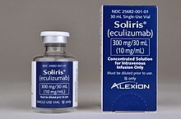
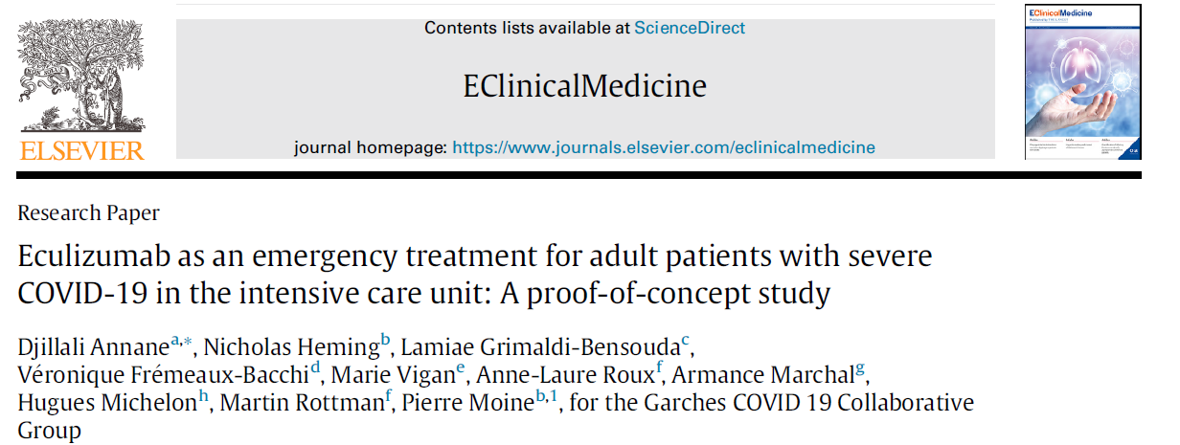
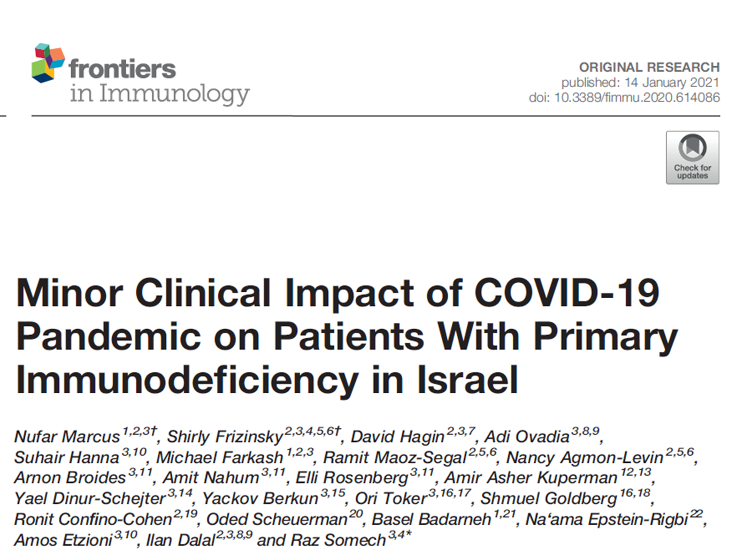
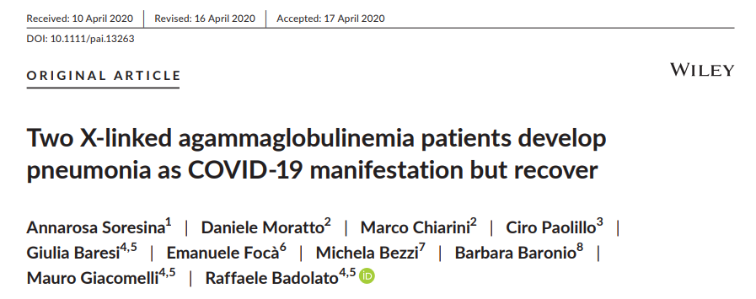
Eculizumab
C3b
C5
C5a
C5b
Eculizumab is humanized therapeutical antibody that binds C5 complement and prevents its cleavage by C3b. It is used to treat paroxysmal nocturnal hemoglobinuria (PNH), atypical hemolytic uremic syndrome (aHUS), and neuromyelitis optica.

Slide 36
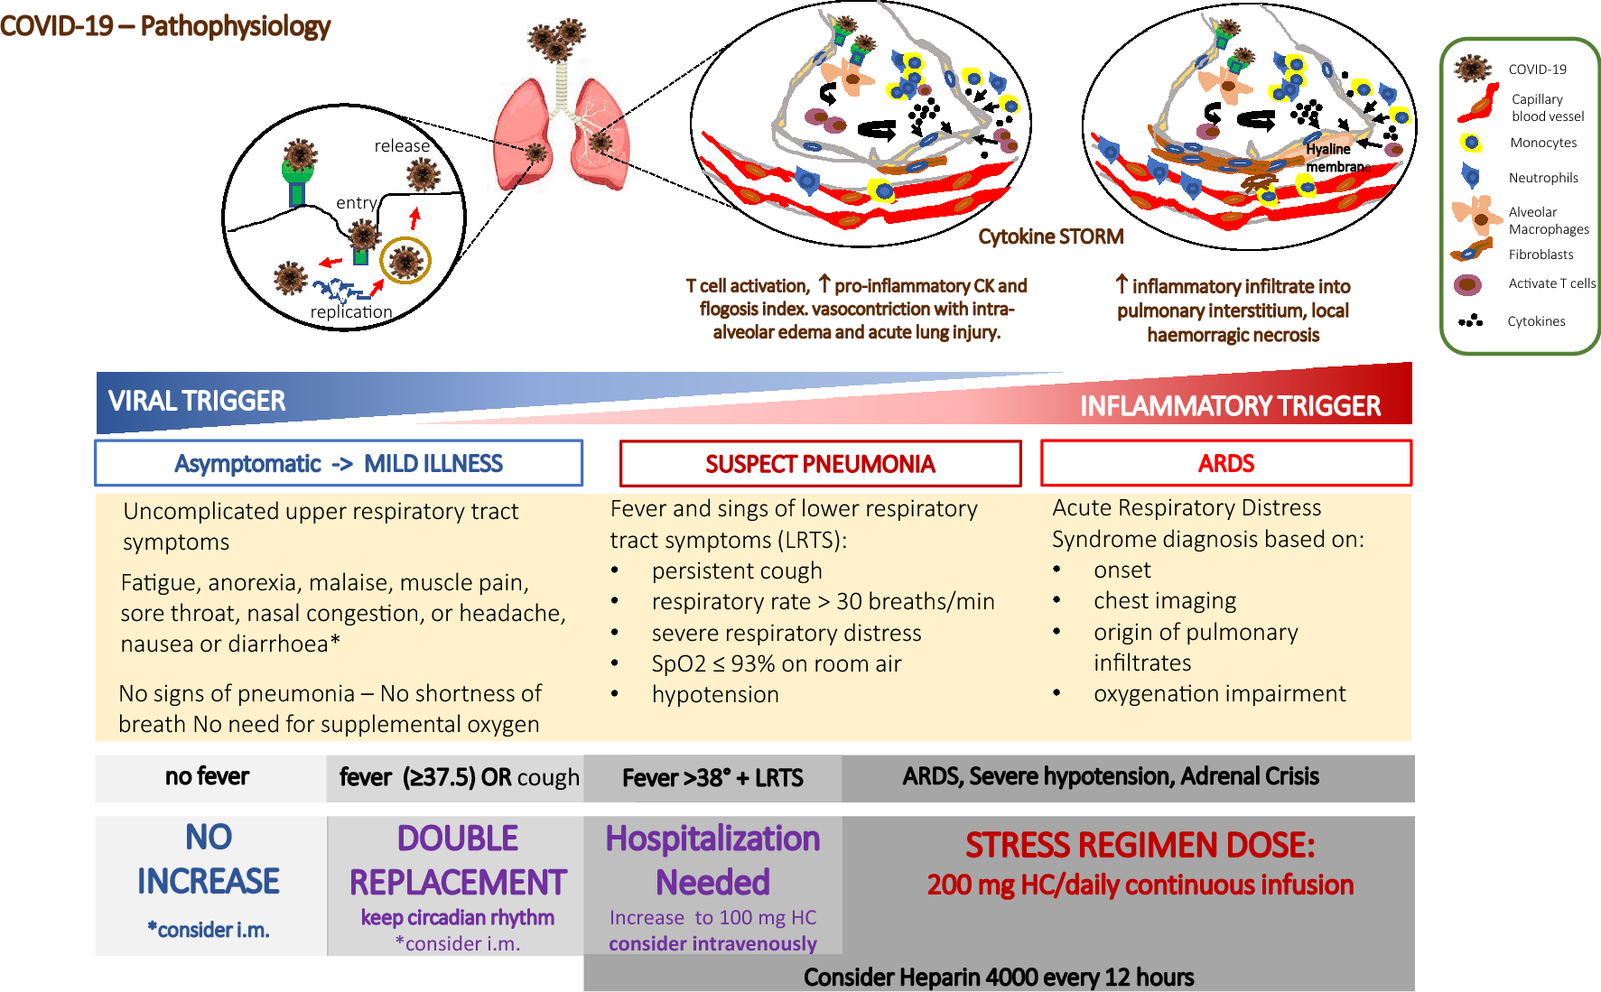


Slide 37
RAS
Complement
Coagulation
Inflamation
High viral load
Edema
Recovery
Delayed immune response:
Primoinfection
Exhausted immunity
IgM

Slide 38
RAS
Complement
Coagulation
Inflamation
High viral load
Edema
Recovery
Therapy:
Anti-inflammatory : corticoids
Anticoagulant: heparin
Therapy:
Antivirotics –remdesivir
Therapeutical antibodies
Delayed immune response:
Primoinfection
Exhausted immunity
IgM

Slide 39
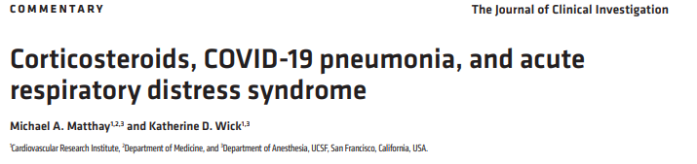
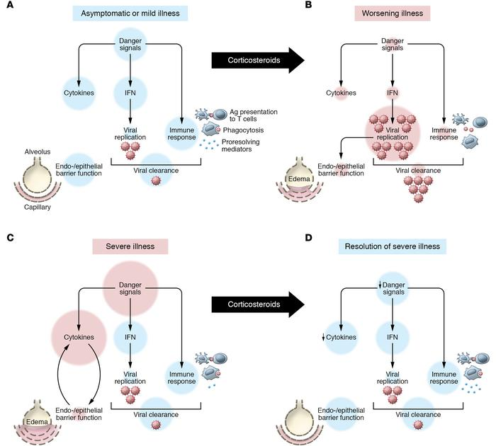
Model for deleterious or beneficial effects of corticosteroids in the treatment of COVID-19.
In asymptomatic or mild cases and in the absence of treatment, SARS–CoV-2 induces transcriptional upregulation of interferons (IFNs) and NF-κB activation, which promote cytokine production and activation of macrophages as well as demargination of PMNs. Antigens are presented to T cells and a targeted cytotoxic response ensues.
In worsening illness, corticosteroid treatment can delay pathogen recognition and control. Dampened danger signaling leads to impaired IFN release, unchecked viral replication, and consequent alveolar and lung damage.
In severe illness with COVID-19 without corticosteroid treatment, viral propagation to the alveoli amplifies danger signals and worsens alveolar epithelial and endothelial damage. Persistent damage leads to exuberant NF-κB activation and inflammation worsens even as viral load decreases.
In severe cases of COVID-19 corticosteroid treatment may decrease proinflammatory cytokine burden and help resolution. Corticosteroids promote a proresolving macrophage phenotype that can clear cellular debris. Corticosteroids also reduce capillary permeability and increase alveolar edema fluid clearance, resulting in improved barrier function.

Slide 42
Mechanismy poškození endotelu při infekci SARS-CoV2
Mechanisms of endothelial damage by SARS-CoV2
C5AR1 (CD88)
C5AR2 (GRP77)
C5a
C3a
C1
complex
FcR
C4b
C2b
IgM
IgG
H₂O₂
C3b
O.
C6 C7
C8 C9
C5b
viral mRNA
S-protein
viral mRNA

