Slide 1
Eye anatomy
Veronika Matušková

Slide 2
Outcome from learning
Student can describe anatomy of the eye and of visual pathway.
Oční lékařství (aVLOL7X1)

Slide 3
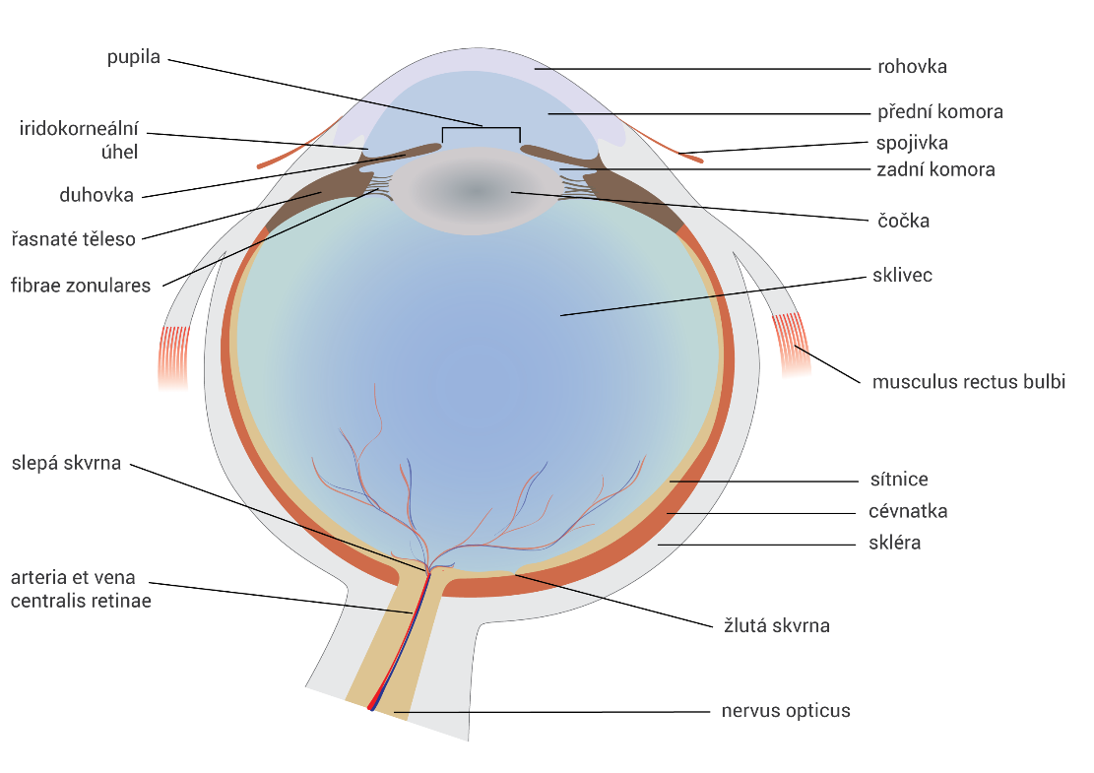
Eyeball – bulbus oculi
The eyeball is protected by bones and eyelids, it is stored in a fat pad.
3 layers of eye wall:
- superficial (fibrous) - cornea, sclera
middle (vascular) - iris, ciliary body, choroid
internal (nervous) - retina
Anterior segment of the eye (in front of the lens)
posterior segment of the eye (behind the lens).
Axial length of the eye 24 mm, 1 mm corresponds to 3D.
Optical power of the eye 63D (cornea 43D, lens 20D).
front pole
equator
back pole

Slide 4
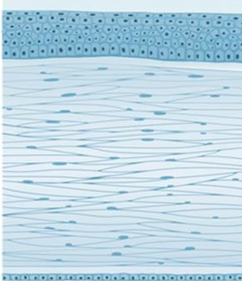
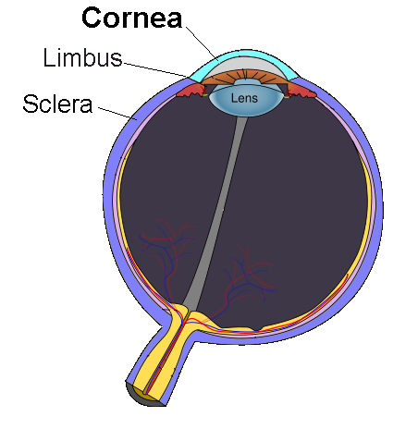
Cornea
tear film
The most important refractive medium - 3/4 of the total optical power of the eye.
Limbus = corneal junction to the sclera
Hemispherical shape with a diameter of 11 mm
Smooth, glossy, transparent, vascular
A tear film on the surface
Consisting of 5 layers
The most sensitive tissue of the human body
- rich sensitive innervation (n.1 / V - n. ophthalmicus).
epithelium - squamous cell epithelium, rapidly regenerates
Bowman layer - does not regenerate
stroma - small ability of
regeneration
Descemet's membrane
- regenerates
endothelium - 1-layer layer of hexagonal cells, decreases with age, is responsible for corneal dehydration, does not regenerate

Slide 5
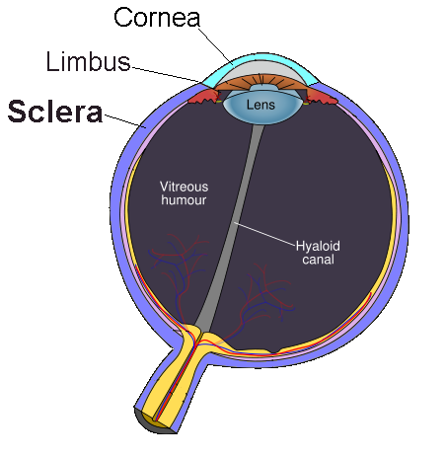
Sclera
Firm, protects intraocular structures and helps maintain intraocular pressure.
Posterior part of the eyeball, it occupies 5/6 of the circumference of the eye.
Solid, white, opaque, contains a small number of blood vessels.
In the anterior part (in front of the equator) it is covered with a conjunctiva.
All oculomotor muscles are attached.
Consists of 3 layers:
episclera (only before the equator, under the conjunctiva)
stroma
lamina fusca (adjacent to the choroid)
Oční lékařství (aVLOL7X1)

Slide 6

Iris
It forms a partition between the anterior and posterior chamber of the eye.
In the middle of the iris is pupil.
The pupil regulates the amount of light passing into the eye with help of 2 muscles:
sphincter (musculus sphincter pupillae) - innervated by a parasympathetic
dilator (musculus dilatator pupilae) - innervated by the sympathetic
The amount of melanin pigment determines the "eye color".
Corpus ciliare
It forms a transition between the iris and the choroid.
Basic functions:
intraocular fluid production
hanging apparatus for the lens using fibrae zonulares
providing accommodation using the ciliary muscle
Choroidea
It contains a number of blood vessels.
Provides nutrition of the outer layers of the retina (a. centralis retinae
provides nutrition of the inner layers of the retina).
Oční lékařství (aVLOL7X1)

Slide 7
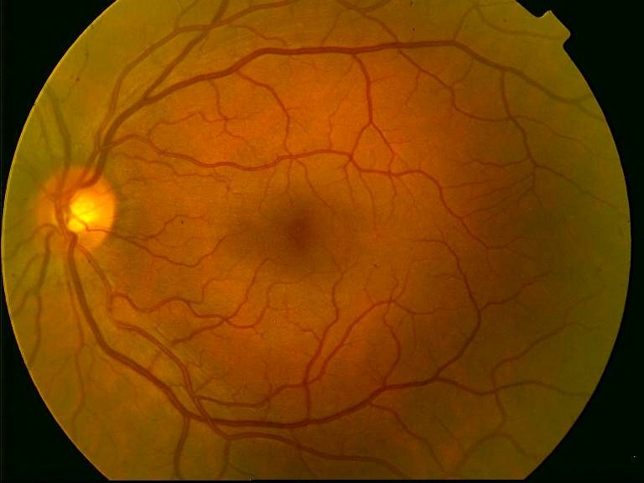
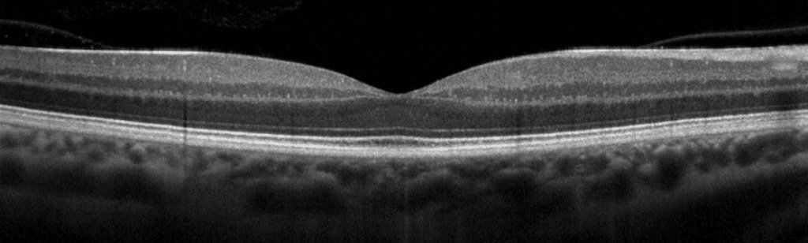
Retina
periphery of the retina
optic disc
2 main layers:
neuroretina (neurosensory epithelium)
retinal pigment epithelium (RPE)
Histologically it consists of 10 layers.
Macula lutea - max. concentration of photoreceptors (cones), area of sharpest and color vision.
Blind spot – place of the optic nerve output, there are no photoreceptors, on the perimeter it corresponds to an absolute scotoma.
The retina is connected to the brain by the visual pathway, and the irritation of photoreceptors (rods and cones) begins the process of vision.
macula lutea
branches of a. centralis retinae
branches of v. centralis retinae
layer of nerve fibers (formed by axons of ganglion cells, converging on the target of the optic nerve and after exiting the eye forms the optic nerve)
Corpus vitreum
neuroretina
ganglion cells
RPE
bipolar cells
choroid
fotoreceptors
RPE
Oční lékařství (aVLOL7X1)
Bruch's membrane

Slide 8

Intraocular space
Anterior chamber (camera anterior oculi) - the space between the posterior surface of the cornea and the anterior surface of the iris.
Posterior ocular chamber (camera posterior oculi) - the space between the posterior surface of the iris and the anterior surface of the lens and ciliary body. Both eye chambers are connected by the pupil and are filled with chamber water.
Lens (lens cristallina) - transparent, biconvex, lenticular structure behind the iris.
The vitreous (corpus vitreum) - a clear, jelly-like mass filling the space between the lens and the posterior pole of the eye and maintaining the tone of the bulb.
Oční lékařství (aVLOL7X1)

Slide 9
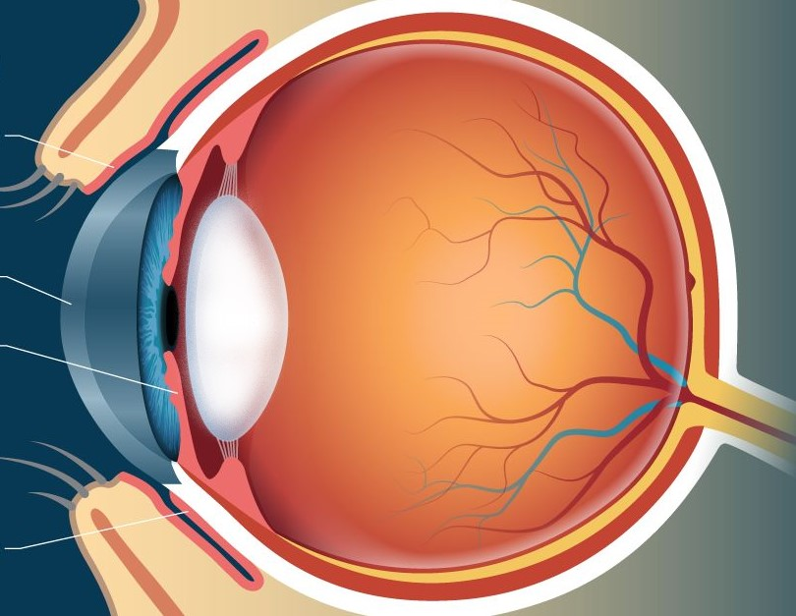
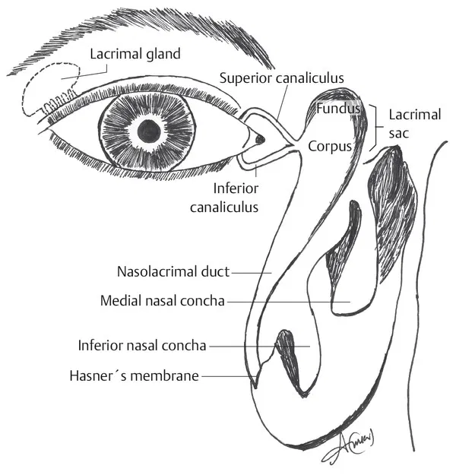
Additional ocular organs
Conjunctiva - a thin, transparent membrane forming a conjunctival sac, which passes from the inside of the lids to the front of the sclera
Eyelids - consisting of skin with subcutaneous tissue, orbicularis oculi muscle (innervated n. VII, lagophthalmus is due to peripheral paresis), cartilaginous disc with tarsus, tarsal conjunctiva
Tear system - formed by the lacrimal gland and lacrimal ducts (lacrimal ducts, lacrimal ducts, lacrimal sac, the tear duct then drains into the nose)
Muscular muscles - 4 straight and 2 oblique, all clamped in the sclera.
tarsal conjunctiva
cornea
iris
bulbar conjunctiva
Oční lékařství (aVLOL7X1)

Slide 10
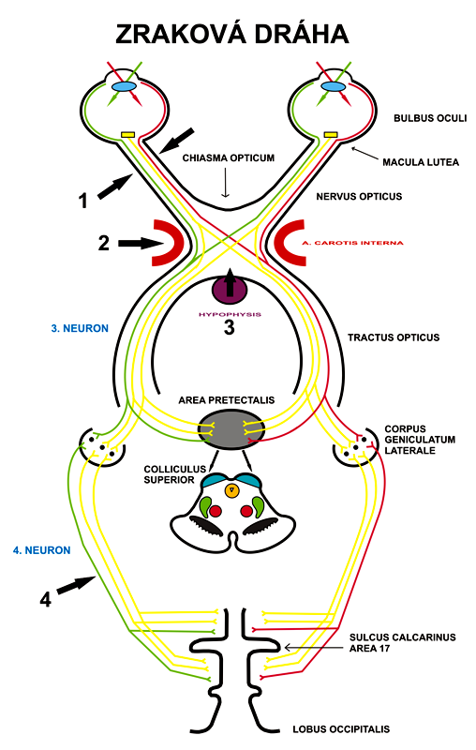
Visual pathway
It is three-neuron pathway:
The 1st neuron is a bipolar cell
The 2nd neuron is a ganglion cell
The 3rd neuron is in the corpus geniculatum laterale
Visual center - visual cortex (Brodmanova area 17, area striata)
Oční lékařství (aVLOL7X1)

Slide 11
Take home message:
Or „What students often don‘ t know“ :
Bruchs membrane
Sensitive innervation of cornae
Pathway of afferent pupilary reaction
Oční lékařství (aVLOL7X1)

