Slide 1
Epidemiologic Methodology
Public Health I

Slide 2
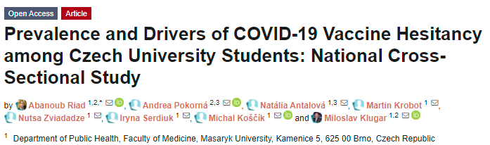

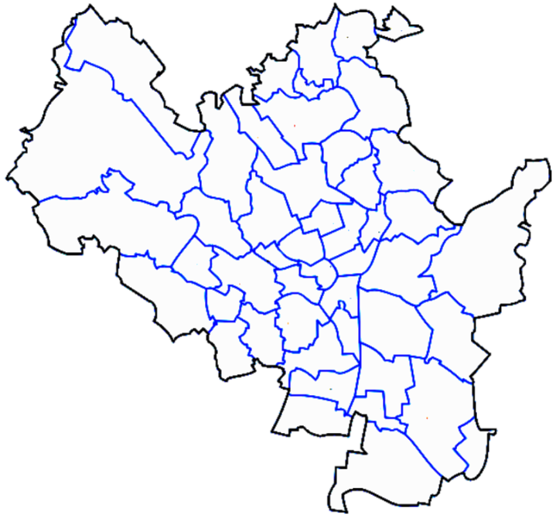
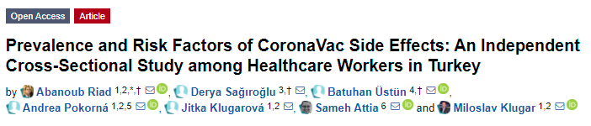

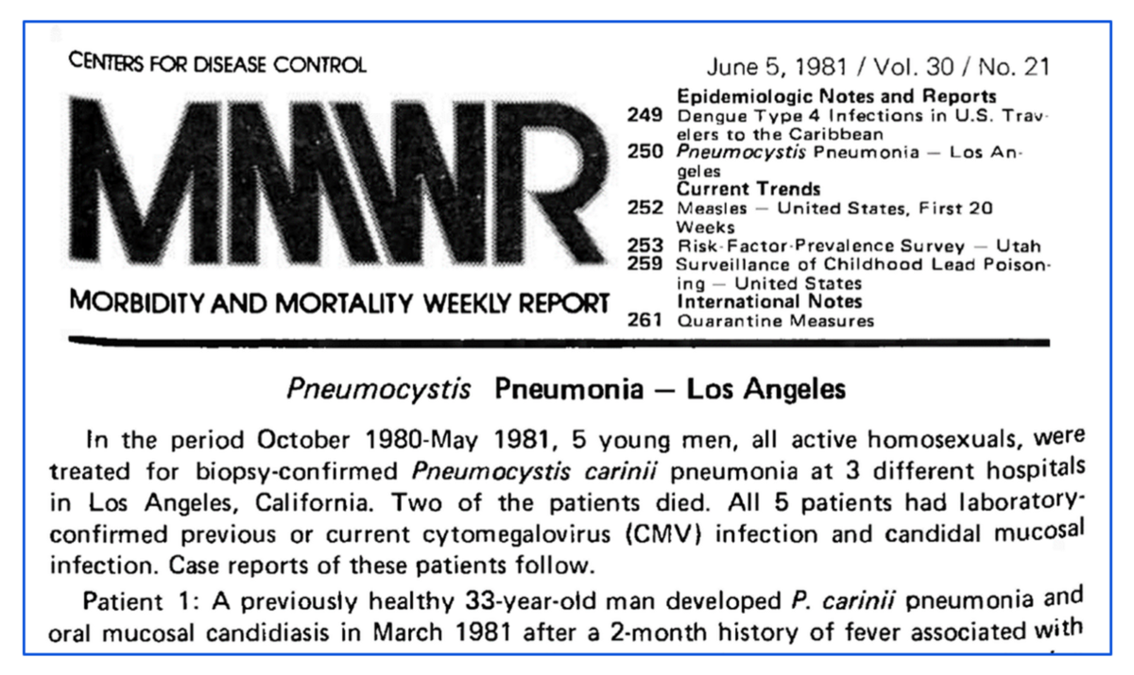


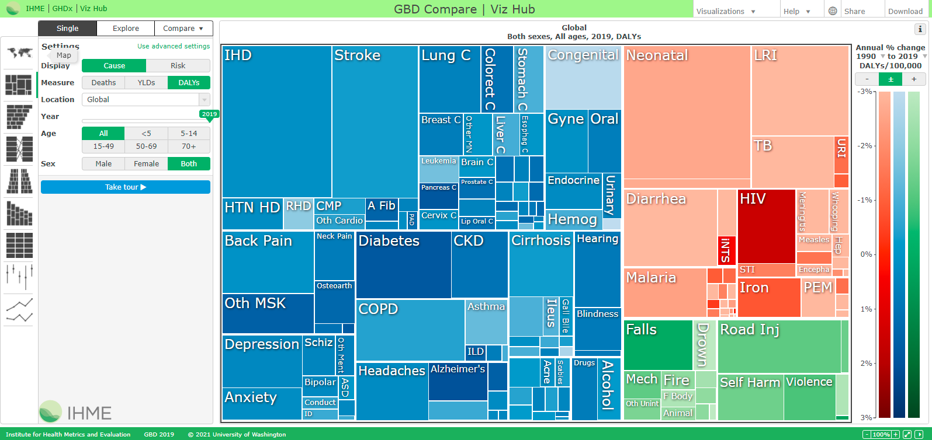
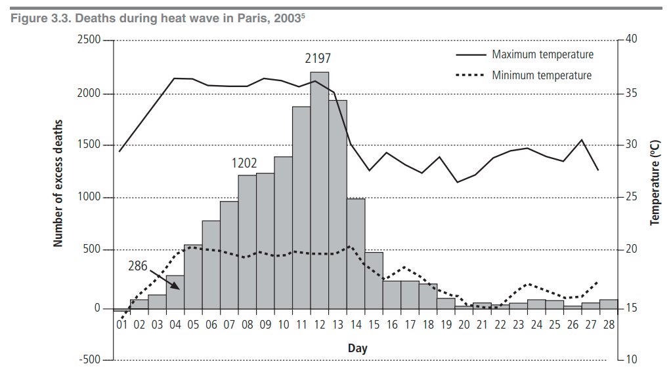
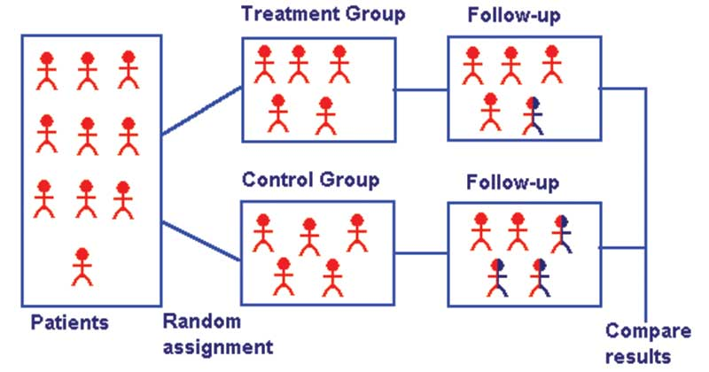
Expert Opinions / Surveillance Studies / Ecological Studies
Exposed
CVD
Non
exposed
Exposed
Healthy
Systematic
Reviews
& Meta-Analyses
Non
exposed
Clinical Trials
Hierarchy of Evidence
CERTAINTY
Lung
Cancer
Cohort Studies
Smoker
Survival
Case-control Studies
Lung
Cancer
Cross-sectional Studies
Non-smoker
Survival
Case Reports / Case Series

Slide 3
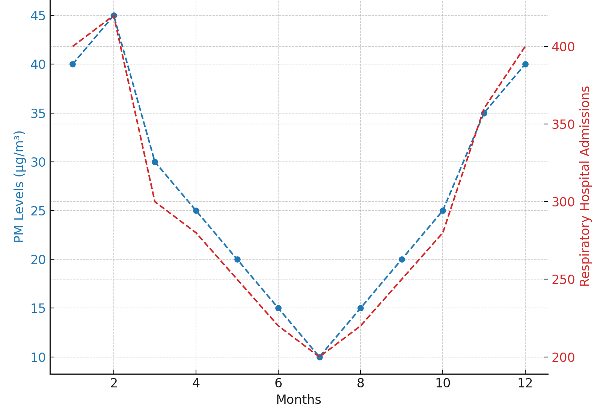
Exercise 1
Study Designs
Background: Air pollution, specifically particulate matter (PM), has long been implicated in respiratory health. Yet, quantifying its direct impact on healthcare systems remains challenging.
Objective: This study aimed to quantify the temporal associations between ambient levels of PM and respiratory hospital admissions in an urban area over multiple years.
Methods: Publicly available air quality data and hospital admissions for respiratory issues were extracted for a five-year period. Seasonal decomposition and time-series analyses were conducted.
Results: Our findings revealed that increases in PM concentrations were associated with a spike in hospital admissions for respiratory conditions, particularly during winter months. An increase of 10 µg/m³ in PM was associated with a 4% increase in respiratory admissions.
Conclusion: The observed associations suggest that PM plays a significant role in respiratory health, thereby having implications for public health policies aimed at reducing air pollution.

Slide 4
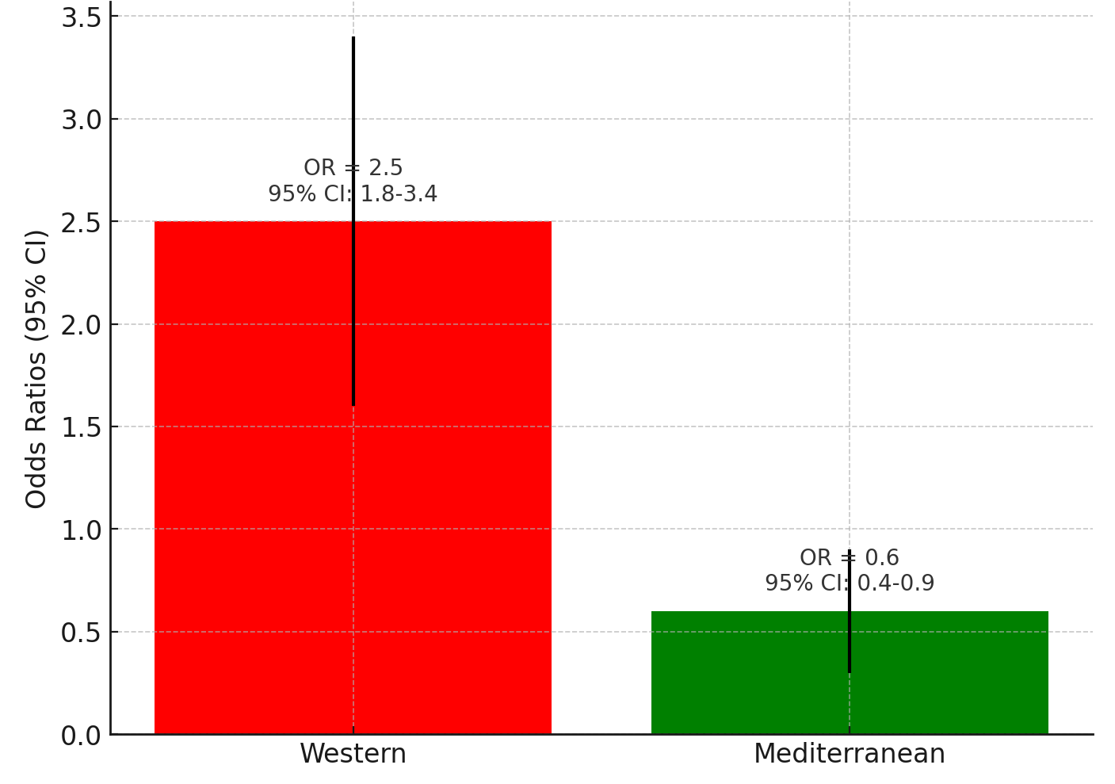
Exercise 2
Study Designs
Background: The incidence of Type 2 diabetes is on the rise globally, and identifying modifiable risk factors is crucial for prevention.
Objective: This study aimed to investigate the association between dietary patterns and the risk of developing Type 2 diabetes among middle-aged adults.
Methods: A total of 500 individuals, comprising 250 cases with Type 2 diabetes and 250 controls without the disease, were recruited. Dietary patterns were assessed using validated food frequency questionnaires. Logistic regression models were used to estimate odds ratios (ORs) and 95% confidence intervals (CIs).
Results: The Western dietary pattern, characterised by high intake of red meat and processed foods, was associated with a significantly higher risk of Type 2 diabetes (OR = 2.5; 95% CI: 1.8–3.4). Conversely, the Mediterranean dietary pattern, marked by high consumption of fruits and vegetables, was linked to a lower risk (OR = 0.6; 95% CI: 0.4–0.9).
Conclusion: The study reveals that dietary patterns significantly influence the risk of Type 2 diabetes. The findings suggest that adopting healthier dietary patterns could serve as a preventive measure.

Slide 5
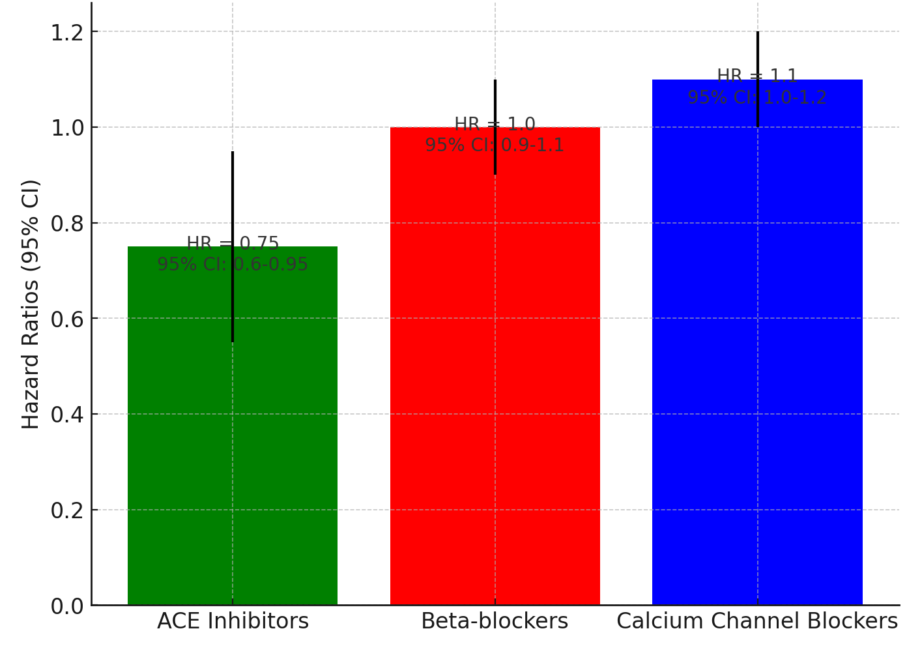
Exercise 3
Study Designs
Background: Hypertension is a major risk factor for cardiovascular diseases (CVD). The effectiveness of different anti-hypertensive medications on long-term cardiovascular outcomes is not well-established.
Objective: The study aimed to retrospectively examine the cardiovascular outcomes among patients who were prescribed anti-hypertensive medications in 2000 and followed until 2010.
Methods: Medical records of 1,500 patients who were prescribed anti-hypertensive medications in 2000 were reviewed. Patients were categorised into three groups based on the class of medication prescribed: ACE inhibitors, Beta-blockers, and Calcium channel blockers. Cardiovascular outcomes were tracked until 2010 using hospital records. Cox proportional hazards models were utilised to estimate hazard ratios (HRs).
Results: Patients on ACE inhibitors exhibited a 25% lower risk of adverse cardiovascular events compared to those on Beta-blockers (HR = 0.75; 95% CI: 0.60–0.95).
Conclusion: The study suggests that the choice of anti-hypertensive medication can influence long-term cardiovascular outcomes. Specifically, ACE inhibitors were associated with a lower risk of adverse events.

Slide 6
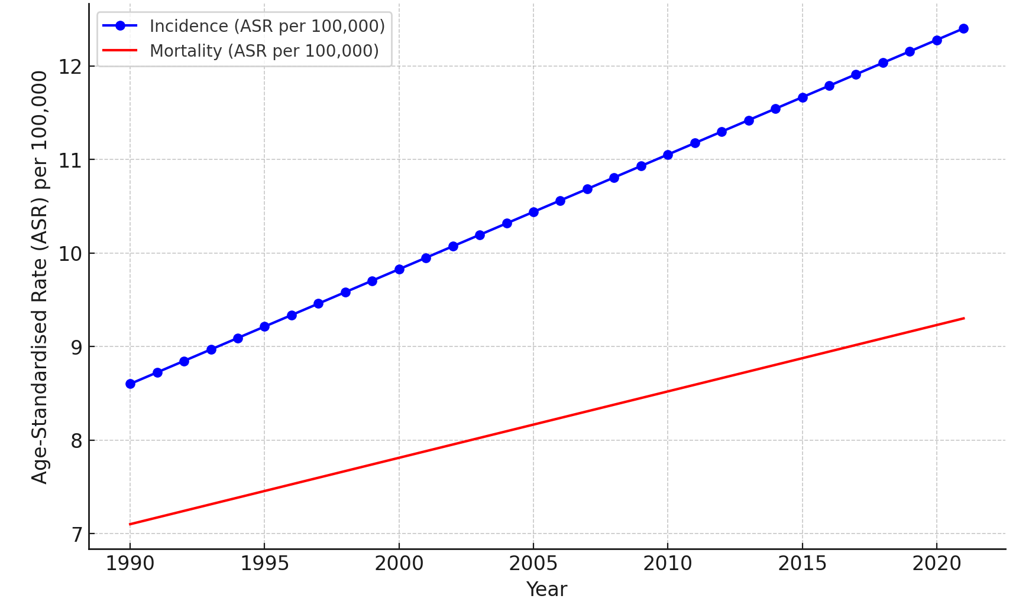
Exercise 4
Study Designs
Background: Liver cancer is among the leading causes of cancer-related deaths globally. Understanding its epidemiological trends is crucial for effective public health planning.
Objective: This Global Burden of Disease (GBD) study aimed to assess the global trends in liver cancer incidence and mortality from 1990 to 2021.
Methods: Data were extracted from multiple international databases, including WHO and national cancer registries. Age-standardised incidence and mortality rates (ASR) were calculated for each year and region. Joinpoint regression analysis was employed to identify significant changes in trends.
Results: Globally, the ASR for liver cancer incidence increased from 8.6 per 100,000 in 1990 to 12.4 per 100,000 in 2021. Mortality rates also increased, but at a slower pace, from 7.1 to 9.3 per 100,000 during the same period. Significant uptrends were observed in several regions, particularly in Sub-Saharan Africa.
Conclusion: This comprehensive GBD study reveals an increasing trend in both liver cancer incidence and mortality rates globally. The findings warrant urgent public health interventions, particularly in regions with accelerating rates.

Slide 7
Cohort Studies
Smoking & CVD
CVD
Exposed
E
N
follow-up
20 years
E
N
Healthy
E
N
E
N
Cohort studies, also called follow-up or incidence studies, begin with a group of people who are free of disease and classified into subgroups according to their exposure to a potential risk factor.
E
N
N
N
E
E
N
N
N
E
E
N
N
E
E
N
N
N
N
N
E
N
E
N
E
N
N
N
E
CVD
N
N
N
E
Non-Exposed
N
N
E
E
N
N
E
N
follow-up
20 years
Healthy Population
Healthy
E = exposed = smoker
N = non-exposed = non-smoker

Slide 8
Incidence
Absolute Risk
100
Number of Incident (New) Cases
Total Number of Cohort Members
1000
CVD
=
Exposed
900
Absolute Risk of CVD among Exposed Cohort (Smokers)
I_{E} = 100 / 1000 = 0.1
Absolute Risk of CVD among Non-exposed Cohort (Non-smokers)
I_{N} = 20 / 1000 = 0.02
E
N
follow-up
20 years
E
N
Healthy
E
N
E
N
E
N
N
N
E
E
N
N
N
E
E
N
N
E
E
N
N
N
20
N
N
E
N
E
N
E
N
N
N
E
CVD
N
N
N
E
Non-Exposed
N
N
E
E
N
N
E
Attributable Risk
N
follow-up
20 years
980
Absolute Risk Reduction
Healthy Population
Risk Difference
Healthy
E = exposed = smoker
N = non-exposed = non-smoker
Risk Difference (RD) of CVD between Smokers and Non-Smokers
I_{E} – I_{N}
= (100/1000) – (20/1000)
= 0.1 – 0.02
= 0.08
1000

Slide 9
Incidence
Absolute Risk
100
Number of Incident (New) Cases
Total Number of Cohort Members
1000
CVD
=
Exposed
900
Absolute Risk of CVD among Exposed Cohort (Smokers)
I_{E} = 100 / 1000 = 0.1
Absolute Risk of CVD among Non-exposed Cohort (Non-smokers)
I_{N} = 20 / 1000 = 0.02
E
N
follow-up
20 years
E
N
Healthy
E
N
E
N
E
N
N
N
E
E
N
N
N
E
E
N
N
E
E
N
N
N
20
N
N
E
N
E
N
E
N
N
N
E
CVD
N
N
N
E
Non-Exposed
N
N
E
E
N
N
E
N
follow-up
20 years
980
Relative Risk
Healthy Population
Risk Ratio
Healthy
E = exposed = smoker
N = non-exposed = non-smoker
Risk Ratio (RR) of CVD between Smokers and Non-Smokers
I_{E} / I_{N}
= (100/1000) / (20/1000)
= 0.1 / 0.02
= 5
1000

Slide 10
?
Prevalence of Exposure (Risk Factor)
in the Population
P = 20%
CVD
Smoking
&
CVD
Exposed
E
N
follow-up
20 years
E
N
Healthy
E
N
E
N
E
N
N
N
E
E
N
N
N
E
E
N
N
E
E
N
N
N
N
N
E
N
E
N
E
N
N
N
E
CVD
N
N
N
E
Non-Exposed
N
N
E
E
N
N
E
N
follow-up
20 years
Healthy Population
Healthy
I = 180 cases / 100,000 person-years
E = exposed = smoker
N = non-exposed = non-smoker
Incidence of the Outcome of Interest
in the Population

Slide 11
Risk Difference (RD) of CVD between Smokers and Non-Smokers
I_{E} – I_{N}
= (500/100,000) – (100/100,000)
= 0.004
= 400 cases / 100,000 person-years
CVD
Exposed
Population-attributable Risk
E
N
follow-up
20 years
E
N
Healthy
E
N
E
N
Population-attributable Risk (ARP) of CVD attributed to Smoking (Exposure) among the General Population
RD x P
= Risk Difference x Exposure Prevalence
= 0.004 x 0.2
= 0.0008
= 80 cases / 100,000 person-years
E
N
N
N
E
E
N
N
N
E
E
N
N
E
E
N
N
N
N
N
E
N
E
N
E
N
N
N
E
CVD
N
N
N
E
Non-Exposed
N
N
E
E
N
N
E
N
follow-up
20 years
Healthy Population
Population-attributable Fraction
Healthy
E = exposed = smoker
N = non-exposed = non-smoker
Population-attributable Fraction (AFP)
ARP / I
= ARP / Total Outcome Incidence
= 0.0008 / (180/100,000)
= 0.44 = 44%

Slide 12
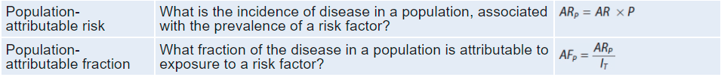
Measures of Effect
Cohort Studies

Slide 13

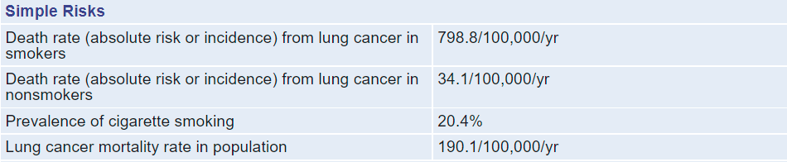
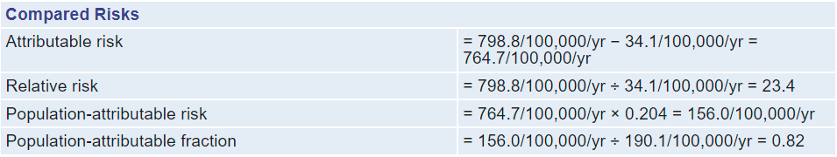
Measures of Effect
Cohort Studies
50-Year Trends in Smoking-Related Mortality in the United States

Slide 14
Exercise 5
Measures of Effect
 | Outcome Status |  | Total
 | Yes | No
Exposed
Non-Exposed
Total
In 2015, a team of epidemiologists from the Jagiellonian University Medical College in Kraków initiated a prospective cohort study in Kraków, Poland. Their research focus was to examine the risk of developing cardiovascular disease (CVD) among smokers as compared to non-smokers. The researchers chose a sample of 800 participants for the study; smokers (n = 240) and non-smokers (n = 560).
Both cohorts were followed up for five years. During this time, participants underwent annual health assessments, including cardiovascular evaluations and blood tests. Incidences of CVD reported by the participants were subsequently verified using medical records. By the end of follow-up, 80 cases of CVD were recorded, 60 of them were smokers. Calculate risk difference (RD) and relative risk (RR) of CVD among smokers vs non-smokers.

Slide 15
Exercise 5
Measures of Effect
 | Outcome Status |  | Total
 | Yes | No
Exposed
Non-Exposed
Total
Absolute Risk of CVD among Smokers =
Absolute Risk of CVD among Non-smokers =
Risk Difference =
Risk Ratio =

Slide 16
Exercise 6
Measures of Effect
 | Outcome Status |  | Total
 | Yes | No
Exposed
Non-Exposed
Total
In 1948, the Framingham Heart Study was initiated in Framingham, Massachusetts, to investigate the factors associated with cardiovascular disease (CVD). Researchers from the National Heart Institute (now the National Heart, Lung, and Blood Institute) selected a sample of 5,209 adult participants aged between 30 and 62. For the purpose of this exercise, let's focus on a sub-sample to study the risk of developing CVD among smokers compared to non-smokers. Researchers identified 1,000 participants for this part of the study: smokers (n = 400) and non-smokers (n = 600).
Both cohorts were followed up for 20 years. During this time, participants underwent biennial health assessments, which included cardiovascular evaluations and blood tests. Incidences of CVD reported by the participants were verified through medical records. By the end of the follow-up period, 120 cases of CVD were recorded; 80 of them were among smokers.
Calculate the risk difference (RD) and relative risk (RR) of developing CVD among smokers versus non-smokers based on this data.

Slide 17
Exercise 6
Measures of Effect
 | Outcome Status |  | Total
 | Yes | No
Exposed
Non-Exposed
Total
Absolute Risk of CVD among Smokers =
Absolute Risk of CVD among Non-Smokers =
Risk Difference =
Risk Ratio =

Slide 18
Exercise 7
Measures of Effect
 | Outcome Status |  | Total
 | Yes | No
Exposed
Non-Exposed
Total
The Nurses' Health Study, initiated in 1976, aimed to investigate the long-term consequences of oral contraceptives among registered nurses in the United States. In this exercise, we will focus on a sub-study examining the risk of breast cancer in relation to hormone replacement therapy (HRT) use. Researchers selected 2,000 post-menopausal nurses for this sub-study: those using HRT (n = 1,000) and those not using HRT (n = 1,000). The study followed both cohorts for 10 years. Participants completed questionnaires every two years regarding lifestyle, health behaviours, and medical histories. The incidences of breast cancer reported were then verified using medical records. By the end of the 10-year period, 100 cases of breast cancer were recorded: 70 among those using HRT and 30 among those not using HRT. Let's assume that the prevalence of HRT use among post-menopausal nurses in the general population is 20% and that the incidence of breast cancer in this population over a similar time frame is 5%. Calculate the following based on this data: Risk Difference (RD), Relative Risk (RR), Population Attributable Risk (PAR), and Population Attributable Fraction (PAF).

Slide 19
Exercise 7
Measures of Effect
 | Outcome Status |  | Total
 | Yes | No
Exposed
Non-Exposed
Total
Absolute Risk of BC among HRT users =
Absolute Risk of BC among Non-HRT users =
Risk Difference =
Population Attributable Risk =
Population Attributable Fraction =

Slide 20
Exercise 8
Measures of Effect
 | Number of persons at the beginning | Number of D.U. Cases
Non-smokers | 22,295 | 60
Past smokers | 20,757 | 60
Current smokers | 4,754 | 16
The Health Professionals Follow-up Study (HPFS) was designed as a prospective cohort study of heart disease and cancer among health professionals in the United States who were 40–75 years of age in 1986. Every two years, questionnaires were sent to the study participants, and newly diagnosed cases of various diseases were reported. The following data are constructed from the surveys returned in the 1992 mailing.
The investigators in this study were interested in the relationship between smoking status and duodenal ulcers (D.U.), a common disorder of the gastrointestinal tract.
Assuming that all the study participants remained alive and responded to all the questionnaires from 1986 until 1992, what was the risk difference of D.U. between current smokers and past smokers?

Slide 21
Exercise 8
Measures of Effect
 | Number of persons at the beginning | Number of D.U. Cases
Non-smokers | 22,295 | 60
Past smokers | 20,757 | 60
Current smokers | 4,754 | 16
Absolute Risk of DU among Current Smokers =
Absolute Risk of DU among Past Smokers =
Risk Difference =

Slide 22
Case-control Studies
Exposed
CVD
Non-exposed
Case-control studies provide a relatively simple way to investigate causes of diseases, especially rare diseases.
The investigators collect data on disease occurrence at one point in time and exposures at a previous point in time.
Exposed
Healthy
Non-exposed

Slide 23
A
200
A+C
Exposed
500
CVD
 | Cases (CVD) | Non-cases (Healthy) | Total
Exposed | A | B | A+B
Non-exposed | C | D | C+D
Total | A+C | B+D | A+B+C+D
C
300
Non-exposed
B
B+D
50
Estimated Relative Risk
Exposed
500
Odds Ratio
Healthy
Odds Ratio (OR) of CVD between Smokers and Non-Smokers
= (A*D) / (B*C)
= (200*450) / (50*300)
= 6
RR = (A / (A+B)) / (C / (C+D)) = (200/250) / (300/750) = 2
D
450
Non-exposed

Slide 24
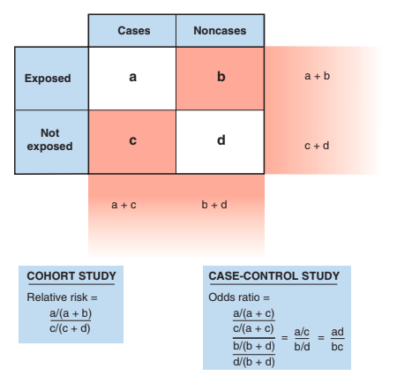
Measures of Effect
Case-Control
As the exposure is not tracked (followed-up), it is not feasible to estimate the incidence (absolute risk) in case-control studies. Therefore, relative risk, attributable risk, population attributable risk, and population attributable fraction can not be calculated.
In case-control studies, we can only calculate the odds ratio (OR) which is sometimes called estimated relative risk.

Slide 25
Exercise 9
Measures of Effect
 | Outcome Status |  | Total
 | Yes | No
Exposed
Non-Exposed
Total
In a case-control study of breast cancer, 100 women had been recruited in each study arm. Upon investigating their previous exposures, 75 of the cases were found to be using calcium supplements while only 25 of the controls were using them. Calculate odds ratio (OR) of breast cancer among exposed vs. non-exposed subjects.

Slide 26
Exercise 10
Measures of Effect
 | Outcome Status |  | Total
 | Yes | No
Exposed
Non-Exposed
Total
In 2002, researchers from the University of Toronto carried out a case-control study within the Canadian National Breast Screening Study to investigate the association between Hormone Replacement Therapy (HRT) and breast cancer.
For this substudy, 400 women were selected—200 cases who had recently been diagnosed with breast cancer and 200 controls without breast cancer. Upon reviewing medical histories, it was found that 80 of the cases had been using HRT, while only 40 of the controls had been using HRT. Calculate the Risk Difference (RD) and Odds Ratio (OR) of breast cancer among HRT and non-HRT users.

Slide 27
Exercise 10
Measures of Effect
 | Outcome Status |  | Total
 | Yes | No
Exposed
Non-Exposed
Total
Absolute Risk of BC among HRT users =
Absolute Risk of BC among Non-HRT users =
Risk Difference =
Odds Ratio =

Slide 28
Randomised Controlled Trials
RCTs
Absolute Risk Reduction (ARR) =
Risk Difference (RD) =
Incidence in Control Group – Incidence in Treatment Group
Number Needed to Treat (NNT) = 1 / ARR

Slide 29
Exercise 11
Measures of Effect
 | Outcome Status |  | Total
 | Yes | No
Treatment
Control
Total
In 1983, researchers from the University of Minnesota launched the Diabetes Control and Complications Trial (DCCT). The study aimed to determine whether tight glucose control could reduce the risk of diabetic complications compared to standard glucose control. The trial recruited 1,441 type 1 diabetes patients, randomizing them into two arms: 721 in the tight control group and 720 in the standard control group. Patients were followed for a median duration of 6.5 years. Both groups were closely monitored for the development of nephropathy (kidney disease), a common complication of diabetes. By the end of the trial, nephropathy was observed in 50 patients from the tight control group and 100 patients from the standard control group. Calculate the Absolute Risk Reduction (ARR), Relative Risk (RR), and Number Needed to Treat (NNT).

Slide 30
Exercise 11
Measures of Effect
 | Outcome Status |  | Total
 | Yes | No
Treatment
Control
Total
Absolute Risk in Control Group =
Absolute Risk in Treatment Group =
Absolute Risk Reduction =
Risk Ratio =
Number Needed To Treat =

Slide 31




THANK YOU
abanoub.riad@med.muni.cz
Abanoub Riad (abanoub.riad@med.muni.cz)
Pavilion: A21 / Third Floor / Office: 315

