Slide 1
Acid-base chemistry and its disturbances
MUDr. Stanislav Matoušek, PhD

Slide 2
System of the presentation
Difficult subject?
Gradual steps good understanding, building on what I already know
Active learning:
  Slide with questions to solve – give it time, try to find solutions by yourself
  Minimum time is below
  Answers – mostly next slide
Why active learning?
  Greater joy and interest (in the end)
  Deeper knowledge
  Remembering longer
  ➔The extra effort pays off
Notes:
Acidobazická rovnováha má pro mnohé pověst obtížné oblasti fyziologie a patofyziologie. Žádný „strašák“ to ale být nemusí, naopak to může být krásná oblast medicíny.
K dobrému učení a pochopení této oblasti použijeme několik fines. Jednak – v této oblasti více než v jakékoliv jiné je důležité postupovat postupně, krok za krokem – pokud něco dobře pochopím, tak na tom mohu stavět.
Pro dobré pochopení daného kroku je nesmírně důležité aktivní učení, které Vám v této prezentaci nabídnu. Bude to vypadat následovně: Na jednom slidu Vám budu prezentovat daný problém formou otázek, na které hledejte sami odpovědi, zamyslete se nad nimi. Věnujte tomu prosím milimálně čas, který je v dolní části slidu! Poté překlikněte na další slide, kde si správnou odpověď můžete zkontrolovat ☺. Pokud jste si správnými odpověďmi jistí, můžete následující slide přeskočit. V takovém případě také můžete zkrátit čas.
Pokud se opravdu tímto způsobem zapojíte do učení, budete mít nejen mnohem větší radost z výsledku, ale také budete jednotlivým částem ABR rozumět mnohem více do hloubky a budete si je déle pamatovat. Tak tedy, pojďme na to.

Slide 3

Acid-base Chemistry and Physiology
Refresher
(hopefully)

Slide 4
Hydrogen ions
Is the concentration of hydrogen ions in extracellular fluid (ICF) small, large, huge or minuscule?
Why is maintaining H⁺ concentration within narrow limits much more important than maintaining strict concentrations of let’s say iodine or zink¹?
Is it more accurate to speak of H₃O⁺ or H⁺? Why?
What is a hydrogen bond (H bond)?
Is there more H₃O⁺ or OH⁻ in plasma under physiological conditions?
Minimum time: 2 min

Slide 5
Hydrogen ions
Concentration of H⁺ = [H⁺] ~ 1 000 000x << [Na⁺] – minuscule
Maintaining pH within tight limits is important because of very large reactivity of H⁺ and its effect on the conformation of many macromolecules, especially proteins.
Hydrogen bond – special type of weak chemical bond created by H⁺; it binds H₂0 molecules together →liquefaction of water
pH_{plasma,Norm} ≈ 7,4 > 7,0 → alkaline pH → [OH⁻] > [H3O⁺]
Notes:
Vodíkový můstek je speciální slabá chemická vazba, která způsobuje vazbu vodíků v molekule H₂0 na vedlejší molekuly. Díky vodíkovým můstkům je voda za běžkého tlaku a teploty kapalinou a nikoliv plynem.

Slide 6
Dynamics of H₃O⁺ and OH⁻ movement in water
+
+

Slide 7
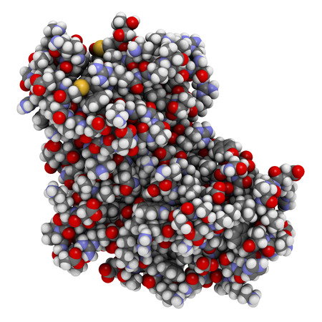
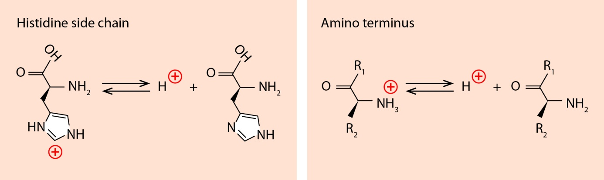
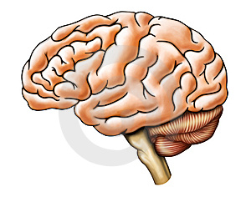
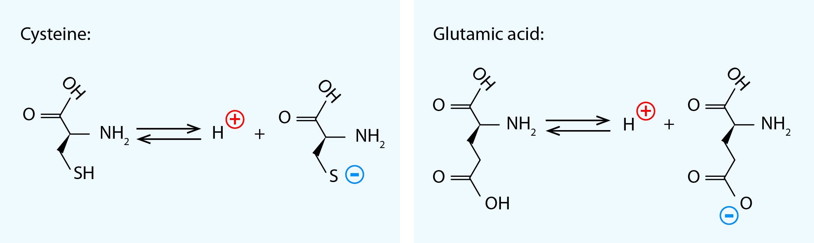
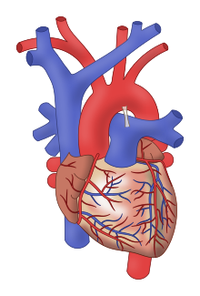
Amino-acid charge and protein conformation
Crucial organs:
pK_{A} = 6,05 pK_{A} = 9,2
Conformation change
pK_{A} = 8,2 pK_{A} =4,25
Dysfunction

Slide 8
pH definition and its consequences
Would you remember how pH is defined?
And what are rules of calculating with logarithms? E.g. log(A x B) =
Try to figure out what these rules imply for the pH behavior: For instance, when H⁺ concentration (denoted as [H⁺]) increases two times, how does pH change?¹
How does pH change, when the H⁺ concentration decreases 10x?
For straight-A students: How does pH change, when [OH⁻] increases 2x?
Minimum time: 3 minutes or until completion of all tasks.
1) You might find it helpful to know that log₁₀(2) = 0.3

Slide 9
pH definition and its consequences - solution
pH = - log₁₀([H⁺])
log(AB)= log(A) + log(B)
H⁺ concentration increasing twice: [H⁺]_{New} = 2[H⁺]_{Old}
From the pH definition and the logarithm calculation rules:
pH_{New} = - log([H⁺]_{New} ) = - log(2 x [H⁺]_{Old} ) = - log(2) + (- log ([H⁺]_{Old}) =
= -0,3 +pH_{Old}
➔Therefore: If H⁺ concentration doubles: pH_{New} = pH_{Old} – 0,3
When [H⁺]_{New} = 1/10 x [H⁺]_{Old} : pH_{New} = - log(1/10) + (- log ([H⁺]_{Old})=
= +1 +pH_{Old} . If [H⁺] decreases ten times, pH goes up by 1.

Slide 10
Buffers
What are buffers and what their effects in a solution are?
How do buffers influence pH change, when acid or base is added?
What does pK_{a} of a simple buffer denote?
For straight-A students: Can you write down the mass action equation of a simple buffer?
Which pH does render a single substance buffer most effective?
Minimum time: 3 minutes

Slide 11
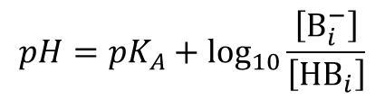
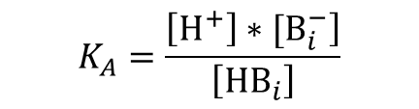
Buffers – Solution 1
Buffers inhibit the pH change by binding the extra H⁺ when their concentration increases (when pH falls) and releasing H⁺ when [H⁺] decreases (pH goes up).
They are crucial for stabilizing pH within certain range!
Hydrogen ion and buffer react according to the formula:
HB H⁺ + B⁻ or:
HB⁺ H⁺ + B
Reaction equilibrium concentra-tions can be expressed by the well-known mass action formula:
This can be expressed in the logarithmic form as well:
[HB] and [B⁻] are in 1:1 ratio, when pH = pK_{A}
(prove this using the previous relationship)
$$K_{A}=\frac{\left.\left[H^{+}\right]∗[B_{i}^{−}\right]}{\left[{HB}_{i}\right]}$$
$$pH={pK}_{A}+\log_{10}{\frac{\left[B_{i}^{−}\right]}{\left[{HB}_{i}\right]}}$$

Slide 12

Buffers – Solution 2
Titration Curve expressed as [B⁻] vs. pH
pK_{A}
[B⁻] at a given pH
Single-substance buffer is most effective when the pH coincides with its pK_{A} .
Efficiency of a buffer at a given pH can be measured by its buffer capacity β.
When pH and pK_{A} fall far, the efficiency of the buffer is constrained by the buffer component that is low in concentration.
For instance, at acidic pH, there is ↓[B⁻],
At alkalic pH, there is ↓[HB]
For straight-A students: How does the [B⁻]/[HB] ratio change when acid is added at pH far from its pK_{A}? Does it change a lot or a bit?
[HB]
[B⁻]
$$β≝\frac{dC_{B}}{dpH}$$
Buffer capacity β : (decreases with distance from pK_{A})

Slide 13
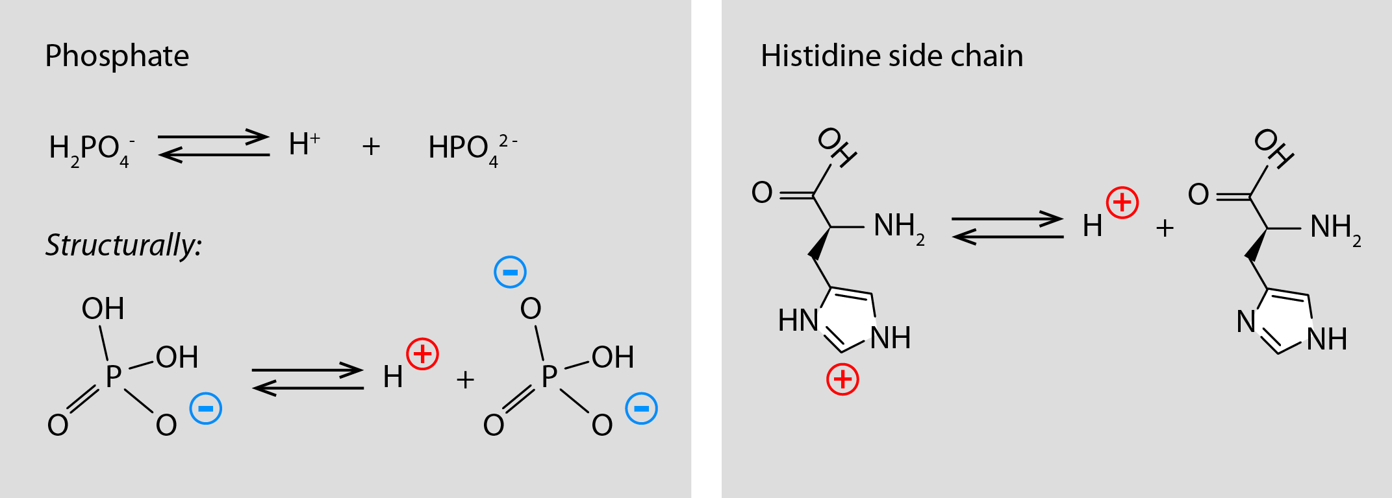
Protein Buffers
Key buffer residues are histidine side chains.
pK_{A}’s of individual histidine side chains differ significantly (influence of surrounding aminoacids)
Principal buffers in blood are:
  Hemoglobin!
  Albumin, and other proteins of blood plasma
Consequence: Virtually linear protein titration curve.
Buffer capacity is almost constant over a wide range of pH.
Tab: pK_{A}’s of 16 histidine side chains in the albumin molecule (ordered)
pK₉ | pK₁₅ | pK₁₀ | pK₁₃ | pK₁₁ | pK₈ | pK₁₂ | pK₇ | pK₅ | pK₃ | pK₁ | pK₂ | pK₁₄ | pK₁₆ | pK₆ | pK₄
4.85 | 5.2 | 5.75 | 5.82 | 6.17 | 6.35 | 6.73 | 6.75 | 7.01 | 7.10 | 7.12 | 7.22 | 7.3 | 7.3 | 7.31 | 7.49

Slide 14
Protein Buffers
Titration curve of a simple buffer

Slide 15
Phosphate Buffer
Principal intracellular buffer
Incl. phosphate residues of DNA
The 2nd dissociation step is important, having pK_{A} = 7.2

Slide 16
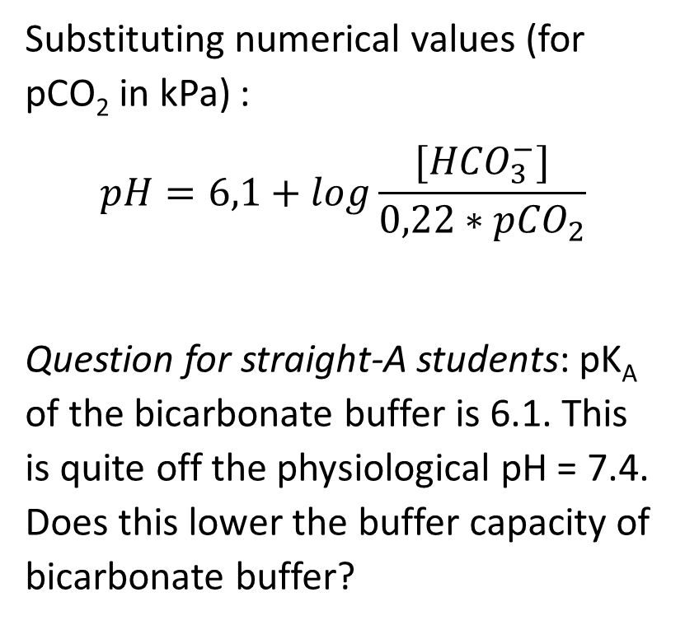
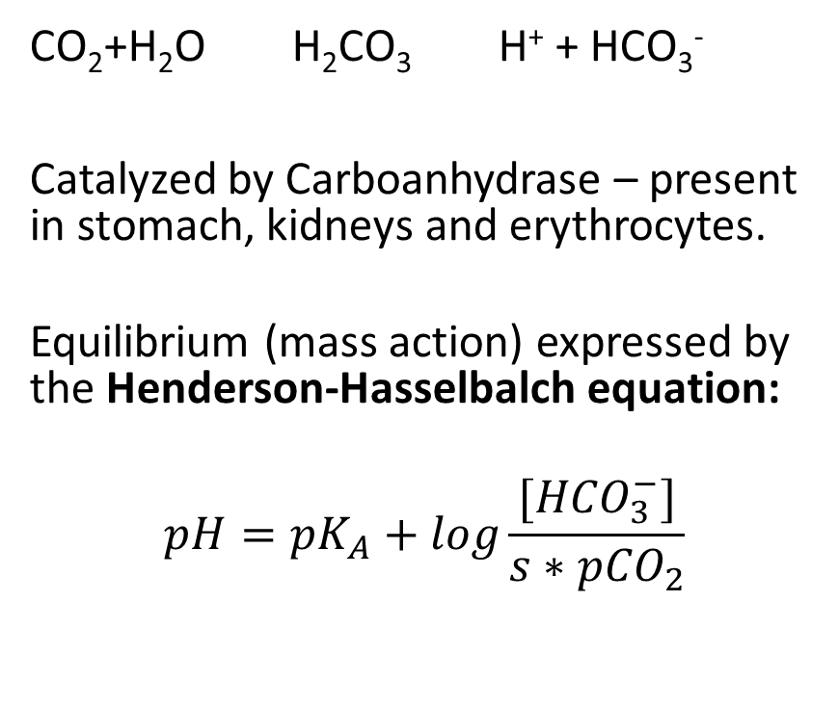
Bicarbonate Buffer
Substituting numerical values (for pCO₂ in kPa) :
$$pH=6,1+log\frac{[{HCO}_{3}^{−}]}{0,22∗{pCO}_{2}}$$
Question for straight-A students: pK_{A} of the bicarbonate buffer is 6.1. This is quite off the physiological pH = 7.4. Does this lower the buffer capacity of bicarbonate buffer?
CO₂+H₂O H₂CO₃ H⁺ + HCO₃⁻
Catalyzed by Carboanhydrase – present in stomach, kidneys and erythrocytes.
Equilibrium (mass action) expressed by the Henderson-Hasselbalch equation:
$$pH={pK}_{A}+log\frac{[{HCO}_{3}^{−}]}{s∗{pCO}_{2}}$$

Slide 17
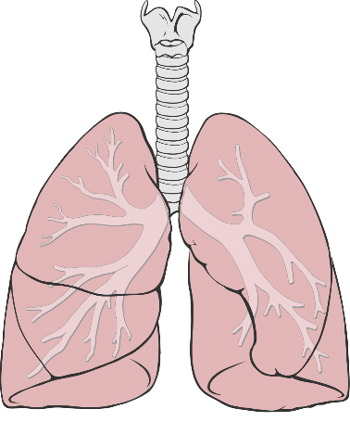
Bicarbonate Buffer
Possible depiction of reaction equilibria (as described by Henderson-Hasselbalch equation):
CO₂+H₂O H₂CO₃ H⁺ + HCO₃⁻
HCO₃⁻
CO₂
CO₂ H₂CO₃
HCO₃⁻
H⁺
H⁺
pH= 7,4
pH= 7,4
Magnifying glass:
Concentrations
in order of 10 nmol/L

Slide 18
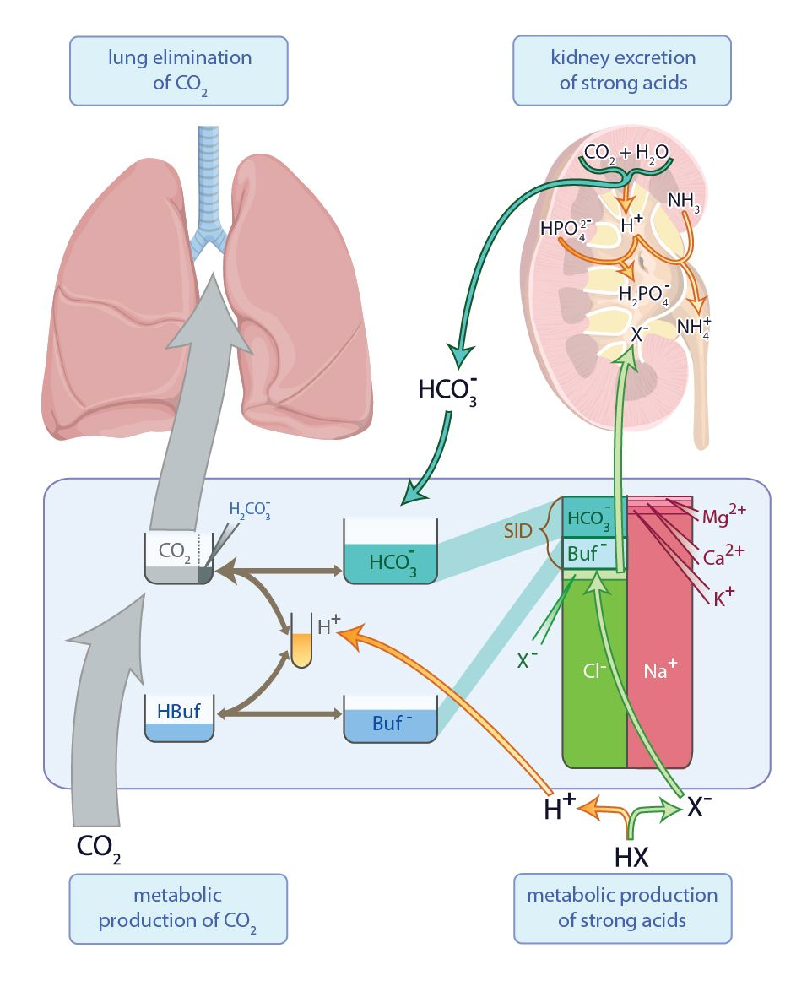
Metabolism and the
System of Regulating
Acid-base Status
The biggest turnover is in the system of CO₂
  Thus pCO₂ can be easily regulated. CO₂ behaves as an open system
Other flows and the relationship with concentrations of other ions (electro-neutrality) are depicted in the figure:

Slide 19
Bicarbonate Buffer
It is the principal buffer in terms of longer-term regulation of H⁺ balance in the body.
Lungs – regulate pCO₂
Kidneys – regulate the level of HCO₃⁻ in blood plasma and excretion of H⁺
 | Primary Disturbance | When H+ = 40 nmol/L | Compensation
Respiratory Acidosis | ↑pCO₂ | Reacts to the right -↑H⁺ | Kidneys - ↑HCO₃⁻, ↑BE
Metabolic Acidosis | ↓HCO₃⁻ (or ↑↑↑H⁺ ) | Reacts to the right when primary cause ↓HCO₃⁻ (Reacts to the left when primary cause ↑↑↑H⁺ ) –end result - ↑H⁺ | Lungs - ↓pCO₂
Respiratory Alkalosis | ↓pCO₂ | Reacts to the left - ↓H⁺ | Kidneys - ↓HCO₃⁻, ↓BE
Metabolic Alkalosis | ↑HCO₃⁻ | Reacts to the left -↓H⁺ | Lungs - ↑pCO₂

Slide 20
Base Excess - BE
Base Excess – a very precise measure of metabolic disturbances (and metabolic compensations)
Underlying logic: Lungs regulate pCO₂ . This regulation does not influence the total concentration of base forms of buffers.
By definition: When pH = 7,4 (norm) and pCO₂ = 5,3 kPa (norm), then BE = 0 mmol/L
Now, when we add 10mmol/L of acids, part of this amount reacts away with bicarbonate and part with the B- form of nonbicarbonate buffers – BE decreases to -10 mmol/L
Conversely, taking away 15 mmol/L of acids (H⁺) when BE =0 increases both the level of bicarbonate and the B- of non-bicarbonate buffers – BE increases to +15 mmol/L
The value of BE is independent of subsequent changes in pCO₂

Slide 21
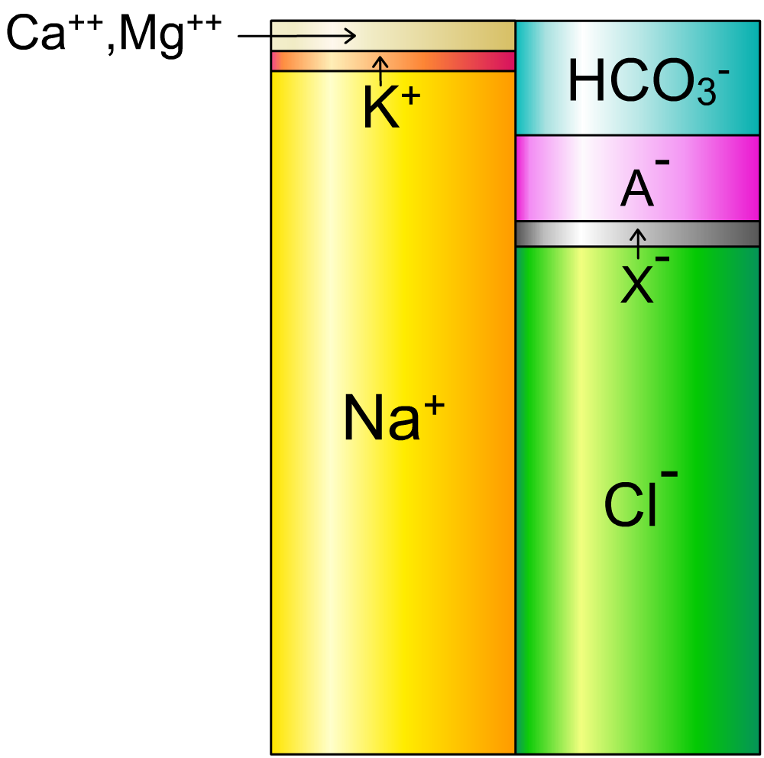
System of Buffers and Electroneutrality
Bicarbonate
Buffers
Albumin
Electroneutrality:
When buffer concentration changes – the concentration of strong ions has to change as well
AG
„Strong“ ions
- Inert in terms of acid-base
X⁻ - (ordinarily) unmeasured ions –e.g. lactate, keto⁻, SO₄²⁻
AG = Anion gap = Na⁺ + K⁺ - Cl⁻ - HCO₃⁻
Parameter used in differential diagnosis of metabolic acidoses

Slide 22


System of Buffers and Electroneutrality 2 – Example
Runner in High Tatras:
Production of lactic acid in muscles
Ca⁺⁺,Mg⁺⁺
HAlb ← Alb⁻ +
CO₂ ← HCO₃⁻+
H⁺
HCO₃⁻
HLac
K⁺
Part of X⁻
Lac⁻
Alb⁻
X⁻
Na⁺
Cl⁻

Slide 23
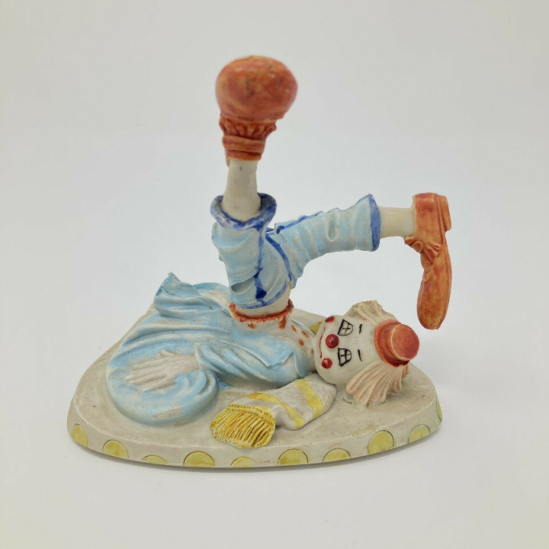
Acid-base Balance Disturbances
= Pathophysiology of ABB
Notes:
Obr, klauna, který spadl z houpačky

Slide 24
Respiratory Disturbances and their Compensation

Slide 25
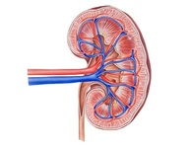
Respiratory Alkalosis and its Compensation
Cause:
Hyperventilation
Kidney (metabolic) compensation:
Takes 2- 3 days to develop
Kidneys excrete less H⁺ and more bicarb.
= less bicarbonate returns to blood
CO₂ H₂CO₃
HCO₃⁻
5,3 kPa
2,7 kPa
H⁺
pH = 7,4
40 nmol/l
pH= 7,4
Thanks to the compensation the [H⁺] and pH return closer to norm
Alkalosis:
pH = 7,7
20 nmol/l

Slide 26
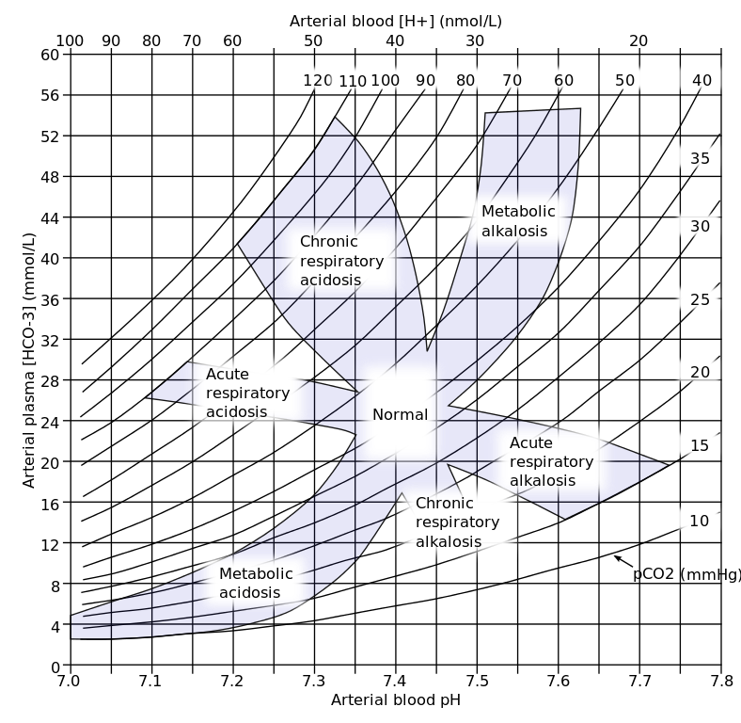
Compensation Diagrams
CO₂ H₂CO₃
HCO₃⁻
H⁺

Slide 27
Compensation Diagrams 2
PCO₂ torr
90
pH=7,1
pH=7,2
pH=7,3
pH=7,37
pH=7,43
80
pH=7,5
Compensated resp. acidosis
70
Acute resp. acidosis
pH=7,6
60
Compensated met. Alcalosis
50
Acute metabolic acidosis
Acute metabolic alkalosis
40
30
Compensated metabolic acidosis
Acute
respiratory alkalosis
Compensated res. alkalosis
20
10
-25
-20
-15
-10
-5
0
5
10
15
20
25
30
Base Excess mmol/l

Slide 28
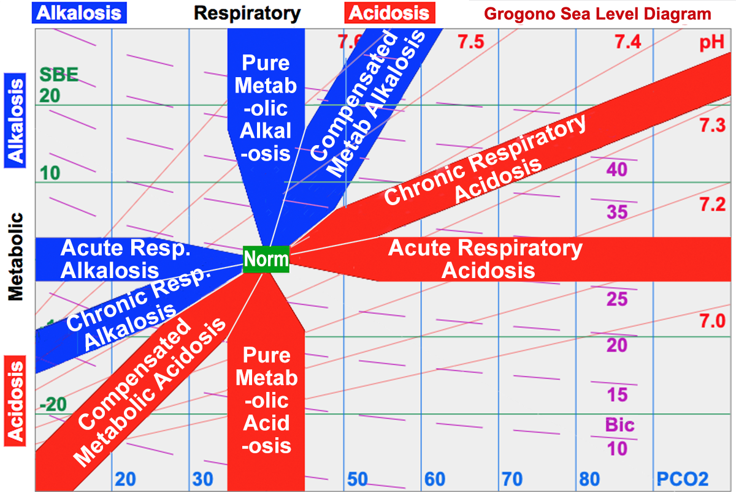
Compensation Diagram pCO₂ vs BE – Different

Slide 29
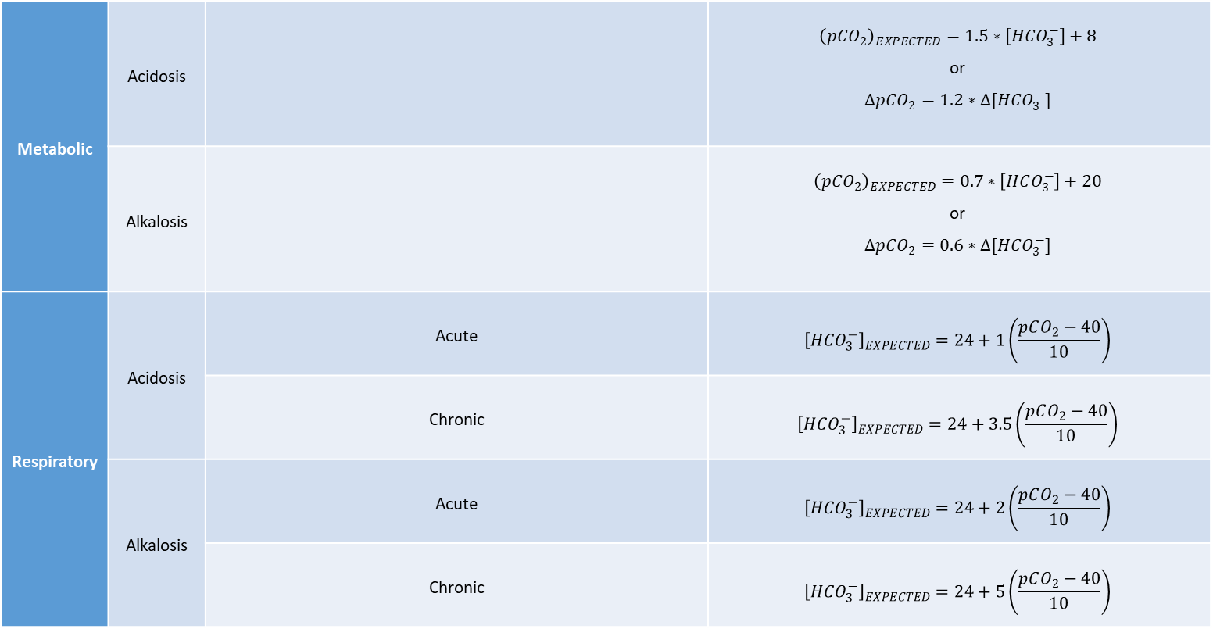
“Boston” Rules for Diagnosing ABB Disturbances
For straight-A students - optional: This is for pCO₂ expressed in mmHg – convert to a version in kPa (pCO₂ 40 mmHg = 5,3 kPa)
Alternative to the compensation diagrams - however, you have to remember them ☹
Metabolic | Acidosis |  | $${\left(pCO_{2}\right)}_{EXPECTED}=1.5∗\left[HCO_{3}^{−}\right]+8$$ or $$∆pCO_{2}=1.2∗∆[HCO_{3}^{−}]$$
 | Alkalosis |  | $${\left(pCO_{2}\right)}_{EXPECTED}=0.7∗\left[HCO_{3}^{−}\right]+20$$ or $$∆pCO_{2}=0.6∗∆[HCO_{3}^{−}]$$
Respiratory | Acidosis | Acute | $${\left[HCO_{3}^{−}\right]}_{EXPECTED}=24+1\left(\frac{pCO_{2}−40}{10}\right)$$
 |  | Chronic | $${\left[HCO_{3}^{−}\right]}_{EXPECTED}=24+3.5\left(\frac{pCO_{2}−40}{10}\right)$$
 | Alkalosis | Acute | $${\left[HCO_{3}^{−}\right]}_{EXPECTED}=24+2\left(\frac{pCO_{2}−40}{10}\right)$$
 |  | Chronic | $${\left[HCO_{3}^{−}\right]}_{EXPECTED}=24+5\left(\frac{pCO_{2}−40}{10}\right)$$

Slide 30
Respiratory Acidosis and its Compensation
Cause: Hypoventilation
Part of global respiratory insufficiency
(insufficiency type II)
Kidney (metabolic) compensation:
Takes 2- 3 days to develop
Kidneys excrete more H⁺ = returning more bicarbonate into blood
HCO₃⁻
CO₂ H₂CO₃
10,6 kPa
5,3 kPa
Acidosis:
pH = 7,7
80 nmol/l
H⁺
Thanks to the compensation the [H⁺] and pH return closer to norm
pH = 7,4
40 nmol/l

Slide 31
Metabolic Disturbances and their Compensation

Slide 32
Metabolic Acidosis-Compensation Diagrams
Respiratory compensation generally develops faster than the metabolic disturbance itself, thus the division into acute and chronic disturbances is missing in diagrams focused more clinically.
CO₂ H₂CO₃
HCO₃⁻
H⁺
pH= 7,4

Slide 33
Metabolic Acidosis – Compensation Diagrams
Try to draw the beakers using your memory only and add corresponding arrows illustrating acute and chronic metabolic acidosis into the diagram (full respiratory compensation develops in about 10 h)

Slide 34

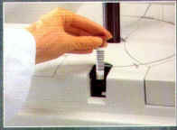

What is Taken and Assessed?
Blood Gases Measurement in Arterial Blood (so called „Astrup“)
Serum electrolytes
Concentrations of buffers (e.g. hemoglobin) and other parameters

Slide 35
Blood Gases Measurement – „Astrup“
Assessed by the machine (sensors = selective electrodes):
pH = 7,4 ± 0,04
pCO₂ = 5,3 kPa
pO₂ = 13,3 kPa
Calculated by the machine:
[HCO₃⁻] = 24 mmol/l
  calculated using HH equation
BE = 0 mEq/l
  Base Excess, Hb concentration is needed for the calculation.

Slide 36
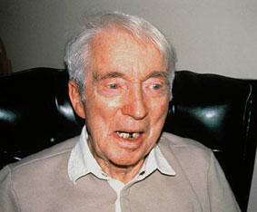
Case study No. 3
68 year old male comes to your ambulance.
History of chronic bronchitis and pulmonary emphysema.
Mild dyspnea, COVID antigen test negative
Lab: pH = 7.31
    pO2 = 8.0 kPa
    pCO2 = 10.6 kPa
    HCO3- = 38 mmol/L
    BE = 12 mmol/L
What kind of acid-base disturbance do we deal with?
It this an acute a chronic problem?

Slide 37
Possible Causes of Respiratory Acidosis
Decreased alveolar ventilation
  A) Respiratory center depression
    Drugs, medicaments (e.g. opioids)
    Damage or ischemia:
      Trauma
      Stroke
      Tumor
      Cerebral edema / increased intracranial pressure
  B) Nerve or muscle disease
    Myasthenia gravis
    Polyradiculoneuritis
    Serious obesity/ Pickwickian syndrome
  C) Lung disease
    Restrictive diseases
      ARDS
      Pulmonary fibroses
    Obstructive diseases
      Astma
      Tumor
      Foreign body
    Increase in dead space
      Pulmonary embolism
      Pulmonary emphysema
    Trauma, pneumothorax,
    serial rib fractures
Increased pCO₂ in the inspired air

Slide 38

Case Study No. 2
You examine a 20 YO student at the hospital admission.
Cannot concentrate and even could not move her fingers for a brief moment (which scared her). Still feels strange pins and needles in her fingers.
She has not been seriously ill until now, no medication
Physical examination – normal
SA: She has split with her boyfriend recently, had been together for 4 years. Difficult to go thru.
Lab: pH = 7.49
    pO2 = 13.4 kPa
    pCO2 = 4.1 kPa
    HCO3- = 22 mmol/L
    BE = -1 mmol/l
What acid-base disturbance this is?
What kind of acute problem do we see here?
What would be your advise her?

Slide 39
Possible Causes of Respiratory Alkalosis
Hyperventilation
  A) At hypoxemia
    High altitude disease
    Right-left pulmonary shunting
      And ventilation-perfusion dysbalance similar to shunt
    With artificial ventilation
  B) Respiratory center irritation
    Trauma, inflammation, salicylates.
  C) Panic attack

Slide 40
Metabolic Acidosis 1 + Compensation
Hyperventilation as a compensation of acidosis: Kussmaul breathing
AG = Na⁺ + K⁺ - Cl⁻ - HCO₃⁻ (does not include X⁻)
CO₂ H₂CO₃
HCO₃⁻
➔ AG is equivalent to X⁻
pCO₂ = 5,3 kPa
Uncompensated metabolic acidosis:
H⁺
X⁻
H⁺
Thanks to the compensation the [H⁺] and pH return closer to norm
pH= 7,4
Concentration in order of 10 nmol/L
< million times ↑ < <
Concentration in order of 10 mmol/L

Slide 41
Metabolic Acidosis 2 + Compensation
Hyperventilation as a compensation of acidosis: Kussmaul breathing
AG = Na⁺ + K⁺ - Cl⁻ - HCO₃⁻
CO₂ H₂CO₃
HCO₃⁻
pCO₂ = 5,3 kPa
Clinically so called:
„Hyperchloremic“ acidosis
Exchange has to be electroneutral
Uncompensated metabolic acidosis:
Cl⁻
Thanks to the compensation the [H⁺] and pH return closer to norm
H⁺
pH= 7,4
Compartment border

Slide 42

Case Study No. 1
38 yo female, DM 1st type
Chills and fever lasting several days
She has not felt well --> not eaten much → not taken much insulin
During admission day: Abdominal cramps, vomited several times
Physical exam: BF 30 min⁻¹, HF 112 min⁻¹, BP 110/70 lying and 100/60 standing, 37 °C,
Dry mucosae and fruity breath odor
What acid base disturbance do we deal with? Is it a compensated disturbance?
What else could be said about her hydration and ion concentrations?
Lab:
    pH 7.20
    pO2 12.8 kPa
    pCO2 2.8 kPa
    HCO3- 8 mEq/L
    Glc 15 mmol/L
    Na+ 148 mEq/L
    K+ 5.5 mEq/L
    Cl- 110 mEq/L
    Positive aceton in urine

Slide 43
Possible Causes of Metabolic Acidosis
Loss of bicarbonates due to increased acid buffering
  Ketoacidosis
    Diabetic
    Alcohol
    Starving
  Lactic Acidosis
    Enormous physical strain
    Circulatory shock / systemic ischemia
  Allogenic substances
    Salicylate poisoning
B) Loss of bicarbonates into the third space/out of body
  Through intestines
    Diarrhea
    Fistulas and stomias
  Through kidneys (loss of regulation)
    So called Renal tubular acidoses
    Renal failure (can have ↑AG)
The difference in common strong ions reflects ↓ HCO₃⁻
E.g. ↑ Cl⁻ (instead of the bicarbonate)- so called „hyperchloremic acidoses“
(Or there can be e.g. ↓ Na⁺ or..)
AG (anion gap) is normal!
AG (anion gap) is increased!: Anion of the buffered away acid accumulates in the body.

Slide 44
Exercise – Metabolic Alkalosis
Try to derive the beaker chart of metabolic alkalosis and its compensation by yourself. (result can be checked on the next slide)

Slide 45
Metabolic Alkalosis + Compensation
Cl⁻
Compensation of metabolic alkalosis by hypoventilation is limited by hypoxia
Clinically, it is often referred to as:
„Hypochloremic“ alkalosis
Exchange has to be electroneutral
HCO₃⁻
CO₂ H₂CO₃
H⁺
pH= 7,4
Thanks to the compensation the [H⁺] and pH return closer to norm
Compartment border
(e.g. stomach mucosa)

Slide 46
Compensation of metabolic alkalosis
Try do deduce the beakers and the arrows in the compensation diagram yourself.
Min 2 minutes

Slide 47
Possible Causes of Metabolic Alkalosis
Loss of acid by vomiting
  ↑ HCO₃⁻ produced by stomach into the blood (when H⁺ is secreted into the lumen).
Increased renal HCO₃⁻ production/ increased urine H⁺ secretion
  Hyperaldosteronism
  So called Bartter syndrome
Liver failure (↓production of urea from NH₄⁺ - the reaction would be acidifying)
Non-adequate infusion of bicarbonates/ Ringer lactate.

Slide 48
Pathogenesis of Paradoxical Aciduria and Loss of K⁺ after Severe Vomiting
Clinacally important!
After profuse vomiting, hypochloremic metabolic alkalosis develops
Under normal circumstances, kidneys should regulate and produce only slightly acidic or alkaline urine.
Instead, kidneys can worsen the alkalosis
See next slide:

Slide 49
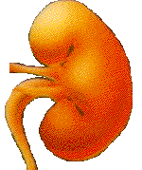
Glomerular filtrate: Normal situation
Primary cause: Loss of Cl⁻ and H⁺ by vomiting
Glomerular filtrate: hypochloremic
metabolic alkalosis
Na⁺
Na⁺
Cl⁻
Cl⁻
Chloride depletion
Cl⁻
H⁺
Reabsorption of sodium with chlorides is diminished
Reabsorption of sodium with chlorides
Metabolic alkalosis
Na⁺
Na⁺
H⁺
H⁺
Cl⁻
Cl⁻
K⁺
K⁺
Sodium more available to be exchanged for potassium and H⁺
Remaining sodium is exchanged for potassium a H⁺
Intracellular fluid
K⁺
K⁺
Potassium depletion
Na⁺
Na⁺
H⁺
Potassium excretion increased and despite the metabolic alkalosis there is aciduria
H⁺
K⁺
K⁺
H⁺
H⁺
Increased loss of potassium
Paradoxial Aciduria
+
NH₄⁺
Notes:
obr. 13.42 Patogeneze vzniku paradoxní acidifikace moči a deplece draslíku po ztrátách chloridů při těžkém zvracení.

Slide 50
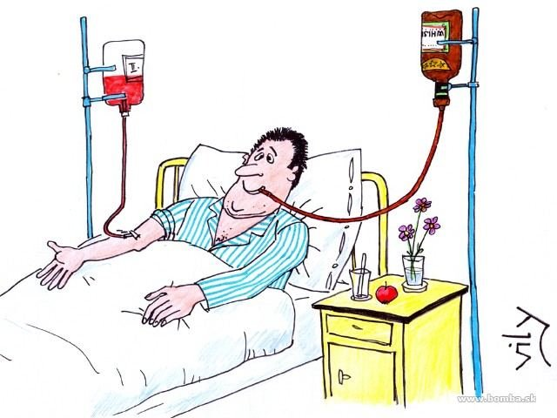
Clinical Examples of
ABB Disturbances

Slide 51
Summary
Physiology and chemistry
  H+, pH, buffers, buffers incorporated into metabolism, HH equation, electroneutrality
Disturbances divided into respiratory and metabolic
Clinical examples and causes
 | Primary disturbance | Compensation
Respiratory acidosis | ↑pCO₂ | Renal - ↑HCO₃⁻, ↑BE
Metabolic acidosis | ↓HCO₃⁻ | Pulmonary - ↓pCO₂
Respiratory alkalosis | ↓pCO₂ | Renal - ↓HCO₃⁻, ↓BE
Metabolic alkalosis | ↑HCO₃⁻ | Pulmonary - ↑pCO₂

Slide 52
Thank you for your attention

