Slide 1

Cognitive-behavioral approach in medicine
Mgr. Barbora Kóša
Podzim 2020
ÚPP LF MU

Slide 2
Affective heuristic
Occurence: Open-ended questions, no intense attention is needed
Current mood: highly affects reasoning
Affective heuristic: relying on emotion concerning object in fast judgement
H: People concentrate their attention less on losess than gains when they are in a good mood
Quick emotional reactions (concern or safety?) can serve as relevant information (affect as information mechanism).
Notes:
Slovic, P., Finucane, M., Peters, E., & MacGregor, D. G. (2002). The affect heuristic. In T. Gilovich, D. Griffin, & D. Kahneman (Eds.), Heuristics and biases: The psychology of intuitive judgment (pp. 397-420). New York: Cambridge University Press.

Slide 3
Heuristics
problem-solving method → shortcuts to produce good-enough solutions
quick decisions, particularly when working with complex data
derived from previous experiences with similar problems
using readily accessible, though loosely applicable, information problem solving
  For example, pattern recognition: seeing a patient with grandiose delusions and pressured speech leading to a rapid differential with the most-likely diagnosis being bipolar disorder.
+ Advantage
  Reduce cognitive load: time and effort to make reasonably good judgments and decisions.
- Disadvantage:
  Potential to lead to systematic cognitive errors called biases.
Acad Med. 2011 Mar;86(3):307-13.

Slide 4
Factors influencing which system is employed
  Task complexity
    S1 – typical signs and symptoms
    S2 – atypical symptoms, complex cases
  Expertise
    S2 – novices, students
  accuracy of systems 2 thinking depends on knowledge base, expertise..

Slide 5
Dual processes theory
Experiential system (intuitive 1) | Analytic system (2)
Holistic | Effortful
Emotional: Pleasure – Pain | Logical: resoning oriented (what is rational?)
Associative connections | Logical connections
Behavior is influenced by previous emotions | Behavior is influenced by rational judgement of events
Reality is encoded in images, metaphores and narratives | Reality is encoded in abstract symbols, words and numbers
Fast processing: focues on immediate action | Slow processing: focused on postponed action
Valid for own person: „experiencing is believing“ | Demands support wit logic and evidence

Slide 6
Heuristic or Bias | Medical Example | Non-medical example
Anchoring is the tendency to lock onto salient features in the patient’s initial presentation and failing to adjust this initial impression in the light of later information. | A patient is admitted from the emergency department with a diagnosis of heart failure. The hospitalists who are taking care of the patient do not pay adequate attention to new findings that suggest another diagnosis. | We buy a new car based on excellent reviews and tend to ignore or downplay negative features that are noticed.
Affective bias refers to the various ways that our emotions, feelings, and biases affect judgment. | New complaints from patients known to be “frequent flyers” in the emergency department are not taken seriously. | We may have the belief that people who are poorly dressed are not articulate or intelligent.
Availability bias refers to our tendency to more easily recall things that we have seen recently or things that are common or that impressed us. | A clinician who just recently read an article on the pain from aortic aneurysm dissection may tend toward diagnosing it in the next few patients he sees who present with nonspecific abdominal pain, even though aortic dissections are rare. | Because of a recent news story on a tourist kidnapping in Country “A,” we change the destination we have chosen for our vacation to Country “B.”

Slide 7
Heuristic or Bias | Medical Example | Non-medical example
Context errors reflect instances where we misinterpret the situation, leading to an erroneous conclusion. | We tend to interpret that a patient presenting with abdominal pain has a problem involving the gastrointestinal tract, when it may be something else entirely: for example, an endocrine, neurologic or vascular problem. | We see a work colleague picking up two kids from an elementary school and assume he or she has children, when they are instead picking up someone else’s children.
Search satisficing, also known as premature closure, is the tendency to accept the first answer that comes along that explains the facts at hand, without considering whether there might be a different or better solution. | The emergency department clinician seeing a patient with recent onset of low back pain immediately settles on a diagnosis of lumbar disc disease without considering other possibilities in the differential diagnosis. | We want a plane ticket that costs no more than $1,000 and has no more than one connection. We perform an online search and purchase the first ticket that meets these criteria without looking to see if there is a cheaper flight or one with no connections.

Slide 8
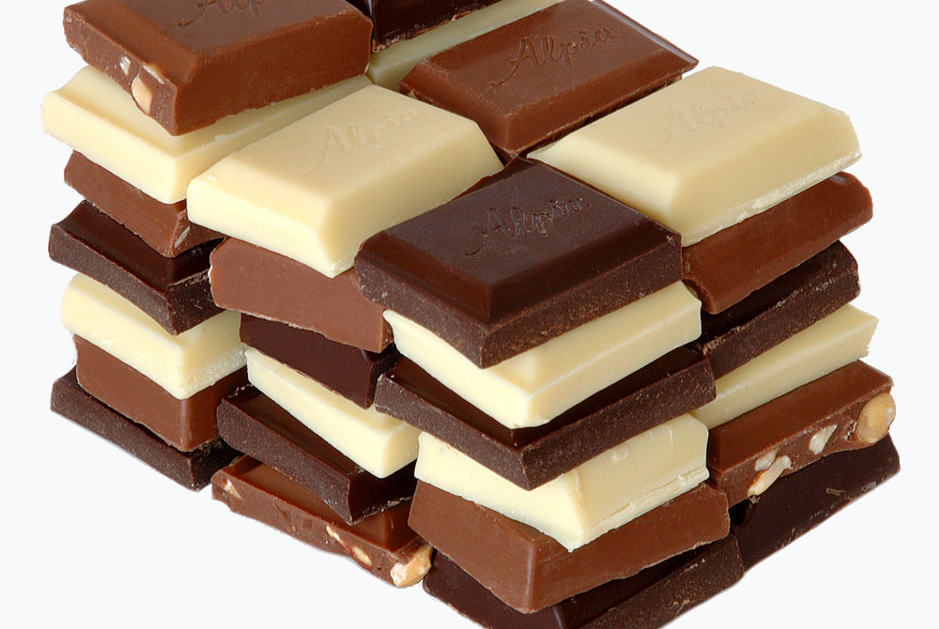


Slide 9
Working memory and affective heuristic
You hold in memory 7 digit number and need to write it down in different room
On the corridor, someone from your family stops you and asks:
Are you going to have chocolate or fruit?
You need to rememer the numbers but are hungry too. What are you going to choose?

Slide 10
Working memory and affective heuristic
63% chose chocolate cake when holding in memory 7 digits
41% chose chocolate cake when holding in memory 2 digits
Fast judgement of object according to emotion.
Capacity of working memory can influence you capacity for reasoning and consider rational arguments.

Slide 11
Historical background of learning theories
affective nature of human beings has long been considered secondary and inferior to the study of rational thinking, “nonscientific“
cognitive shift (1960s) – psychology was directed even more
on cold, afectless mental processes
since 1980s – mood plays central role in how information about world is represented and affect determines cognitive representation of social experiences

Slide 12
Early evidence linking Mood and Cognition
Classical conditioning: if neutral stimulus associates with negative stimulus: child encounters live rabbit + noise → negative evaluation of neutral stimulus → avoidance of neutral: the child avoids the rabbit (Watson, 1929) https://www.youtube.com/watch?v=V09FuazW8bc
People evaluated sociopolitical messages more favorably when in good rather than in a bad mood, induced either by a free lunch (!) or aversive smells, respectively (Razran, 1940)
Electric shocks induced negative affect in subjects. Fearful subjects‘ evaluations of another person were more negative than neutral subjects‘ and even greater when subjects were trying to suppress their fear (Wegner, 1994).
  “suppression of fear facilitates the tendency to project fear onto another social object” (p. 286)

Slide 13
Learning: Operant conditioning
Operant conditioning, is a method of learning that employs rewards and punishments for behavior. Through operant conditioning, an association is made between a behavior and a consequence
P, of behavior to repeat depends on consequences
stimulus reaction consequence

Slide 14
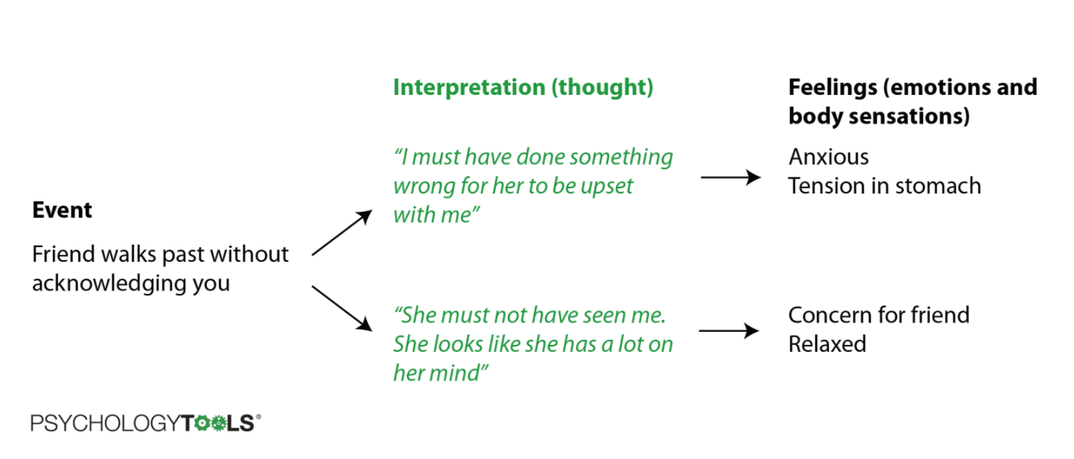

Slide 15
Cofnitive factors in learning
Not stimulus provokes behavior, but the meaning it has for a person
Behavior can be predicted and understood based on cognitive processes
Eye contact with attracitve man → Organism: THOUGTHS: I look silly! EMOTION: anxiety BODY: redness in face → Reaction: turning away eye contact → Consequence: relief from anxiety
Eye contact with attracitve man → Organism: T: I like him, I want to look good! E: excitement T: pupil enlargement → Reaction: smile, long eye contact → Consequence: pleasant arousal
stimulus organism reaction consequence

Slide 16
Cognitive factors when response is formed
ABC – Albert Ellis
Situation Cognition Consequence: emotion, behavior

Slide 17
Beliefs | Rationality | Type | Description | Example
Primary | Irrational | Rigid and extreme demand | Assertion of preference transmitted into a demand | “I want to be successful and therefore I must”
 | Rational | Flexible and non- extreme preference | Assertion of preference and negation of demand | “I want to be successful but that does not mean I have to be”
Secondary | Irrational | Awfulizing | Athlete believes that if x happens: nothing could be worse, x is worse than 100% bad, and no good could possibly come from this bad event | “I must succeed and if I don't it will be awful”
 |  | Low frustration tolerance | Athlete believes that, in face of a struggle to put up with adversity: I will die if the discomfort continues, and I will lose the capacity to experience happiness if the discomfort continues | “I must succeed and it is unbearable to fail”
 |  | Self-/other-downing | Self and others are rated on the basis of one aspect | “When I fail, it means that I am an idiot” “When they treat me poorly, it proves they are bad people”
 | Rational | Anti-awfulizing | Athlete believes that if x happens: worse things could happen, x is not more than 100% bad, and some good could possibly come from this bad event | “I want to succeed but if I don't it will not be awful”
 |  | High frustration tolerance | Athlete believes that, in face of a struggle to put up with adversity: I will not die if the discomfort continues, and I will not lose the capacity to experience happiness if the discomfort continues | “I want to succeed but failure is not unbearable”
 |  | Self-/other- acceptance | Self and others are not rated on the basis of one aspect. It is unconditionally accepted that self and others are fallible, unique, and un-rateable | “When I fail, it is bad, but does not mean that I am an idiot” “When they treat me poorly it is bad, but does not prove they are bad people”

Slide 18
Experience of patient
Part of human psychology in awareness:
  emotion, cognition a behavior
Thoughts – hypotheses which can be confirmed or not, not facts
Emotion – validate that there are no good or bad feelings, labeling helps to deal and act in constructive ways
Behavior – strengthen: valued behavior condition with positive consequences

Slide 19
Cognitive behavioral interview
When too ambiguos or technical → “What exactly do you mean?“
Reflective feedback: to make sure you understand
Don‘t use suggestive questions („You were probably scared, right?“ better: „How did you feel in that situation?“)
Open ended → more specific questions
Avoid starting with „Why...“ (asking for explanation), better: “Who?“, “Where?“, „How often?“ (asking for description)
Assure the patient that his problems are common
Strong emotion – be patient, curious, compassionate (What does it mean for the patient? Why is he/she so upset?)

Slide 20
Problem description
Subjective description of symptoms, their evolution, triggers, consequences, related problems ...
Looking for mechanisms that maintain problem behavior
Predisposing factors
Precipital factors – internal / external

Slide 21
Microanalysis of problematic behavior
Situation
Cognition
Modifying factors
Emotion
Bodily signals
Behavior
Consequence

Slide 22
Microanalysis of problematic behavior
SYMPTOMS
Eg. Increased heart rate
palpitations
Emotion
Increased anxiety →
Increased symptoms
(Mis)interpretation
„It mus be a heart
attack“

Slide 23
Consequences
Relationships, work, reputation, health....
Short-term positive / negative
Long-term positive / negative

Slide 24
Goal setting to motivate the patient
What do you want to happen at the end of your treatment?
  S: specific
  M: measurable
  A: attainable
  R: relevant
  T: timely

Slide 25
Myšlienky
How to know patients thouths
  What do you think? What is going to happen? What if you will never change how you think? What is the worst case scenario?
Hot – + emotion / Cold – descriptive
Notes:
Scenár návštevy
Horúce myšlienky človeku len tak nevyvrátite, ale môžete ich zjemniť

Slide 26
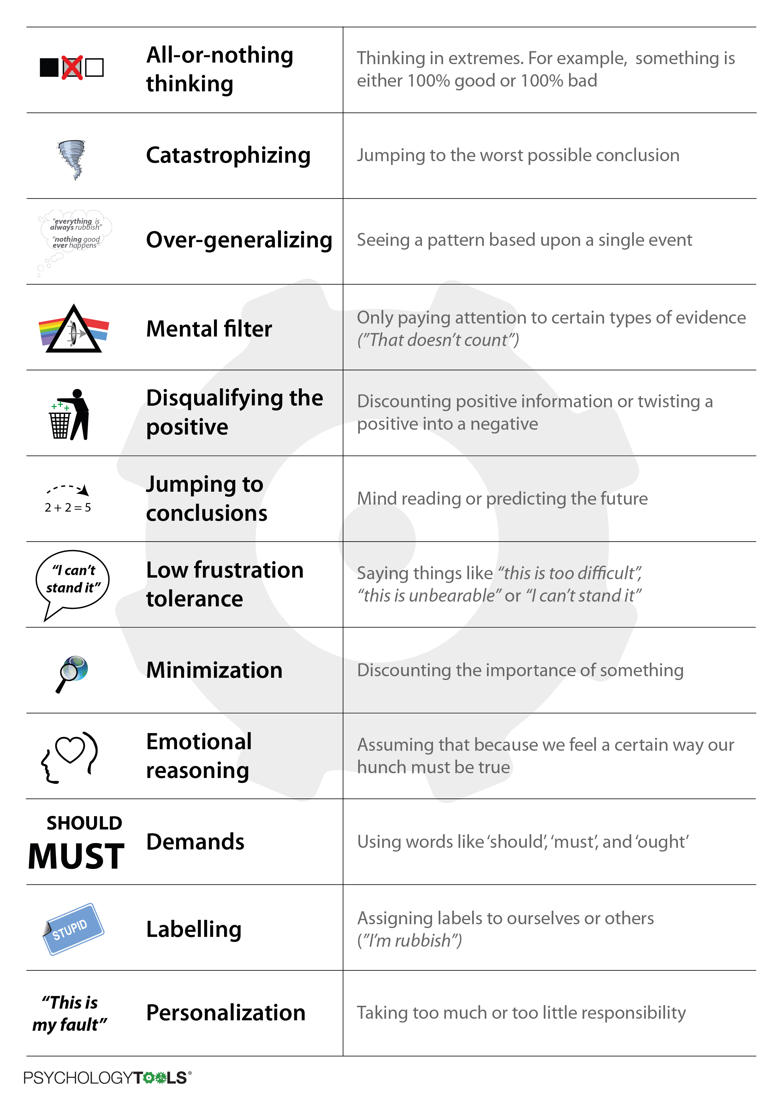
Cognitive distortions

Slide 27
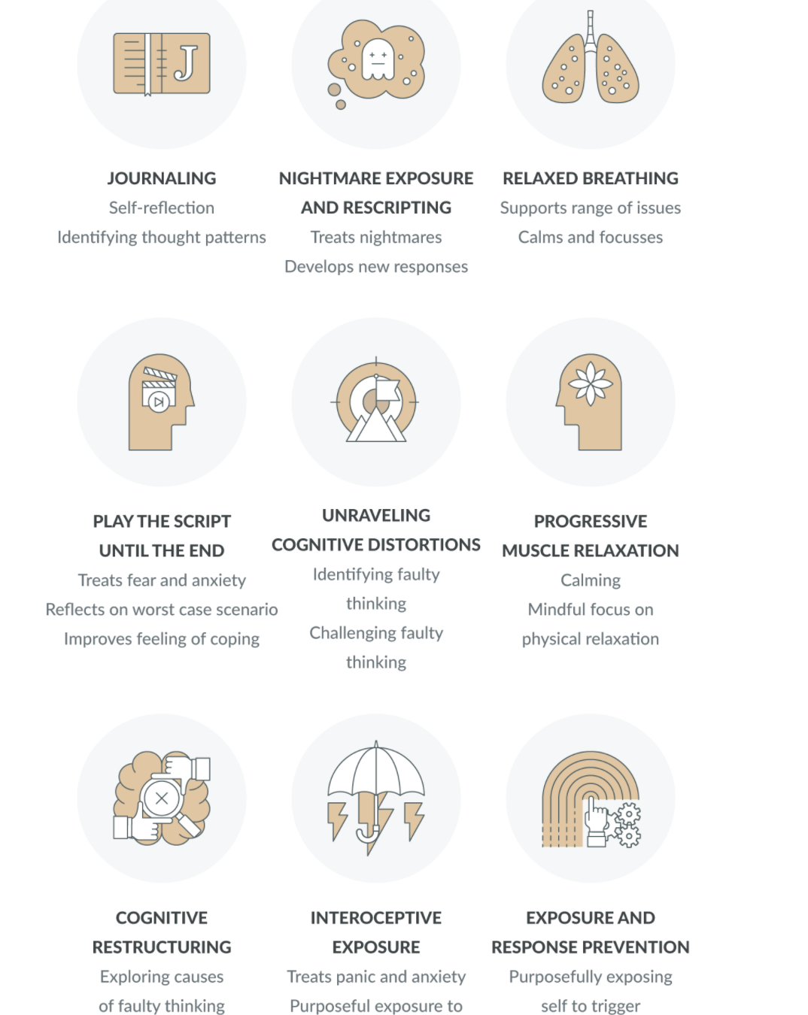
Useful CBT techniques

Slide 28
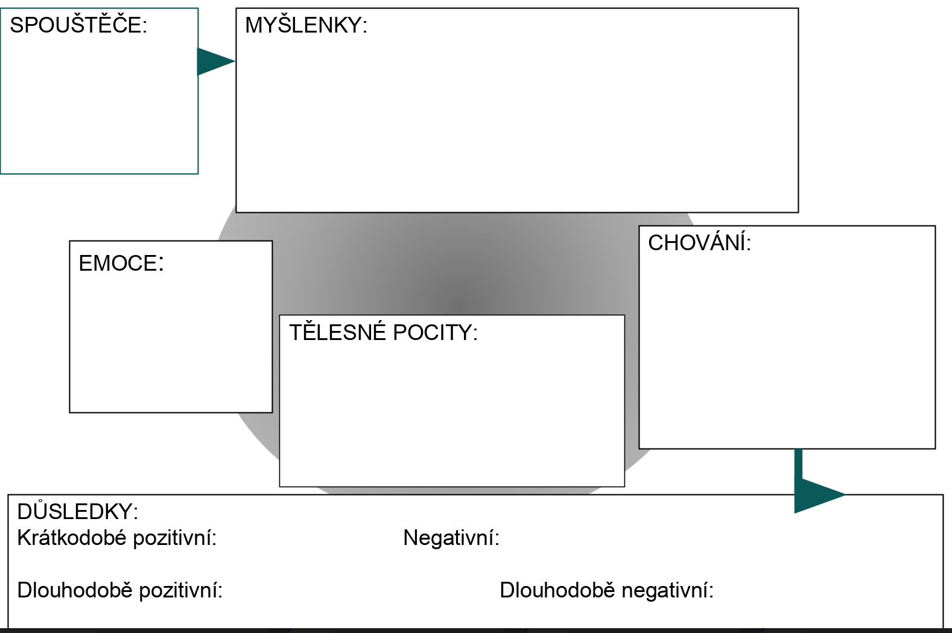
Trigger (situation)
Thougts....
Behavior
Emotions
Bodily signals...
Consequences
Short-term positive....
Short-term negative...
Long-term positive....
Long-term negative.....

Slide 29
Cognitive restructuring
Situation When? Where? Who? What? | 2. Emotion Intesity 1-10 | 3. Automatic thought Persuasiveness 0 – 100%
4. Evidence proving thought | 5. Evidence against thought | 6. Alternative thought Persuasiveness 0-100% | 7. Emotion now Intensity 1-10

Slide 30
Thank you for attention
Suggested study materials:
Croskerry P. (2002). Achieving quality in clinical decision making: cognitive strategies and detection of bias. Academic emergency medicine : official journal of the Society for Academic Emergency Medicine, 9(11), 1184–1204.
Howard, J. (2018). Cognitive Errors and Diagnostic Mistakes. Springer Berlin Heidelberg.
Mandatory study materials:
Chapters from Psychology in medicine

