Slide 1
Non-invasive methods of blood pressure measurement

Slide 2
Arterial blood pressure curve
Blood pressure (BP): pressure on the vascular wall (a continual variable)
Mean arterial pressure (MAP) : mean value of blood pressure in the inter-beat interval (IBI)
area under MAP = area above MAP
approximation: MAP ≈ DBP + 1/3 PP (PP = SBP – DBP)
Definition:
SBP - maximum of BP in the inter-beat interval
DBP – minimum of BP in the inter-beat interval
Attention: Values of SBP and DBP varies in different parts of cardiovascular system!
SBP
Systolic blood pressure
area above MAP
MAP
Mean arterial pressure
PP
pulse pressure
DBP
Diastolic blood pressure
area under MAP
inter-beat interval

Slide 3
MAP is a function of cardiac output and total peripheral resistance
Mean arterial pressure (MAP)
Cardiac output
(CO)
Total peripheral resistance (TPR)
=
*
Heart rate
(HR)
Stroke volume
(SV)
*
SBP is given mainly by CO
DBP is given mainly by TPR

Slide 4
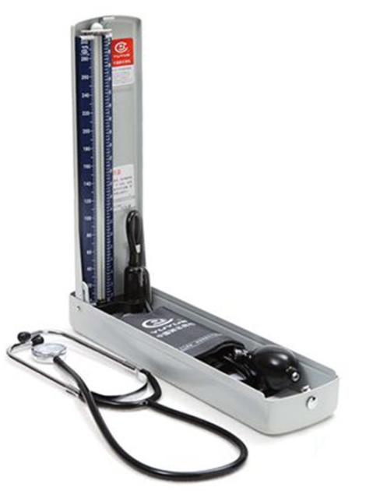
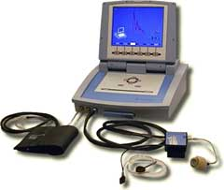
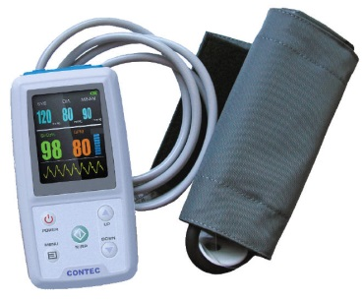
Methods of the arterial blood pressure measurement
Auscultatory
(sphygmomanometer,
stethoscope)
Palpatory
(sphygmomanometer)
Oscillometric
24-hour blood pressure monitoring
Photoplethysmographic
(volume-clamp method, Peňáz)

Slide 5
Laminar / turbulent flow, Korotkoff sounds
$$Re=\frac{v∙S∙ρ}{η}$$
laminar flow Re < 2000
turbulent flow Re > 3000
Reynolds number Re: predicts the transition from laminar to turbulent flow v: velocity of blood flow
S: area of vascular lumen (π.r²)
ρ: density of blood
η: viscosity of blood
(lower in anemias)
cuff
a. brachialis
Re₂
r₁
r₂
v₂
v₁
Re₁
laminar flow
turbulent flow
right behind the narrowing of the artery:
S₁ < S₂ , v₁≈ v₂ → Re₁ < Re₂ → turbulent flow

Slide 6
Principles of blood pressure measurement
SBP
MAP
DBP
Korotkoff sounds
(auscultatory method)
Pressure in the cuff
SBP
DBP
Pressure oscillations in the cuff
(Oscillometric method)
Continually measured BP
Blood flow in the artery

Slide 7
During BP measurement, following rules must be observed:
Patient is sitting and resting for a few minutes before the measurement.
Only validated measuring equipment must be used.
At least two measurements have to be performer, in the course of 1–2 minutes.
Use cuff of standard size (12–13 cm width and 35 cm length); smaller and bigger cuffs must however be available for patients with smaller or bigger arms, respectively.
Cuff must always be at the level of heart of examined person.
Pressure in the cuff must be decreased slowly: 2mmHg/s.

Slide 8
24-hour blood pressure monitoring
BP decrease during night: 10 - 15%
[mmHg]
Heart rate
Blood pressure
SBP
DBP
Heart rate
[bpm]
140
120
100
80
60
120
100
80
60
8
9
10
11
12
13
14
15
16
17
18
19
20
21
22
23
24
1
2
3
4
5
6
7
hours
waking
sleeping

Slide 9
Photoplethysmography
Control system:
Correction of the pressure in the finger cuff according to the arterial lumen changes.
Aim: maintaining of constant arterial lumen through pressure changes in the cuff.
pressure
cuff
Control system
Constant finger volume
SBP
DBP

Slide 10
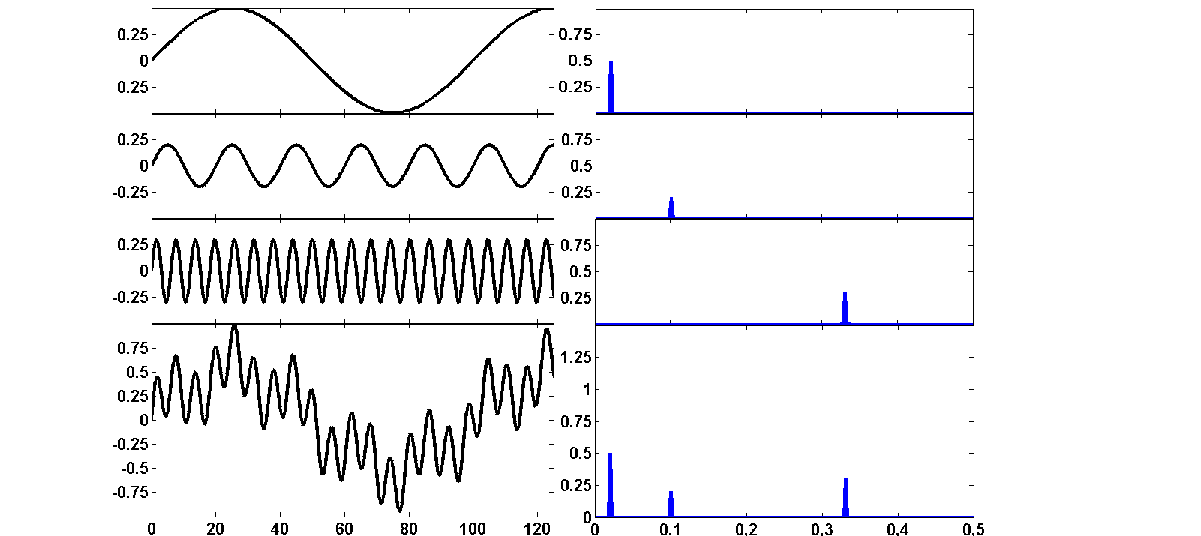
Variability of circulatory parameters
Spectrum
Frequency domain
Time domain
period T
amplitude a
frequency f = 1/T
T=50 s
0.5
a=0.5
f = 1/50 = 0.02 Hz
+
T=10 s
+
amplitude
a=0.2
0.2
+
T=3 s
f = 1/10 = 0.1 Hz
+
0.3
=
a=0.3
=
f = 1/3 = 0.33 Hz
0.5
f = 0,1 Hz
0.3
f = 0,02 Hz
f = 0,33 Hz
0.2
time (s)
0.02
0.1
0.33
frequency (Hz)

Slide 11
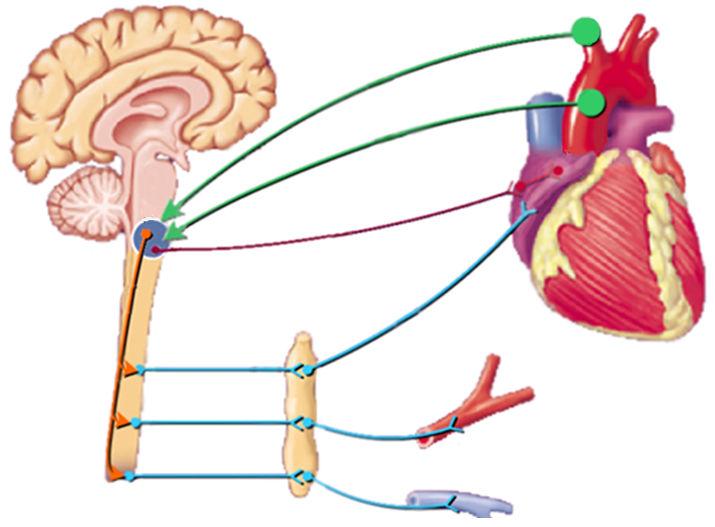
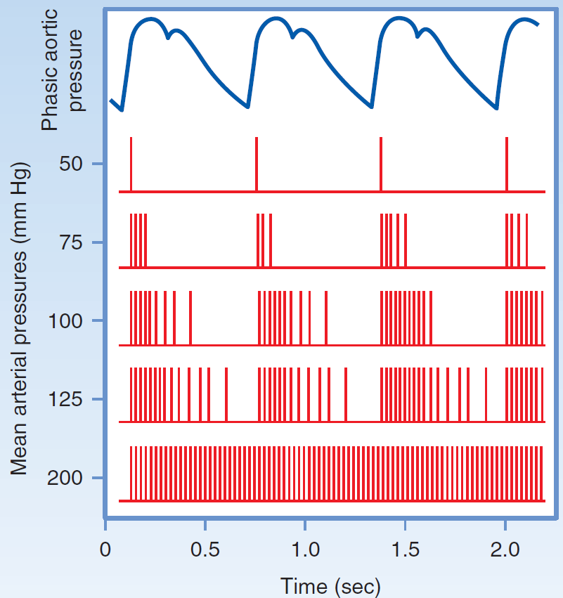
Baroreflex
HR
Aferent pathway
Parasympathetic pathway
Sympathetic pathway
BP=HR x SV x R
R
Inotropic
Chronotropic
Dromotropic
Batmotropic
BP=HR x SV x R
effect

Slide 12
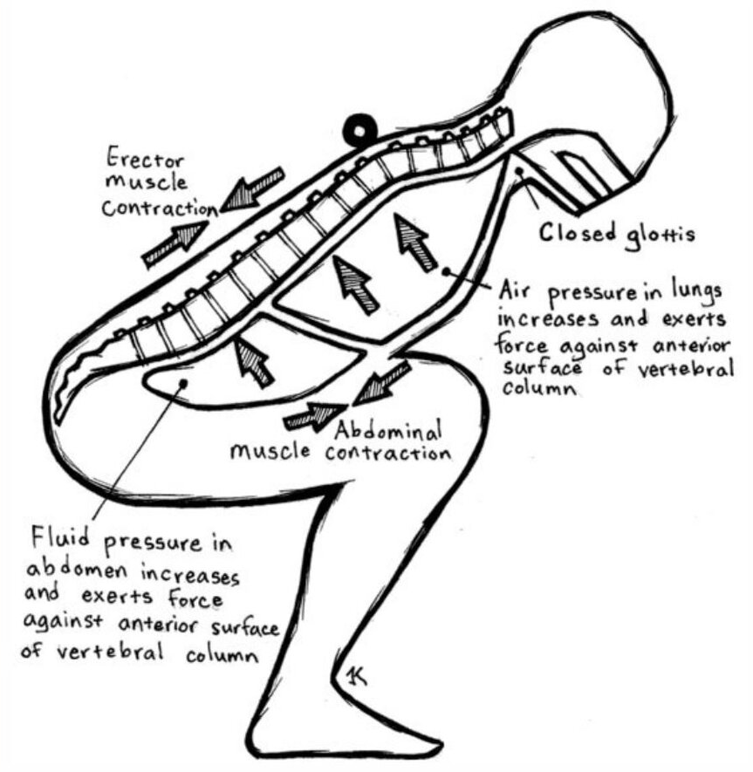
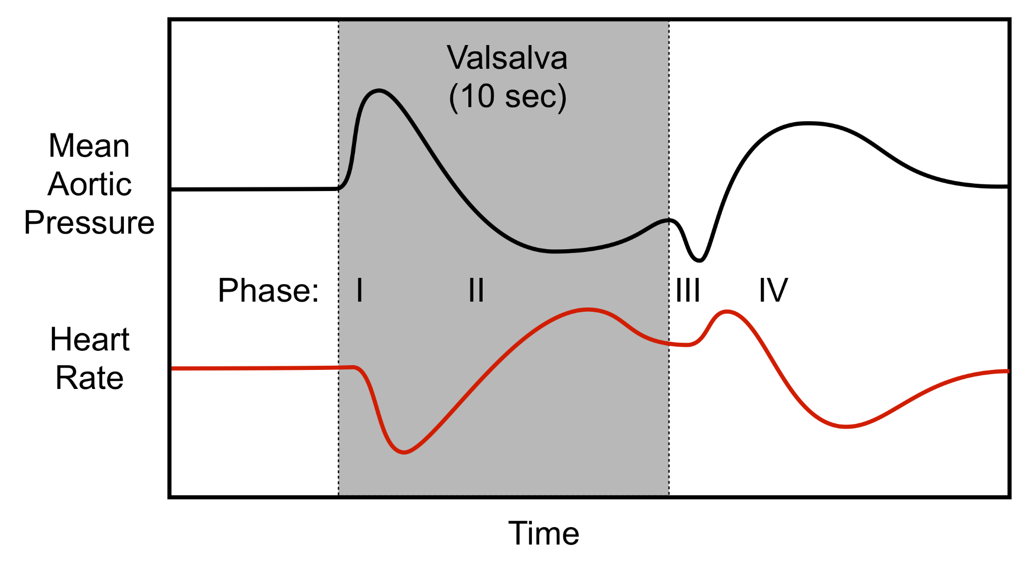
Valsalva maneuver

