Slide 1
Spirometry

Slide 2
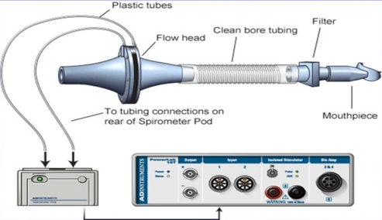
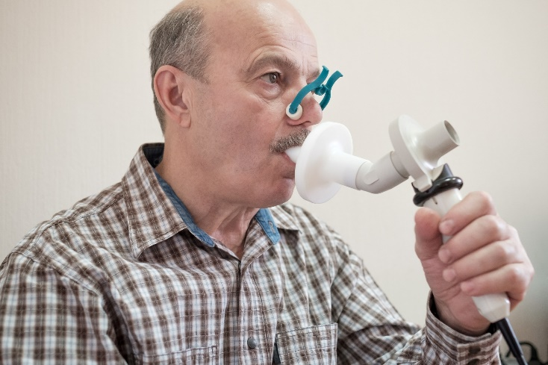
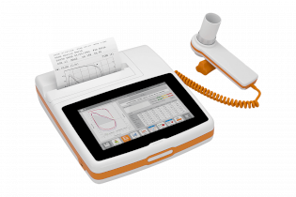

Types of spirometers
pressure differences between the inner and outer spirometer membranes
air flow velocity according to the speed of the turbine rotation

Slide 3
Static parameters
V [l]
IRV (2,5 l)
Vt (0,5 l)
ERV (1,5 l)
RV (1,5 l)
Tidal volume (TV) – the volume of air that enters the lungs during each inspiration (or the volume that is exhaled during every expiration).
Inspiratory reserve volume (IRV) – the maximal amount of additional air that can be drawn into the lungs by determined effort after a normal inspiration at rest.
Expiratory reserve volume (ERV) – the additional amount of air that can be exhaled from the lungs by determined effort after a normal expiration.
Residual volume (RV) – the volume of air still remaining in the lungs after the most forcible expiration possible.

Slide 4
Static parameters
V [l]
IRV (2,5 l)
Vt (0,5 l)
ERV (1,5 l)
RV (1,5 l)
Lung capacity:
VC = VT + IRV + ERV
TLC = VC + RV
FRC = ERV + RV
IC = IRV + VT
EC = ERV + VT
Dynamic lung volumes:
VE
MMV

Slide 5
Dynamic parameters
V [l]
Apneic pause
Frequency
time
Dynamic lung volumes:
Minute ventilation
Apneic pauses (inspirium/expirium)
Frequency of breathing

Slide 6
Dynamic parameters
Dynamic lung volumes
V [l]
FVC – the maximum volume of air that can be exhaled after maximum inhale
FEV₁ – the volume of air exhaled with the greatest effort in 1 second after maximum inhale
FEV₁/FVC (%) – Tiffeneau index – around 0,8 (80 %)
FEV₁
FVC
RV
1 s
Time [s]

Slide 7
Obstructive/restrictive lung disease
V [l]
V [l]
FVC > FVC
FEV₁
FEV₁
1 s
Time [s]
1 s
Time [s]
Obstructive lung disease
(FVC=N; FEV₁=↓)
tracheal stenosis
astma bronchiale
CHOPN
tumor
Restrictive lung disease
(FVC=↓; FEV₁=N)
Pulmonary etiology
pulmonary fibrosis
lung resection
pulmonary edema
pneumonia
Extrapulmonary etiology
ascites
kyphoscoliosis
burns
high diaphragm condition

Slide 8
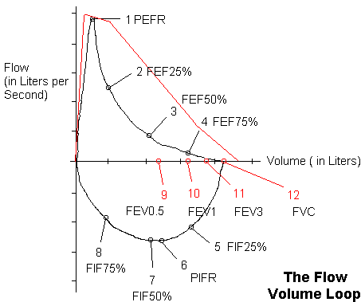
Flow - volume curve
PIF – peek inspirátory flow; the highest speed of air flow at peak of inhale
PEF – peek expiratory flow; the highest speed of air flow at peak of exhale
FEF – maximum expiratory flow rates at different FVC levels (75 %, 50 % and 25 % of FVC)

Slide 9
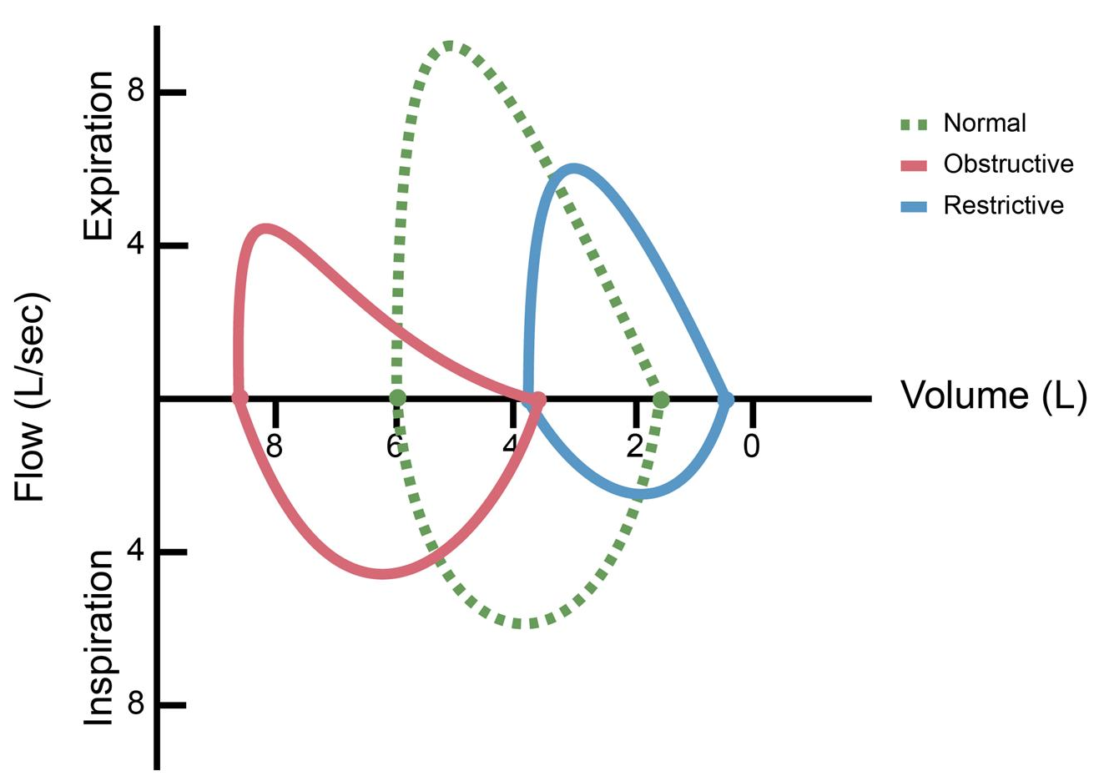
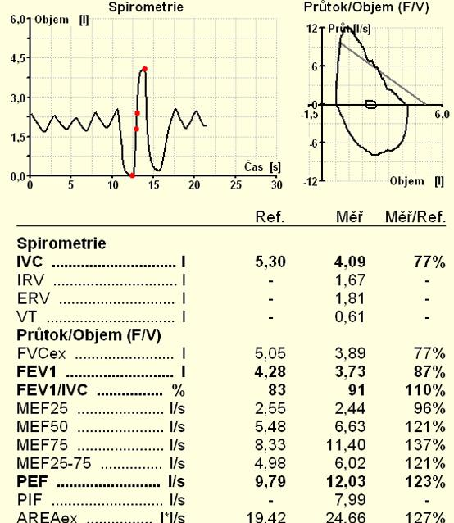

Slide 10
