Slide 1

Handling chemical substances
A brief overview for students of Faculty of Medicine
Jiří Dostál
Department of Biochemistry

Slide 2
People who handle chemical substances as part of their employment or studies, must be acquainted with:
hazardous properties of chemical substances,
the rules of protecting health and the environment from their harmful effects,
the principles of pre-medical first aid.

Slide 3
Handling chemical substances
Study material available in IS:
Principles of Fire Protection and Safe Handling of Chemicals
Editors: Jaromír Literák, Barbora Loučková, Jiří Příhoda, MU 2017,
pages 8 - 40

Slide 4
Legal standards
Regulation (EC) No. 1272/2008 of the European Parliament and of the Council focusing on classification, labelling, and packaging of substances (CLP)
Act No. 350/2011 Coll., on chemical substances and mixtures
Act No. 205/2020 Coll., which amends Act No. 258/2000 Coll. on the protection of public health

Slide 5
Terminology
Hazard classes - for the classification of physical, health or ecological hazards of a certain chemical substance.
Hazard category - specifies the nature and severity of the hazard.
Each hazard class and category is assigned:
hazard statements (H-phrases).
precautionary statements (P-phrases).
hazard pictogram (symbol)
signal word - the word "danger" refers to more serious hazards; the word "warning" refers to a less serious hazard category

Slide 6
Hazard classes: physical hazard (16), health hazard (10), environmental hazard (2)
-----------------------------------------------
17. acute toxicity
18. skin corrosion/irritation
19. serious eye damage
20. respiratory / skin sensitizer
21. germ cell mutagenicity
22. carcinogenicity
23. reproductive toxicity
24. specific organ toxicity (single exposure)
25. specific organ toxicity (repeated exposure)
26. aspiration hazard
--------------------------------------
27. aquatic toxicity
28. ozone layer hazard
1. explosives
2. flammable gases
3. aerosols
4. oxidising gases
5. gases under pressure
6. flammable liquids
7. flammable solids
8. self-reactive substances
9. pyrophoric liquids
10. pyrophoric solids
11. self-heating substances
12. emitting flammable gases with water
13. oxidising liquids
14. oxidising solids
15. organic peroxides
16. substances corrosive to metals
-----------------------------------------

Slide 7
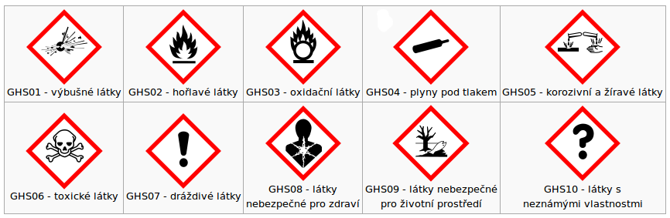
Hazard pictograms
Explosive Flammable Oxidizing Compressed gas Corrosive
Toxic Harmful Health hazard Environmental hazard

Slide 8
In handling chemical substances, it is the responsibility of everyone to observe:
hazard symbols
hazard statements
precautionary statements
protection of human health
protection of the environment

Slide 9
Hazard statements - They are intended to form a set of standardized phrases about the hazards of chemical substances
https://en.wikipedia.org/wiki/GHS_hazard_statements
Precautionary statements - They are intended to form a set of standardized phrases giving advice about the correct handling of chemical substances
https://en.wikipedia.org/wiki/GHS_precautionary_statements

Slide 10
Signal word
"Danger" or "Warning"
are used to emphasize hazards and indicate the relative level of severity of the hazard, assigned to a hazard class.
Some lower-level hazard categories do not use signal words.

Slide 11
H-Phrases | P-Phrases
H200−H299 Physical hazards | P100–P199 General statements
H300−H399 Health hazards | P200–P299 Prevention
H400−H499 Environmental hazards | P300–P399 Response (if something)
 | P400–P499 Storage
 | P500–P599 Disposal

Slide 12
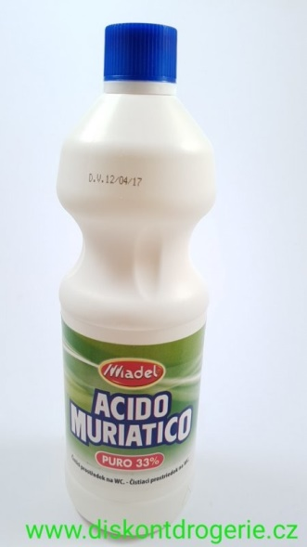
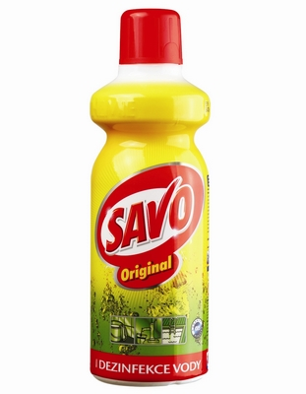


Preparations with hazard pictograms may be used in the household environment
Examples:
- detergents
- cleaning agents
- sprays
- pool chemicals
- DIY supplies
- etc.
NaOH
HCl
NaClO
8% CH₃COOH

Slide 13
Rules for handling chemical substances
General rules for Masaryk University
approved by Regional Hygiene Administration
available at https://provoz.rect.muni.cz/cs/cebe/chemicke-latky (Czech only)
Principles of Fire Protection and Safe Handling of Chemicals, Editors: Jaromír Literák, Barbora Loučková, Jiří Příhoda
Specific rules for particular departments
hazardous properties of chemical substances,
the rules of protecting health and the environment from their harmful effects,
the principles of pre-medical first aid.

Slide 14
Persons handling chemical substances are required to observe
hazard pictograms
signal words
H-Phrases
P-Phrases
specific rules for substances classified as:
corrosive,
toxic for target organs, category 1,
carcinogenic, category 1 or 2,
mutagenic, category 1 or 2,
reproductive toxicants, category 1A or 1B,
acutely toxic, category 1 or 2.
highly hazardous substances
The list of highly hazardous substances shall be stored in an electronic database and must be continuously updated. The update period cannot be longer than one year.

Slide 15
Packaging and labelling of chemicals
The packaging of the chemical or mixture is equipped with a label which contains the following information:
name, address and telephone number of the supplier,
amount of substance or mixture in the package,
product identifiers,
any required hazard warning symbols,
any required signal word,
any standard hazard phrases,
any precautionary phrases,
any additional information necessary.

Slide 16


Conditions for handling highly toxic substances
Class: acute toxicity
Category: 1 or 2
Chemical substances and mixtures classified of acute toxicity, category 1 or 2 must be stored in lockable rooms secured against theft and entry of unauthorised persons. Mutual harmful effects or misplacement of stored substances must be eliminated as well as leakage into the environment including danger to individuals.
The consumption of substances and mixtures classified as hazardous under acute category 1 or 2 must be recorded. These records must be kept separately for each substance and must include data on the quantity received and released, inventory status including the name of the person to whom the chemical or mixture was given. Records shall be kept for at least 5 years after the stock has been completely exhausted.

Slide 17
Who is qualified for handling highly toxic substances?
University graduates who:
have completed a university degree in general medicine, dentistry, pharmacy, veterinary medicine,
have obtained a university degree in the field of chemistry, biology, ecology,
have obtained a university degree in the field of toxicology.
Persons who:
have successfully passed a professional proficiency test and possess a certificate of professional competence authorising them to handle chemical substances classified as highly toxic

Slide 18
Accidents with chemical substances
Inhalation:
move the victim into the fresh air, do not let the victim walk!
rinse out mouth or nose with water
if the situation warrants, call an ambulance
Contact with eyes:
immediately rinse eyes with flowing water, open eyelid (even by force)
from the inner corner of the eye outward
if needed, remove contact lenses
call an ambulance
Contact with skin:
remove the affected clothing, rinse the affected area with a flow of tepid water
cover burned parts of the skin with sterile bandage
if the situation warrants, call an ambulance

Slide 19
Accidents with chemical substances
Ingestion:
highly toxic substances - apply charcoal in water, induce vomiting
toxic substances - apply charcoal in water
corrosives - drink cool water (200 – 500 ml), do not induce vomiting
seek medical attention as soon as possible
in case of uncertainty on how to proceed, contact Toxicology Information Centre, Prague

Slide 20
Chemical waste disposal
Only water-miscible chemicals may be poured into the sink and only in quantities which do not pose any risk to rivers or to the water sewage system such as water-soluble solvents up to 0.5 litres (diluted at least 10 times),
Acids and hydroxides (diluted 30 times, pH should remain within 6.5 - 8.5). Corrosives, acids and hydroxides may only be poured into sink while the water faucet runs.
Water-immiscible solvents which are toxic, flammable and explosive, concentrated acids and hydroxides and compounds releasing toxic or irritant fumes on contact with water, and heavy metal solutions cannot be poured into the sink.
Each workplace shall arrange for waste disposal through a company that the deals with the disposal of chemical waste.

Slide 21
Safety data sheet (SDS)
it is intended to provide workers with procedures for handling that substance in a safe manner,
includes information such as physical data (melting point, boiling point, flash point, etc.), toxicity, health effects, first aid, reactivity, storage, disposal, protective equipment, and spill-handling procedures.
SDS formats can vary from source to source within a country depending on national requirements.

Slide 22
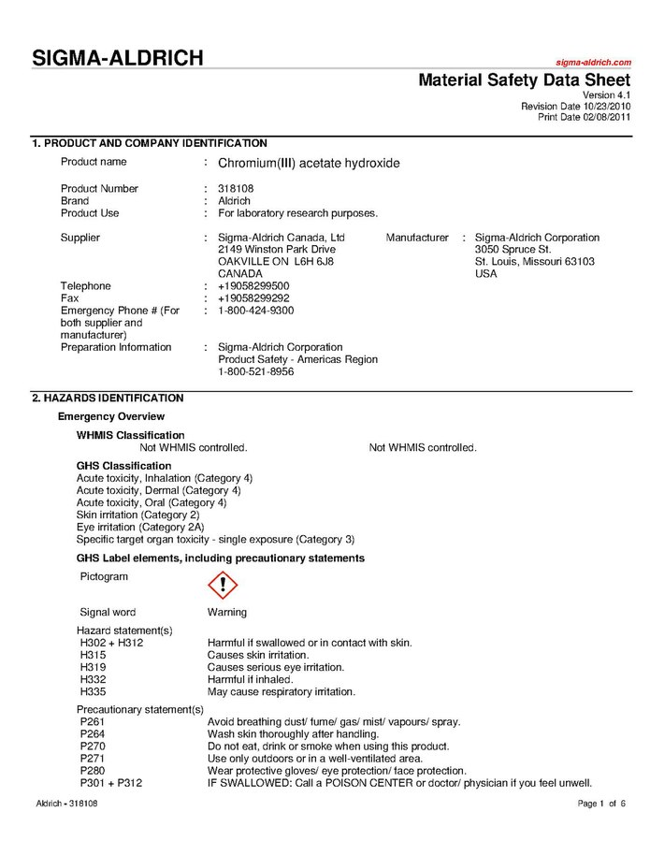
Example

