Slide 1
Anticancer drugs

Slide 2
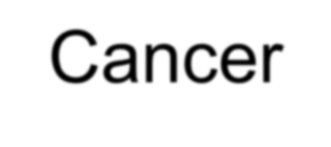
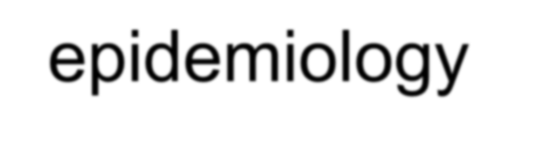

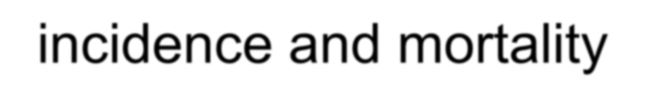
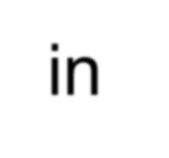

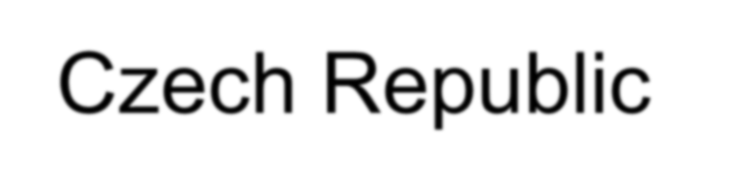



Cancer epidemiology - incidence and mortality in the Czech Republic
Breast Ca
Colorectal Ca
NSCLC
ZN prsu (C50) u žen
90
80
70
60
50
40
30
20
10
ZN kolorekta (C18-C21)
ZN plic (C34)
140
70
Počet na 100 000 žen
120
Počet na 100 000 osob
Počet na 100 000 osob
60
100
50
80
40
60
30
40
20
20
10
0
0
0
Rok
Rok
Rok
Prostatic Ca
Renal ca
Pancreatic Ca
ZN prostaty (C61)
ZN ledviny (C64)
20
18
16
14
12
10
8
6
4
2
0
ZN slinivky břišní (C25)
120
30
Počet na 100 000 mužů
100
Počet na 100 000 osob
25
Počet na 100 000 osob
80
20
60
15
40
10
20
5
0
0
Rok
Rok
Rok
incidence
mortalita
Czech Cancer Care in Numbers 2015

Slide 3
Complex Cancer Treatment
Surgery
Radiotherapy
Pharmacoterapy
Psychotherapy, physiotherapy, nutrition care

Slide 4
Pharmacotherapy
—cytostatic agents
‒classification according to the mechanism of action
—endocrine (hormonal) therapy
—targeted therapy
‒monoclonal antibodies targeting extracellular part of receptors
‒tyrosine kinase inhibitors / intracellular signaling cascades inhibitors
—pain management, supportive care

Slide 5
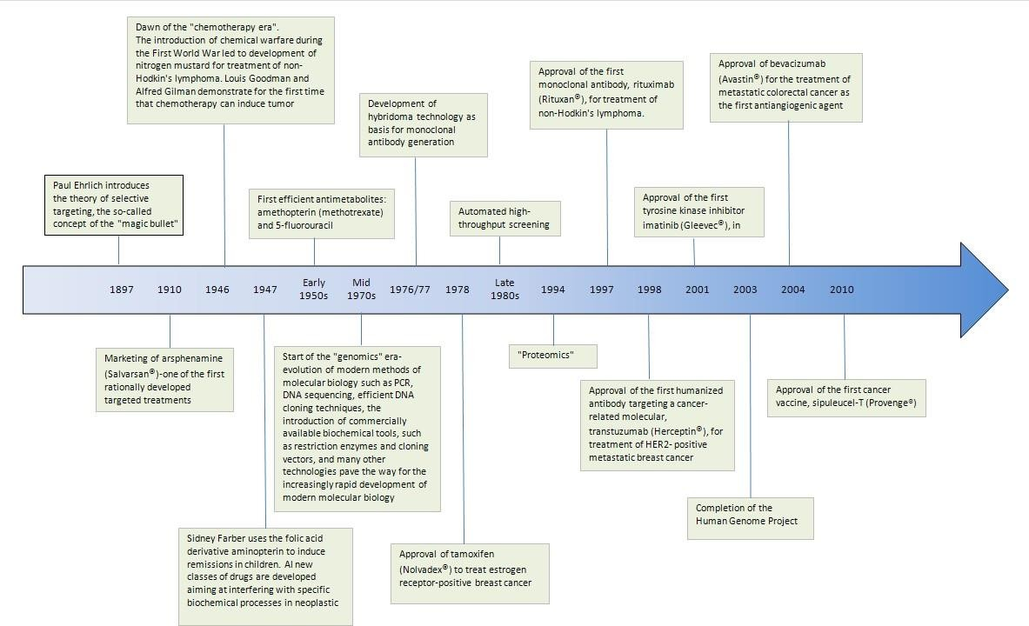

Slide 6
Cytostatic drugs
—route of administration:
—parenterally (i.v. bolus, infusion, intrathecally, intravesically…)
—orally
—posology: dose in mg/m² or mg/kg
—monotherapy and combination regimens
—repeated administration in cycles
pause = patient‘s recovery, prevention of severe AE
+ „waking“ dormant cells in G₀ phase

Slide 7
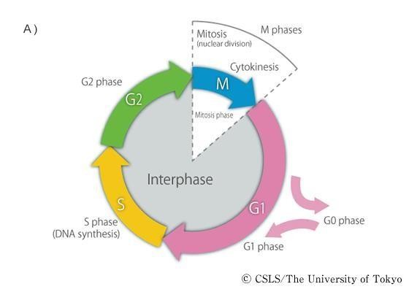
Cytostatic drugs
Different efficacy according to the cell cycle phase:
—Cell cycle non-specific cytostatics (e.g., busulfan)
—Cell cycle specific cytostatics:
−Phase-nonspecific (e.g., some of alkylating agents)
−Phase-specific (e.g., antimetabolites, taxanes)
http://csls-text3.c.u-tokyo.ac.jp/active/13_01.html

Slide 8
Cytostatics according to their MoA
Drugs that damage the structure of DNA
  Alkylating agents
  Platinum derivatives
  Intercalating agents
  Bleomycin
Drugs that inhibit key enzymes of DNA metabolism
  Antimetabolites:
    Purine analogues
    Pyrimidine analogues
    Folic acid analogues iv.Hydroxyurea
  Topoisomerase inhibitors:
    Inhibitors of topoisomerase I – camptothecins
    Inhibitors of topoisomerase II – podophyllotoxins
Drugs that alter microtubules
  Inhibitors of tubulin polymerization – Vinca alkaloids
  Inhibitors of tubulin depolymerization – taxanes
Others
  Drugs that inhibit protein synthesis – L-asparaginase

Slide 9
Drug groups overview

Slide 10
Cytostatics according to their MoA
Drugs that damage the structure of DNA
  Alkylating agents
  Platinum derivatives
  Intercalating agents
  Bleomycin
Drugs that inhibit key enzymes of DNA metabolism
  Antimetabolites:
    Purine analogues
    Pyrimidine analogues
    Folic acid analogues iv.Hydroxyurea
  Topoisomerase inhibitors:
    Inhibitors of topoisomerase I – camptothecins
    Inhibitors of topoisomerase II – podophyllotoxins
Drugs that alter microtubules
  Inhibitors of tubulin polymerization – Vinca alkaloids
  Inhibitors of tubulin depolymerization – taxanes
Others
  Drugs that inhibit protein synthesis – L-asparaginase

Slide 11
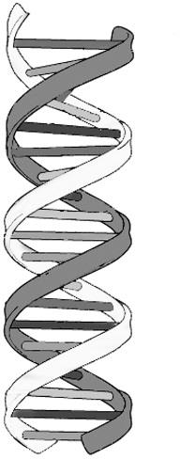
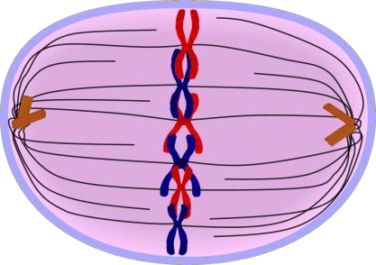
1a) Alkylating agents
alkylating agents
DNA structure
A C T G
THF
syntesis
DHF

Slide 12

1a) Alkylating agents
MoA: transfer of the alkyl group on nitrogen in nucleobases, covalent bond
between two guanines of one or two DNA strands
– Inhibition of replication, cell cycle arrest
50s: first derivatives of sulphur mustard in the clinical practice
AE – typical toxicity: secondary malignancies – hematological

Slide 13
1a) Alkylating agents – main drugs
CHLORAMBUCIL
IFOSFAMIDE
Nitrosourea derivatives:
MELPHALANE
CYCLOPHOSPHAMIDE
CARMUSTINE
LOMUSTINE
ALKYLATING AGENTS
TEMOZOLOMIDE
BUSULFAN
MITOMYCIN C
DACARBAZINE

Slide 14
1a) Alkylating agents
Melphalane
i.v., p.o. administration
treatment of hematological malignancies and solid tumors
Cyclophosphamide
i.v., p.o. administration
prodrugs → CYP450 → cytotoxic metabolites
AE: urotoxicity, emetogenity
low doses – immunosuppressant
hematological malignancies and solid tumors
Lomustine
p.o. administration
lipophilic, crosses BBB → treatment of brain tumors

Slide 15
1a) Alkylating agents
Temozolomide
100% bioavailability after oral administration
crosses BBB → treatment of brain tumors
Busulfan
i.v., p.o. administration
bone marrow transplantation
treatment of hematological malignancies

Slide 16
1b) platinum derivates
platinum derivatives
DNA structure
A C T G
THF
syntesis
DHF

Slide 17
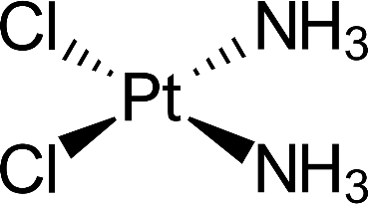
1b) platinum derivates
MoA: binding on DNA, cross-linking of DNA strands, inhibition of topoisomerases
AE – most important: emetogenity, nephrotoxicity
  AE are dose-dependent
  prevention of nephrotoxicity: i.v. hydration, forced diuresis
cisplatin – high nephrotoxicity
  treatment of solid tumors
others:
  carboplatin
  oxaliplatin – typical neurotoxicity

Slide 18
1c) intercalating agents
intercalating agents
DNA structure
A C T G
THF
syntesis
DHF

Slide 19
1c) intercalating agents
Anthracyclines
MoA: intercalation = insertion between base pairs, binding of DNA strands
AE – typical toxicity: acute and chronic cardiotoxicity
cardioprotective cumulative dose = restraint of therapy (e.g., doxorubicin 550 mg/m²)
i.v., intravesical administration
doxorubicin
  treatment of hematological malignancies and solid tumors
  modern dosage form (PEGylated liposomes) – higher cumulative dose (860 mg/m²)
others: epirubicin…

Slide 20
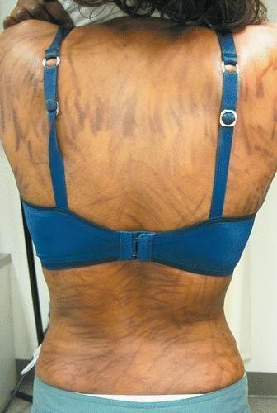
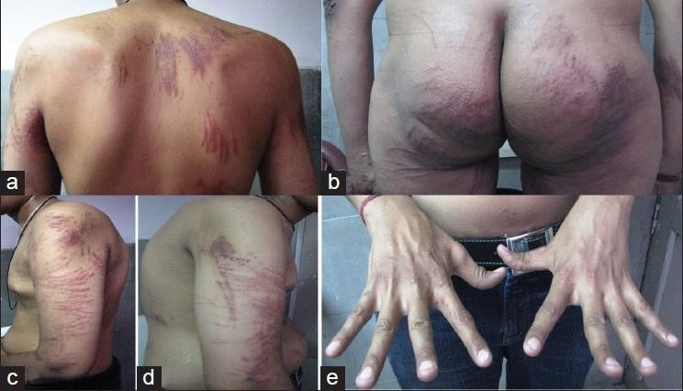
1d) bleomycin
MoA: intercalation between base pairs
+ inhibition of thymine incorporation
→ breaks → DNA fragmentation („radiomimetic“ effect)
i.v. administration
treatment of solid tumors
typical AE: fever, hyperkeratosis and hyperpigmentation of skin (flagellate = whip-like)
risk of anaphylactic reaction

Slide 21
Cytostatics according to their MoA
Drugs that damage the structure of DNA
  Alkylating agents
  Platinum derivatives
  Intercalating agents
  Bleomycin
Drugs that inhibit key enzymes of DNA metabolism
  Antimetabolites:
    Purine analogues
    Pyrimidine analogues
    Folic acid analogues
    Hydroxyurea
  Topoisomerase inhibitors:
    Inhibitors of topoisomerase I – camptothecins
    Inhibitors of topoisomerase II – podophyllotoxins
Drugs that alter microtubules
  Inhibitors of tubulin polymerization – Vinca alkaloids
  Inhibitors of tubulin depolymerization – taxanes
Others
  Drugs that inhibit protein synthesis – L-asparaginase

Slide 22
2a. antimetabolites
antimetabolites
metabolism of
nucleic acids
A C T G
THF
syntesis
DHF

Slide 23
2a. antimetabolites
- MoA: false substrates = affinity to target structure, loss of endogenous effect → blockade of nucleic acid synthesis, inhibition of nucleotides metabolism enzymes, production of non-sense DNA sequences
- prodrugs: intracellular activation mostly by phosphorylation
purine analogues – 6-mercaptopurine, azathioprine, fludarabine…
pyrimidine analogues – fluorouracil, capecitabine, gemcitabine…
folic acid analogues – methotrexate, pemetrexed…

Slide 24
2a. Antimetabolites – i/ purine analogs
6-Mercaptopurin
MoA: inhibition of purine nucleobases biosynthesis de novo, inhibition of mutual conversion of purine nucleotides
thiopurin methyltransferase (TPMT): MP → MeMP
  genetic polymorphism – ↑toxicity / ↓efficacy
  available pharmacogenetic testing of TPMT
p.o. administration, treatment of hematologic malignancies
azathioprine – prodrug of MP, immunosuppressant
inactive

Slide 25
2a. Antimetabolites – ii/ pyrimidines analogs
5-Fluorouracil
MoA: incorporation to RNA + inhibition of thymidylate
synthetase
combined chemotherapeutic regimens of solid cancers (i.v.)
AE – typical toxicity: GIT toxicity (mucositis)
biochemical modulation of effect: leucovorin (folinic acid)
enhances binding on thymidylate synthetase, i.v. administered before FU
– „FUFA“ regimen = colorectal carcinoma
capecitabine – prodrug

Slide 26
2a. Antimetabolites – iii/ folic acid analogs
Methotrexate
- MoA: inhibition of dihydrofolate reductase, thymidylate synthetase and other enzymes
i.v., intrathecal administration, p.o.
leucovorin (folinic acid) – „rescue therapy“, antidote
forces free MTX out of healthy cells ; in cancer cells, polyglutamylation is more intensive → more MTXPG → MTXPG cannot be forced out
TDM – calculation of time interval from MTX administration, frequently in pediatric patients, less frequent in adults
AE – typical toxicity:
nephrotoxicity – precipitation (acute renal failure)
prevention: hydration, urine alkalinization (pH 7–7,5)
pneumotoxicity
low-dose MTX = immunosuppressant (p.o.)
high-dose MTX = hematological malignancies

Slide 27
Cytostatics according to their MoA
Drugs that damage the structure of DNA
  Alkylating agents
  Platinum derivatives
  Intercalating agents
  Bleomycin
Drugs that inhibit key enzymes of DNA metabolism
  Antimetabolites:
    Purine analogues
    Pyrimidine analogues
    Folic acid analogues
    Hydroxyurea
  Topoisomerase inhibitors:
    Inhibitors of topoisomerase I – camptothecins
    Inhibitors of topoisomerase II – podophyllotoxins
Drugs that alter microtubules
  Inhibitors of tubulin polymerization – Vinca alkaloids
  Inhibitors of tubulin depolymerization – taxanes
Others
  Drugs that inhibit protein synthesis – L-asparaginase

Slide 28
2b. Topoisomerase inhibitors
A C T G
THF
syntesis
DHF
DNA replication
topoisomerase inhibitors

Slide 29
2b. Topoisomerase inhibitors
Topoisomerase I inhibitors – camptothecins
plant-derived drugs – identification in bark of the tree
Camptotheca acuminata
derivatives: irinotecan, topotecan
  treatment of solid tumors
Topoisomerase II inhibitors – podophyllotoxins
plant-derived drugs – identification in Podophyllum peltatum
derivatives: etoposide, teniposide
  treatment of solid tumors (etoposide) and hematological malignancies (teniposid)

Slide 30
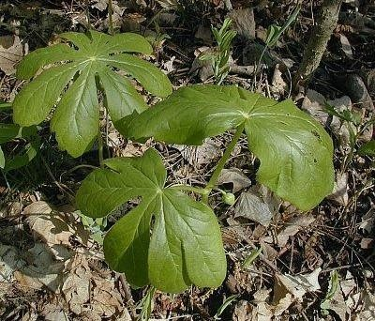
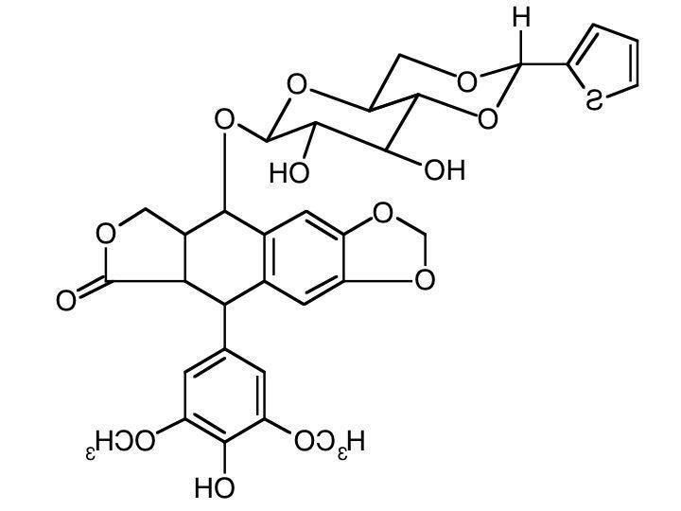
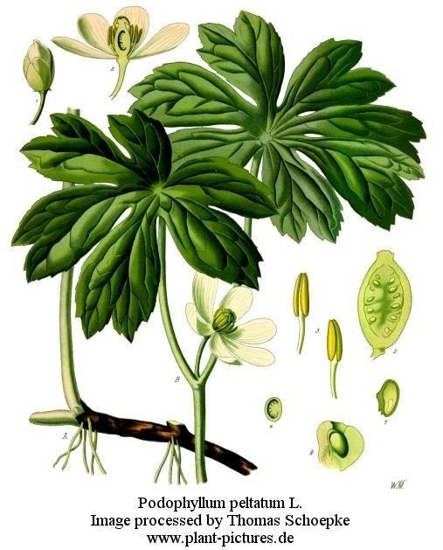
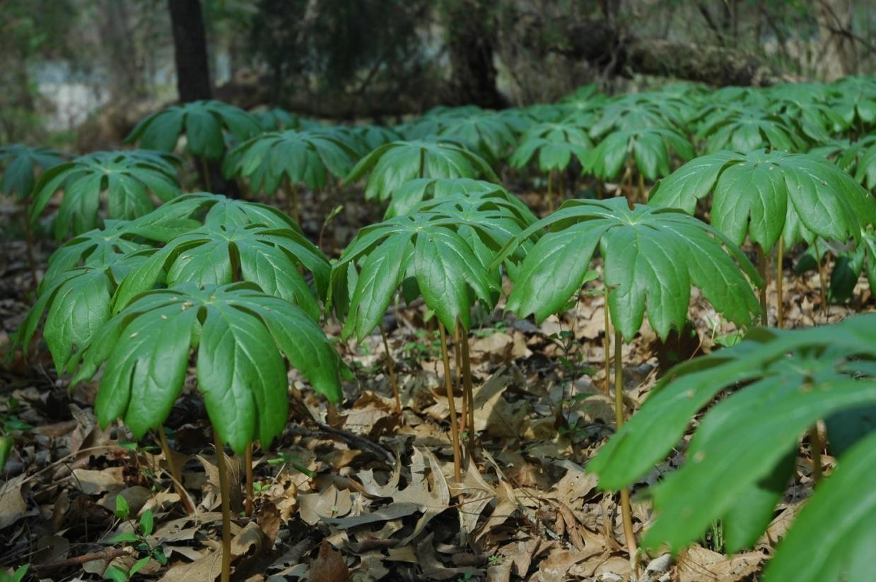
ETOPOSIDE

Slide 31
Cytostatics according to their MoA
Drugs that damage the structure of DNA
  Alkylating agents
  Platinum derivatives
  Intercalating agents
  Bleomycin
Drugs that inhibit key enzymes of DNA metabolism
  Antimetabolites:
    Purine analogues
    Pyrimidine analogues
    Folic acid analogues iv.Hydroxyurea
  Topoisomerase inhibitors:
    Inhibitors of topoisomerase I – camptothecins
    Inhibitors of topoisomerase II – podophyllotoxins
Drugs that alter microtubules
  Inhibitors of tubulin polymerization – Vinca alkaloids
  Inhibitors of tubulin depolymerization – taxanes
Others
  Drugs that inhibit protein synthesis – L-asparaginase

Slide 32
3. Tubulin alterating cytostatics
A C T G
THF
syntesis
DHF
tubulin
Vinca alkaloids and taxanes

Slide 33
3a. Vinca alkaloids
- ant-derived drugs
- MoA: inhibition of tubuline dimers polymerization inhibition of mitotic spindle formation, depolymerization prevails
i.v. administration, some for p.o. (vinorelbine)
treatment of hematological malignancies and solid tumors
- AE – typical toxicity: peripheral neuropathy
original alkaloids: vincristine, vinblastine
semisynthetic derivatives: vinorelbine, vindesin, vinflunine
increased affinity to mitotic spindle tubulin, ↓AE

Slide 34
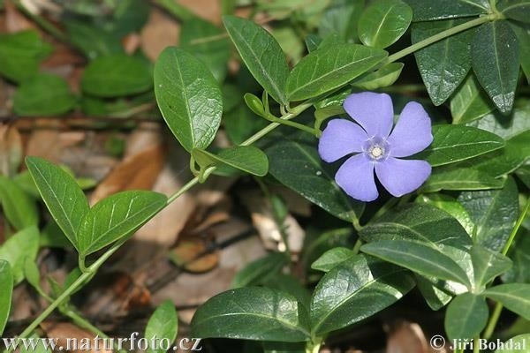
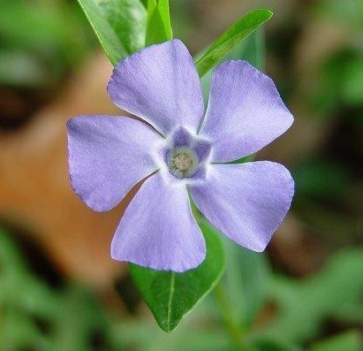
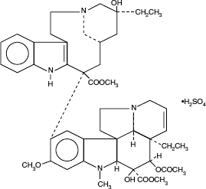
Vinca alkaloids
identification: lesser periwinkle (Vinca minor)
isolation:
Cataranthus roseus
VINBLASTINE

Slide 35
3b. taxanes
- plant-based drugs
- MoA: inhibition of tubulin depolymerization
i.v. administration – treatment of solid tumors
AE – typical toxicity: neurotoxicity
paclitaxel, docetaxel, cabazitaxel
modern dosage form: paclitaxel conjugated with albumine nanoparticles
- transporter protein for albumine in cancer cells = better
distribution from circulation into the tissues
– ↓toxicity, ↑efficacy

Slide 36
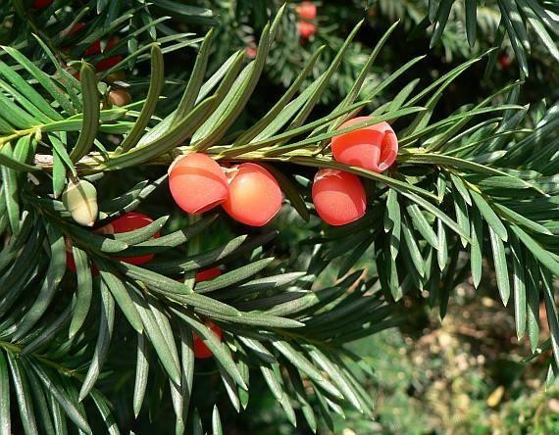
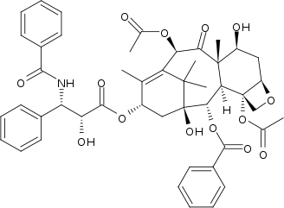
Taxanes
identification and isolation: Taxus brevifolia (Pacific yew) a Taxus baccata (European yew)
PACLITAXEL

Slide 37
Combination of cytostatics
monotherapy
combination regimens – examples:
FUFA FOLFOX ABVD BEACOPP
fluorouracil, folinic acid
folinic acid, fluorouracil, oxaliplatin
doxorubicin, bleomycin, vinblastine, dacarbazine
bleomycin, etoposide, doxorubicin, cyclophosphamide, vincristin, procarbazine, prednisone

Slide 38
„Targeted therapy“in oncology

Slide 39
Targeted therapy in oncology (biological therapy)
„target“ should be on A/ tumor cells
- Cell membrane receptor – extracellular part or/ intracellular signalling pathway
B/ immune system (specific T-cells) – cancer immunotherapy
- Immune check-point inhibitors (anti-CTLA-4 or anti-PD(L)1)

