Slide 1
Anticonvulsive drugs (antiepileptics)

Slide 2
Epilepsy
brain disorder characterized by an enduring predisposition to generate epileptic seizures and by the neurobiologic, cognitive, psychological, and social consequences of this condition
Seizures
  manifestation of abnormal hypersynchronous or hyperexcitable discharges of cortical
neurons
  many causes, including a genetic predisposition for certain types of seizures, head trauma, stroke, brain tumors, alcohol or drug withdrawal, repeated episodes of metabolic insults, such as hypoglycemia
Prevalence 0,5–1 %

Slide 3
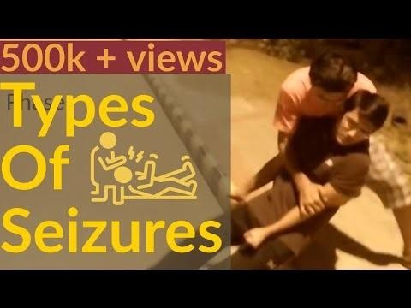
Types of seizures

Slide 4
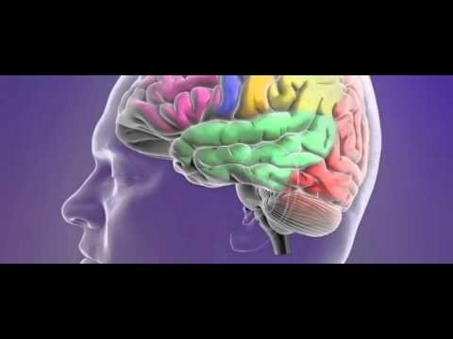
Types of seizures

Slide 5
Factors lowering seizure threshold
Sleep deprivation
Alcohol withdrawal
Television flicker
Epileptogenic drugs
Systemic infection
Head trauma
Recreational drugs
Non-compliance
Menstruation
Dehydration
Barbiturate withdrawal
Benzodiazepine withdrawal
Hyperventilation
Flashing lights
Diet and missed meals
Stress
Intense exercise

Slide 6
Pharmacotherapy
The goal to achieve a seizure-free status without adverse effects
Monotherapy is desirable - avoids drug interactions
Many of the older anticonvulsant agents have hepatic enzyme– inducing properties
Main mechanism - to stabilize membrane of neuron and to decrease the excitability

Slide 7
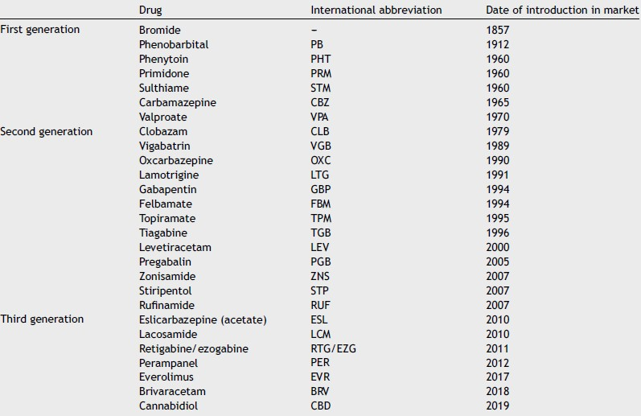
An Pediatr (Barc). 2019;91(6):415.e1--
-415.e10

Slide 8
Mechanisms of action
Classical
  Enhancement of GABA mainly via GABA-A rc
  Inhibition of sodium channel function
  Inhibition of calcium channel function
Mechanisms of newer drugs
  Inhibition of glutamate release
  Inhibition of GABA uptake
  AMPA receptor antagonism
  Synaptic vesicle protein SV2A
(multiple mechanisms)

Slide 9
GABA-ergic drugs
Barbiturates (phenobarbital), BZD
Vigabatrin – irreversible inhibition of GABA transaminase
Tiagabine – inhibitor of GABA transporter (increases extracellular GABA)
Stiripentol
— increases GABA effect similarly as barbiturates and inhibits lactate dehydrogenase, which may reduce metabolic energy prodcution requiered to mainain the seizure, used as adjunctive treatment in children
GABAergics may exacerbate absences

Slide 10
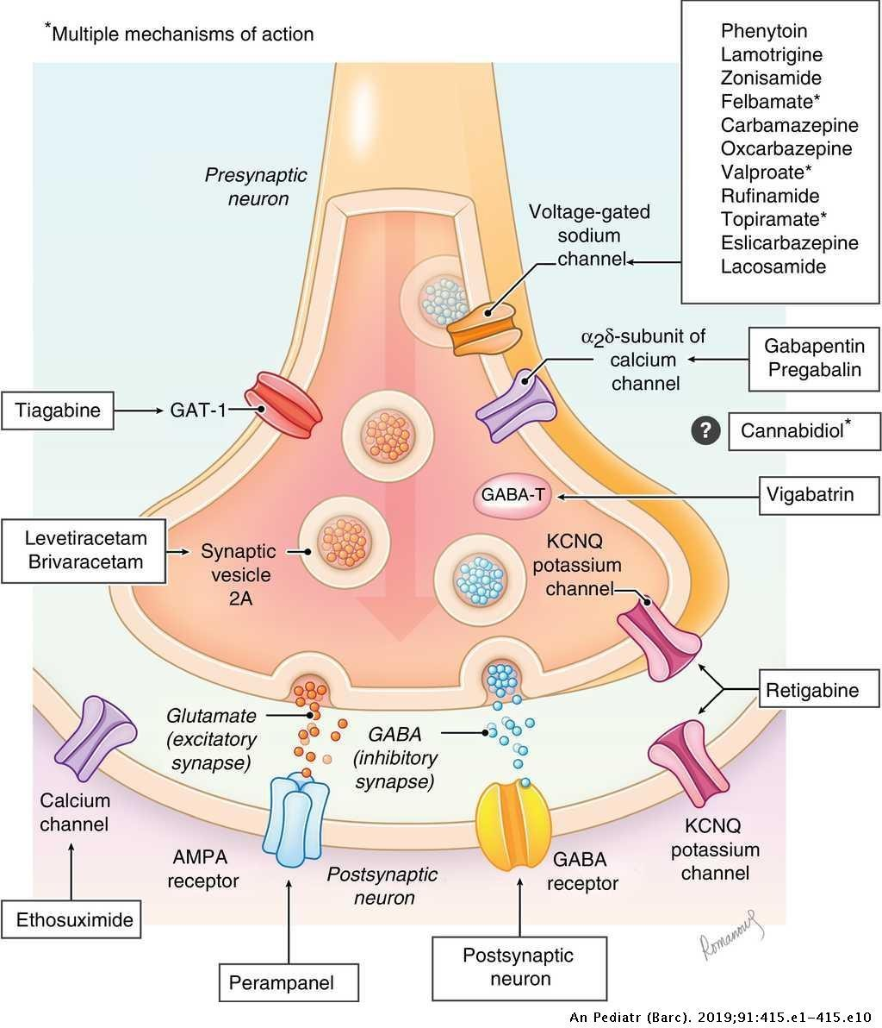
An Pediatr (Barc). 2019;91(6):415.e1-
--415.e10

Slide 11
Na+ channel inhibitors
Carbamazepine
Lamotrigine
Phenytoin
Lacosamide
Bind preferentially to incativated channels and lower the number of functional channels able to generate action potential

Slide 12
An Pediatr (Barc). 2019;91(6):415.e1-
--415.e10

Slide 13
Ca2+ channel inhibitors
Ethosuximide, valproate
  Act primarily on T type channels in the thalamus, which are responsible for absences
Gabapentin, pregabalin
  GABA analogues, act primarily on P/Q type channels
  Lower trafficking of the channels to the membrane - reduce the calcium entry to the cell – reduce neurotransmitter release

Slide 14
An Pediatr (Barc). 2019;91(6):415.e1-
--415.e10

Slide 15
Other mechanisms
Levetiracetam, brivaracetam
  Bind to SV2A protein and probably have also other mechanisms
Perampanel, topiramate (multiple mechanisms)
  AMPA antagonism
Rufinamide
  Inhibition of GABA reuptake
Retigabine
  Opens KCNQ/Kv7 potassium channels

Slide 16
An Pediatr (Barc). 2019;91(6):415.e1-
--415.e10

Slide 17
Multiple mechanisms
Valproate
  Inhibition of both sodium and calcium channels (T type), GABA transaminase
  All types of seizures
Felbamate
  Inhibition of both sodium and calcium channels, GABA-A and NMDA rc
  Lennox-Gastaut sy
Topiramate
  Inhibition of both sodium and calcium channels, GABA-A and AMPA rc
  Lennox-Gastaut sy
Zonisamide
  Inhibition of both sodium and calcium channels, GABA-A rc
  Partial seizures

Slide 18
Choice of anticonvulsant agent
— https://pathways.nice.org.uk/pathways/epilepsy#path=view%3A/ pathways/epilepsy/anti-epileptic-drugs-to-offer-based-on- presenting-epilepsy-seizure-types.xml&content=view- node%3Anodes-absence-seizures

Slide 19
All types of seizures
— All but absence
— Carbamazepine (oxcarbazepine, eslicarbazepine), phenytoin, phenobarbital (primidon)
— All
— Vigabatrin, lamotrigine, valproate

Slide 20
Treatment of specific types of seizures
Absence
  ethosuximide or valproate
  lamotrigine
Partial (focal) seizures
  Carbamazepine or lamotrigine
  Valproate, levetiracetam, clobazam, gabapentin, topiramate
Generalised tonic–clonic seizures
  Valproate, carbamazepine or lamotrigine
  Topiramate, levetiracetam
Myoclonic seizures
  Valproate, topiramate, levetiracetam

Slide 21
Status epilepticus
Critical, life threatening condition, one seizure comes after another without recovery, lasts at least 30 min, fatal in 5-10% patients
  Shall be distinguished from a series of seizures with recovery in between
Causes – frontal lobe lesion (including stroke), head trauma, anticonvulsant discontinuation, alcohol withdrawal, metabolic
disturbances, pregnancy
  Requires inpatient treatment – energetically demanding condition, hypoglycaemia, lung edema, hyperthermia, excitotoxicity, ...
Lorazepam IV or midazolam IM or diazepam rectally

Slide 22
Epilepsy resistant to monotherapy
Consider combination therapy when:
  Treatment with two first line AEDs has failed
  The first well-tolerated drug substantially improves seizure control, but fails to produce
seizure freedom at maximal dosage.
  The choice of drugs in combination should be matched to the patient’s seizure type(s) and should be limited to two or at most three AEDs.
Gabapentin, lacosamide, lamotrigine, levetiracetam, pregabalin, topiramate, zonisamide (alphabetical order) may be considered as adjunctive therapy dependent on patient and seizure type.

Slide 23
Other uses on antiepileptic drugs
Bipolar disorder (valproate, carbamazepine, oxcarbazepine, lamotrigine, topiramate)
Prophylaxis of migraine (valproate, gabapentin, topiramate)
Anxiety disorders (gabapentin, pregabalin)
Neuropathic pain (gabapentin, pregabalin, carbamazepine, lamotrigine)

Slide 24
Generic substitution
— Changing the formulation or brand of AED is NOT recommended because different preparations may vary in bioavailability or have different pharmacokinetic profiles and, thus, increased potential for reduced effect or excessive side effects.

