Slide 1
Spirometric examination
Recording of forced vital capacity
Physiology I – practice
Autumn, weeks 7–9

Slide 2
Static lung volumes
Static lung volumes:
  Tidal volume Vt (0.5 L)
  Inspiratory reserve volume IRV (2.5 L)
  Expiratory reserve volume of the ERV (1.5 L)
  Residual volume RV (1.5 L)
Static lung capacity:
  Vital capacity of lungs VC (4.5 L)
  = IRV+Vt+ERV
  Total lung capacity TLC (6 L)
  = IRV+Vt+ERV+RV
  Inspiratory capacity IC (3 L)
  = IRV+Vt
  Functional residual capacity FRC (3 L) = ERV+RV
  Depends on height, weight, age and gender – RV increases, VC decreases with age
  All volumes can be measured with spirometer except RV and FRC

Slide 3
Static lung volumes
V (l)
IC
IRV
VC
TLC
EC
Vt
ERV
RV
FRC
t (min)

Slide 4
Frequency and depth of breathing
Changes in respiration rate
Changes in resiratory depth
Eupnea – resting respiration
Bradypnea – slow respiration
Hyperpnea – deep respiration
Tachypnea – fast respiration
Hypopnea – shallow respiration

Slide 5
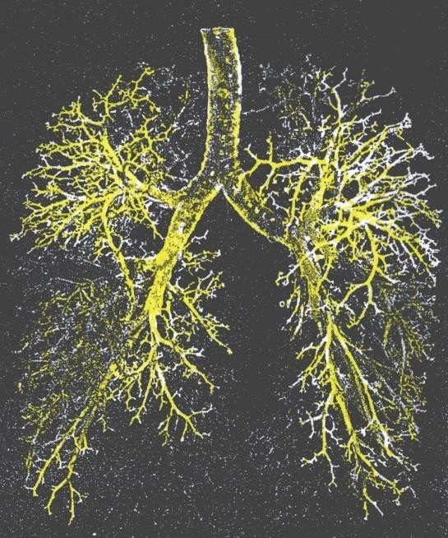
Dead space
Dead space represents the volume of ventilated
air that does not participate in gas exchange
There are two types of dead space:
  Anatomic – represented by the volume of air that fills the conducting zone of respiration made up by the nose, trachea, and bronchi (this volume is considered to be 30% of normal tidal volume (500 mL); therefore, the value of anatomic dead space is 150 mL)
  Physiologic or total dead space is equal to anatomic plus alveolar dead space which is the volume of air in the respiratory zone (respiratory bronchioles, alveolar duct, alveolar sac, and alveoli ) that does not take part in gas exchange
In a healthy adult physiologic dead space is equivalent to anatomic

Slide 6
Dynamic lung volumes
Resting respiration:
  Respiratory rate 10-18 breaths/min
  Minute ventilation – air volume at respiration per minute (Vt x respiration rate)
  5-9 l/min
Maximum voluntary ventilation (MVV) – the amount of air that can be ventilated at maximum effort (up to 160 l/min)
  Ventilation is increased by increasing both the respiration rate and depth of the respiration
Respiratory reserve = maximum ventilation / resting ventilation
Parameters of forced vital capacity

Slide 7
Recording of forced vital capacity

Slide 8
Lung diseases
Obstruction: increased airway resistance (asthma, bronchitis, vocal cord swelling, tracheal stenosis, COPD, tumor in the airways)
Restrictions: decreased lung volumes (tumor, inflammation, swelling of the lungs, pneumothorax... )
An increase in the respiratory rate at a constant tidal volume leads to a relative increase in dead space

Slide 9
Recording of forced vital capacity
Dynamic lung volumes
  FVC – forced vital capacity – the maximum volume of air that can be exhaled after maximum inhale
  FEV₁ – forced expiratory volume in 1 second – the volume of air exhaled with the greatest effort in 1st second after maximum inhale
  FEV₁/FVC ratio (%) – relative forced expiratory volume in 1 second = Tiffeneau index
  0.7-1.0 (70%-100%)
V [l]
FEV₁
FVC
RV
1 s
Time [s]

Slide 10
Recording of forced vital capacity
Obstructive diseases:
  Obstruction → increased resistence in the airways
  Causes: asthma, bronchitis, vocal cord swelling, tracheal stenosis, COPD, tumor in the airways
  FVC normal, FEV₁ ↓, Tiffeneau index ↓ (<0.7)
V [l]
FEV₁
FEV₁
1 s
Time [s]

Slide 11
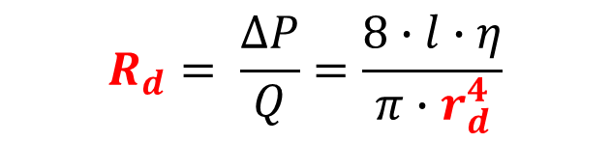
Airway resistance (Hagen-Poiseuille law)
Airway resistance (R_{d}) arises as a result of internal friction between the flowing gas and the airway wall.
  A small change in the radius of the airways (r_{d}) causes a significantly larger change in the resistance to airflow (R_{d}).
  Narrowing (obstruction) of the airways occurs when the chest is compressed, the mucous membrane becomes swollen, the vocal cords swell, the smooth muscles of the airways are constricted, when a foreign body is inhaled, during an asthma attack or other allergic reaction
  Bronchioles are the most involved in resistance: they possess a large proportion of smooth muscle and no cartilaginous reinforcement, they also contain receptors for various agents (histamine – bronchioloconstriction, adrenaline – bronchiolodilation)
$$R_{d}= \frac{∆P}{Q}=\frac{8∙l∙\text{η}}{π∙r_{d}^{4}}$$

Slide 12
Recording of forced vital capacity
Restrictive diseases:
  Restriction: decreased lung volumes
  Causes: pulmonary (fibrosis, resection, edema, pneumonia) or extrapulmonary (ascites, kyphoscoliosis, burns, elevated diaphragm)
  FVC ↓, FEV₁ N or ↓, Tiffeneau index N or ↑
  If the expiratory muscles are strong enough, Tiffeneau index value can be 100% and it is not a pathology. Therefore, its usage during the diagnosis of a restrictive disorder is not suitable.
V [l]
FVC > FVC
1 s
Time [s]

Slide 13
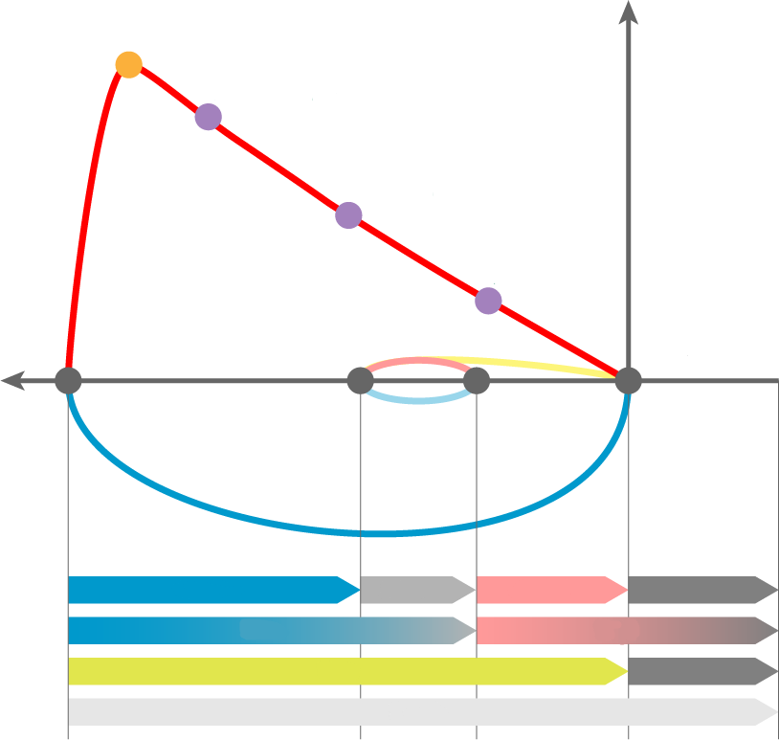
Maximal respiratory flow – volume curve
Principle: the measurement of the airflow velocity according to the speed of the turbine. Then the volumes are calculated.
PEF – peak expiratory flow; the highest speed of airflow at peak of exhale
MEF – maximum expiratory flow rates at different FVC levels, which is still to be exhaled (75%, 50% and 25% of FVC)
PEF
MEF_{25%}
MEF_{50%}
MEF_{75%}
IRV
Vt
ERV
RV
IRC
FRC
VC
RV
TLC

Slide 14
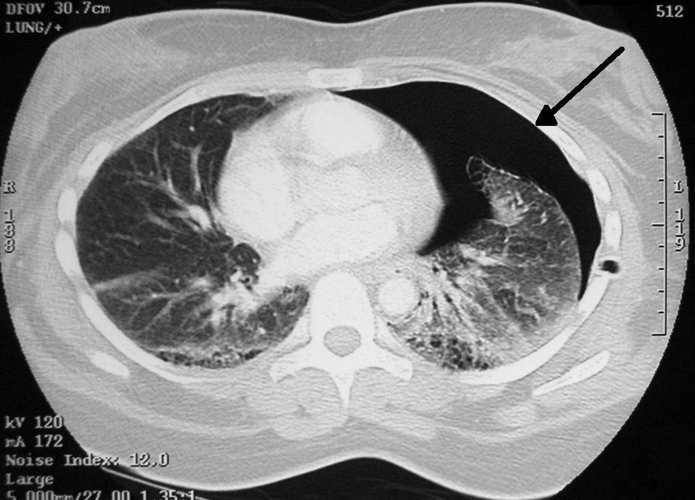
Pneumothorax
Accumulation of air or other gas in the pleural cavity with a partial or complete collapse of the lung
  It can be traumatic (chest injury, rib fracture), spontaneous (unknown origin), caused by a disease (COPD, cystic fibrosis) or caused by surgery
  Symptoms: shortness of breath, pain, higher lung resistance, decreased heart filling, decrease in blood pressure, tachycardia, decreased blood oxygen saturation
  Tension pneumothorax: occurs in the so-called valve mechanism, when air penetrates into the pleural cavity during inhalation and during exhalation the defect closes which leads to an air accumulation in the cavity. It is the most dangerous type of pneumothorax because the air accumulating in the thoracic cavity gradually oppresses all the mediastinal organs to the unaffected side, thereby oppressing even the second lung, worsening the functions of the heart and causing damage to large vessels.

