Slide 1
Physiology of blood. Blood types. Immune system.
Budínská Xenie

Slide 2
Final exame questions
76. Blood composition – values
77. Red blood cell. Haemolysis.
78. Haemoglobin and its derivatives
79. Suspension stability of RBC (sedimentation rate)
80. Mechanism of innate immunity
81. Acquired immunity
82. Blood groups antigens
83. Function of platelets
84. Hemocoagulation
85. Anticlotting mechanism

Slide 3
Functions of the blood
homeostatic function
buffering
thermoregulation (transport of heat)
transport of substances
blood gases
nutrients
metabolites
vitamins
electrolytes
humoral control of organism (hormones)
defence of organism (immune functions)
blood clotting

Slide 4
Basic characteristics
Suspension character
6 - 8% total body mass
55% - fluid phase (plasma)
45% - formed phase (blood cells)

Slide 5
Blood plasma. Inorganic substances
Na⁺ (137-147 mmol/l): osmotic pressure, volume, pH
Cl⁻ (98-106 mmol/l): osmotic pressure, volume, pH
K⁺ (3,8-5,1 mmol/l): muscle aktivity
Ca²⁺ (2,1-2,7mmol/l): nerve excitability, muscle aktivity, blood clotting, membrane permeability, bone mineralization
P (0,65-1,62 mmol/l): pH regulation, bone mineralisation
Mg²⁺ (0,75-1,25 mmol/l): enzyme activity, nerve excitability
HCO₃⁻ (25-34 mmol/l): CO2 transport, pH maintenance
Fe (16-25 μmol/l): part of haemoglobin - gas transport
I (275-630 nmol/l): thyroid hormone production

Slide 6
Blood plasma. Organic substances.
Plasma proteins 60-80 g/l
Albumins (40-48 g/l): oncotic pressure, transport of ions, fatty acids, hormones
Globulins (18-30 g/l)
α-globulins: transport of hormones, metals, vitamins
β- globulins: heme binding, vit. B12, iron, cholesterol transport
γ- globulins: antibodies, specific immunity
Fibrinogen (3 g/l): blood clotting
Lipids (4-10 g/l)
Glucose (4-5,5 mmol/l)
Nitrogen substances (0,2-0,4 g/l): urea, bilirubin, amino acids
Hormones, vitamins, enzymes, drugs

Slide 7
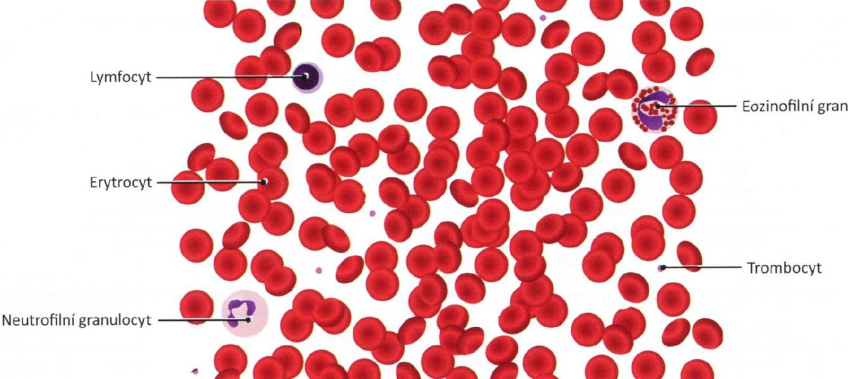
Formed blood elements

Slide 8
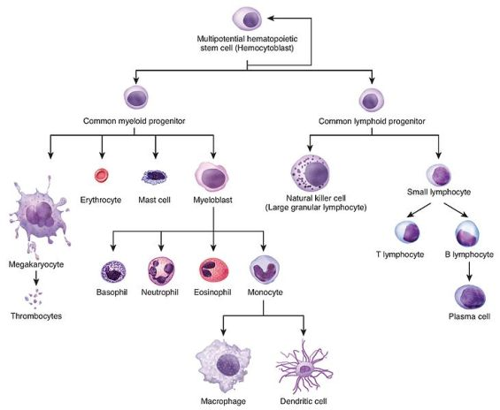
Haematopoiesis

Slide 9
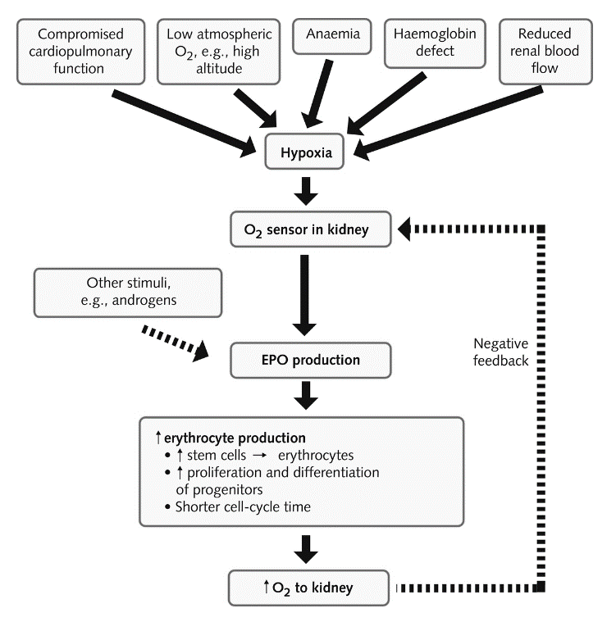
Erythropoiesis
Erythropoietin - formation in the kidneys
acts on sensitive determinate progenitor cells in the bone marrow
stimulates nucleic acid synthesis
activates genes required for haemoglobin synthesis
increases Fe intake
Substances needed for erythrocyte production
amino acids: the protein part of haemoglobin
iron: binding of oxygen to haemoglobin and myoglobin
vitamin B12: essential for DNA synthesis
Folic acid: essential for DNA synthesis

Slide 10
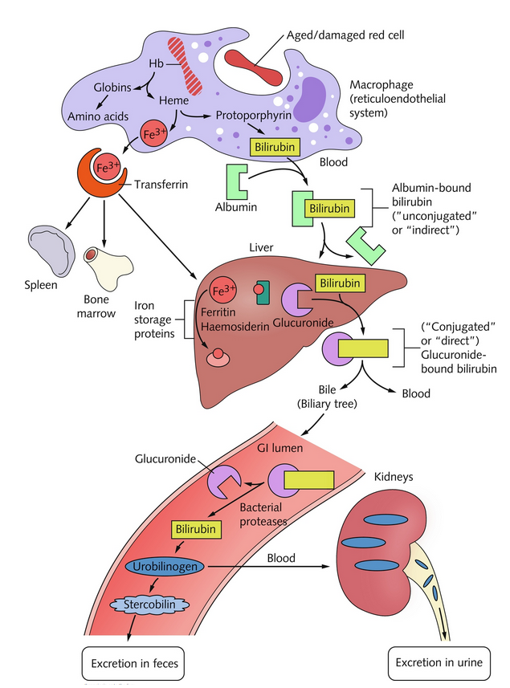
Extinction of red blood cells
Spleen: phagocytosis of old and damaged erythrocytes
Hemoglobin=globin+hem
Globin – amino acids
Hem=CO2+Fe+biliverdin
Fe – synthesis of additional hemoglobin

Slide 11
Red blood cell
biconcave disc - the shape increases the surface by 30%
shape is ensured by the protein spectrin
shape plasticity important for penetration through narrow capillaries

Slide 12
Functions of the RBC
Transport of respiratory gases
Buffering system
Maintaining blood viscosity

Slide 13
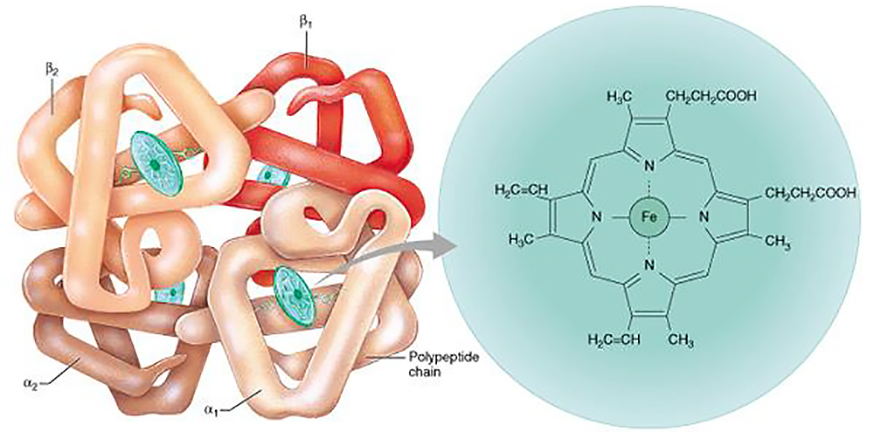
Haemoglobin
Red pigment transporting oxygen.
Protein, 64 450, 4 subunits.
Hem – derivative of porphyrine containing iron, conjugated with polypeptides (globin)
Types of hemoglobin:
Embryonic haemoglobin (t2e2, a2e2)
Fetal haemoglobin: Hb F, b2g2
Adult haemoglobin: Hb A, a2b2
Hemoglobin derivative:
oxyhaemoglobin - O₂
carbaminohaemoglobin – CO₂
methaemoglobin – Fe³⁺ in hem
carboxyhaemoglobin – CO

Slide 14
Hemolysis
Breakdown of RBC due to disintegration of its membrane – hemoglobin and intracellular fluid are spilt into the solution
Physical (mechanical damage):
shaking, ultrasound, extreme temperature changes, UV radiation
Osmotic (hypotonic solution)
Chemical
strong acids and bases, fat solvents, surfactants (detergents)
Toxic
bacterial toxins, poisons (plant, snake, insect, spider), parasites
Immunological
transfusion of incompatible blood
Malaria
(Plasmodium spp.)

Slide 15
Suspension stability of blood
Helmholtz electrical double-layer:
negative charge on the membrane of RBC (sialic acid)
1st layer: positively charged ions (primarily Na+)
2nd layer: negatively charged ions (Cl-)
RBCs repel each other => suspension stability
Sedimentation rate indirectly corresponds to suspension stability of blood
Fahraeus-Westergren (FW) – direct method
A glass tube in vertical position
Measured after 1 hour (2 hours)
Wintrobe
100 mm long, thin glass tube in oblique position (45°)
Measured after 15 minutes
RBC - -
-
+

Slide 16
Sedimentation rate
Men: 2-8 mm/h
Women: 7-12 mm/h
Newborns: 2 mm/h
Infants: 4-8 mm/h
Effect on ESR | ↑ value | ↓ value
Erythrocytes
Number of RBCs | decelerates | accelerates
Size of RBCs | accelerates | decelerates
Plasma
Albumin | decelerates | accelerates
Imunoglobulins | accelerates | decelerates
Fibrinogen | accelerates | decelerates
Lipids | accelerates | decelerates

Slide 17
Blood groups
is a classification of blood, based on the presence and absence of antigenic substances on the surface of red blood cells
antigens (depending on the blood group system):
proteins
carbohydrates
glycoproteins
glycolipids
some of these antigens are also present on the surface of other types of cells of various tissues

Slide 18
AB0 system
Antigens on the surface of RBCs (agglutinogens): A, B
Antibodies in the blood (agglutinins): anti-A, anti-B (IgM)
Immunization against A and B happens during the first months of life (these antigens are also in the diet) – agglutinins are then in the blood for the rest of the life

Slide 19
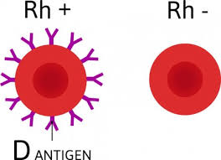
Rh factor
Antigens D, d (also C,c, E, e, which are weaker) are only on RBCs
The strongest one is an antigen D – if present → Rh+ blood group
In recessive homozygotes (dd) → blood group Rh- (17% in Europe, <1% elsewhere)
in Rh- blood, antibodies (anti-D, IgG) develop only after immunization
The first reaction is weaker, the next encounter with Rh+ blood will trigger a stronger immune response → hemolysis
I. Rh⁻ + Rh⁺ => N
Anti-D
Rh⁺
Rh⁺
Rh⁺
II. Rh⁻ + Rh⁺ => hemolysis
Anti-D
^{(IgG)}

Slide 20
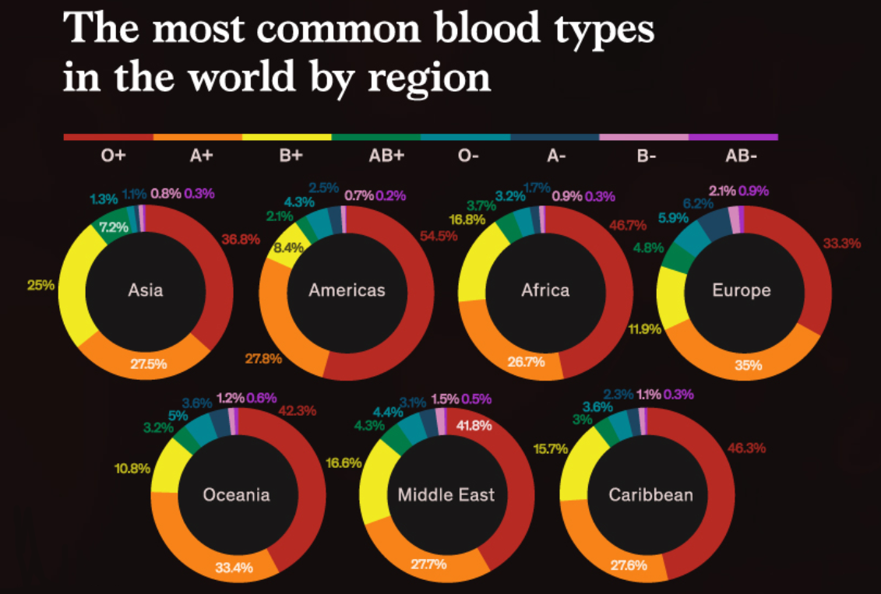
Blood groups

Slide 21
Haematopoiesis

Slide 22
Innate immune system
already in place
rapid response
non-specific pattern response
functions:
physical barriers
leukocyte recruitment (inflammation)
antiviral defenses
Parts:
physical/chemical barriers
phagocytes (neutrophils, macrophages, dendritic cells, mast cells, NKCs)
complement

Slide 23
Recognizing invaders
Pathogen-associated molecular patterns (PAMPs):
common molecular patterns typically found on pathogens (ex. Bacterial lipopolysaccharides, mannose, viral nucleic acids)
Damage-associated molecular proteins (DAMPs):
common molecular patterns found on the surface of injured or dead host cells (ex. Heat shock proteins)
Pattern recognition receptors:
receptors on cells of the immune system that recognize PAMPs and DAMPs
when the pattern recognition receptor binds a ligand (PAMP or DAMP) this triggers signal pathway activation → transcription factors → gene expression of inflammatory and antiviral products → recruitment/activation of immune cells

Slide 24
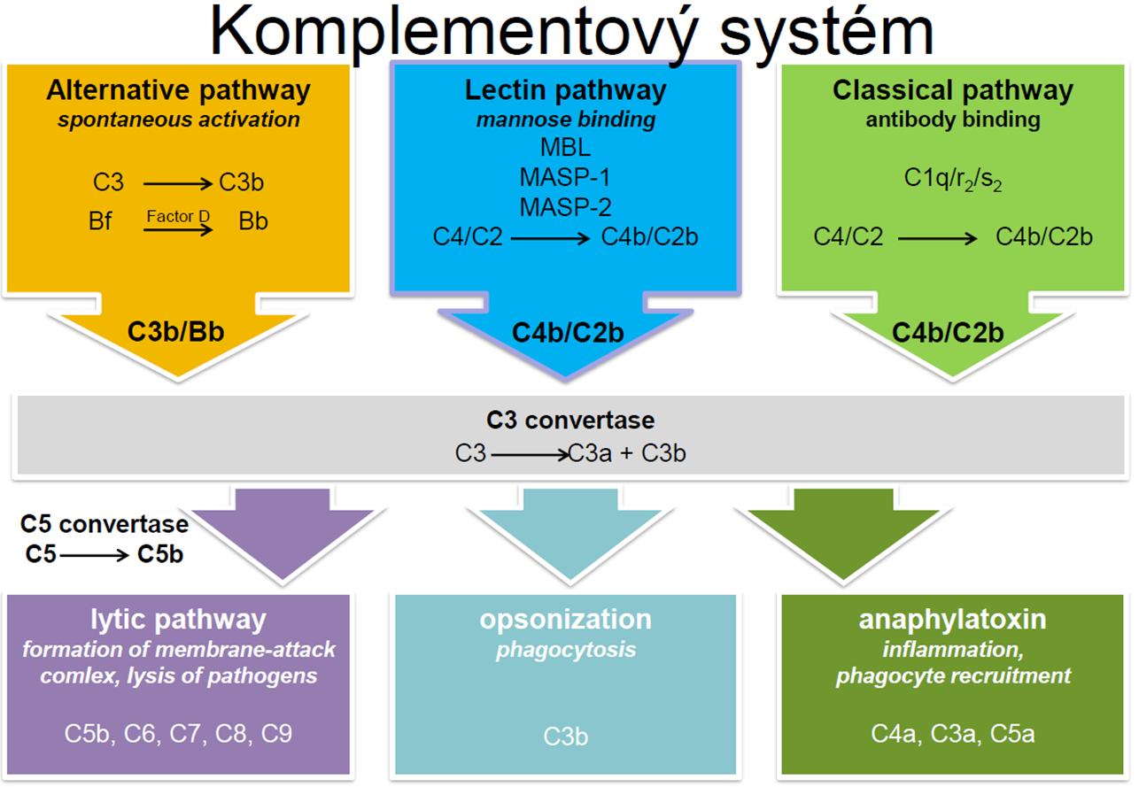
Complement cascade
system of proteins; part of the innate immune system
functions:
cell lysis (membrane attack complex – MAC)
opsonize
attract other immunological cells
complement activation pathways:
classical activation pathway
alternative activation pathway
lectin activation pathway

Slide 25
Complement activation pathways
classical (Ab dependent) complement activation pathway:
IgM/IgG brings together multiple C1 complexes
inhibitor falls off C1
C1 starts cascade that cleaves C3
alternative (Ab INdependent) complement activation pathway:
spontaneous cleavage of C3
lectin complement activation pathway:
mannose binding lectin (MBL) binds mannose on pathogen surface
activates MASP
MASP cleaves C3

Slide 26
Common pathway
C3 => C3a + C3b
C3a
C3b + proteins
C3b
C5 => C5a + C5b
opsonization
Chemoattractants:
attraction
activatation
C5b + C6 – 9=>MAC
macrophages
The membrane attack complex (MAC) is a complex of proteins typically formed on the surface of pathogen cell. Assembly of the MAC leads to pores that disrupt the cell membrane of target cells, leading to cell lysis and death.

Slide 27
Adaptive immune system
develops in response to pathogen (antigen)
specific (responds to Ag)
diverse (recognizes a lot of Ags)
immunological memory
humoral immunity:
targets extracellular pathogens in blood + mucosal secretions
B-cells → make Ab
cell-mediated immunity:
targets intracellular pathogens
T-cells (Cytotoxic T-cells (CD8+), Helper T-cells (CD4+)

Slide 28
Major histocompatibility complex
MHC I expressed on all nucleated cells
what's happening inside cell (endogenous peptides)
MHC class I recognized by CD8+ T cells
MHC II expressed on APCs
shows what's happening outside cell (exogenous peptides)
MHC II recognized by CD4+ T cells

Slide 29
Immunoglobulin structure
2 identical heavy chains
2 identical light chains
constant region (Fc) remains the same among all antibodies in a class
Fab fragments (fragment antigen-binding region) are responsible for antigen recognition and binding; form the "arms" of the Y;
The variable region (Fv) is the top part of the Fab fragment; this area varies between antibodies; contains the paratope (antigen binding site)

Slide 30
IgM:
is the first antibody produced by activated naive B-cells
first response to early infection
can be attached to cell surface or secreted into blood & lymph
can activate classical complement pathway
IgG
is the most abundant ab in blood
can pass from parent to fetus via the placenta
tags antigens so phagocytes can eat them (opsonization)
capable of antibody-dependent cellular cytotoxicity
IgA:
is responsible for mucosal immunity
secreted in GI, respiratory, and genitourinary tracts and found in saliva, tears, & milk
IgE:
provides helminth protection
is responsible for mast cell degranulation
IgD
co-expressed with IgM
least understood

