Slide 1
Case report 2
Alagille syndrome
Dagmar Procházková

Slide 2
Learning outcomes
the student is presented with a case report of children with microdeletion syndrome

Slide 3
Alagille syndrome is a highly variable, autosomal dominant multisystem disease
Alagille syndrome 1, ALGS1 (MIM # 118450), which is caused by a mutation in the JAG1 gene on chromosome 20p12, with an incidence of 1:30,000 live births, 98% of patients with ALGS
Alagille syndrome 2, ALGS2 (MIM # 610205), which is associated with a mutation in the NOTCH2 gene on chromosome 1p12 and represents a rarer form of disability (1: 70,000 live births), 1-2% of patients with ALGS

Slide 4
we estimated that less than 7% of patients with Alagille syndrome have deletions of 20p12

Slide 5
The basic symptom of the syndrome is a reduction of intrahepatic bile ducts in combination with 5 diagnostic features:
Cholestasis (jaundice with conjugated hyperbilirubinemia, ↑ GGT, ↑ Chol, ↑ TGL, 10-20% of patients with rapid progression of liver disease)
Congenital heart disease (most often peripheral pulmonary stenosis, Fallot's tetralogy, pulmonary atresia, atrial or ventricular septal defect)
Skeletal abnormalities (most often butterfly vertebrae, vertebral fusion, spina bifida occulta, hemivertebra, 12th rib anomalies)
Eye disorders (most often posterior embryotoxon - prominence of the Schwalbe´s ring at the interface of the iris and cornea)
Characteristic appearance of a triangular face with a wide forehead, deep set eyes, hypertelorism, lower set ears and a longer onion-shaped nose

Slide 6
3 of these 5 major characters must be present to confirm the diagnosis

Slide 7
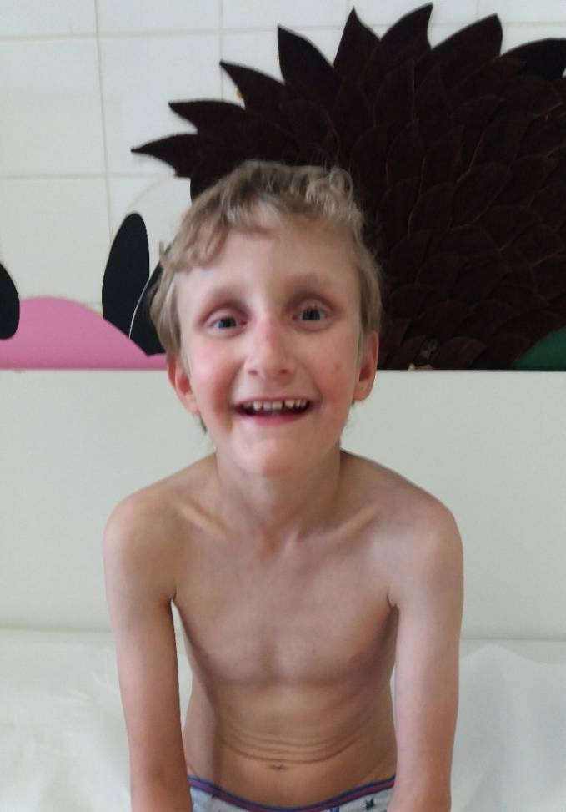
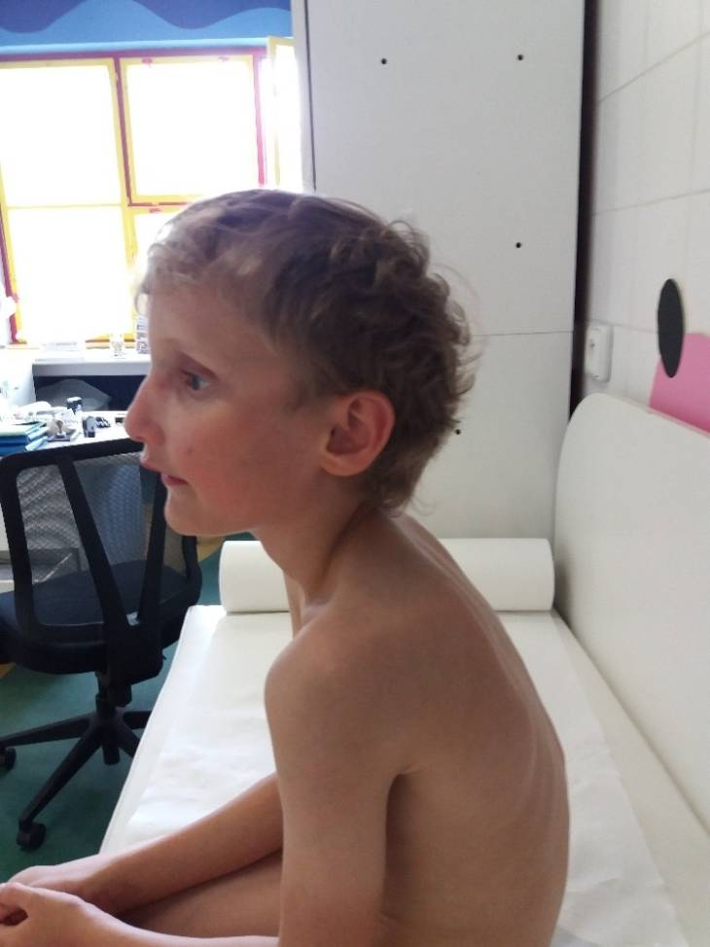
Patient with ALGS, typical face

Slide 8
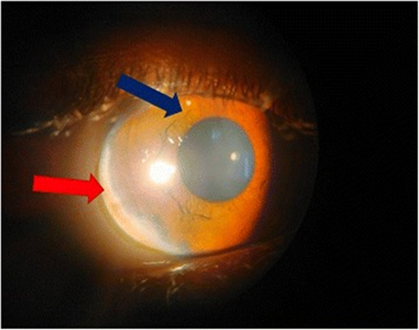
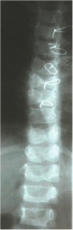
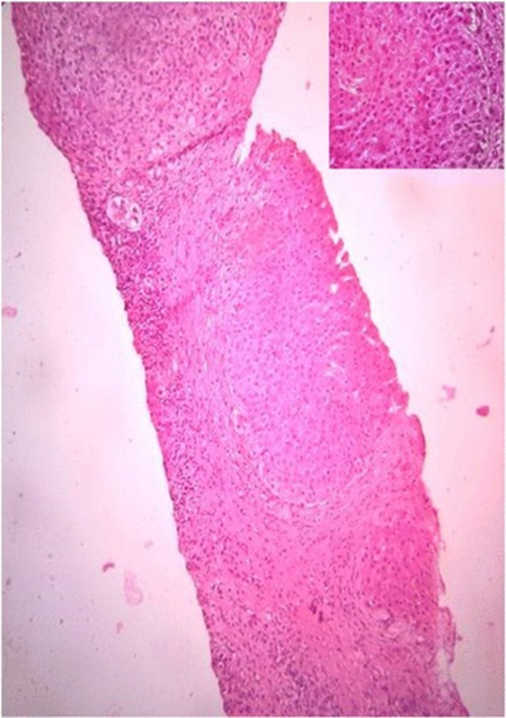
posterior embryotoxon
butterfly vertebrae
bile duct paucity

Slide 9
About 39% of patients suffer from kidney problems, most often renal dysplasia
Growth retardation
Pancreatic insufficiency (40%)
Hypothyroidism
Recurrent infections
Mental retardation and learning disabilities usually in patients with deletion 20p12
Alagille syndrome is a genetically heterogeneous disorder

Slide 10
We present phenotype of 4 probands with ALGS1, whose involvement was confirmed by molecular genetic examination
Method: next generation sequencing technique (MiSeq, Illumina) followed by direct sequencing of PCR products on a genetic analyzer. At the genomic DNA level, the coding region of the JAG1 gene, including exon / intron boundaries, was sequenced. The obtained sequences were compared with the reference sequences of the JAG1 gene NG_007496.1 and NM_000214.2. The analysis of the found variants was performed on the basis of the reference database (http://www.ncbi.nlm.nih.gov/projects/SNP).

Slide 11
Phenotype of patients with ALGS1
Table 1 Clinical features present in carriers of JAG1 mutations
Pacient | Diagnosis | Peculiar face | Cholestasis | Liver biopsy |  | Heart disease |  | Ocular | Skeletal | Renal | Others
 | Age |  |  |  |  |  |  | anomalies | anomalies | anomalies
1 | 16 month | yes | yes | intrahepatic bile duct |  | peripheral pulmonary |  | no | butterfly | no | learning disability
 |  |  |  | paucity |  | artery stenosis |  |  | vertebrae
2 | 6 years | yes | yes | intrahepatic bile duct |  | peripheral pulmonary |  | no | no | no
 |  |  |  | paucity |  | artery stenosis
3 | 7month | yes | yes | intrahepatic bile duct |  | peripheral pulmonary |  | no | no | ren | behavioral disorders
 |  |  |  | paucity |  | artery stenosis |  |  |  | arcuatus
4 | 3 month | yes | yes | intrahepatic bile duct |  | peripheral pulmonary |  | embryotoxon | rib | cystic | hypothyroidism
 |  |  |  | paucity |  | artery stenosis |  | posterior | anomalies | disease | growth retardation

Slide 12
Results of molecular genetic testing of the JAG1 gene
Table 2 Mutations in JAG1 found in patients with Alagille syndrome
Pacient | identified sequence variants |  |  |  |  |  |  |  | Mutation | Exon | cDNA | Protein | Mutation
 |  |  |  |  |  |  |  |  | origin |  |  |  | type
1 | gene JAG1 (NM_000214.2):c.3189dupG in heterozygous state |  |  |  |  |  |  |  | not | 25 | c.3189dupG | p.Asn1064Glufs*45 | frameshift
 | novel mutation, duplication |  |  |  |  |  |  |  | investigated
2 | gene JAG1(NM_000214.2): c.2039delG in heterozygous state |  |  |  |  |  |  |  | mother | 16 | c.2039delG | p.Gly680Alafs*63 | frameshift
 | novel mutation, deletion
3 | gene JAG1 (NM_000214.2):c.1913delG in heterozygous state |  |  |  |  |  |  |  | father | 15 | c.1913delG | p.Cys638Leufs*105 | frameshift
 | novel mutation, deletion
4 | gene JAG1 (NM_000214.2):c.2230C>T p.(Arg744Ter) in heterozygous state |  |  |  |  |  |  |  | de novo | 18 | c.2230C>T | p.Arg744Ter | nonsense
 | substitution
the c. nomenclature is based on the cDNA sequence NM_000214.2

Slide 13
Family screening
The mother of proband No. 2 was monitored at the Department of Gastroenterology for unexplained hepatitis
Molecular - genetic examination also confirmed ALGS1
Cardiac examination revealed aortic valve insufficiency
Another sibling - molecular-genetically ALGS1 excluded
Importance: diagnosis and genetic counseling in the family

Slide 14
The care of these patients is multidisciplinary
It includes a pediatrician, hepatologist, cardiologist, ophthalmologist, nephrologist, endocrinologist, nutritional therapist, radiologist, geneticist and, in some cases, a transplant team.
Molecular-genetic examination x classical scoring system
Genetic testing in unclear cases

Slide 15
Take home message
syndromological analyzes and syndromological diagnostics benefit from working together to share clinical and related laboratory findings

