Slide 1
Case report 3
Late diagnosis of classical phenylketonuria in our patient (infant)
Dagmar Procházková

Slide 2
Learning outcomes
the student will be introduced to the importance of neonatal screening of phenylketonuria (PKU)

Slide 3
The case of a 9.5-month-old girl who was investigated for unexplained psychomotor retardation

Slide 4
History:
Family history: without interest
A girl from 4th pregnancy, 2 x spontaneous abortion, healthy brother, oligohydramnion, prenatal ultrasound in pregnancy 2x (12th and 38th week), biochemical screening of M. Down, all in the norm, childbirth in 40th week by caesarean section for non-advancing birth, 3600g/ 51 cm, breastfed 6 months, then mixed baby food, parents observed a difference from older healthy brother – the girl did not smile, did not make contact, family doctor advised to wait
At 8.5 months – eye examination, finding in the norm
In 9.5 months was admitted to the hospital, at the Deparment of Neurology – delay of psychomotor development, does not sit, does not climb, she rolls over on the tummy and back, on the tummy is on the elbows, sometimes on the palms, says the syllables
age-appropriate nutrition, head frontooccipital circumference 41 cm ↓, other anthropometric parameters in the standard

Slide 5
Examination
Differential diagnosis:
MRI of the brain: myelinization of white matter corresponds to 6-8 months of age, delayed, further finding in the norm
metabolic screening was performed to rule out inborn error of metabolism (IEM)
Phenylalanine (Phe) in the blood was found to be significantly increased and reached 1768μmol/l (standard up to 120μmol/l), corresponding to classical phenylketonuria (PKU)
molecular-genetic examination of PAH gene for PKU/HPA: genotype p.(Gly272*)/p.(Thr328Ala),mutations are described causal, listed in the HGMD database (www.hgmd.org)

Slide 6
Phenylketonuria - PKU
IEM of amino acid Phe caused by deficiency of phenylalanin hydroxylase enzyme (PAH) in the liver (EC 1.14.16.1), PAH gen 12q23.2
Heredity: autosomal recessive, incidence in the Czech Republic 1: 5,250 live birth
r.1954 - prof. Bickel – therapy: low-protein diet, low in phenylalanine
Early postnatal, sufficiently intense and long-term low protein diet allows normal or almost normal development of cognitive functions
The diet is compiled individually according to sex, weight, age, protein, carbohydrate and fat needs and Phe tolerance in the diet
Other treatment options: GMP-glycomacropeptide, cofactor BH4-Kuvan, enzyme replacement therypy-ERT-Pegvaliasa® (BIOMARIN)

Slide 7
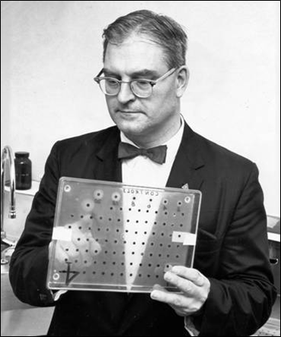
Phenylketonuria-screening
Introduced by Prof. Robert Guthrie (1916-1995), University of Buffalo, USA, NY
PKU - bacterial inhibitory test (B. subtilis)
In 1963 introduced - neonatal screening in the Czech Republic, by law only in 1975
Since 2009 in the Czech Republic screening is provided using MS/MS (tandem mass spectrometry)

Slide 8
Newborn screening in the Czech
Republic - IEM
Disorders of fatty acid oxidation
Medium-chain acyl-CoA dehydrogenase (MCAD) deficiency
Long-chain hydroxyacyl-CoA dehydrogenase (LCHAD) deficiency
Very long-chain acyl-CoA dehydrogenase (VLCHAD) deficiency
Carnitine palmitoytransferase I (CPT1) deficiency
Carnitine palmitoytransferase II (CPT2) deficiency
Carnitin acylcarnitine translocase (CACT) deficiency
biotinidase deficiency
Disturbances of amino acid metabolism:
Phenylketonuria – PKU
Maple sirup urine disease – MSUD
urea cycle defects: Argininemia, Citrullinemia
Homocystinuria from CBS deficiency, pyridoxine non-responsive
Homocystinuria from MTHFR deficiency
Organic acidurias
Glutaric aciduria type 1, Isovaleric aciduria (IVA)

Slide 9
How could that happen?

Slide 10




Slide 11
The child was born in Thailand, his parents worked here in tourism
Parents had health insurance
Screening was conducted: 2nd day after birth, blood Phe level 3.4 mg/ dl, i.e. 204μmol/l, standard up to 2 mg/dl or 120μmol/l
Parents were communicated that the blood Phe up to 4 mg/ dl, i.e. 240μmol/l, is normal in Thailand, within this range, no further control was performed !!!!!!!!!!!???????

Slide 12
Thailand and inborn errors of metabolism (IEM)
Incidence of IEM in Europe and North America 29-40/100,000, in Asia 16-26/100,000 live births
In Thailand provided PKU screening since 1996, incidence of PKU 2.22/ 100,000 live births (180,000 newborns examined in 2012 at Siriraj Hospital Bangkok)
Method: Guthrie test for low price and simple examination
In 2015, a pilot study on selected IEM using MS/MS – a highly costly method for Thailand, yet the introductions recommend for PKU, IVA, MSUD, MCD (Thiboonboon K et al.: An Economic Evaluation of Neonatal Screening fo Inborn Errors of Metabolism Using Tandem Mass Spectrometers in Thailand, Plos One, August 2015)

Slide 13

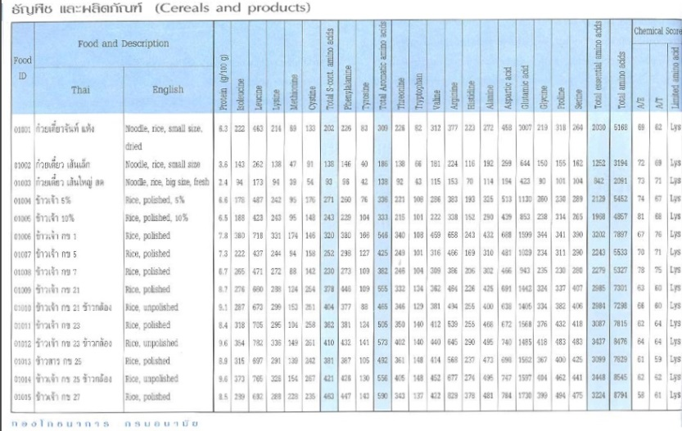
the diet of our patients with PKU is vegetarian and vegan

Slide 14
Our patient at the age of 24 months:
Anthropometric parameters: weight 12.1 kg, length 86.5 cm, head frontooccipital circumference 46.7 cm
Laboratory tests: Phe in the blood 60-150μmol/l (60-360); Zn in the blood 10.5μmol/l (11.5-15.3); Se in the blood 0.67μmol/l (0.7-1.24); other laboratory parameters in the standard
Neurological examination: pathological EEG in the sense of epilepsy, but the finding improved, clinically free of seizures, antiepileptics is not used
NMR of the brain now not done due to progress in psychomotor development and improved EEG
psychological examination: the level of motor functions ranged from 12 months, the overall level of mental functions corresponded to about 10 months of age. Prediction for the future: IQ 44, impairment of neurocognostic functions is irreversible

Slide 15
you can get more information about neonatal screening in the Czech Republic at www.novorozeneckyscreening.cz

Slide 16
Take home message
therapeutic restrictive diet in PKU will allow normal development of cognitive functions with early introduction
neonatal screening is essential for the diagnosis and treatment of PKU

