Slide 1
Restorative dentistry I.
Subgingival defects

Slide 2
Main problems
Substantial loss of hard dental tissues
Subgingival cervical borders – difficulties with dry operative field
(bleeding, sulcular liquid)
Adhesive procedures in region without enamel
– consider selfetching adhesive

Slide 3
SUBGINGIVAL DEFECTS
Technical parameters:
Possibility to keep the operating field dry
Biological parameters: measurement of distance between clean gingival border and insertion of periodontal ligament or crest of alveolar bone using periodontal probe and/or xray.
Biological width

Slide 4
Biological width
Epithelium junction
1-2 mm+
Connective tissue junction
supraalveolar fibers
1 -2 mm
= 2 - 4 mm
Dentogingival complex
DGC =
biological width
2-4mm +
sulcular depth
1-3mm
= 3-7 mm
1 - 2 mm
1- 2 mm
Gargiulo AW, Wentz FM, Orban B
(J Perio 1961)
Vacek JS, Gher ME, Assad DA, Richardson AC,
Gambaressi LI
(Int J Perio & Rest Dent 1994)

Slide 5
Classification of subgingival defects
1. Ruberdam is possible to use, gingival border can be seen.
2. Rubberdam does not allow complete isolation of operating field, biological width is ok.
3. Subgingival defect, biological width is affected.

Slide 6
Solution
1. Margin elevation – cervical margin relocation using flowable material or composite filling materiál
2. Gingivectomy + gingivoplasty
3. Elongation of clinical crown – crown lenghtening (gingivectomy + ostectomy)
Reconstruction: direct or indirect

Slide 7
Cervical margin relocation
SEQUENCE OF OPERATION – MARGIN RELOCATION •
Consider possibility of effect of rubberdam and biological width •

Slide 8
Cervical margin relocation
Application of rubberdam
Matrix band – can be cut (appr.3 - 5 mm)
Tihgtening of the matrix with the retainer
Insertion of a wooden wedge
Adhesive procedure consider selfetching adhesive system
Flowable
Composite

Slide 9
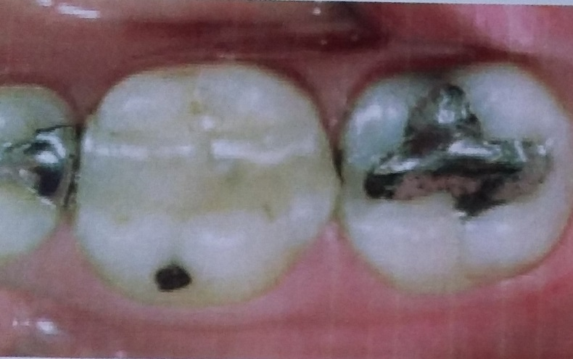
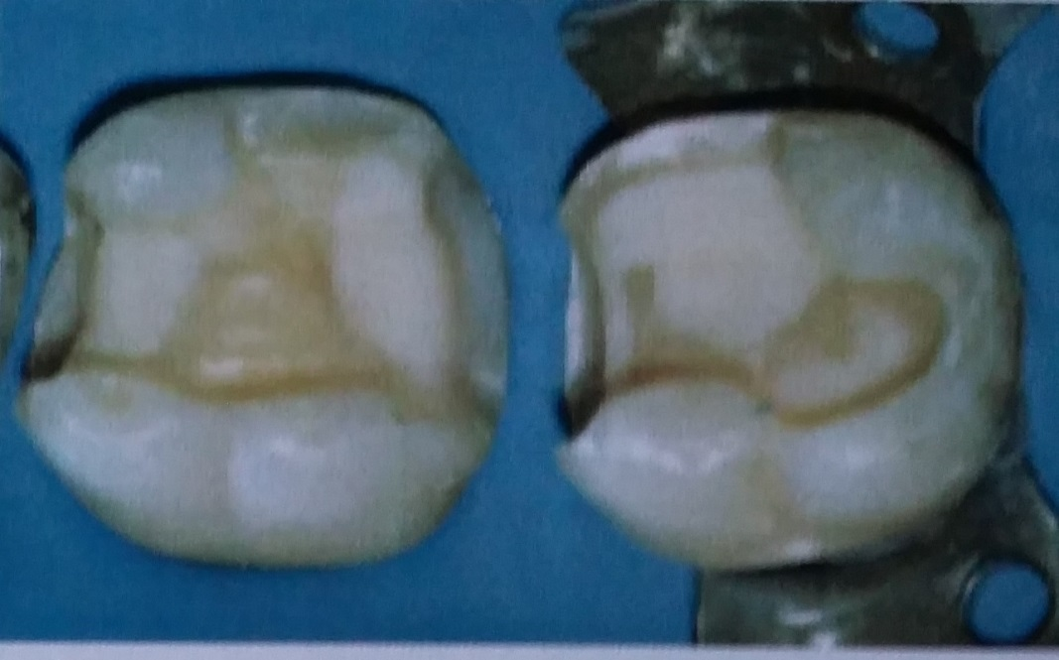

Slide 10
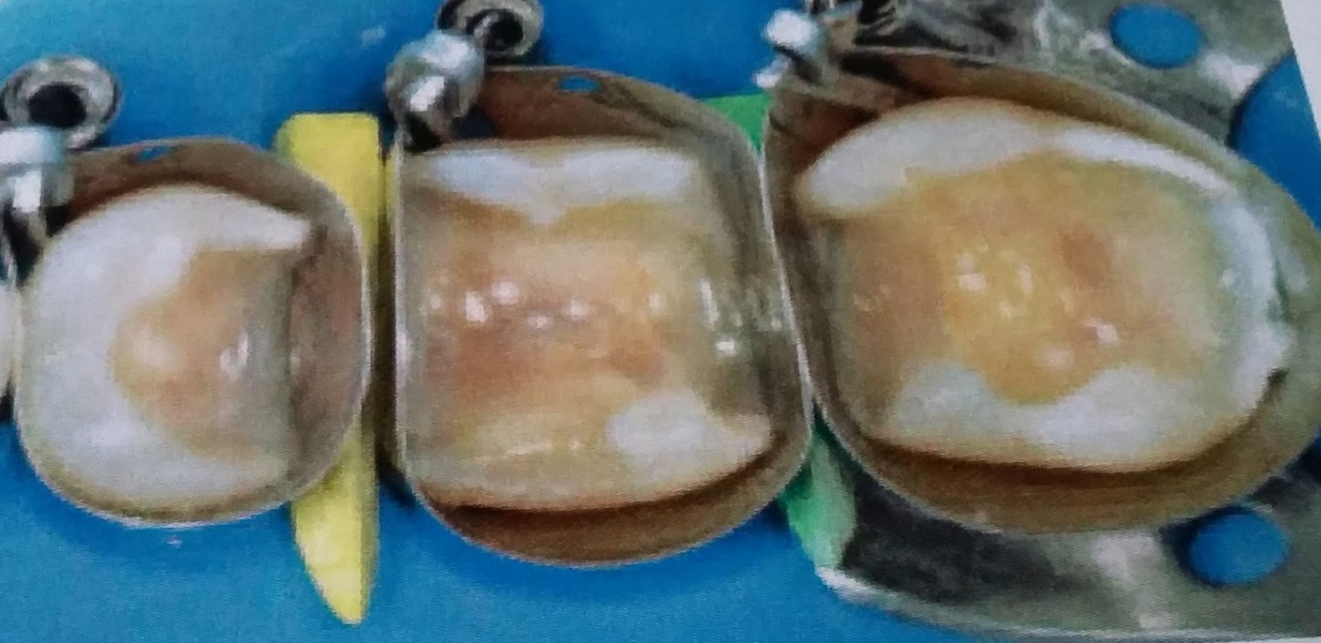

Slide 11
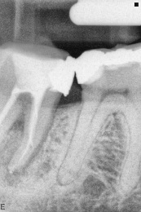
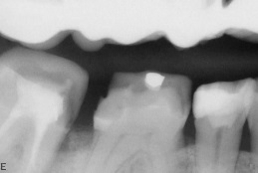
New margin

Slide 12
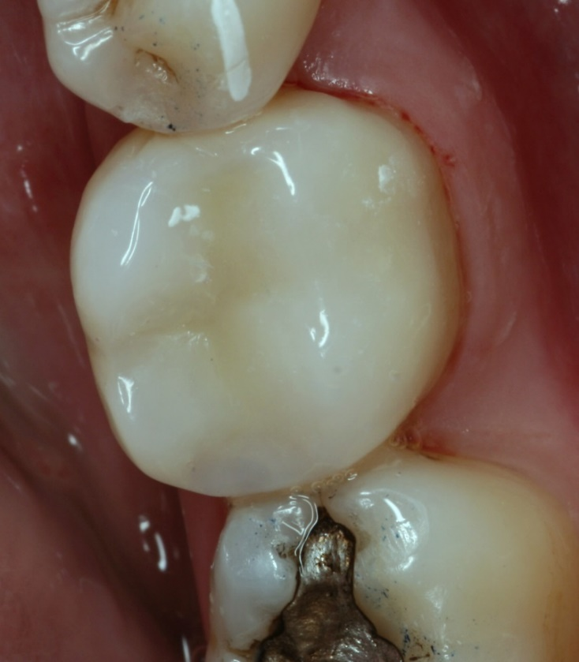
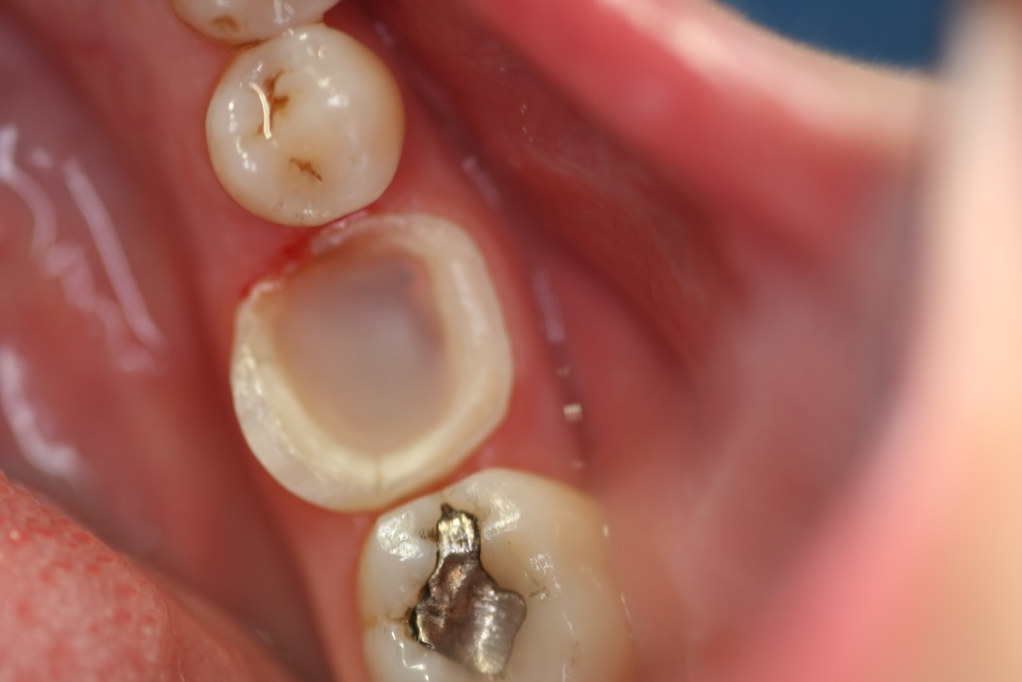

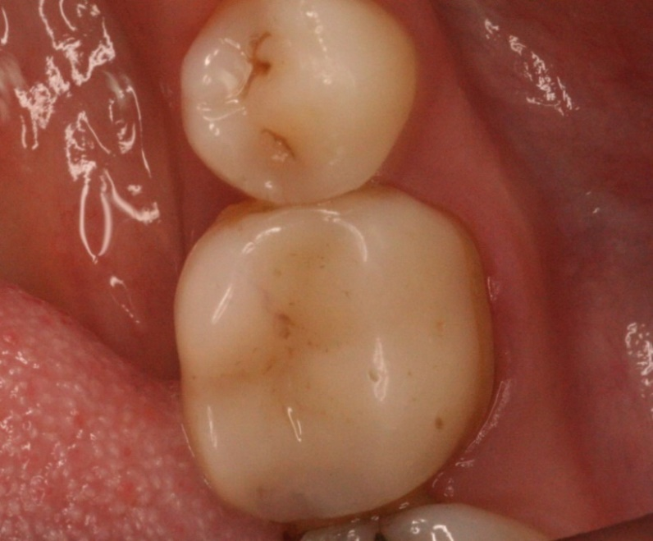

Slide 13
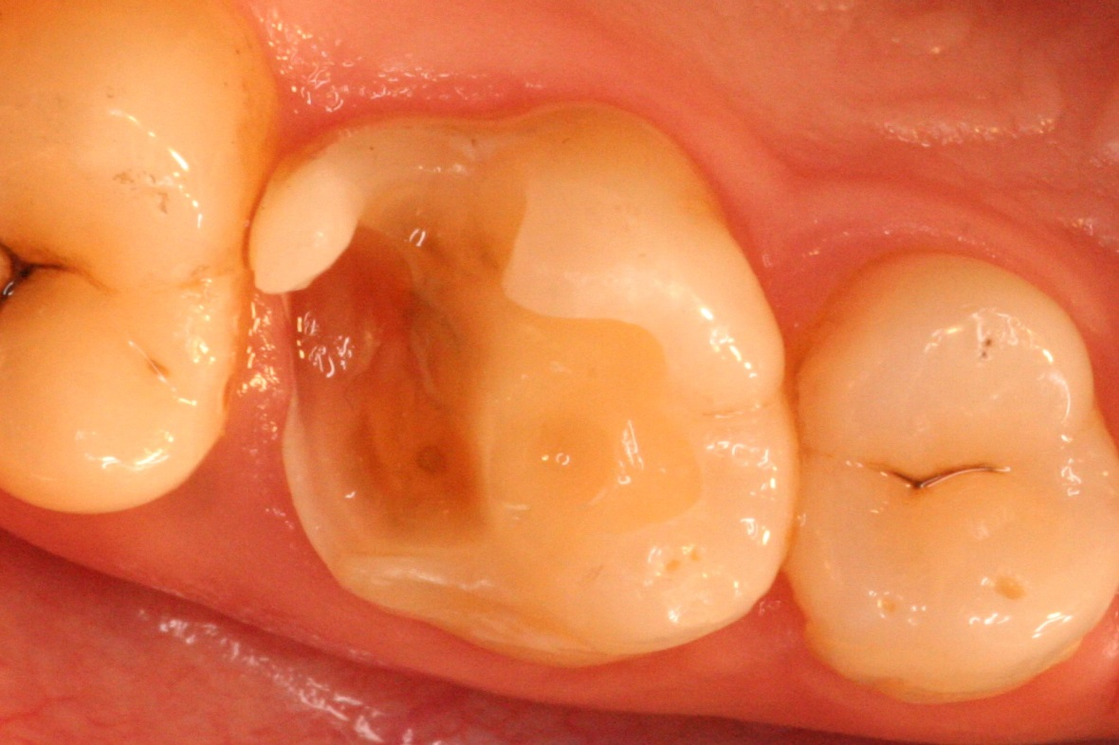
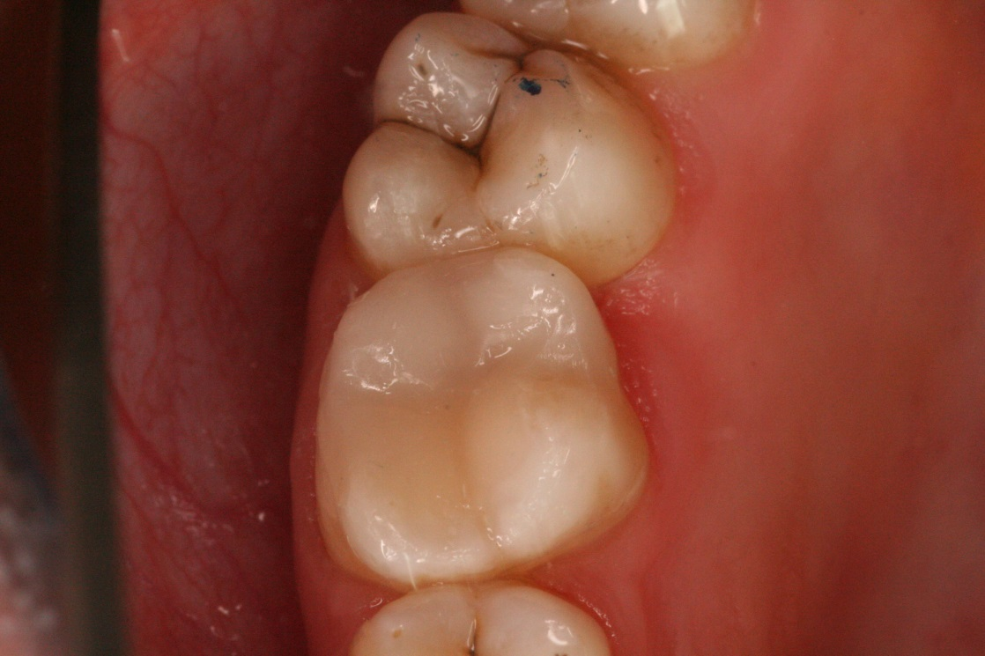
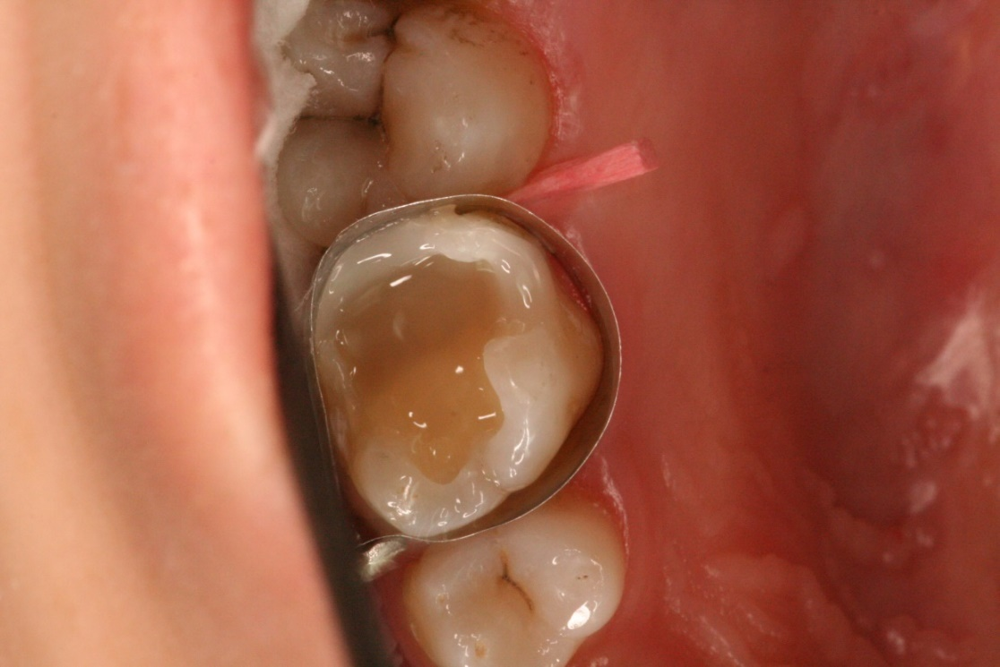

Slide 14
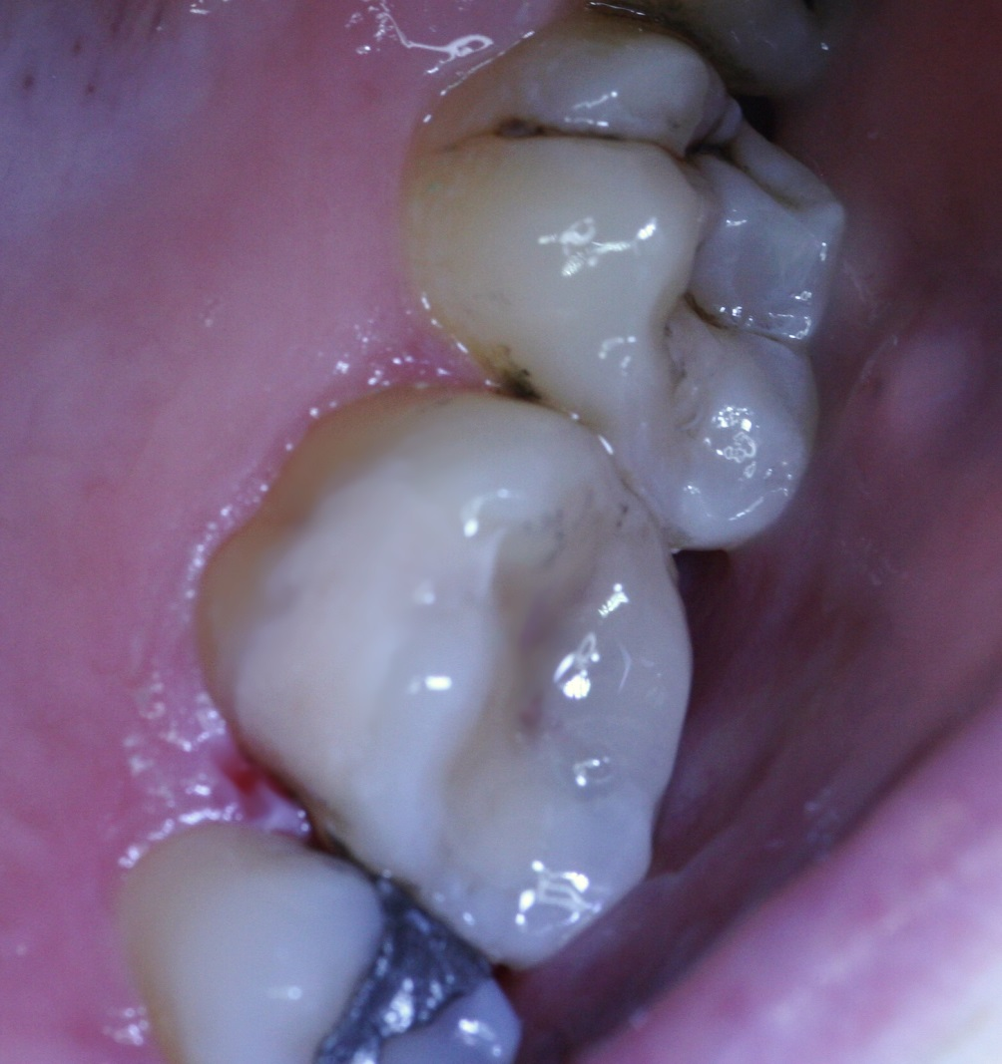
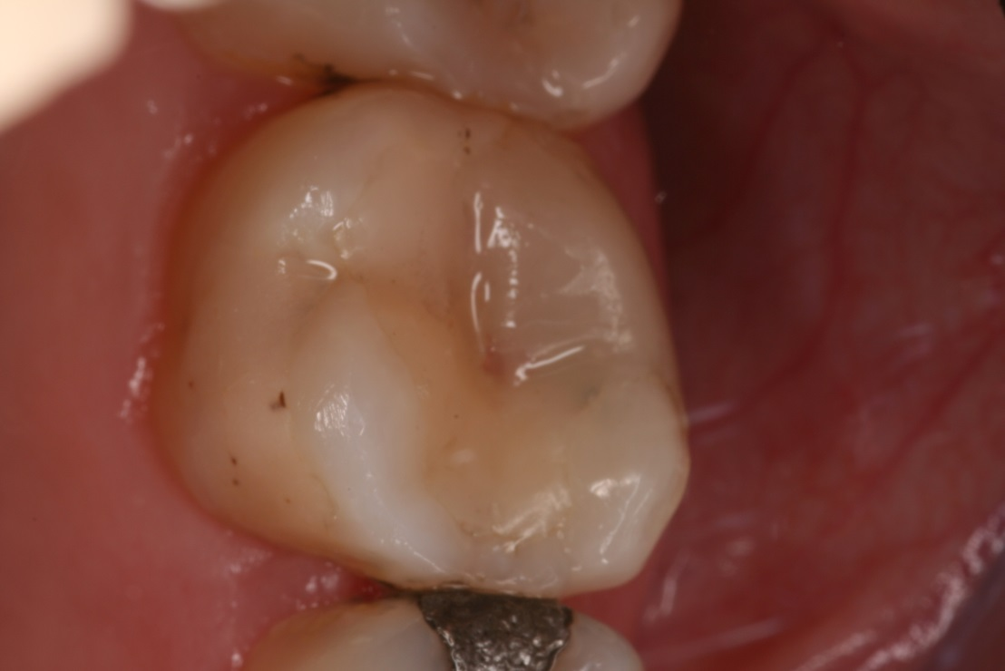
lenka.roubalikova@tiscali.cz

Slide 15
Gingivectomy and gingivoplasty
Cutting gingiva and shaping it anatomically :
Scalpel - Laser - Cauter

Slide 16
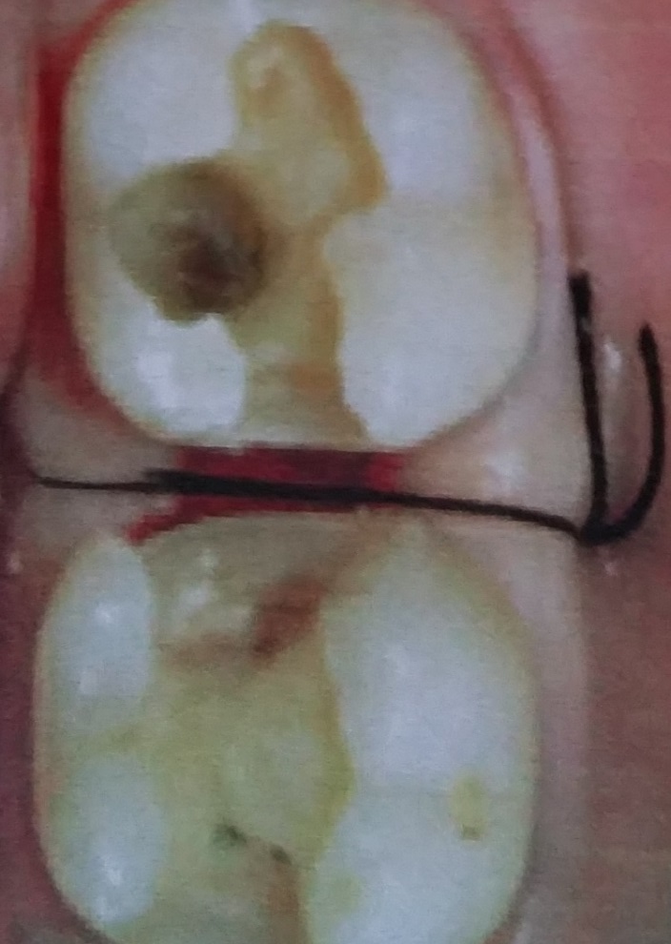

Slide 17
Crown lenghtening
Surgical procedure based on gingivectomy, gingivoplasty and ostectomy.
Closed and open

Slide 18
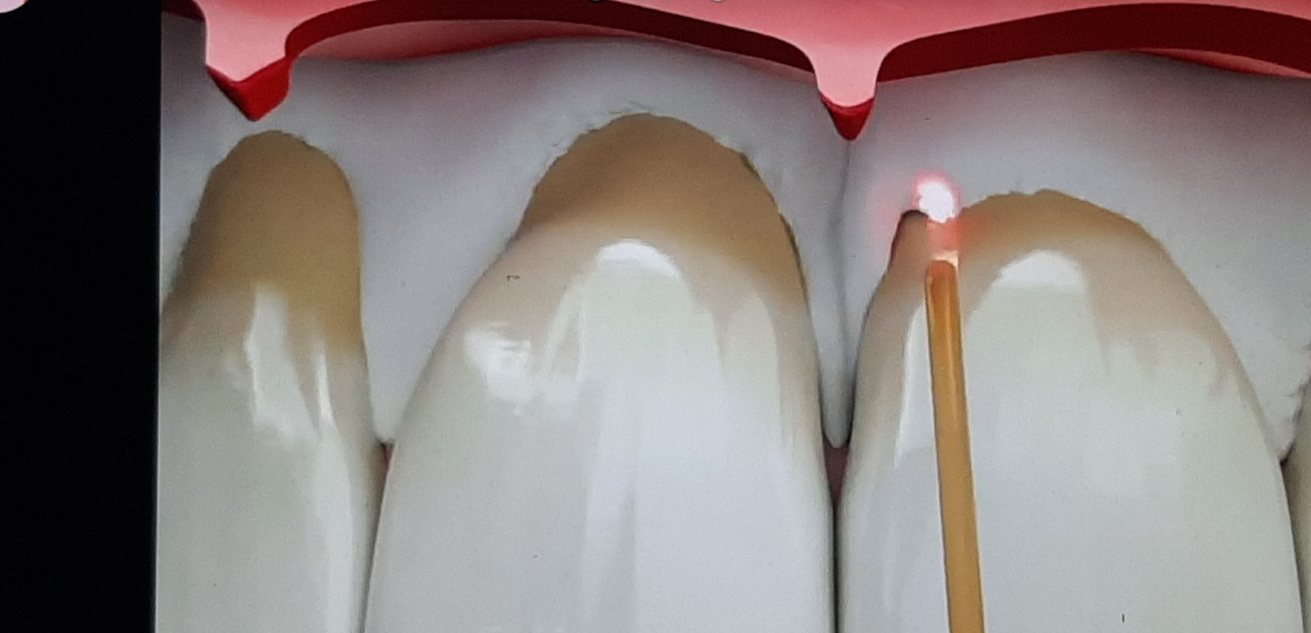

Slide 19
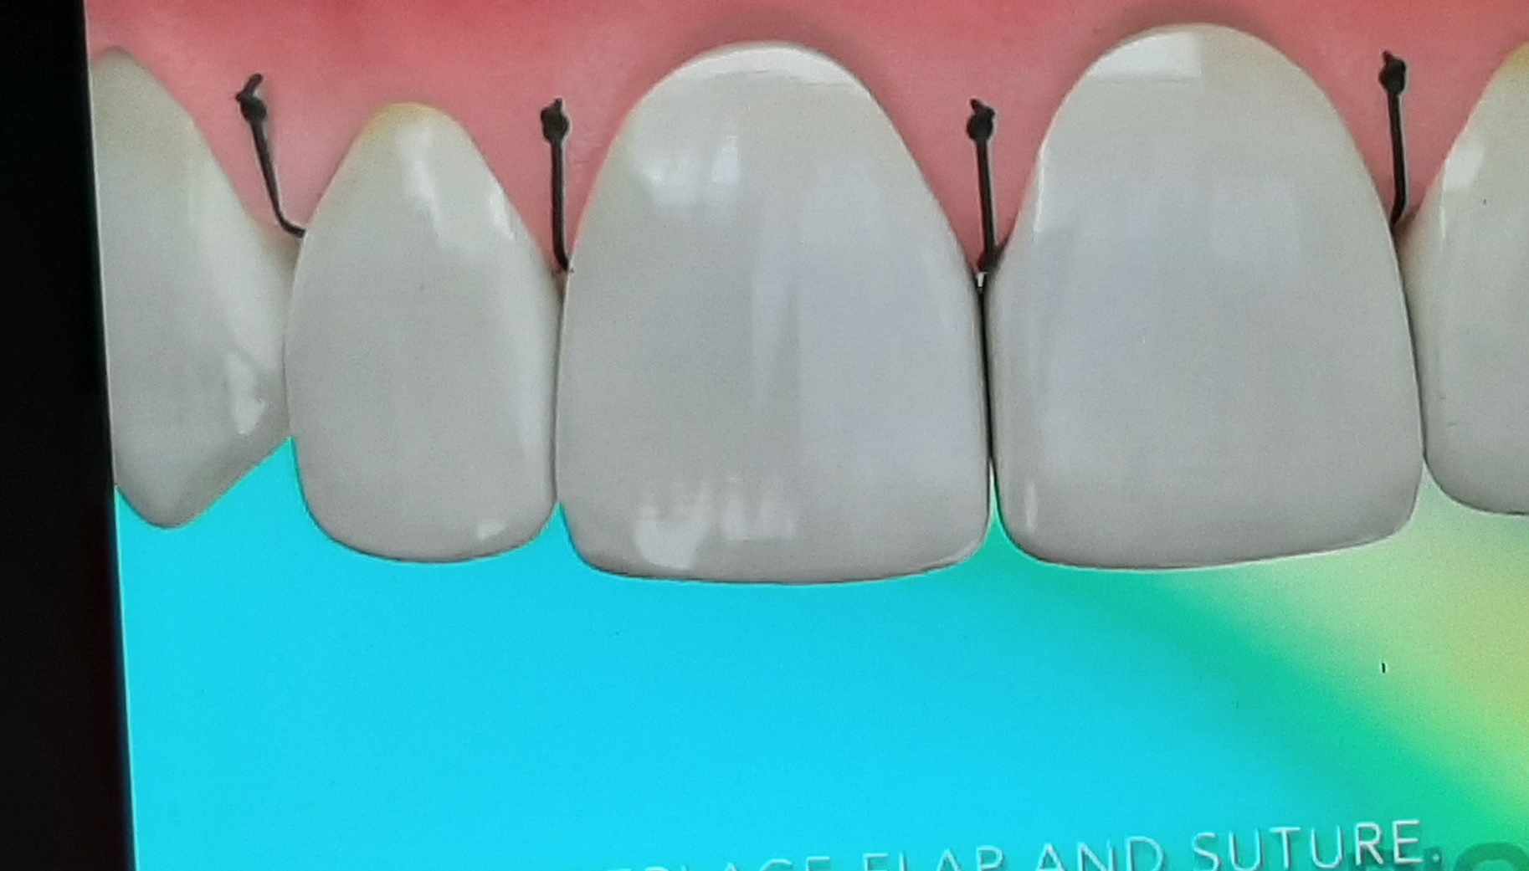

Slide 20
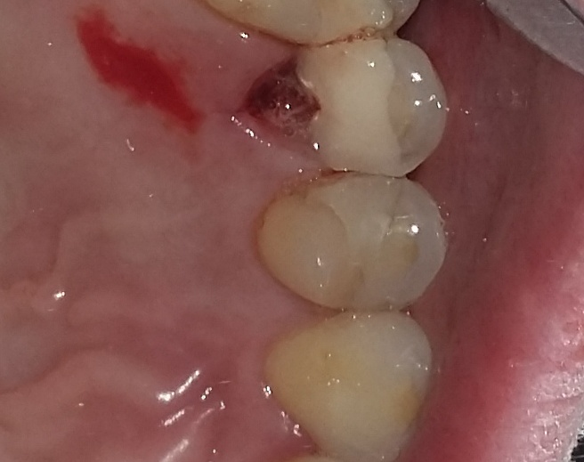
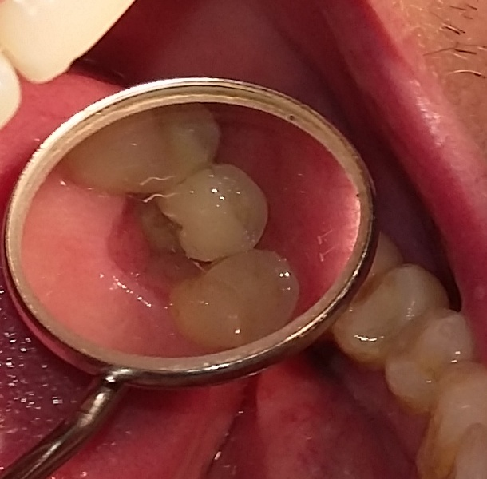
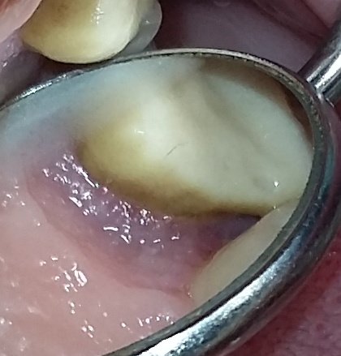
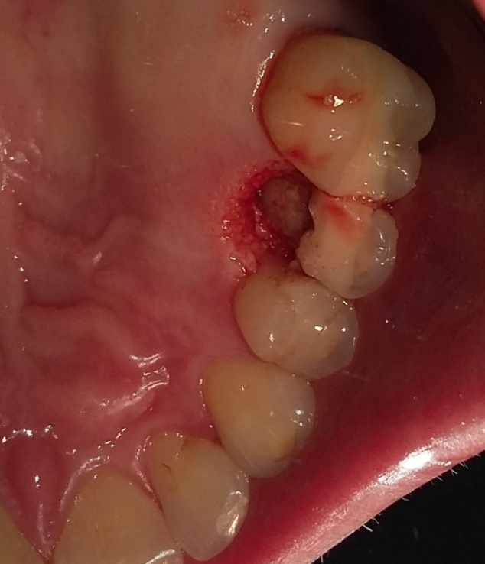
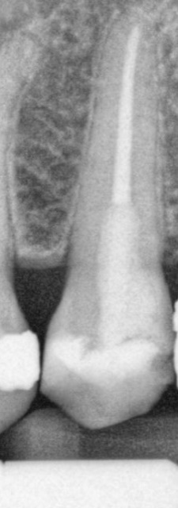

Slide 21
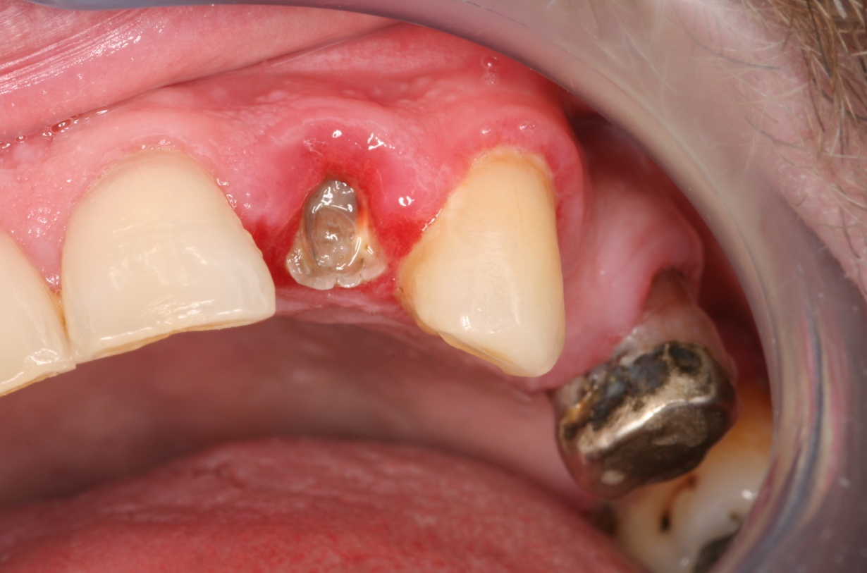
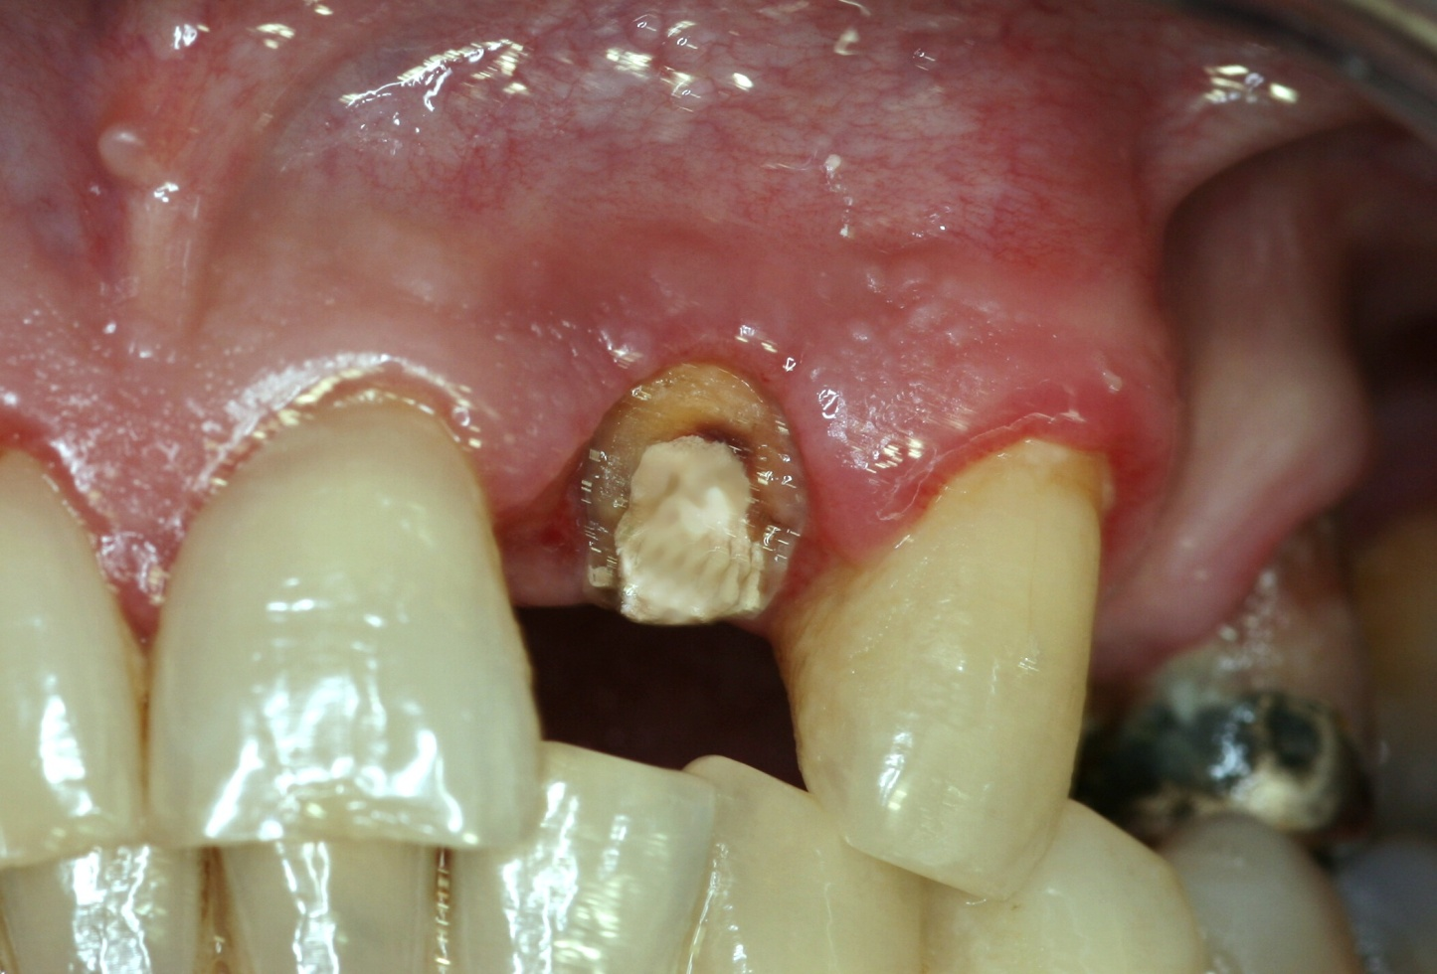

Slide 22
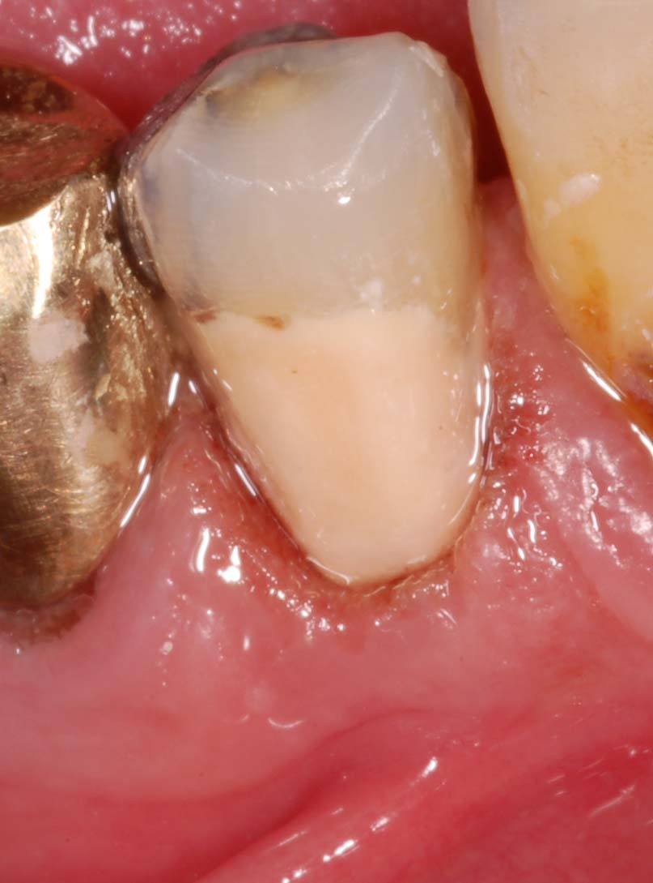
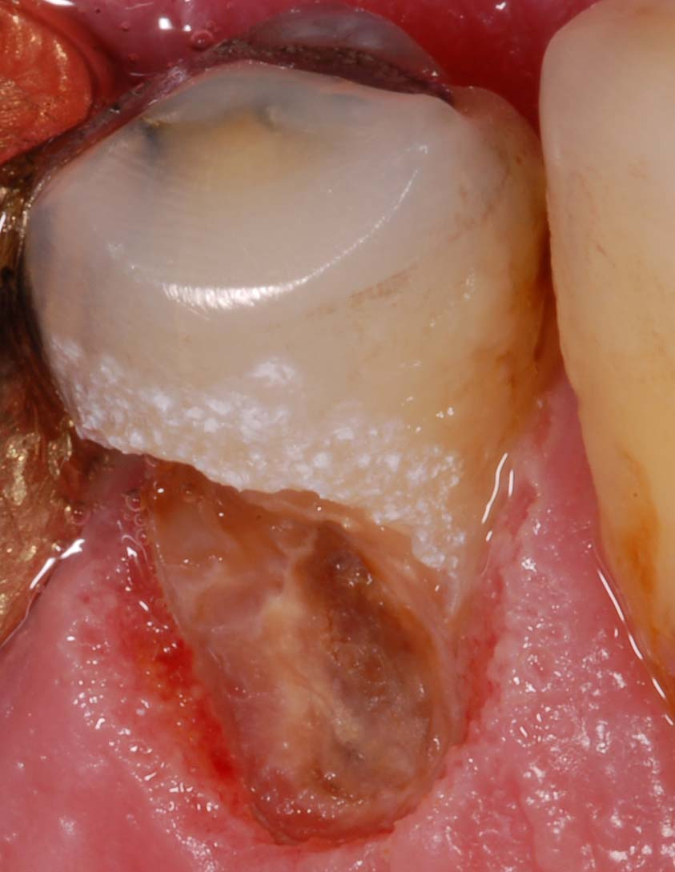
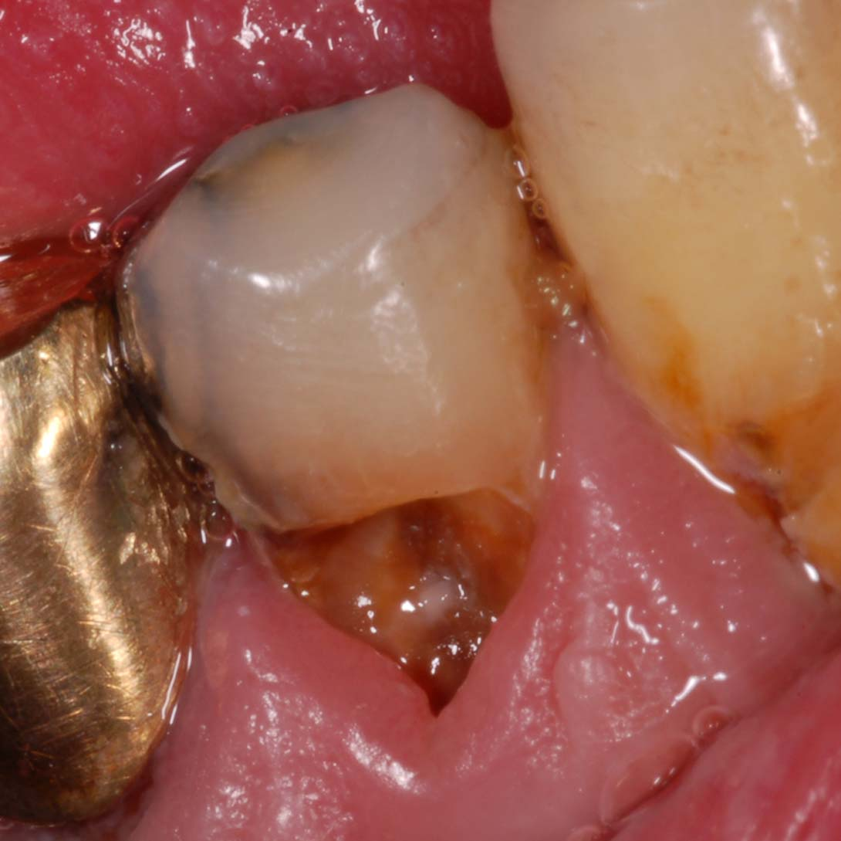
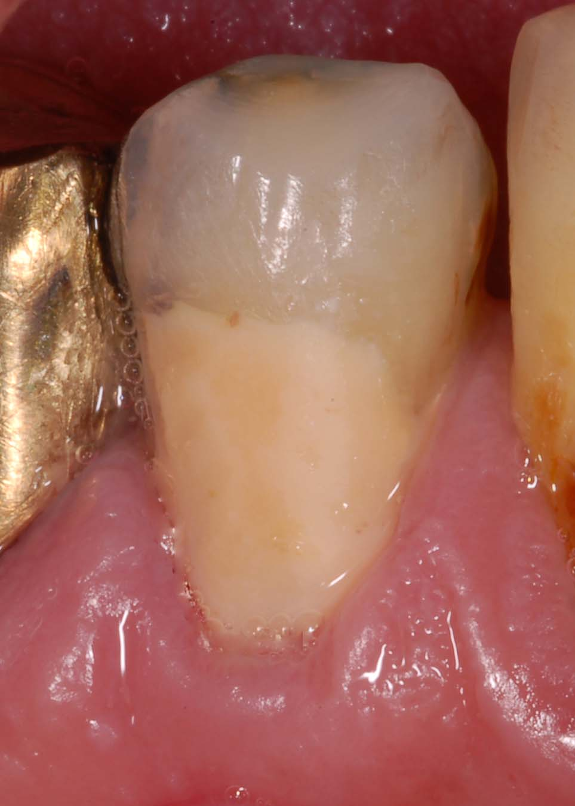
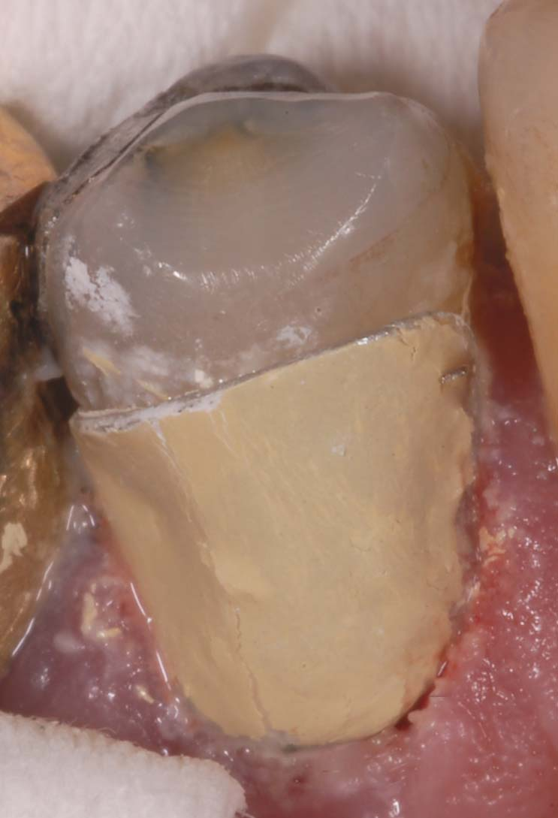
Gingivectomy
Gingivoplasty
GIC as a temporary

Slide 23
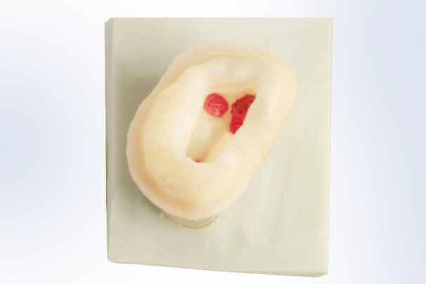
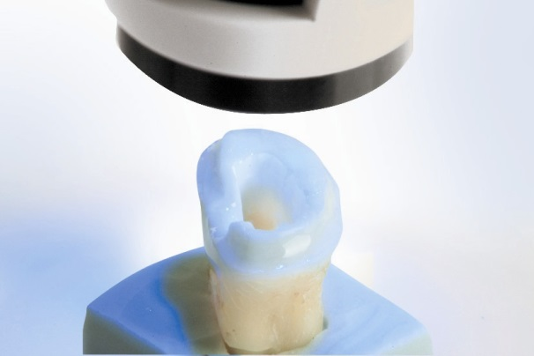
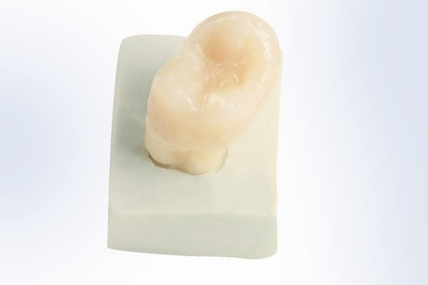
FRC výztuha
lenka.roubalikova@tiscali.cz

Slide 24
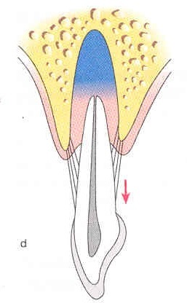
Extrusion
Extrusion orthodontic
Fast
Surgical

Slide 25
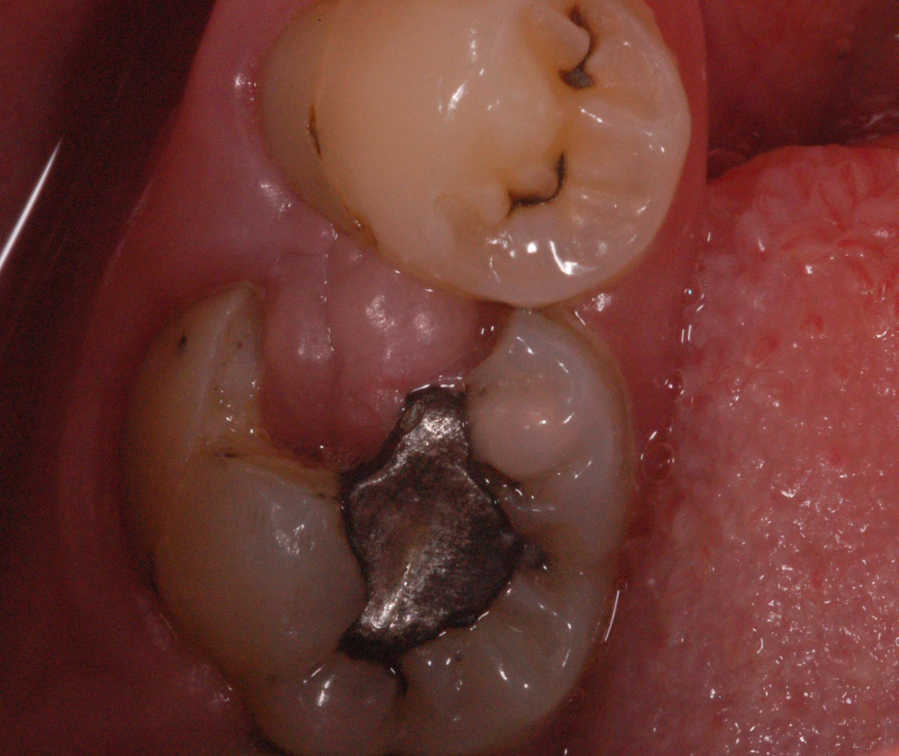
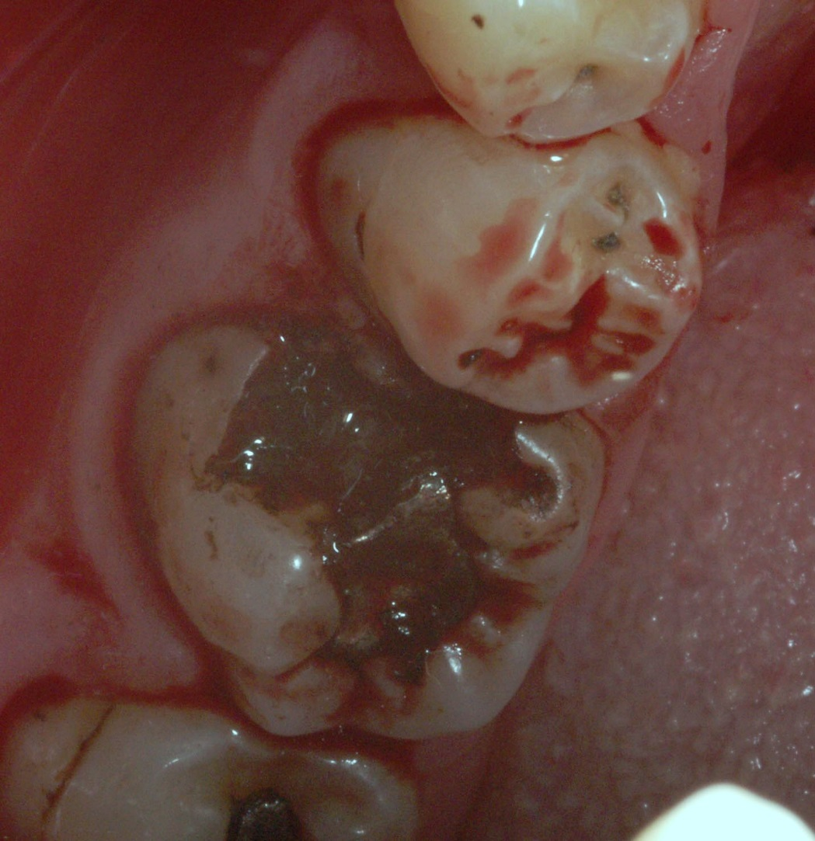

Slide 26
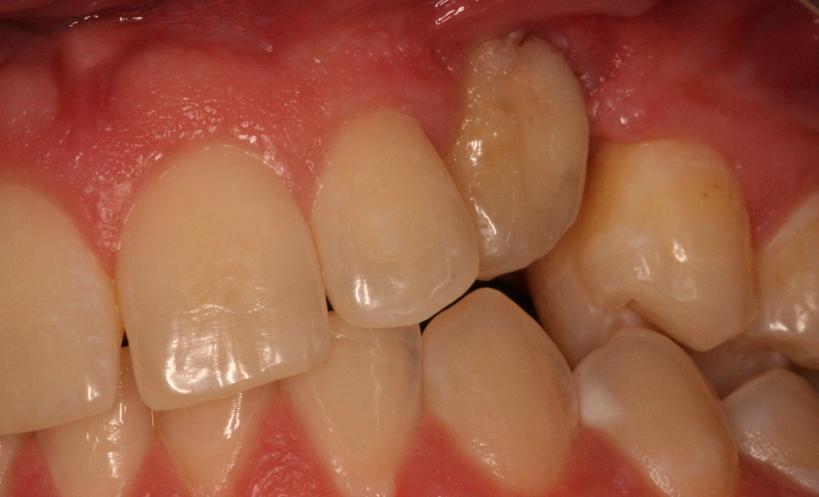

Slide 27
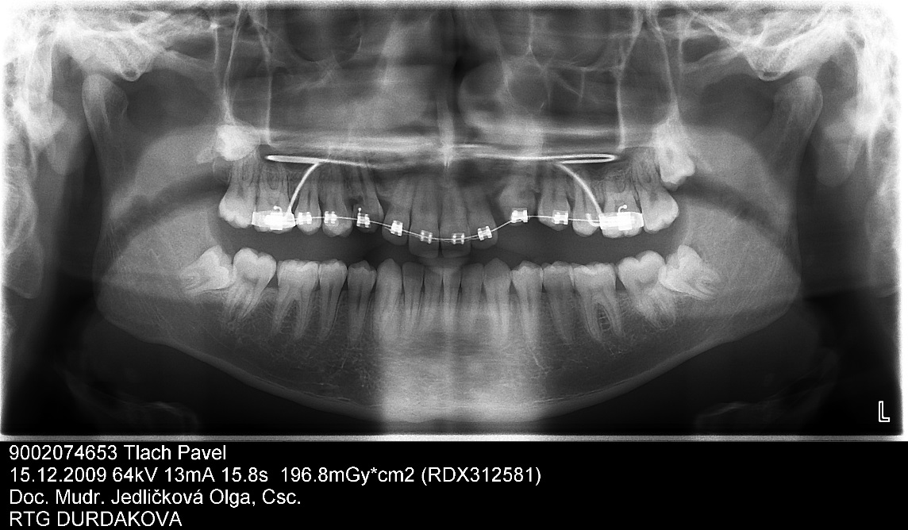
Resorpce

Slide 28
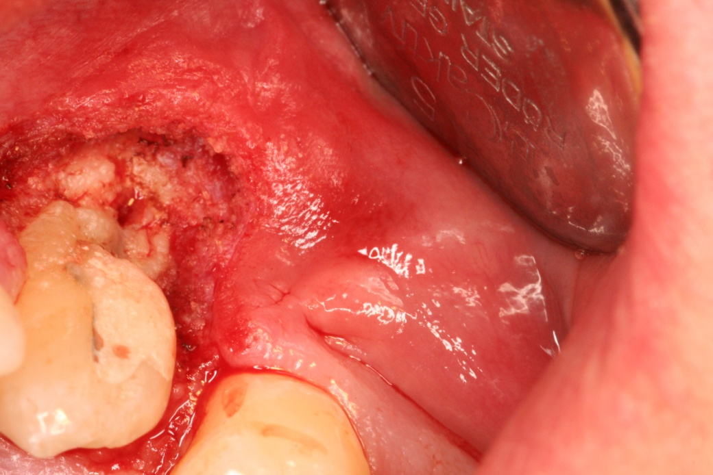
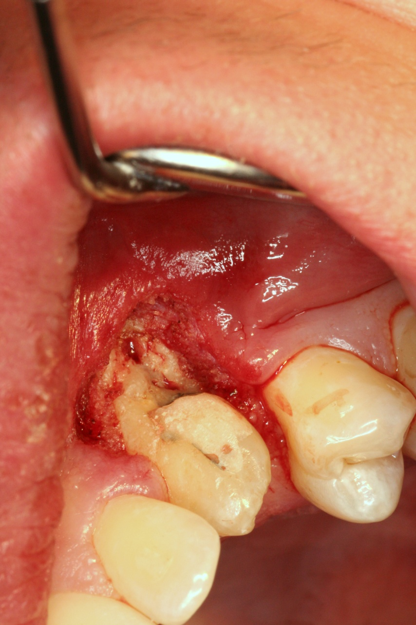
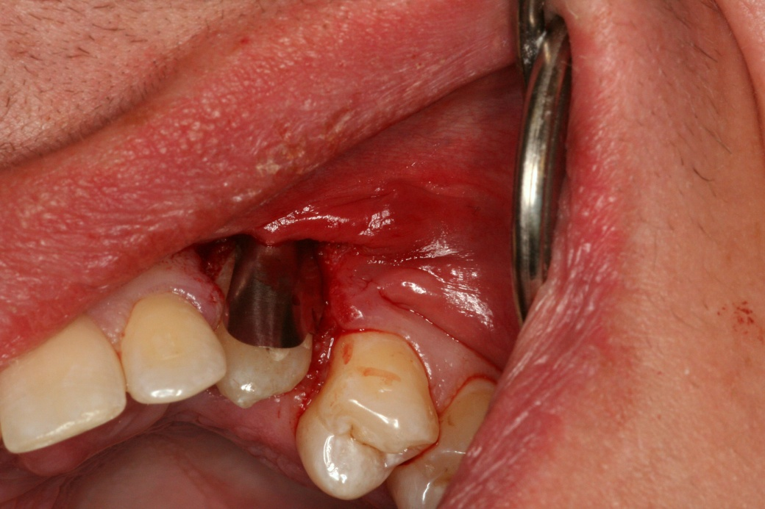

Slide 29
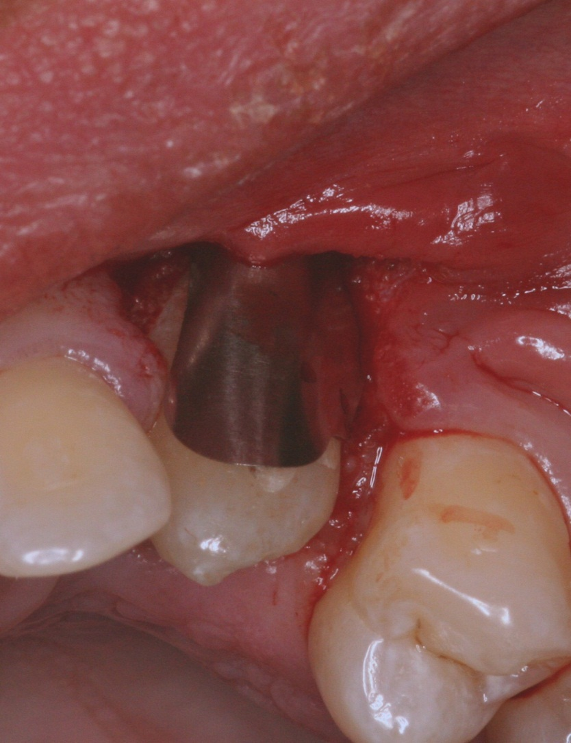
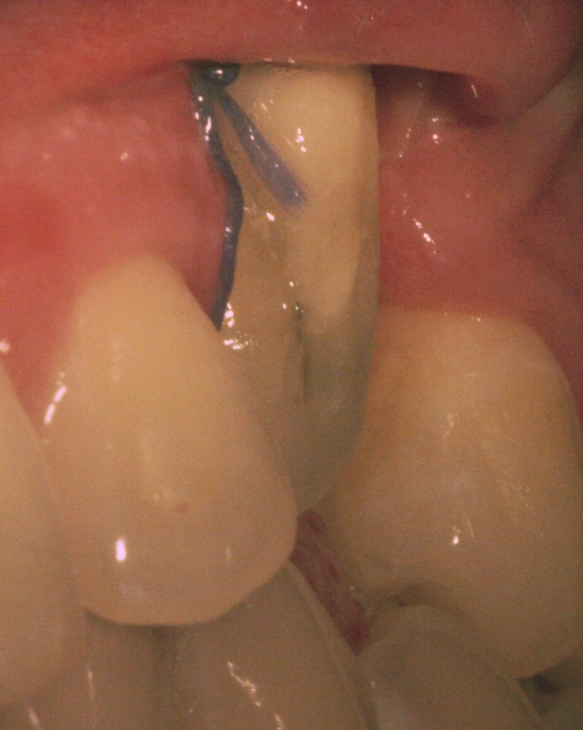
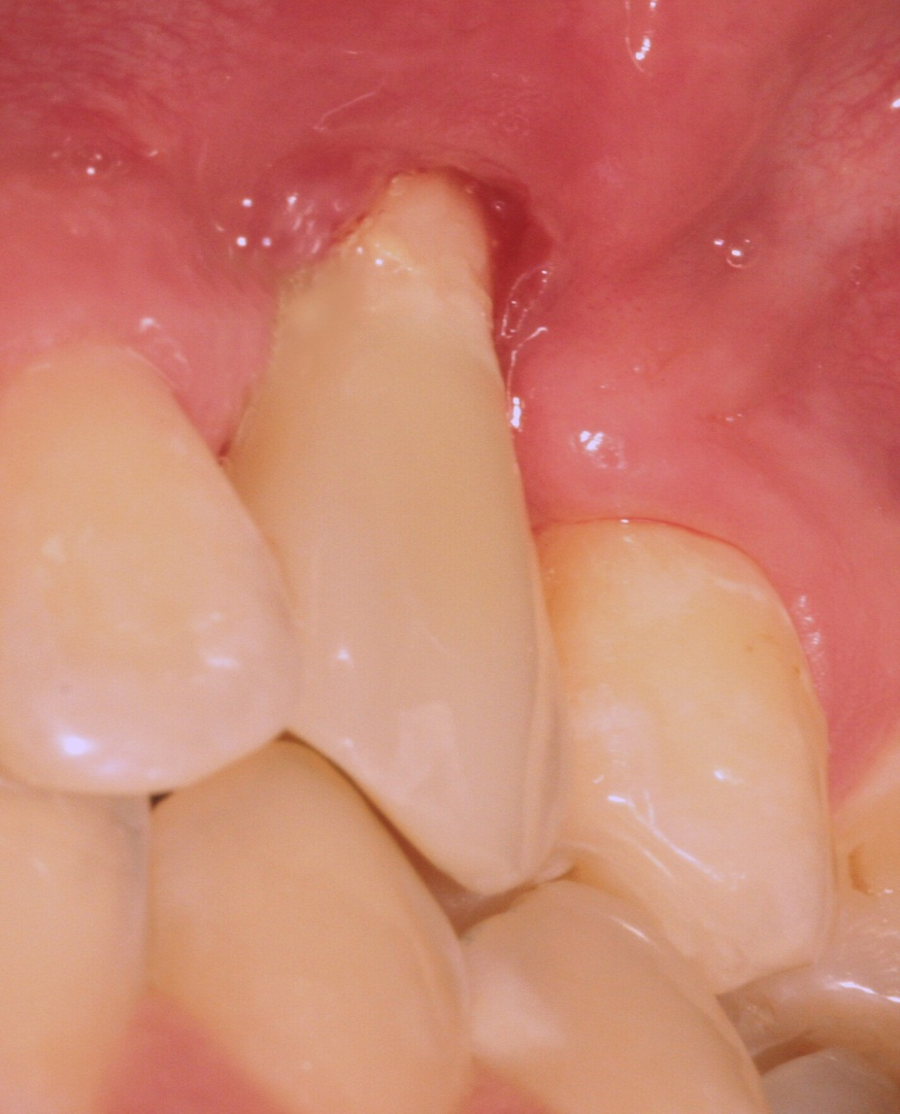

Slide 30
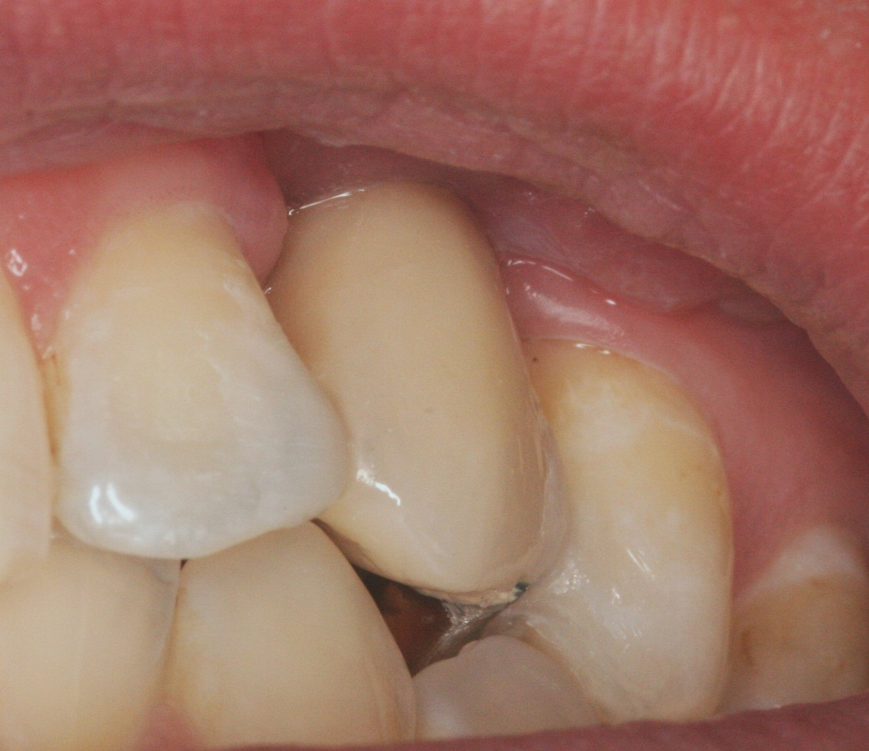
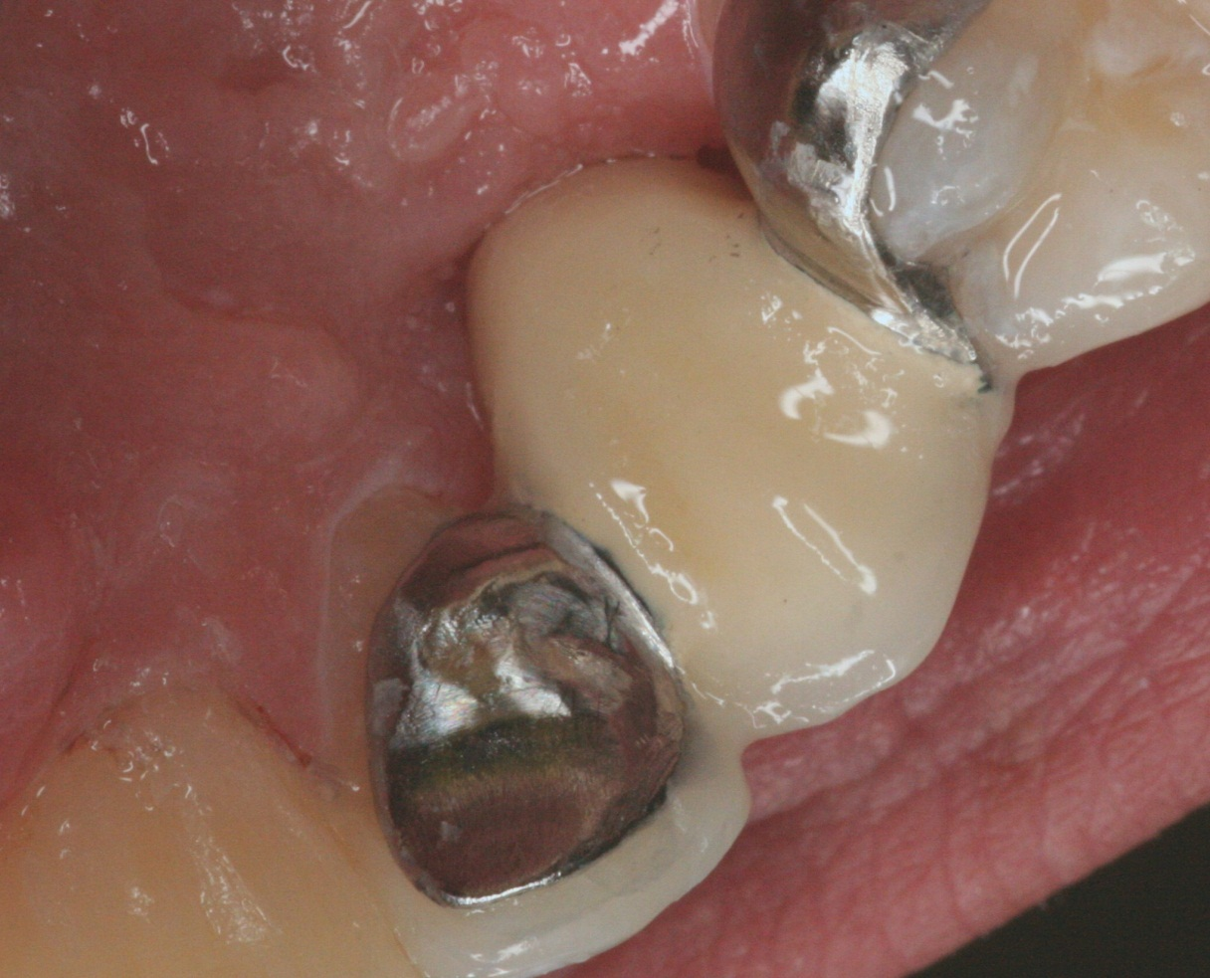
The story continues….

