Slide 1

Oral surgery
Preclinical dentistry III.
Lectures 1. – 2.

Slide 2
Oral and mafilofacioal surgery.
Dental speciality that deals with diagnosis and surgical treatment of diseases, injuries and deformities of teeth and surroundung structures (oral surgery). Maxilofacial surgery is focused also on jaws and face.

Slide 3
Surgical procedures
Incision
Extractions
Single ectraction
Multiple extractions
Surgical extractions
Exposure of impacted tooth (e.g. Canine, third molar)
Periodontal surgery
- Frenectomy
- Gingivectomy, gingivoplasty
- Osteoplasty
Biopsy
Implantation
Endodontic surgery

Slide 4
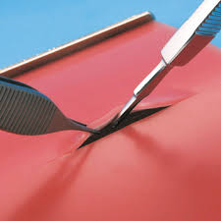
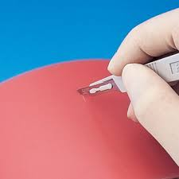
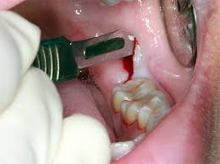
Incision
Surgical knife

Slide 5
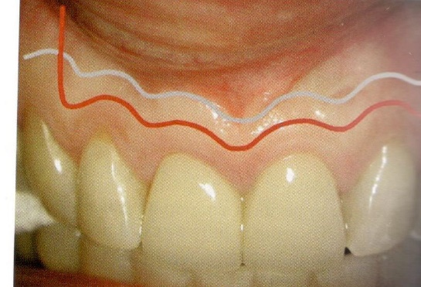
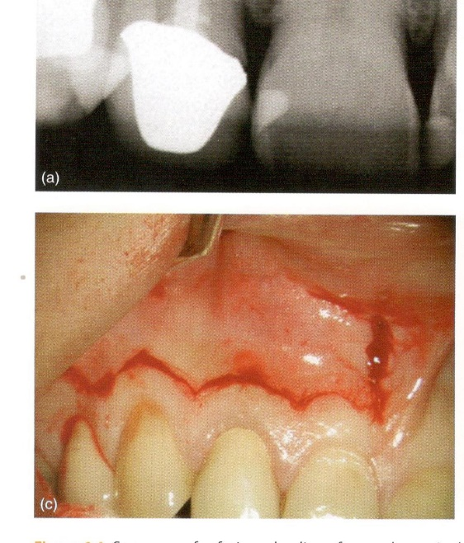
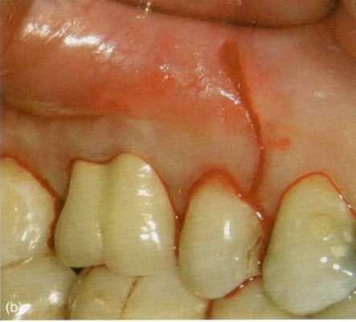
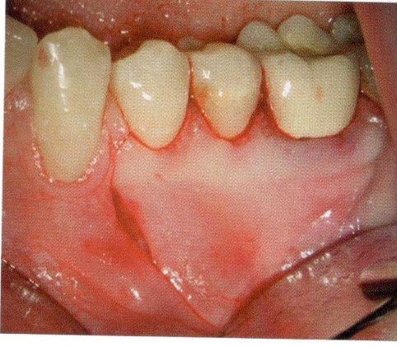
Incision – possibilities in periodontal sutgery
Example

Slide 6
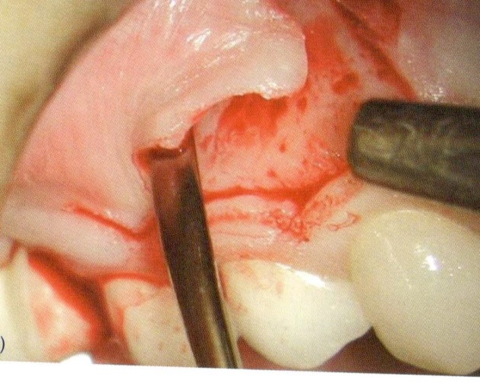
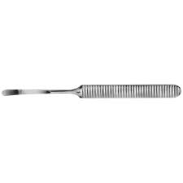
Raising the flap (mucosa and periosteum)

Slide 7
Control of Infection

Slide 8
Special terms in relation to control of infection
Asepsis
All procedures that prevent contamination of the operating field:
Sterile gloves and clothes
Sterile instruments
Using antiseptics for decontamination the operative field before the surgical procedure.

Slide 9
Special terms in relation to control of infection
Antisepsis
Preventin of infection by inhibiting or arresting the growth and multiplication of germs (infectious agents) on skin or mucosa.

Slide 10
Antiseptics
Antiseptics (from Greek αντί - anti, '"against" + σηπτικός - septikos, "putrefactive") are antimicrobial substances that are applied to living tissue/skin to reduce the possibility of infection, sepsis, or putrefaction

Slide 11
Special terms in relation to control of infection
Disinfection
is destruction od macroorganisms that are living on the objects. Desinfection does not necesarilly kill all microorganisms. We use various substances – disinfectants.

Slide 12
Disinfectants
Disinfectants are substances that are applied to non-living objects to destroy microorganisms that are living on the objects. Disinfection does not necessarily kill all microorganisms, especially not resistant bacterial spores; it is less effective than sterilisation, which is an extreme physical and / or chemical process that kills all types of life. Disinfectants are different from other antimicrobial agents such as antibiotics, which destroy microorganisms within the body, and antiseptics, which destroy microorganisms on living tissue. Disinfectants are also different from biocides — the latter are intended to destroy all forms of life, not just microorganisms.

Slide 13
Special terms in relation to control of infection
Sterilization (or sterilisation)
is a term referring to any process that eliminates (removes) or kills all forms of life, including transmissible agents (such as fungi, bacteria, viruses, spore forms, etc.) present on a surface, contained in a fluid, in medication, or in a compound such as biological culture media.

Slide 14
Sterilisation
Sterilization (or sterilisation) is a term referring to any process that eliminates (removes) or kills all forms of life, including transmissible agents (such as fungi, bacteria, viruses, spore forms, etc.) present on a surface, contained in a fluid, in medication, or in a compound such as biological culture media. Sterilization can be achieved by applying the proper combinations of heat, chemicals, irradiation, high pressure, and filtration.

Slide 15
Dry heat sterilisation
Sterilisation unit - sterilisator
Hot air
Circulation
160,170 or 180 °C
(60,30,20 min)

Slide 16
Hot steam sterilisation
Autoclave
Phases: vacuum –steam-air – drying.
Steam – pressure
Autoclaves commonly use steam heated to
121–134 °C (250–273 °F). To achieve
sterility, a holding time of at least 15 minutes at
121 °C (250 °F) or 3 minutes at 134 °C (273 °F) is
required.

Slide 17
Cold sterilisation
Irradiation
Special gas
No in dental surgery

Slide 18
Scrubbing
Aims and objectives:
Effectively reduce the number of microorganisms on the skin
By mechanical washing

Slide 19
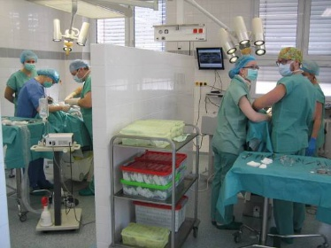
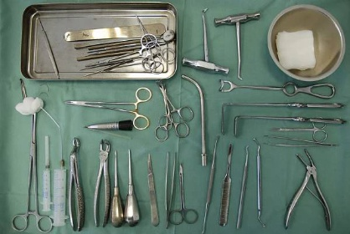

Slide 20
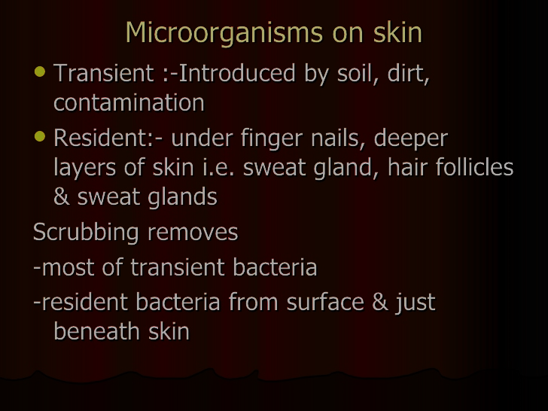

Slide 21
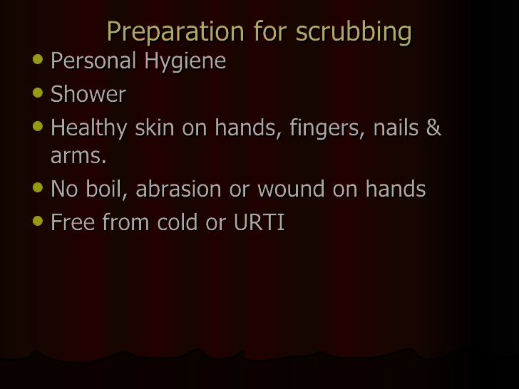

Slide 22
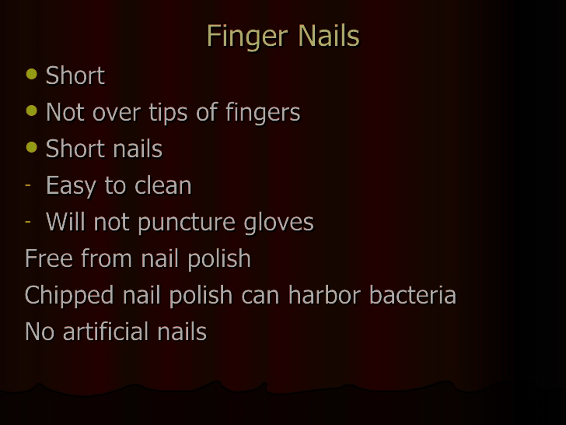

Slide 23
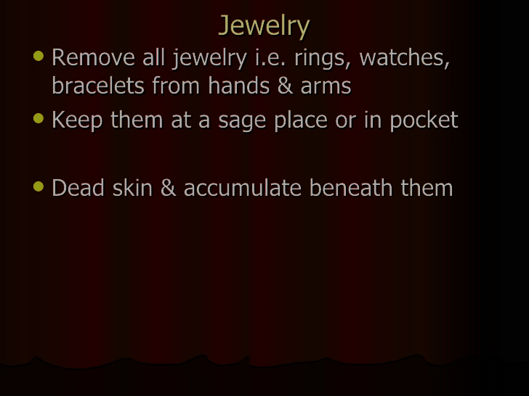

Slide 24
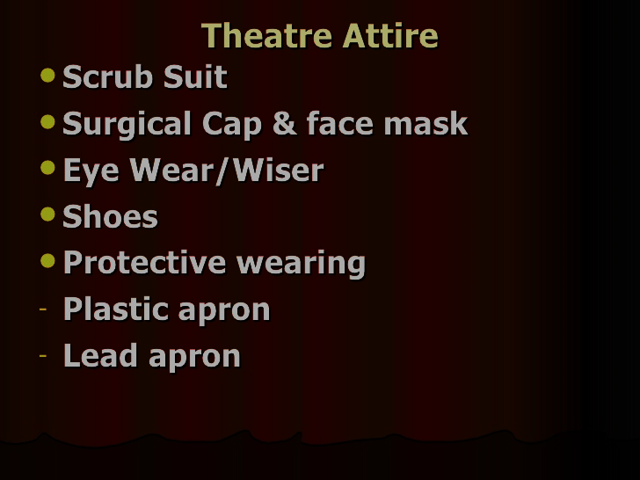

Slide 25
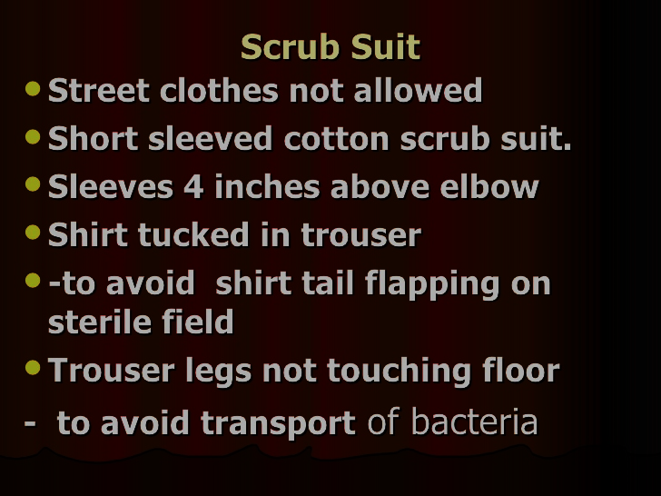

Slide 26
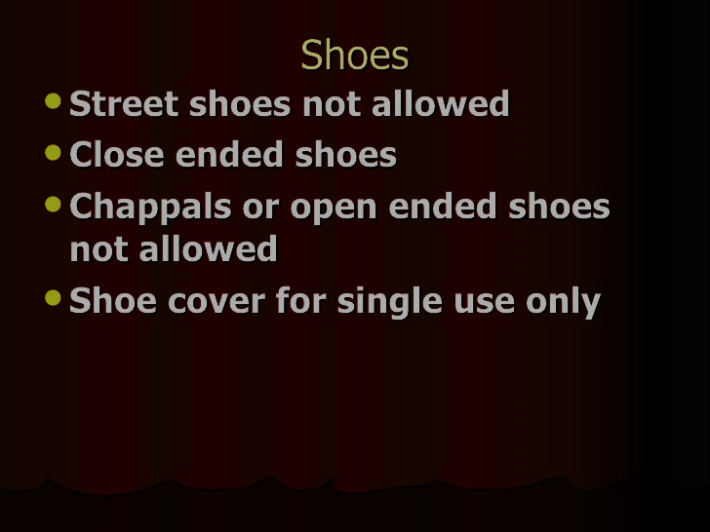

Slide 27
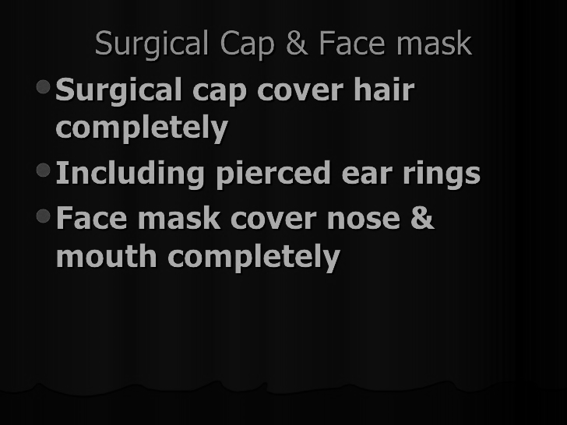

Slide 28
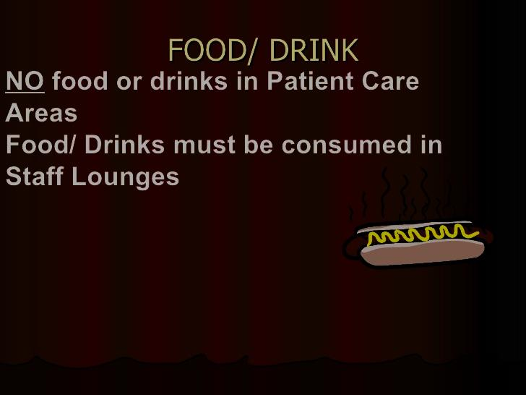

Slide 29
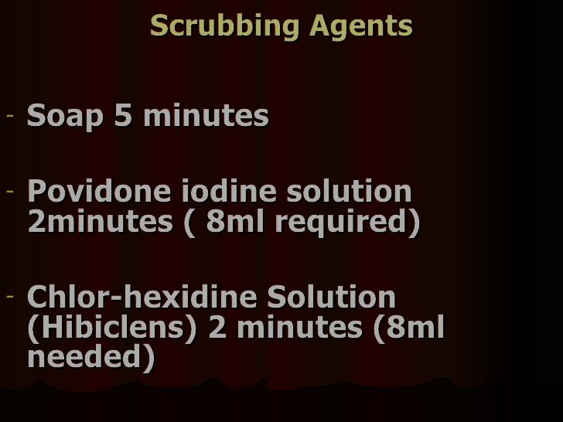

Slide 30
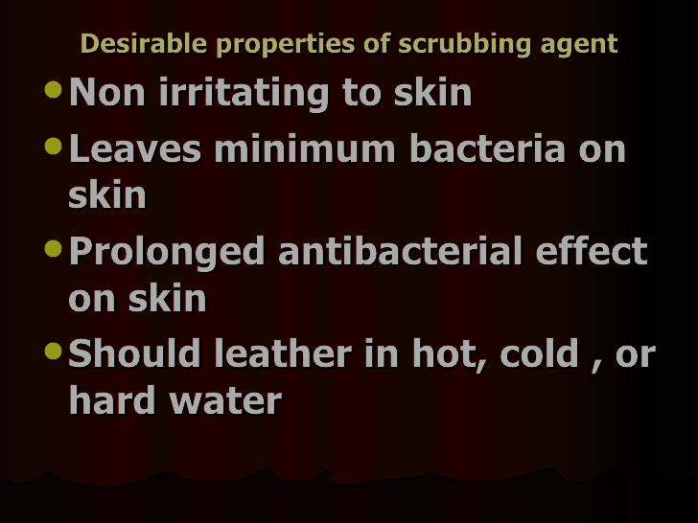

Slide 31
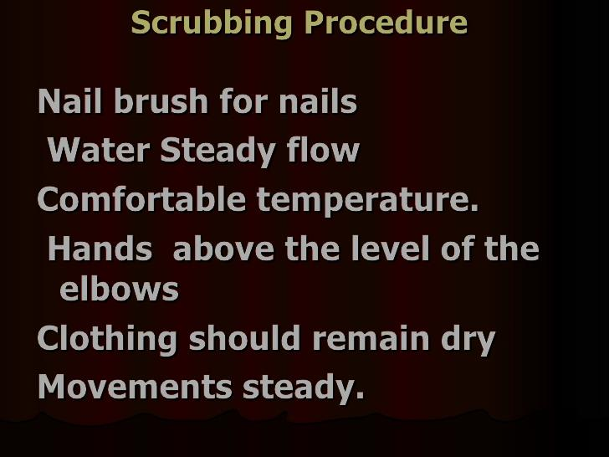

Slide 32
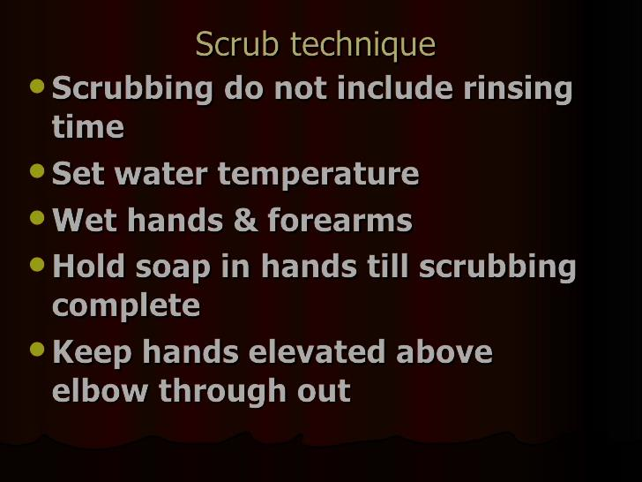

Slide 33
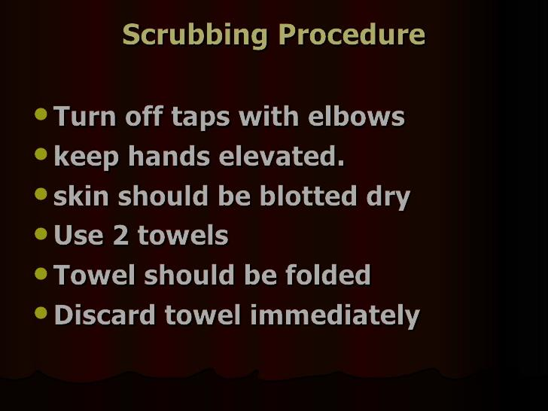

Slide 34
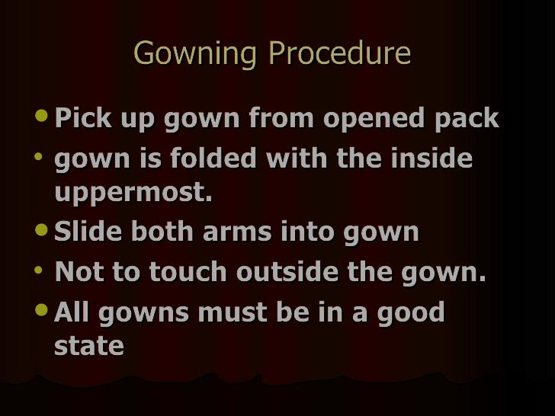

Slide 35
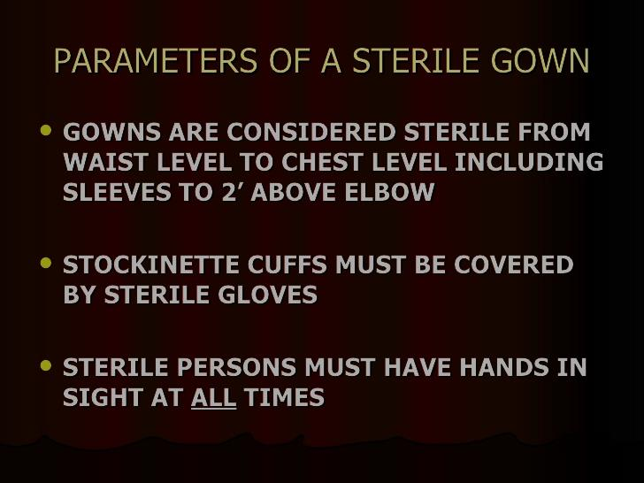

Slide 36
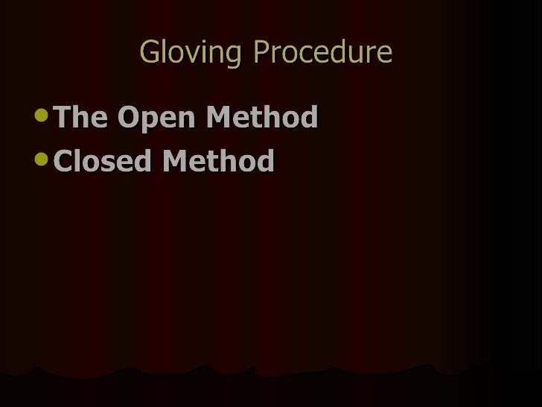

Slide 37
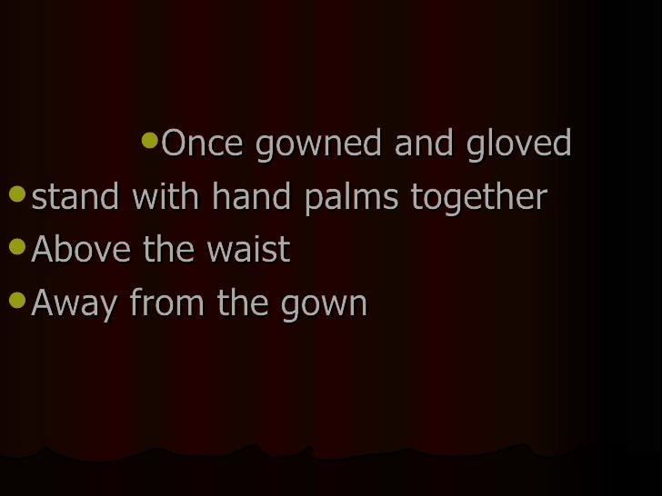

Slide 38
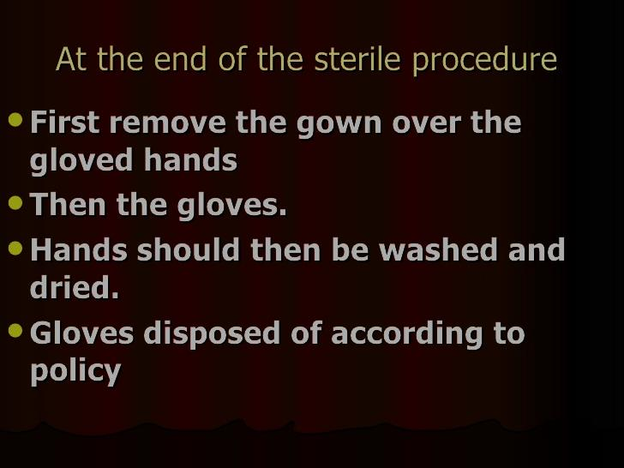

Slide 39
The preparation of operator and operating field will explained and trained practically from 3rd year
This is the endo of the first lecture.

Slide 40
ANAESTHESIA

Slide 41
Anaesthesia
Dentist is responsible for providing the
patient with comfortable dental
treatment !

Slide 42
Pain
Sensory and emotional experience
associated with actual or potentional
tissue damage.

Slide 43
Pain and anaesthesia
Pain occurs when pain receptors or
nerve endings transmit impulses to the
central nervous system.
Anaesthesia eliminates the pain
experience by interrupting the
transmitted impulse.

Slide 44
Anaesthesia
Absence of normal sensation, esp
sensitivity to pain.

Slide 45
Pain control - Indications of anaesthesia
Surgical treatment
Preparation of cavities
Preparation for crowns
Endodontic treatment
Peridontal treatment (scaling, periodontal surgery)

Slide 46
classification
General anaesthesia
Analgesia (inhalation, sedation)
Hypnosis
Local anaesthesia

Slide 47
Anaesthesia
Conscious sedation: an anaesthetic agent
used to produce a sedative effect while
patient remains conscious. (Sometimes
inhalation)
General anaesthesia: an anaesthetic agent
creates a state od unconsciouness
with absence of sensation of entire
body.

Slide 48
Local Anaesthesia
Topical (spray,liquid) applied on mucosa
By injection
- Infiltration
- Nerve block
- PDL –periodontal ligament anaesthesia
- Intrapulpal anaesthesia

Slide 49
Pain control - Indications of anaesthesia
Surgical treatment
Preparation of cavities
Preparation for crowns
Endodontic treatment
Peridontal treatment (scaling, periodontal surgery)

Slide 50
Local anaesthesia Contraindications
Allergy
Serious systemic diseases (blood circulation)
Antithrombotic therapy , coagulopathy – nerve blocked anaesthesia

Slide 51
Drugs
Articain 4% with epinephrine 1: 200 000
Articain 4% with epinephrin 1:100 000
Mepivacain 3%plain
Prilocaine 4% with epinephrine 1:200 000
Prilocaine plain
Lidocain spray 10%
Xylocain spray 10%

Slide 52
Benefits of local anaesthesia
Comfort for the patient
Haemostasis (addtion of epinephrin – hormone of suprarenal gland – arteficial)
Operator efficiency

Slide 53
Topical anaesthesia (on mucosa or skiN)
Liquid
Spray
Creme, paste
Only nerve endings are affected
For extraction of primary teth (when roots are completely resorbed)
Anesethesia of the puncture will be

Slide 54
Infiltration ANAESTHESIA
The drug is delivered by infiltration of soft tissues using syringe and needle.
Nerve branches in tissues are affected.

Slide 55
Infiltration anaesthesia
Suitable for - indications
- simple extractions in maxilla,
- extractions of mandibular incisors, canines
- soft tissue surgery

Slide 56
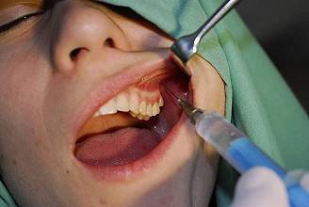
Infiltration
Syringe with short needle
Raise lip or cheek The puncture is situated into mucosa appr. 1cm from fornix vestibuli. Do not touch periosteum.

Slide 57
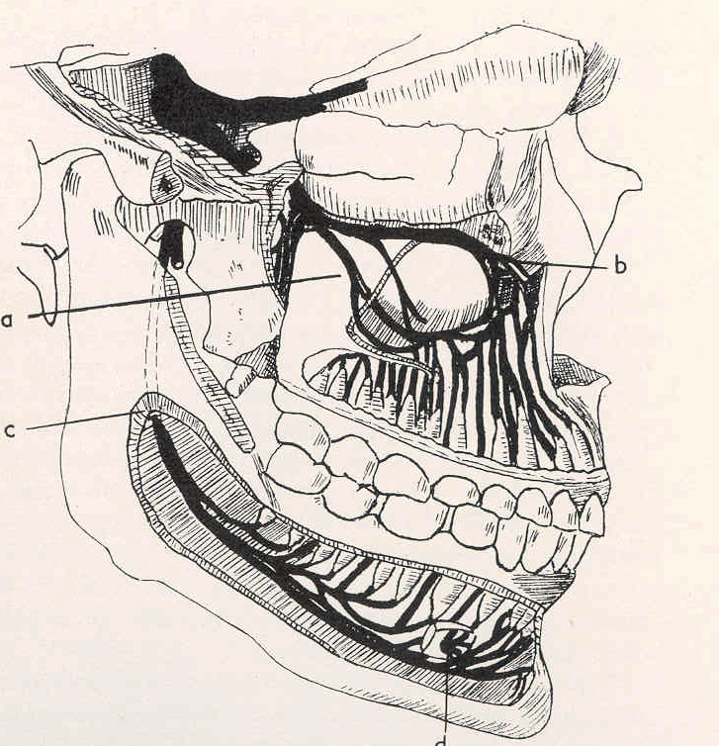
Nerve block anaesthesia
Syringe with long needle
Foramen mandibulare
Foramen mentale
Foramen palatinum
majus
Foramen incisivum
Foramen infraorbitale

Slide 58
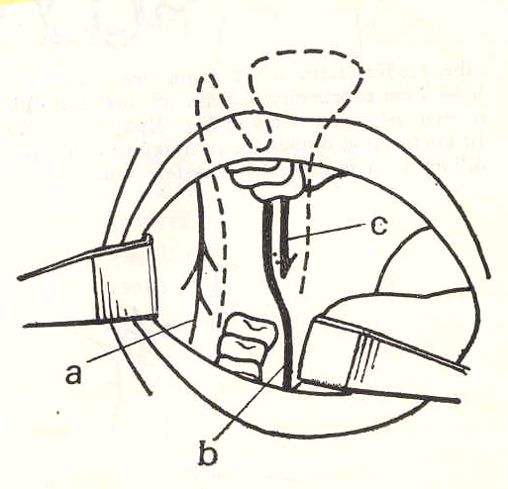
Nerve block anaesthesia
N. alveolaris inferior
Foramen mandibulare
N. Alveolaris inferior
N. lingualis

Slide 59
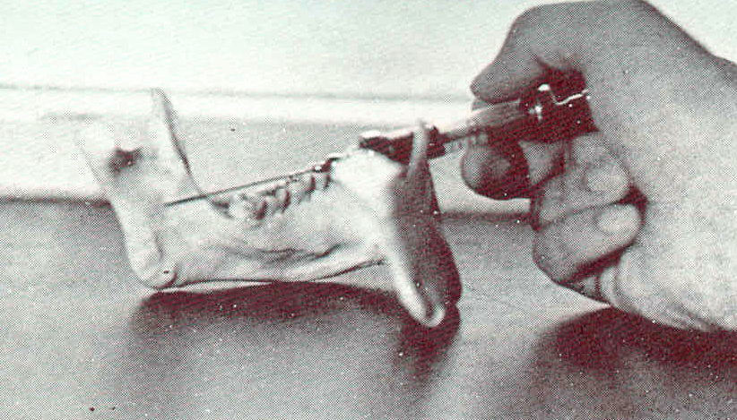
Nerve block anaesthesia
Nervus alveolaris inferior
In sulcus colli mandibulae

Slide 60
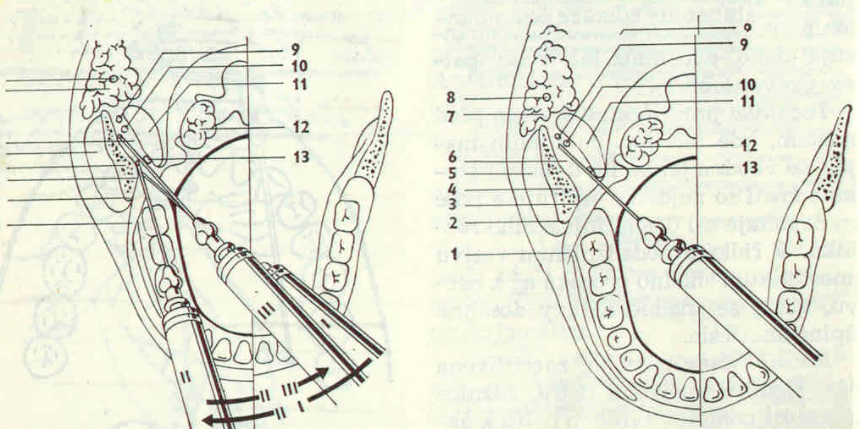
Nerve block anaesthesia
N. alveolaris inferior
Indirect
Direct

Slide 61
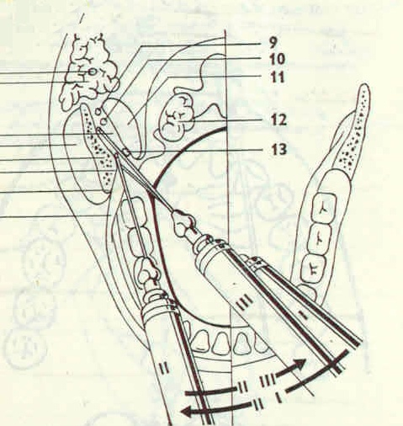
Nerve block anaesthesia
N. alveolaris inferior
Indirect
Put the forefinger
on the occlusal surface
Rotate inside (nail inside)
1 cm up occlusal surface
the puncture is situated

Slide 62
Nerve block anaesthesia
N. alveolaris inferior
Indirect
1. The syringe
on the opposite canine
The needle goes behind
the crista temporalis,

Slide 63
Nerve block anaesthesia
N. alveolaris inferior
Indirect
2. The needle goes deeper
in the contact with the bone
The syringe goes mesial

Slide 64
Nerve block anaesthesia
N. alveolaris inferior
Indirect
3. The contact with bone
is lost, the syringe goes back
Aspiration and a injection of
the drug.

Slide 65
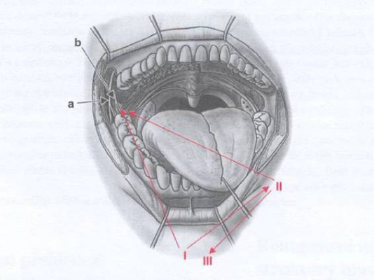
I.
II
III.
II.

Slide 66
DIRECT Method
The beginning is the same
Put the forefinger
on the occlusal surface
Rotate inside (nail inside)
1 cm up occlusal surface
the puncture is situated

Slide 67
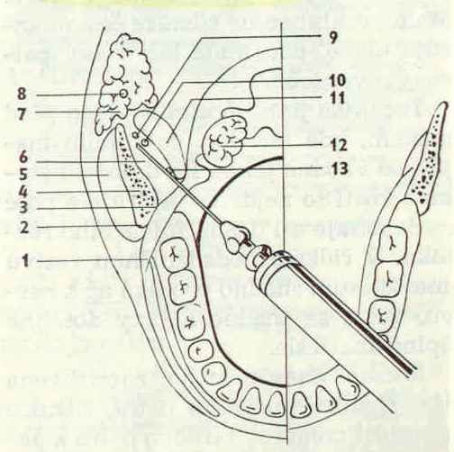
Nerve block anaesthesia
N. alveolaris inferior
Direct
The puncture see previous slide
The syringe on opposite premolars
The puncture is situated
medially from crista temporalis
and laterally from plica prerygomandibularis (into a small depression in mucosa)
1,5 cm deep

Slide 68
Nerve block anaesthesia
N. alveolaris inferior
Anaesthetic zone
Molars, premolars, mucosa, skin, bone, tongue

Slide 69
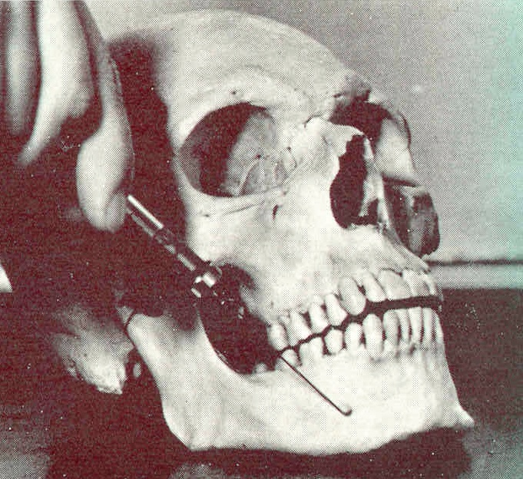
Nerve block anaesthesia
F. mentale
The puncture is situated behind
the distal surface of 2nd premolar
The needle goes between
roots of premolars from up to down,
Forward and mesially
Anaesthetic zone: Premolars and canine,
mucosa, skin.

Slide 70
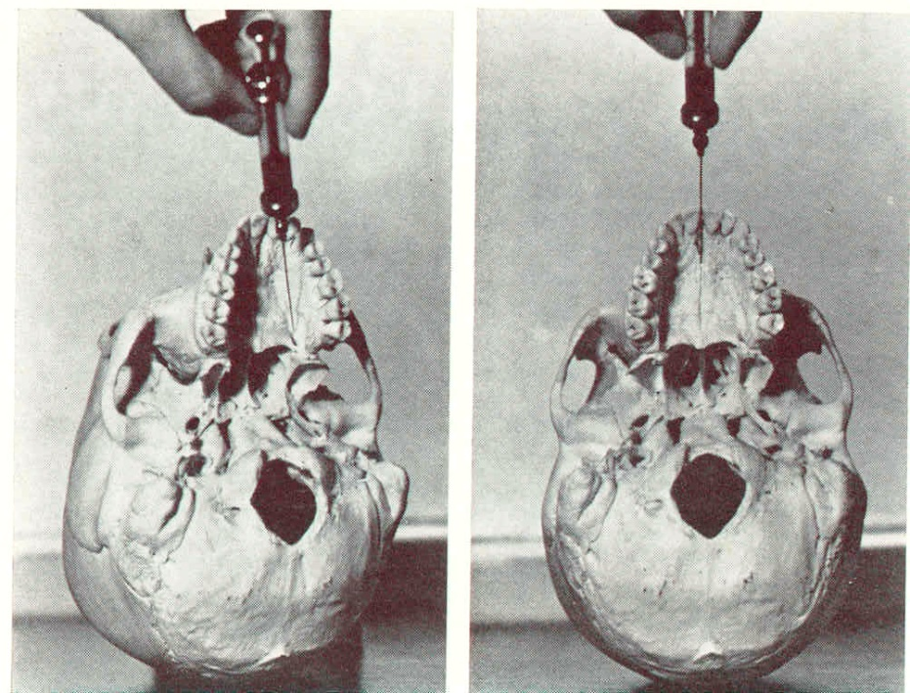
Nerve block anaesthesia
Foramen palatinum majus – nervus palatinus major
Distal surface of second molar
The puncture is
0,5 – 1 cm before
from behind forward
Anaesthetic zone: Half of palate

Slide 71
Nerve block aesthesia
Foramen incisivum – n. nasopalatinus
Nervus incisivus
Papilla incisiva
Next tu papilla,
mesial direction
Triangular area
behind incisors

Slide 72
Anaesthesia on f. infraorbitale
Find the margo infraorbitalis
Raise the lip
The puncture is situated between canine and 1st premolar
The needle goes to the region (appr 1 cm below margo infraorbitalis)
Anaesthetic zone: Canine and premolars

Slide 73
Anaesthesia on tuber maxillae
The durg si delivered on tuber maxillae
The puncture is situated behind 2nd molar (distal surface), goes behind and upper around tuber maxillae.
Anaesthetic zone: Upper molars

Slide 74
PDL anaesthesia
Intraligamentary
Special syringe (pen or gun) The needle is inserted into periodontal space – few drops on anaesthetic
Indication: single extraction, preparation, pulp exstirpation

Slide 75
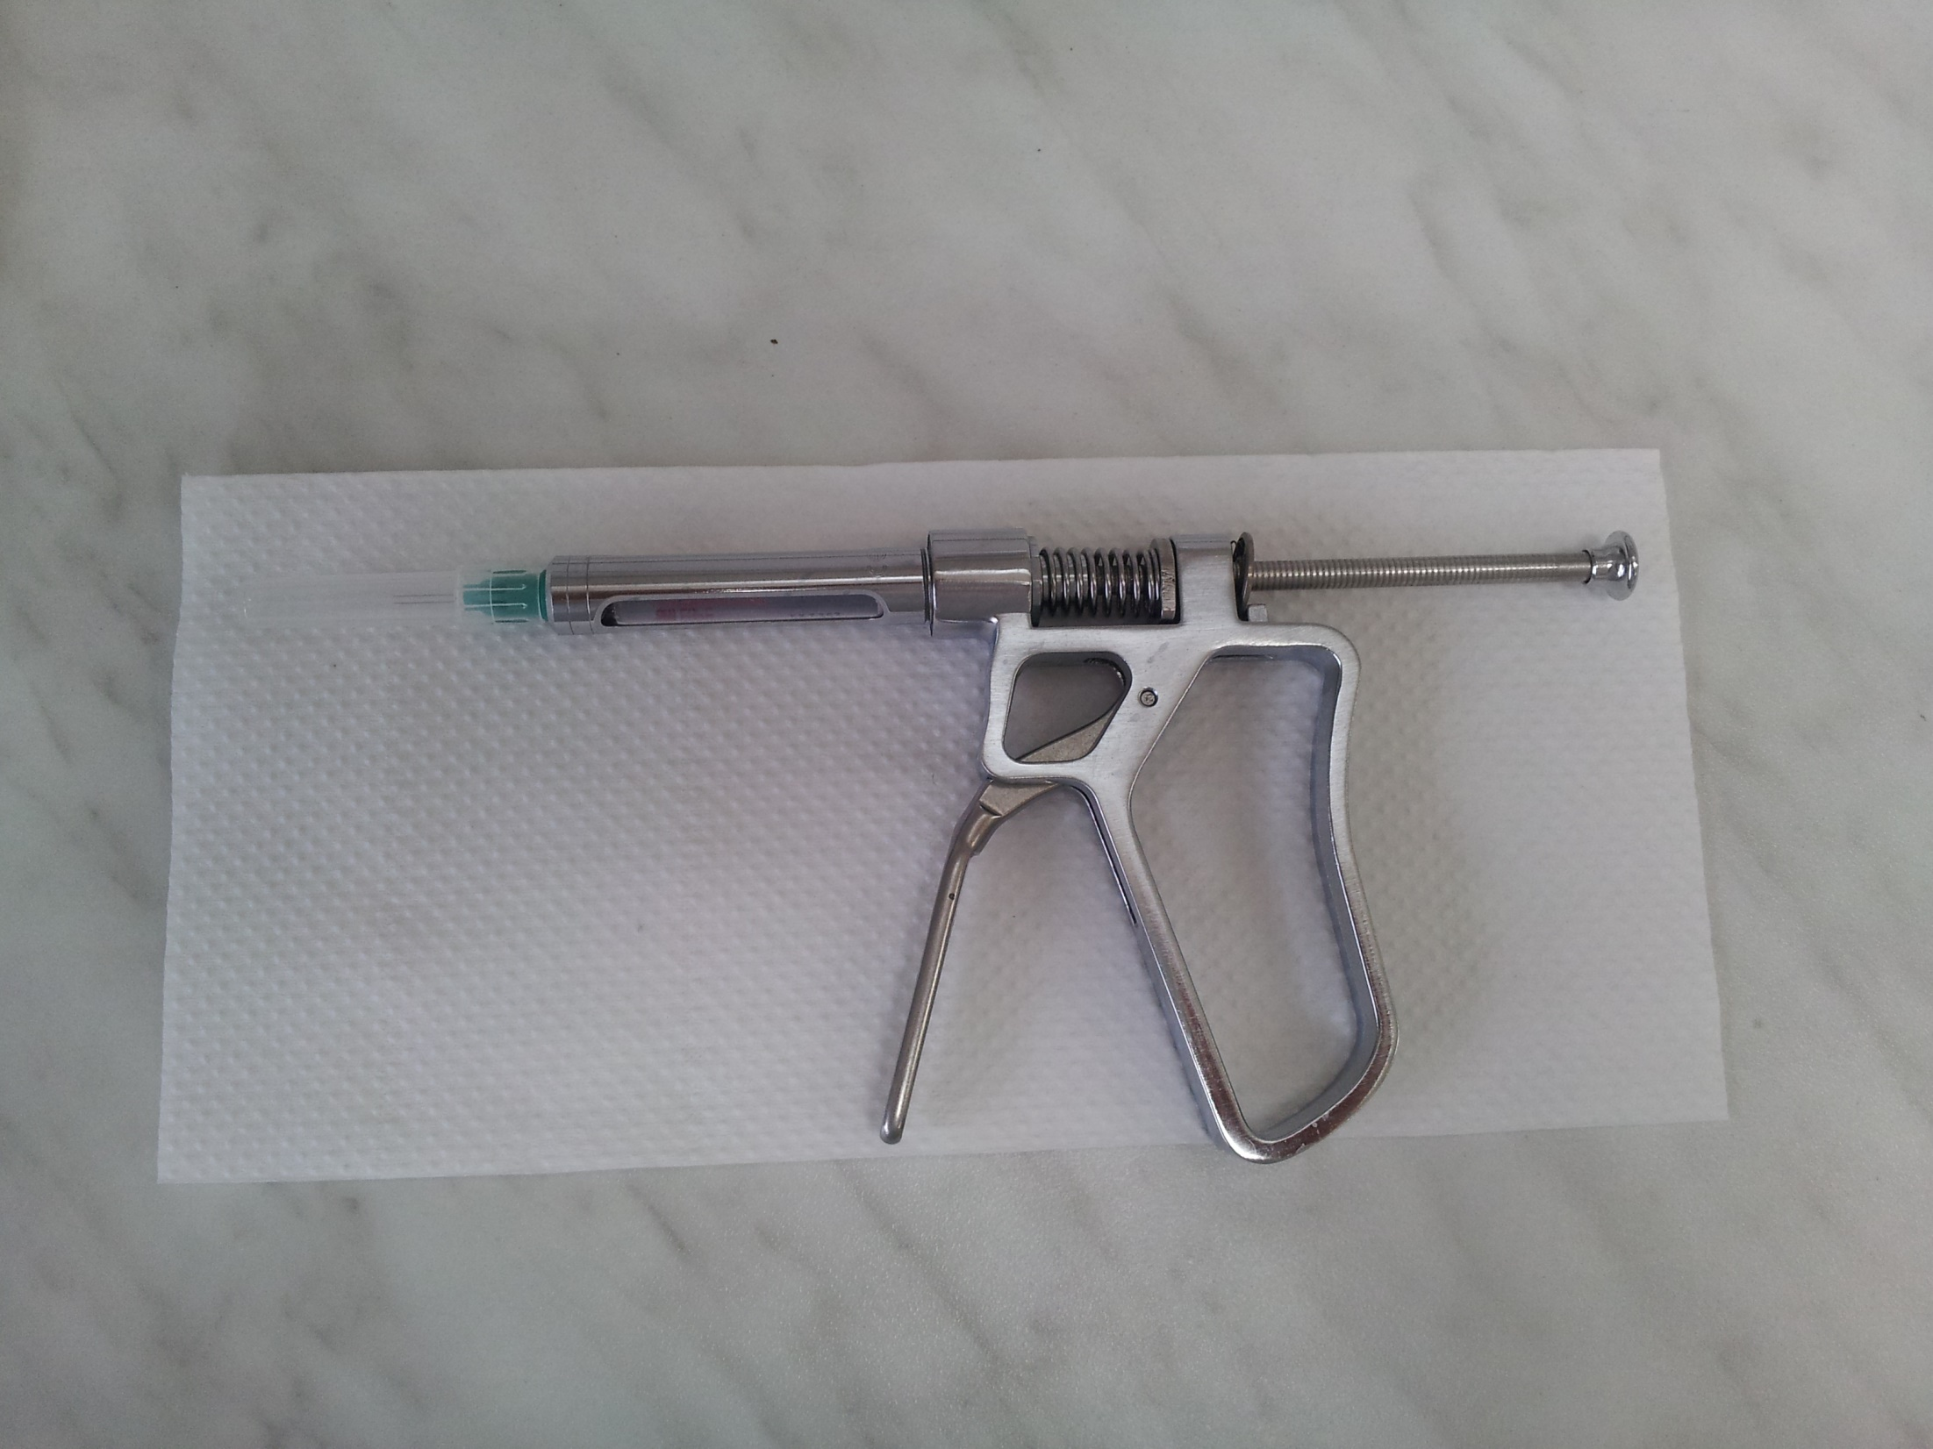

Slide 76
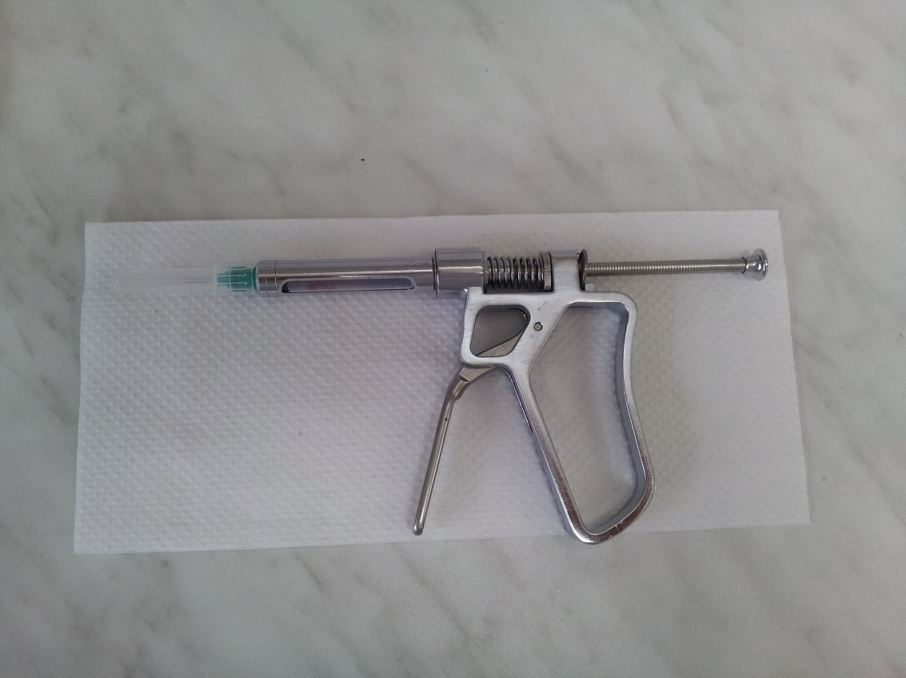
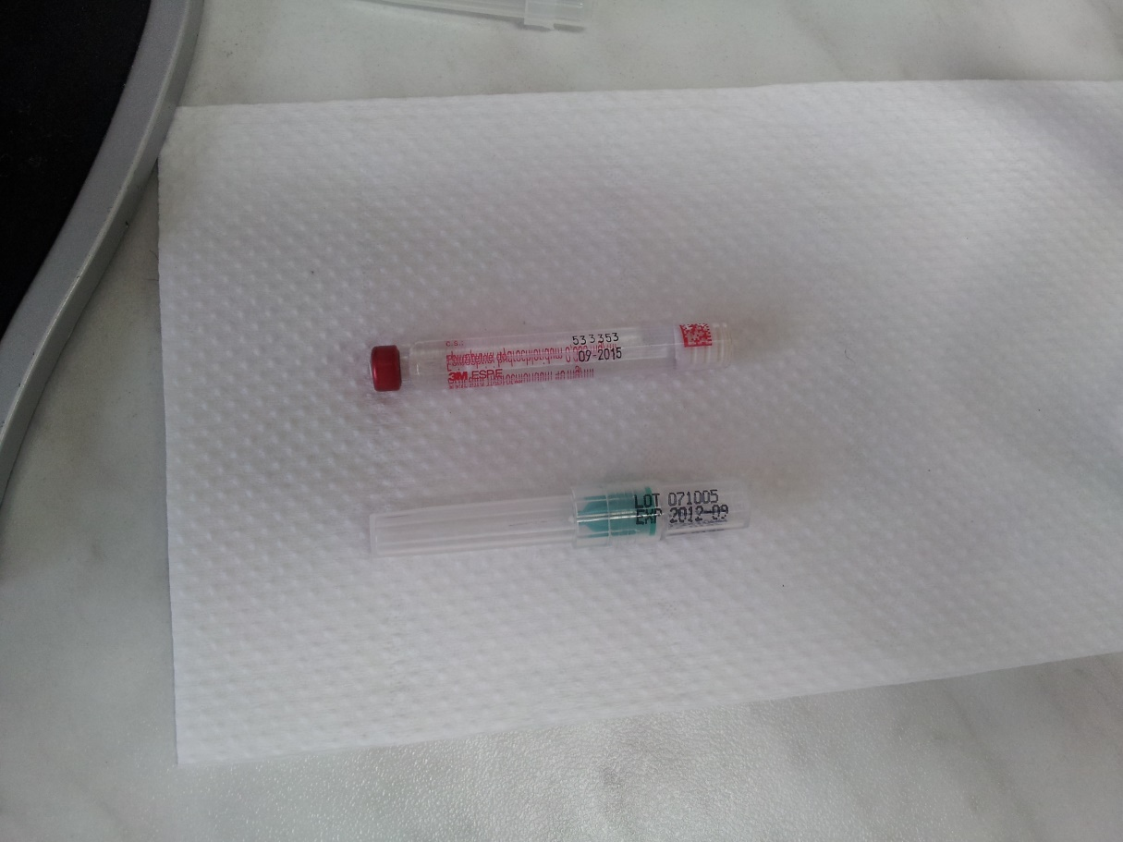
Special gun
Anaesthetic Needle

Slide 77
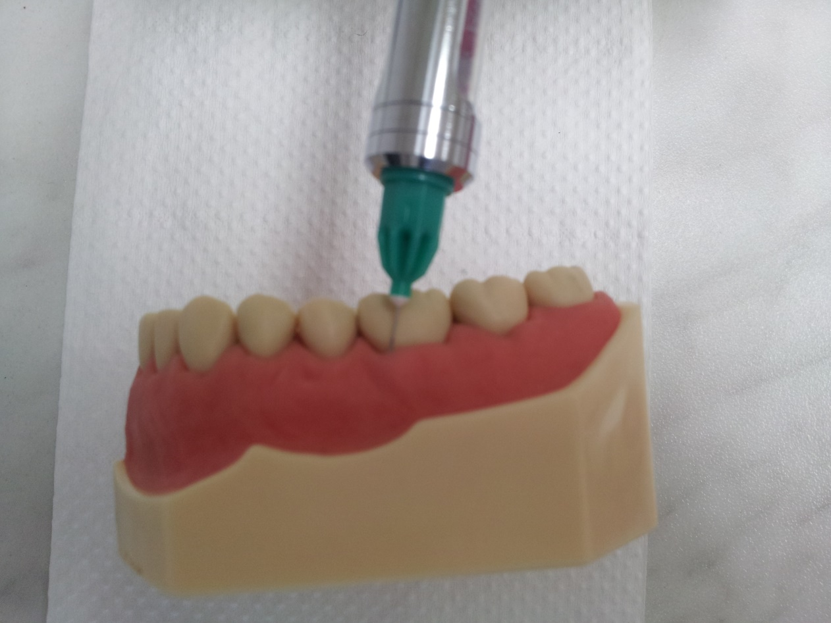
The puncture is between gingiva and tooth and goes into gingival sulcus
MB, ML, DB, DL

Slide 78
Intrapulpal Anaesthesia
Exstirpation of the pulp – additional step.
Directly into the pulp chamber

Slide 79
Anaesthesia - complications
Bleeding
Breakage of needle
Heamatoma
Allergy (swelling, collaps)
Patient´s history is necessary!!!!

Slide 80
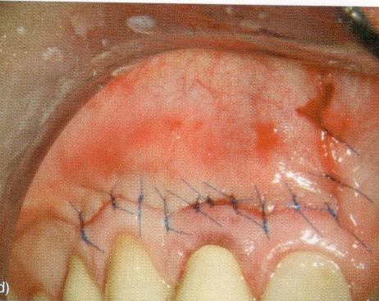
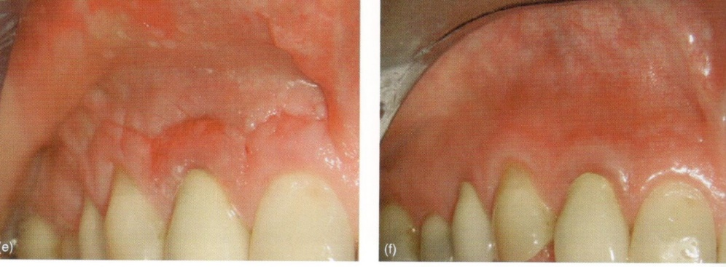
Adaptation of the flap, suture

Slide 81
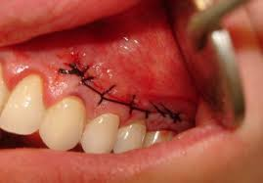
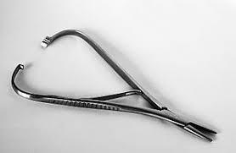
suturE

Slide 82
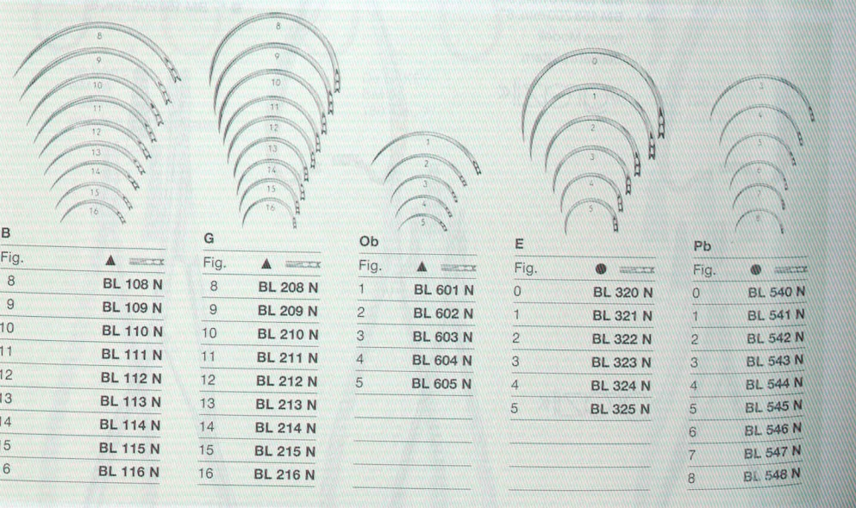
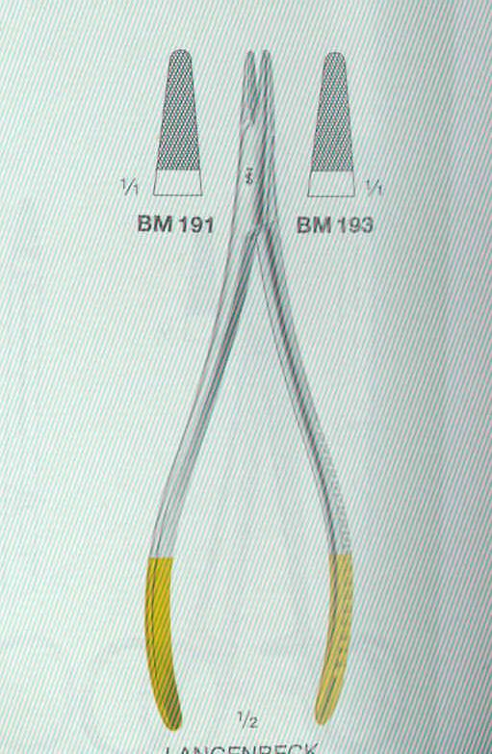

Suture
Instruments:
Needles: bent
Straight
Various size
Needleholder:
Without fixation
Autofix

Slide 83


Suture
Tweezers – tissue forceps

Slide 84
Suture
Suture material
Resosbable,
Polyglycol, polyglactin, polydioxynon
Non resorbable
Silk,nylon, PTFE, Polyester,polyamid.
Monofil, polyfil

Slide 85

Single suture
The puncture is situated appr. 2 mm
from the border of the wound
The same on the opposite site.
The knot is out of the wound

Slide 86

Single suture
Coninuing suture

Slide 87



Wide wound – the borders are brought closer
Mattress suture
Cross mattress suture

Slide 88
For the exam:
Students will be asked for preformance of:
Single suture
Matress suture
Here is also a link on you tube:
https://www.youtube.com/playlist?reload=9&list=PLWXXOUqxJ_VP8lxhFP7jJbXVSdXDi0iaC
This is an end of second lecture.

