Slide 1
Determinants of health
What keeps population healthy?

Slide 2
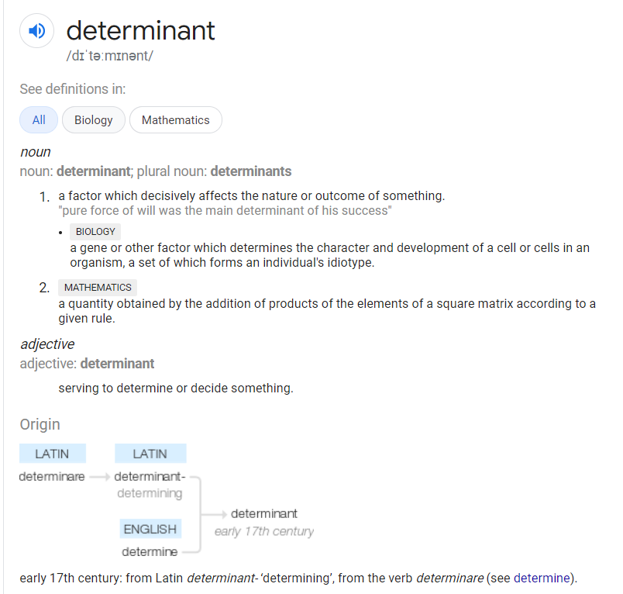

Slide 3
Major groups of health determinants
Biology and genetics
Physical determinants
Social determinants
Health services
Public policies
Individual behaviour

Slide 4
Taxonomy of health determinants
Not universal
Each country/reagion agency has its own terminology
The principle is not contested and questioned

Slide 5
Social Factors
Availability of resources to meet daily needs, such as educational and job opportunities, living wages, or healthful foods
Social norms and attitudes, such as discrimination
Exposure to crime, violence, and social disorder, such as the presence of trash
Social support and social interactions
Exposure to mass media
Socioeconomic conditions, poverty
Quality schools
Transportation options
Public safety
Residential segregation
Physical determinants
Natural environment, such as plants, weather, or climate change
Built environment, such as buildings or transportation
Worksites, schools, and recreational settings
Housing, homes, and neighborhoods
Exposure to toxic substances and other physical hazards
Physical barriers, especially for people with disabilities
Aesthetic elements, such as good lighting, trees, or benches
Healthcare
Lack of availability
High cost
Lack of insurance coverage
Limited language access
Individual Behavior
Diet
Physical activity
Alcohol, cigarette, and other drug use
Hand washing

Slide 6
USA (healthypeople.gov)
CANADA (canada.ca/en/public-health)
Social Factors
Physical determinants
Healthcare
Individual Behavior
Income and social status
Employment and working conditions
Education and literacy
Childhood experiences
Physical environments
Social supports and coping skills
Healthy behaviours
Access to health services
Biology and genetic endowment
Gender
Culture
Race / Racism

Slide 7
WHO taxonomy
the social and economic environment,
the physical environment, and
the person’s individual characteristics and behaviours.

Slide 8
Social determinants of health in accordance to WHO
Income and social protection
Education
Unemployment and job security
Working life conditions
Food insecurity
Housing, basic amenities and the environment
Early childhood development
Social support and inclusion
Structural conflict
Access to affordable health services of decent quality.

Slide 9
Are all health determinants equal?
NO!

Slide 10
http://determinantsofhealth.org

Slide 11
Statistical relevance of determinants:
Ranking
Individual behaviour 38%
Social determinants 23%
Genetics and biology 21%
Medical care 11%
Physical environment 7%
Be careful with generalisation !
Interprets the data of population (North America)
Little relevance to individual cases

Slide 12
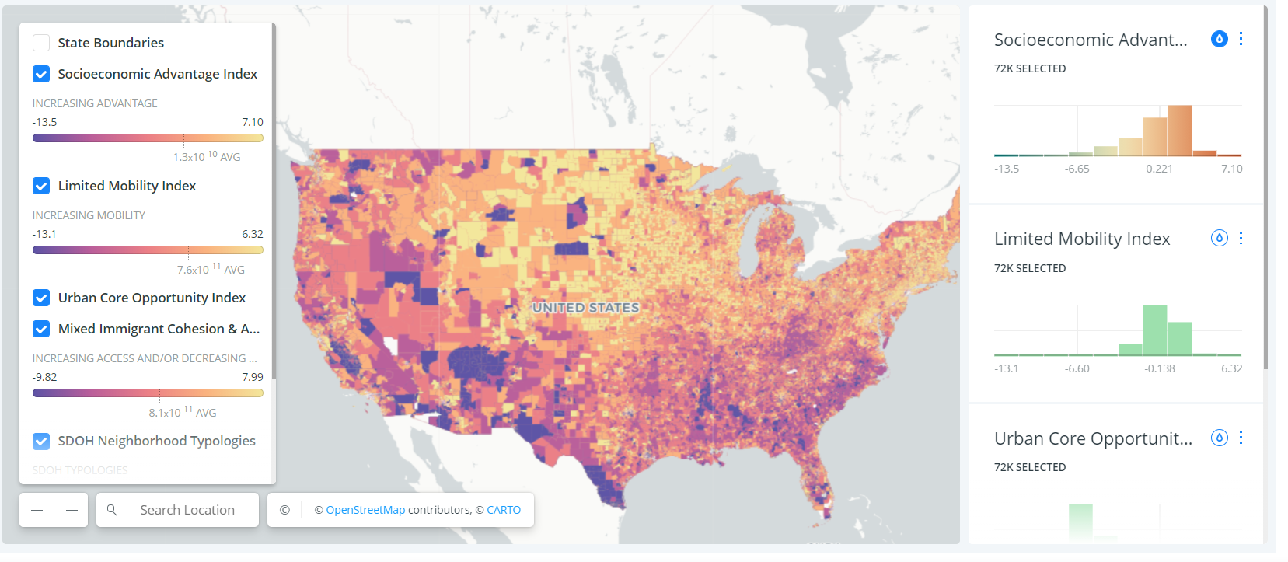
Geographical variability Quantification of Neighborhood-Level Social Determinants of Health in the Continental United States Kolak M, Bhatt J, Park YH, Padrón NA, Molefe A. Quantification of Neighborhood-Level Social Determinants of Health in the Continental United States. JAMA Netw Open. 2020;3(1):e1919928. doi:10.1001/jamanetworkopen.2019.19928

Slide 13
OECD Data

Slide 14
Conclusions …
The context of people’s lives determine their health, and so
blaming individuals for having poor health or crediting them for good health is inappropriate!
Individuals are unlikely to be able to directly control many of the determinants of health.
…. World health organisation https://www.who.int/news-room/q-a-detail/determinants-of-health

Slide 15
What can we do to change health determinants?
… we have to change society …..

Slide 16
Health in all policies
The developed countries go beyond physical infrastructure
Social programs
Cash transfers
Reduction of poverty
Educational programs
Improving social status of individuals
Promoting healthy lifestyle
Behavioural incentives
Tobacco, Alcohol regulations

Slide 17
Rio Political Declaration on Social Determinants of Health
Work across different sectors and levels of government
Develop policies that are inclusive and take account of the needs of the entire population
Specific attention to vulnerable groups and high-risk areas
Support comprehensive programmes of research
Promote awareness of policy-makers
Support all sectors to address social determinant
Foster collaboration with the private sector, safeguarding against conflict of interests,
Strengthen occupational health safety
Promote and strengthen universal access to social services and social protection floors
Give special attention to gender-related aspects
Access to affordable, safe, efficacious and quality medicines
Strengthen international cooperation

Slide 18
Balancing public health objectives against other societal/cultural values

Slide 22
European perspective

Slide 23
European union perspective

Slide 24
European union
Basic facts
27 countries
550 million citizens
It is not a state but …
Union of sovereign states
Common policies in certain areas
Free movement of citizens, goods, services
Common currency (in most countries)

Slide 25
What can EU do about it (and what should be left for national sates).

Slide 26
1. Health in all policies
Since health is determined to a large extent by factors outside the health area, an effective health policy must involve all relevant policy areas, in particular:
social and regional policy
taxation
environment
education
research.
All EU policies are required by the EU treaty to follow this "Health in all Policies" (HIAP) approach. But to be fully effective, this approach needs to be extended to national, regional and local policies.

Slide 27
Agencies on EU level
Consumers, Health and Food Executive Agency (Chafea) –
European Centre for Disease Prevention and Control (ECDC) –
European Environment Agency (EEA)
European Monitoring Centre for Drugs and Drug Addiction (EMCDDA)
European Medicines Agency (EMA) –
European Chemicals Agency (ECHA) –
European Food Safety Authority (EFSA) –
European Agency for Safety and Health at Work (EU-OSHA) –
Eurofound
implements the EU Health Programme, Consumer Programme and Better Training for Safer Food initiative.
works to strengthen Europe's defences against infectious diseases.
provides reliable, independent information on the environment.
supplies comprehensive information on drugs and drug addiction in Europe.
protects and promotes public and animal health by evaluating medicines for human and veterinary use.
ensures chemical substances are registered, evaluated, authorised and restricted consistently across the EU.
provides independent scientific advice and clear communication on risks to food and feed safety.
supplies information needed by EU employers and workers to address safety and health issues.
– provides expertise on living and working conditions, industrial relations and managing change for key EU social policy actors.

Slide 28
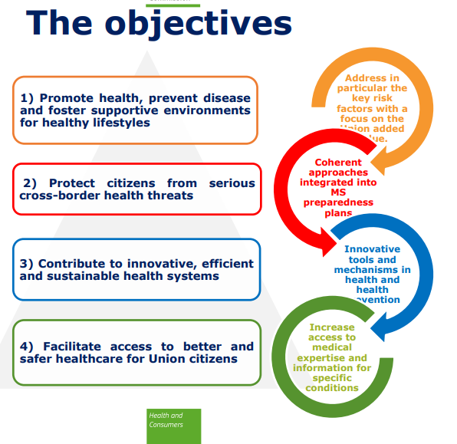
Third EU Health Programme 2014-2020

Slide 29
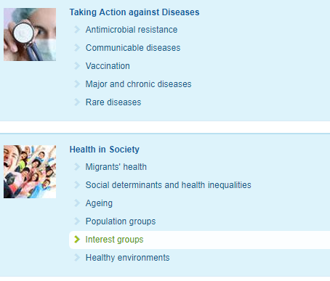
Where is EU taking action (?)

Slide 30
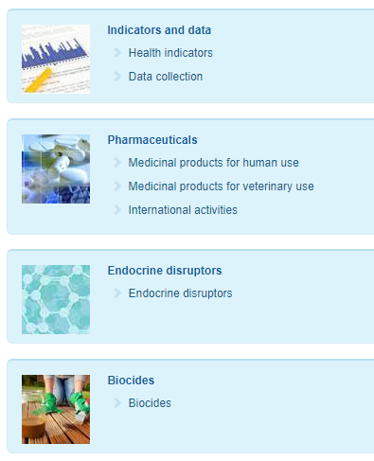

Slide 31
Further actions
Movement of workforce
Health professional
Movement of goods
Safety standards
Marketing rules
Cross-border provision of healthcare

Slide 32
Thank you for your attention

