Slide 1



Chest trauma
Petráš M.,.
Klinika úrazové chirurgie LF MU a TC FN Brno

Slide 2
Introduction
vital structures – chest trauma is often sudden and dramatic
  heart, great vessels, tracheobronchial tree and lungs
abdominal injuries are common with chest trauma
the most common type of injuries is blunt
serious pathological consequences – hypoxia, hypovolaemia, myocardial failure

Slide 3
Physiology
ventilation
the mechanical process of moving air into and out of the lungs
respiration
the exchange of oxygen and carbon dioxide between the outside atmosphere and the cell of the body

Slide 4
Anatomy
skin
bones
  12 pair of ribs
    ribs 1-7: join at sternum with cartilage end-points
    ribs 8-10: join at sternum with combined cartilage at 7th rib
    ribs 11-12: no anterior attachment
  sternum
  thoracic spine

Slide 5
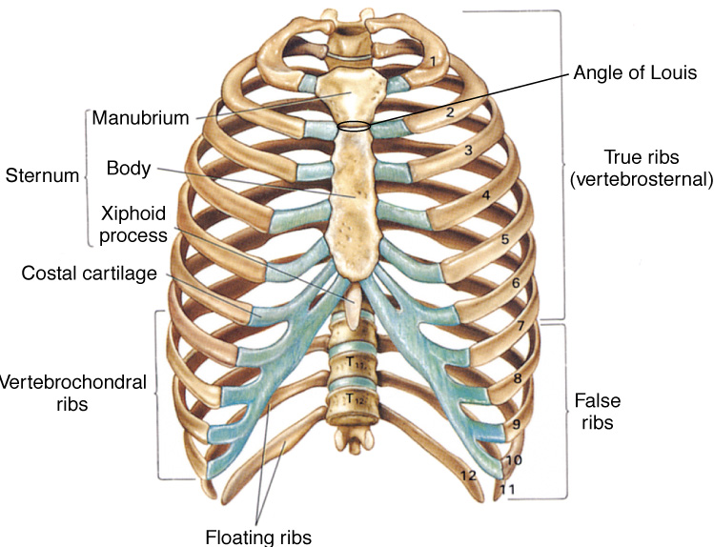

Slide 6
Anatomy
  topographical thoracic reference lines
    midclavicular line
    anterior axillary line
    mid-axillary line
    posterior axillary line
  intercostal space
    artery, vein and nerve on inferior margin of each rib

Slide 7
Anatomy
  muscles of respiration
    diaphragm
    intercostal muscles
      contract to elevate the ribs and increase thoracic diameter
      increase depth of respiration
    sternocleidomastoid
      raise upper rib and sternum

Slide 8
Anatomy
  trachea
    hollow & cartilage supported structure
  bronchi
    right & left extend for 3 centimeters
    enters lungs at pulmonary hilum
      also where pulmonary arteries & veins enter
    further subdivide and terminate as alveoli
      basic unit of structure & function in the lungs
      single cell membrane
  lungs
    right = 3 lobes
    left = 2 lobes

Slide 9
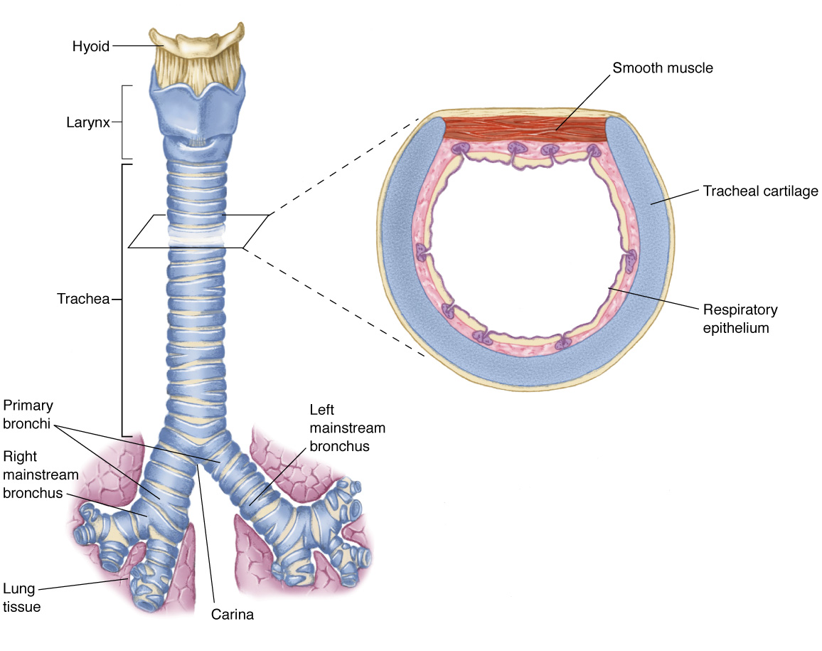

Slide 10
Anatomy
  pleura
    visceral pleura
      cover lungs
    parietal pleura
      lines inside of thoracic cavity
    pleural space
      POTENTIAL SPACE
        Air in Space = PNEUMOTHORAX
        Blood in Space = HEMOTHORAX
      serous (pleural) fluid within

Slide 11
Anatomy
mediastinum
  central space within thoracic cavity
  boundaries
    lateral: lungs
    inferior: diaphragm
    superior: thoracic outlet
  structures
    heart
    great vessels
    esophagus
    trachea
    nerves
      vagus
      phrenic
    thoracic duct

Slide 12
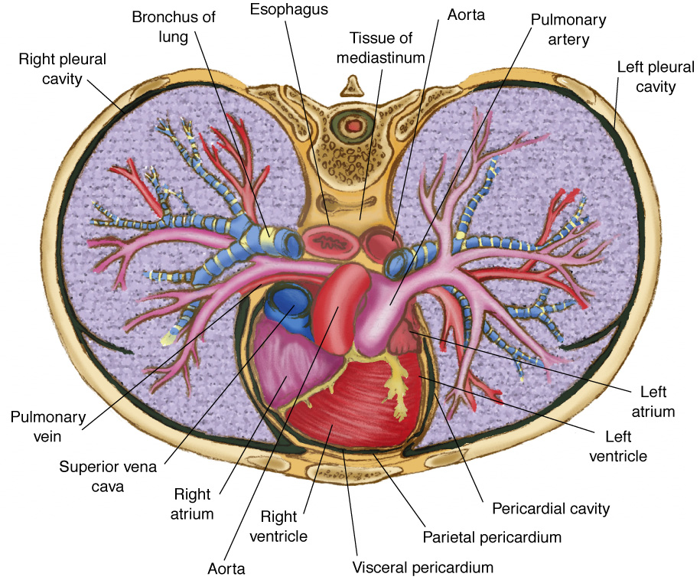

Slide 13
Classifications
skeletal injury
pulmonary injury
heart and great vessel injury
diaphragmatic injury

Slide 14
Classification mechanism of injury
blunt thoracic injuries - most common
forces distributed over a large area
deceleration
compression
age factors
    pediatric thorax: more cartilage = absorbs forces
    geriatric thorax: calcification & osteoporosis = more fractures
penetrating thoracic injuries

Slide 15
Pathophysiology
impairments in cardiac output
blood loss
increased intrapleural pressures
blood in the pericardial sac
vascular disruption
impairments in gas exchange
atelectasis
contused lung tissue
disruption of the respiratory tract

Slide 16
Assessment findings
pulse
deficit
tachycardia
bradycardia
blood pressure
narrowed pulse pressure
hypertension
hypotension

Slide 17
Assessment findings
respiratory rate and effort
tachypnea
bradypnea
laboured
other evidence of respiratory distress

Slide 18
Assessment findings
Skin
diaphoresis
pallor
cyanosis
open wounds
other evidence of trauma

Slide 19
Assessment - neck
position of trachea
subcutaneous emphysema
jugular venous distention
penetrating wounds

Slide 20
Assessment - chest
contusions
tenderness
asymmetry
lung sounds
absent or decreased
unilateral
bilateral
location
bowel sounds in hemothorax

Slide 21
Rib fractures
incidence
  is the most common thoracic injury
  most often elderly patients
  older ribs are more brittle and rigid
  ribs 3 to 8 are fractured most often
  they are thin and poorly protected
  lower ribs fracture are associated with spleen and liver injury

Slide 22
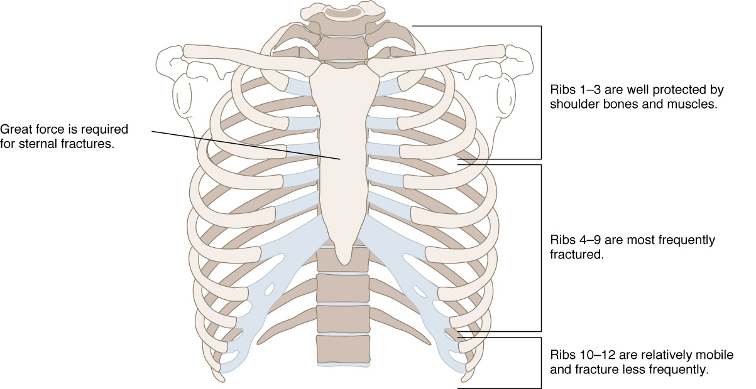

Slide 23
Rib fractures
signs and symptoms
  localized pain
  crepitus

Slide 24
Rib fractures
management
  analgesics – for pain and improve chest
  excursion
  oxygen
  encourage coughing and deep breathing
  position of comfort

Slide 25
Flail chest
3 or more ribs broken in 2 or more places
  segment of the chest that becomes free to move with the pressure changes of respiration

Slide 26
Flail chest
signs and symptoms
  chest pain
  crepitus
  respiratory distress
  tachypnea
  paradoxical chest wall movement

Slide 27
Flail chest
management
  analgesics
  oxygen
    position of comfort
    stabilize the flail segments
    endotracheal intubation, positive pressure ventilation

Slide 28
Sternal fracture
high association with myocardial or lung injury
myocardial contusion
myocardial rupture
cardiac tamponade
pumonary contusion
association with thoracic vertebrae fractures

Slide 29
Sternal fracture
management
  analgesics
  high –concentration oxygen
  restrict fluids if pulmonary contusion suspected
  transport to cardiology if myocardial injury suspected

Slide 30
Pulmonary injury
Closed pneumothorax
  occurs when lung tissue is disrupted and air leaks into the pleural space
  incidence
10% to 30% in blunt chest trauma
morbidity/ mortality
extent of atelectasis
associated injuries

Slide 31
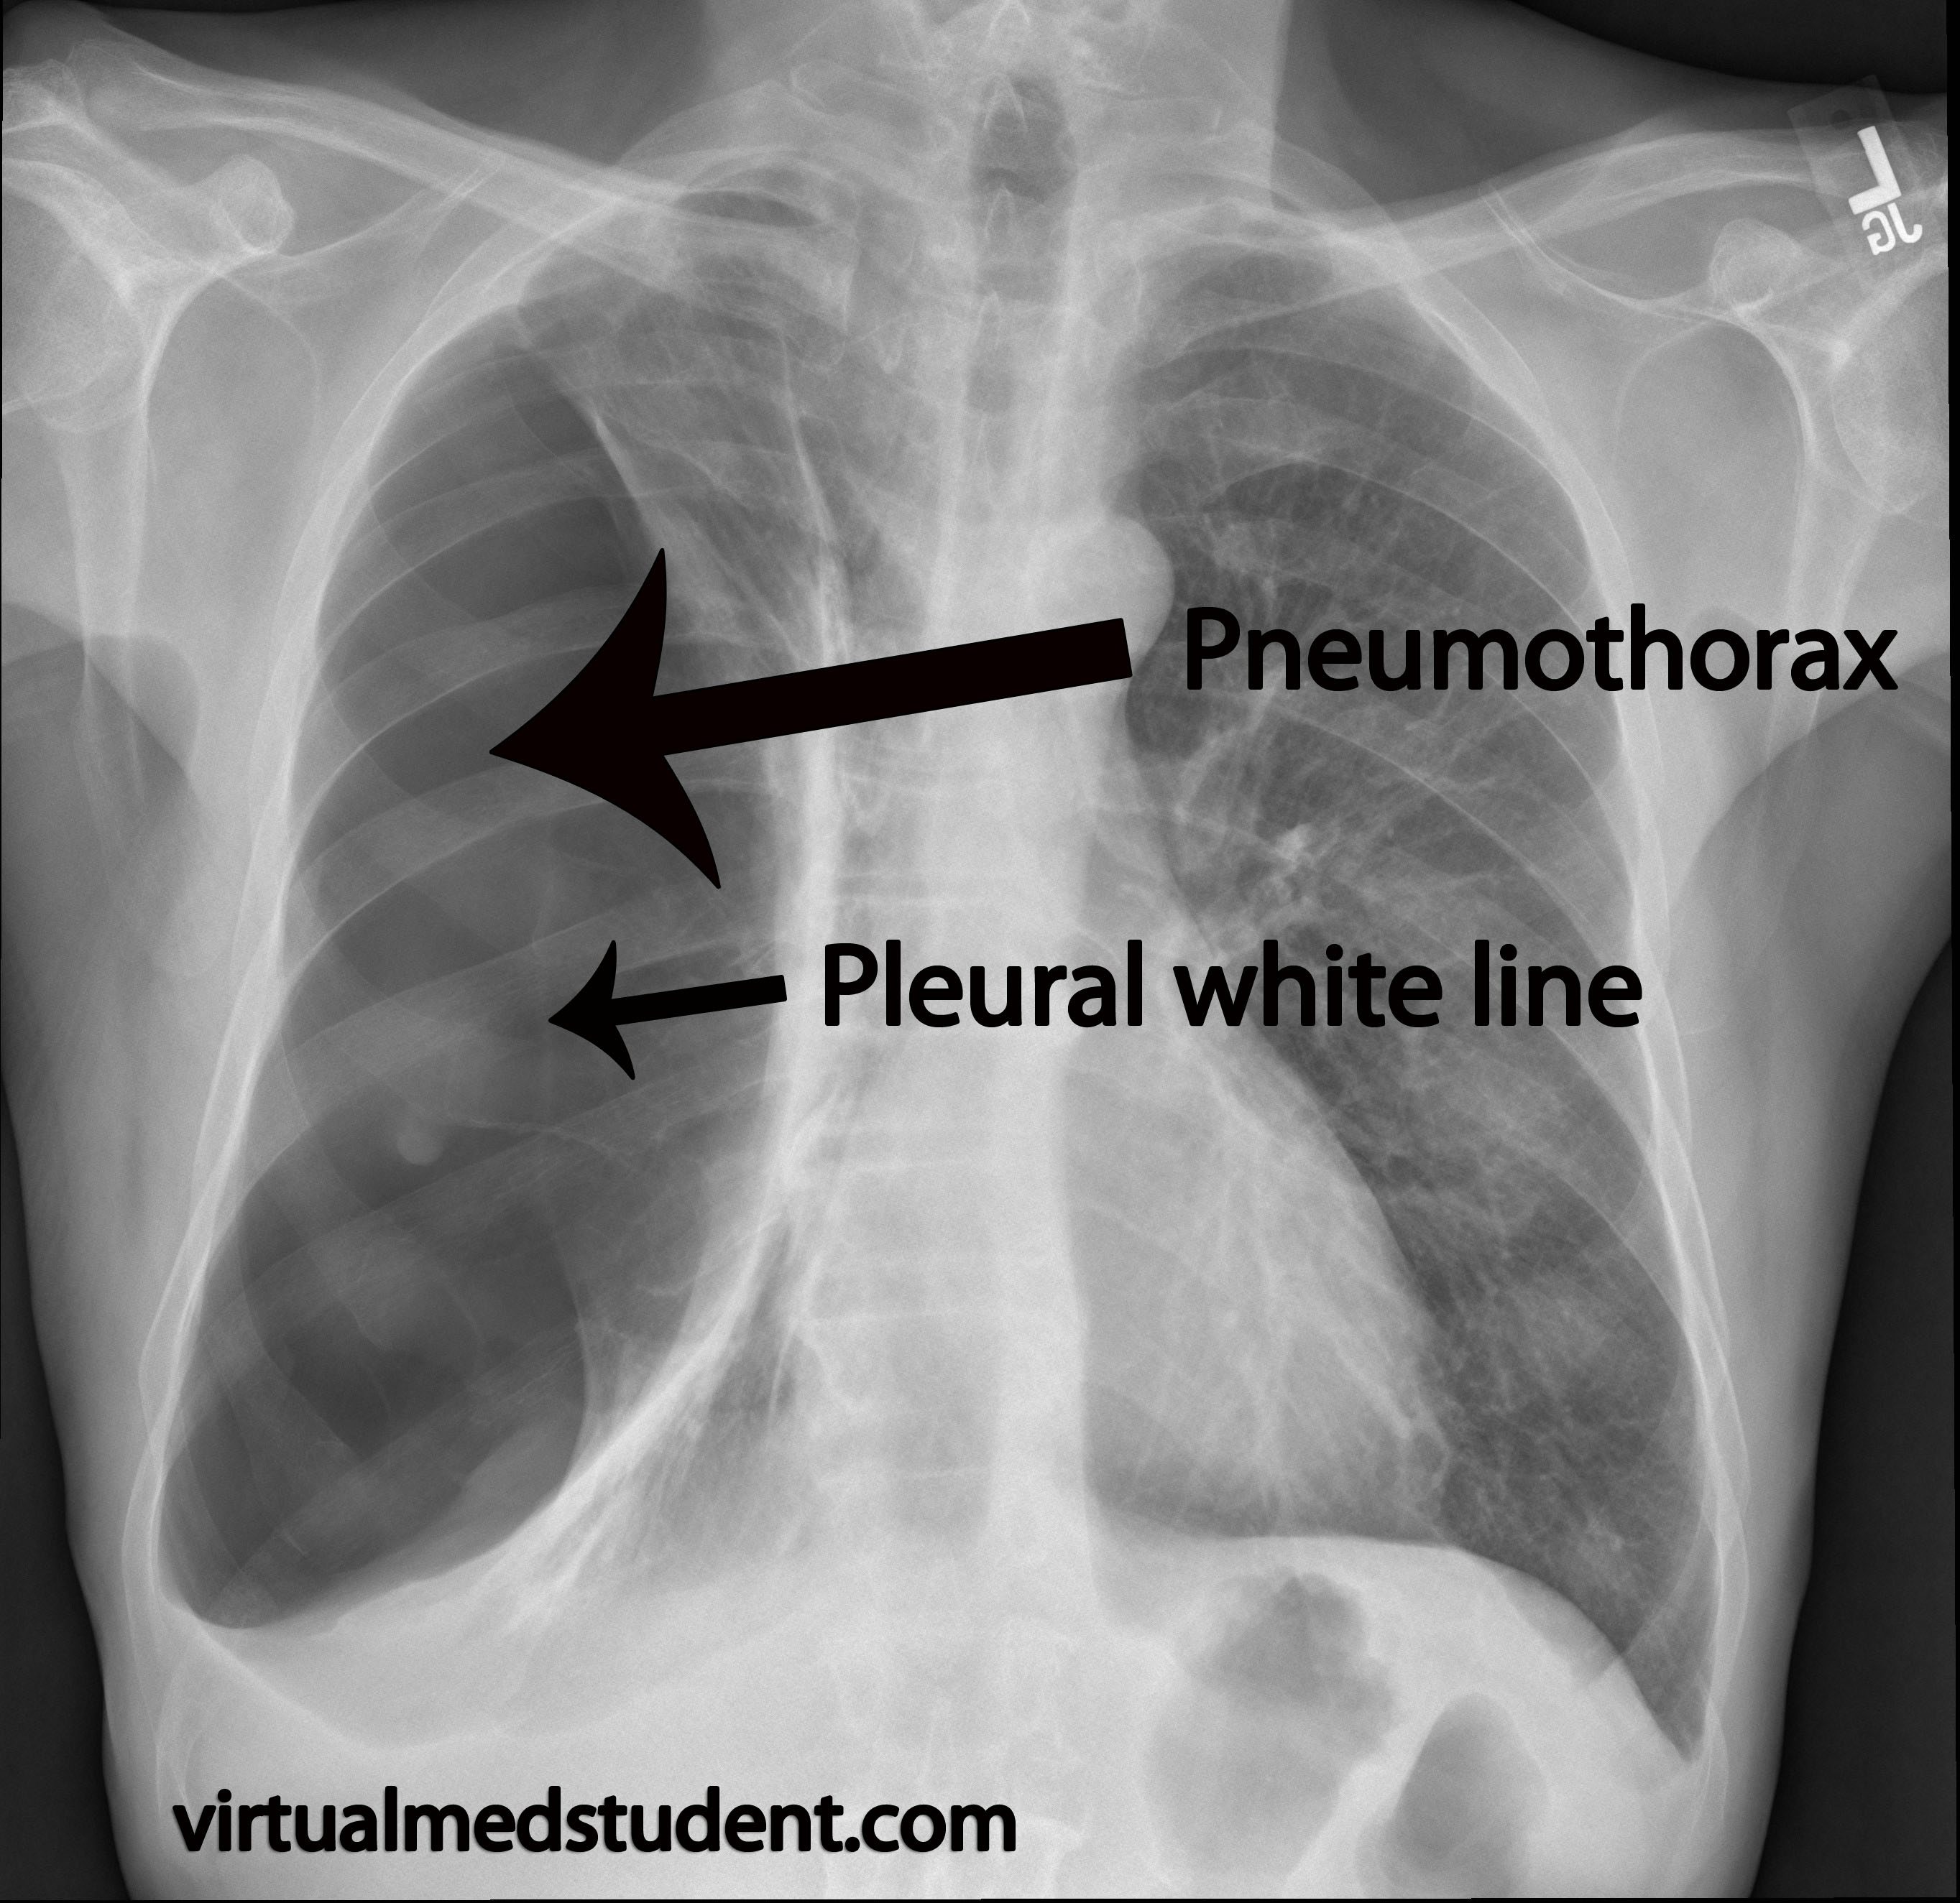

Slide 32
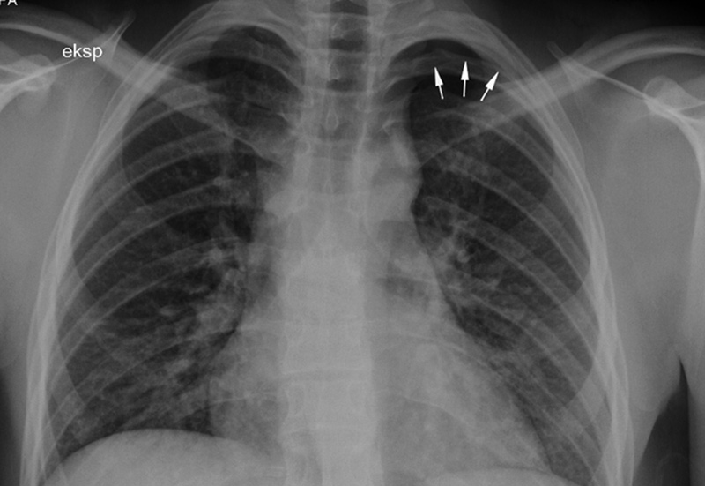

Slide 33
Pulmonary injury
Closed pneumothorax
  signs and symptoms
  - absent or decreased breath sounds on the injured
  side
- hyperresonant percussion
- tachypnea
- dyspnea
- chest pain referred to the shoulder or arm on the
injured side
- respiratory distress

Slide 34
Pulmonary injury
Closed pneumothorax
Management
  analgesics
  position of comfort
  high –concentration oxygen
  positive-pressure ventilation if necessary
  if respiration is rate <12 or >28 per minute, ventilatory assistance with a bag-valve mask may be indicated

Slide 35
Pulmonary injury
Closed pneumothorax
management
  tube thoracostomy – pleural decompression
    4nd intercostal space in mid-axillary line
      TOP OF RIB

Slide 36
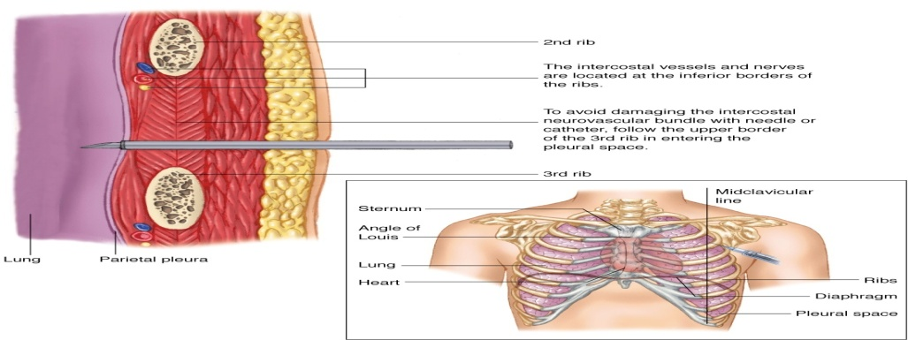

Slide 37
Pulmonary injury
Open pneumothorax
  incidence
  gunshot wounds
  knife wounds
  falls
  motor vehicle collisions
  If the chest wound opening is greater than two-thirds the diameter of the trachea, air follows the path or least resistance through the chest wall with each inspiration

Slide 38
Pulmonary injury
Open pneumothorax
  signs and symptoms
  - decreased breath sounds on the injured side
- a defect in the chest wall
- a sucking sound on inhalation
- subcutaneous emphysema
- tachypnea
- tachykardia
- respiratory distress

Slide 39
Pulmonary injury
Open pneumothorax
management
  analgesics
  high – flow oxygen
  positive-pressure ventilation if necessary
  ventilatory assistance with a bag-valve mask
  circulation – treat for shock with crystalloid infusion
  cover site with sterile occlusive dressing taped on three sides
  tube thoracostomy, videothoracoscopy, thoracotomy – in- hospital management

Slide 40
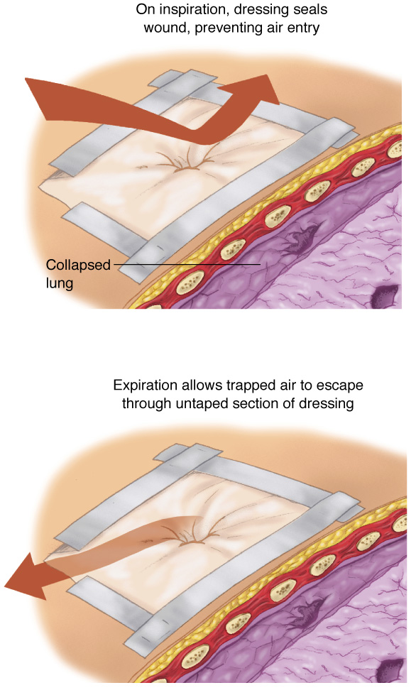

Slide 41
Pulmonary injury
Tension pneumothorax
  occurs when air enters the pleural space from a lung injury or through the chest wall without a means of exit
  results in death if it is not immediately recognized and treated
  when air is allowed to leak into the pleural space during inspiration and becomes trapped during exhalation, an increase in the pleural pressure results

Slide 42
Pulmonary injury
Tension pneumothorax
  increased pleural pressure produces mediastinal shift
  mediastinal shift results in:
  - compression of the uninjured lung
  - compression of the superior and inferior vena
  cava, decreasing venous return to the
  heart
  progression of simple or open pneumothorax

Slide 43
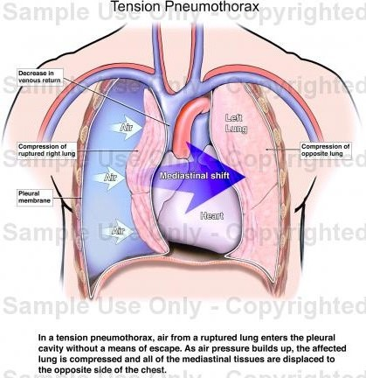

Slide 44
Pulmonary injury
Tension pneumothorax
  signs and symptoms
  - absent breath sounds on the injured side
- hyperresonance to percussion
- subcutaneous emphysema
- tachypnea and increasing dyspnea
- tachykardia
- cynosis
- hypotension
- jugular venous distention
- extreme anxiety
- respiratory distress

Slide 45
Pulmonary injury
Tension pneumothorax
management
emergency care is directed at reducing the pressure in the pleural space
occlude open wound
needle thoracostomy
tube thoracostomy – in-hospital management
    4nd intercostal space in mid-axillary line
      TOP OF RIB

Slide 46
Pulmonary injury
Tension pneumothorax
management
pleural decompression should only be
employed if the patient demonstrates
significant dyspnea and distinct signs and
symptoms of tension pnemothorax

Slide 47
Pulmonary injury
Hemothorax
  accumulation of blood in the pleural space caused by bleeding from
  -penetrating or blunt lung injury
  -chest wall vessels
  -intercostal vessels
  -myocardium

Slide 48
Pulmonary injury
Hemothorax
  incidence
  -associated with pnemothorax – it is called a
  hemopnemothorax
  -blunt or penetring trauma
  -rib fractures are frequent cause
  hypovolemia results as blood accumulates in the pleural space

Slide 49
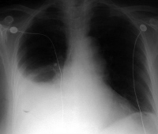

Slide 50
Pulmonary injury
Hemothorax
  signs and symptoms
  - diminished or decreased breath sounds on the injured side
- hypotension
- tachypnea
- dyspnea
- narrowed pulse pressure
- pale, cool, moist skin
- respiratory distress

Slide 51
Pulmonary injury
Hemothorax
management
  analgesics
  high – flow oxygen
  positive-pressure ventilation if necessary
  ventilatory assistance with a bag-valve mask
  circulation – volume-expanding fluids to correct hypovolemia
  tube thoracostomy
  videothoracoscopy or thoracotomy - if it is blood loss by tube thoracostomy more than 2000ml or next 3 hours is blood loss more than 500ml/hours

Slide 52
Pulmonary injury
Contusion
  30-75% of patients with significant blunt chest trauma
  frequently associated with rib fracture
  younger patients – also without rib fracture
  signs and symptoms
- cough
- tachypnea
- tachycardia
- dyspnea
- cyanosis
- respiratory distress

Slide 53
Pulmonary injury
Contusion
management
  analgesics
  high – flow oxygen
  positive-pressure ventilation if necessary
  ventilatory assistance with a bag-valve mask
  respiratory rehabilitation
  antibiotics
  bronchoscopy

Slide 54
Cardiovascular injuries
Myocardial contusion
  injury may reduce strength of cardiac contractions
    reduced cardiac output
  progressive problems
    myocardial necrosis
    dysrhythmias
    cardiogenic shock
S/S
tachycardia and/or irregular rhythm
retrosternal pain
associated injuries
  rib/sternal fractures

Slide 55
Cardiovascular injuries
Myocardial contusion
management
  monitor ECG
    Alert for dysrhythmias

Slide 56
Cardiovascular injuries
Pericardial tamponade
  restriction to cardiac filling caused by blood or other fluid within the pericardium
  occurs in <2% of all serious chest trauma
    however, very high mortality
  results from tear in the coronary artery or penetration of myocardium
    blood seeps into pericardium and is unable to escape
    200-300 ml of blood can restrict effectiveness of cardiac contractions

Slide 57
Cardiovascular injuries
Pericardial tamponade
  increased intrapericardial pressure
  - does not allow the heart to expand and refill with blood
  - results in a decrease in stroke volume and cardiac output
  myocardial perfusion decreases due to pressure effects on the walls of the heart and decreased diastolic pressures
  ischemic dysfunction may result in infarction
  removal of as little as 20ml of blood may drastically improve cardiac output

Slide 58
Cardiovascular injuries
Pericardial tamponade
  signs and symptoms
  - tachycardia
- respiratory distress
- Becks triad - narrowing pulse pressure
- neck vein distention
- muffled heart sounds
- ECG changes

Slide 59
Cardiovascular injuries
Pericardial tamponade
management
  high flow O2
  IV therapy
  pericardiocentesis – needle insertion through the skin incision directed toward the left shoulder at a 45 degree angle to the abdominal wall.

Slide 60
Cardiovascular injuries
Aortic rupture
  occurs almost exclusively with extreme blunt thoracic trauma - rapid deceleration in high-speed motor vehicle crashes
  - falls from great heights
    85-95% of these patients die at the scene as result of massive hemorrhage
  signs & symptoms
    rapid and deterioration of vitals
    retrosternal pain

Slide 61
Cardiovascular injuries
Aortic rupture
  IV therapy
    mild hypotension may be protective
  keep patient calm
  endovascular repair
  operativ repair – is associated with high mortality

