Slide 1
Computer network user
Daniel Klimeš , Jan Krejčí , Roman Šmíd

Slide 2
Safety principles when working with IT
Risks when working in a computer network
Roman Šmíd , Jan Krejčí , Daniel Klimes

Slide 3
Computer security
is part of information security
deals with the part of security that is related to ICT
  Network security
  Internet security
  Security of end devices
  Cryptography (PKI and certification authorities, e-signature, e-archiving)
  Special means (wiretapping, surveillance)
the goal is
  prevent computer attacks
  ensure safe operation
  limit the likelihood of risks occurring

Slide 4
Computer security
Relates to:
  end devices, (personal computers, mobile devices)
  all other parts of the IT infrastructure, especially servers and computer networks.
includes roughly the following activities:
  Ensuring protection against unauthorized physical manipulation of IT (physical theft)
  Data access security (authentication and authorization)
  Ensuring protection against unauthorized data manipulation (violation of integrity, confidentiality and availability)
  Ensuring data is backed up (recovery plan)
  Security of software protection against theft (copyright protection)
  Security of communication and data transfer (cryptography)
Notes:
https://managementmania.com/cs/ computer- bezpecnost %A9,kr%C3%A1de%C5%BE%C3%AD)

Slide 5
Data security above all else
data is the most valuable electronic asset we have
in order to be used correctly, they must be available and only to authorized persons
in order for them to be protected, they must be secured
  so that we don't lose them somehow
  so they don't end up in the wrong hands
but the consequences of the loss are individual, it depends on the nature of the data
  if we lose them or our key information is acquired by a competitor, it could also mean the end of our business or operations
  when it comes to personal or sensitive data, it can be used to blackmail or compromise the user
Notes:
https://managementmania.com/cs/ computer- bezpecnost %A9,kr%C3%A1de%C5%BE%C3%AD)

Slide 6
The most common attacks and threats
  a virus is a malicious program that can spread and operate without the user's knowledge
  phishing is an attack that uses social engineering methods to obtain sensitive or login information
  spyware is software that sends data from an infected computer without the user's knowledge
  DoS and DDoS is an attack that causes a service to be overwhelmed and shut down
  spam is unsolicited commercial communication (most often by e-mail)
  hoax is deceptive information
  ransomware is a virus that encrypts the end device, for decryption the attackers want a high ransom in an anonymous currency
Notes:
https://managementmania.com/cs/bezpecnost-a-ochrana-informaci:
These are situations where, with the exception of ransomware, we lose information, but no one else has it. This leads us to situations that are even more sensitive from the point of view of information protection and are caused by the activities of someone else - an attacker or a thief.
theft of data or information - means that someone else has the data - in the best case, if we have the data backed up, it will remain with us. In the worst case, we lose the information, and on top of that, someone else has it. Such a situation can occur if someone steals our computer or phone with data. The question remains whether the thief will misuse the data and how.
misuse of data or information - it can occur in case of theft or active attack. This tends to be the most dangerous, because the attacker or the worker who abuses the information does it intentionally and usually knows very well what information he wants to abuse and how. In such a situation, we do not lose the information, but its value can be completely lost at the moment of theft, because someone else has the valuable information. He can then use this to his business advantage (for example, when a competing company finds out about our price offer) or even against our company or person (an attacker can blackmail).

Slide 7
Network security - home wifi network I.
The basic thing is not to leave the wireless access point or router in the default settings from the manufacturer.
It is necessary to set a new administrator password and choose the appropriate Wi-Fi security.
Existing forms of security for home wifi routers:
  Open network (do not use even by mistake, communication is not encrypted)
  WEP encryption (obsolete, long broken)
  WPA-PSK encryption (can be used in an emergency, but has weaker encryption)
  WPA2-PSK encryption (if AES or TKIP encryption option is additionally available, use AES encryption)
  WPA3 encryption (new since 2018) – improved encryption, but not all devices support it

Slide 8
Network security - home wifi network II.
in domestic conditions, we prefer WPA2-PSK security in combination with AES encryption
  offers a reasonable level of security
  It is already supported by all wireless devices
it is necessary to choose a good PSK (reasonably long and complex password) and also a non-trivial name of the access point (SSID).
  a password of at least 13 characters, a combination of letters and numbers is recommended
  do not use known passwords (there are lists of the most used passwords)
turn off WPS ( WiFi Protected Setup)
  broken in December 2011

Slide 9
Internet security - email threats
Threats:
  SPAM - unsolicited messages sent for the purpose of:
    Advertising distribution
    Collection of active email addresses
    Distribution of malicious code
    Lure of money
  Phishing - an unsolicited message, sent in bulk for the purpose of:
    Enticing access data to various services
    Eliciting private information
  Spear Phishing – an unsolicited message targeted and customized for a specific user
    The goal is to introduce malicious code into the organization's internal network in order to gain access to sensitive company data
    It is a very sophisticated attack that even experienced users can fall for

Slide 10
Internet security - email rules
Rules:
  Do not click on links in unknown messages (danger of address forgery, redirection to a page with malicious code)
  Do not open attachments in unknown and suspicious messages
  Do not send logins and passwords, credit card numbers anywhere
  Paying attention to suspicious features in messages (machine-translated text, links leading elsewhere than their description, messages pretending to come from mass-used services (Facebook, banks, etc.), suspicious sender address
  Do not ignore any warnings from antivirus programs
  Don't be intimidated (If you don't install XY software, your computer will be at risk...)

Slide 11
Internet security sample spam containing a virus
Dear Madam, dear Sir,
thank you for your trust in online shops obchody24.cz.
With this email, we confirm that we received your order in good order.
Order number (variable symbol): JCBDF729B439057
Order date and time: 11.01.15 00:45
Contact details: Barbora Záňová, +420 604 920 148
Your order:
------------------------------
SONY DSC-F828 Cyber -Shot 8 million pixels , white: 1 x CZK 23,549.00 = CZK 23,549.00
Transport PPL: 113 CZK
------------------------------
Total purchase price incl. VAT: CZK 23,662.00 Payment method: Payment in advance - payment card
Note: Payment confirmation and invoice can be found in the attached file ( ucet111D535.zip )
-
Now please wait for our operator, who will contact you within a maximum of 1 working day and agree on the details of your order.
Notes:
Here, the attacker tries to force the user to open an attachment, possibly infected. If you have not ordered anything and do not know the sender, do not open it under any circumstances.

Slide 12
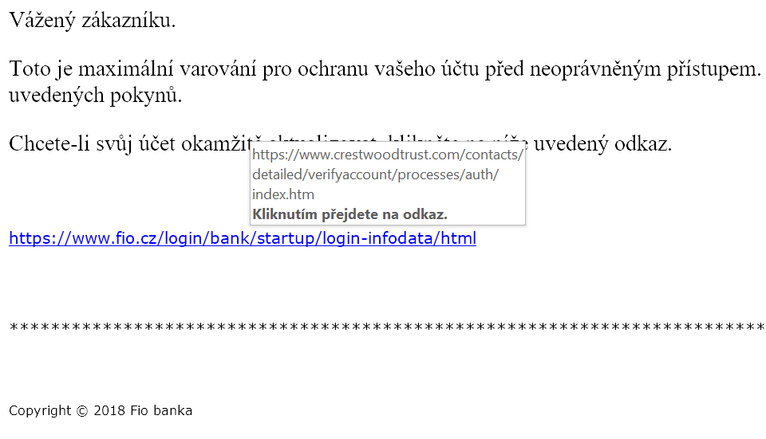
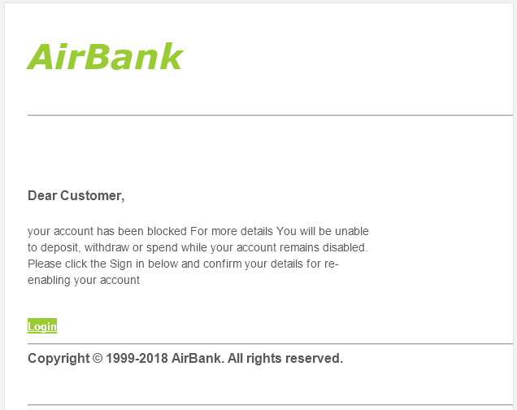
Internet Security - Sample Phishing
Notes:
In the image on the right, you can see that the link leads to a different address than its description. Most email clients already recognize this and warn the user themselves.

Slide 13
Internet Security - Instant Messaging
What is IM ? Facebook chat, WhatsApp, Viber, Skype, Telegram ... any real-time communicator
Threats in instant messages are similar to email threats
The rules for safe use are the same as the email rules
Threats stemming from an out-of-date IM client
  An outdated client can be exploited to install malicious code on a PC without the user's knowledge
  Ensure regular updating of the client used to the latest version and have an updated anti-virus program
  Not mindlessly clicking on every link someone sends me

Slide 14
Internet security - cloud services
MS OneDrive, Goggle Drive (Google Drive) etc ...
The threat is the handing over of your data to a foreign entity.
With most cloud services, by using them, you agree that the company can use the data uploaded there for any purpose , pass it on to other entities, publish it, analyze it, etc.
This applies to the vast majority of unencrypted cloud providers and email service providers.
These services are unsuitable for any sensitive data – personal data, scientific publications….
A possible solution is encrypted cloud services , i.e. those where the service provider cannot see your data, because it is stored encrypted on their servers and only the user has the key.
  Email services – Protonmail , Lavabit ,…
  Storage Services – SpiderOak , Mega.nz,…
If you don't want to hand over your data to a third-party company, use only encrypted cloud services. It is always advisable to read the terms of use of the given service.

Slide 15
Internet security - social networks
The basic rule is not to click on anything, think. Even your friends' computers can be attacked by malicious code that sends posts or links to their FB profile or private messages.
Always remember that what you post about yourself on the Internet usually cannot be taken back.
When using social media, think about who and what information you make available.
Beware of mindlessly spreading or sharing/ liking hoaxes ( HOAXes ).
Facebook - misused to spread spam, hoaxes, malicious code
  Trusting friends is dangerous: I'll click on anything one of my friends posts
  Difficult orientation in an environment that changes frequently - traps for uninformed users
  Clickjacking - a combination of social engineering and Like buttons
    Example: Click all the Like buttons one by one to view the video, etc.
    In the end, it's often just a website with malicious code, a page that sucks people's money or artificially increases traffic
LinkedIn - similar rules apply to Facebook, so far less widespread, focusing on the workspace
Twitter - spreading addresses of sites containing malicious code

Slide 16
Security of end devices
End devices can be considered:
  Desktop computers
  Notebooks
  Tablets
  Smart phones
  Smart watch
The security of end devices can be increased:
  Antivirus
  Antispyware
  By backing up your data
  By regularly updating the OS and the programs used

Slide 17
Security of end devices - mobile
main problems:
  operating systems and their updates
    Device manufacturers are often slow or non-existent in updating the OS in response to new security vulnerabilities. Especially older phone models are often left without updates by the manufacturer and thus vulnerable to long-known bugs. It is always advisable to check whether the manufacturer guarantees the availability of system security updates for its device, and for how long. (E.g. Android One service , etc.)
  user inattention
    When installing new applications, the OS always asks the user if he can grant the application permission for certain activities within the system (eg reading/sending SMS, accessing the Internet, etc.). Users should be careful what permissions they grant to an app and what apps they install.
devices often include:
  confidential user data
  access to various services (email, banking, etc.)
however, they are often not adequately secured in case of device loss.
  A PIN or gesture unlock is not enough
  Encrypting the entire device, including the SD card, is sufficient protection.
  It is also convenient to activate the option of remotely erasing the device in case of loss
full-fledged work tools - the need to follow the same safety principles as when working with a PC

Slide 18
Security of end devices - mobile
A smart phone (smartphone) contains an advanced operating system, allows the installation and modification of other programs that further expand the capabilities of the phone.
OS examples: Android, iOS, Firefox OS, Tizen , MeeGo , HarmonyOS , ChromeOS
Advantages:
  a large number of applications and thus the possibilities of what can be done with the phone (office, games, reading books, Internet applications, navigation, etc.)
Disadvantages:
  typically shorter battery life
  often larger dimensions
  various security risks (viruses, disclosure of private information)
  Price

Slide 19
Security of end user devices - tablets
Touch devices, the operating system often the same as on smartphones, can also have telephone functions.
They form an intermediate link between smartphones and classic personal computers or laptops.
Some newer tablets are full-fledged computers with a standard OS
OS used: Android, iOS, Linux, Windows

Slide 20
Security of end devices - connectivity
the connection is wireless ( WiFi or LTE)
may contain
  full-featured internet browser
  email client
  Communicators
  VoIP clients
  VPN
  terminal clients
  remote area
when connected via GSM, the data tariff may be a limiting factor. After the data limit is exhausted, the connection slows down and working with the Internet becomes inconvenient or does not work practically at all. Choosing the right data plan is important.
A full-fledged work tool - the need to follow the same safety principles as when working with a PC

Slide 21
Ensuring protection
Principles when working with the Internet, email and social networks
Regular updates
Antivirus and antispyware
Saving access passwords
Proper home network security
Prevention is crucial!

Slide 22
Ensuring protection - regular updates
you need to understand the messages of the operating system and other programs
be able to respond adequately to events requiring a user response
update regularly:
  operating system
  antivirus database
  antispyware database
  all software

Slide 23
Ensuring protection - regular backups
The data is often more important than the hardware itself
It is important to back up:
  Do I know what is being backed up from my device, where and at what intervals?
  Can I check if the backup is working?
  Can I restore the backed up data if needed?
  Do I have backups in multiple locations?
  Are my backups secure?
  We back up at regular intervals, preferably automatically

Slide 24
Ensuring protection - backup options
Backup options:
Physical medium
  CD/DVD
  Another computer
  USB drive
NAS
  (Network Attached Storage - "data storage on the network", for example an external disk connected to the network)
Cloud storage
  OneDrive
  GoogleDrive
Application backup
  Windows Backup (in Windows 7 and Windows 10)
  Duplicates (for both Windows and Linux)
  Cobian Backup (for Windows)
  SyncThing - synchronization

Slide 25
Ensuring protection - antivirus
It is advisable to use some of the commercial solutions, but it is recommended to use at least some freely available antivirus product.
For domestic non-commercial use, these are for example:
  Microsoft Antivirus - a product of Microsoft, since Windows 10 part of the system as Protection against viruses and threats. Sufficient, in Czech.
  Avast Free Antivirus - product of the Czech company AVAST Software, free registration renewal required after 1 year
  AVG Antivirus FREE – another Czech product, also suitable for normal use
  Panda Cloud Antivirus FREE – cloud-based antivirus, less PC load
Anti-viruses usually automatically update their virus databases, you need to leave this function enabled!

Slide 26
Ensuring protection - antispyware
Antispyware is spyware removal and blocking software.
There are plenty of free programs for home use:
  Spybot Search & Destroy - free for commercial purposes, Czech translation
  Spyware Terminator - free even for commercial purposes, Czech translation
  Ad Aware SE Personal Edition - free for non-commercial purposes
  Windows Defender - a standard component of Windows Vista and higher versions
antispyware is not necessary all the time, but it is advisable to occasionally install one, update it and have your computer scanned .

Slide 27
Ensuring protection - access passwords
We normally use many different internet services - we have many access data
Dangerous tendencies - to use the same and simple password everywhere
Well-known services face frequent hacker attacks to steal user credentials (often successfully)
If I have the same login and password everywhere, a hacker will gain access to all my accounts at once !
Principles:
  unique password for important services (access to the bank, etc.).
  Email and password are often required as access data. Never enter the same password as we have in the email !! If this information is disclosed , hackers will start using your e-mail to spread spam and viruses, and there is a risk of blocking your account.
  If we have many passwords, consider using a software password manager
  two-factor authentication for important services (banking, etc.) (e.g. confirmation via SMS code, etc.)

Slide 28
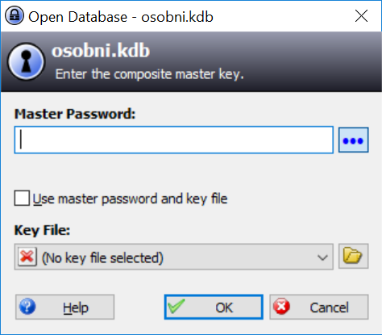
Access passwords - password manager
A password manager is a useful helper for safe work with passwords
You only need to remember one main password, the other passwords are safely and clearly stored in the program.
Among the most famous software in this category are:
  KeePass Password Safe - clear password manager, free and for commercial use, there is also a version for mobile phones
  Bitwarden - add-on for Internet browsers, prefills Internet forms, generates passwords
  Password Agent - can store passwords and other information, installation option on a USB stick

Slide 29
Services providing authentication
Third-party authentication services are also a suitable way to authenticate users.
We set up an account with the provider and then leave the transmission of authentication information to the provider.
The advantage is that we only have to remember one name and password, and in all other services that support it, we will use the login through this provider.
We also have control over what data we pass on and to whom.
mojeID ( www.mojeid.cz ) is a widespread and trusted provider , which can also be used to log in to state administration websites, the Citizen Portal, etc.

Slide 30
Breach of protection - what we are at risk of
A breach of protection may result in loss or unavailability of data:
caused by inattention or carelessness (they can be prevented):
  loss of information
  unavailability of information
caused by a third party (attacker, thief):
  data theft
  misuse of data

Slide 31
Problem situations - accidental data leakage
Caused by inattention or carelessness (they can be prevented):
loss of information
  occurs in the event of technical failure (for example, disk failure), or deletion or shredding by the user (by mistake)
  neither you nor anyone else has the information –> they cease to exist
  the only protection is regular backups
  the consequences of data loss are individual, depending on the nature of the data.
unavailability of information
  we do not have access to the storage location (we are offline ), or we have lost access data (password, key)
  the main protection is regular backups
  secondary protection in some cases can be a backup access path (or access backup)
Notes:
https://managementmania.com/cs/bezpecnost-a-ochrana-informaci:
These are situations where, with the exception of ransomware, we lose information, but no one else has it. This leads us to situations that are even more sensitive from the point of view of information protection and are caused by the activities of someone else - an attacker or a thief.
theft of data or information - means that someone else has the data - in the best case, if we have the data backed up, it will remain with us. In the worst case, we lose the information, and on top of that, someone else has it. Such a situation can occur if someone steals our computer or phone with data. The question remains whether the thief will misuse the data and how.
misuse of data or information - it can occur in case of theft or active attack. This tends to be the most dangerous, because the attacker or worker who abuses the information does it intentionally and usually knows well what information he wants to abuse and how. In such a situation, we do not lose the information, but its value can be completely lost at the moment of theft, because someone else has the valuable information. He can then use this to his business advantage (for example, when a competing company finds out about our price offer) or even against our company or person (an attacker can blackmail).

Slide 32
Problem situations - data leakage by attack
Caused by a third party (attacker, thief):
data theft
  occurs during data theft or a ransomware attack
  availability protection is regular backups
  protection against abuse is the security of data carriers (encryption or password - external disk, flash disk, telephone, ...)
  there is a possibility of data misuse
misuse of data
  occurs when data is stolen or actively attacked by an attacker
  we do not physically lose data as such
  if the data is misused, its value decreases and the information can be used against us
Notes:
https://managementmania.com/cs/bezpecnost-a-ochrana-informaci:
These are situations where, with the exception of ransomware, we lose information, but no one else has it. This leads us to situations that are even more sensitive from the point of view of information protection and are caused by the activities of someone else - an attacker or a thief.
theft of data or information - means that someone else has the data - in the best case, if we have the data backed up, it will remain with us. In the worst case, we lose the information, and on top of that, someone else has it. Such a situation can occur if someone steals our computer or phone with data. The question remains whether the thief will misuse the data and how.
misuse of data or information - it can occur in case of theft or active attack. This tends to be the most dangerous, because the attacker or the worker who abuses the information does it intentionally and usually knows very well what information he wants to abuse and how. In such a situation, we do not lose the information, but its value can be completely lost at the moment of theft, because someone else has the valuable information. He can then use this to his business advantage (for example, when a competing company finds out about our price offer) or even against our company or person (an attacker can blackmail).

Slide 33
Problematic situations - what threatens us
Direct financial loss (theft of money from an account via a credit card)
  Correct setting of limits on the card
  Authorization of all operations through the second factor
Police prosecution (accusation of using a PC for illegal activities)
Problems at work (blocked email, VPN, ...)
Blackmail and discrediting (publication of sensitive information, photos, e-mails...)
Data Loss ( RansomWare )
  WannaCry (May 2017)
  Benešov Hospital (December 2019)
    In a ransomware attack on a hospital in Benešov at the end of 2019, the network drives of all devices in the network were encrypted and the hospital was out of order for more than 3 weeks.
  FN Brno – in 2020, FN Brno experienced a similar attack, vital hospital systems were shut down, operations were postponed, and there were large financial losses.
Notes:
https://managementmania.com/cs/bezpecnost-a-ochrana-informaci:
These are situations where, with the exception of ransomware, we lose information, but no one else has it. This leads us to situations that are even more sensitive from the point of view of information protection and are caused by the activities of someone else - an attacker or a thief.
theft of data or information - means that someone else has the data - in the best case, if we have the data backed up, it will remain with us. In the worst case, we lose the information, and on top of that, someone else has it. Such a situation can occur if someone steals our computer or phone with data. The question remains whether the thief will misuse the data and how.
misuse of data or information - it can occur in case of theft or active attack. This tends to be the most dangerous, because the attacker or worker who abuses the information does it intentionally and usually knows well what information he wants to abuse and how. In such a situation, we do not lose the information, but its value can be completely lost at the moment of theft, because someone else has the valuable information. He can then use this to his business advantage (for example, when a competing company finds out about our price offer) or even against our company or person (an attacker can blackmail).

