Slide 1
Pathological fractures
Pazourek L., Rozkydal, Z.
I.orthopaedic dpt., St. Anna Hospital, Medical faculty, Brno

Slide 2
Features
Fracture in bone with pathological lesion decresing the stregth of bone
  Without trauma
  Minimal violence
  Normal traumatic mechanism

Slide 3
Etiology
Metabolic diseases
  osteoporosis
  osteomalacia, HPT
Local lesions
bone metastasis, multiple myeloma
benign tumors
malignant tumors
Congenital anomalies
osteogenesis imperfecta,..
Other entities
Paget´s disease of bone, fibrous dysplasia
  osteomyelitis
  osteonecrosis

Slide 4
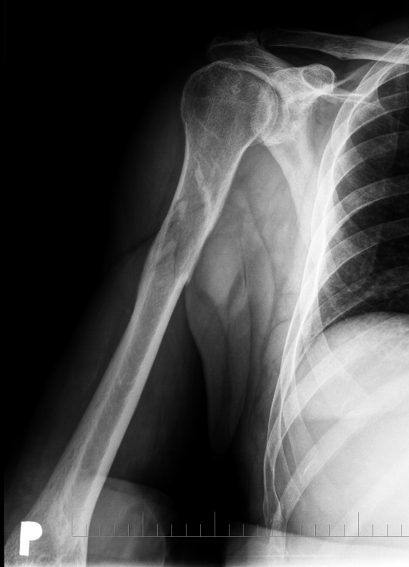
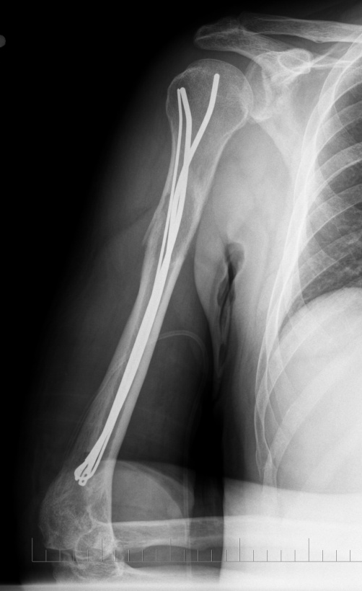
♂ 53 let
Fr. by opening a bottle
i.m. osteosynthesis
Increasing swelling and mass in upper arm
X- ray repeated no finding
back pain after 3 months

Slide 5
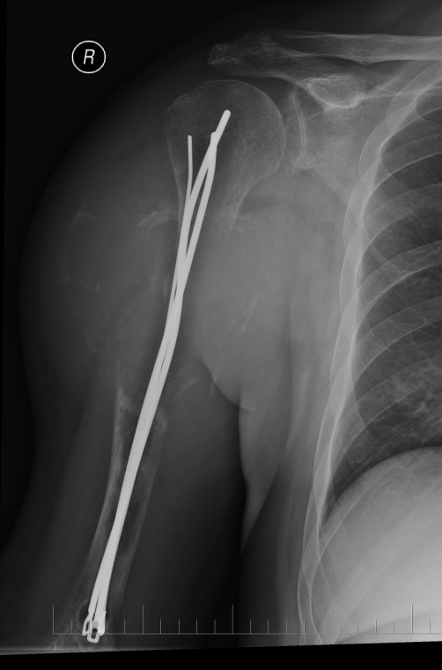
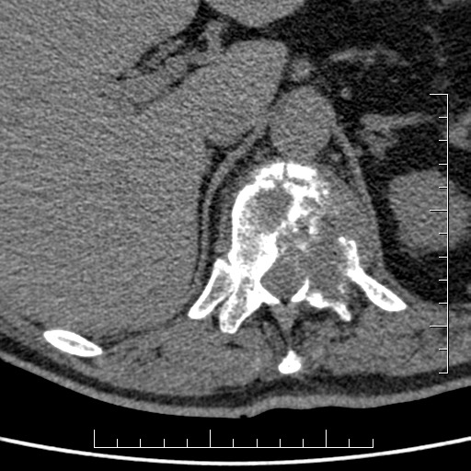
Metastasis of carcinoma
After 4 months referred to our clinic
Exulceration
Th 12 large osteolytic lesion
Risk o paraplegia
Metastasis of carcinoma from small
cells

Slide 6
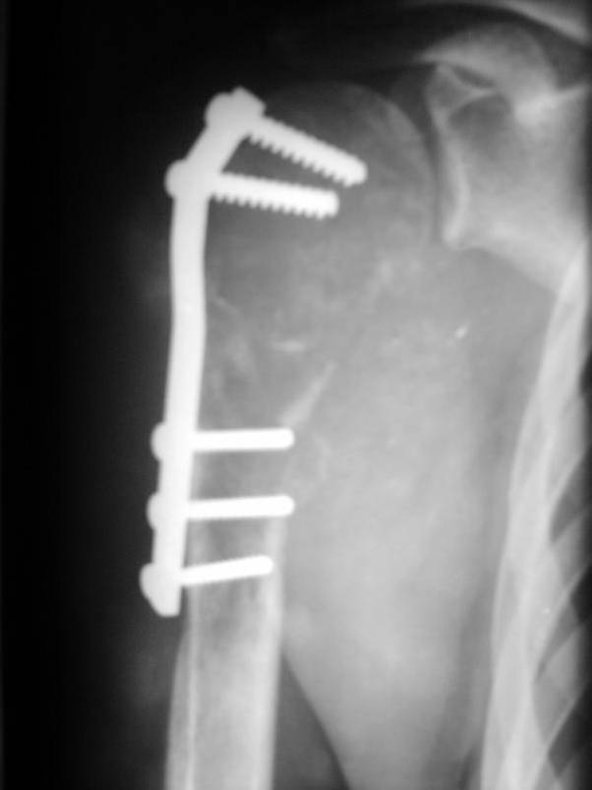
♂ 26 let
Fr. by driving a car
AO plate osteosynthesis
Afterwards increasing mass
X ray after 3 months
OSTEOSARCOMA HIGH-GRADE

Slide 7
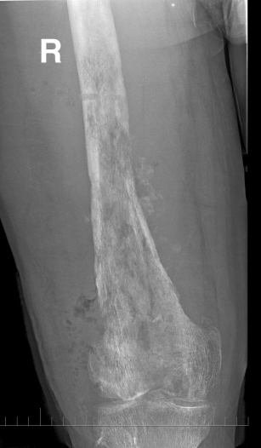
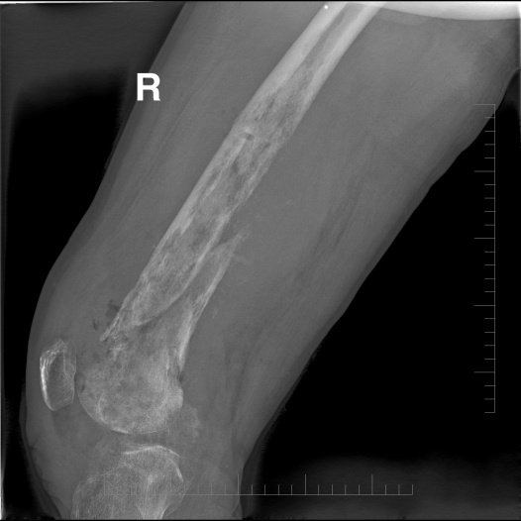
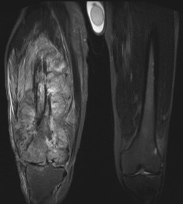
LEIOMYOSARCOMA G3
Fall on stairs
Supracondylar fr.
Osteosynthesis with a nail
Increasing pain and swelling
After 6 months removal of metal a biopsy
Fracture not healed
Referred to our clinic
♂ 42 let

Slide 8
Bone metastases of carcinoma
Breast, prostate, kidney, lung, thyreoid gland
  Assessment of prognosis
    Visceral or bone lesions, solitary or multiple lesions
    Type of primary tumor, staging
    Time of first occurrence
    Sensitivity to other treatment
    Comorbidities and general condition
    Pathological fracture makes always the prognosis worse
    Multidisciplinary access

Slide 9
Mirel´s score
points | 1 | 2 | 3
Localisation | Upper extr. | Lowe extr. | Pertrochant. region
Pain | low | medium | big
Type | Osteoplastic | mixed | Osteolytic
Size | <1/3 widht of bone | 1/3 – 2/3 widht of bone | >2/3 widht of bone
≤ 7 ponts | Risk 4% | Preventive ORIF no
8 points | Risk 15% | Indication for ORIF on border
≥ 9 points | Risk 33% and more | Indication for preventive ORIF

Slide 10
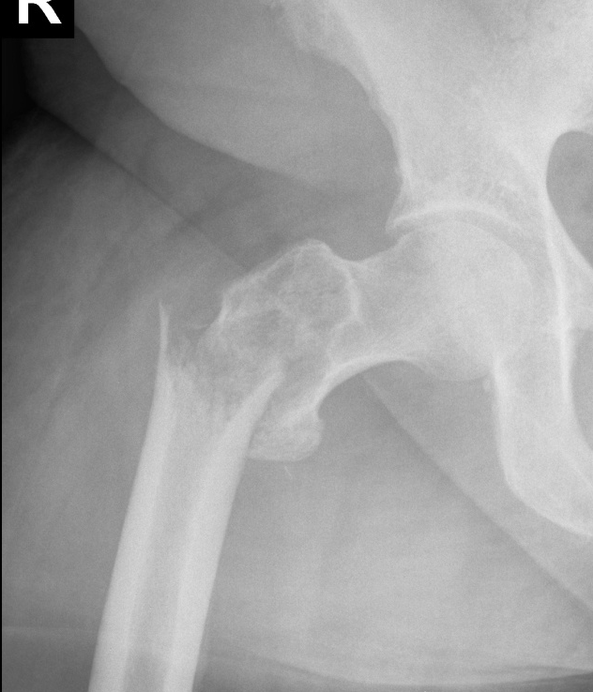
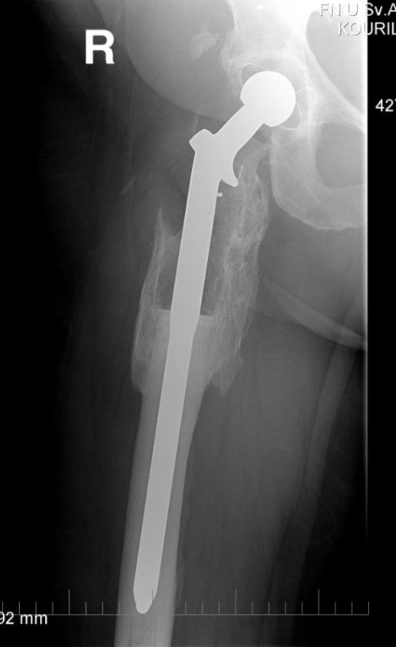
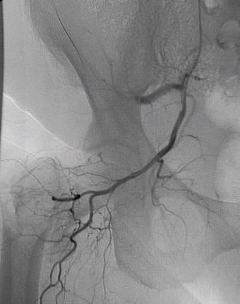
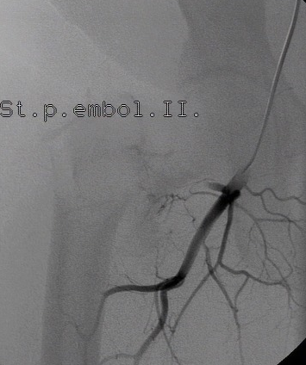
TU-THA optimal solution
Metastasis of clear cells renal carcinoma (angiography with embolisation)

Slide 11
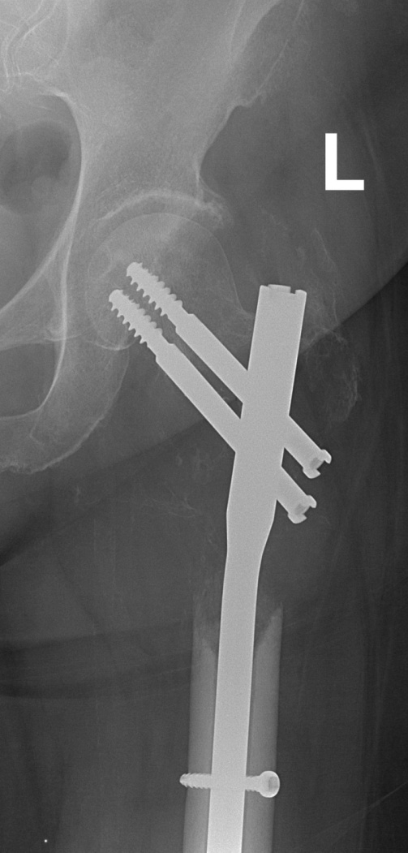
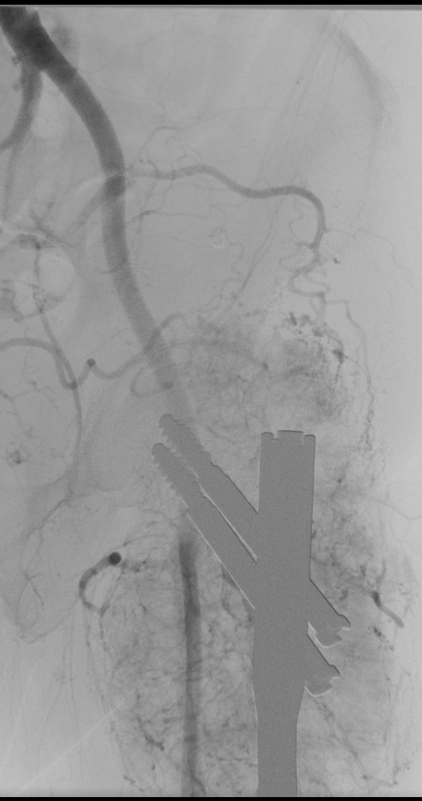
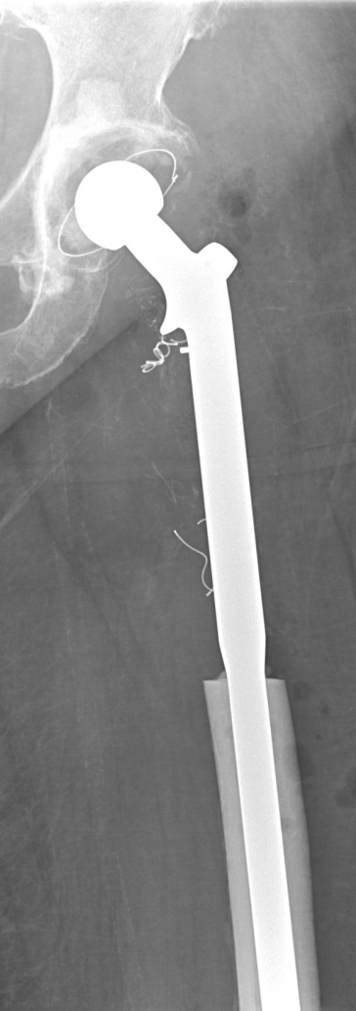
Condition after osteosynthesis for pathological fr. with metastasis of renal tumor, progresion of osteolytic lesion
No adjuvant chermotherapy
Angiography + embolisation, resection
TU THA

Slide 12
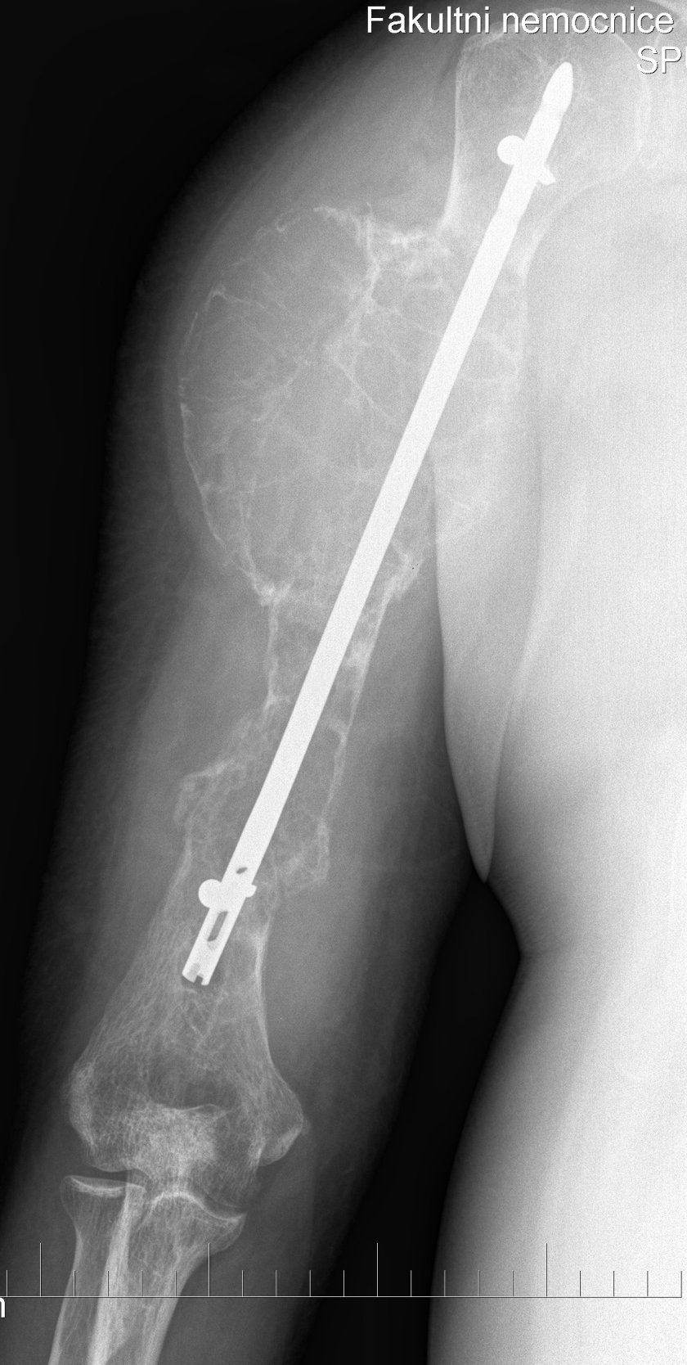
METASTASIS of thyroid carcinoma
♂ 58 let
Total thyroidectomia 7 years ago, radiotherapy and chemotherapy
X- ray osteosynthesis 2 years ago, no further treatment
No further treatment for humeral lesion
No radiotherapy
Disarticulation in shoulder

Slide 13
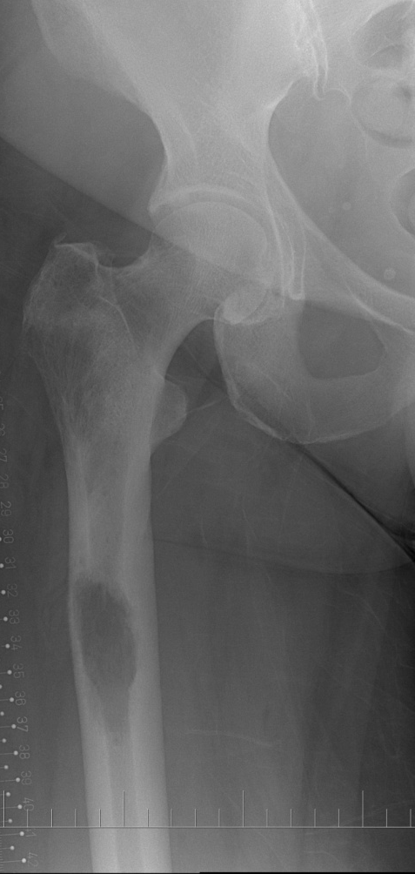
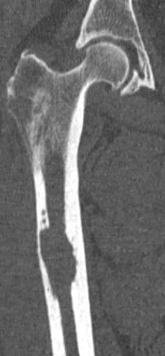
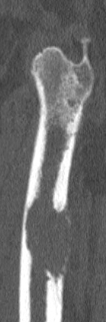
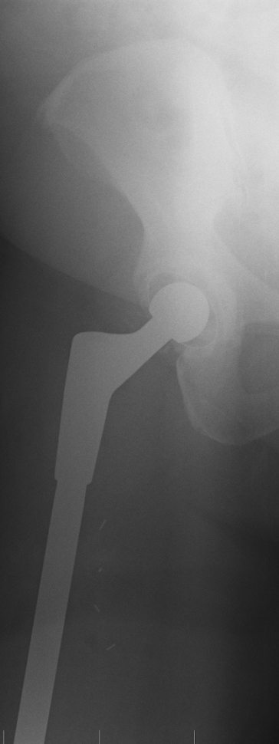
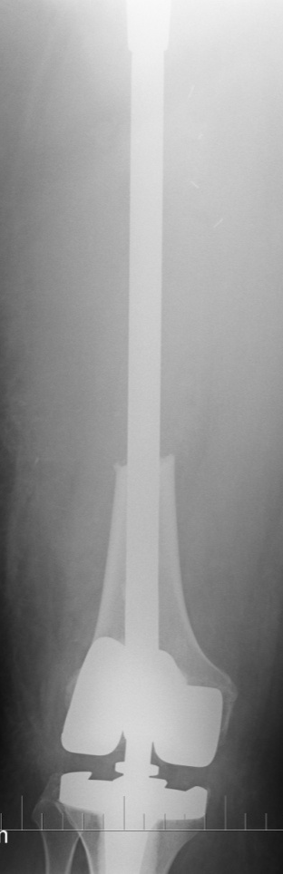
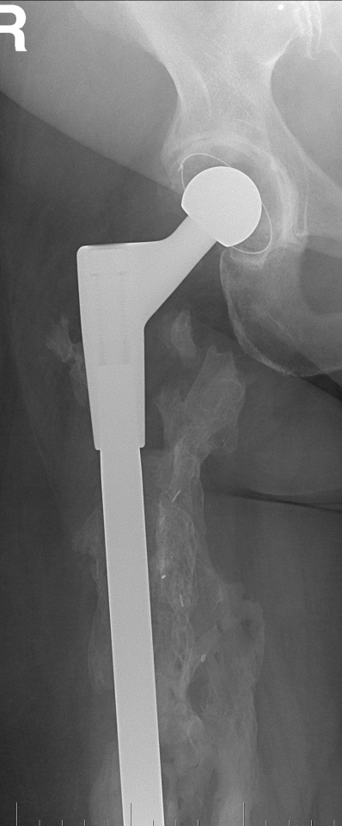
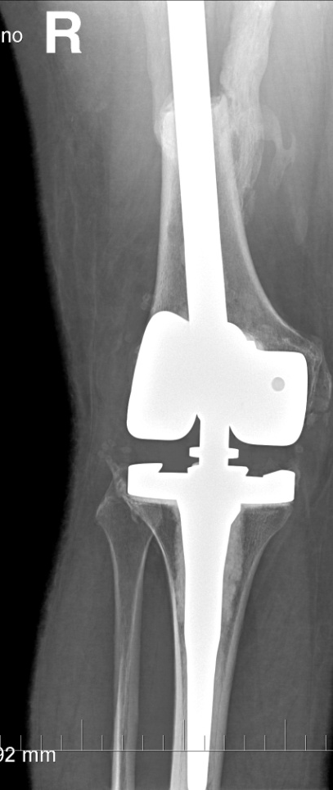
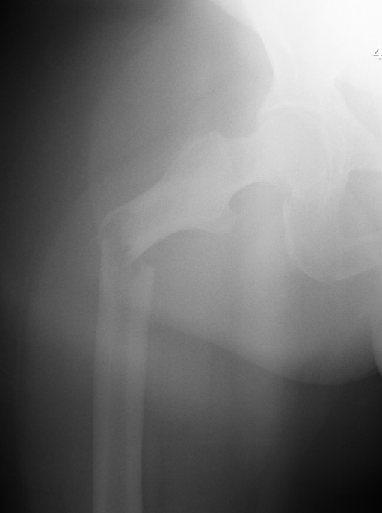
Total femur
Metastasis of breast carcinoma,
good prognosis

Slide 14
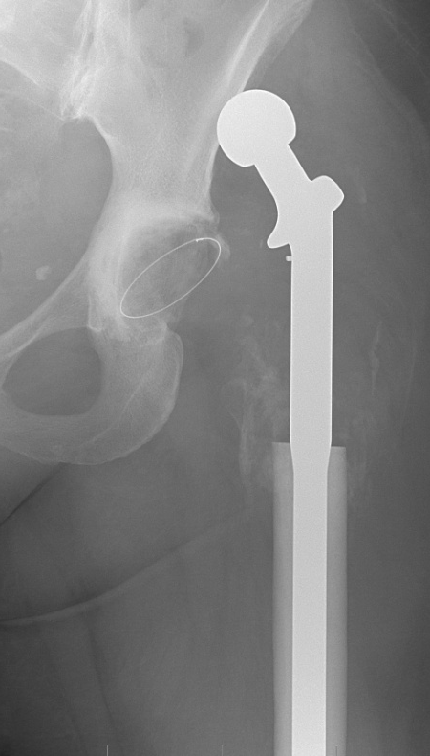
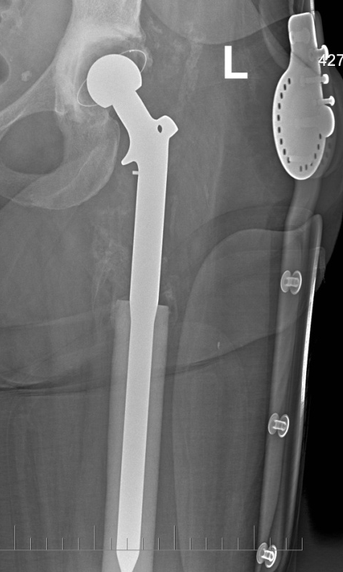
Dislocation of TU THA

Slide 15
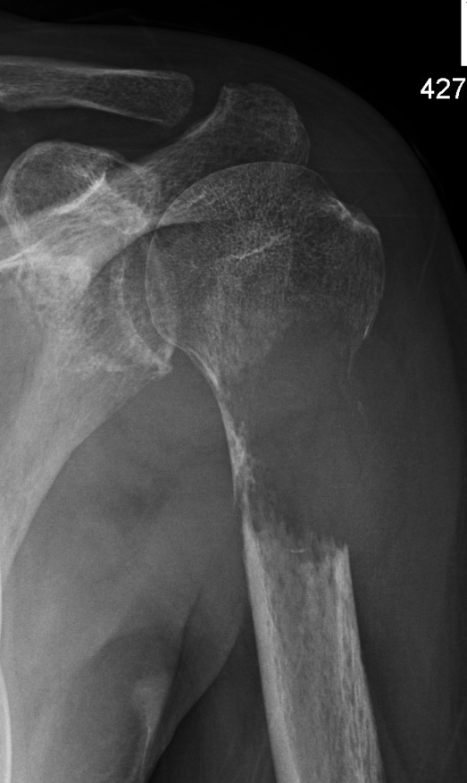
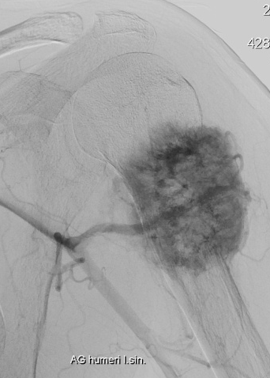
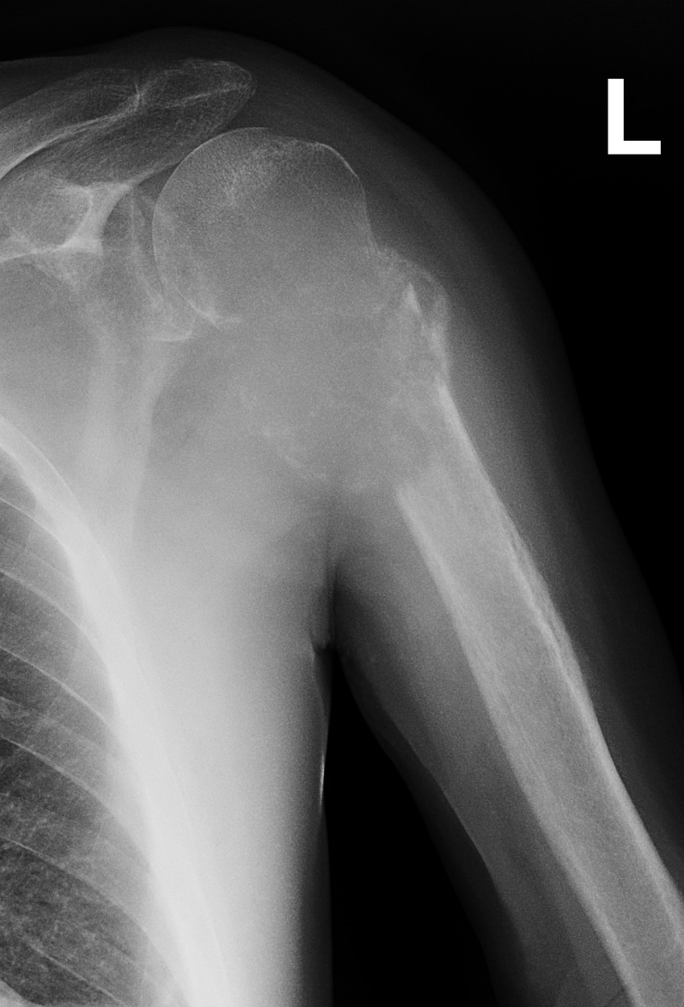
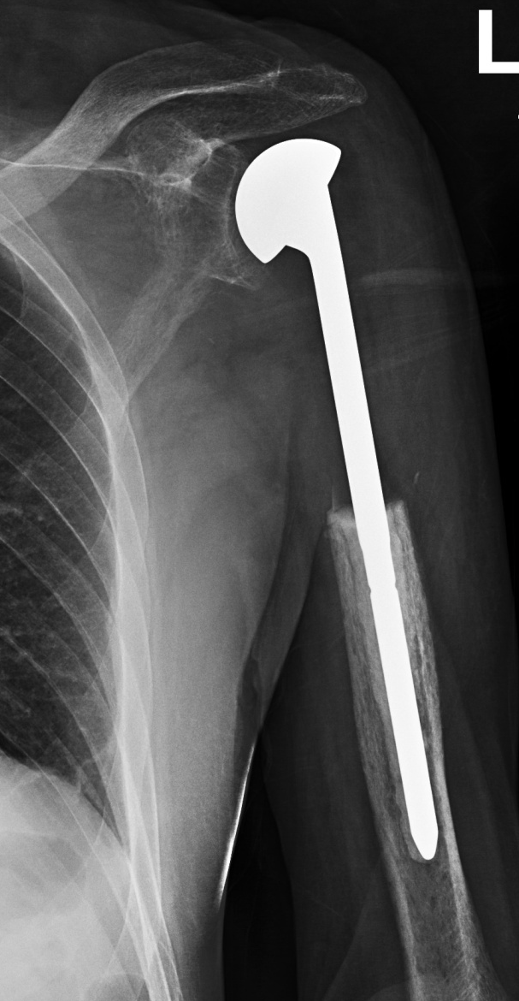
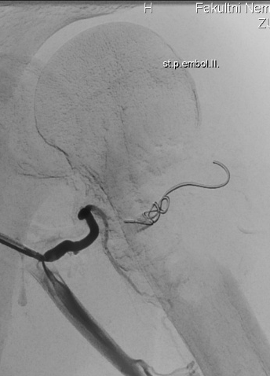
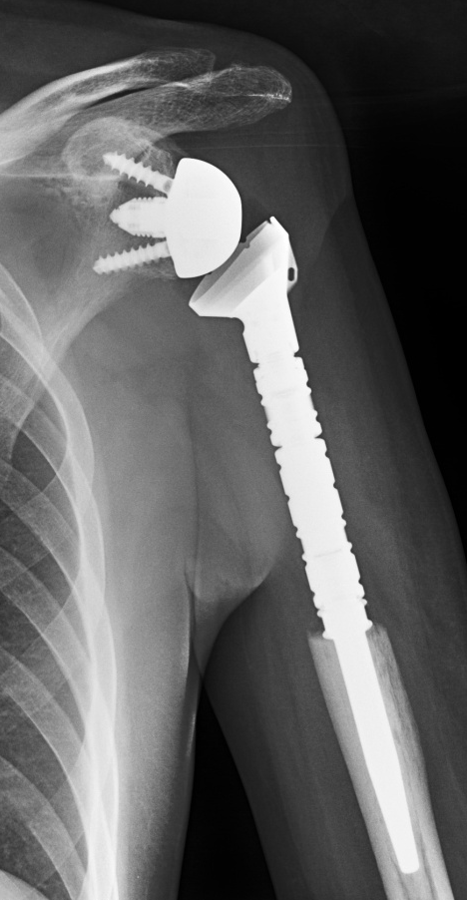
Proximal humeru
Head prosthesis
Reverse total shoulder replacement

Slide 16
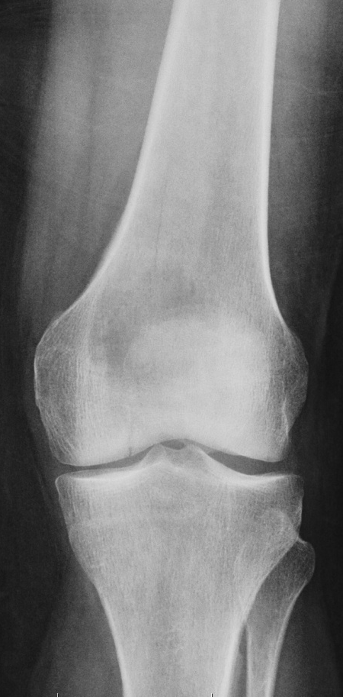
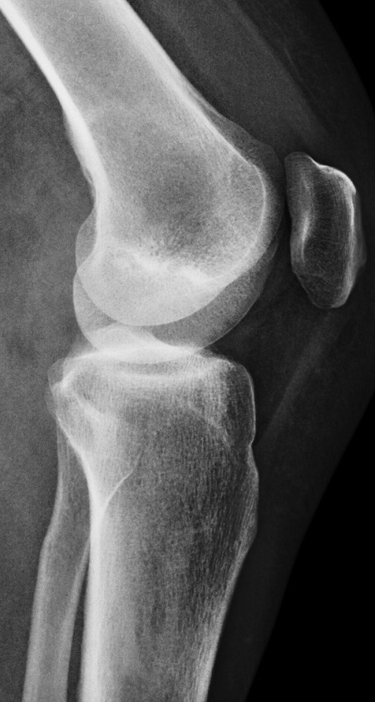
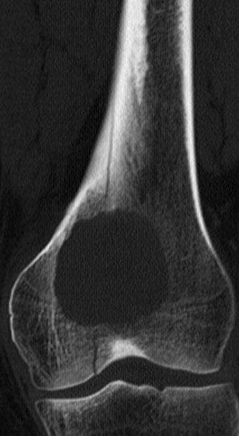
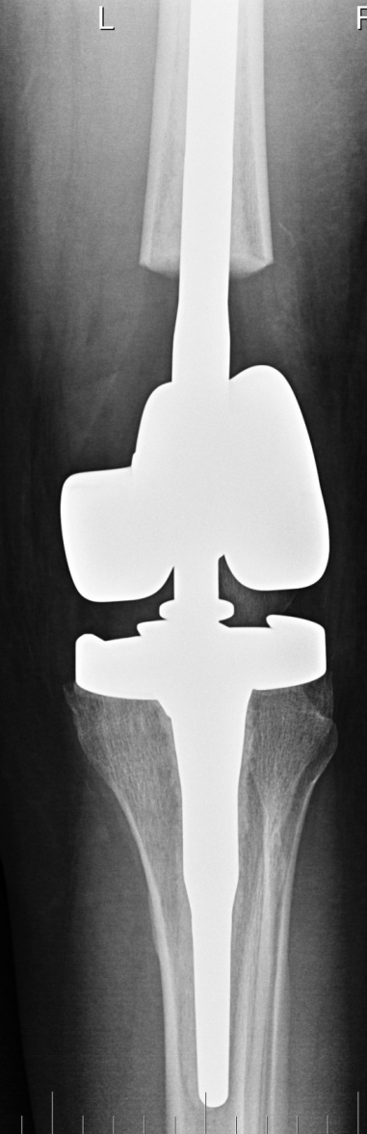
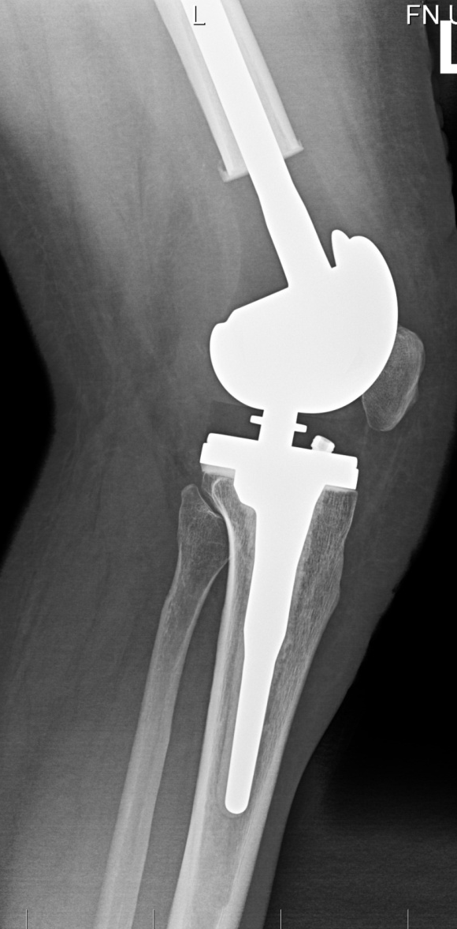
TU-TKA

Slide 17
Metastasis in diaphyseal region
Femur and humerus
Types
  i.m. nail
  Resection + cement a osteosynthesis
  Resection + intercalary spacer
  Resection + bone graft and osteosynthesis
Radiotherapy in a case of nonradical surgery

Slide 18
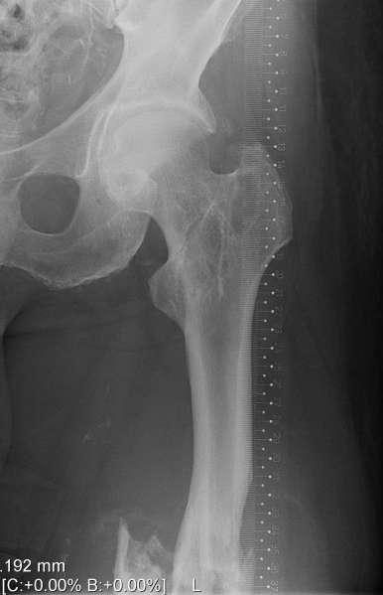
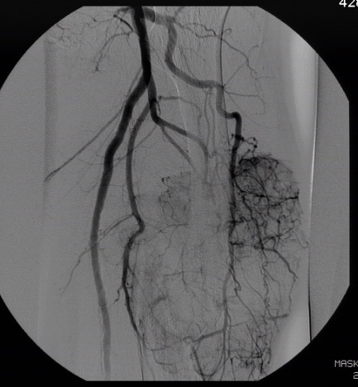
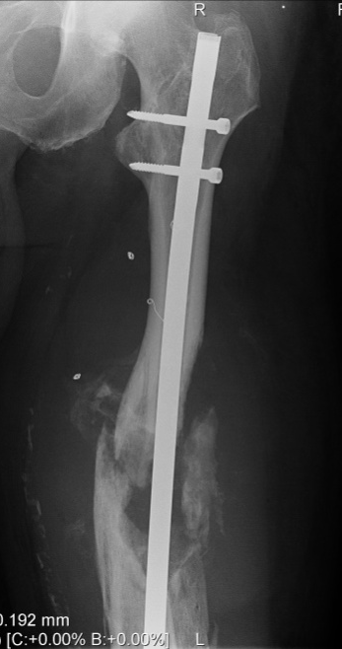
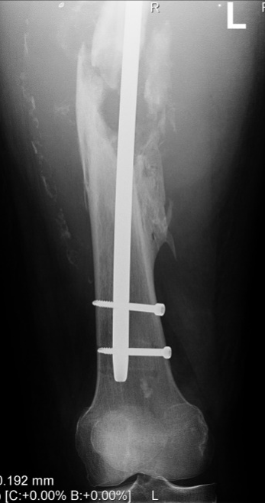
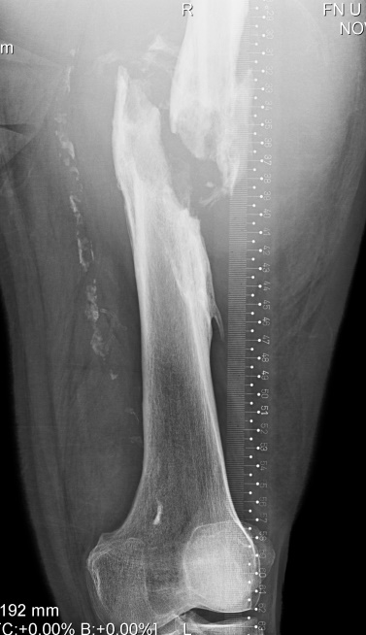
i.m. nail
Tumor in situ
paliative surgery
wrong prognosis
Adjuvant radiotherapy

Slide 19
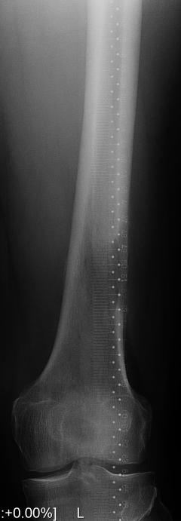
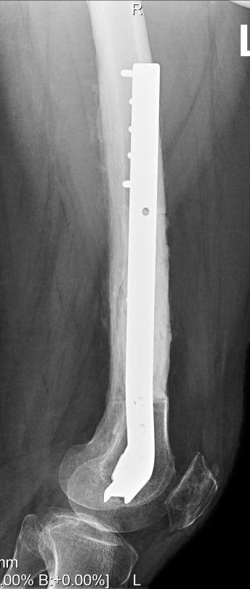
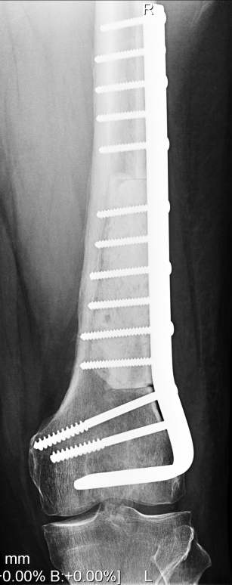
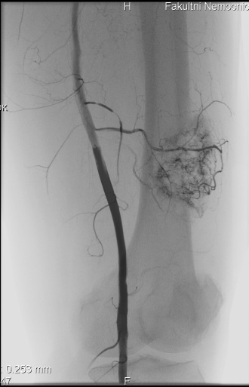
Curretage + osteosynthesis + cement

Slide 20
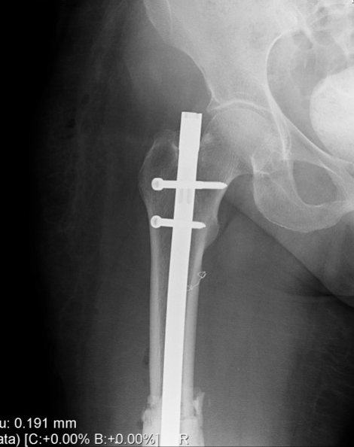
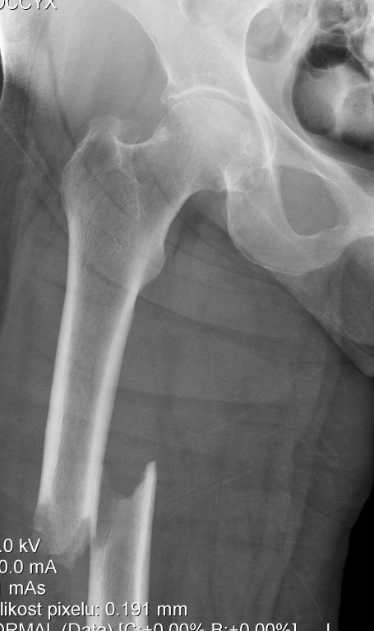
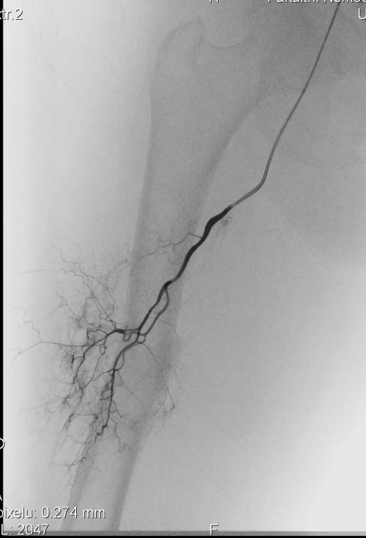
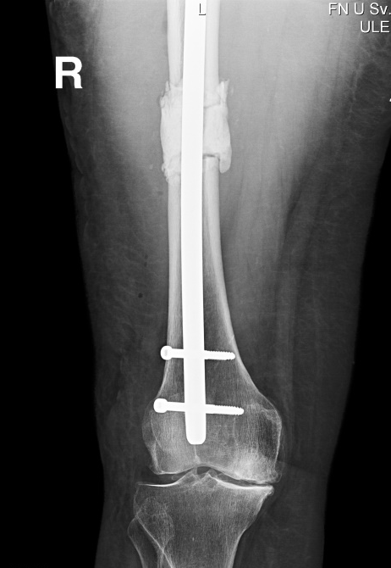
Resection + i.m. nail and cement

Slide 21






Diaphyseal spacer

Slide 22
Primary malignant bone tumors
Osteosarcoma, Ewing sa, chondrosarcoma
Pathological fracture
  Worse prognosis
  High risk of dissemination
  Less chance for local control
  Amputation ?

Slide 23





Orthesis
chemotherapy
Resection bone graft
plate
♂13 let boy
By throwing of a ball
High grade osteosarcoma

Slide 24



♀73 let, Dediferentiated chondrosa G3
Pathol. fracture
Amputation

