Slide 1
Total knee replacement
MUDr. Jan Emmer, I. Ortopedická klinika FNUSA v BRně

Slide 2
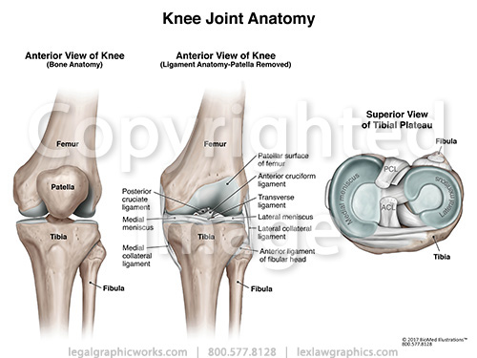
Anatomy
Hinge synovial type joint(femur, tibie, patella)
Ligaments, static stabilizers:
  MQF tendon, ligamentum patellae
  Retinacula patellae
  Lig. Collateralis tibiale et fibulare
  Lig. Popliteum obliquum, lig. Popliteum arcuatum
  Ligamena cruciata genus (anterieor et posterior)
  Meniscus medialis et lateralis
  Joint capsule

Slide 3
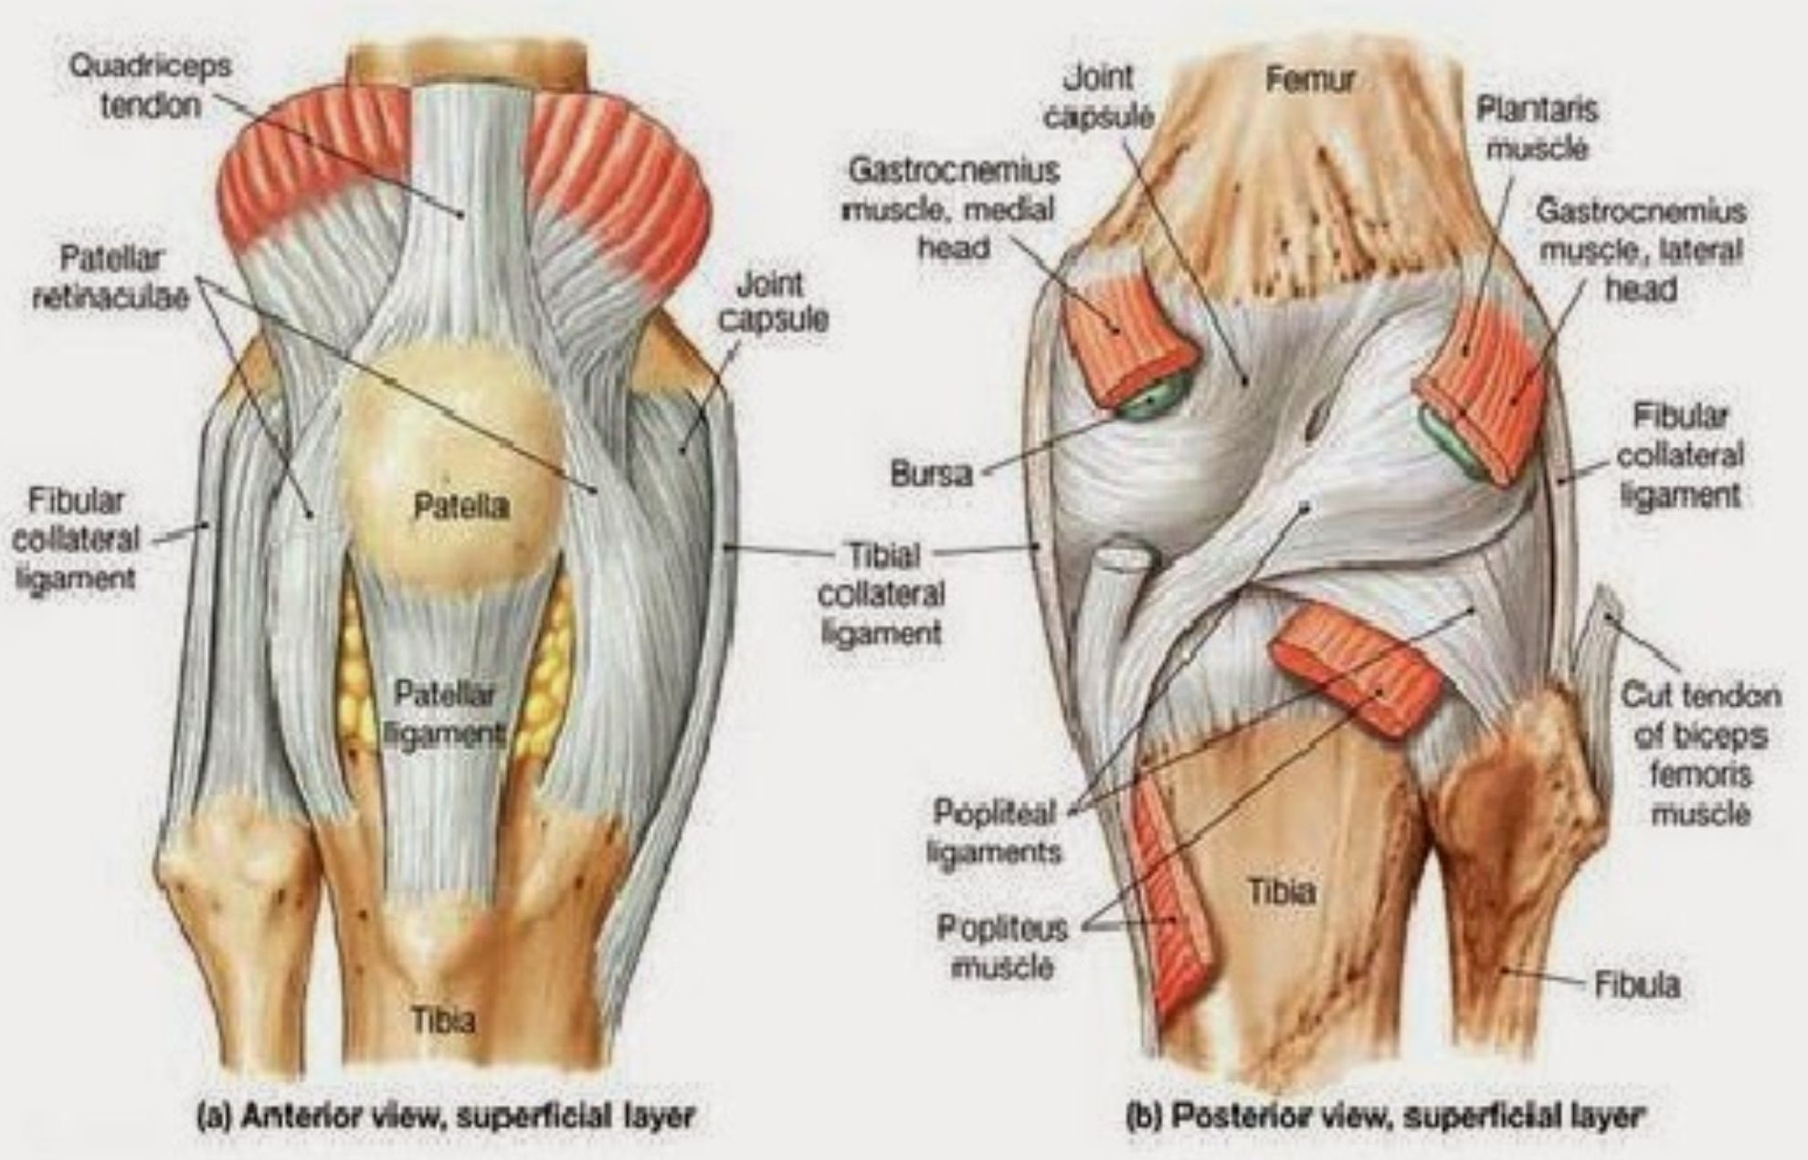
Anatomy
Muscles- extenzors
  MQF (n. femoralis)

Slide 4
Anatomy
Muscles – flexors
  M. biceps femoris (+ aditional hip extension; n. ischiadicus)
  M. semitendinosus (+ aditional hip extension and adduction , I.R. knee joint; n ischadicus)
  M. semimembranosus (+ aditional hip extension and adduction , I.R. knee joint; n ischadicus)
  M. sartorius (+E.R. hip joint, aditional hip flexion; n. femoralis)
  M. gracilis (+Hip addkuction, aditional hip flexion; n. obturatorius)
  M. triceps surae (aditional knee flexion, postural muscle; n. tibialis)
  M. popliteus (aditional knee flexion, tendon intraarticlulary!)

Slide 5
Knee joint kinematics
S 0-0-140 (hyperextension fyziol. up to 10 st, passively bigger flection)
Motion:
  1: Initial rotation („unlocking knee joint“) internal tibial rotation , initial 5° st felxion
  2: Rolling motion (meniscofemoral joint)
  3: Rollback (terminal flexion, femur on tibia moves dorzaly)
  4: Terminal tibial external rotation

Slide 6
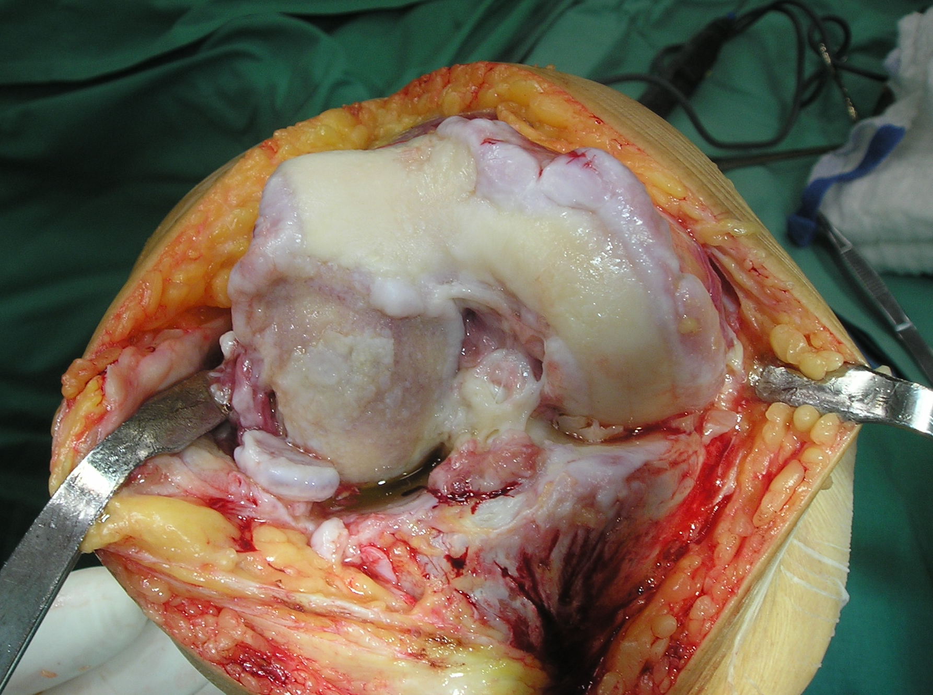
TKR indications
Painfull knee condition
Poor effect of conservative therapy
No salvage surgeries indicated
Life comfort deteriorated

Slide 7
TKR indications
OA primary
OA secundary
Psoriatic arthropathy
Aseptic femoral condyle necrosis (m. Ahlback)
Hemophilic arthropathy
Rheumatoid arthropathy
Tumors
Traumas

Slide 8
TKR cotraindications
Poor general condition, poor physical status (ASA IV)
Persistent infection
Severe comorbidity with poor prognosis
Poor vascular status of extremity
Neurogenic arthorpaty
Extreme obesity
Strong malcompliance

Slide 9
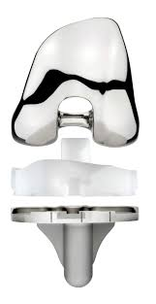
TKR fixation options
Cemented
  Most frequent
  Good results
  Usus of departement/clinic
  Price

Slide 10
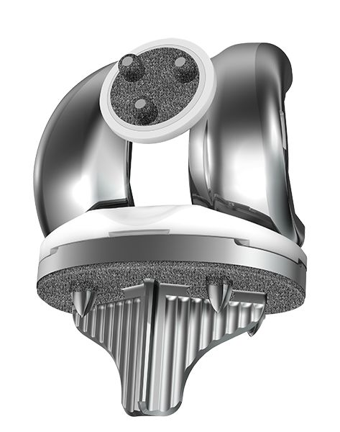
TKR fixation options
Hybrid
Tibia cementless (most cases)
Better life expectancy

Slide 11
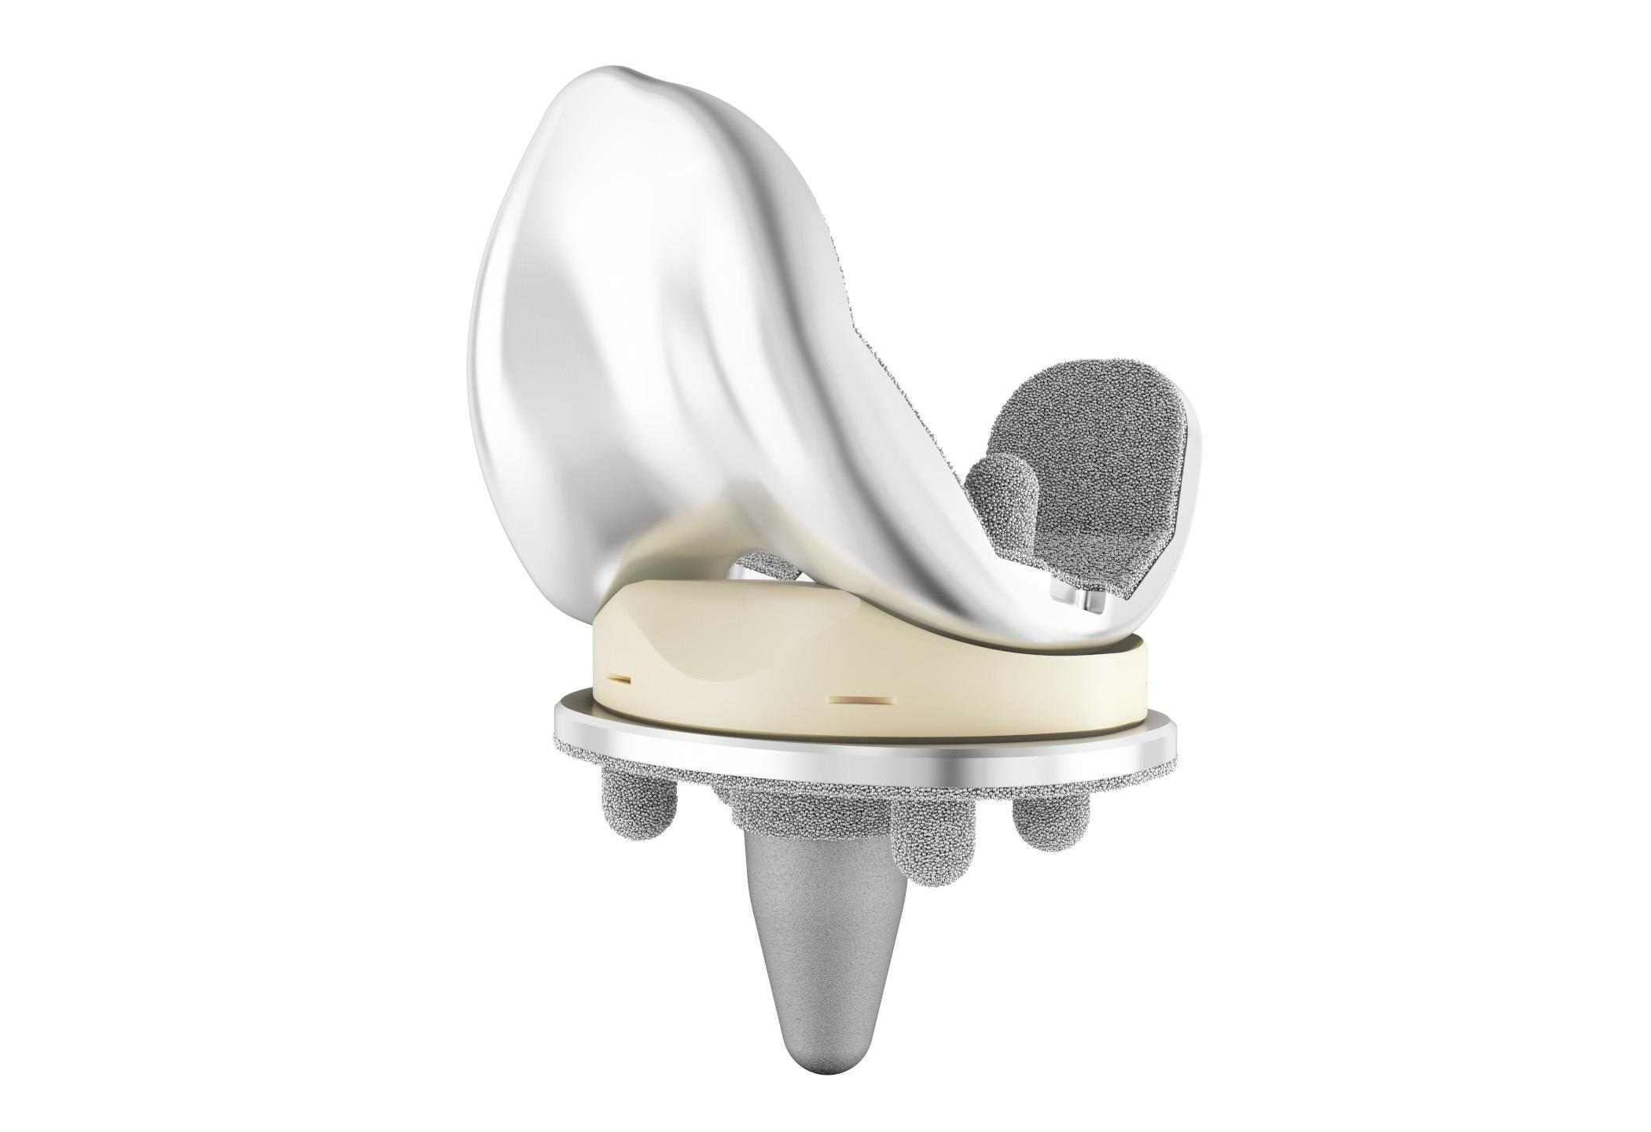
TKR fixation options
Cementless
  Good results
  Young patients
  Bone cement alergy
  Price?

Slide 12
Knee replacement range
Unicompartmental
Bicompartmental
Tricompartmental

Slide 13
TKR implant types (stability)
CR (cruciate retaining – PCL retaining)
UC (ultra congruent) – „deeper“ tibial plateau – higer stability
PS (posterieor stabilized – insuficient/missing PCL ) Component design takes over function of PCL
CCK (condylar constrained knee replacement) – if correct soft tissue ballancing impossible (varus over 15°, LCL lesion)
Hinged (Always if LCM insuficient!) Fully constrained design. Revisions, tumors, extreme pimary valgozity

Slide 14
Materials
Femoral component - requirements
  Biocompatibility
  Wear resistance
  Mechanical strenght
  Osteointegration (cementless implants)
  Antialergic implants (if metal allergy presented)
  Future? Biofilm resistance

Slide 15
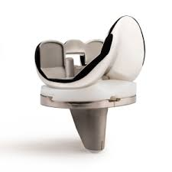
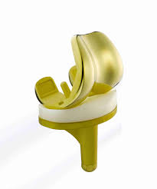
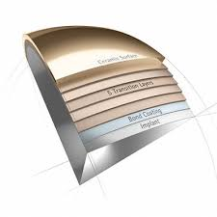
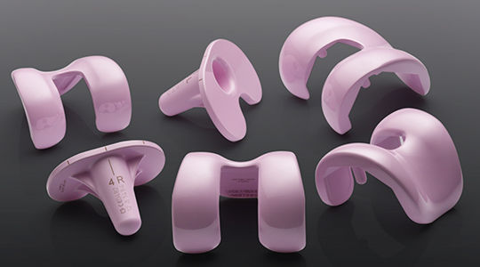
MaterialS
Femoral component
  Alloys (Fe, Ni, Co, Cr, Ti)
  Metal allergy: Ceramic
  Composite (ZrN coated)

Slide 16
Materials
Tibial component + articulation plateau - requirements
  Biocompatibility
  Wear resistance!!
  Modulus of elasticity similar as bone
  Osteointegration (cementless implants)
  Antialergic implants (if metal allergy presented)
  Future? Biofilm resistance

Slide 17
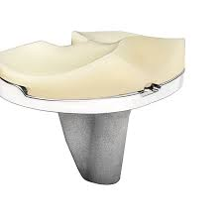
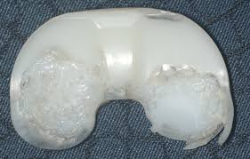
Materials
Tibial component
  Metalback – titanium alloys
  PE plateau
    UHMWPE - Ultra high molecular weight polyethylen ) – golden standard, good elasticity modulus x wear resistence ratio
    HXLCPE- Highly cross-linked polyethylene – poor results so far (too rigid?)

Slide 18
Materials
Cementless implants requirements – bone adjacent surface
  Biocompatibility
  Osteoinductive material
  Rapid bone ingrowth and reliable incorporation

Slide 19
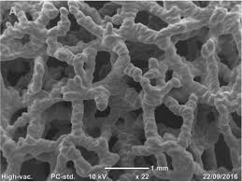
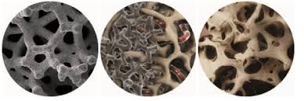
Materials
Cementless implants requirements – bone adjacent surface
  Trabecular titan
  Trabecular tantal

Slide 20
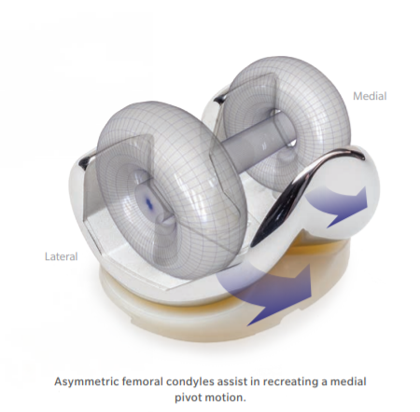
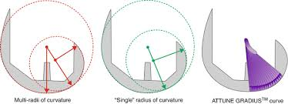
Design of components
Aim – as much natural kinematics as possible
  Medial pivot
  Multi radius femoral komponent – higer flexion of TKR

Slide 21
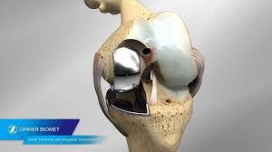
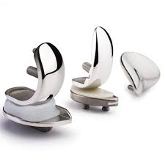
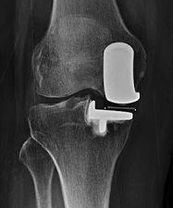
UKR – Unicompartmental knee replacement
Medial (very most cases), lateral (rare)
Indications:
  Medial OA
  Intact all ligaments (ACL included)
  Varus/valgus up to 10°; reponible
  Extension deficit up to 5°, flexion over 120°
  Asymtomatic FP compartment
Benefits:
  Biger ROM
  Proprioception
  Natural kinematics
  TKR conversion possible

Slide 22
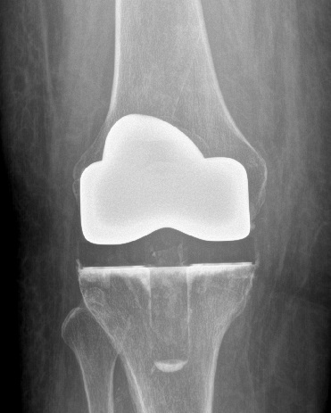
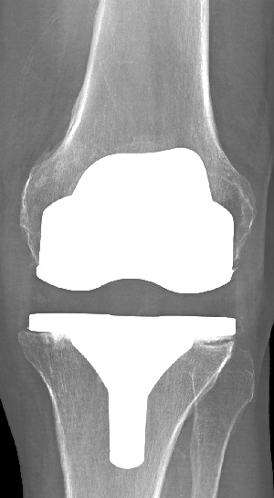
TKR – condylar replacement
Very most implantations
All poly/ metal backed tibial c.
ACL resection
Intact functional PCL, LCM, LCL

Slide 23
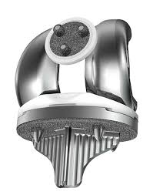
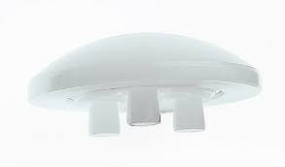
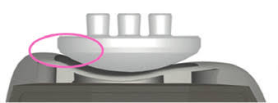
TKR – patelar replacement
Second stage surgery – if FP copmartment symtomatic after TKR (philosophy?)
If rotation of femoral component correct, no need in very most cases
If femoral component malposition – patellar maltracking

Slide 24
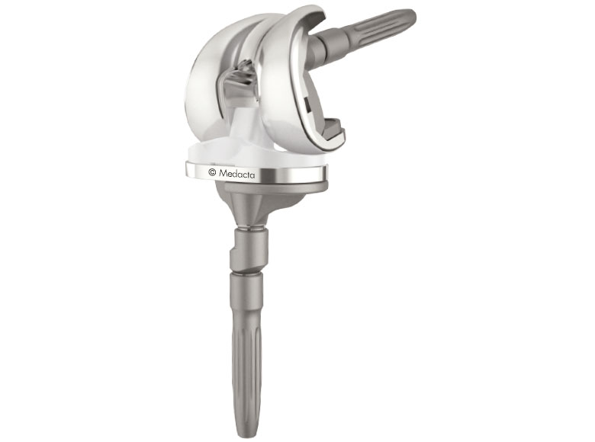
TKR Stems, augments, posterior stabilized (PS)
Poor bone quality
Bridging of bone defects
Posttraumatic OA
Revisions
PS if PCL deficient/missing
Intact functional LCM, LCL!

Slide 25
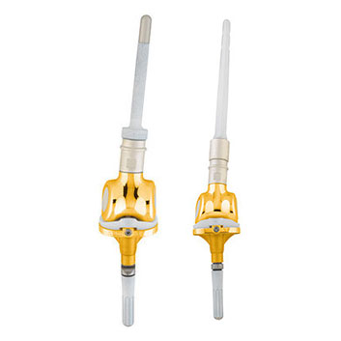
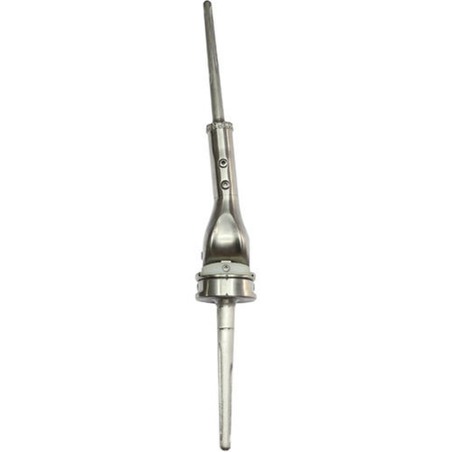
Tu - TKR
Resection Tu/meta around knee joint including joint ends
Onkological radicality first!!
Custom - made implants
Inferior outcome (compare TKR)
Higer complication ratio

Slide 26
Preoperative examination
ASA
Infection focus exclusion (neg FW, CRP), stomatological examination incl. OPG
CAVE!
  Warfarin
  NOAK
  NSAID
  PAD
  Vascular status

Slide 27
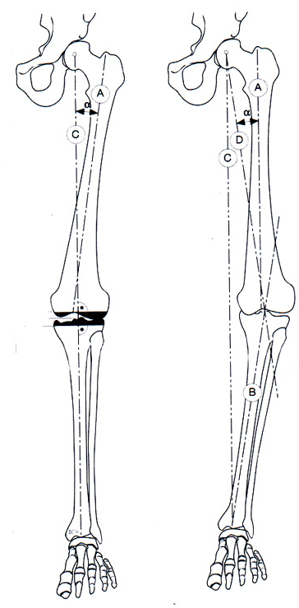
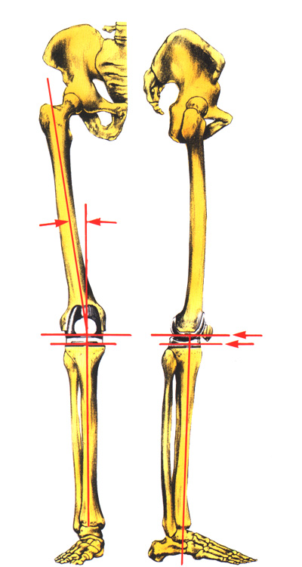
Preoperative planning
Long film X ray
Mechanical x anatomical axis
Ideal 6° valgus

Slide 28
Basic implantation philosophy
MA (mechanical alignement)
  Respect mechanical axis
  Does not respect individual status
  Resection to gain 6°valgosity
  Goal – physiological mechanical axis

Slide 29
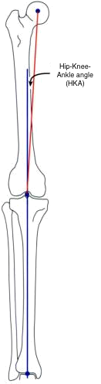
Basic implantation philosophy
Kinematic alignment
  Does not respect physiological mechanical axis
  Respect individual knee situation
  Goal – gain axis used to be before severe OA developed
  „resurfacing“

Slide 30
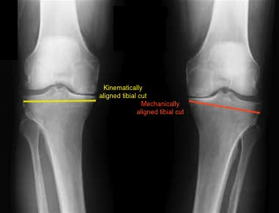
Basic implantation philosophy
Planning

Slide 31
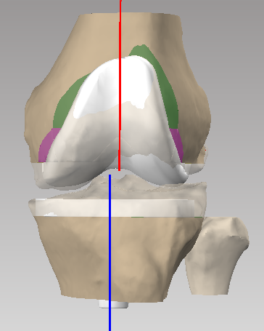
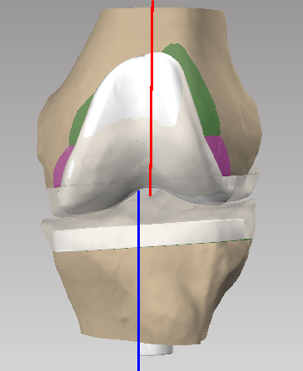
Basic implantation philosophy
  Mechanical alingnment Kinematic alignment

Slide 32
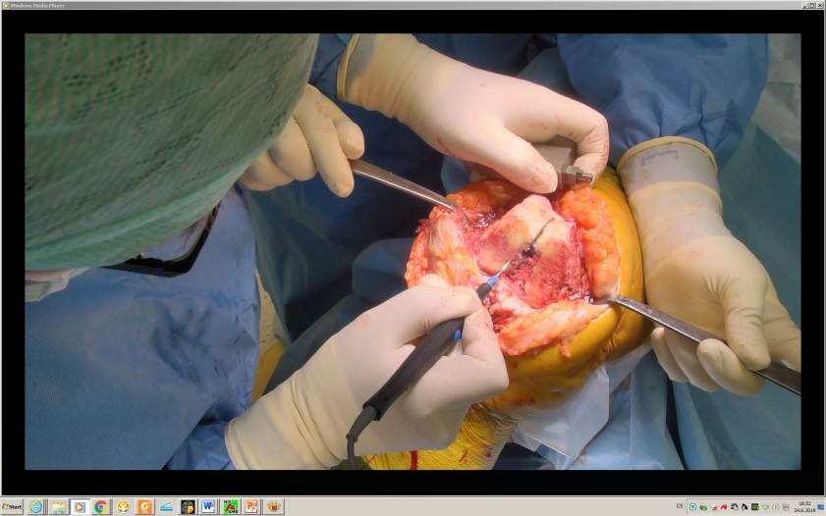
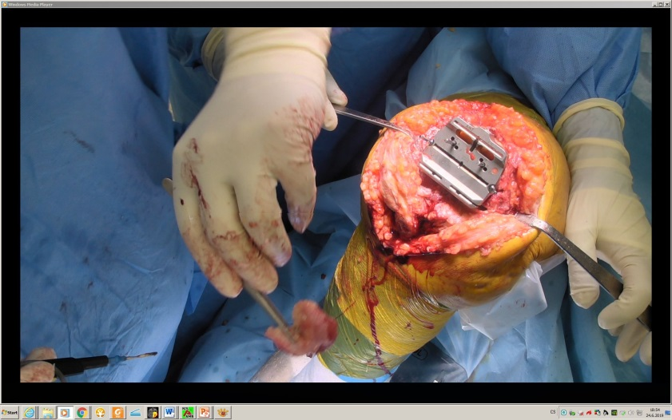
Operation technic
Standardized
Medial parapatellar approach x mid x subvastus
Parc. Hoff fat pad resection
Patella – Eversion, denervation + cheilectomy x parc. resection x patellar replacement implantation
Distal femoral cut
Proximal tibial cut
Soft tissue balancing!!

Slide 33
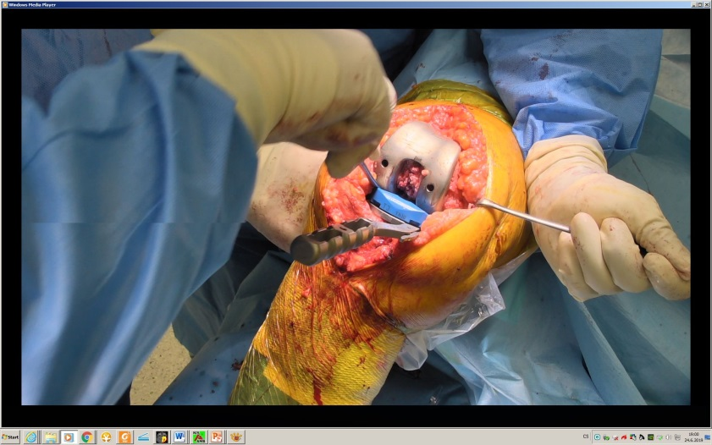
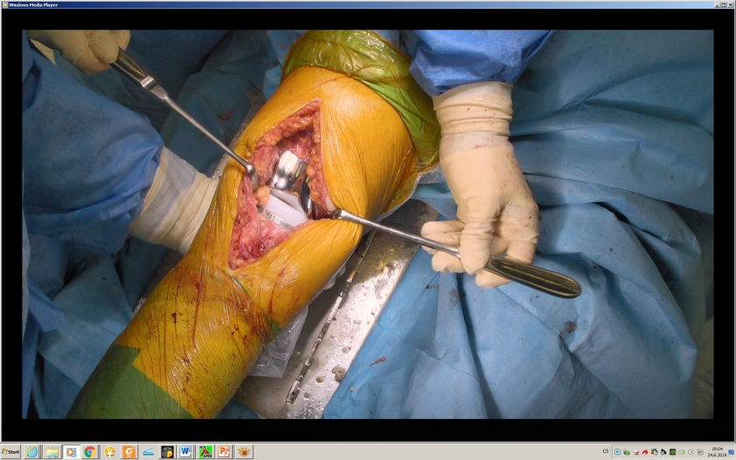
Operation technic
Flexion x extension gap
Femoral component rotation
Femoral resection
Probe component (soft tissue balance test)
Tibial preparation (correct rotation!)
Pulsed lavage
Original components + bony cement
Reliable suture!

Slide 34
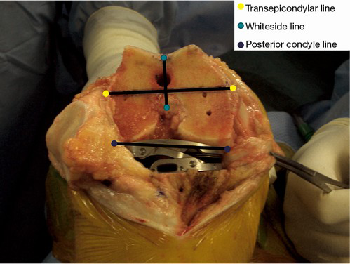
Operation technic
Tibia first
X
Femur first
X
Extension gap technique

Slide 35
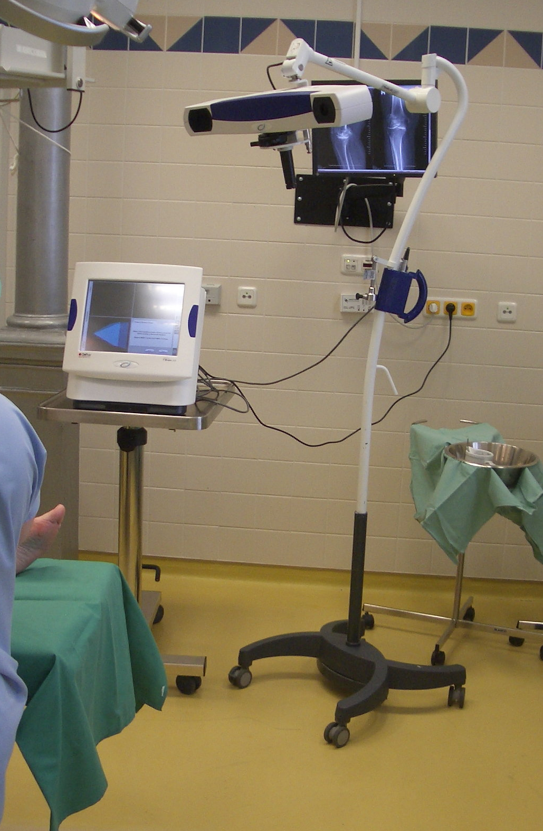
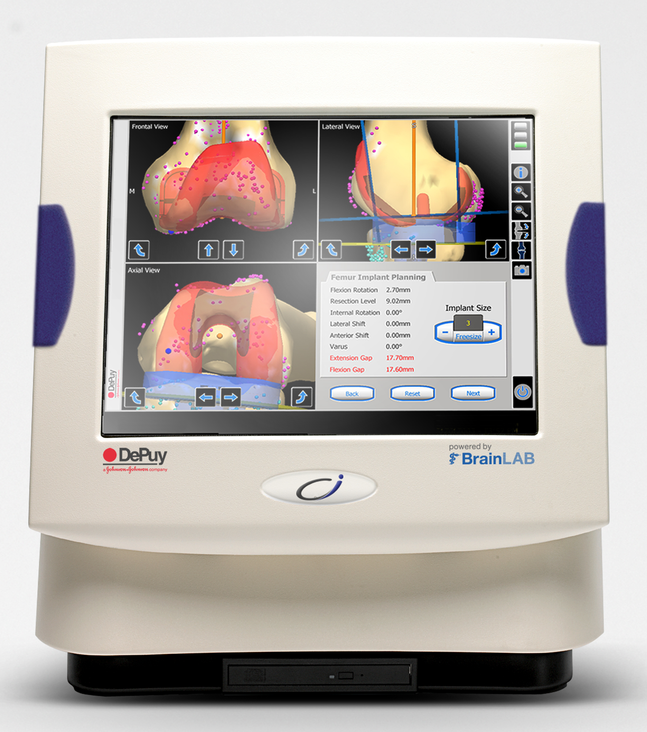
Computer navigation
Optional, some hospital /countries obligatory
Mapping reference points and kinematics into SW
Special instrumentary
Surgeon is guided
Necesserry if intramedular instrumentary impossible (trauma)

Slide 36
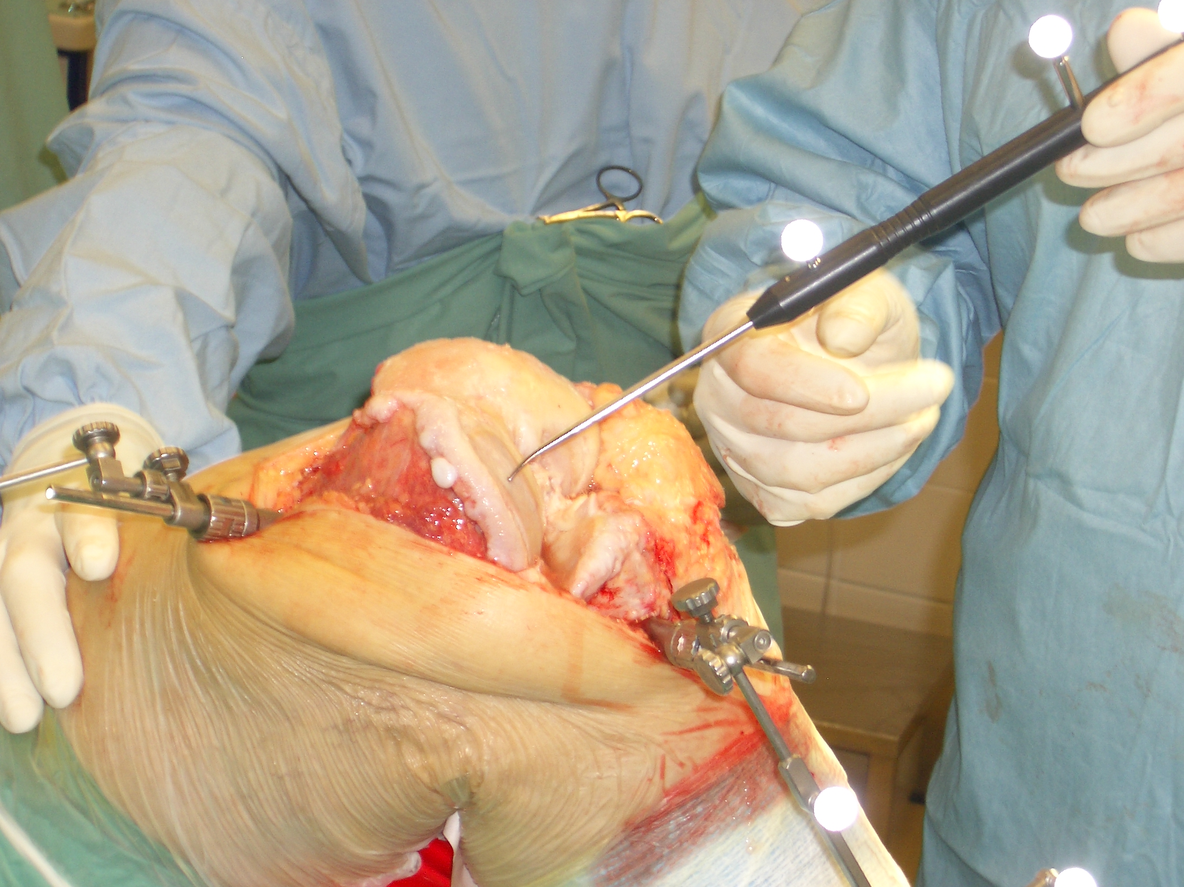
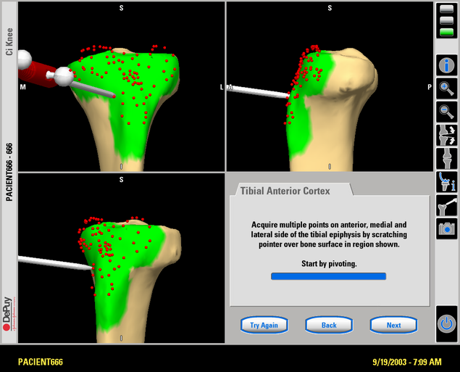
Computer navigation
Reference points mapping
3D virtual model

Slide 37
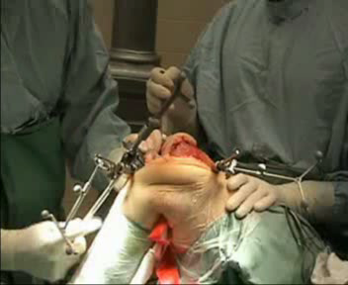
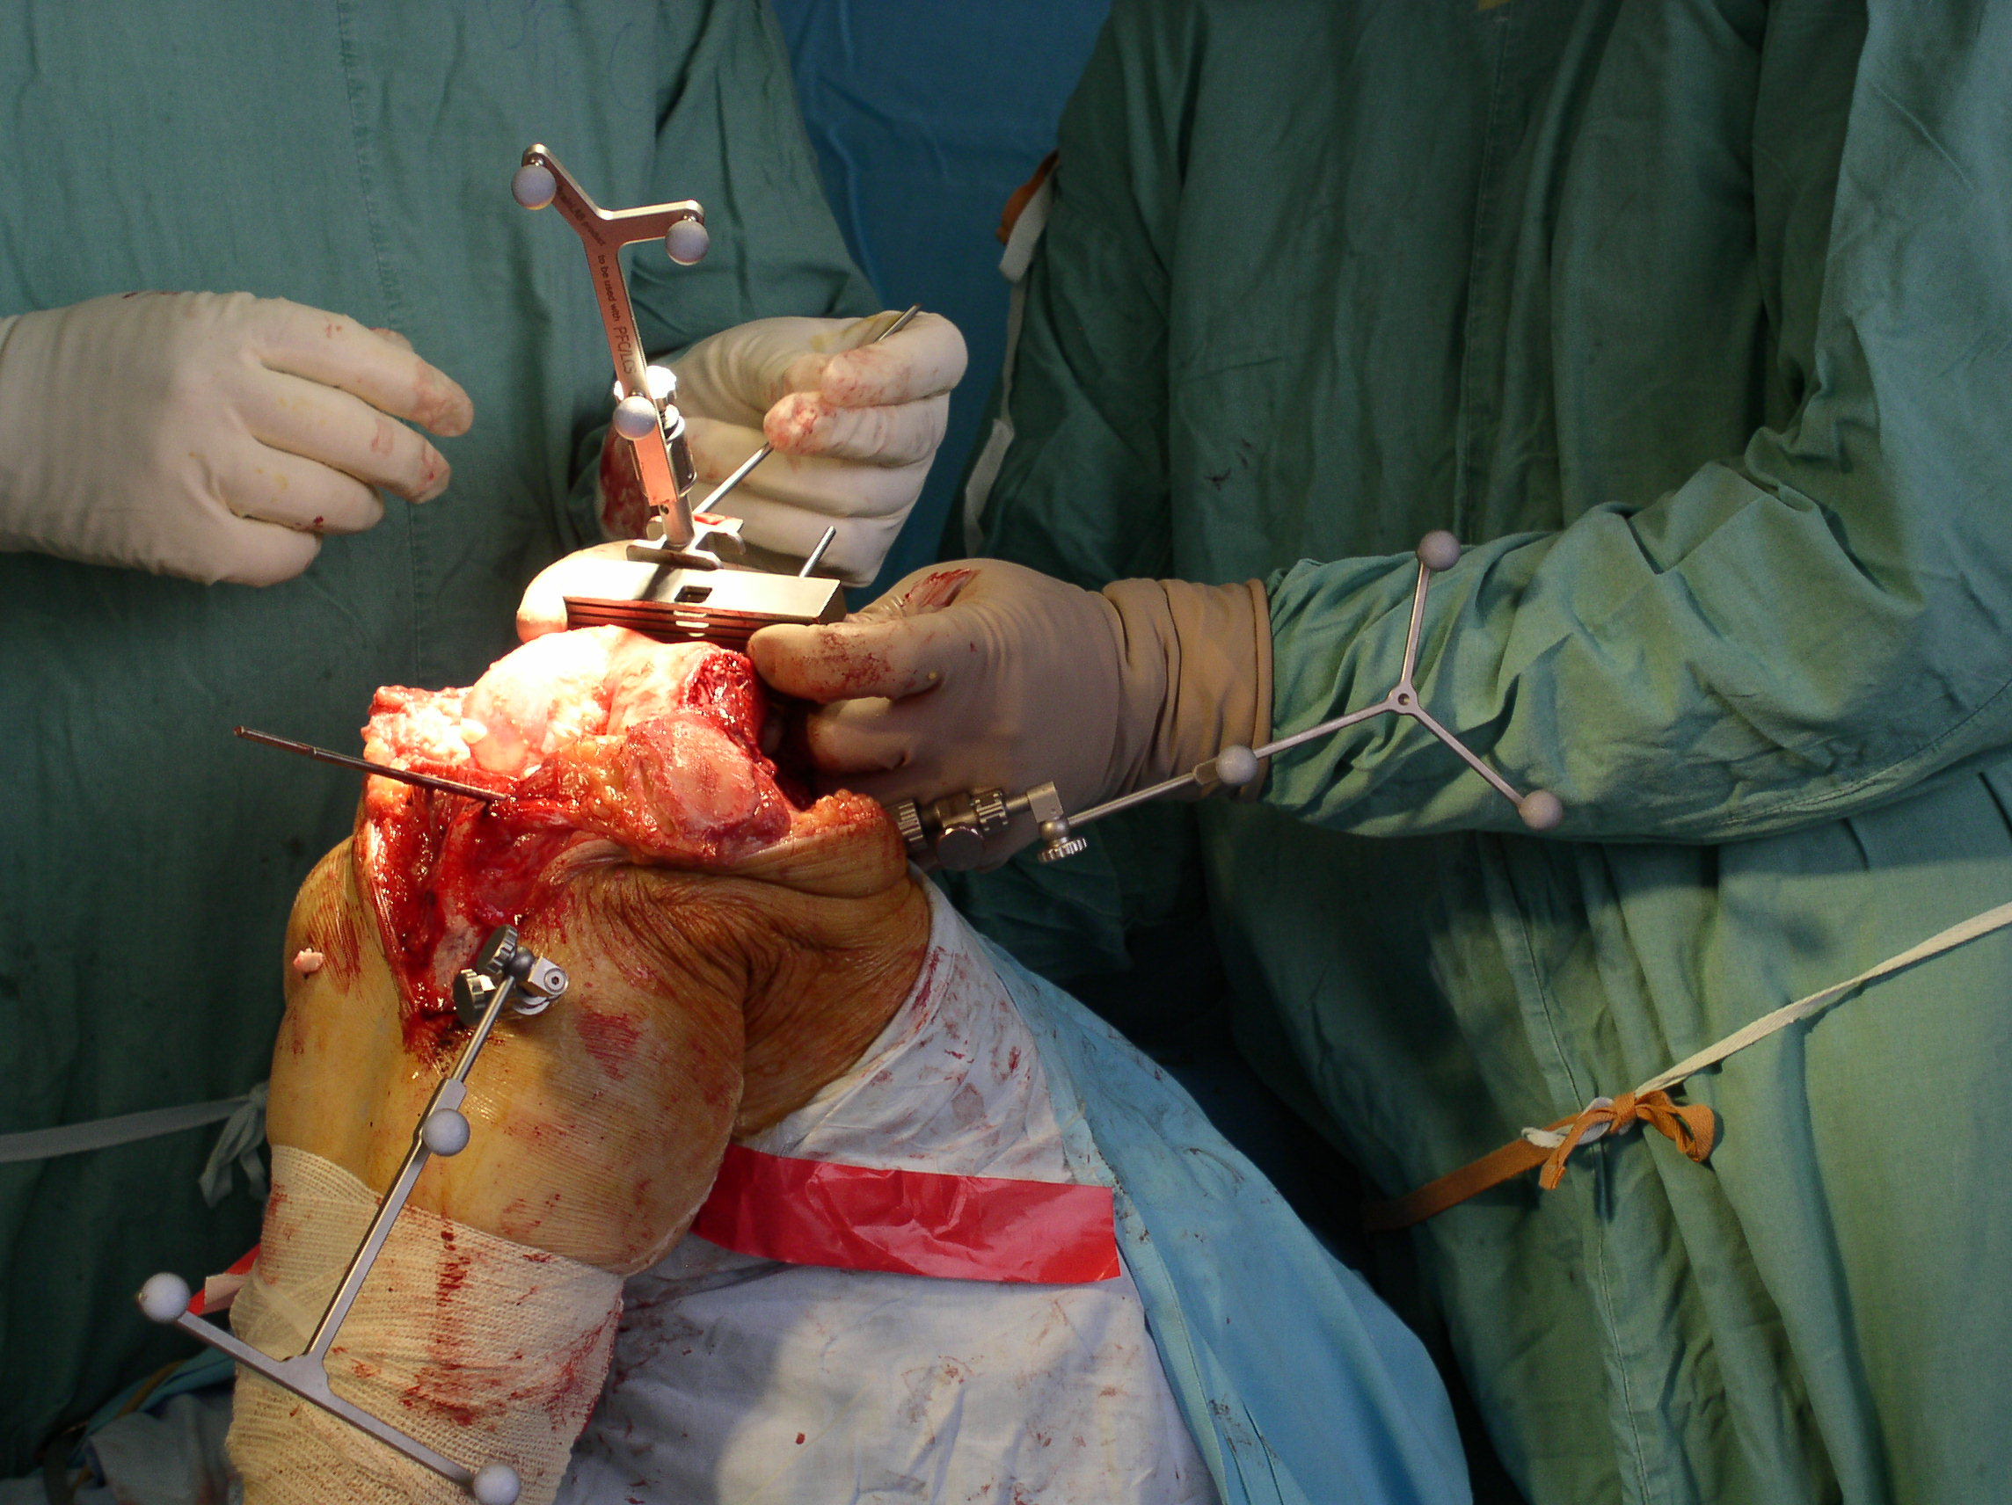
Computer navigation
Proximal tibial cut planning
Distal femoral cut planning

Slide 38
periprosthetic joint infection (PJI) prevention
Preop. Examination!
ATB perioperatively – Cefazolin i.v. 1 dose before + 3 doses post op.
Drainage EX in 24h
If urinary catheter present - ATB
Strict régime at op. theater
Wound care till healing
Lege artis diagnostic and therapy protocol of eventual PJI

Slide 39
Post op. management
ICU (post op ward) one day if no complication
Hospitalization at orotpedic ward for 5 days
Verticalization first post op. day
Complex rehabilitation protocol, rehabitalitation nurse obligatory
6. day – tranfer to rehabilitation ward
Spa – in CZ coverd by public health insurance in 3 post op. months
DVT prevention – standard 10 days (LMWH), if risk factor presented, 6 weeks (NOAK)
Trends: Shoretening inpation period (risc of nosocomial infection, economic aspects)
Fast track physiotherapy
Outpatient surgery?

Slide 40
Follow up
Standardized
First check up by ortopedical surgeon in 6 weeks (X ray included)
Second in 3 months, then 6 month
Further each 2 years (X ray included) if no problem present
EDUCATION, EDUCATION, EDUCATION!
  Activity, limitation and régime with TKR
  PJI prevention
  Urgent check – up if suspected PJI

Slide 41
Complications
Peri and early pos op. morbidity and mortality
  Nervous and vascular injury
  Blood loss
  Perioperative fracture (femoral condyle)
  Pulmonary embolism
  IM
  General decompensation
  Development of delirium

Slide 42
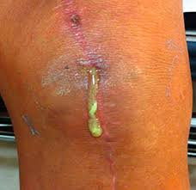
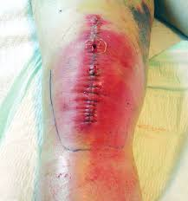
Complications
Periprosthetic infeciton (PJI) – 1-2% primo, 5-10% revision
  Early – up to 2 weeks after surgery
  Late hematogenic
  Diagnostic
    General symptomas of infection
    Local condition
    Artrocentesis + aspiration - cultivation + PCR
    Fistula with purulent secretion
    Radiolucent periprosthehic lines around implant on X ray (chronic PJI)

Slide 43
Periprosthetic infection (PJI)
Therapy
  Up to 2 weeks from manifestation - DIAR (debridement, ATB, implant retention)
  Uprard of 2 weeks – revision, debridement, replantation
    One stage – dubious outcome
    Two stage – cemented ATB spacer, after healing ínfection revision and new implant possible
    ATB supression of chronic infection optional (old patients with no perspective to surgery)
ATB therapy
  Cultivation(punciton + aspiration, perioperativly samples, sonication of implant)
  ATB i.v. 2 weeks minimum
  6 weeks p.o.

Slide 44
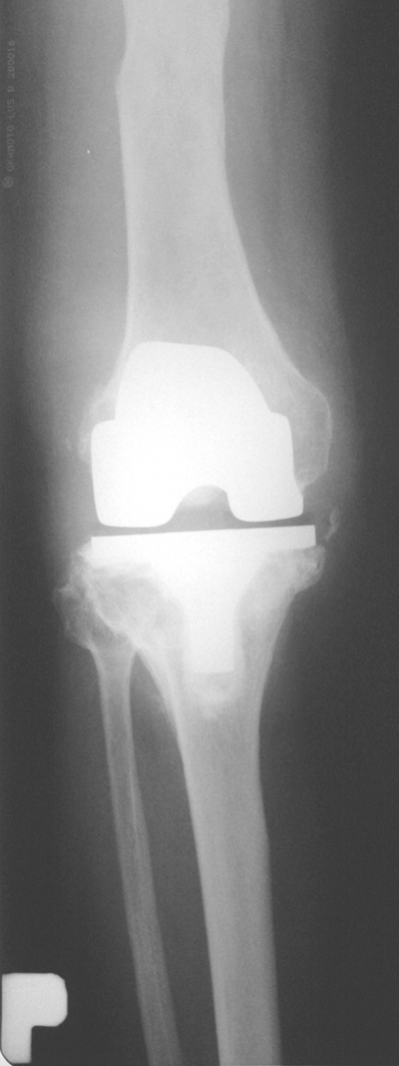
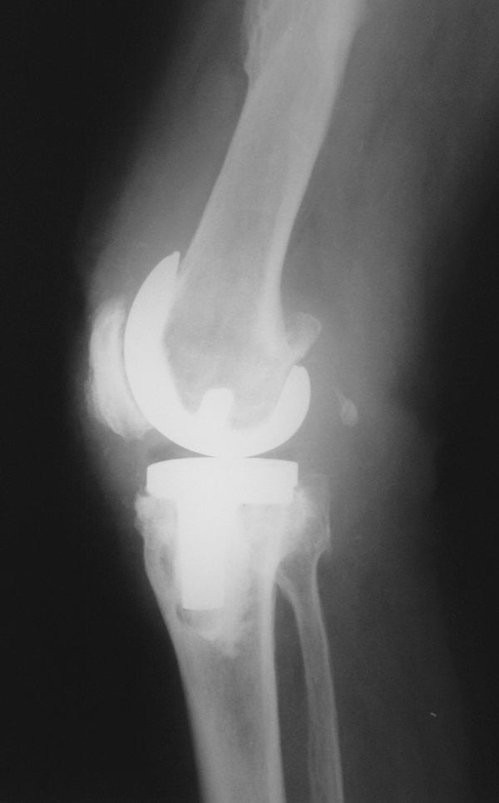
Periprosthetic infection (PJI)
Chronic PJI X ray

Slide 45
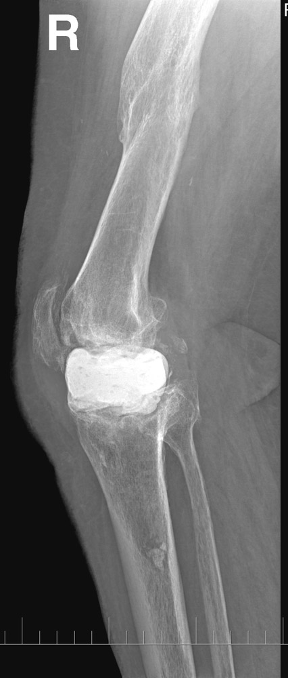
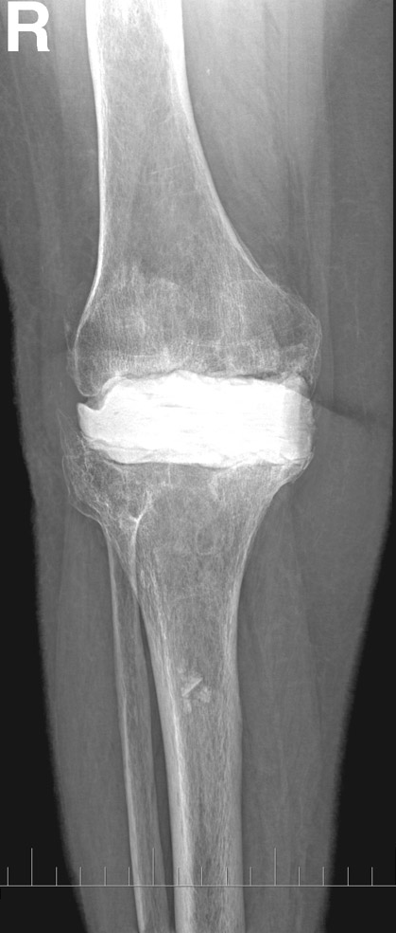


Periprosthetic infection (PJI)
ATB spacer
Rigid (stiff)
Articulation

Slide 46

Periprosthetic infection (PJI)
Revision, new TKR implantation

Slide 47


Periprostehtic infection (PJI)
Relapse of infection – ultimum refugium
  Fusion
  Amputation (rarely)

Slide 48




Aseptic loosening
Most frequent TKR revision reason
Macrophage-induced inflammatory response resulting in bone loss and implant loosening
PE particle inducted granuloma

Slide 49



Aseptic loosening - therapy
Revision, replantation
  Revision implant, stems, augmens. Cement with ATB
  Double ATB combination – higer infection risk

Slide 50
Aseptic loosening - prevention
Modern quality PE (minimal wear rate)
Correct surgery technique - ballancig
Reasonable régime after TKR
Follow up, early revision indication.

Slide 51

Periprosthetic fracture
Relatively frequent complication
Dist. Femur x prox tibia x patella
Older patients, worse general condition
Osteoporosis, poor implant retention
High mortality and morbidity rate
High compliction rate
Demanding surgeries (experienced surgeon)

Slide 52

Periprosthetic femoral fracture; classifcation
Su
Lewis and Roarbeck
Neer, Tomáš, DiGioia and Rubash, Chen…

Slide 53
Periprosthetic femoral fracture; therapy
conservative – no/minimal displacement + implant retention; poor general condition
IM stem (implant retention + fr. above fem. component)
OS (LCP, condylar plate –implant rtention + fr. In the level of fem. component)
Femoral component replantation + stem (loosening of fem. component)

Slide 54

Periprosthetic tibial fracture; classification
Mayo, Felix

Slide 55

Periprosthetic tibial fracture; THERApy
conservative – no/minimal displacement + implant retention; poor general condition
ORIF (unstable fracture, stable implant)
Replantation of tib. component + stem (unstable tib. component)

Slide 56
Thank you for yor attention

