Slide 1
I. Red blood cell count. Estimation of haemoglobin concentration. Calculated parameters of red blood cells
II. Estimation of blood group by slide method
Physiology I – practice
Autumn, weeks 4-6
Fyziologický ústav LF MU, 2015 © Michal Hendrych

Slide 2
Red Blood Cell Count

Slide 3
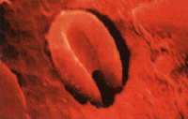
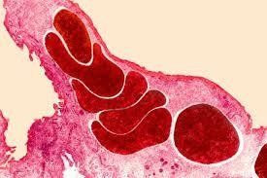
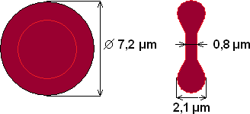
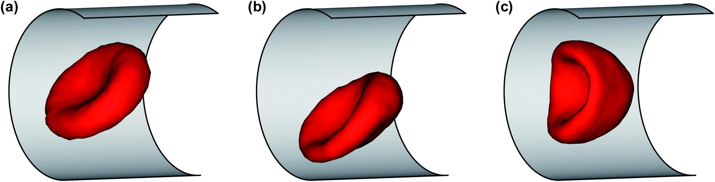
Red Blood Cell (RBC) – erytrocyte
Anucleated cell, the most abundant blood cell
Shape:
  biconcave disc – surface increased by 30%
  the shape is ensured by a protein named spectrin
  the ability to deform inside the capillaries is necessary
Functions:
  Transport of oxygen to tissues (bonded mainly to haemoglobin)
  Role in acid-base balance and CO2 transport
Size:
  Normocyte: 7.5 µm
  Microcyte: ≤ 7 µm
  Macrocyte: ≥ 9 µm
  Megalocyte: ≥ 20 µm
  The width is around 2.5 µm peripherally and 1 µm centrally

Slide 4


Reticulocyte
Immature RBC
In peripheral blood: 1% ± 0.5% of RBC
  reticulocytosis: increased ratio of reticulocytes in peripheral blood, occurring mainly after blood loss or blood donation
No nucleus, but residues of membrane organelles in the cytoplasm (substantia granulo-filamentosa)
Within 48 hrs. maturation to RBC
retikulocyte
mature RBC

Slide 5
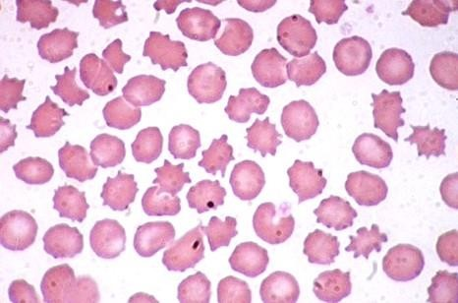
Poikylocytosis: irregular shape of RBCs
Usually in anaemia

Slide 6
RBC count
Number of RBC (red blood count)
  Men: 4.3-5.3 * 10¹² / l
  Women: 3.8-4.8 * 10¹² / l
  Newborns: 4.4-7.0 * 10¹² / l
Intersexual differences:
  Men: testosterone (male sex hormone) stimulates releasing of erythropoietin
  Women in fertile period: relative erythrocytopaenia due to menstruation (and lower levels of testosterone)
Alterations of RBC count
  Polyglobulia – increased number of RBCs, increased blood viscosity
    polycythemia vera, dehydration, adaptation to high altitude
  Erythrocytopaenia – decreased number of RBCs, decreased blood viscosity

Slide 7
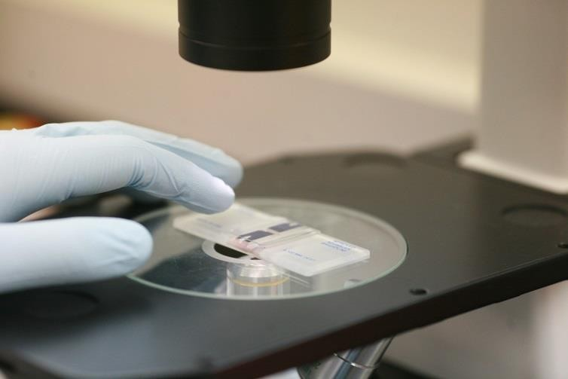
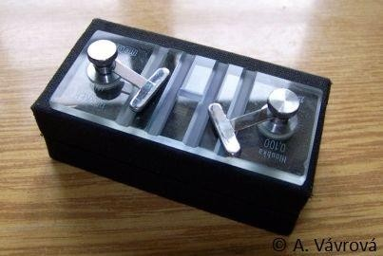

Estimation of RBC count
Automatic methods
  Electrical impedance – RBC count is determined based on the increase in electric resistance and the decrease in electric current while passing through the capillary from the storage container to the smaller container. RBC has a lower conductivity than diluent. It allows us to find out the size of the RBC, small = higher current, large = lower current.
  Photo-optical – when passing through the capillary, a light beam falls on the RBC and the RBC causes the dispersion of light which we capture.
Classical method:
  Bürker‘s chamber + Hayem‘s solution for dissolution
  4950 µl of Hayem‘s solution and 25 µl of blood – dilution *198, or
  4975 µl of Hayem‘s solution and 25 µl of blood – dilution *199

Slide 8
Haematocrit
The volume percentage of red blood cells in a blood sample (erythrocyte volume fraction)
Estimation after centrifugation of anti-coagulated blood*
  Plasma
  Buffy coat – white non-transparent layer above RBCs consisting of leukocytes and thrombocytes making up 1% of the whole volume
  RBC
Hct (hematocrit)
  Men: 42-52%
  Women: 37-47%
  •centrifugation of coagulated blood results in blood serum (which differs from plasma by the absence of coagulation factors)

Slide 9
Hematocrit
Normal Anaemic
_{blood blood} Polycythemia
plasma (55%)
leukocytes and thrombocytes (1%)
erythrocytes (44%)

Slide 10
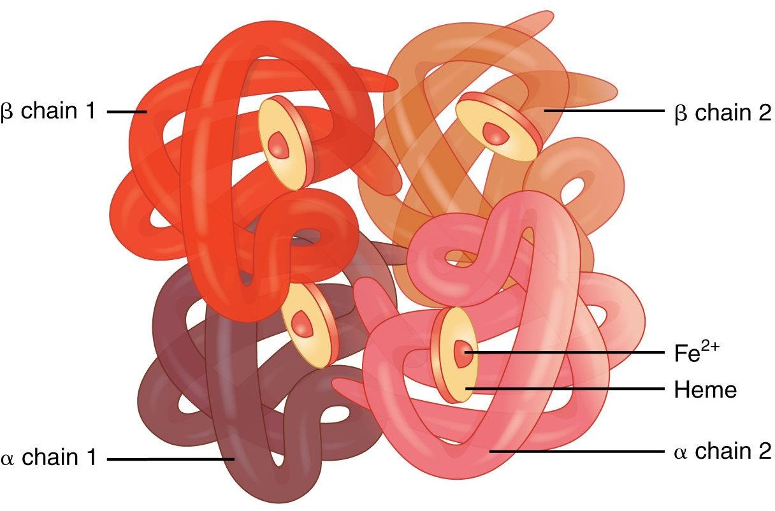
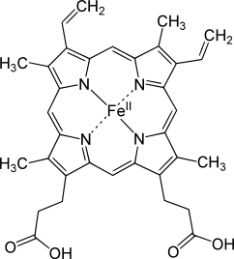
Hemoglobin
Structure:
  Adult haemoglobin is comprised of α and β globin subunits
  Fetal haemoglobin consists of α and γ globin subunits
    higher affinity to oxygen than in adult hemoglobin
  A heme group contains an iron ion (Fe²⁺) which is the site of oxygen binding
Hemoglobin concentration (HGB)
  Men: 140-180 g/l
  Women: 120-160 g/l
  Newborns: 160-240 g/l
Spectrophotometric determination of HGB
  An addition of the transformation solution to the blood causes the lysis of erythrocytes and the release of haemoglobin and its transforms into cyanohaemoglobin. Measurement of light absorption follows.

Slide 11
Hemoglobin – derivates
Oxyhemoglobin – hemoglobin + O₂
  Bright red color
Carboxyhemoglobin – hemoglobin + CO
  cherry red color, CO saturation higher than 50% results in a loss of consciousness
Carbaminohemoglobin – hemoglobin + CO₂
  dark red color, CO₂ binds to an amino group at the N end of the protein chain. The CO₂ concentration in inhaled air higher than 5% may lead to an impaired consciousness because of the disrupted binding of O₂ to hemoglobin
Methemoglobin = hemiglobin with oxidized Fe (Fe³⁺)
  dark "chocolate" brown, it does not bind O2, 1-3% levels are normal, 70% levels are fatal
Glycated hemoglobin
  a molecule of glucose binds to the protein chain – it reflects long-term blood sugar levels (glycemia). Normal levels are up to 4 mmol/l, increased levels are in uncompensated diabetes

Slide 12
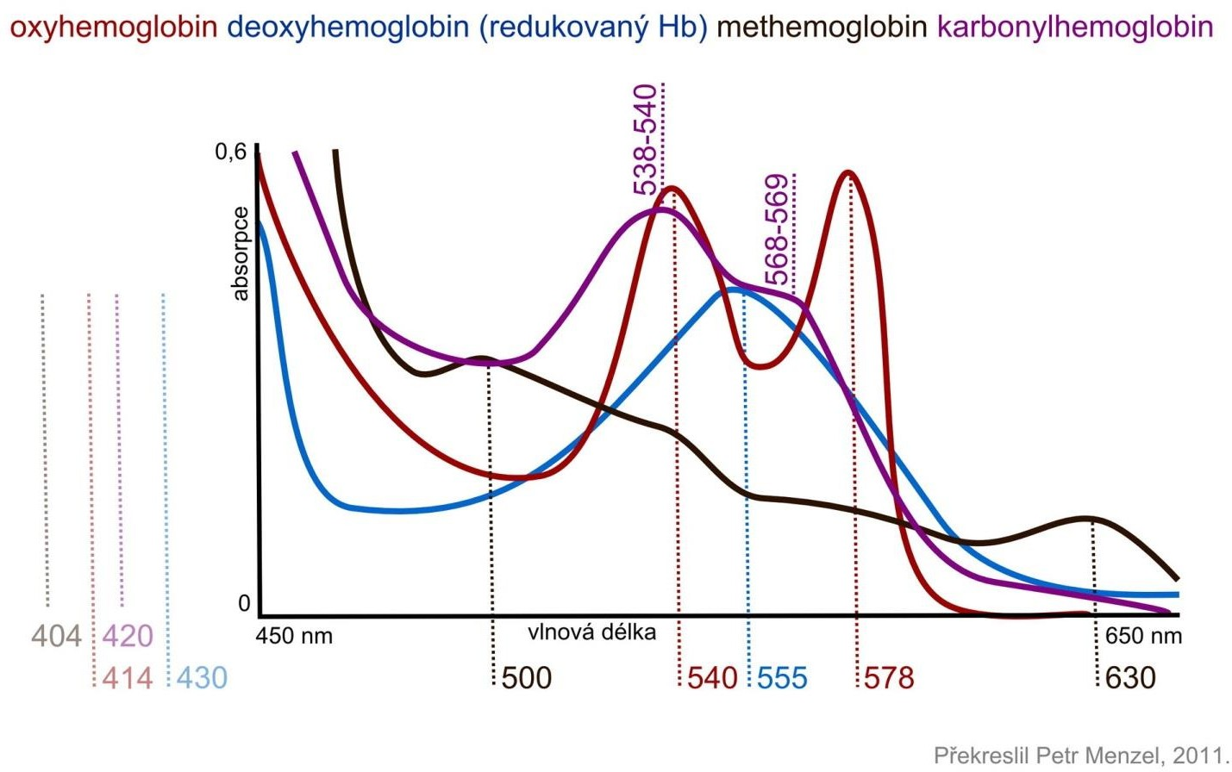

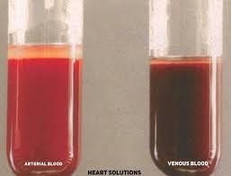

Oxy and deoxyhemoglobin
Absorption spectra of hemoglobin derivates
arterial oxygenated blood
venous deoxygenated blood
oxyhemoglobin
deoxyhemoglobin
(without oxygen)
methemoglobin
carbonylhemoglobin
Spectra of oxyhemoglobin and carboxyhemoglobin are similar at the wavelength that evaluates the saturation of hemoglobin with oxygen → hypoxia caused by CO poisoning cannot be detected this way unless the sensor is specialized for it

Slide 13
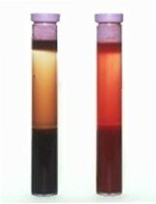
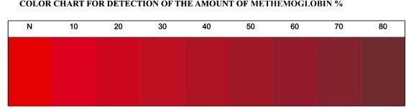
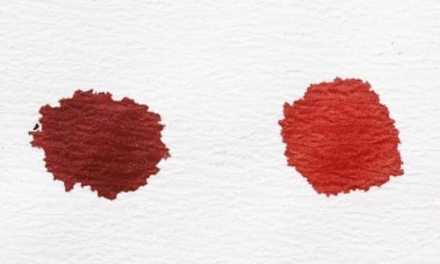
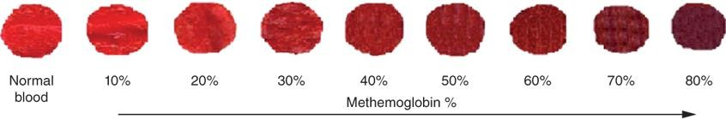
Hemoglobin derivates – methemoglobin
Higher methemoglobin concentration leads to the darker coloration of the arterial blood
High metHb concentration in blood
Normal blood
Color spectrum for evaluation of metHb concentration
Oxygenated blood is used for the evaluation

Slide 14
Hemoglobin derivates – methemoglobin
Formation of metHb – nitrite reacts with the blood to create metHb
A blood enzyme named methemoglobin-reductase reduces Fe⁺³ back to Fe²⁺
  Furthermore, non-enzymatic reduction via vitamin C is possible
Infants have insufficiently developed reduction mechanisms
  (+ fetal hemoglobin is easily oxidized)
  → it is necessary to reduce intake of nitrites in the infant diet (use of infant water)
Methemoglobinemia – congenital or acquired causes
  Congenital – impaired synthesis of enzymes
  Gained – increased intake of nitrates and nitrites
  (fertilizers), poisoning (nitrobenzene, aniline), drugs
  (benzocaine, also phenacetin, sulfonamides)
  Therapy – administration of reducing agents such as
  methylene blue or ascorbic acid
MetHb values | Symptoms
0–2% | normal values
<10% | cyanosis
<35% | cyanosis a others (headache, dyspnoea)
>70% | fatal

Slide 15
Calculated parameters of RBCs
The average volume of one RBC (MCV, mean corpuscular volume)
  MCV = HCT/RBC (hematocrit/red blood count) = 80-95 fL
The average weight of Hb in one RBC (MCH, mean corpuscular hemoglobin)
  MCH = HGB/RBC (hemoglobin/red blood count) = 28-32 pg
The average concentration of Hb in one RBC (MCHC, mean corpuscular hemoglobin concentration)
  MCHC = HGB/HCT (hemoglobin/hematocrit) = 310-360 g/L
Red cell distribution width (RDW) = 11,5-14,5%
  Variation of RBCs size
  ↑RDW – anisocytosis

Slide 16
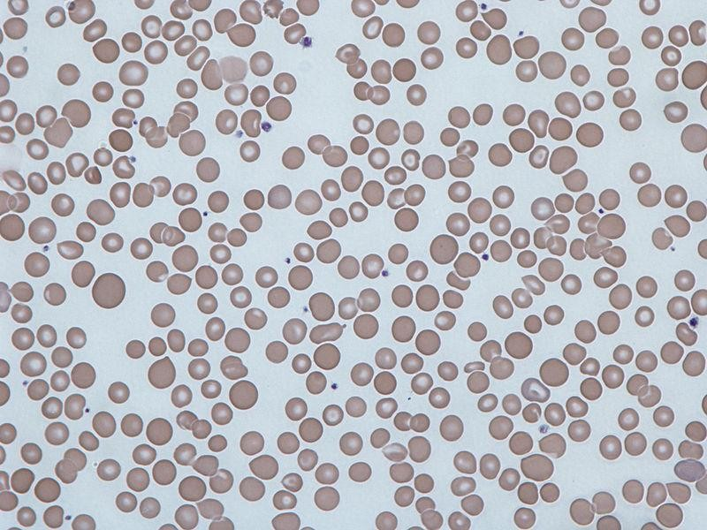
Anisocytosis: varying size of RBCs
Mild anisocytosis is physiological

Slide 17
Calculated parameters of RBCs
HCT
↑MCV → macrocytosis
↓MCV → microcytosis
hematocrit
men: 42-52%
women: 37-47%
MCV = HCT/RBC
MCHC = HGB/HCT
RBC volume
80-90 fL
Hb in RBC
310-360 g/L
number of RBCs
men: 4.3-5.3 * 10¹²/L
women: 3.8-4.8 * 10¹²/L
RBC
HGB
hemoglobin concentration
men: 140-180 g/L
women: 120-160 g/L
MCH = HGB/RBC
Hb concentration in RBC
28-32 pg/RBC
↑MCH → hyperchromic RBC
↓MCH → hypochromic RBC

Slide 18
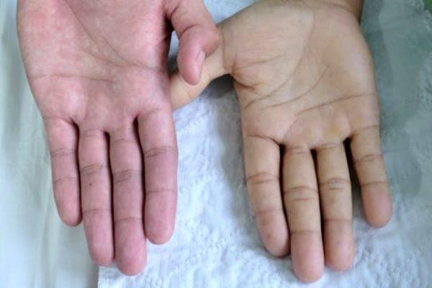
Anemia
= Decreased concentration of functional Hb in the blood
  A small number of RBCs or low hematocrit or unfunctional Hb
  Impaired RBC production (proliferation or differentiation), increased RBC destruction or blood loss
  RBCs are one of the fastest proliferating cells within the body thus early signs of malnutrition may be seen in RBC count
  Anemia has various causes (congenital or acquired)
Symptoms (anemic syndrome)
  Tissue hypoxia: pale skin and mucose membranes
  (best seen in the conjunctiva), fatigue, weakness
  Tachycardia
  Dyspnoea in mild physical activity

Slide 19
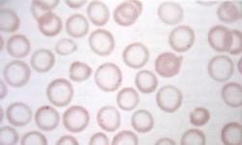
Sideropenic anemia
Cause: deficiency of Fe²⁺ → decreased production of hemoglobin → hypoxia stimulates releasing of erythropoietin → increased production of RBCs with insufficient Hb levels
Microcytic hypochromic anemia
  ↓MCV and ↓MCH, RBC count increased or unchanged
RBCs are small and pale with Hb only peripherally

Slide 20
Megaloblastic anemia
Megaloblasts (oversized immature RBCs) in the bone marrow and a reduced number of reticulocytes in the peripheral blood
Macrocytic hyperchromic anemia (↑MCV, ↑MCH, ↓RBC)
  A small number of large erythrocytes with an increased hemoglobin content
  It occurs due to a lack of vitamins B12 and folic acid which are important for the methylation of uracil to thymine
  ↓ B12 and folic acid → ↓DNA formation, while RNA and protein synthesis is intact
  B12 supply - years; folic acid – months → manifestations of hypovitaminosis occur with time delay
Pernicious anemia – the most common type of megaloblastic anemia
  Autoimmune disease interfering with B12 absorption
  Autoimmunely damaged parietal cells of the gastric mucosa do not form intrinsic factor, which is necessary for the absorption of B12 (a disorder of factor formation can also
  be due to gastric surgery)

Slide 21
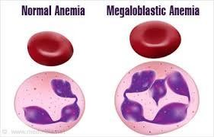
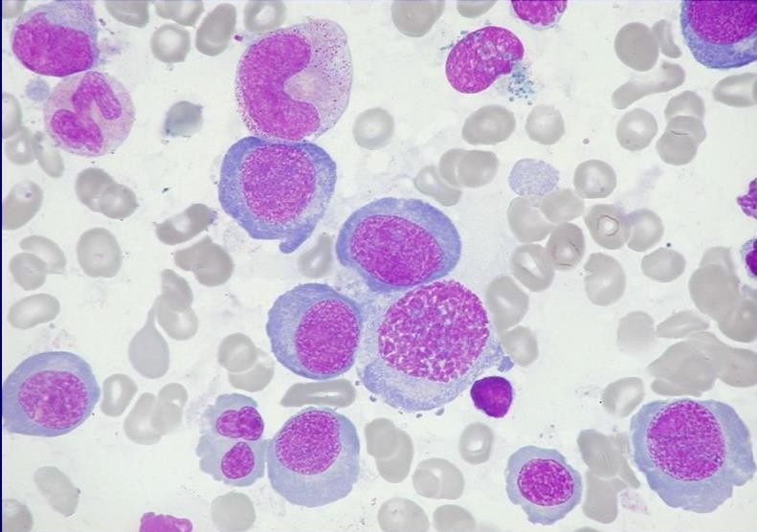
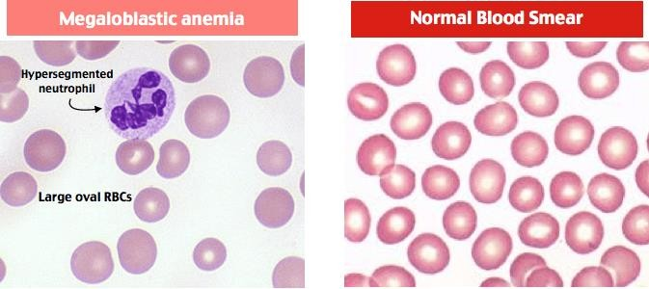
Megaloblastic anemia
Normal blood
Megaloblastic anemia
RBC
neutrophil
Megaloblastic anemia
Norrmal blood smear
megaloblast
RBCs are larger, hyperchromic, their centre is less pale than in normal RBCs
decreased RBC count (+presence of hypersegmented neutrophils)

Slide 22
Blood groups (types)

Slide 23
Antigens and antibodies in blood groups
Blood groups are determined by antigens on the RBC membrane
  These blood traits are inherited and remain unchanged throughout life
A light introduction to the general principles of immunization
  An antigen is a "recognition mark" by which the immune system determines whether it is a body’s cell or a foreign one
  When the immune system first encounters a foreign erythrocyte in the blood, it begins to produce antibodies against the foreign antigens on the erythrocyte (but not against those antigens that are the same as on the body’s erythrocytes). It remembers the foreign antigen and creates antibodies faster the next time it encounters it.
  If there are antibodies against a certain blood type in the blood, the erythrocyte of this blood type triggers an immune reaction → destruction of the foreign blood cell (hemolysis)

Slide 24
Antigens and antibodies in blood types
The most important blood groups are AB0 and Rh
  Antibodies against AB0 antigens are in the blood from the first months of life
  Antibodies against Rh factor and other blood types form only after immunization with incompatible blood – unwanted immune response during repeated transfusions of not fully compatible blood
  There are dozens of other systems that need to be considered from an immunological point of view (MNS, Kell, Lewis, Kidd systems, ...)

Slide 25










AB0 system
agglutinin
agglutinogen
Antigens on the surface of RBCs (agglutinogens): A, B
Antibodies in the blood (agglutinins): anti-A, anti-B (IgM)
  They do not cross the placenta
Agglutination (clumping):
  anti-A reacts with A, anti-B reacts with B
  RBCs are connected by agglutinogens – clumps are formed
  An immune response is triggered (complement activation) that destroys foreign erythrocytes via hemolysis
  Immunization against A and B happens during the first months of life (these antigens are also in the diet) – agglutinins are then in the blood for the rest of the life
  When incompatible blood is administered - strong activation of the immune system occurs, leading to hemolysis, anemia, hemoglobinuria (hemoglobin in the urine), kidney failure, ... death

Slide 26
























AB0 system
Blood groups | Group A | Group B | Group AB | Group 0
Prevalence in CZ | 41% | 18% | 9% | 32%
RBCs
Antigens on RBCs | A | B | A a B | none
Antibodies in the blood | anti-B | anti-A | none | anti-A + anti-B

Slide 27
Rh factor
Antigens D, d (also C,c, E, e, which are weaker) are only on RBCs
  The strongest one is an antigen D – if present → Rh+ blood group
  In recessive homozygotes (dd) → blood group Rh- (17% in Europe, <1% elsewhere)
in Rh- blood, antibodies (anti-D, IgG) develop only after immunization (Rh- blood must meet Rh+ blood)
  The first reaction is weaker, the next encounter with Rh+ blood will trigger a stronger immune response → hemolysis

Slide 28
Rh factor
Causes of immunization:
  Transfusion of incompatible blood – Rh- recipient receives Rh+ blood
  Childbirth (miscarriage, abortion, bleeding from the placenta, invasive procedures) where the mother is Rh- and the fetus is Rh+
  Immunization will manifest only during further pregnancies of this combination – IgG antibodies pass through the placenta and attack fetal RBCs → blood hemolysis → anemia → increased hematopoiesis → fetal erythroblastosis (more erythroblasts – immature RBCs), unconjugated hyperbilirubinemia (icterus), anemia, hydrops (tissue swelling due to hypoxia), death
  Prevention – administration of anti-D after delivery (or other events) will eliminate Rh- RBCs before the mother's immune systém notices them

Slide 29

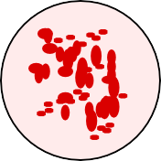
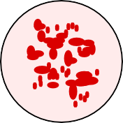
Estimation of blood groups by slide method
Drop anti-A, anti-B and a combination of anti-A and anti-B antibodies onto the glass slide
  Or blood group sera A (contains anti-B), B (anti-A) and 0 (anti-A, anti-B) are used – serum is blood plasma without coagulation factors, it contains the relevant agglutinins
Mix the antibodies with a drop of blood (sera must not mix)
A positive result occurs in serum with agglutination (clumping)
anti-A anti-B anti-AB
-
+
+

Slide 30

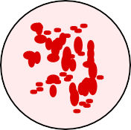
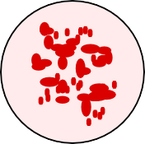

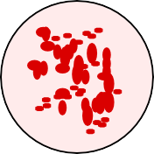

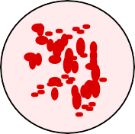





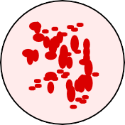

Fill correct blood groups to results
anti-A anti-B anti-AB
anti-A anti-B anti-AB
1
3
anti-A
anti-B
anti-AB
anti-A
anti-B
anti-AB
2
4
anti-A
anti-B
anti-AB
5

Slide 31
Correct results
anti-A anti-B anti-AB
anti-A
anti-B
anti-AB
B
AB
anti-A
anti-B
anti-AB
anti-A
anti-B
anti-AB
A
0
anti-A
anti-B
anti-AB
wrong sera

