Slide 1
XXXI. Skin sensation and general physiology of the skin
XXXII. Cutaneous sensory organs
Physiology - practice
Dep. of Physiology, Fac. of Medicine, MU, 2016 © Ksenia Budinskaya

Slide 2
Skin performs the following functions
protection:
  physical: mechanical protection (elasticity and strength of fibres, subcutaneous fat); protection against UV radiation (melanin)
  biological: keratinization and flaking epithelium, secretion of the sebaceous and sweat glands
  chemical: pH
sensation: warm, cold, pressure or pain
thermoregulation: skin helps to maintain a constant body temperature through the skin blood vessels and sweat glands
secretion:
  sebaceous glands (exocrine – secretion of sebum which is antibacterial and lubricates the skin)
  sweat glands

Slide 3
Skin performs the following functions
resorption: compound dissolved in fat or fat solvents (e.g. different drugs in the form of ointments)
immunity:
  nonspecific barrier (biological, chemical, physical)
  specific barriers (cellular components, skin-associated lymphoid tissue, humoral)
storage: blood, fat, vitamins

Slide 4
Test of acidity of the skin
There is a hydrolipid layer on the surface of the skin. It consists of products of sebaceous glands, sweat glands and the cells of the skin stratum corneum. Intact skin sheath protects the skin from excessive dehydration, negative effects of external factors and proliferating germs. Dermal sheath reacts usually weakly acidic, which prevents the propagation of germs. The acid value is expressed with 4,5-5,5 pH.
Test of acidity of the skin:
  it is the examination of the skin resistance to alkaline substances
  monitored for how long the skin will be irritated
  the longer the time of irritation is, the better the resistance of the skin

Slide 5
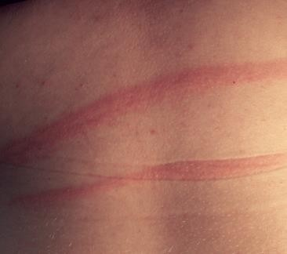

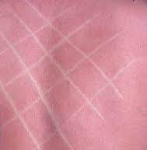
Test of dermografism
Dermographism is a vascular reaction of the skin occurring in response to mechanical stimuli. There is:
  Red (dermographismus ruber) or dilatator dermographism is a normal skin reaction to the irritation. Amplified red dermographism is a manifestation of increased parasympathetic activity.
  White (dermographismus albus) or constrictor dermographism is an abnormal skin reaction to the irritation. Amplified white dermographism is a manifestation of increased sympathetic activity.
  Raised dermographism (dermographismus oedematosus) regularly occurs in a contact urticaria. Due to the reactivity of the skin blood vessels, it is also called transudative. At the point of skin compression, a slight rise also appears.
dermographismus ruber
dermographismus oedematosus
dermographismus albus

Slide 6
Test of Minor
Sweat glands
  Sweat glands are used to regulate temperature and remove waste by sweat containing mainly water (98.5-99.0%), NaCl (0.6%) and various organic substances (urea, fatty acids or amino acids) onto the skin surface. The amount of produced sweat differs according to the temperature of the environment and the level of body activity between 0.5 to 10.0 L in 24 hours.
  The number of active sweat glands varies greatly among different people, though comparisons between different areas (the palm has around 370 sweat glands per cm2; the back of the hand has 200 per cm2; the forehead has 175 per cm2; the breast, abdomen, and forearm have 155 per cm2; and the back and legs have 60–80 per cm2).
The test of reactivity of sweat glands

Slide 7
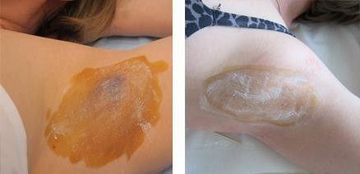
Test of Minor
The test of reactivity of sweat glands
* removal of excessive sweating witg botulotoxin or laser
Before a procedure: active sweat glands
After a procedure: inactive sweat glands*

Slide 8
Warm and cold spots (peripheral thermoreceptors)
Capsulated nerve endings of sensory neurons in the skin (Krause corpuscles and Ruffini bodies)
Temperature sensing is based on the expression of cationic channels from TRP family (TRP = transient receptor potential); their conductivity is temperature-dependent
Thermoreceptors sensing cold (cold spots) express channels TRPA1 and TRPM8 and are sensitive to temperatures between 0°C and 40°C
Thermoreceptors sensing warm (warm spots) express channels TRPV1-V4 and are sensitive to temperatures between 30°C and 50°C
Skin thermoreceptors are distributed unevenly: more thermoreceptors on the skin of the face, lips and fingertips; less on the skin of the trunk and proximal parts of limbs
Cold spots are more numerous than warm spots (mean ratio approx. 4:1)

Slide 9
Warm and cold spots (perception of temperature)
Based on the location, peripheral (skin) thermoreceptors respond to changes in ambient temperature
Both warm and cold thermoreceptors can respond by phasic (dynamic) and/or tonic (static) response
A signal is transmitted (1) via thalamus to the somatosensory cortex and (2) via pons to hypothalamus (thermoregulation)
Extreme temperatures are sensed as pain (via nociceptors)
40
30
warm
pain
Action potential frequnecy [1/s]
Adopted from:
Boron and Boulpaep, Medical Physiology
Guyton and Hall, Textbook of Medical Physiology
20
cold
10
pain
0
0
5
10
15
20
25
30
35
40
45
50
55
Skin temperature [°C]

Slide 10
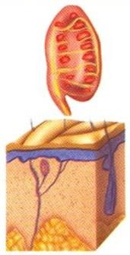
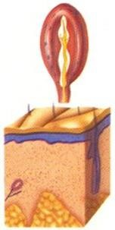
Tactile and pain spots
Meissner's corpuscle: it is a highly adaptive mechanoreceptor, especially for touch on the fingers and lips. It is made by an encapsulated nerve ending of one myelinated nerve fibre. The receptor is triggered by the deformation of its capsule and following stimulation of the nerve fibre. It is a special pressure-sensitive sensory end organ involved in the recognition of light and superficial vibrations. It plays an important part in a sense of touch, particularly in fast and light contact or in contact with a mobile surface.
Lamellar corpuscles, or Pacinian corpuscles: the lamellar corpuscle is approximately oval-cylindrical-shaped and 1-2 mm in length. The lamellae are very thin, flat, epithelial cells inside the capsule and modified Schwann cells inside the inner core of the corpuscle. They are characterized by the ability to almost immediate adaptation, so they can be stimulated by only a very rapidly changing mechanical stimulus (e.g. compression). Their main importance lies in the registration of higher frequency vibrations.

Slide 11
Tactile and pain spots
Merkel cells are epidermal cells located on the whole surface of the skin. In hairless regions of skin, they are nearby to Meissner‘s corpuscles but they differ in a level of sensitivity to stimuli, Merkel cells are less sensitive than Meissner‘s corpuscles. At first, they generate a strong signal but it gradually weakens till reaching a stable level of signal. Their main function is to register continuing contact with a surface.
Pain is a physiological perception serving as a protective mechanism, its task is to prevent further tissue damage. There are two types of pain:
  Fast pain develops for tenths of a second. It is also known as a sharp pain. This term most often arises during a mechanical skin injury like stings or cuts. It originates only in superficial tissues.
  Slow pain starts after a few seconds of causing a painful stimulus. The intensity of pain slowly develops and increases. The cause can be in deep or superficial tissues.

Slide 12
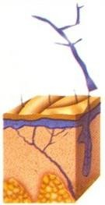
Tactile and pain spots
Pain receptors or nociceptors are free nerve endings stratified throughout the body - in the skin, in the periosteum, in the walls of large arteries, in joints etc. Nociceptors react to stimuli, which can be divided into three types: mechanical, chemical and thermal. All three types can induce slow pain, but only mechanical and thermal types cause fast pain.
  Unlike any other receptors, they are non-adaptive which ensures that the pain is registered at all times. On the other hand that leads to lower quality of life in patients with chronic pain. Sensitivity of nociceptors under certain conditions increases and as well as the sensation of pain. This sensitivity increase is called hyperalgesia.

Slide 13
Simultaneous spatial discrimination
Sensitivity to a particular initiative is not the same everywhere on the body. Reception areas may overlap and in these parts the sensitivity is higher. Also, the receptor density in different parts of the body is different. The tongue and fingertips on the hand have more touch receptors than the skin on the back (two pointed objects with 1 mm distance between each other are distinguished as two in the tongue, on the back this distance had to be around 50 mm to distinguish them). The number of receptors for each sensation is not the same.
Determining spatial threshold:
  simultaneous spatial threshold (the esteziometr is attached simultaneously)
  successively threshold (the esteziometr is attached successively)
Assessment: The patient is asked to report whether one or two points were felt. The smallest distance between two points that still results in the perception of two distinct stimuli is recorded as the patient's two-point threshold. Performance on the two extremities can be compared for discrepancies. This threshold varies throughout the body.

