Slide 1
XLIII. Electroencephalography XLIV. Evoked potentials XXXIII. Estimation of visual acuity
Physiology I – practice
Autumn, week 10-12
© Kateřina Fialová

Slide 2
Electroencephalography (EEG)
Method used for the registration of electrical potentials of the brain
Hans Berger (1929)
Scalp EEG
Electrocorticogram (ECoG)
Stereoelectroencephalogram (SEEG)
Macro EEG
Micro EEG

Slide 3
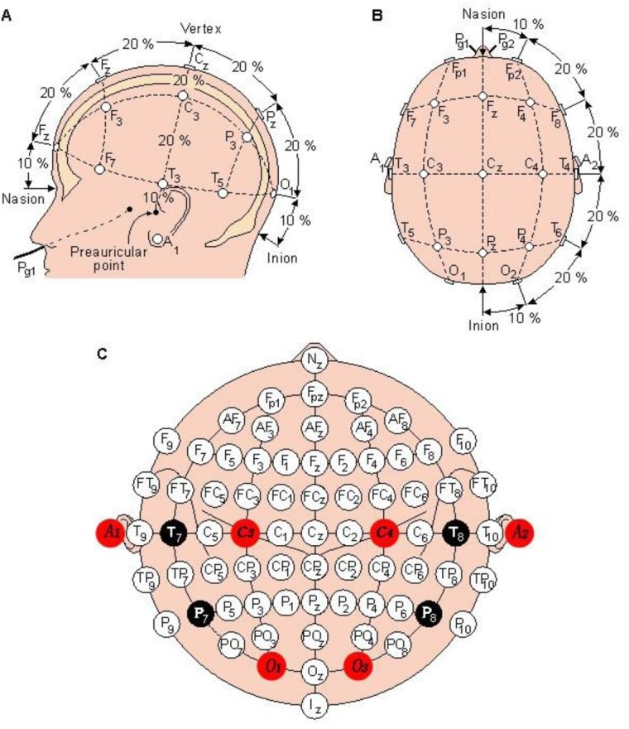
Electroencephalography
Placement of electrodes: system 10-20

Slide 4
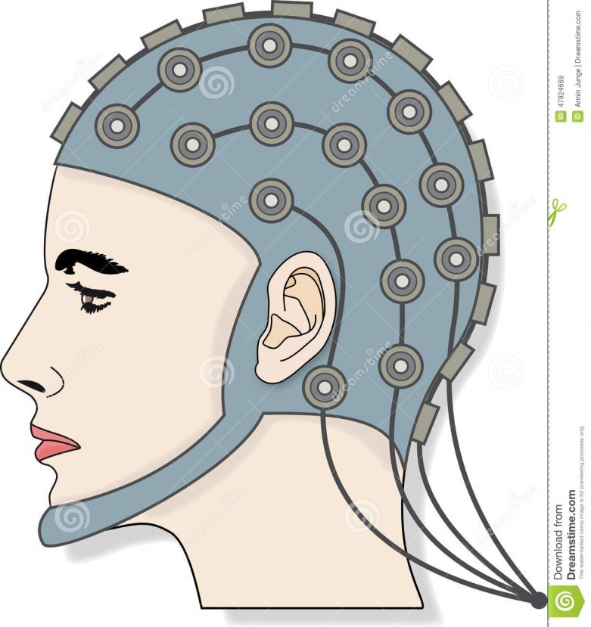
Electroencephalography
www.dreamstime.com
Attachment of electrodes during scalp EEG

Slide 5
Electroencephalography
Alpha rhythm
Frequency 8-13 Hz, noticeable with eyes closed, in the awake, healthy and mature brain, especially in parietooccipital lobes
Beta rhythm
Frequency 14-30 Hz, noticeable with open eyes, sometimes constantly over the frontal area. The phenomenon of suppression of the alpha rhythm by opening eyes – alpha attenuation reaction (AAR).
Theta rhythm
Frequency 4-7 Hz, noticeable in children, in healthy adults only during shallow sleep stages
Delta rhythm
Frequency 1-3 Hz, in neonates and infants, in healthy adults only during deep non-REM sleep

Slide 6
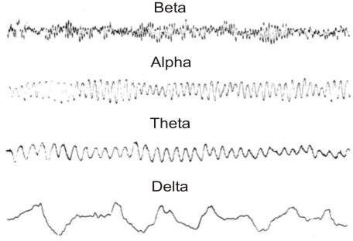
EEG waves

Slide 7
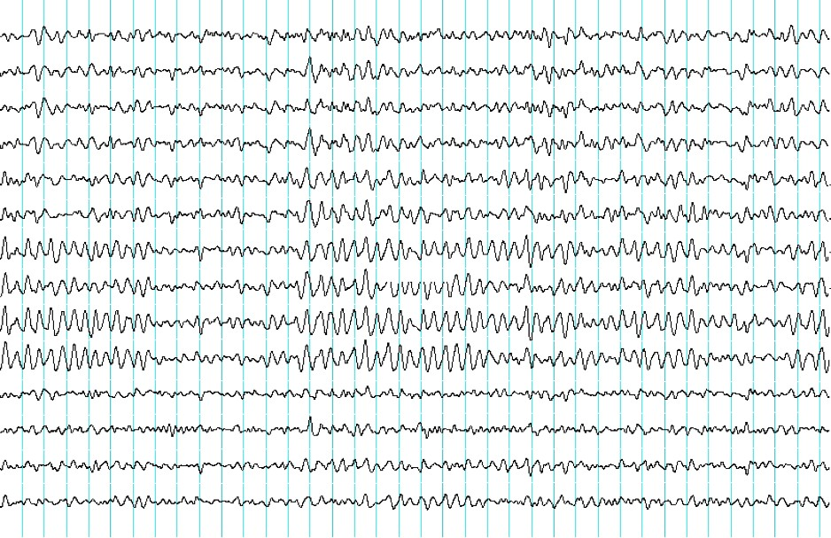
EEG record - example

Slide 8
Evoked potentials (EP)
Electrical manifestation of brain activity triggered by external sensory stimulus
Evaluation of the functional state of the nerve pathway
Types of EP:
VEP (visual)
AEP (auditory)
SEP (somatosensoric)
MEP (motoric)
SSEP (stable)
ERP (cognitive)

Slide 9
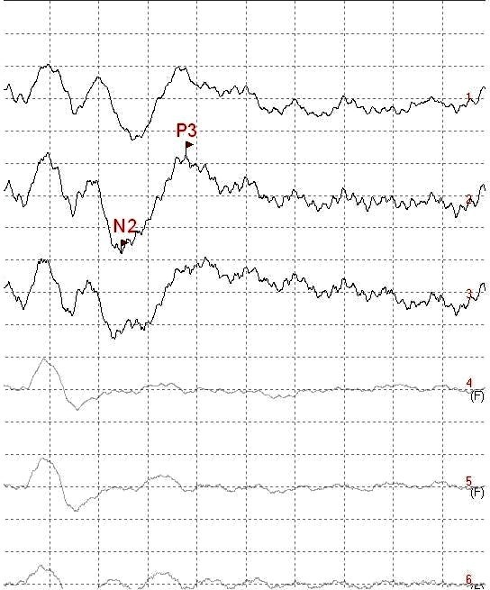
Evoked potentials
Wave p300 (mean latency 300 ms)

Slide 10
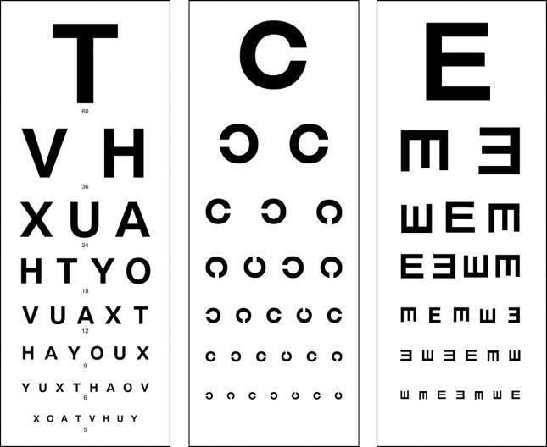
Visual acuity examination – optotypes
Snellen
Landolt
Pflüger

Slide 11
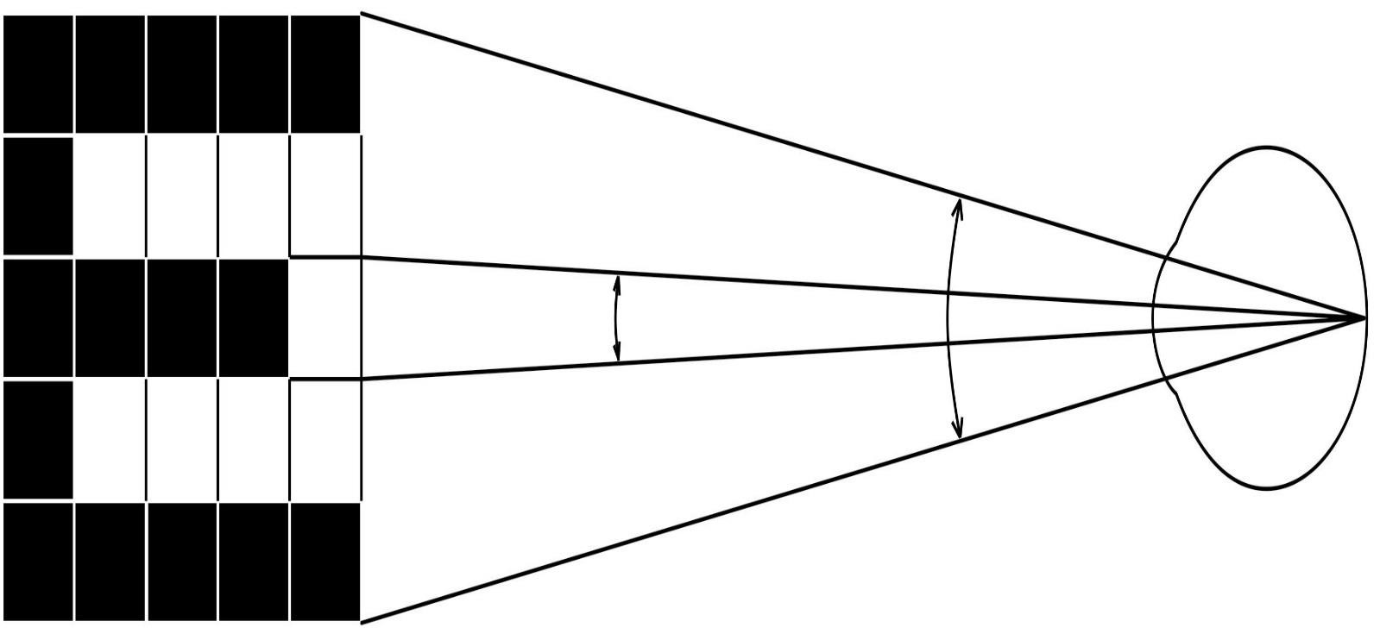
Visual acuity examination – optotypes
Physiological background:
the eye can distinguish 2 points as 2 points when the light rays from these two points fall on the retina at an angle of 1 arc minute
5´
₁1´´
Examination:
Each row of optotypes has a number on the side that expresses the distance from which the rays from 2 points (for their differentiation and correct reading of the sign) fall on the retina at an angle of 1 arc minute
The most frequently used distance is 5 m
The result of the examination:
Visus – we write it as a fraction: the numerator is the distance from which we are examining, the denominator is the number of the line read without error
for the right eye ….V_{OD} = 5/5 …….. healthy eye, good visual acuity
for the left eye…… V_{OS} = 5/10 …. an eye with impaired visual acuity

