Slide 1
Vaccinations
Department of Children’s Infectious Diseases
MUDr. Martin Sihlovec

Slide 2
Vaccine types
Live weakened = attenuated vaccines
  TBC, Polio (Sabin oral), yellow fever)
Inactivated vaccines
  Hepatitis A, KME
Toxoid vaccines
  Tetanus, diphtheria, meningococcal diseases, pneumococcal diseases, haemophilus
Subunit and conjugate
  Flu, meningococcal diseases
Recombinant
  HPV, Hepatitis B
mRNA
  SARS-CoV-2
Advantages | Disadvantages | Application schedule
Polyvalent x Combined vaccines (Prevenar 13 x Hexacima)

Slide 3
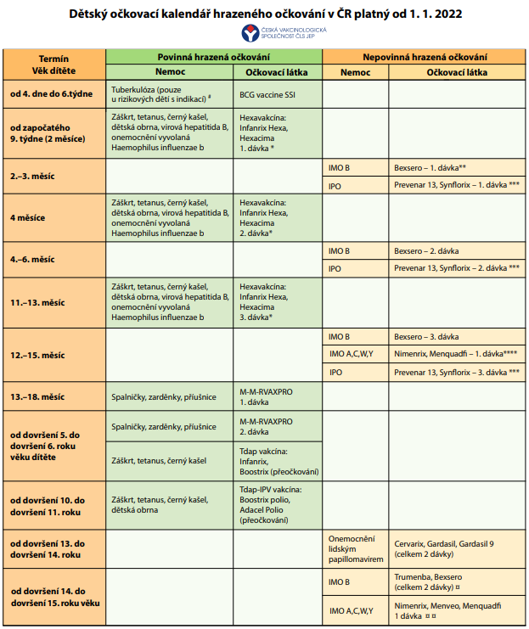
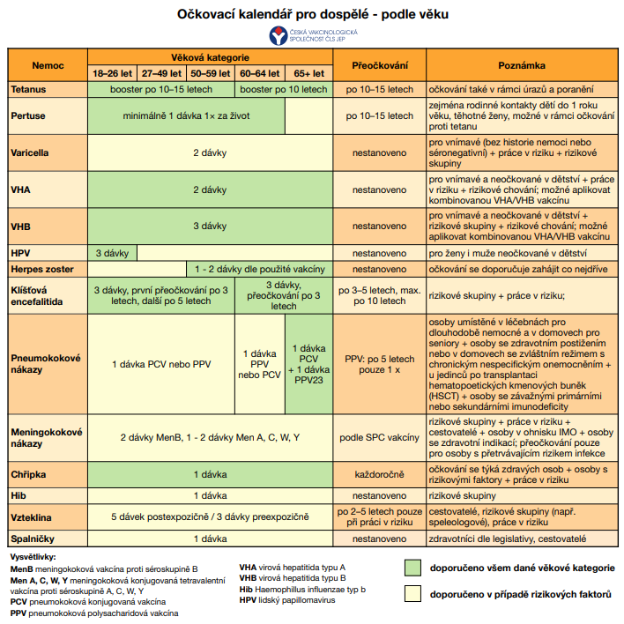
Vaccination schedule valid in CZ from 1 Jan 2022

Slide 4
Hexa vaccine = DTaP+VHB+HIB+IPV
(2+1)
Tetanus – injury by a sharp object, dirty injuries of unvaccinated individuals, abdominal operations
Diphtheria
Pertussis – pregnancy from od 26 wks to 36 wks
Hepatitis B (in CZ, vaccinations started in 7/2001) – injury by a sharp object, rape
H. influenzae type B
Poliomyelitis (inactivated)
Vaccination from 9 wks of age, max. application by 7 years of age.
We can also vaccinate with split vaccination substances in the same schedule

Slide 5
M - M - R vaccine (1 + 1)
Measles
Mumps
Rubella
We start the vaccination from 13 months of age up to 1.5 years of age. The second dose is administered between year 5 and 6 of life
live attenuated vaccine, application s.c., i.m.

Slide 6
Optional vaccinations for children
Meningococcal disease (MEN ACWY, MEN B)
Pneumococcal disease (Synflorix, Prevenar 13, Vaxneuvance, Prevenar 20?)
Varicella
Rotavirus infections
TBC
Flu
Tick-borne encephalitis
HPV
VHA
RSV (passively)

Slide 7
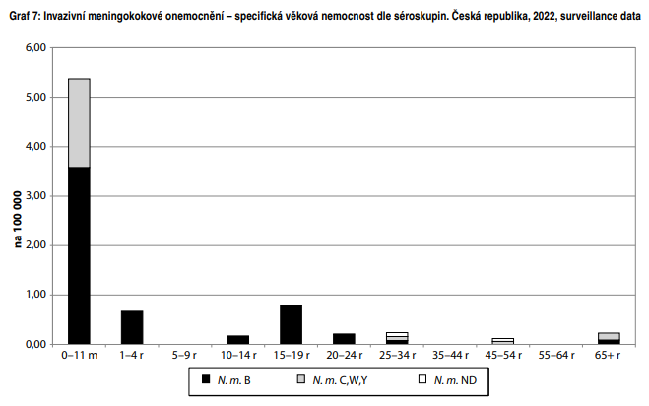
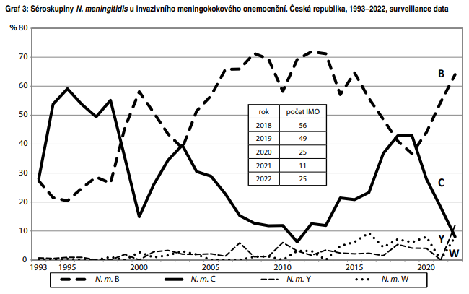
Meningococcal disease
Goal: to prevent IMO = invasive meningococcal disease (purul. meningitis, sepsis or both
Application i.m., s.c.
MEN B vaccines – Trumenba for children from 10 years of age
- Bexsero from infant age, from 2 months
MEN ACWY vaccines – Nimenrix, MenQuadfi, Menveo
Protection for ca 10 years

Slide 8
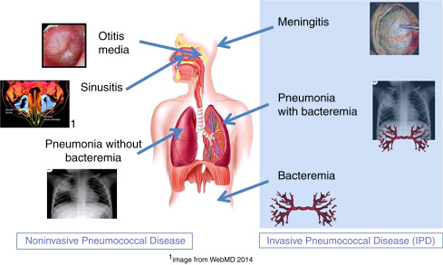
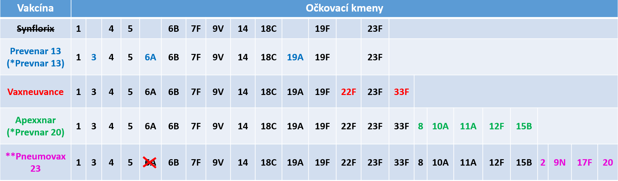
Pneumococcal disease
IPO – Invasive pneumococcal disease
= a sever disease with a laboratory proof of pneumococcus from a clinical material,
which is sterile under normal conditions.
Bronchopneumonia with fluidothorax
Purulent meningitis
Sepsis
We can vaccinate from 2 months of age at any time
Application i.m., s.c.
Recommend this vaccination to children suffering from repeated OMA and sinusitis

Slide 9
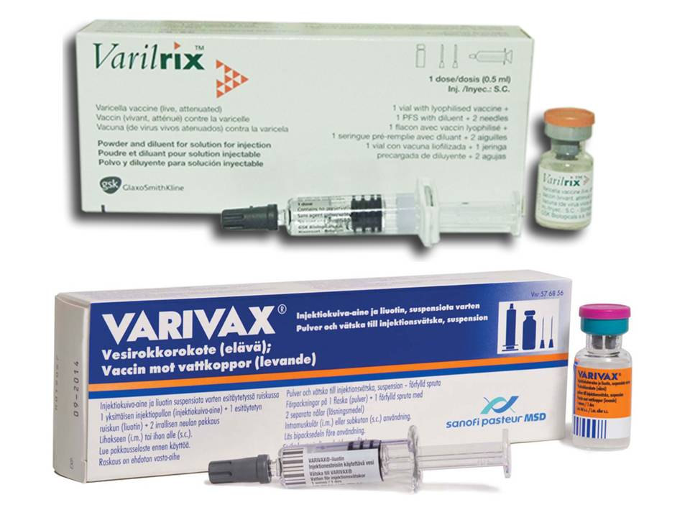
Varicella – Zoster virus
1910 CZK
This vaccine is suitable for all children and adults who
have not had varicella yet (except for pregnant women and
immunocompromised individuals) to prevent severe course of varicella.
Live attenuated vaccine
Application primarily s.c. or i.m.
This vaccine can be used also as a post-exposure prophylaxis ideally within 72 hrs from exposition,
max. 5 days.
We start vaccinating against VZ from 9 months of age at the earliest; mostly at 12 months, in 2 doses 4-8 weeks apart.
1720 CZK

Slide 10
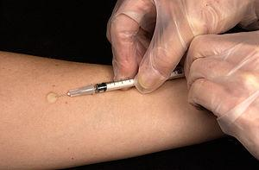
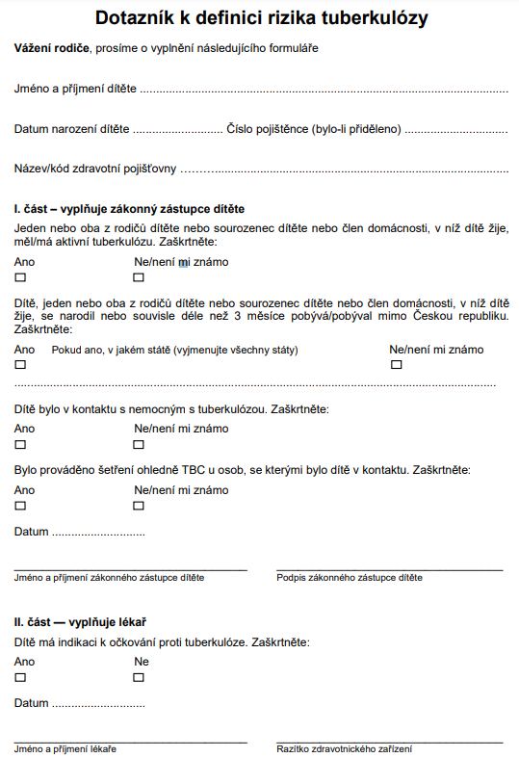
TBC
Only i.d. application
Live attenuated vaccine
This vaccine is applied within the 4th day and the 6th week of age
Only newborns/infants are routinely vaccinated nowadays (from 4th day to completed 6th week of age) to prevent the risk of TBC occurrence.

Slide 11
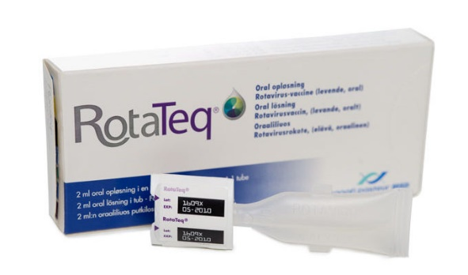
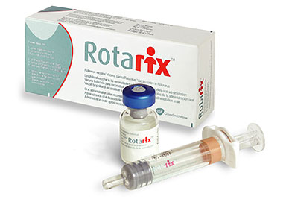
Rotavirus vaccines
1600 CZK
1650 CZK
Both available vaccines are live attenuated vaccines to be taken orally.
Rotateq – from 6 to 32 weeks of age, administered in 3 doses, protection lasts to approx. 7 yes of age, protecting against 5 serotypes
Rotarix - from 6 to 24 weeks of age, administered in 2 dávkách, protection lasts for approx. 3 years, protecting against 1 serotype
CAVE: Risk of intussusception

Slide 12
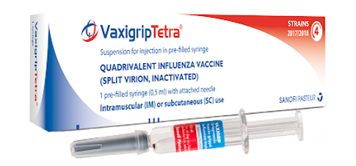
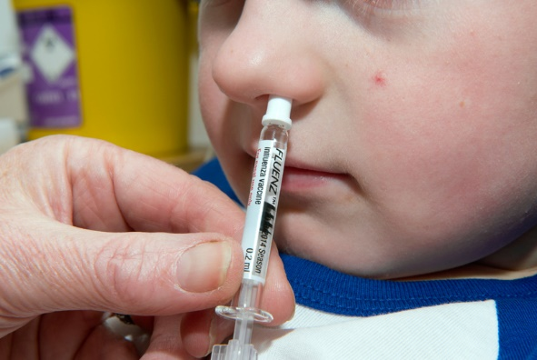
Flu vaccines
A/Victoria/4897/2022 (H1N1)pdm09 – varianta,
A/Darwin/9/2021 (H3N2) – varianta,
B/Austria/1359417/2021 – varianta (patřící do linie B/Victoria/2/87).
B/Phuket/3073/2013 – varianta (patřící do linie B/Yamagata/16/88)
Various application methods by the given vaccine type – s.c., i.m., i.n.
We vaccinate primarily to prevent complications (the vaccine does not prevent infection) and to protect vulnerable population groups - do not be afraid to vaccinate pregnant women!!!
There are live attenuated and also split (subunit) vaccines available
The best vaccination time is before the flu season starts, i.e. October/November
In tropical zones, the flu season is year-round!!! I
n the southern hemisphere, the flu season is during European summer months.
We can vaccinate children from 6 months of age (If the child has never been vaccinated, they have to have the 2nd dose one month apart by the age of 9). From age 9 forward, 1 dose is sufficient for a year of protection.

Slide 13
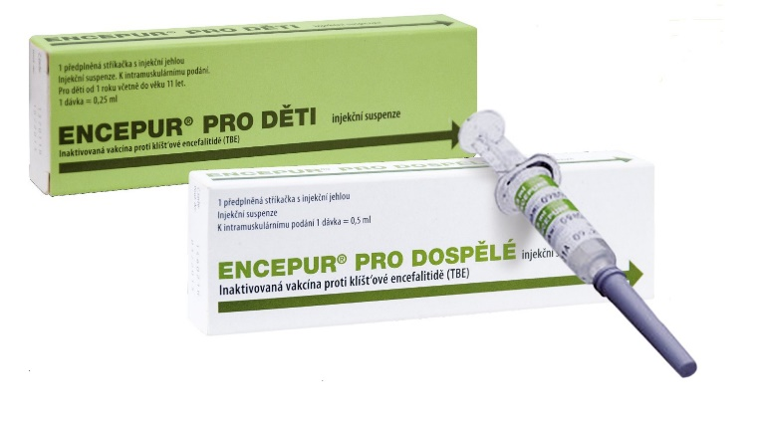
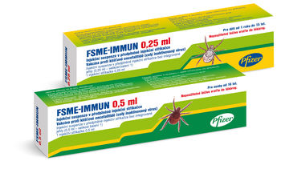
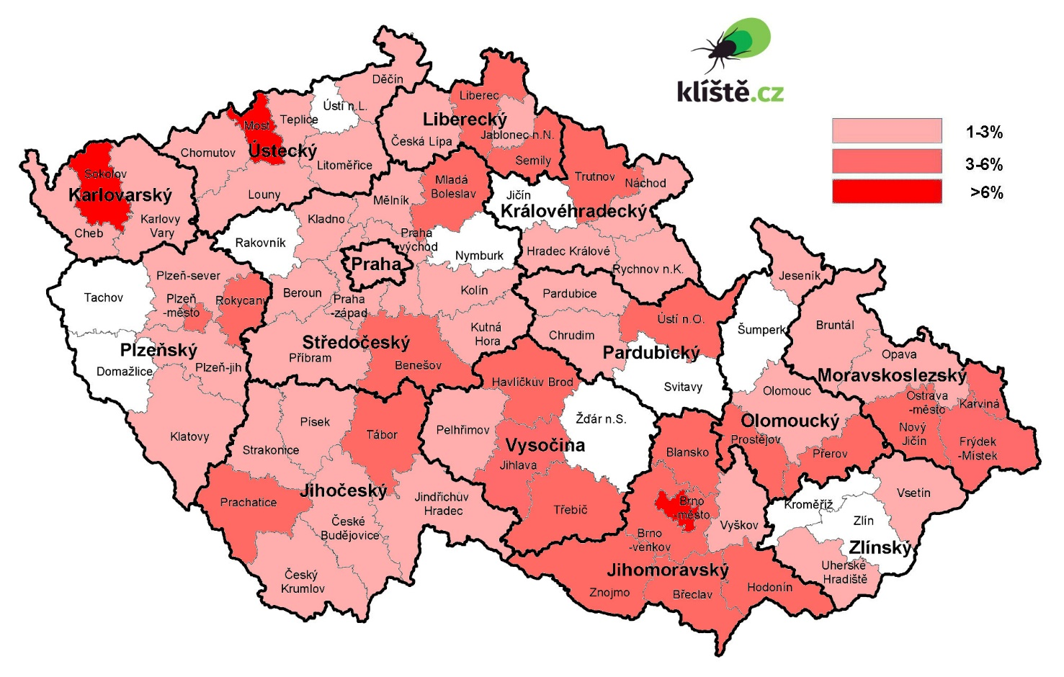
Tick-borne encephalitis
- it is not a virus occurring exclusively in Europe
1090 CZK
Meningoencephalitis, Encephalomyelitis
The best prevention and “treatment” is the vaccination
There are 2 vaccines available – Encepur and FSME-Immun, we can vaccinate from 1 year of age, in 2+1 schedule or in an accelerated schedule 0-7-21, re-vaccination as age appropriate every 3-5 years.
Application i.m., s.c.

Slide 14
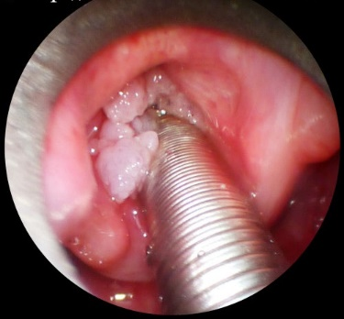

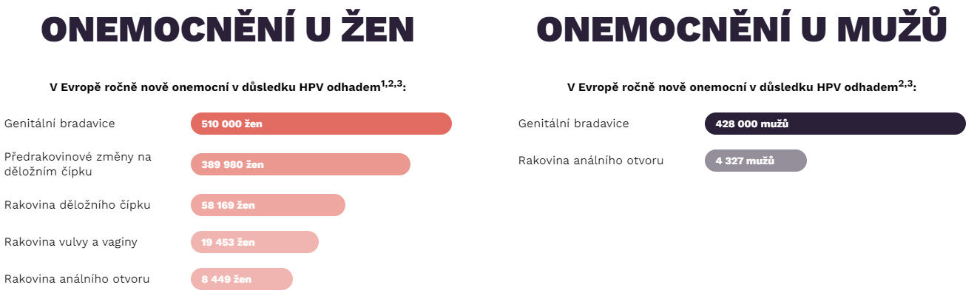
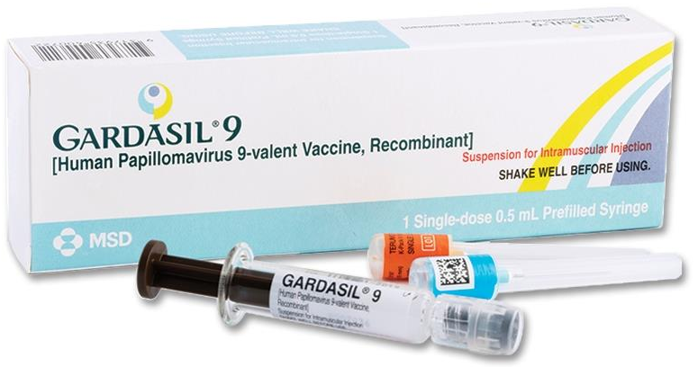
Human papillomaviruses (HPV)
3528 Kč
The vaccine only has preventative effects – genital warts, cervical cancer, cancer of vagina, vulva, anus and penis, cancer in the head and throat (pharynx), larynx papillomatosis. Approx. 80 % of men and women encounter HPV in their life.
The vaccine protects against 2 types causing genital warts (6, 11) and also against 7 high risk types of HPV causing malignant diseases (16, 18, 31, 33, 45, 52, 58).
We can start the vaccination from the 9 year of life, according to SPC up to 45 years of age, but there is no factual age limit.
Application - i.m.

Slide 15
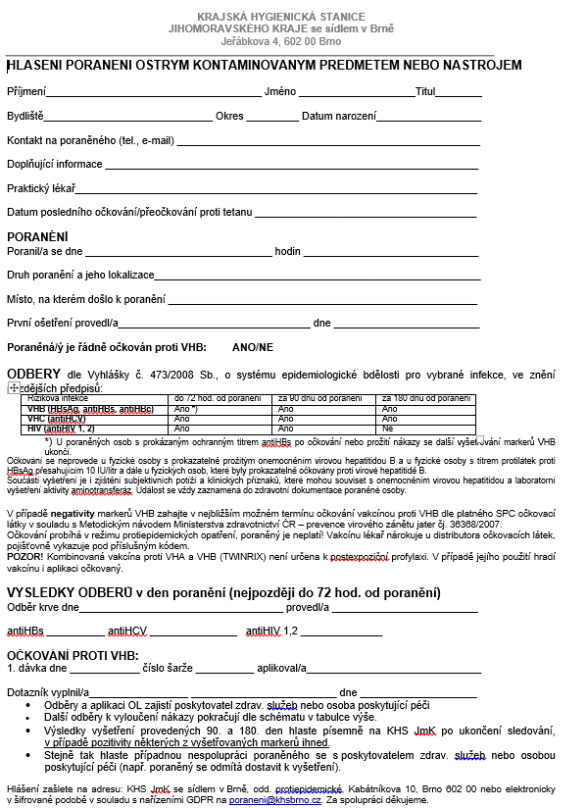
Injury by a sharp or contaminated object
Always check the vaccination log and the last dose of
tetanus vaccination!
Vaccination against:
Hepatitis A
Hepatitis B
Tetanus

Slide 16
Vaccinations for travel
Regular “Routine” vaccinations
(T/Tdap, poliomyelitis, MMR, sezónní chřipka, IPO, MEN
“Required” vaccinations
YF, IMO ACWY, poliomyelitis
“Recommended” vaccinations
Always plan your vaccinations in advance!
Complications from “vaccination” infections are approx. 1 % of health issues during travels.

Slide 17
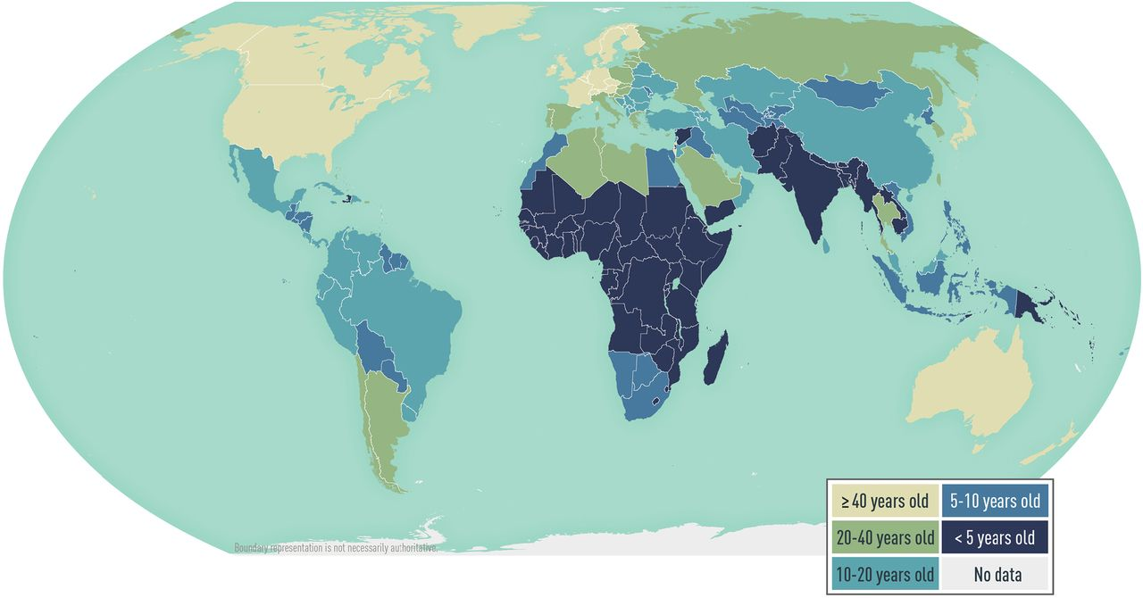
Hepatitis A = VHA
The “unwashed hands” disease
We administer 2 vaccine doses 6-18 months apart. Protection comes into effect approx. 14 days after the first dose. After completing the full vaccination schedule, the vaccinated person becomes immune to Hep A for at least 20 years.
Post-exposure prophylaxis is also possible.
We can vaccinate as early as from 1 year of age.
The vaccine is inactivated, application i.m, s.c.

Slide 18
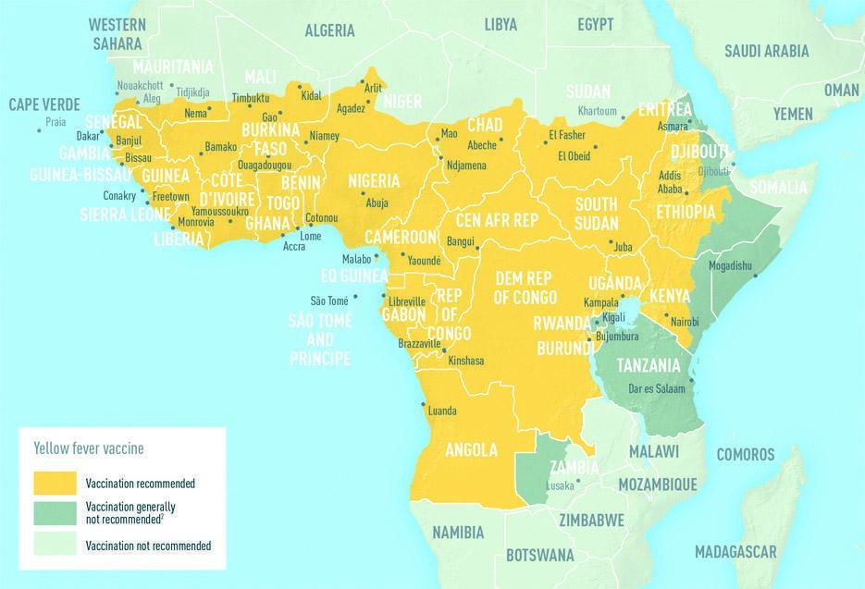
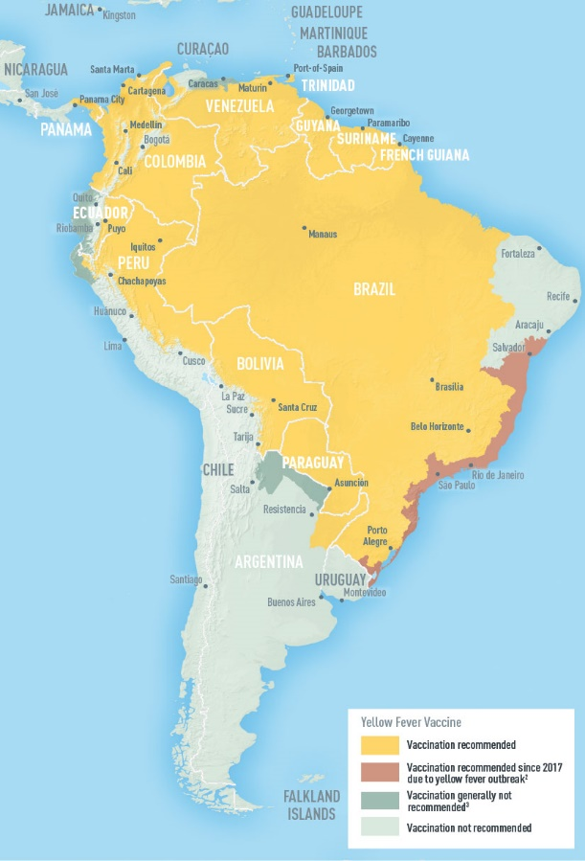
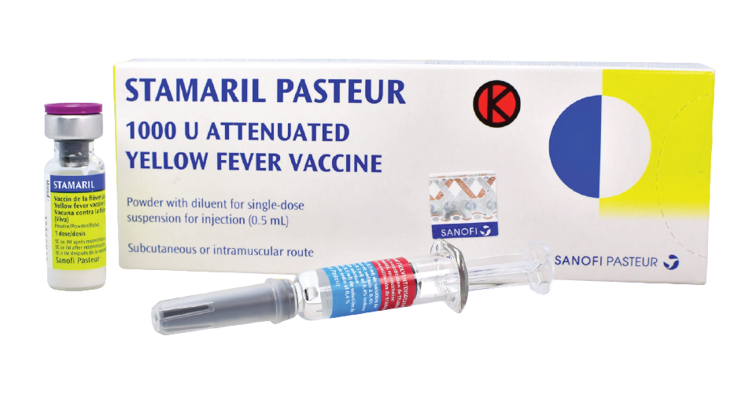
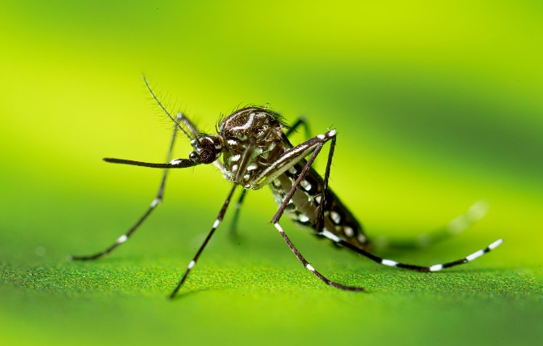
Yellow fever
Hemorrhagic fevers
We can vaccinate from 9 months of age, according to SPC up to 60 years.
Live attenuated vaccine, application i.m., s.c.
Protection for at least 10 yrs, vaccination certificate even state is as “lifelong”

Slide 19
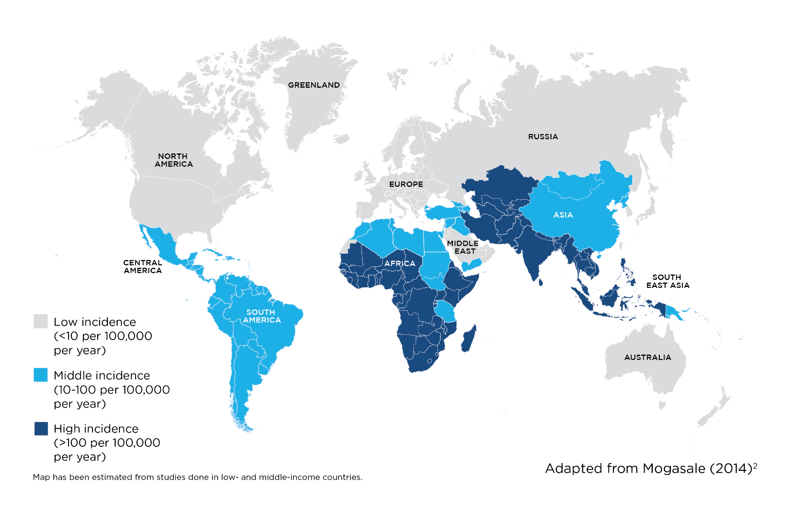
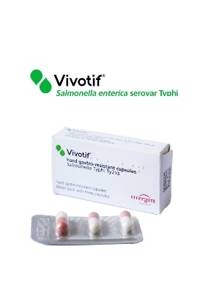
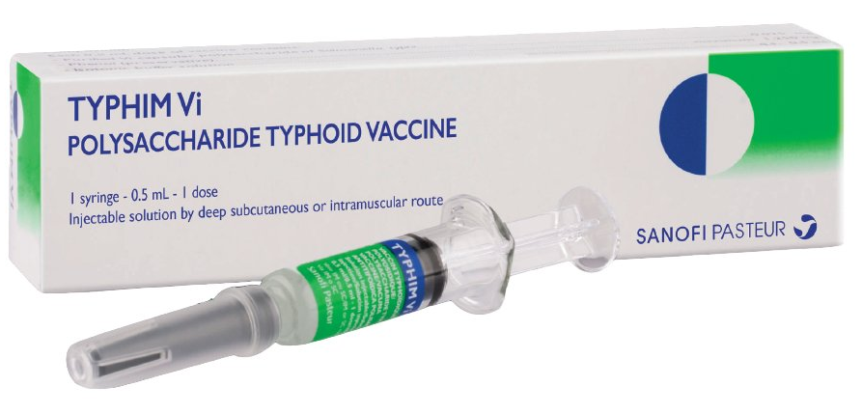
Typhoid fever
Typhoid fever – fever, headaches, diarrhea is not typical!
Salmonella typhi - ATB treatment!
Typhim Vi – polysacharid vaccine, protection for 3 years, repeated vaccination reduced efficiency.
According to vaccine type, application i.m. or p.o.

Slide 20
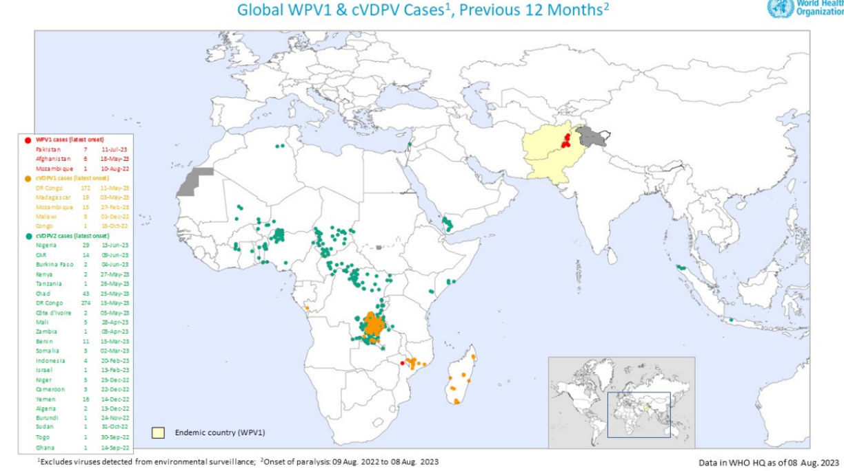
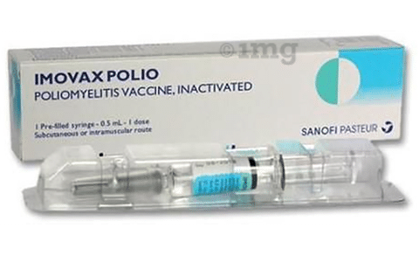
Poliomyelitis
Transferable polio ≠ Cerebral palsy
ImovaxPOLIO – inactivated vaccine, schedule 2+1, protects against all 3 serotypes, application i.m. or s.c.
Required vaccination when traveling to Mecca (SA)

Slide 21
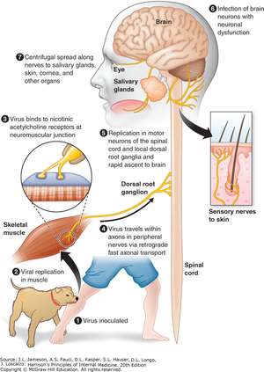
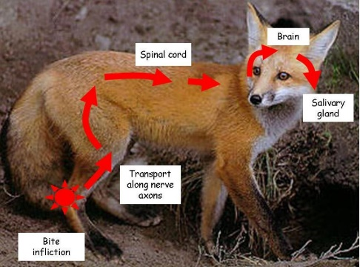
Rabies, Lyssa
If the virus gets into the neuron = 100% death
(ID: 7 days to 6 months)
Pre-exposition prophylaxis: 0 – 7 – (21/28)
Post-exposition prophylaxis: 0-3-7-14-28 + RIG (Rabies imunoglobulin)
We can administer this vaccine from 2 months of age,
but there is essentially no contraindication to the vaccine!
Verorab – inactivated vaccine with a good safety profile, well tolerated,
application i.m. or s.c.

Slide 22
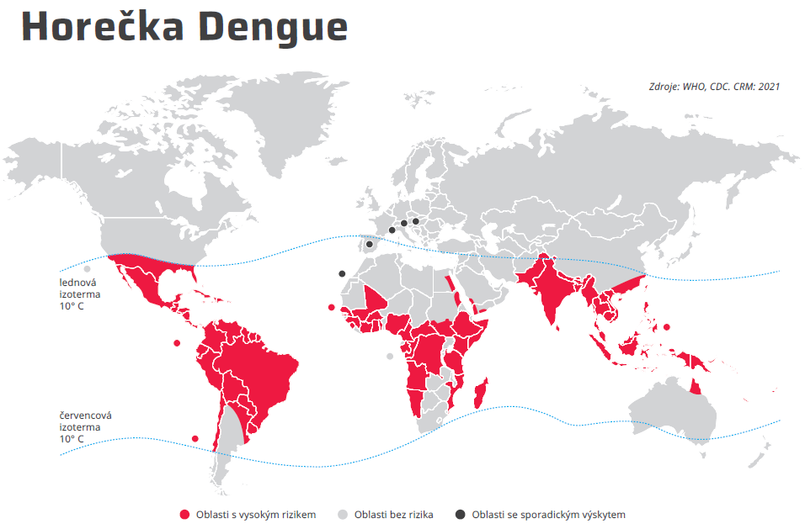
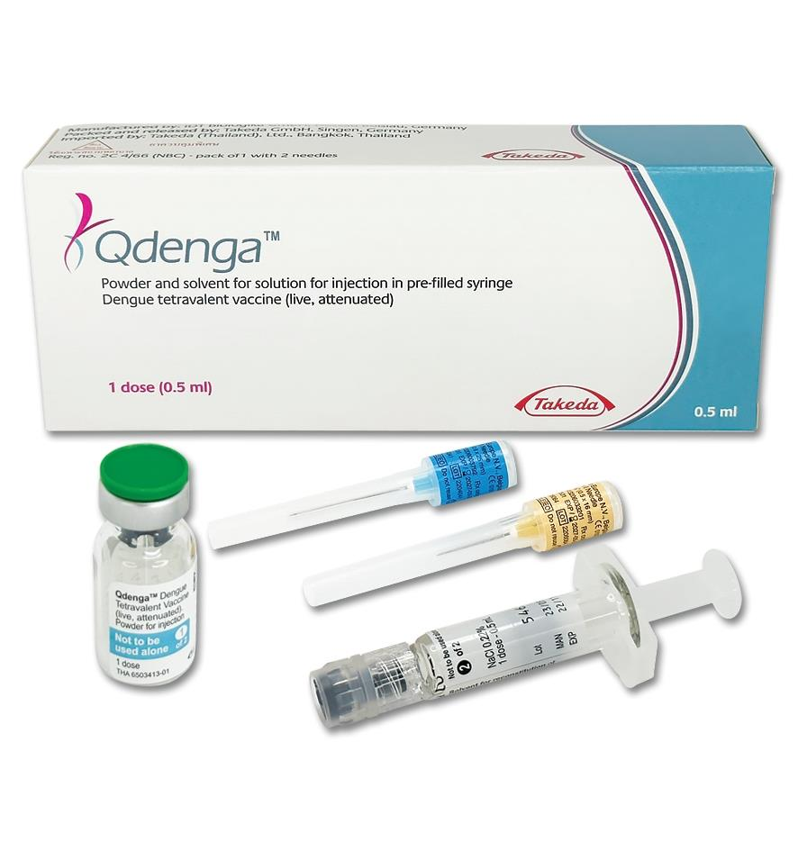
Dengue fever
“Break-bone fever”
Transmitted from Aedes mosquitoes,
4 sérotypy
We use the Qdenga vaccine for rophylaxis.
We use the Dengvaxia vaccine after the dengue fever infection.
Qdenga – live attenuated vaccine,
administered in 2 doses 3 months apart,
only s.c. application
Pregnant and breastfeeding women must not use this vaccine!

Slide 23
Resources
Infectious Diseases Textbook, School of Medicine MUNI – L. Krbková, P. Husa
https://www.vakcinace.eu/
https://www.cdc.gov/vaccines/index.html
https://wwwnc.cdc.gov/travel
https://www.cdc.gov/vaccines/acip/recommendations.html
https://infektologie.cz/

