Slide 1
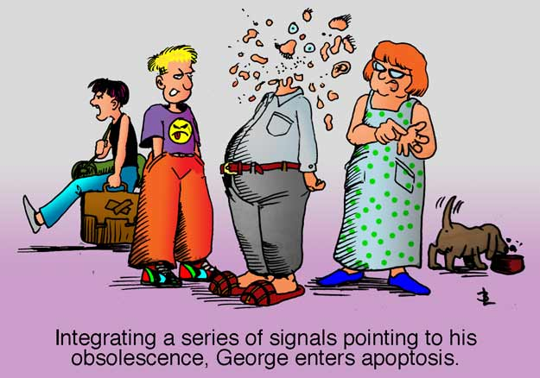
Apoptosis
and the clearance of apoptotic cells
https://peopleinwhitecoats.blogspot.com/2011/07/

Slide 2
Apoptosis – Programmed Cell Death
The human body generates 10–100 billion cells every day, and the same number of cells die to maintain homeostasis in our body.
Cells infected by bacteria or viruses also die.
The cell death that occurs under physiological conditions mainly proceeds by apoptosis, which is a noninflammatory, or silent, process, while pathogen infection induces necroptosis or pyroptosis, which activates the immune system and causes inflammation.
Dead cells generated by apoptosis are quickly engulfed by macrophages for degradation.
HNSCC cells dying by apoptosis, QPI, 10x mag.
Nagata, S., Tanaka, M. Programmed cell death and the immune system. Nat Rev Immunol 17, 333–340 (2017). https://doi.org/10.1038/nri.2016.153

Slide 3
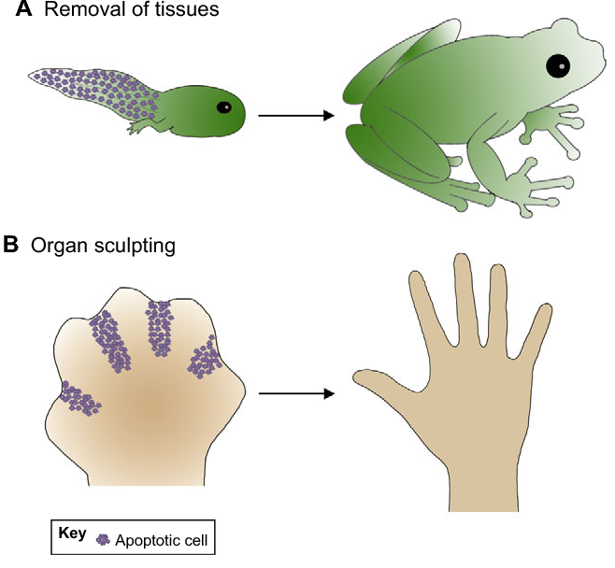
Apoptosis – Programmed Cell Death?
Apoptosis occurs in developing embryos or in cells that die under physiological conditions, “programmed cell death” and “apoptosis” are often used synonymously.
When apoptosis was discovered to be mediated by gene products, it was regarded as being programmed.
The term programmed cell death has been used, confusingly, with two different meanings: the cell death programmed into animal development, and the cellular death process elicited by a molecular mechanism.
Cell death with a necrotic morphology that occurs during inflammation or infection was also found to be programmed or regulated by gene products and was categorized as necroptosis and pyroptosis.
In addition, nonapoptotic cell death was observed during Caenorhabditis elegans development and Drosophila metamorphosis, indicating that cell death in animal development can occur by a nonapoptotic mechanism.
Programmed cell death should not be used as a synonym for apoptosis; it should be reserved for the cell death that takes place in animal development.

Slide 4
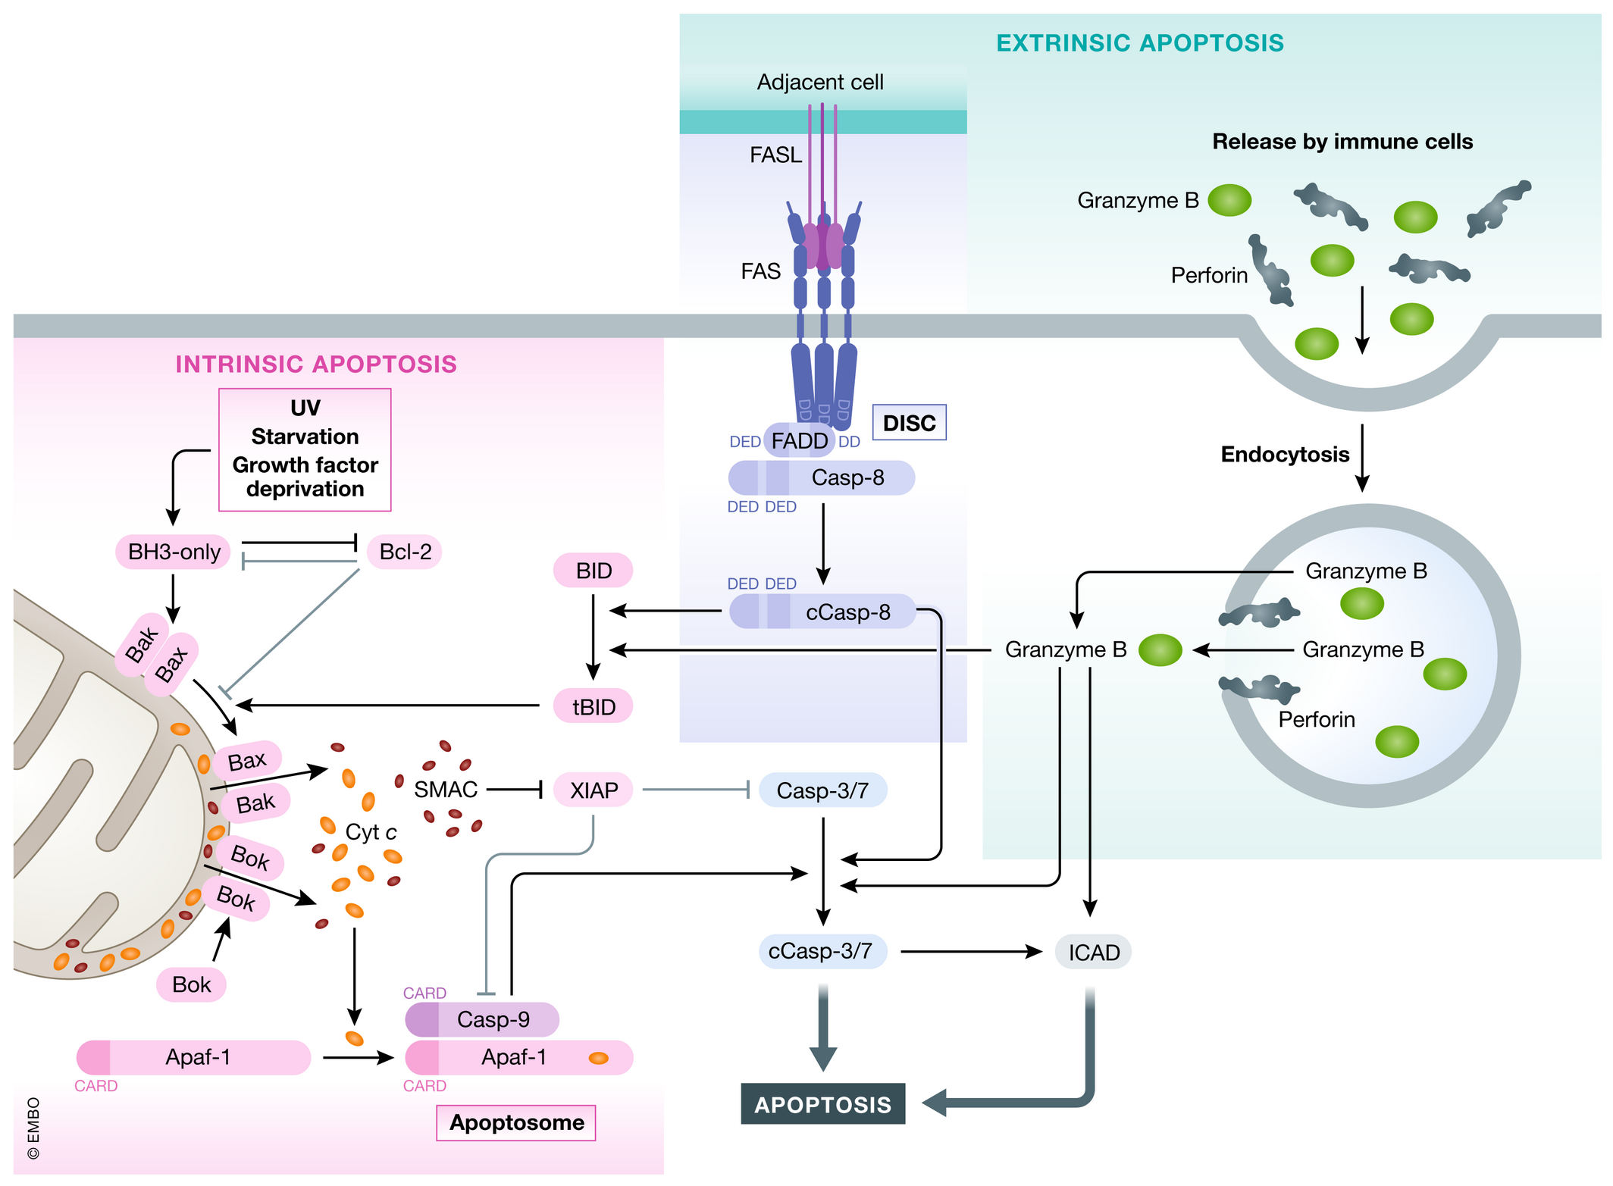
Apoptotic pathways

Slide 5
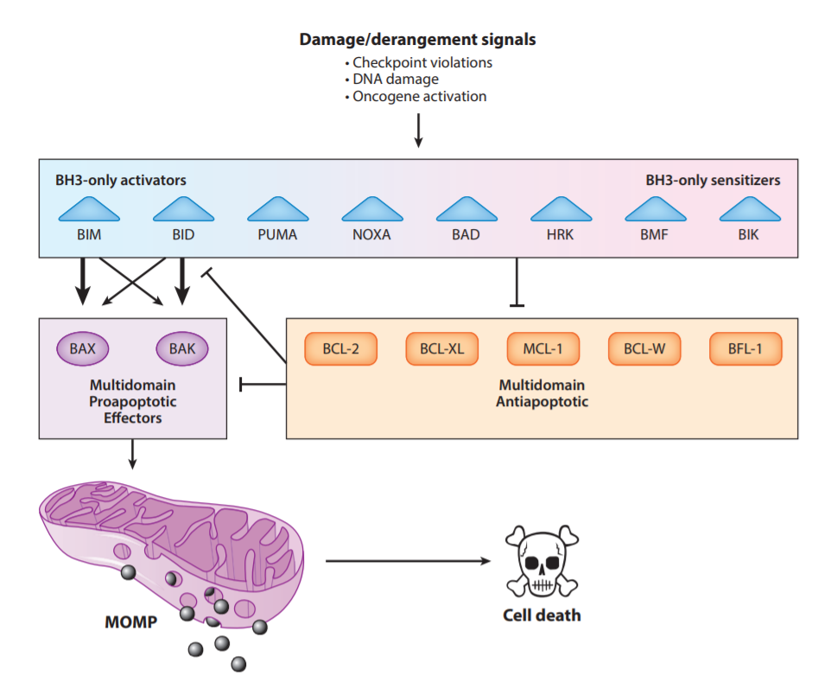
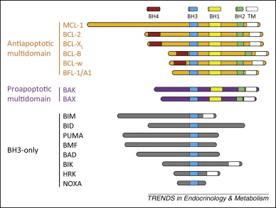
The Bcl-2 protein superfamily

Slide 6
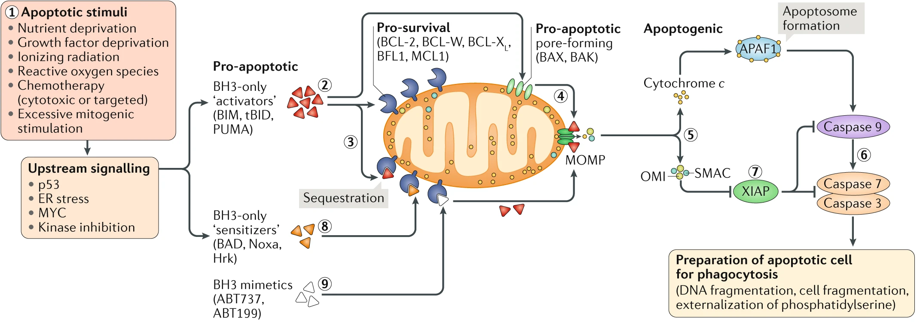
Mechanism: The Mitochondrial Apoptosis Pathway
Singh, R., Letai, A. & Sarosiek, K. Regulation of apoptosis in health and disease: the balancing act of BCL-2 family proteins. Nat Rev Mol Cell Biol 20, 175–193 (2019). https://doi.org/10.1038/s41580-018-0089-8

Slide 7
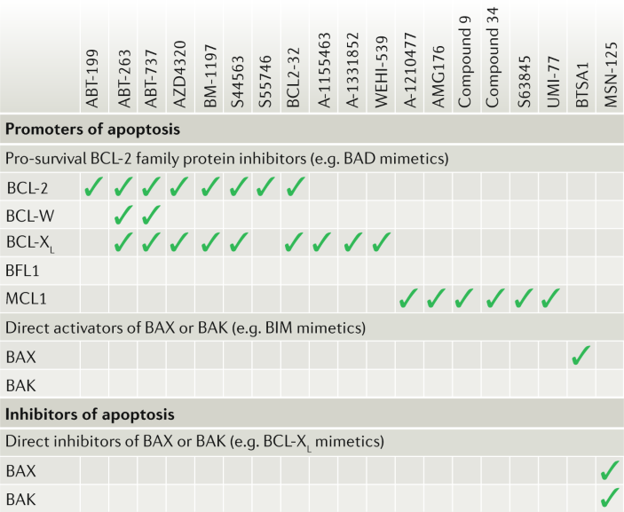
BH3 Mimetics
The recent development of novel small-molecule inhibitors of pro-survival proteins from the BCL-2 family, called BH3 mimetics, enables the direct and selective activation of mitochondrial apoptosis in cells that are highly dependent on one or more pro-survival proteins.
The US Food and Drug Administration approved the BCL-2 inhibitor venetoclax (ABT-199) for use in chronic lymphocytic leukaemia on the basis of its excellent clinical activity, including in patients who have relapsed after multiple rounds of therapy and those with mutated p53.
Agents targeting other major pro-survival proteins BCL-X_{L} and MCL are also undergoing clinical evaluation.
Although great potential in haematological cancers, their deployment in solid cancers and non-malignant diseases has been challenging owing to an insufficient understanding of apoptotic dependencies and how to identify and exploit them safely and effectively in the clinic.
The development of novel small-molecule inhibitors of pro-survival proteins from the BCL-2 family, called BH3 mimetics.
Singh, R., Letai, A. & Sarosiek, K. Regulation of apoptosis in health and disease: the balancing act of BCL-2 family proteins. Nat Rev Mol Cell Biol 20, 175–193 (2019). https://doi.org/10.1038/s41580-018-0089-8

Slide 8
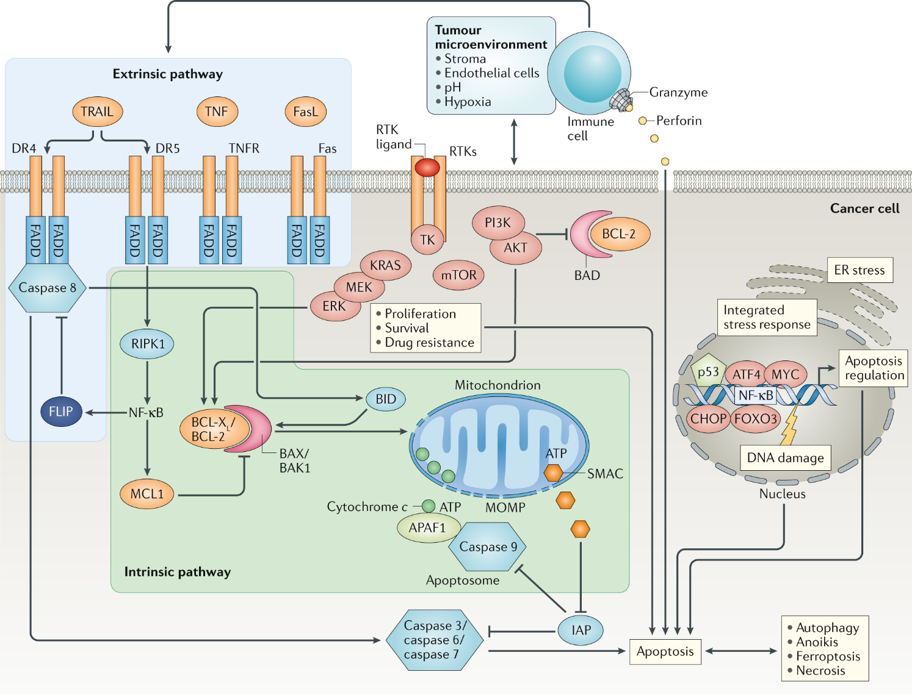
Mechanism: The Receptor Mediated Apoptosis Pathway
Pro-apoptotic death receptors:
Fas (whose physiological ligand is FasL)
the tumour necrosis factor (TNF) receptors TNFR1 and TNFR2,
the TNF-related apoptosis-inducing ligand (TRAIL) receptors DR4 and DR5
The intracellular domains of the pro-apoptotic death receptors include a conserved protein–protein interaction domain referred to as the death domain.
Singh, R., Letai, A. & Sarosiek, K. Regulation of apoptosis in health and disease: the balancing act of BCL-2 family proteins. Nat Rev Mol Cell Biol 20, 175–193 (2019). https://doi.org/10.1038/s41580-018-0089-8

Slide 9
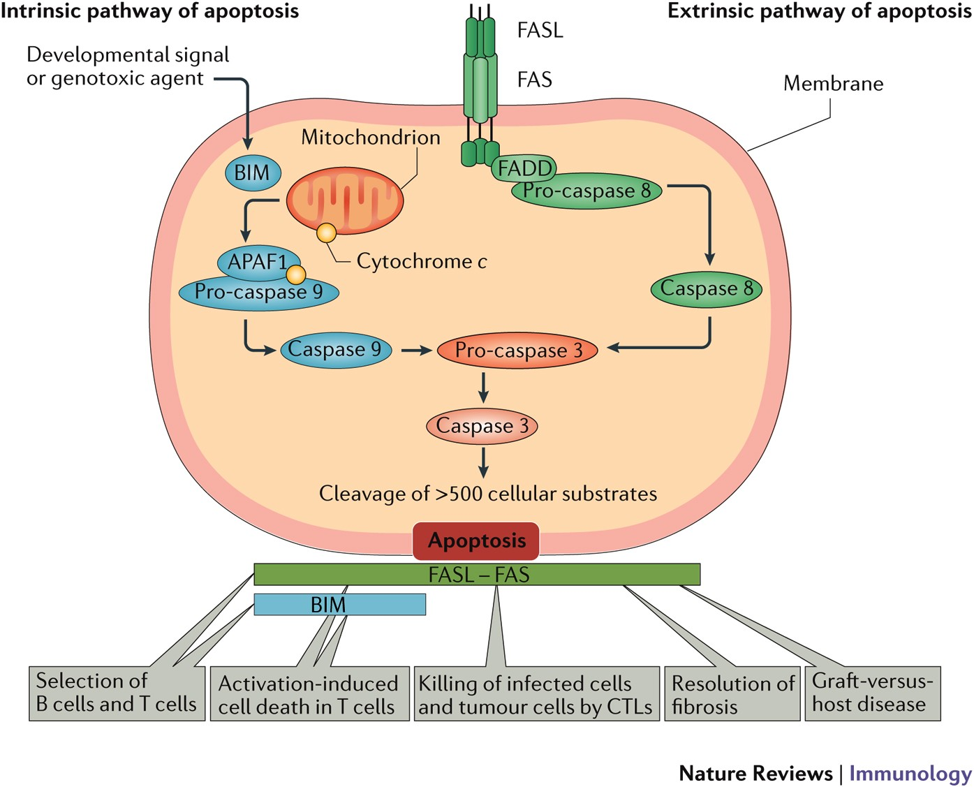
The Receptor Mediated Apoptosis Pathway
Immune mechanisms can activate cell death through the extrinsic pathway, for example, through TRAIL produced by natural killer cells in response to interferons.
FAS-mediated extrinsic apoptosis pathway is responsible for the deletion of peripheral T cells (patients with autoimmune lymphoproliferative syndrome carry somatic or germline mutations in the genes that encode FAS or FASL).
FASL expression is restricted to specific lymphocyte populations, such as CTLs, T helper 1 (T_{H}1) cells and natural killer cells. By contrast, FAS is widely expressed by most cell types in various tissues.
Nagata, S., Tanaka, M. Programmed cell death and the immune system. Nat Rev Immunol 17, 333–340 (2017). https://doi.org/10.1038/nri.2016.153

Slide 10
Morphological Hallmarks of Apoptosis
Cells undergoing apoptosis shrink.
Their plasma membrane is apparently intact, but it undergoes blebbing.
The fragmentation of chromosomal DNA into nucleosomal units, exposure of phosphatidylserine (PtdSer) on the cell surface, and loss of mitochondrial potential are biochemical hallmarks of apoptosis.
These features disappear when apoptosis is induced in the presence of caspase inhibitors, indicating that they are all mediated by activated caspases.
During the apoptosis of a human cell, nearly 1,300 different proteins are cleaved by caspases at more than 1,700 sites.
Different caspases have preferred substrates. Since caspase 3 is at the end of the caspase cascade and is activated by both the intrinsic and extrinsic death pathways, it is conceivable that the general characteristics of apoptosis are mediated by the caspase 3 substrates. In fact, several apoptotic characteristics, including membrane blebbing, DNA fragmentation, and PtdSer exposure are mediated by caspase 3 targets. The PtdSer exposure is essential for apoptotic cells to be eaten.
Head and neck squamous cell carcinoma FaDu cell undergoing apoptosis. 20x mag. obj., Quantitative Phase Imaging (QPI, Q-PHASE).

Slide 11
ASYMMETRICAL DISTRIBUTION OF PHOSPHOLIPIDS
Biological membranes consist of two layers, outer and inner leaflets, between which lipids are asymmetrically distributed.
In the plasma membrane of eukaryotic cells, amine-containing or anionic phospholipids [PtdSer, phosphatidylethanolamine (PtdEtn), phosphoinositides (PtdIns), phosphatidic acids (PtdOH)] are predominantly or exclusively localized to the inner leaflet, whereas the outer leaflet is enriched in choline-containing phospholipids [phosphatidylcholine (PtdCho) and sphingomyelin (Sph)] and glycosphingolipids.
Three types of lipid transporters have been proposed, based on the direction of transport, substrate specificity, and ATP requirement:
Using the energy of ATP, flippases and floppases translocate specific lipids from the outer to inner leaflet or from the inner to outer leaflet, respectively, against a concentration gradient, whereas scramblases, driven by the existing lipid gradient, nonspecifically and bidirectionally transport lipids between the inner and outer leaflets.
Cells undergoing apoptosis expose PtdSer on their surface in a caspase-dependent manner. The cellular protein annexin V specifically binds to PtdSer, and fluorescently labeled annexin V is widely used to detect apoptotic cells.
Flippase cleavage by caspase 3 inactivates their flippase activity. However, flippase inactivation alone is insufficient to quickly expose PtdSer on the cell surface. Thus, once the asymmetrical distribution of phospholipids is established, the rate of their spontaneous translocation or scrambling is extremely low. Thus, an enzyme(s) or scramblase(s) is needed to perform this job.
Macrophages engulf apoptotic or senescent cells but not healthy cells, suggesting that the engulfed cells present a determinant(s) or eat me signal on their cell surface.
Nagata S. Apoptosis and Clearance of Apoptotic Cells. Annu Rev Immunol. 2018 Apr 26;36:489-517. doi: 10.1146/annurev-immunol-042617-053010. Epub 2018 Feb 5. PMID: 29400998.

Slide 12
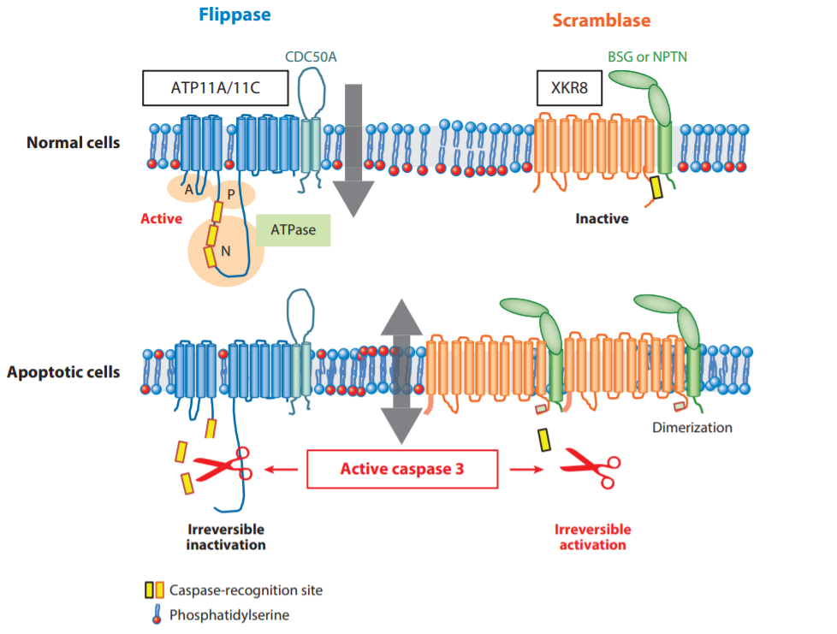
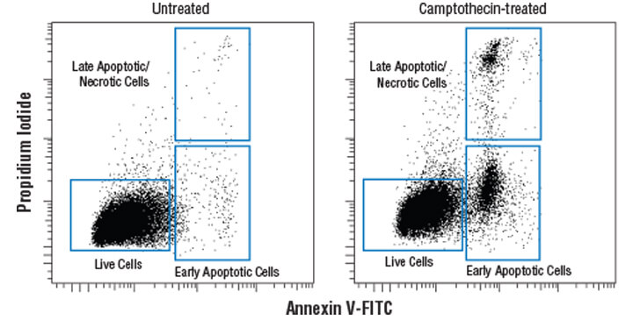
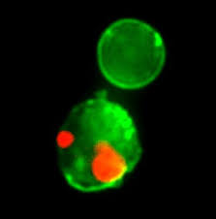
ASYMMETRICAL DISTRIBUTION OF PHOSPHOLIPIDS
Cells undergoing apoptosis expose PtdSer on their surface in a caspase-dependent manner. The cellular protein annexin V specifically binds to PtdSer, and fluorescently labeled annexin V is widely used to detect apoptotic cells.

Slide 13
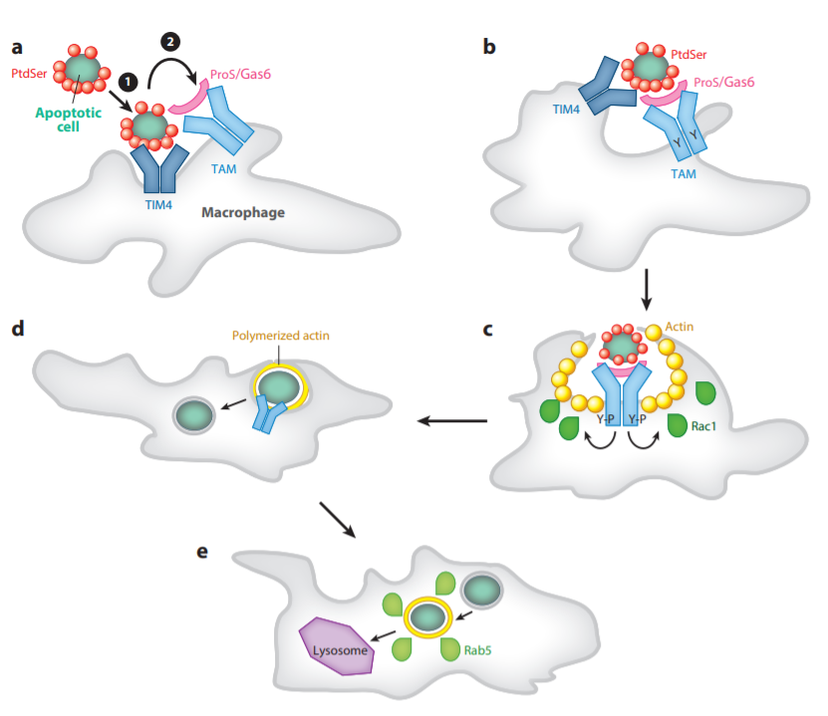
Engulfment of Apoptotic Cell
deCathelineau & Henson coined efferocytosis, Latin for “carry to grave,” to describe the engulfment of apoptotic cells.
PtdSer exposure is necessary and sufficient as an eat me signal.
Molecules that recognize PtdSer:
secreted soluble proteins, including MFG-E8, Gas6, and Protein S (PROS),
type I membrane proteins expressed in phagocytes, including TIM1, TIM4, and CD300.
When apoptotic cells are recognized by macrophages, various signaling molecules are activated in the macrophages that lead to phagosome formation to encapsulate the apoptotic cells. The phagosomes are transported into lysosomes, where the components of dead cells are degraded into their building units.
Nagata S. Apoptosis and Clearance of Apoptotic Cells. Annu Rev Immunol. 2018 Apr 26;36:489-517. doi: 10.1146/annurev-immunol-042617-053010. Epub 2018 Feb 5. PMID: 29400998.

Slide 14
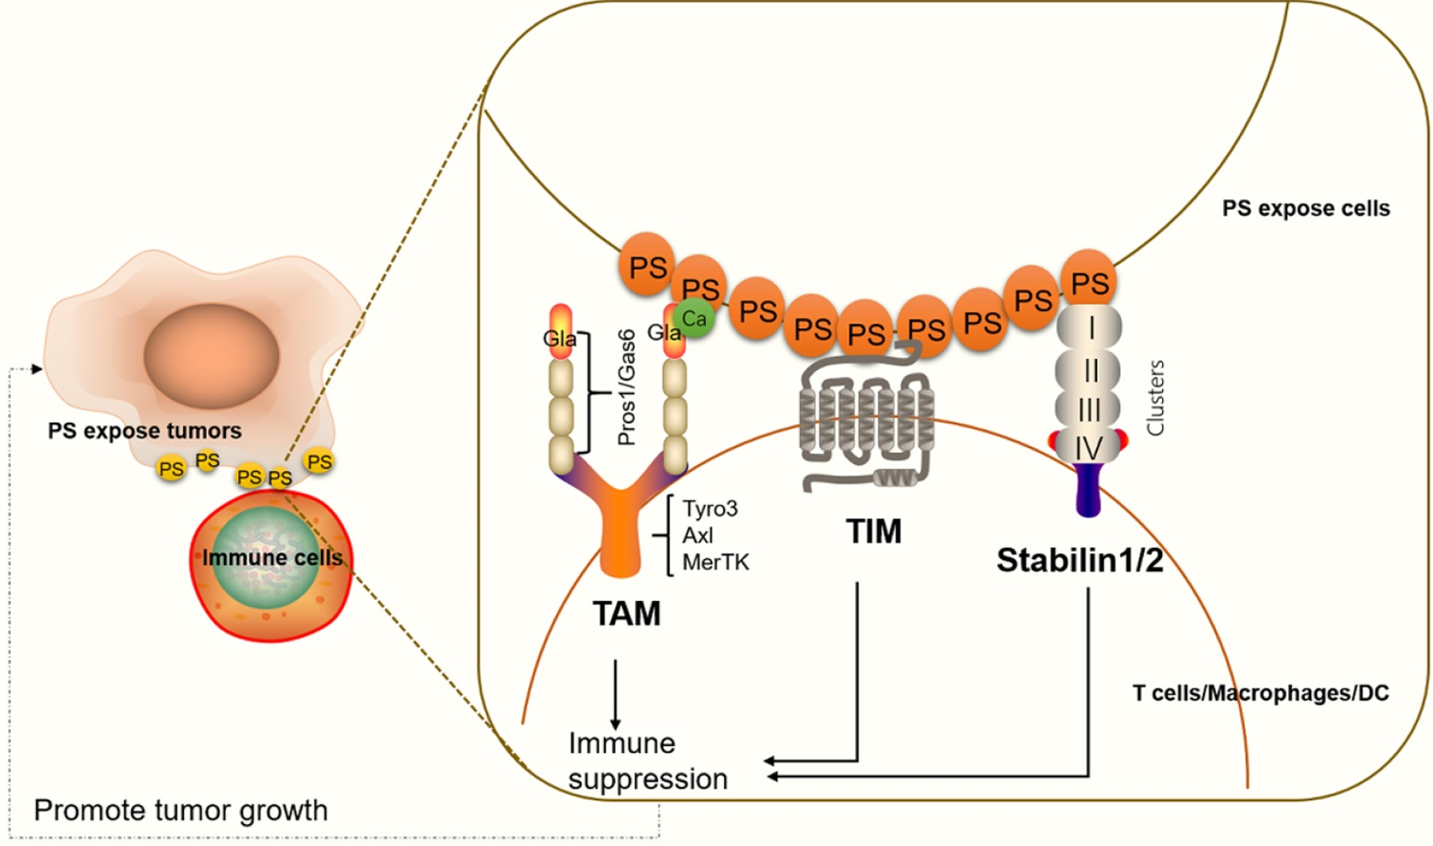
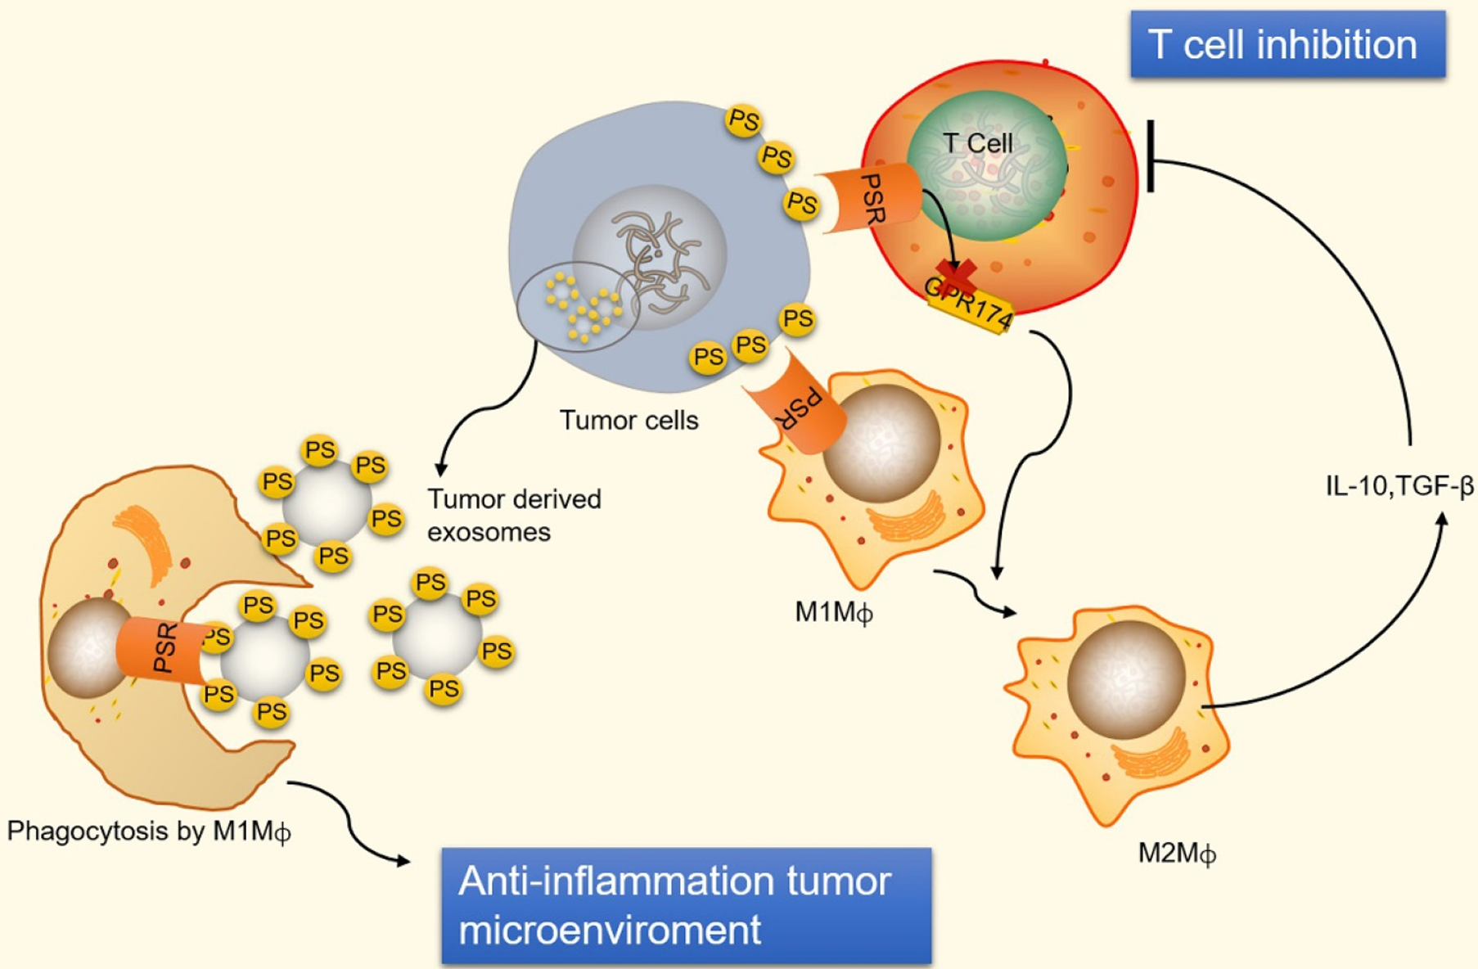
Exposure to phosphatidylserine on the surface of viable tumor cells
PS exposure on the external leaflet not only acts as an engulfment signal for phagocytosis in apoptotic cells but also participates in blood coagulation, myoblast fusion and immune regulation in nonapoptotic cells.
In the tumor microenvironment, PS exposure is significantly increased on the surface of tumor cells or tumor cell-derived EVs, which have immunosuppressive properties and facilitate tumor growth and metastasis.
PS biomarkers have been successfully employed to target a variety of cancer cells with PS-binding specificity
Chang, Wenguang et al. “Targeting phosphatidylserine for Cancer therapy: prospects and challenges.” Theranostics, 2020.
Notes:
bavituximab
Type IV P-type ATPase (P4-ATPase)-mediated confinement of phosphatidylserine (PtdSer) to the inner leaflet of the plasma membrane. ATP11A and ATP11C are complexed with CDC50A at the plasma membrane and serve as flippases to specifically translocate PtdSer from the outer leaflet to the inner leaflet in growing cells. ATP8A1 and ATP11B seem to recycle between the endosomes and plasma membranes and maintain the asymmetrical distribution of PtdSer at the plasma membrane. b, Ca²⁺-induced PtdSer exposure and microvesicle release. When platelets, osteoblasts and other cells are activated, the intracellular Ca²⁺ concentration increases. Binding of Ca²⁺ to ATP11A and ATP11C inhibits their flippase activity while activating TMEM16F, which causes temporal PtdSer exposure on the cell surface and the release of microvesicles. These microvesicles also expose PtdSer, which conveys further functions (see also Fig. 4c). c, When cells undergo apoptosis, caspase 3 is activated and cleaves the carboxy-terminal part of XKR8 to trigger its scrambling activity. At the same time, caspase 3 cleaves ATP11A and ATP11C in the middle of the molecule to inactivate them, allowing the cells to expose PtdSer irreversibly. This process is accompanied by the release of apoptotic bodies, which also expose PtdSer and are engulfed by phagocytes. d, ATP-induced PtdSer exposure and cell lysis. XK, a member of the XK-related (XKR) family, is complexed with VPS13A lipid transporter via its β-hairpin in the centre of the molecule. ATP released from necrotic cells binds the P2X7 homotrimer, and an unidentified signal (question mark) from the ATP-engaged P2X7 receptor activates the XK–VPS13A complex to scramble phospholipids in the plasma membrane. This causes the PtdSer exposure on the cell surface, followed by cell rupture. PtdCho, phosphatidylcholine; SM, sphingomyelin; TMEM16, transmembrane protein 16.
PS is one of the primary apoptotic cell ligands that provides eat-me signals to phagocytes. Upon recruitment, phagocytes recognize PS directly or indirectly through cell–cell interac tions mediated by specific bridging or adapter molecules recruited to the surfaces of dying cells. Macrophages recognize additional abnormal cell characteristics such as elevated lateral mobility of PS11 or modifications of the glycocalyx.43 These interactions initiate signaling pathways

Slide 15
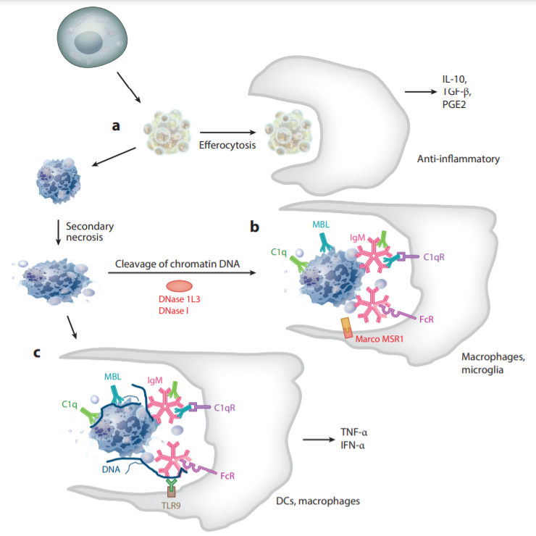
Engulfment of Apoptotic Cell
Efferocytosis often has a defect in patients with systemic lupus erythematosus (SLE). Thus, it was thought that rapid efferocytosis prevents secondary necrotic cells from releasing DAMP, which promotes SLE development.
Apoptotic cells are engulfed by macrophages via efferocytosis, in which the macrophages engulfing apoptotic cells produce anti-inflammatory molecules such as IL-10, TGF-β, and PGE2.
When the efferocytosis does not occur efficiently, the apoptotic cells undergo secondary necrosis. Chromatin DNA of necrotic cells is cleaved by DNase 1 or DNase1L3. Other remnants of dead cells are recognized and cleared by scavenger receptors (Marco and MSR1) This step may not be inflammatory.
On the other hand, when chromatin DNA of necrotic cells is not degraded, DNA activates macrophages and dendritic cells (DCs) via TLR9 to produce inflammatory cytokines such as TNF-α and IFN-α. It may also promote the aggregation of immune complex, which can be strongly immunogenic.
Nagata S. Apoptosis and Clearance of Apoptotic Cells. Annu Rev Immunol. 2018 Apr 26;36:489-517. doi: 10.1146/annurev-immunol-042617-053010. Epub 2018 Feb 5. PMID: 29400998.

Slide 16
Apoptosis Pathway in Physiology
An important mechanism that ensures organismal homeostasis is the removal of damaged or superfluous cells via apoptosis, and in the former case, their replacement from stem-cell-derived progeny.
For example neutrophils — the most common nucleated cell type in peripheral blood — have a lifespan of only 5.4 days, meaning that roughly 20% of neutrophils die via apoptosis each day in an adult human. (The short half-life of these cells is likely due to their prominent role as phagocytes for invading pathogens; mammals have presumably evolved to allow these cells (together with their microbial load) to self-destruct via apoptosis and be replaced instead of using a detoxification strategy).
Heightened apoptotic sensitivity is a hallmark of developing tissues
Perinatal brain development is associated with massive proliferation of neural progenitors, followed by a wave of apoptosis that eliminates approximately half of cells that are either excessive or have not established appropriate synaptic connectivity.
The heart, kidneys and liver are more sensitive to pro-apoptotic stimuli at the perinatal and early postnatal stages than at the adult stage. Importantly, this heightened apoptotic sensitivity is frequently associated with active proliferation of tissues and expression of the growth- and division-supporting transcription factor MYC, suggesting that active proliferation is tightly coupled to expression of the machinery necessary for apoptosis induction.
Nagata, S., Tanaka, M. Programmed cell death and the immune system. Nat Rev Immunol 17, 333–340 (2017). https://doi.org/10.1038/nri.2016.153

Slide 17
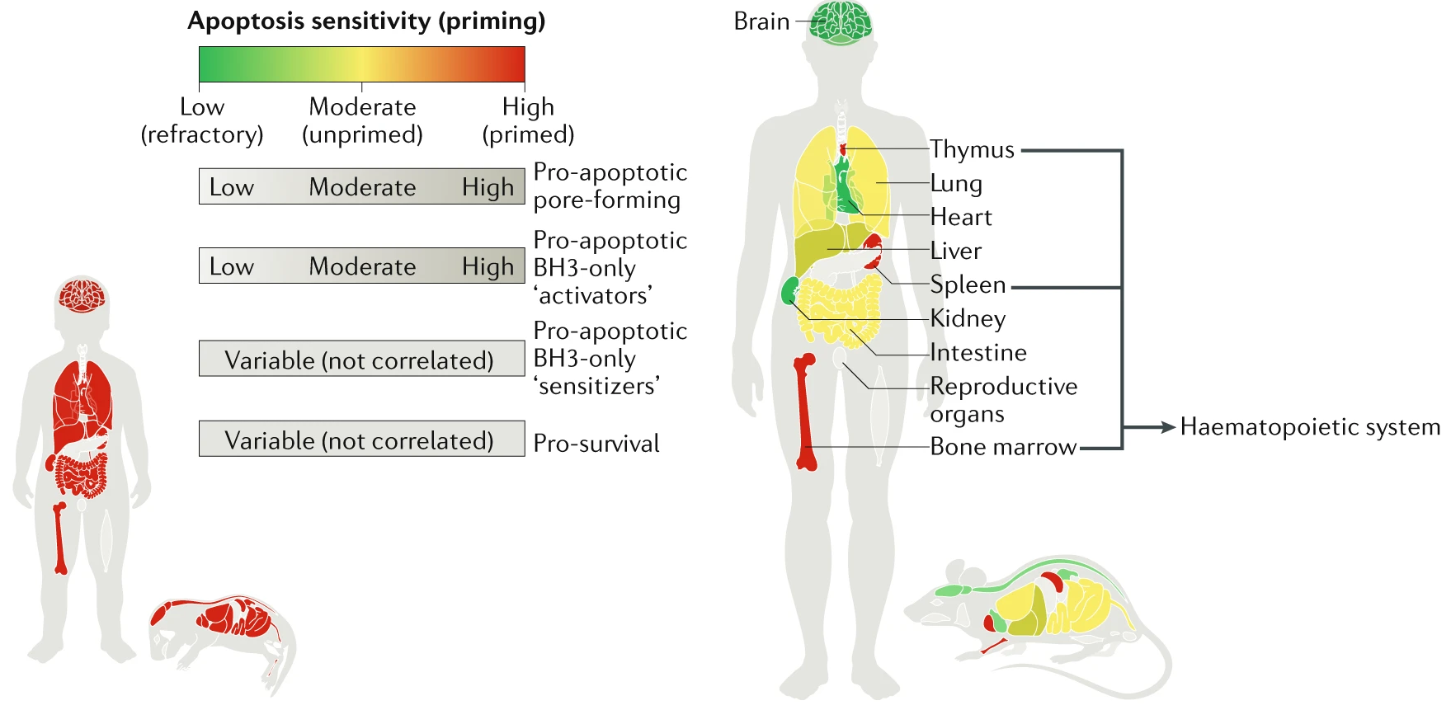
Heightened apoptotic sensitivity is a hallmark of developing tissues
Nagata, S., Tanaka, M. Programmed cell death and the immune system. Nat Rev Immunol 17, 333–340 (2017). https://doi.org/10.1038/nri.2016.153

Slide 18
Apoptosis and Immune System
Around 1990, apoptosis or cell death was reported to have important roles in the adaptive immune system in the deletion of thymocytes that express autoreactive or non-reactive T cell receptors (TCRs), and in the deletion of autoreactive immature B cells.
Cell death is involved in various immunological processes:
During lymphocyte development, many lymphocyte progenitors that express antigen receptors with a high affinity for self-antigens or that cannot respond to antigens are eliminated by apoptosis. The lymphocytes that survive this stage of development remain in the periphery and form the naive T cell and naive B cell compartments.
When naive lymphocytes encounter pathogens, they proliferate and are activated to combat the pathogens. These activated lymphocytes will subsequently die after the pathogens have been removed. A similar situation can be found with neutrophils during inflammation. When our body is infected by bacteria, neutrophil populations expand, and neutrophils are activated to phagocytose bacteria, but they quickly undergo apoptosis after the infection has been cleared.
Cytotoxic T lymphocytes and natural killer cells recognize virus-infected, bacteria-infected and transformed cancer cells, and induce these cells to die by apoptosis.
Bacteria-infected cells, particularly phagocytes, often undergo necrosis (pyroptosis or necroptosis) to prevent bacteria from proliferating further inside the cell. Unlike apoptosis, necrosis is an inflammatory form of cell death and can lead to further tissue inflammation.
Nagata, S., Tanaka, M. Programmed cell death and the immune system. Nat Rev Immunol 17, 333–340 (2017). https://doi.org/10.1038/nri.2016.153

Slide 19
Insufficient apoptosis and the development of autoimmune diseases.
Beyond cancer, the most compelling evidence of insufficient apoptosis contributing to disease is seen in autoimmune disorders.
Defects may involve predominantly perturbations to the extrinsic pathway, but the intrinsic pathway is also implicated.
In humans, abnormally high expression of BCL-2 in peripheral blood B and T lymphocytes has been observed in patients diagnosed with systemic lupus erythematosus (SLE) — a prototypical autoimmune disease characterized by inflammation and organ damage in association with the expression of autoantibodies against double-stranded DNA. Such high BCL-2 levels may be responsible for the abnormal survival of self-reactive lymphocytes driving SLE.
Autoimmune lymphoproliferative syndrome (ALPS) is a recently characterized disorder caused predominantly by inherited mutations in the gene that encodes tumour necrosis factor receptor superfamily member 6 (FAS), leading to reduction in apoptosis potential and expansion of double-negative T cells (DNTCs) — a hallmark of ALPS.
Gastrointestinal autoimmune diseases such as Crohn’s disease and ulcerative colitis are believed to occur as a consequence of chronic inflammation and consequent death of intestinal epithelial cells. This inflammation is established by hyperproliferating T cells that normally would be eliminated by cell death. However, in these conditions, an increase in pro-survival BCL-2 prevents T cell apoptosis.

Slide 20
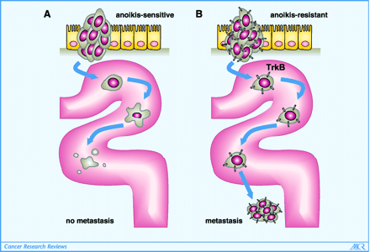
Apoptosis and Cancer
In cancer, apoptosis is a well-established tumor suppressor mechanism, and loss of apoptotic control allows cancer cells to survive longer thus acquiring additional oncogenic hits.
Tumor cells evolve a variety of strategies to limit cell death:
loss of p53
increased expression of antiapoptotic regulators (Bcl-2, Bcl-xL) and survival signals (insulin-like growth factors; Igf1/2)
downregulating of proapoptotic factors (Bax, Bim, Puma)
opportunistic modes of behavior (cell fusion)
Anoikis is a form of programmed cell death that occurs in anchorage-dependent cells when they detach from the surrounding extracellular matrix.
barrier to metastasis
circulating tumor cells are anoikis resistant
TrkB (neurotrophic receptor) overexpression protects disseminated, circulating tumor cells from undergoing anoikis.

Slide 21
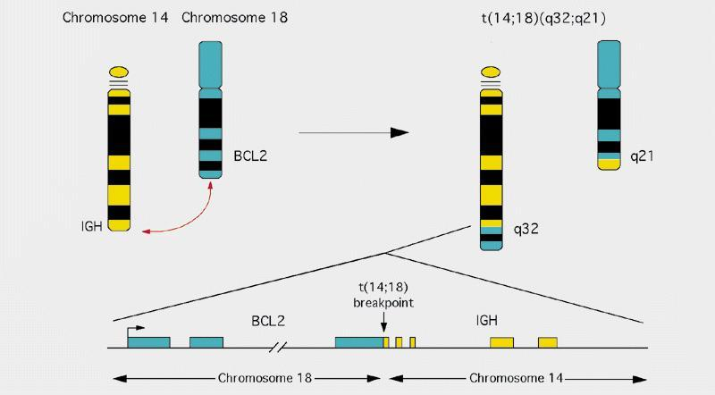
Evading apoptosis as a hallmark of cancer
There is little evidence that cancer cells are more resistant to apoptosis than normal cells are.
The presence of a therapeutic index for conventional chemotherapy in most cancers relies on the increased sensitivity to apoptosis in cancer cells than in normal cells .
Apoptosis can facilitate the carcinogenic action of other oncogenes, but it is by itself only weakly oncogenic.
When cancer cells are subjected to chemotherapy, there is selection for reduced sensitivity to apoptosis, likely an important contributor to the pan-resistant phenotype of many relapsed tumors.
Chromosomal translocation associated with B-cell lymphomas. The Bcl-2 gene is translocated behind a potent immunoglobulin gene promoter. Increased expression of Bcl-2 gene is associated with inhibition of apoptosis.
Anthony Letai Annual Review of Cancer Biology 2017 1:1, 275-294

Slide 22
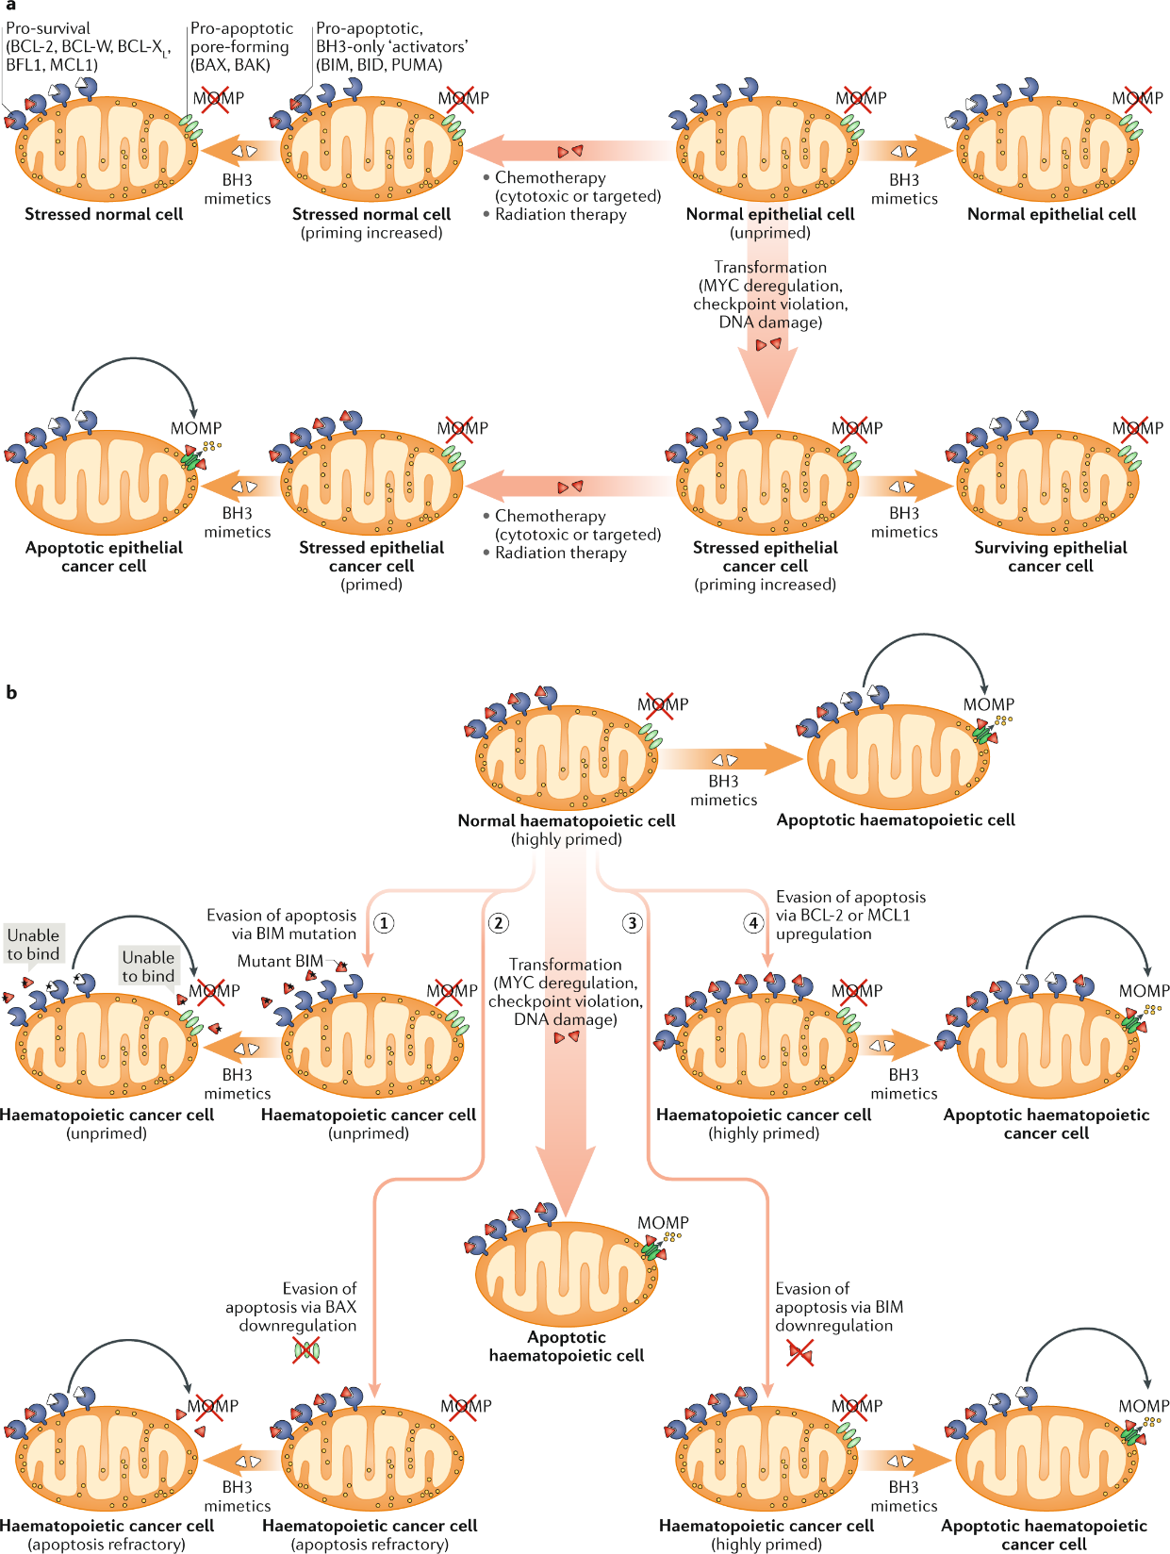
Apoptosis and Cancer
During the process of neoplastic transformation, oncogene-driven abnormal growth signals and cell-cycle checkpoint violation lead to cellular stress and upregulation of pro-apoptotic proteins.
This upregulation results in higher apoptotic priming of malignant cells at the basal state than normal cells. Because healthy adult tissues are mostly refractory to apoptosis or unprimed, this increase in apoptotic priming of aberrant cells can be exploited therapeutically using BH3 mimetics, particularly when combined with standard anticancer therapies such as radiation or chemotherapy.
Haematopoietic cells are naturally highly primed for apoptosis. Hence, oncogenic stress and the resulting upregulation of pro-apoptotic factors frequently result in the removal of pre-malignant cells derived from this lineage (middle arrow). Several mechanisms associated with BCL-2 protein deregulation, including BCL-2-interacting mediator of cell death (BIM) mutations (step 1), downregulation of BCL-2-associated X protein (BAX) (step 2) or BIM (step 3) and upregulation of BCL-2 or myeloid cell leukaemia 1 (MCL1) (step 4) support the emergence of haematopoietic cancers, which depend on these mechanisms for their survival. Notably, these mechanisms are mainly employed to keep malignant cells alive, and haematopoietic cancers typically remain primed for apoptosis and hence are susceptible to therapy and respond well to treatment with BH3 mimetics. However, certain mechanisms, including mutations of sensitizer proteins (step 1) and downregulation of mitochondrial outer membrane permeabilization (MOMP) pore-forming components (step 2) yield cells that are unprimed or even apoptosis refractory and hence resistant to therapy. Solid tumours can employ similar mechanisms to boost their survival, but these dependencies are much less pronounced than in haematopoietic cancers. Nevertheless, these mechanisms may underlie the development of resistance to treatment and disease relapse. BAK, BCL-2 antagonist/killer; BCL-W, B cell lymphoma W; BCL-X_{L}, B cell lymphoma extra large; BFL1, BCL-2-related isolated from fetal liver 1; BID, BH3-interacting domain death agonist; PUMA, p53-upregulated modulator of apoptosis.
Singh, R., Letai, A. & Sarosiek, K. Regulation of apoptosis in health and disease: the balancing act of BCL-2 family proteins. Nat Rev Mol Cell Biol 20, 175–193 (2019). https://doi.org/10.1038/s41580-018-0089-8

Slide 23
Pro-oncogenic roles of apoptotic signaling
(A) In dying tumor cells, activated caspases activate iPLA2 (Phospholipase A2) leading to generation of arachidonic acid.
Arachidonic acid can be converted into PGE₂ dependent on COX-1/2 function.
PGE₂ can act through its receptors to exert pro-proliferative effect on surrounding cells. This process is termed apoptosis-induced proliferation (AiP).
(B) Apoptotic tumor cells not only can induce the anti-inflammatory M2 TAM differentiation that inhibits antitumor immunity, but also secrete a variety of cytokines/chemokines that promote angiogenesis and metastasis. Some types of tumor cells can also express death ligands (FASL and TRAIL) and inhibitory B7 family members (PD-L1 and CTLA-4) that can induce T-cell death, leading to immune escape.
(C) Nonlethal stress can lead to MOMP in a minority of mitochondria, called miMOMP. Following miMOMP, caspases are activated similar to a sublethal level, which leads to the activation of CAD. CAD activation results in DNA damage and genetic instability and can lead to cell transformation. The endonuclease Endo G can also be released upon MOMP, leading to DNA cleavage. Endo G-mediated dsDNA breaks also activate ATM, leading to NF-κB and STAT3 activation and subsequent tumor growth.

Slide 24
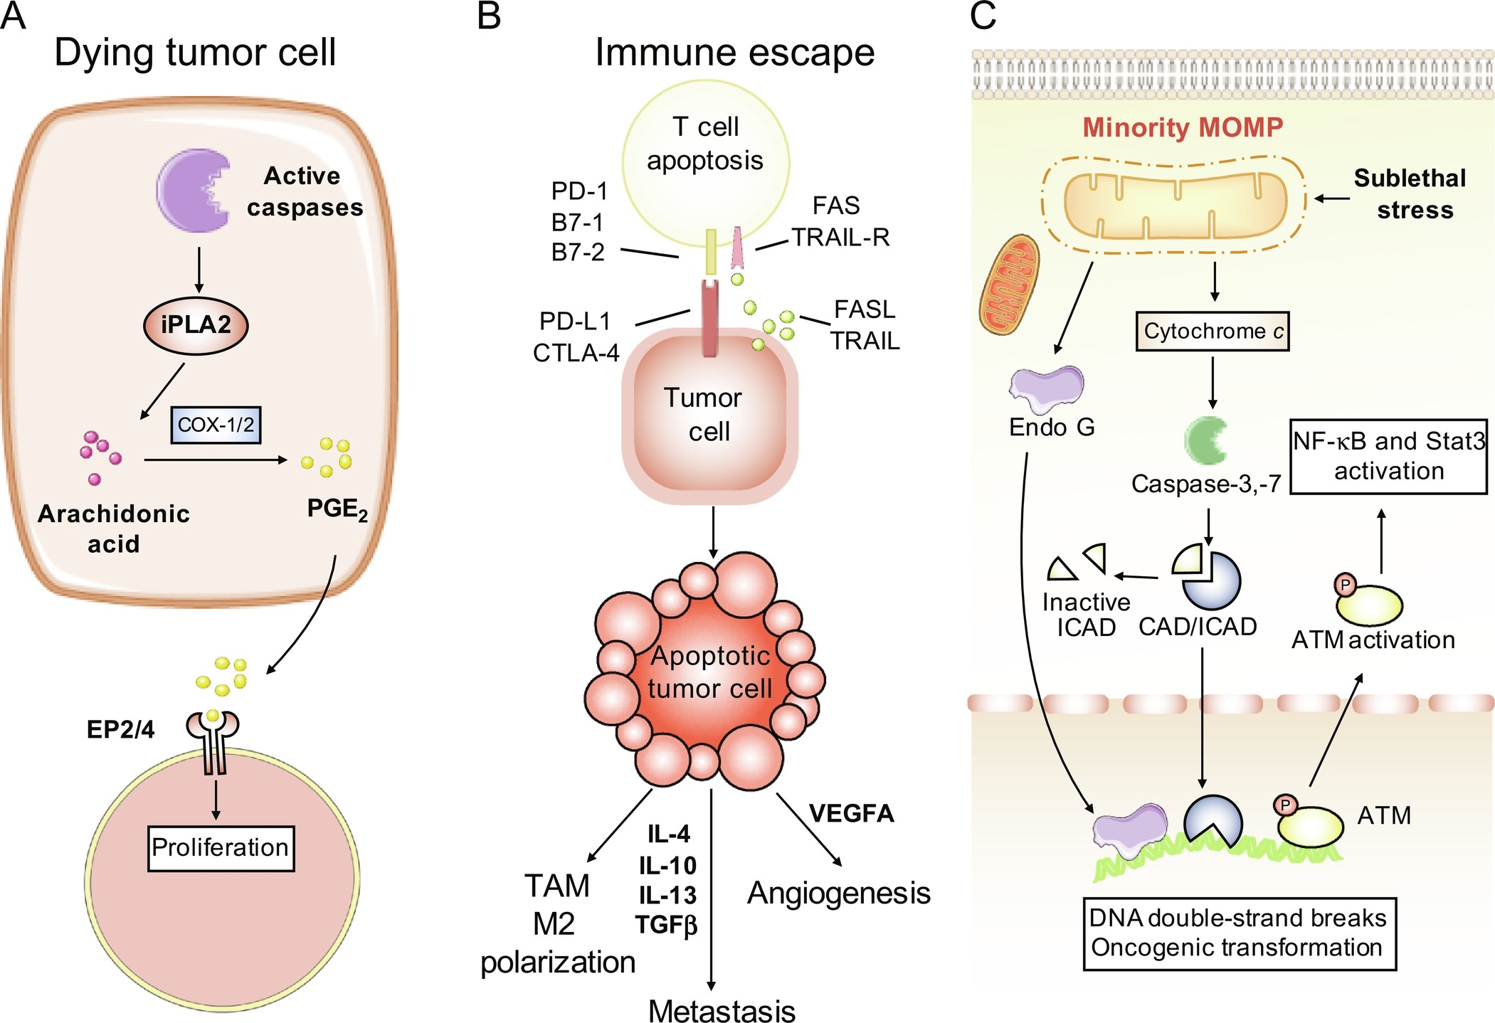
Pro-oncogenic roles of apoptotic signaling
Apoptosis-induced proliferation

Slide 25
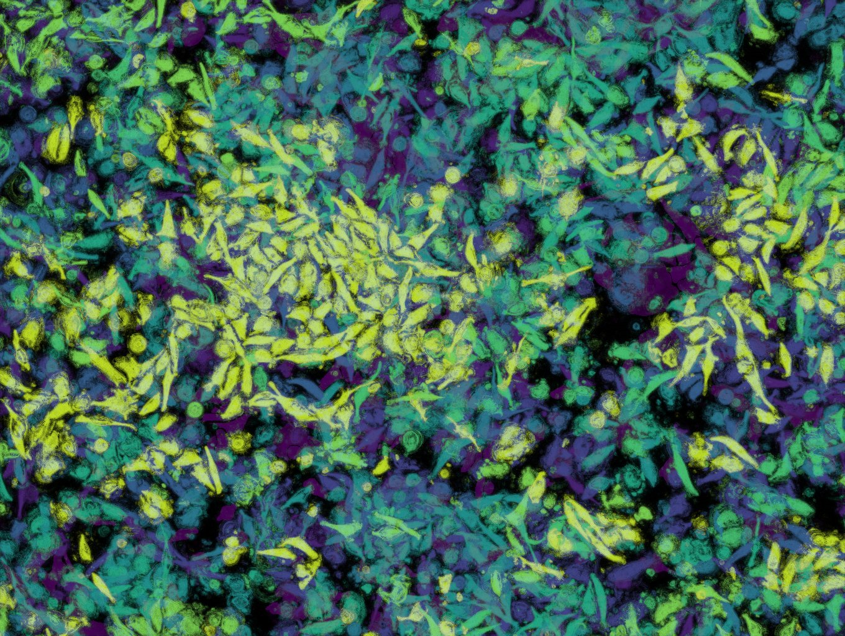
Thank you for your attention!

