Slide 1
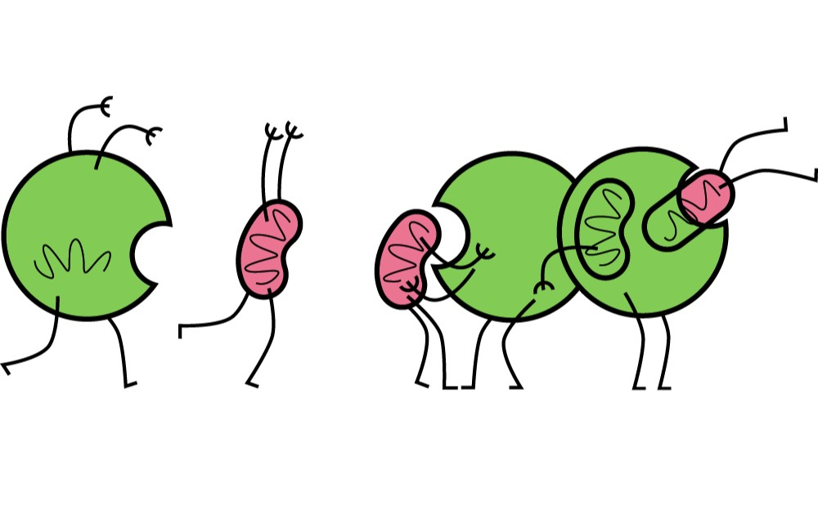
Autophagy
The role in health and disease.
Jan Balvan Ph.D.

Slide 2
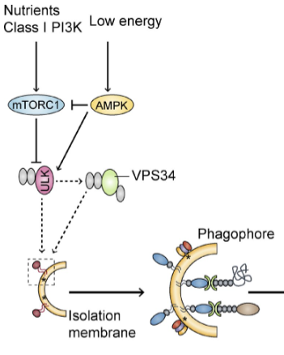
What is Autophagy?
Autophagy is a highly conserved catabolic process induced under various conditions of cellular stress, which prevents cell damage and promotes survival in the event of energy or nutrient shortage and responds to various cytotoxic insults.
Chemical or genetic disturbance of autophagy and the age-dependent decline in autophagic activity have been implicated in the progression of cancer, neurodegeneration and immune diseases, as well as ageing.
The most characterized trigger for induction of autophagy is deprivation of amino acids, which results in inhibition of the master cell growth regulator serine/threonine kinase mTOR.

Slide 3
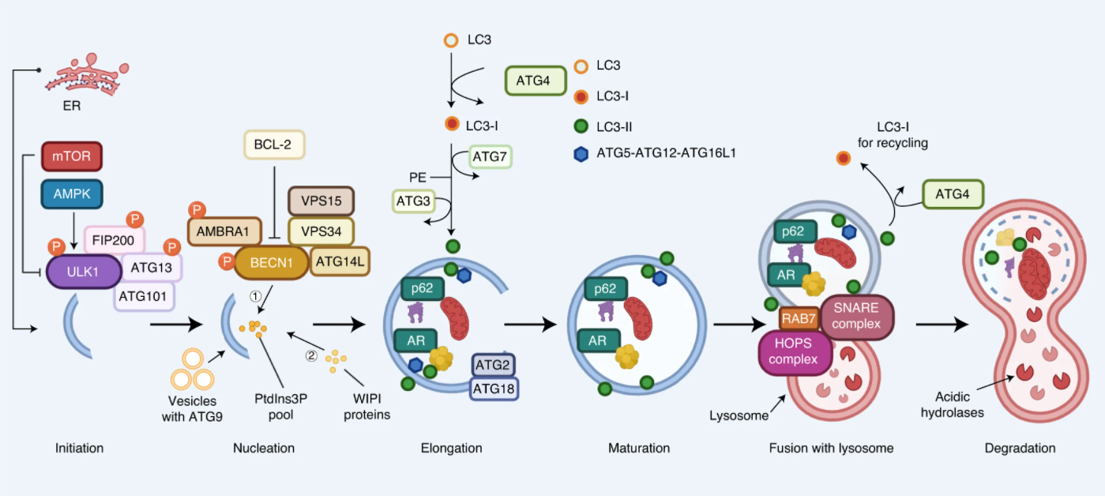
Mechanism of autophagy
Autophagy (from the Greek words auto, meaning ‘self’, and phagein, meaning ‘to eat’) is a fundamental cellular process that eliminates molecules and subcellular elements, including nucleic acids, proteins, lipids and organelles, via lysosome-mediated degradation to promote homeostasis, differentiation, development and survival.

Slide 4
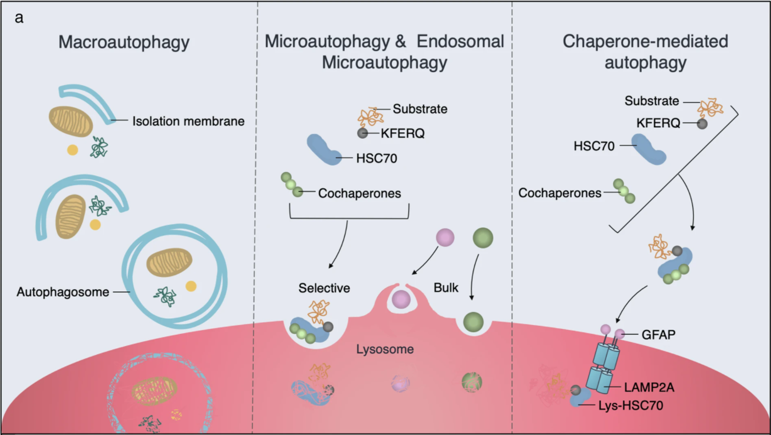
Types of Autophagy
Autophagy process can be distinguished according to how cargo enters the lysosome compartment.
In macroautophagy, a double-membrane isolation membrane elongates, expands, and seals to make an autophagosome around cytoplasmic components before fusing with the lysosome.
Microautophagy and endosomal microautophagy deliver small cargoes directly to the lysosome either without or with chaperones, respectively.
Chaperone-mediated autophagy requires the lysosome-associated membrane protein 2A (LAMP2A), in addition to molecular chaperones.

Slide 5
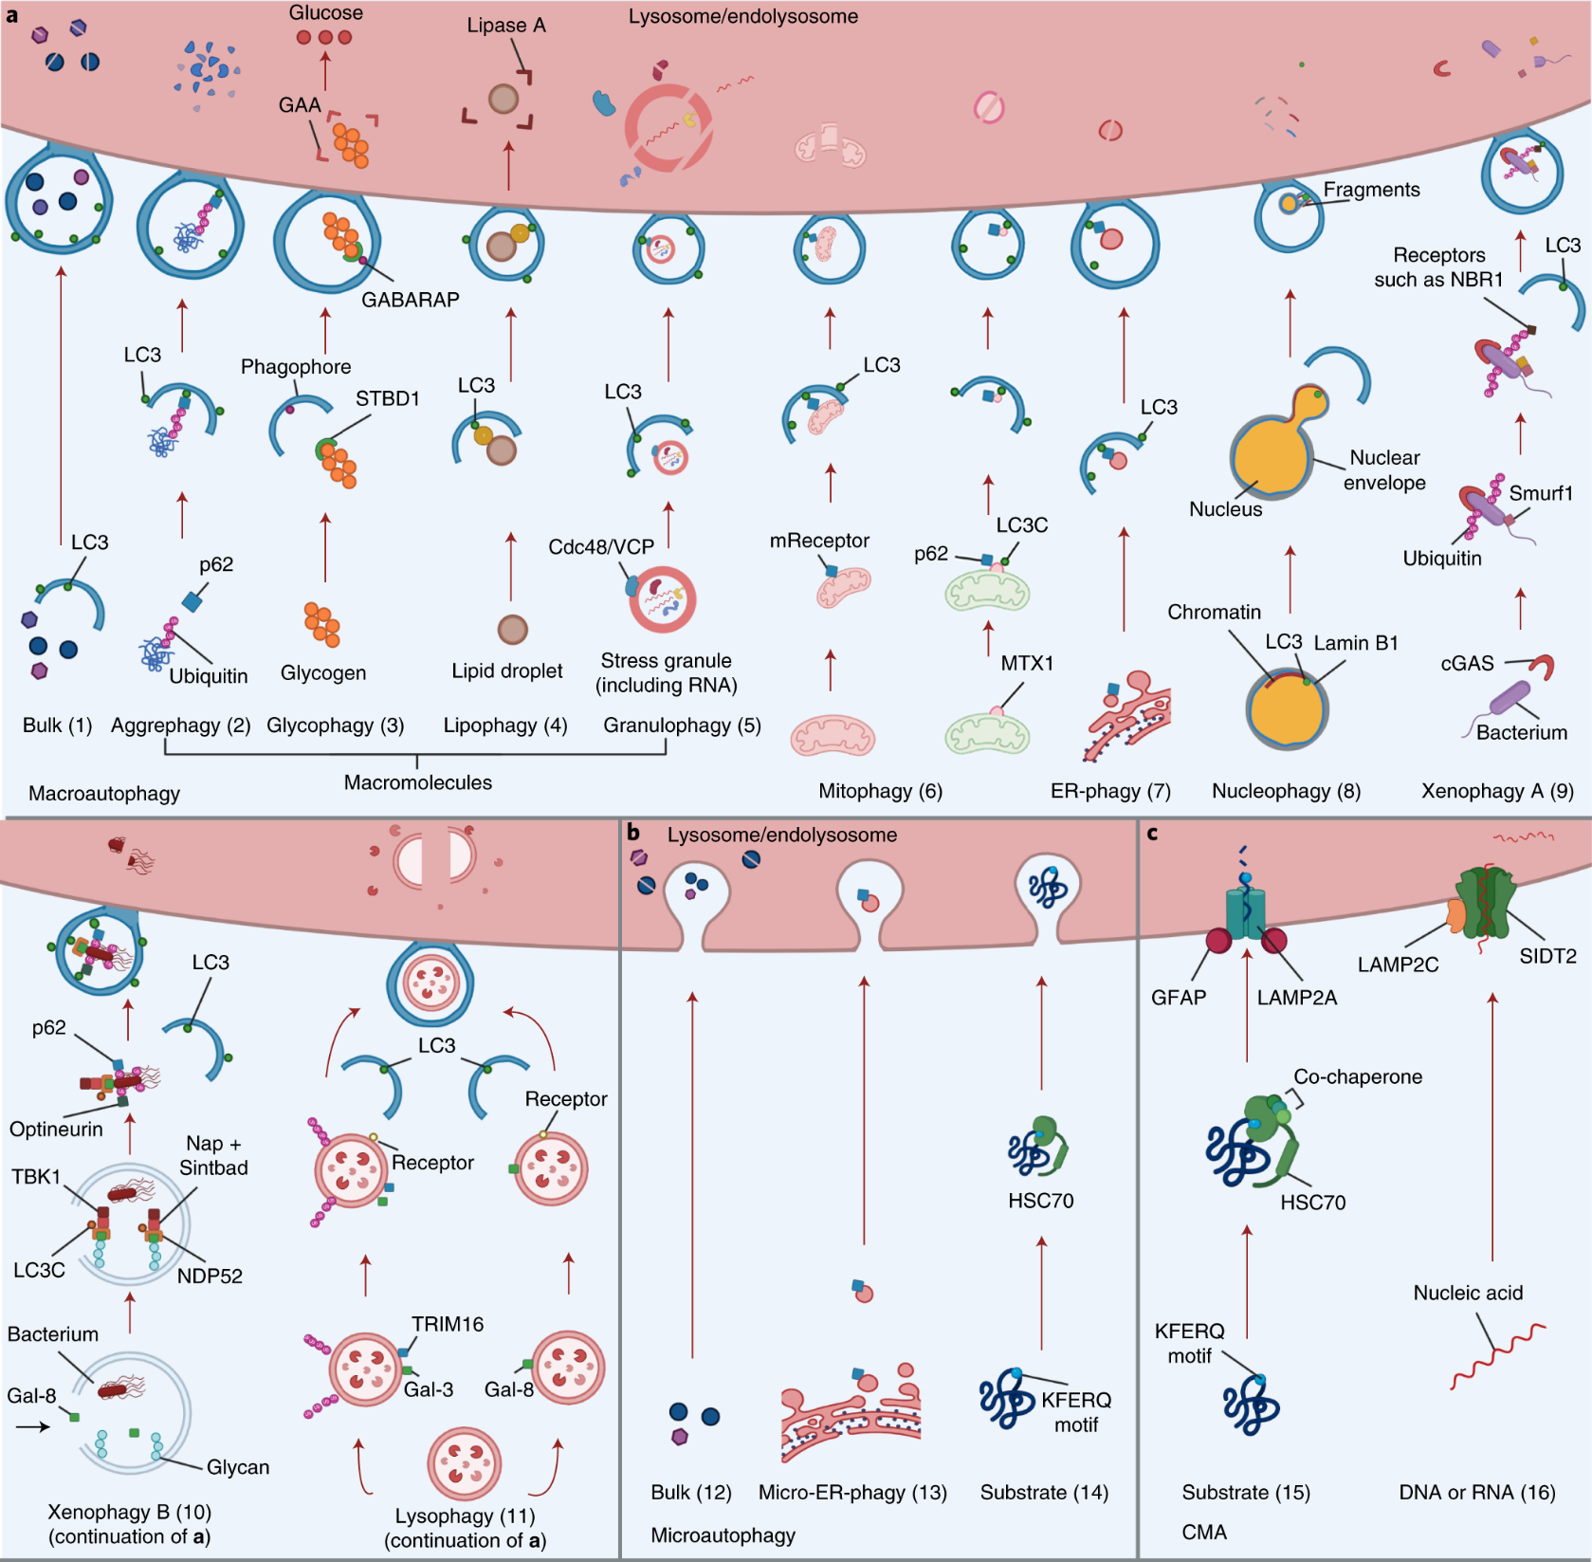
Types of Autophagy
Autophagy is recognized as a highly selective cellular clearance pathway that is associated with the maintenance of cellular and tissue homeostasis.
Selective autophagy can be further divided into many subtypes on the basis of the specific cargos involved.
Aman, Y., Schmauck-Medina, T., Hansen, M. et al. Autophagy in healthy aging and disease. Nat Aging 1, 634–650 (2021). https://doi.org/10.1038/s43587-021-00098-4

Slide 6
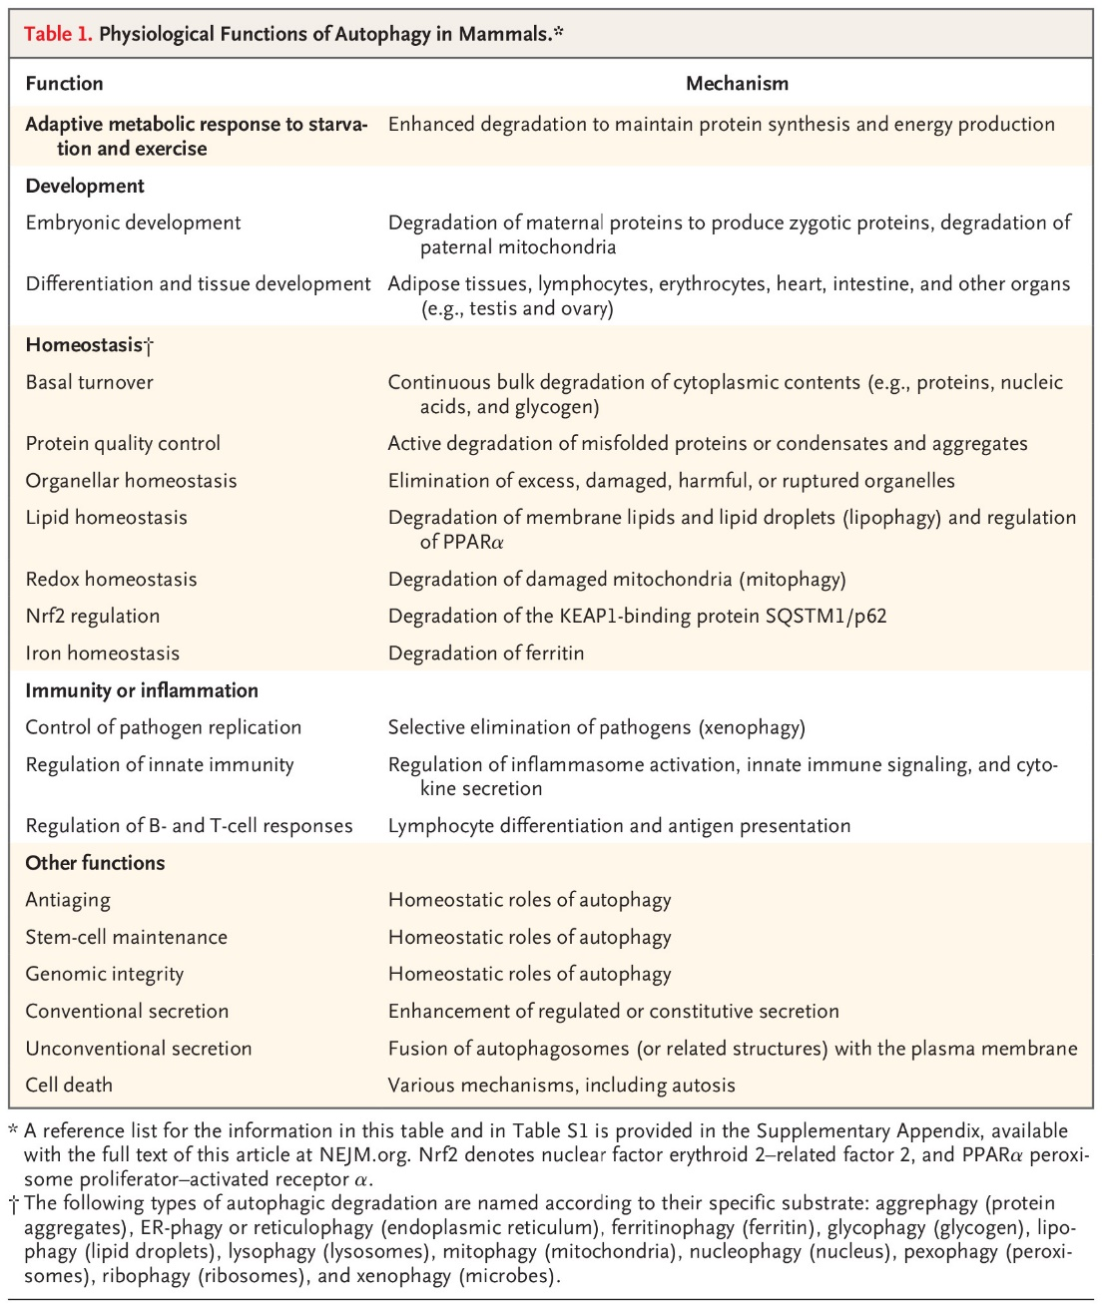
Physiological Roles of Autophagy
At first autophagy activation was identified as the response to starvation; currently, we know that autophagy is activated in response to different cellular stressors including exercise, endoplasmic reticulum stress, infection, and hypoxia.
Emerging results of the research are highlighting the pivotal role of autophagic response in tissue differentiation, functions, and remodeling after stimuli.
Mizushima, N. and B. Levine, Autophagy in Human Diseases. New England Journal of Medicine, 2020. 383(16): p. 1564-1576.

Slide 7
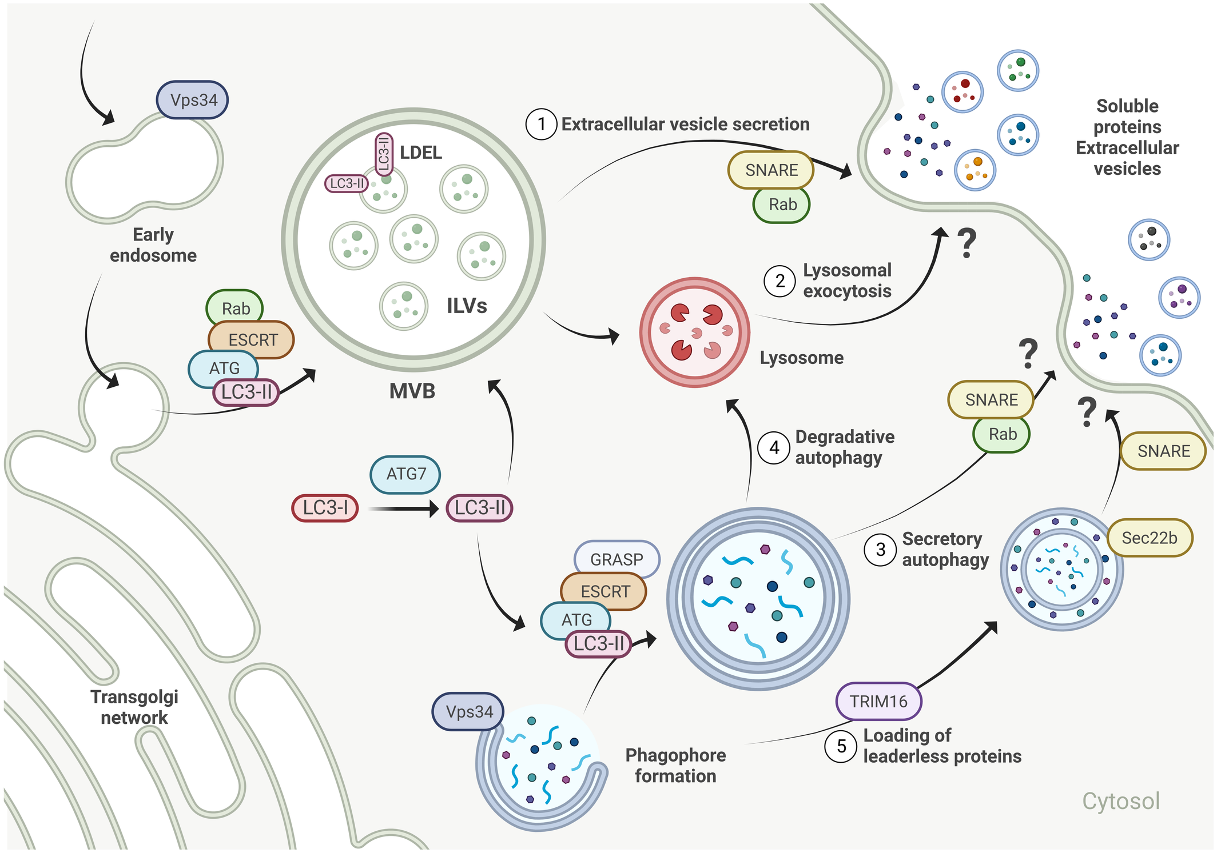
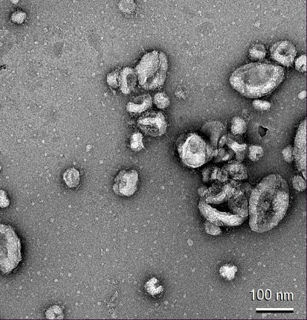
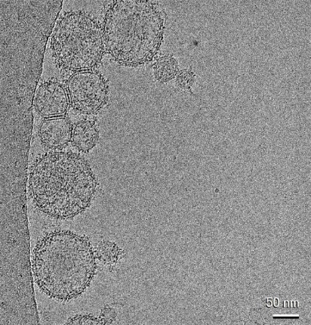
Secretory or non-cell autonomous autophagy
Secretory or non-cell autonomous autophagy is an umbrella term for autophagy-mediated extracellular secretion through autophagosomes/endosomes, including conventional and unconventional secretion of proteins, extracellular vesicle (EV) production, and egress of secretory lysosomes
Micrographs of extracellular vesicles. Negative stain EM (left) and Cryo EM (right).

Slide 8
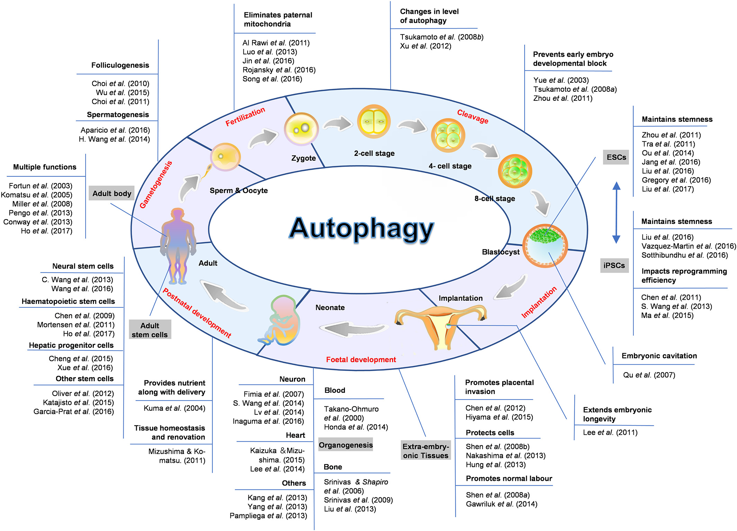
Function of Autopahgy
Autophagy plays an essential role during the mammalian life cycle. These functions span from fertilization, cleavage, implantation, fetal development, and postnatal development, to the next generation of gametogenesis, indicating that autophagy has important functions during the whole mammalian life cycle.
At birth the trans-placental nutrient supply is suddenly interrupted, and neonates face severe starvation until supply can be restored through milk nutrients. Neonates adapt to this adverse circumstance by inducing autophagy.

Slide 9
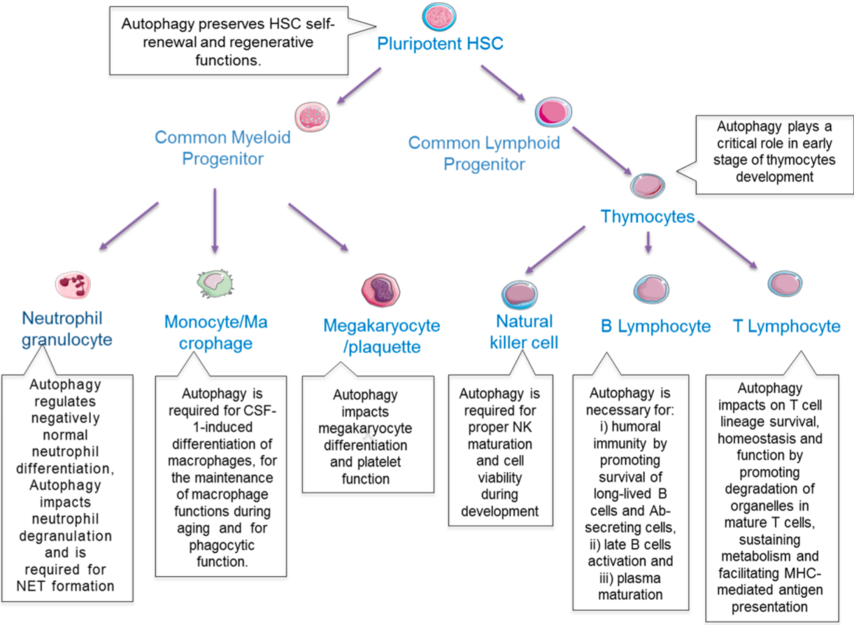
Autophagy and immunity
Autophagy plays a crucial role in initiating and supporting several processes in both innate and adaptive immunity.
ATG proteins directly contribute to pathogen clearance through selective autophagy of microorganisms, coordinated response with pattern recognition receptors, inflammasome formation, antigen presentation, and LC3-associated phagocytosis.
In adaptive immunity, autophagy modulates antigen processing and presentation and regulates the development of lymphocytes. Regulation of the organelle content of lymphocytes, especially mitochondria, by autophagy is crucial during differentiation.
The importance of autophagy for these functions is highlighted by the susceptibility of autophagy-deficient animals to infection and the implication of autophagy defects in autoimmune diseases, such as systemic lupus erythematosus, rheumatoid arthritis, psoriasis, diabetes and multiple sclerosis
Metur, S.P., Klionsky, D.J. Adaptive immunity at the crossroads of autophagy and metabolism. Cell Mol Immunol 18, 1096–1105 (2021). https://doi.org/10.1038/s41423-021-00662-3

Slide 10
Autophagy and Aging
Aging is a biological process that is characterized by time-dependent cellular and functional decline, resulting in reduced quality of life for the organism.
Aging is the primary risk factor for the development of many disorders, including cardiovascular disease (for example, stroke), cancer and neurodegenerative disease (for example, Alzheimer’s disease (AD)).
Among the many molecular changes associated with old age, altered autophagy has emerged as a feature of aging across diverse species.
Compromised autophagy is a hallmark of aging

Slide 11
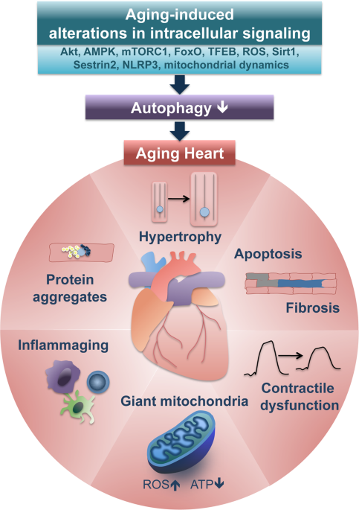
Autophagy and Aging
Aging is associated with an accumulation of damage to subcellular organelles. Selective autophagy is the common mechanism underlying the clearance of damaged and/or superfluous subcellular organelles such as mitochondria (mitophagy), the ER (reticulophagy or ER-phagy), the nucleus (nucleophagy) and lysosomes (lysophagy).
Gradual decline in the abundance of autophagy-related proteins and reduced delivery of cargo to lysosomes occur with age, implicating compromised autophagy as a cardinal feature of organismal aging.
The mounting evidence that an imbalance of autophagy is an important age-associated characteristic has driven extensive research into the development of compounds that can stimulate autophagy to promote longevity.
Aman, Y., Schmauck-Medina, T., Hansen, M. et al. Autophagy in healthy aging and disease. Nat Aging 1, 634–650 (2021). https://doi.org/10.1038/s43587-021-00098-4
Miyamoto, S. Autophagy and cardiac aging. Cell Death Differ 26, 653–664 (2019). https://doi.org/10.1038/s41418-019-0286-9

Slide 12
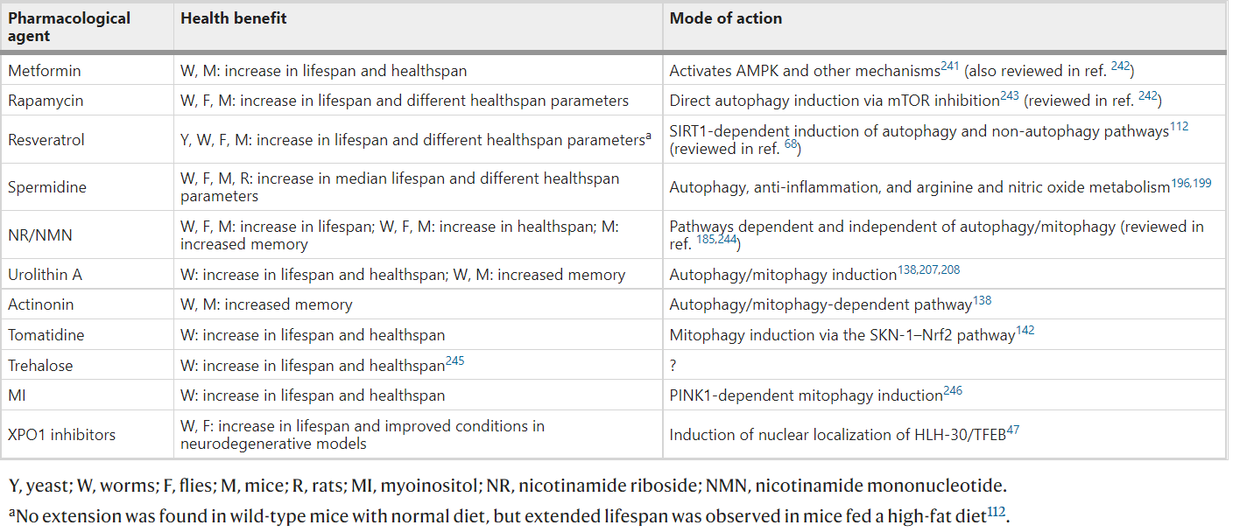
Autophagy and Aging
Summary of autophagy inducers that extend healthspan and increase lifespan in laboratory animals.
Aman, Y., Schmauck-Medina, T., Hansen, M. et al. Autophagy in healthy aging and disease. Nat Aging 1, 634–650 (2021). https://doi.org/10.1038/s43587-021-00098-4

Slide 13
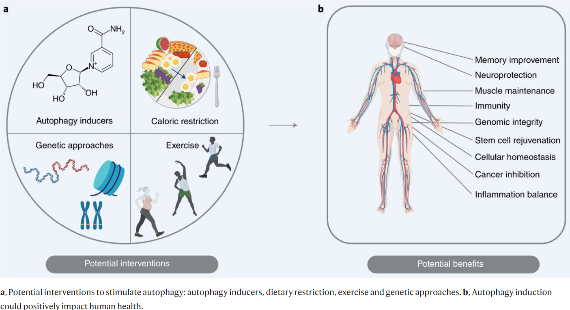
Autophagy and Aging
Aman, Y., Schmauck-Medina, T., Hansen, M. et al. Autophagy in healthy aging and disease. Nat Aging 1, 634–650 (2021). https://doi.org/10.1038/s43587-021-00098-4

Slide 14
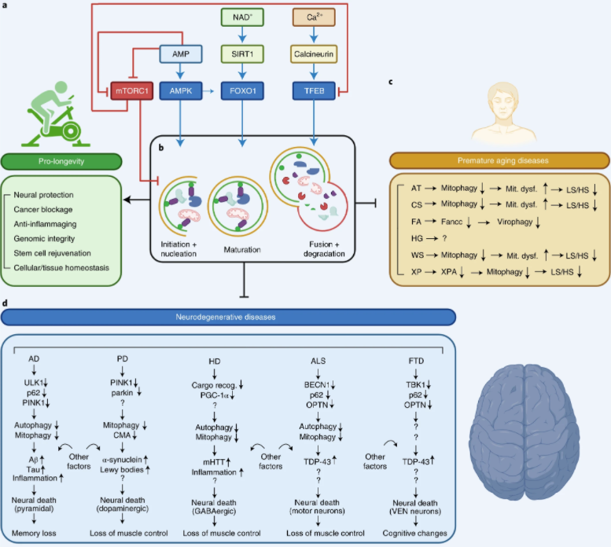
Autophagy in Health and Disease
Premature aging diseases with impaired mitophagy as a cause of mitochondrial dysfunction, which contributes to short lifespan (LS) and healthspan (HS).
ataxia telangiectasia (AT),
Cockayne syndrome (CS),
Fanconi anemia (FA),
Hutchinson–Gilford syndrome (HG),
Werner syndrome (WS) and xeroderma pigmentosum (XP; especially group A).
Autophagy (including subtypes of selective autophagy, such as mitophagy) is impaired in broad neurodegenerative diseases, where impairment may drive or exacerbate disease progression.
Alzheimer's disease (A)D,
Parkinson’s disease (PD),
Huntington’s disease (HD),
amyotrophic lateral sclerosis (ALS),
frontotemporal dementia (FTD).
We emphasize that these are not the only drivers of the diseases and other processes may have roles leading to pathology and symptomatology.
Aman, Y., Schmauck-Medina, T., Hansen, M. et al. Autophagy in healthy aging and disease. Nat Aging 1, 634–650 (2021). https://doi.org/10.1038/s43587-021-00098-4

Slide 15
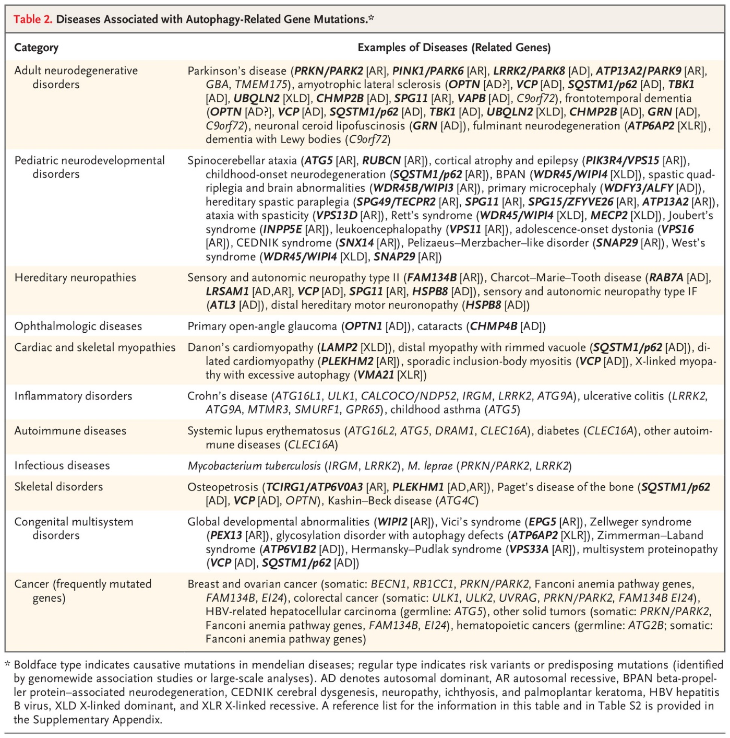
Autophagy in Health and Disease
Mutations in autophagy-related genes are now known to cause mendelian disorders, and autophagy gene polymorphisms have been found to be associated with susceptibility to some diseases.
In the future, because autophagy has a waste disposal function, its activation and inhibition could be a novel therapeutic strategy for neurodegenerative diseases and cancers.
Mizushima, N. and B. Levine, Autophagy in Human Diseases. New England Journal of Medicine, 2020. 383(16): p. 1564-1576.

Slide 16
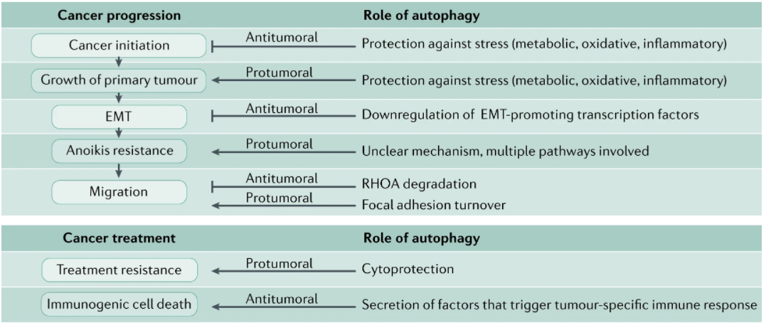
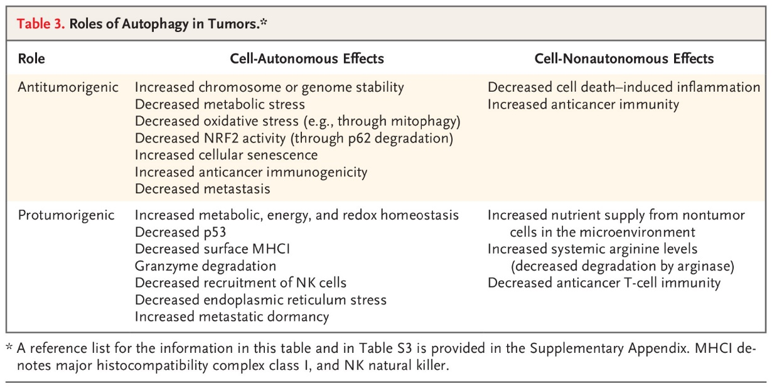
Complex roles of autophagy in cancer development and progression
Autophagy is an important process during cancer progression, but the exact roles of autophagy in cancer cells are strongly context-dependent.
Its cytoprotective function is believed to have tumour-suppressive potential before the onset of tumorigenesis, and loss of autophagy has been associated with increased risk of cancer.
autophagy provides cancer cells with metabolic plasticity, allowing them to thrive in suboptimal environments and to exploit the pro-survival activity of autophagy to cope with therapy-induced stresses
autophagy induction is a side effect of many cancer therapies, and thus, pharmacological inhibition of autophagy has been proposed as a valid strategy to enhance the efficacy of therapies and to avoid resistance to treatment in certain cancers
Mizushima, N. and B. Levine, Autophagy in Human Diseases. New England Journal of Medicine, 2020. 383(16): p. 1564-1576.

Slide 17
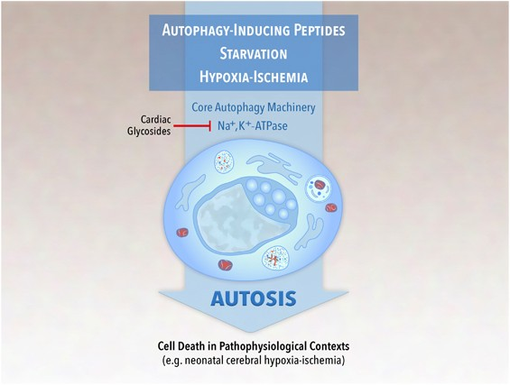
Autophagy as a cell death modality?
It is controversial whether cells truly die via autophagy or whether — in dying cells — autophagy is merely an innocent bystander or a well-intentioned ‘Good Samaritan’ trying to prevent inevitable cellular demise.
An aggressive form of autophagy termed autosis has been described in cells following either ischemia/reperfusion injury or in response to autophagy-inducing proteins like Tat-Beclin 1.
While it has not been demonstrated unambiguously that autophagy drives cell death during development (Kroemer and Levine, 2008), there is increasing evidence that ADCD is a bona fide cell death program. Nevertheless, there are still major gaps in our understanding of this mechanism in development and pathogenesis.
Genetic models where an absolute requirement for the autophagic machinery has been shown to be essential for cell death: Dictyostelium discoideum, Drosofila melanogaster

Slide 18
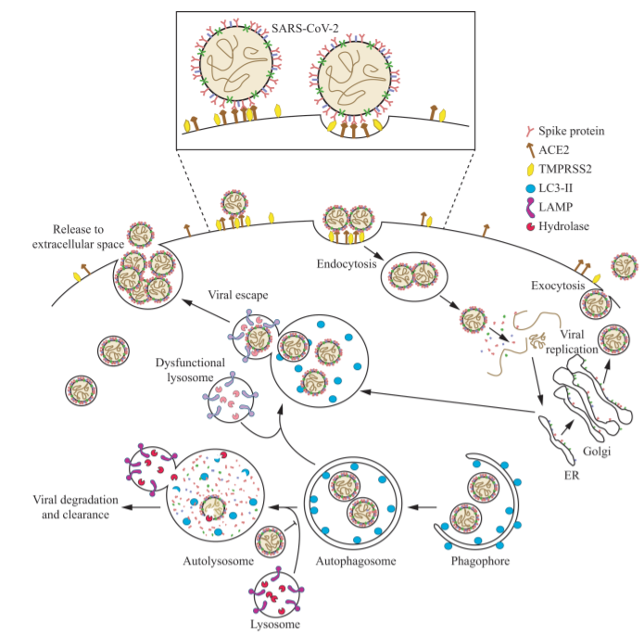
Coronavirus interactions with the cellular autophagy machinery
The viruses enter the host cell via endocytosis (they can do that also by different mechanisms) and release their RNA into the cytosol;
this is followed by replicative translation with the membrane proteins being made in the endoplasmic reticulum.
The newly formed viral particles may be released from the cell via exocytosis, or they may then intersect with autophagy.
In general, autophagy plays an “antiviral” role, sequestering viral structural proteins or even completely assembled viral particles within autophagosomes; these will bind with lysosomes leading to degradation of the cargo by lysosomal hydrolytic enzymes.
However, recent studies suggest that SARS-COV-2 disrupts and hijacks the autophagy-lysosomal pathway and subverts it.
For example, the viral ORF3a protein may block autophagosome-lysosome fusion.
In addition, viral proteins may be delivered to a de-acidified lysosome from which they can be released from the cell. This “proviral” role of the disrupted autophagy process leads to extensive production and release of the virus to the extracellular space causing the infection to spread to non-infected cells.
Nastaran Samimi, Mojtaba Farjam, Daniel J. Klionsky & Nima Rezaei (2021) The role of autophagy in the pathogenesis of SARS-CoV-2 infection in different cell types, Autophagy, DOI: 10.1080/15548627.2021.1989150

Slide 19
Thank you for your attention!

