Slide 1
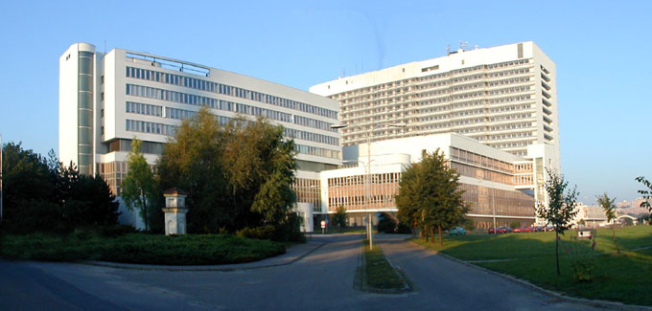
Posterior segment surgery
MUDr. Veronika Matušková
Oční klinika FN Brno
Přednosta prof. MUDr. Eva Vlková, CSc.

Slide 2
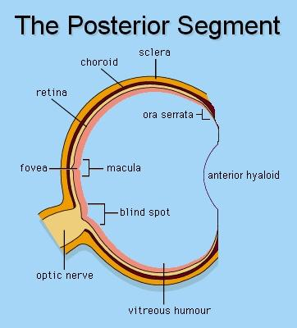

Slide 3
Retinal detachment
Rhegmatogenous - tear
Tractional - traction of corpus vitreum
Serose – production of fluid

Slide 4
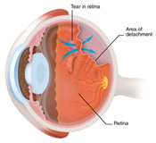
Retinal detachment

Slide 5
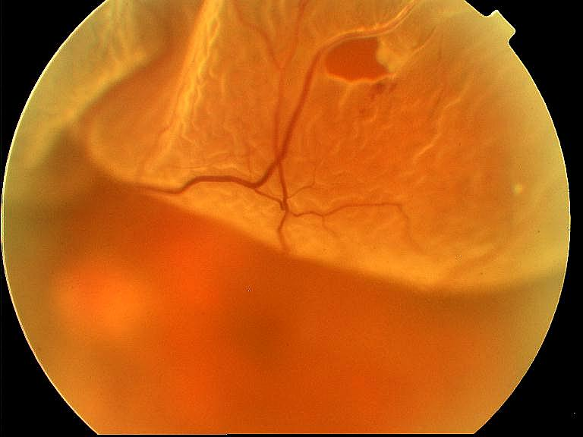
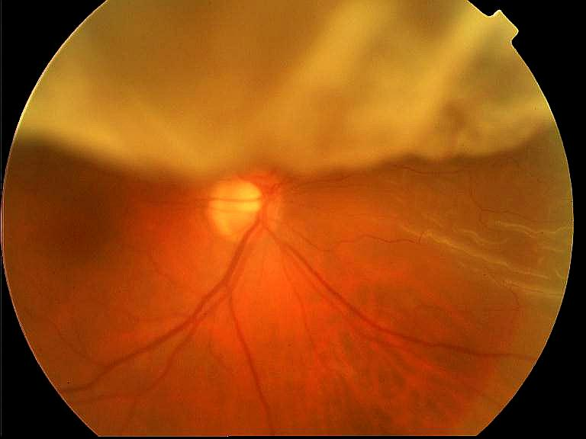
Retinal detachment

Slide 6
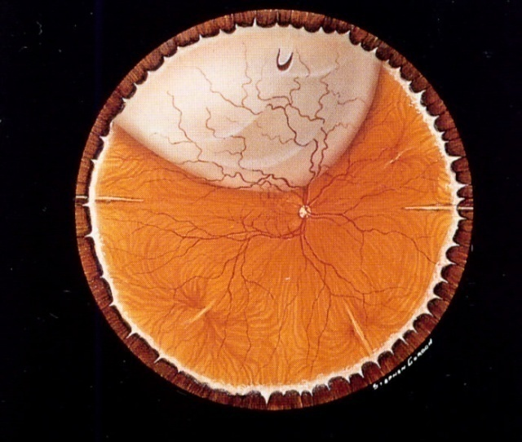
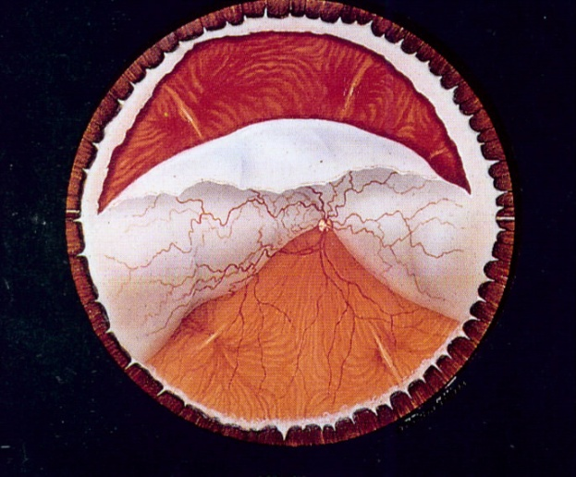
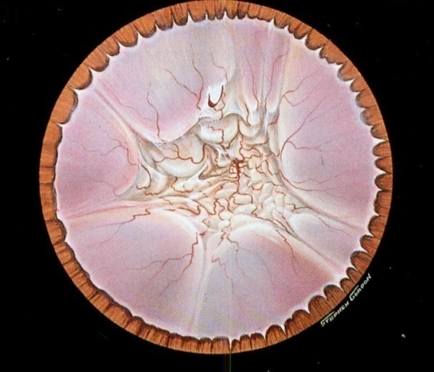
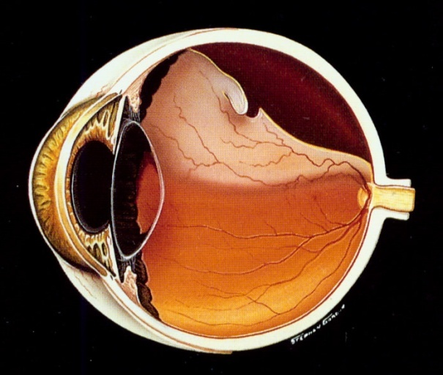
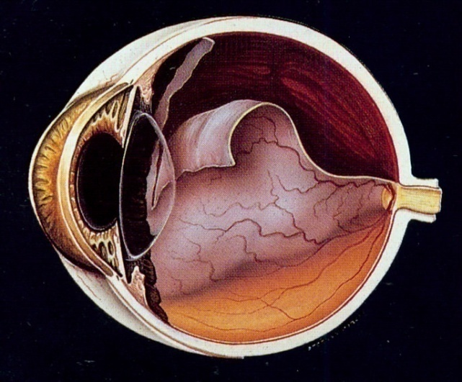
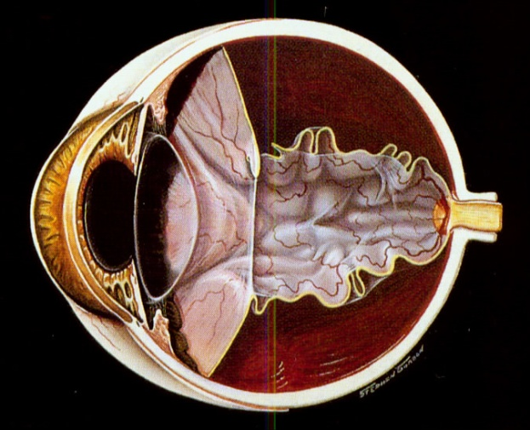
Retinal detachment

Slide 7
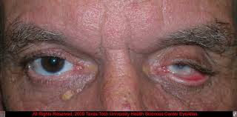
Phtisis bulbi

Slide 8
Retinal detachment - symptoms
Fotopsia (flashes)
Black spots (black snow)
Scotoma (black spot in peripheral visual field)
Decrease of visual accuity
Metamorfopsia

Slide 9
Surgery:
Close the tear

Slide 10
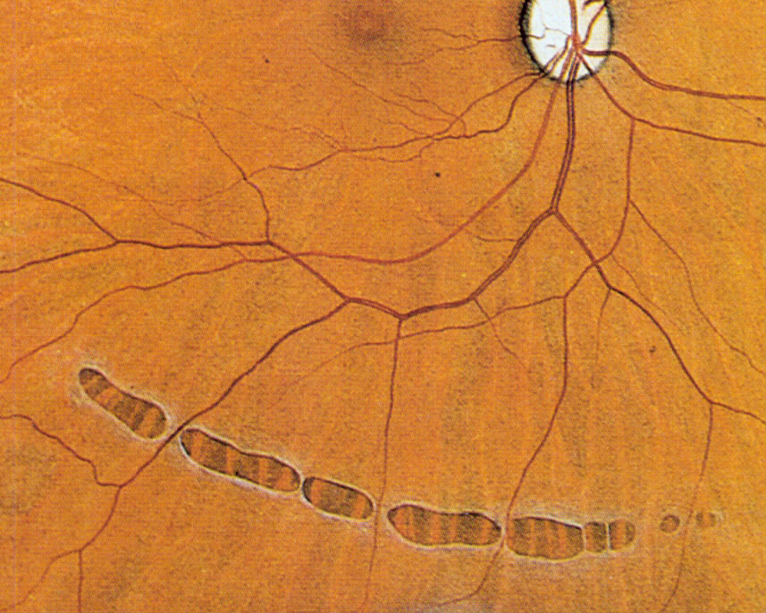
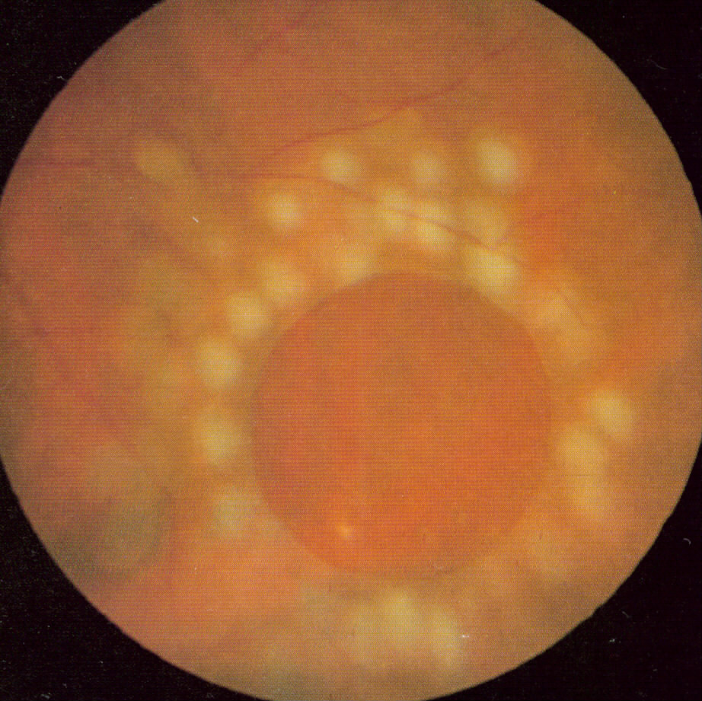
Laser photocoagulation

Slide 11
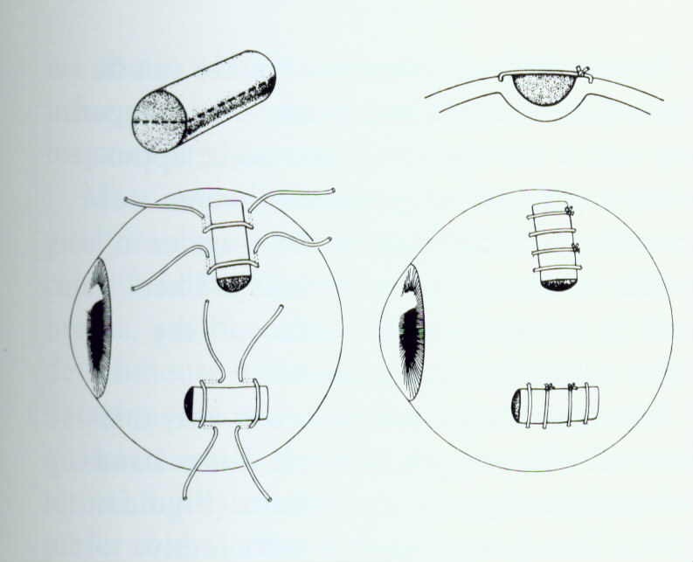
Extrabulbar operations
Cryotherapy and plombage

Slide 12
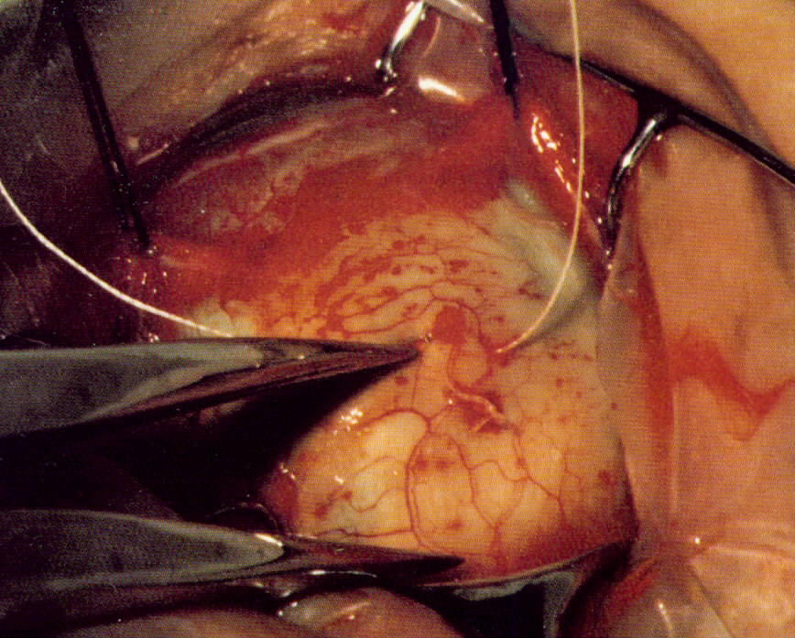
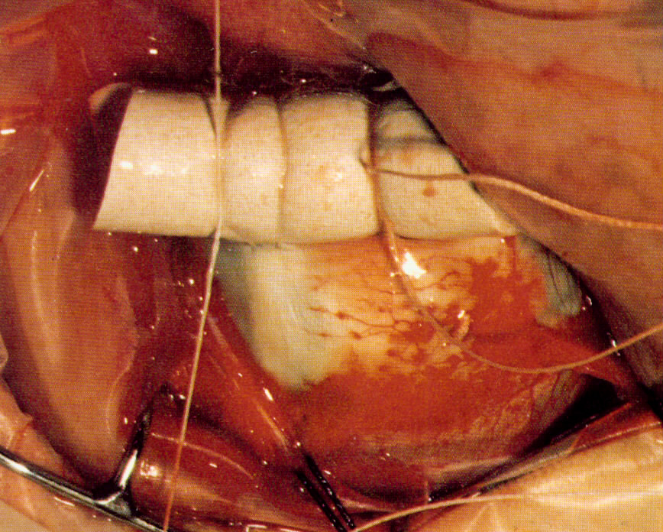
Plombage

Slide 13
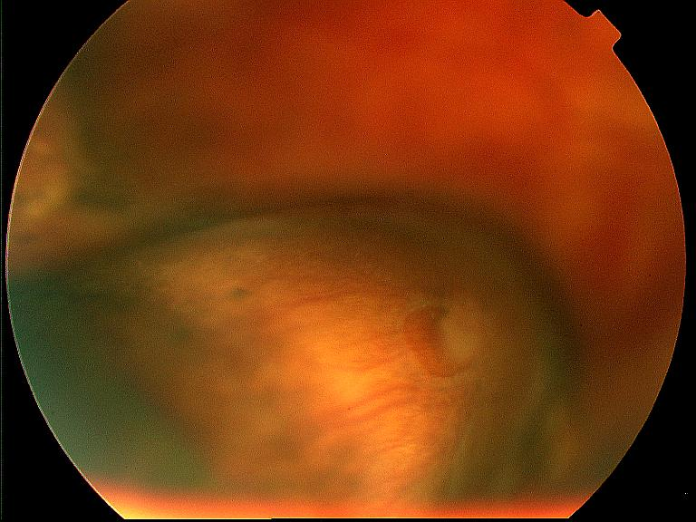
Plombage

Slide 14
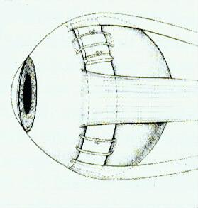
Cerclage

Slide 15
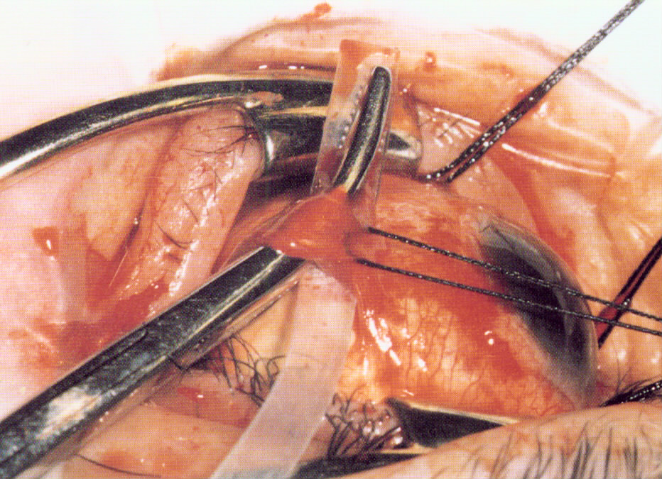
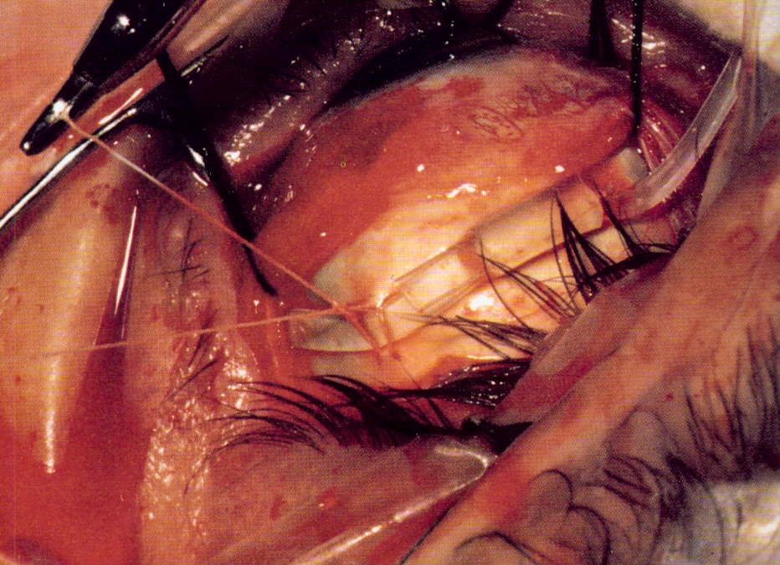
Cerclage

Slide 16
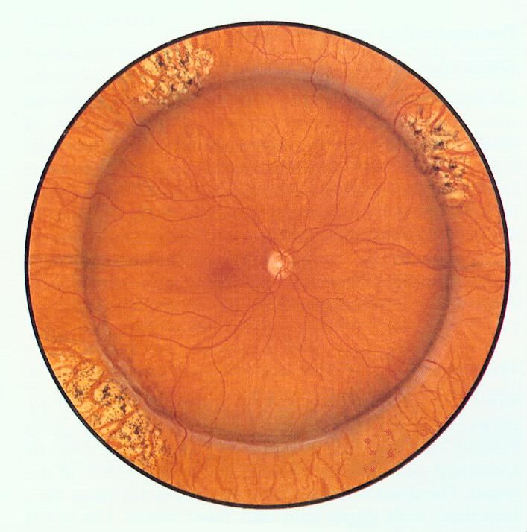
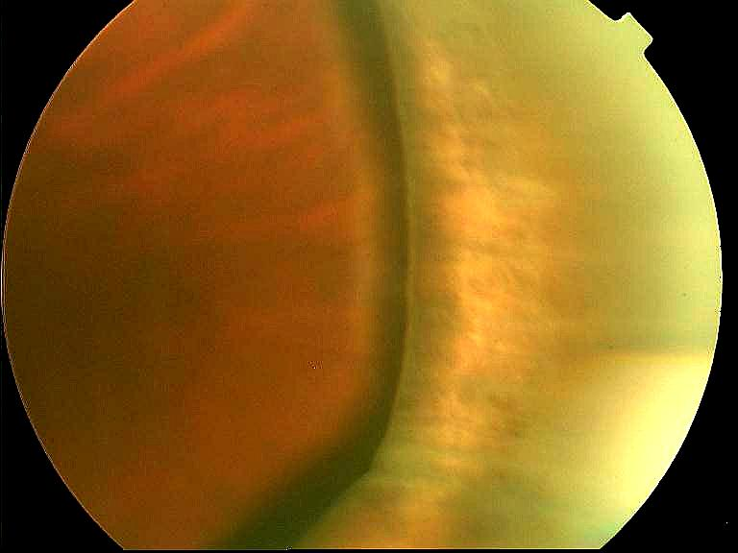
Cerclage

Slide 17
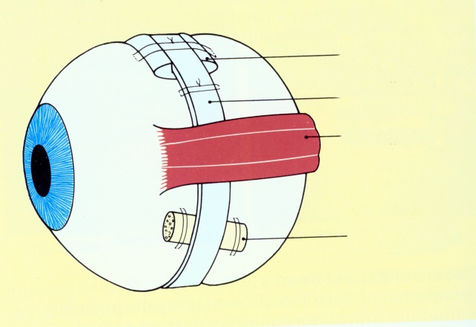
Extrabulbar surgery
cerklážní pásek
přímý sval
plomba

Slide 18
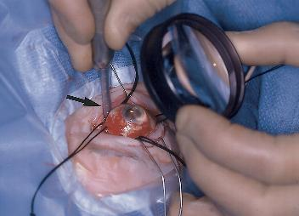
Cryotherapy - development of chorioretinal adhesion (scar)

Slide 19
Complications
Fenestra is not closed
PVR - proliferative vitreoretinopathy

Slide 20
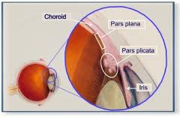
PPV
Pars plana vitrektomie

Slide 21
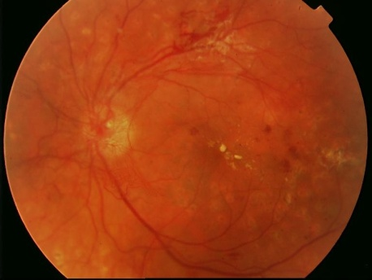
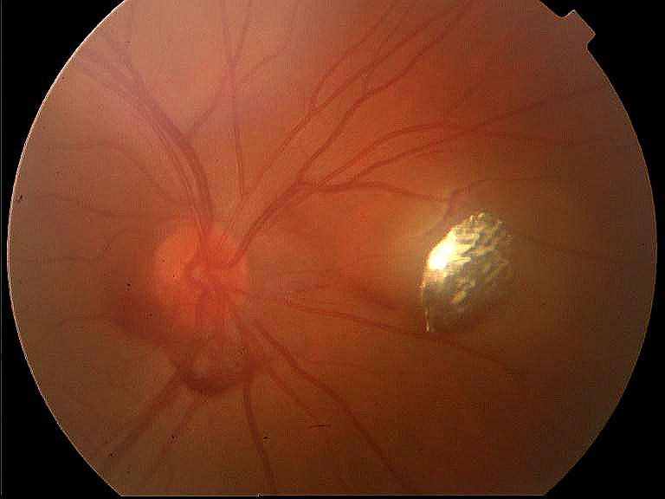
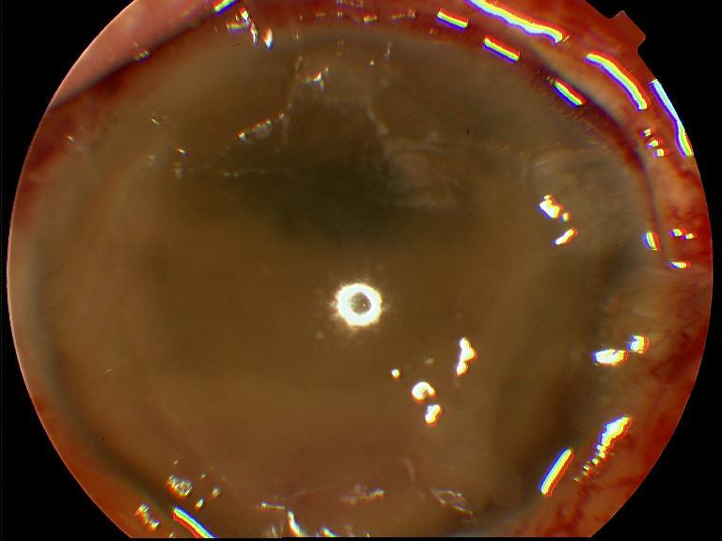
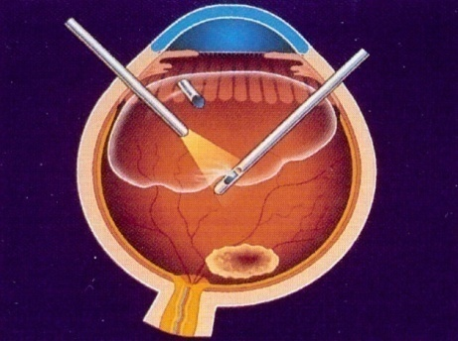
Pars plana vitrectomy
Haemophtalmus
PDR
Retinal detachment
Complications of cataract surgery
Posterior luxation of lens
Foreign intraocular body
Endophtalmitis

Slide 22
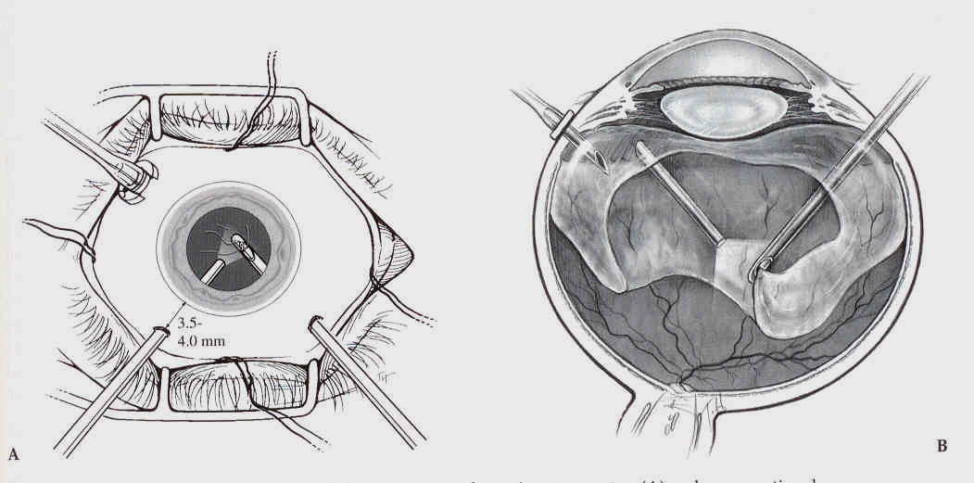
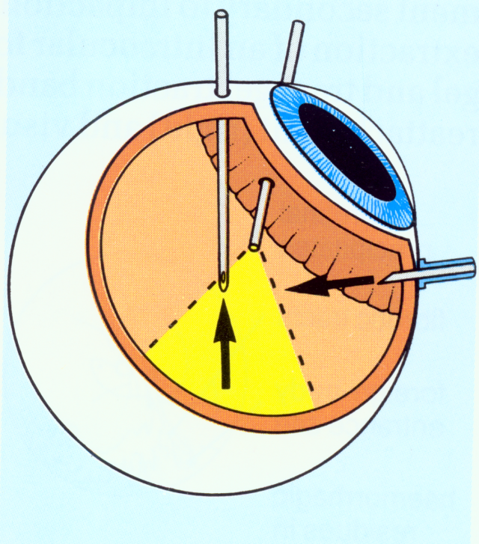
Pars plana vitrectomy -PPV

Slide 23
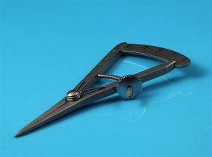
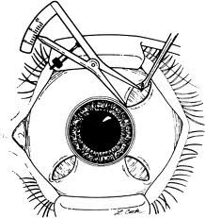
PPV – pars plana

Slide 24
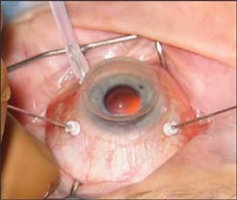
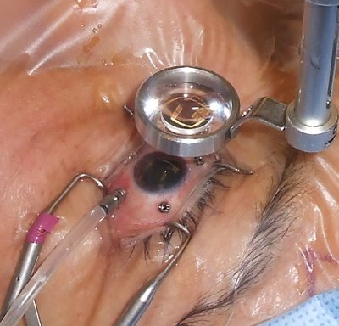
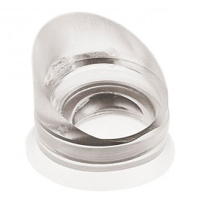
PPV

Slide 25
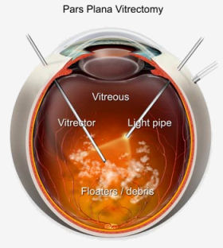
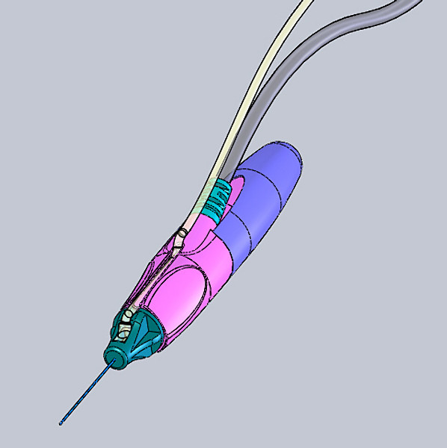
PPV

Slide 26
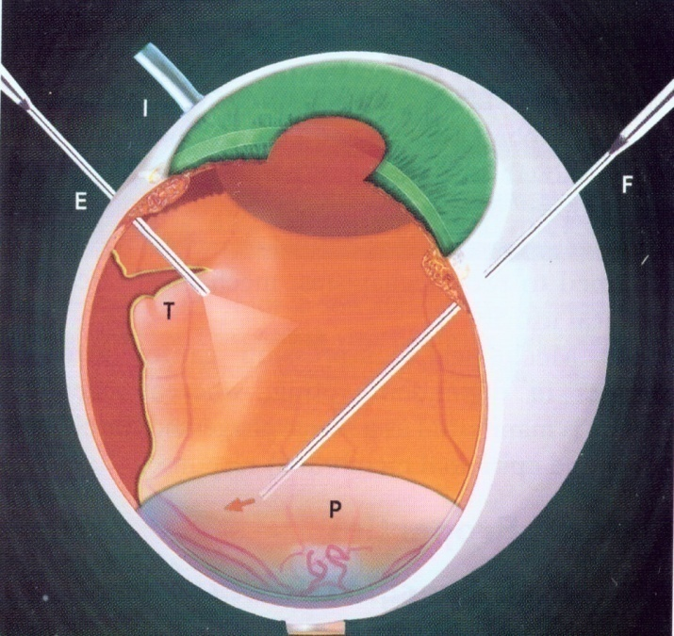
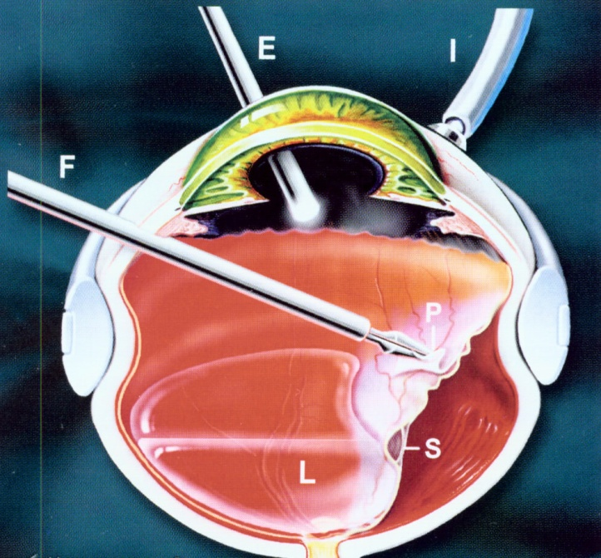
Internal tamponade
Infusion solution
Silicone oil
Gas ( C3F8, SF6)

Slide 27
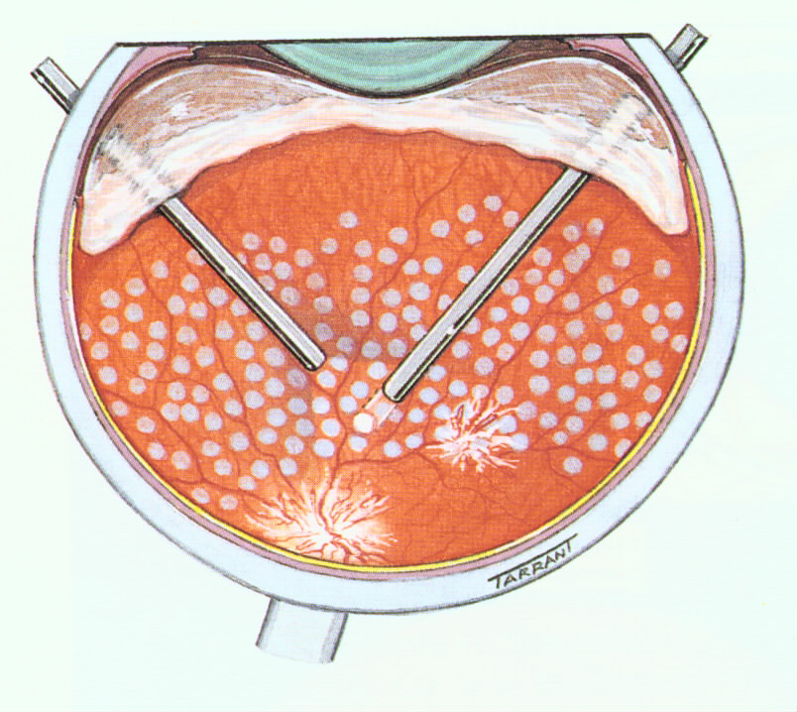
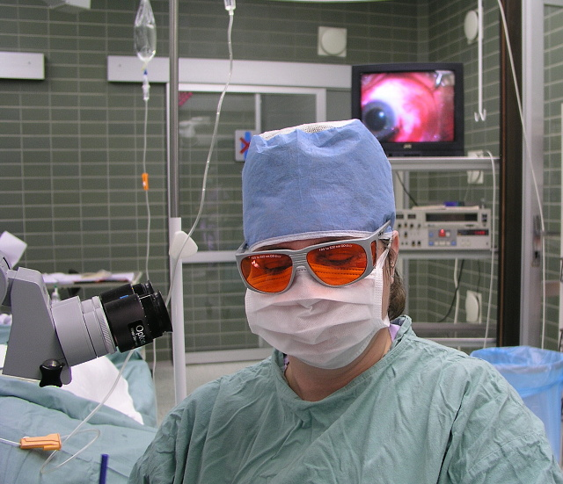
Endolaser

Slide 28
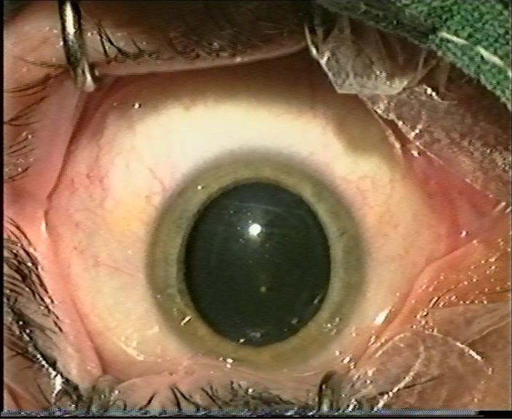
PPV-video

Slide 29
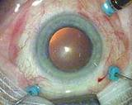
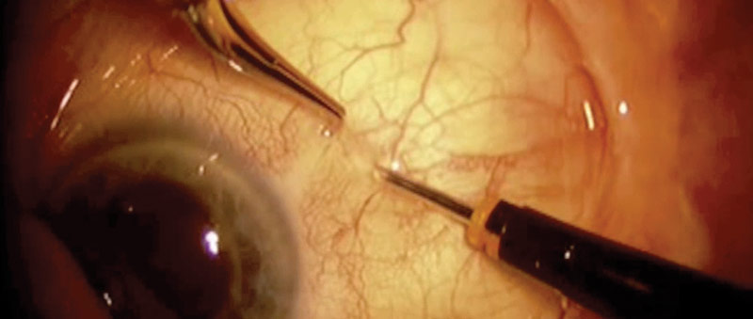
PPV -23 or 25 G
Sutureless surgery
23 G (0,57 mm)
20 G (0,45 mm)

Slide 30
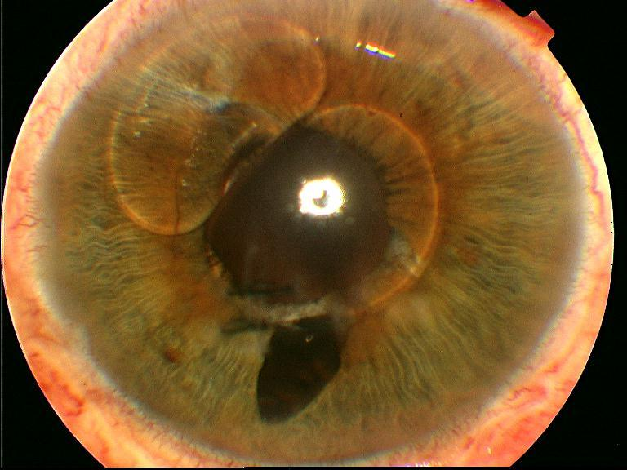
Complications

Slide 31
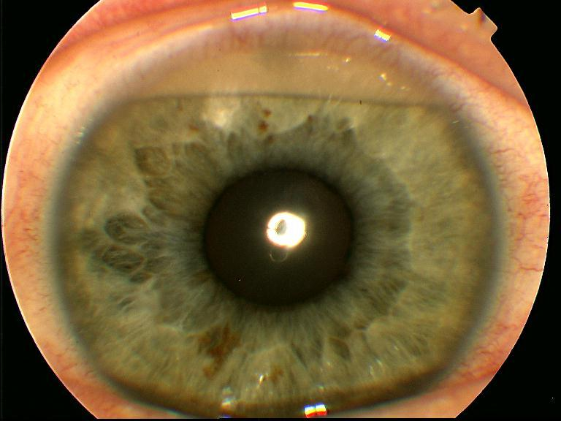
Complications

Slide 32
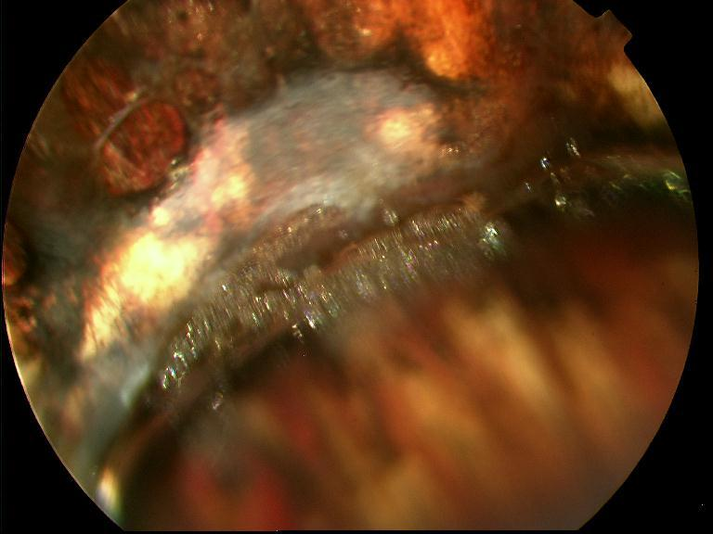
Complications - emulsification

Slide 33
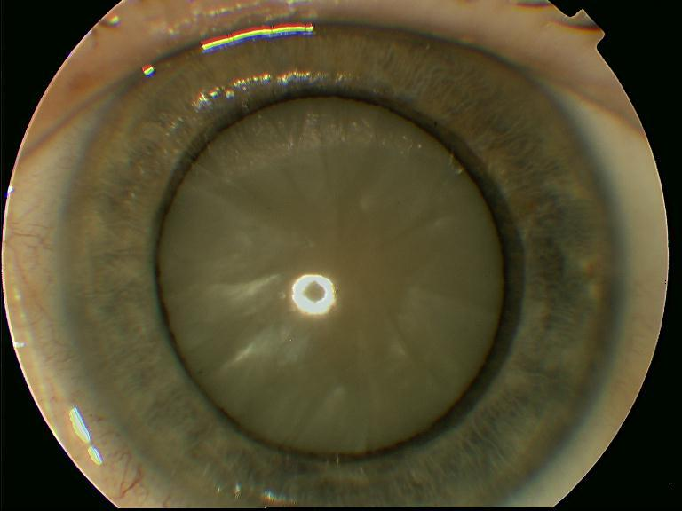
Complications

Slide 34

Complications

Slide 35

Anesthesia
GA
ANS
LA

Slide 36

Surgery

Slide 37

Surgery

