Slide 1
Red eye – differential diagnosis

Slide 2
Red eye
„Red eye“ is a sign of pathology of the anterior or posterior part of the eyeball, orbit or ocular adnexa.

Slide 3
Anamnesis
Systemic disease
Ocular disease (trauma, surgery)
Development of ocular diffuculties
Characteristic of diffuculties (type of the pain, discharge…)

Slide 4
Orbit – preseptal cellulitis
Infection of the subcutaneous tissues anterior to the orbital septum.
Causes
  Skin trauma - laceratio, insect bites (S. aureus or S. pyogenes)
  Spread of local infection - from an acute hordeolum or dacryocystitis.
  From remote infection of the upper respiratory tract or middle ear by haematogenous spread
Signs - Unilateral, tender and red periorbital oedema

Slide 5
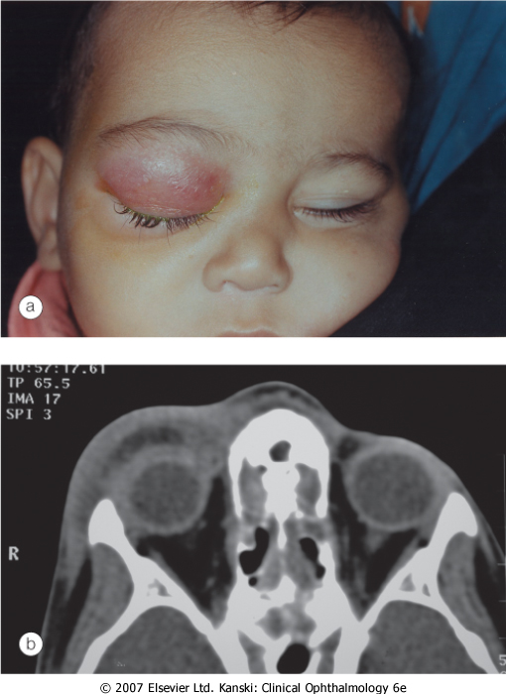

Slide 6
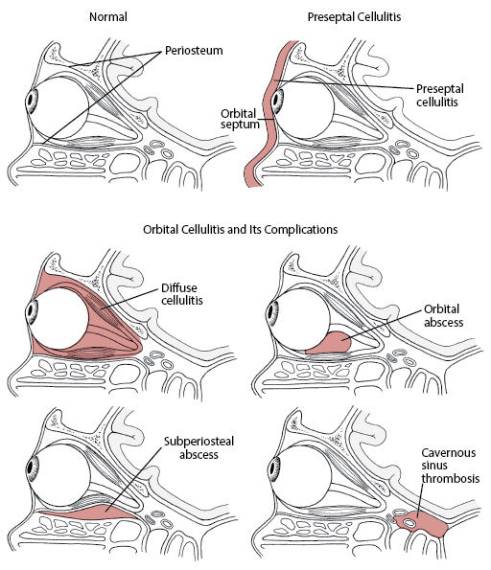

Slide 7
Orbit - Bacterial orbital cellulitis
Life-threatening infection of the soft tissues behind the orbital septum, mainly in children
The most prevalent causative organisms are S. pneumoniae, S. aureus, S. pyogenes and H. influenzae.
Pathogenesis
Sinus-related - ethmoidal, typically affects children and young adults.
Extension of preseptal cellulitis
Local spread from adjacent dacryocystitis, and mid-facial or dental infection
Haematogenous spread

Slide 8
Orbit - Bacterial orbital cellulitis
Presentation is with a rapid onset of severe malaise, fever, pain and visual impairment
Signs
Unilateral, tender, warm and red periorbital oedema
Proptosis, lid swelling
Painful ophthalmoplegia
Optic nerve dysfunction

Slide 9
Orbit - Bacterial orbital cellulitis
Complications
Ocular complications - exposure keratopathy, raised intraocular pressure, occlusion of the central retinal artery or vein, endophthalmitis and optic neuropathy
Intracranial complications - meningitis, brain abscess and cavernous sinus thrombosis
Subperiosteal abscess - along the medial orbital wall
Orbital abscess in post-traumatic or postoperative cases.

Slide 10
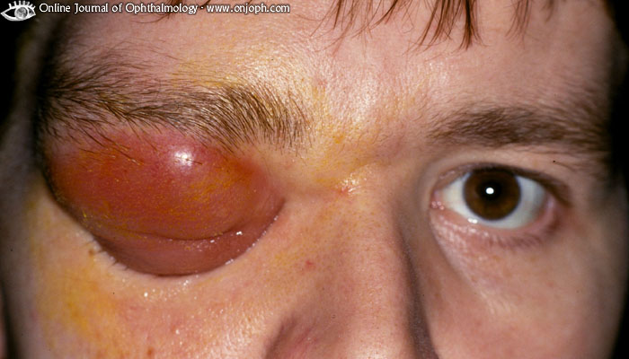

Slide 11
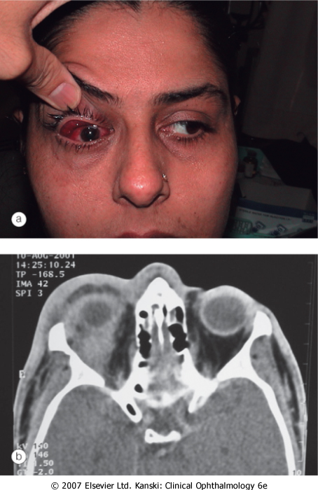

Slide 12
Dry Eye Syndrome
There is inadequate tear volume or function resulting in an unstable tear film and ocular surface disease.
Keratoconjunctivitis sicca (KCS) refers to any eye with some degree of dryness.
Xerophthalmia describes a dry eye associated with vitamin A deficiency.
Xerosis refers to extreme ocular dryness and keratinization that occurs in eyes with severe conjunctival cicatrization.
Sjögren syndrome is an autoimmune inflammatory disease which is usually associated with dry eyes.

Slide 13
Dry Eye Syndrome
Symptoms
feelings of dryness, grittiness and burning - worsen during the day, transient blurring of vision, redness and crusting of the lids

Slide 14
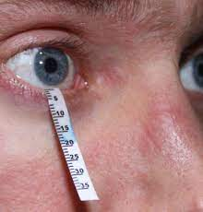
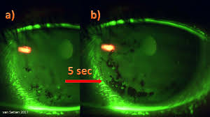
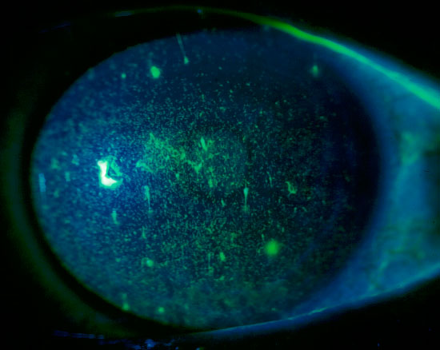
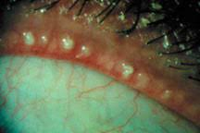
Dry Eye Syndrome
Tests

Slide 15
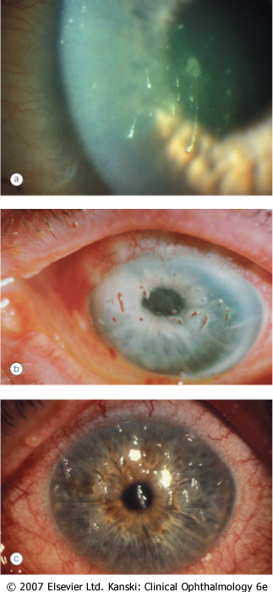

Slide 16
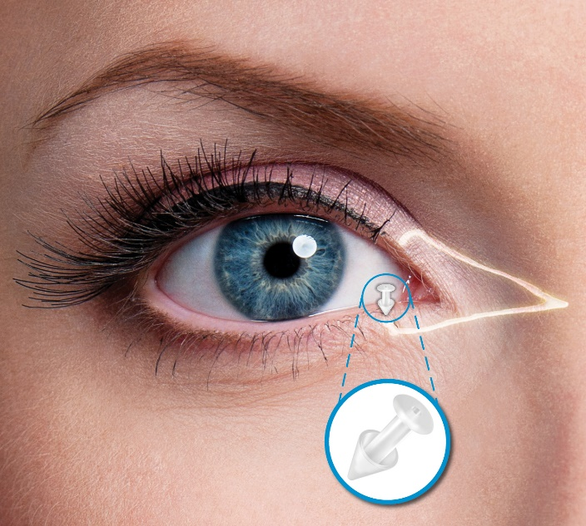
Dry Eye Syndrome
Therapy:
Arteficial tears
Antiflogistic drugs- steroids, cyclosporin A
Contact lens
Punctal plugs

Slide 17
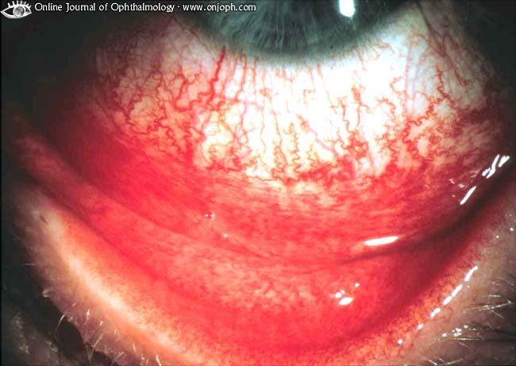
Conjunctival injection
Conjunctival injection is diffuse, beefy-red and maximum in fornix
Instillation of 10% phenylephrine drops will constrict the conjunctival and superficial episcleral vasculature

Slide 18
Conjunctivitis
Bacterial - H. influenzae, S. pneumoniae, S. aureus
Papillary reaction over the tarsal plates
Mucopurulent discharge
Gonococcal keratoconjunctivitis - pseudomembrane formation, lymphadenopathy, corneal ulceration
!New born babies

Slide 19
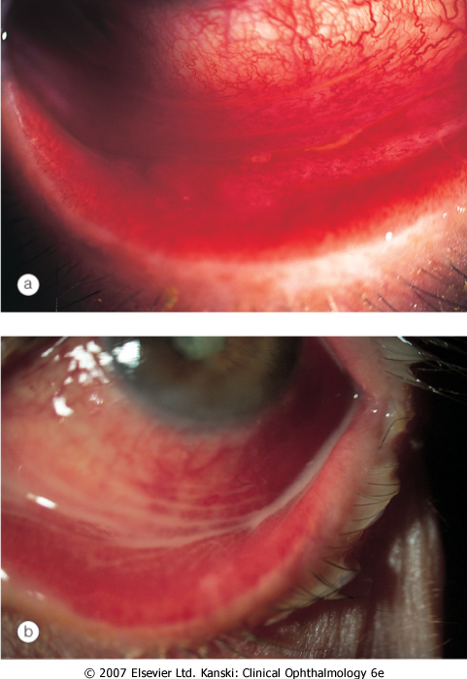

Slide 20
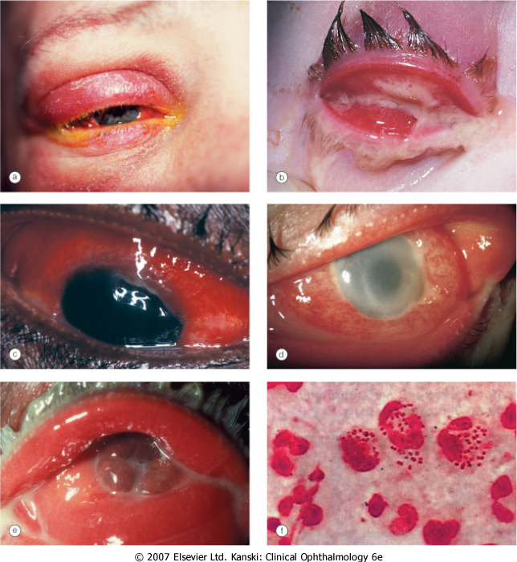

Slide 21
Conjunctivitis
Viral conjunctivitis
Adenoviral keratoconjunctivitis - the most common external ocular viral infection
Sporadic or occur in epidemics in hospitals, schools and factories
Transmission of this highly contagious virus -respiratory or ocular secretions
Dissemination is by contaminated towels or equipment such as tonometer heads

Slide 22
Conjunctivitis
Presentation
Unilateral watering, redness, discomfort and photophobia
The contralateral eye is typically affected 1-2 days later, but less severely
Eyelid oedema and tender pre-auricular lymphadenopathy.
Follicular conjunctivitis

Slide 23
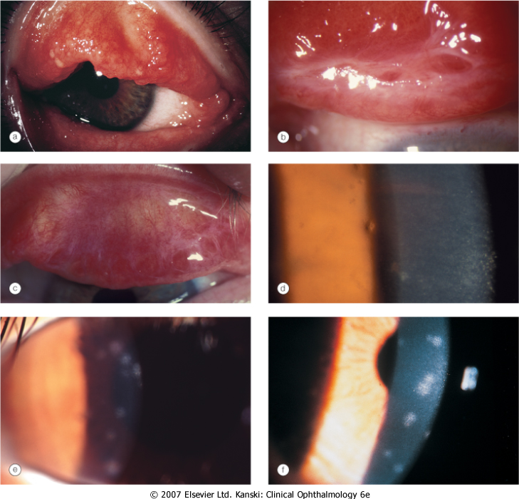

Slide 24
Conjunctivitis
Acute allergic rhinoconjunctivitis
Seasonal allergic conjunctivitis (hay fever) - onset during the spring and summer
The most frequent allergens are tree and grass pollens
Perennial allergic conjunctivitis causes symptoms throughout the year with exacerbation in the autumn when exposure to house dust mites, animal dander and fungal allergens is greatest
Presentation - redness, watering and itching, associated with sneezing and nasal discharge

Slide 25
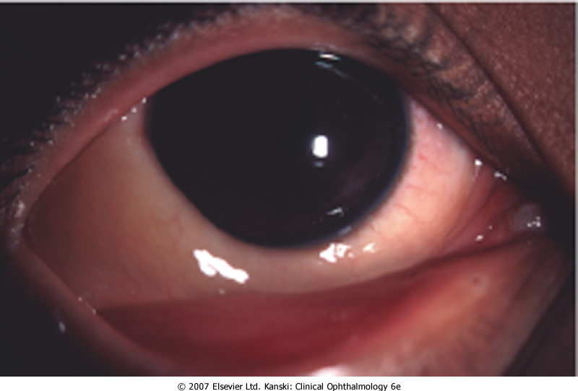

Slide 26
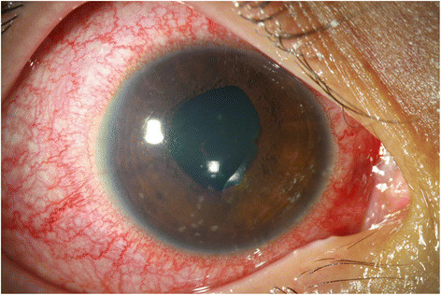
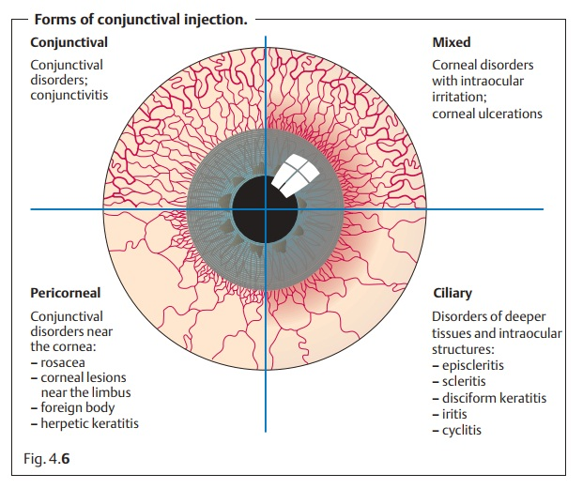
Cilliary injection
Violet colour
Maximum around limbus

Slide 27
Cornea – infectious keratitis
Keratitis – bacterial (P. aeruginosa ,S. aureus, S. pyogenes)
Risk factors - Contact lens wearing, trauma
Presenting symptoms - pain, photophobia, blurred vision and discharge
Signs
An epithelial defect, infiltrate around the margin, circumcorneal injection
Stromal oedema and small hypopyon
Progressive ulceration may lead to corneal perforation and endophthalmitis.

Slide 28
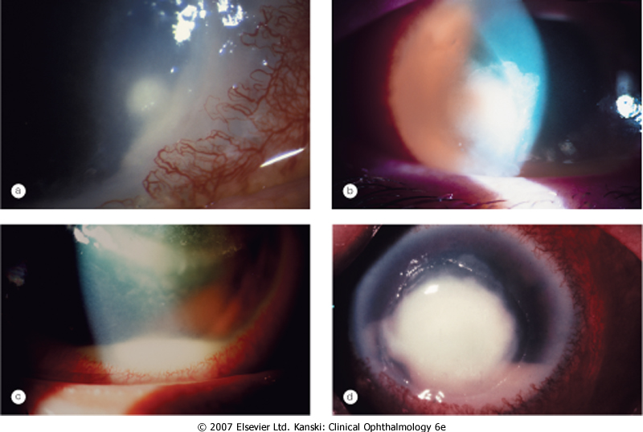

Slide 29
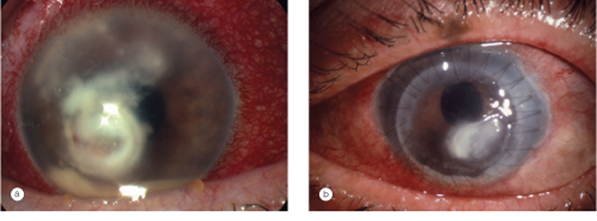
Cornea – infectious keratitis
Keratitis – fungal (stromal infiltrate with indistinct margins, surrounded by satellite lesions, hypopyon)
T: antimycotics – local and systemic

Slide 30
Cornea – infectious keratitis
Keratitis viral – herpes simplex virus
linear-branching (dendritic) ulcer, corneal sensation is reduced
T: local antivirotics

Slide 31
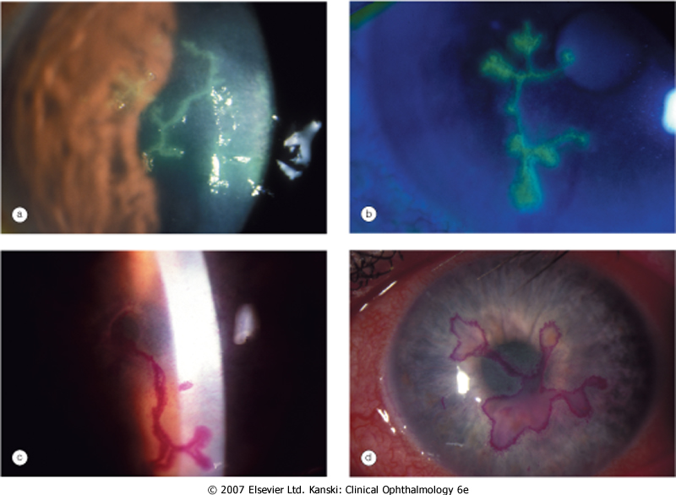

Slide 32
Episclera
Episcleritis – simple (sectoral or diffuse) , nodular – young, female
Presentation - always sudden
The eye becoming red and uncomfortable within an hour of the start of an attack - hotness,feeling of pressure
Without systemic associations
T: systemic antiflogistics

Slide 33
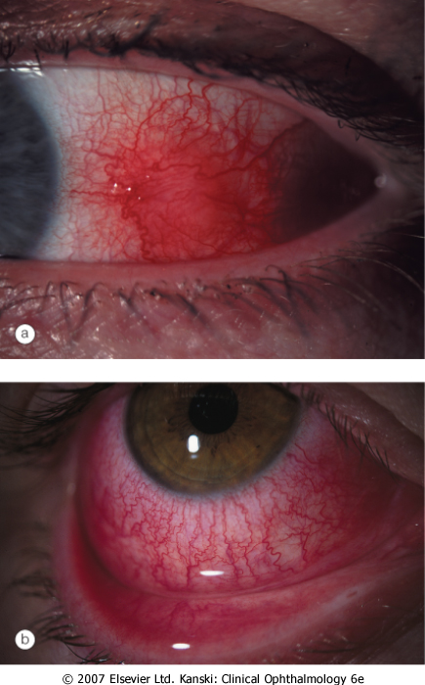

Slide 34
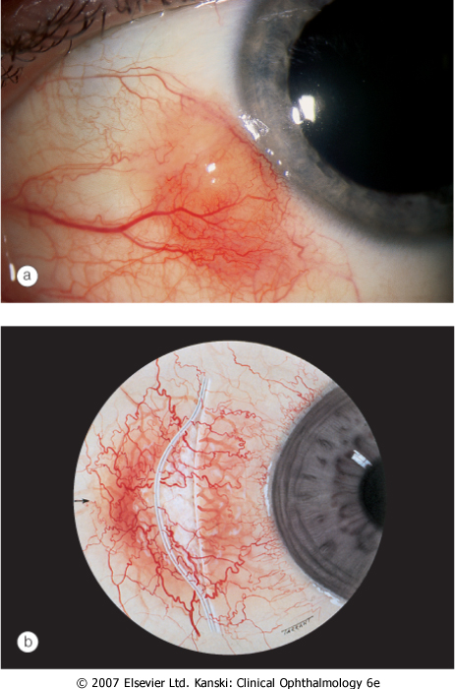

Slide 35
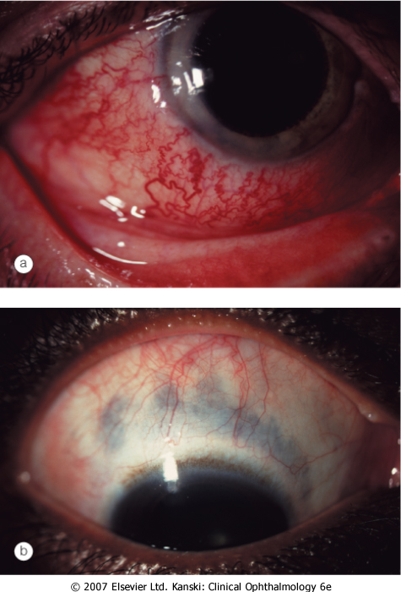
Sclera
Scleritis - oedema and cellular infiltration of the entire thickness of the sclera
Anterior non-necrotizing scleritis – diffuze or nodular
Redness, severe pain which may spread to the face and temple

Slide 36
Sclera
Necrotizing anterior scleritis with inflammation
pain - severe and persisten
Scleral thinning due to necrosis allows the blue choroid to show through the translucent hydrated scar tissue that has replaced normal sclera

Slide 37
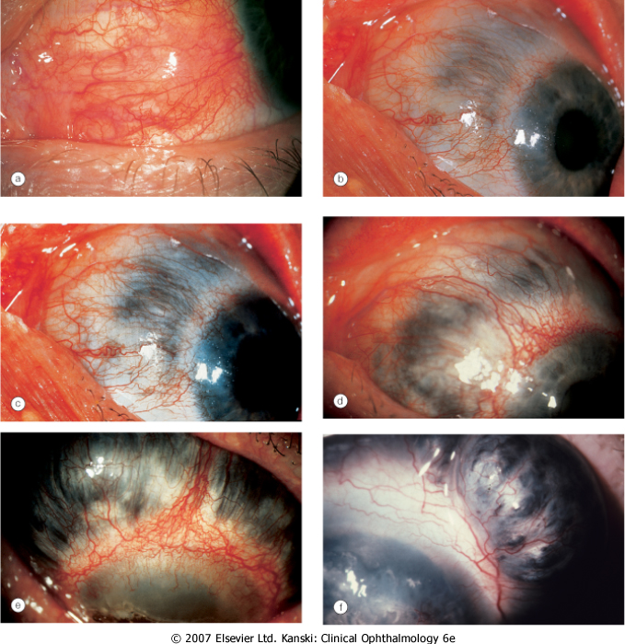

Slide 38
Sclera
Scleromalacia perforans
Specific type of necrotizing scleritis without inflammation that typically affects elderly women with long-standing rheumatoid arthritis
Yellow scleral necrotic plaques near the limbus without vascular congestion

Slide 39
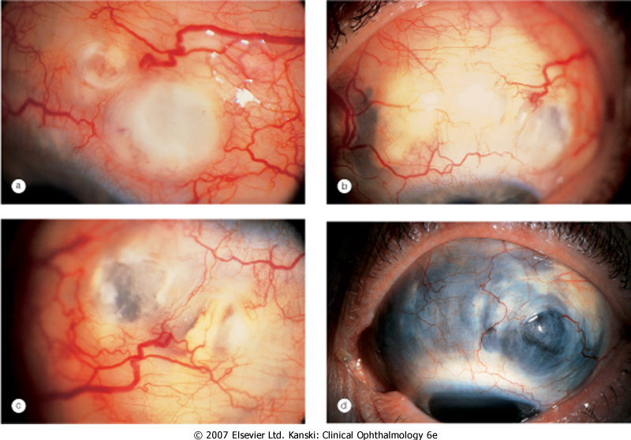

Slide 40
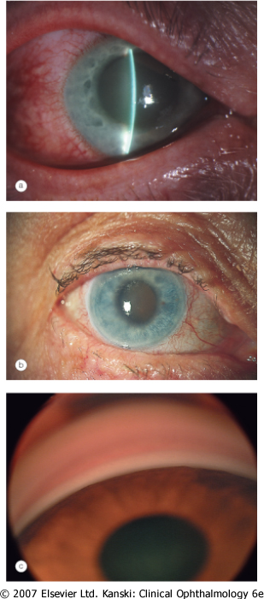
Glaucoma - Acute congestive angle closure

Slide 41
Uveitis
Anterior uveitis may be subdivided into:
Iritis in which the inflammation primarily involves the iris.
Iridocyclitis in which both the iris and ciliary body are involved
Ciliary injection - peripheral hyperemia of the anterior ciliary vessels which produces a deep red or rose color of the corneal stroma, and must be distinguished from hyperemia of the conjunctival vessels. May spread to the perilimbic corneal tissue. Called also ciliary flush.

Slide 42
Anterior uveitis
Ciliary (circumcorneal) injection
Miosis due to sphincter spasm Endothelial dusting by myriad of cells is present early and gives rise to a 'dirty' appearance
Aqueous cells
Aqueous flare reflects the presence of protein due to a breakdown of the blood-aqueous barrier
Aqueous fibrinous exudate
Hypopyon
Posterior synechiae may develop quite quickly and must be broken down before they become permanent

Slide 43
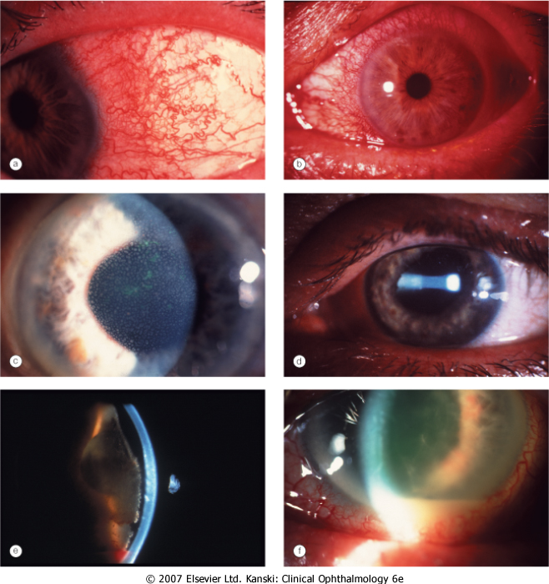

Slide 44
Acute endophtalmitis
Acute inflammation of all ocular structure
Endogennous or exogennous (surgery,trauma)
Signs - chemosis, corneal injection, relative afferent pupil defect, corneal haze, fibrinous exudate and hypopyon, vitritis with impaired view of the fundus
T: systemic antibiotics, acute PPV

Slide 45
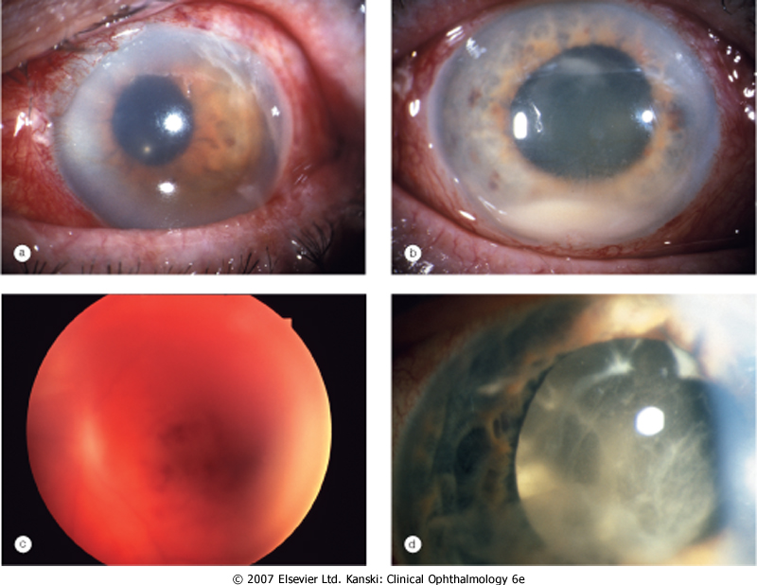
Acute endophthalmitis

Slide 46
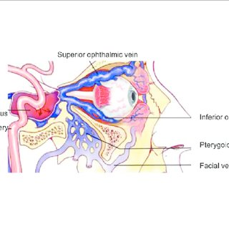
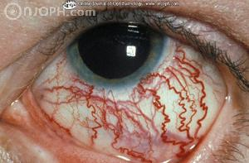
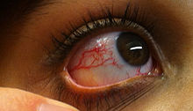
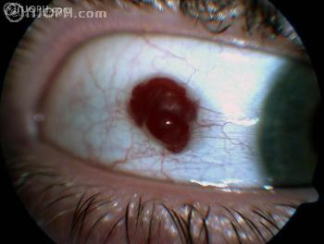
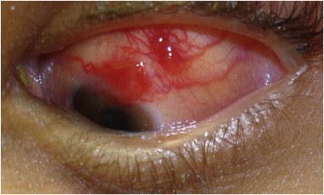
Vascular anomalies
Caput medusae
Conjunctival teleangiectasis
Conjunctival hemangioma
Kaposi sarcoma

Slide 47

Děkuji za pozornost !

