Slide 1
Knee joint
Anatomy, clinical examination,
imaging, pathology

Slide 2
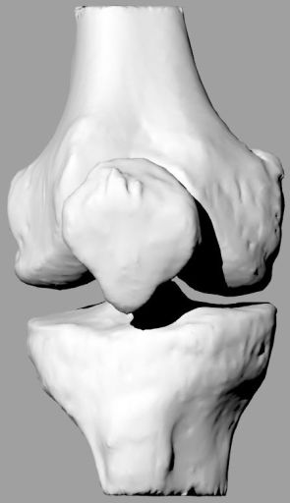
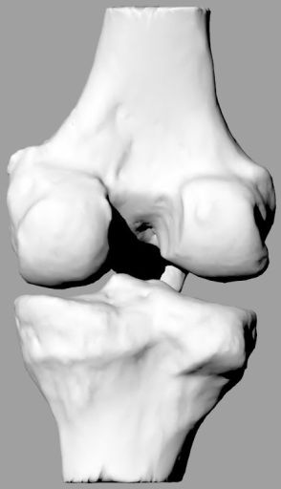
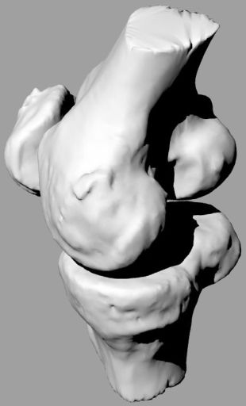
Anatomy- skeleton
Complicated osseous sctructure- soft tissue for stability is needed

Slide 3
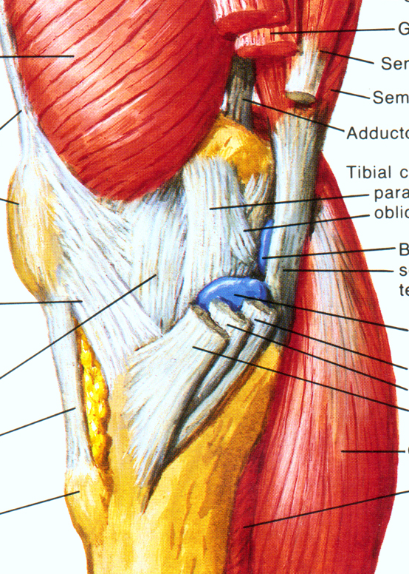
Medial side

Slide 4
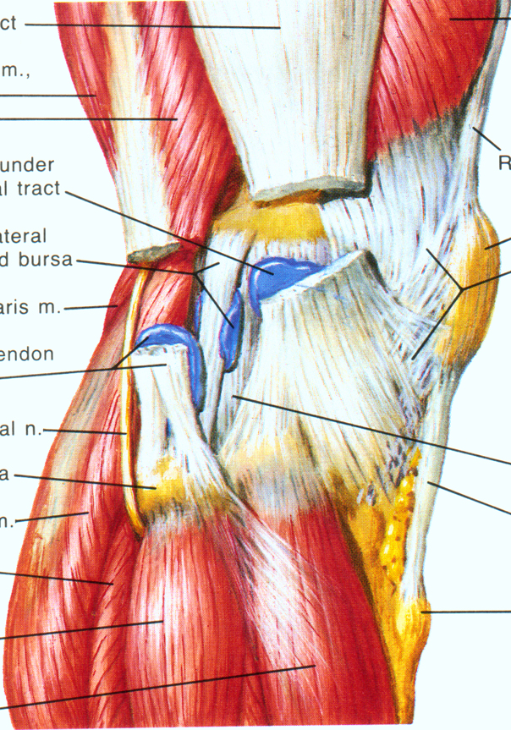
Lateral side

Slide 5
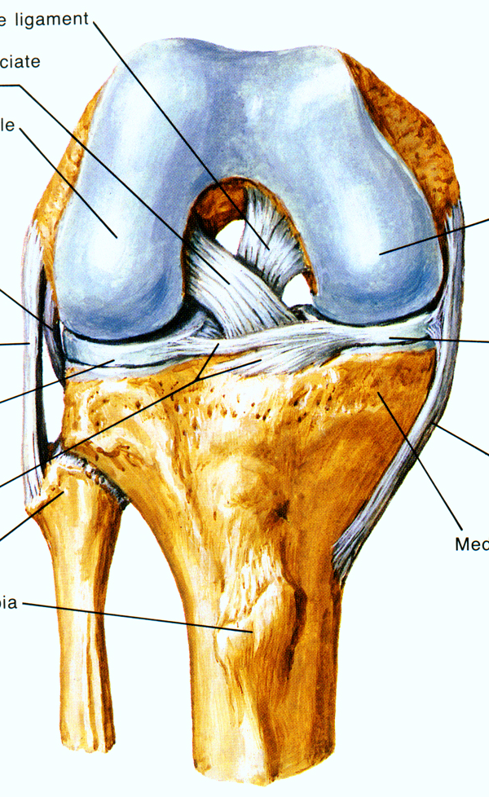
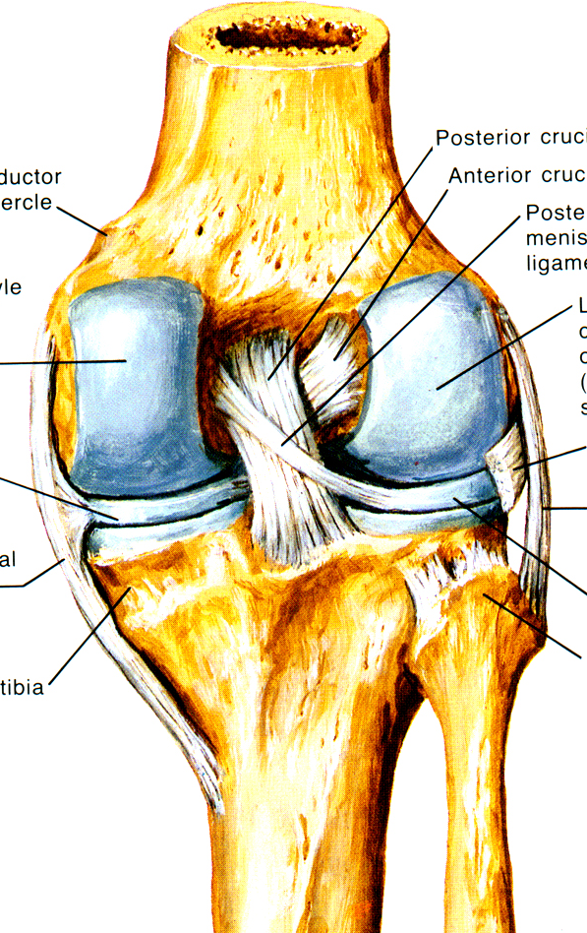
Cruciate ligaments

Slide 6
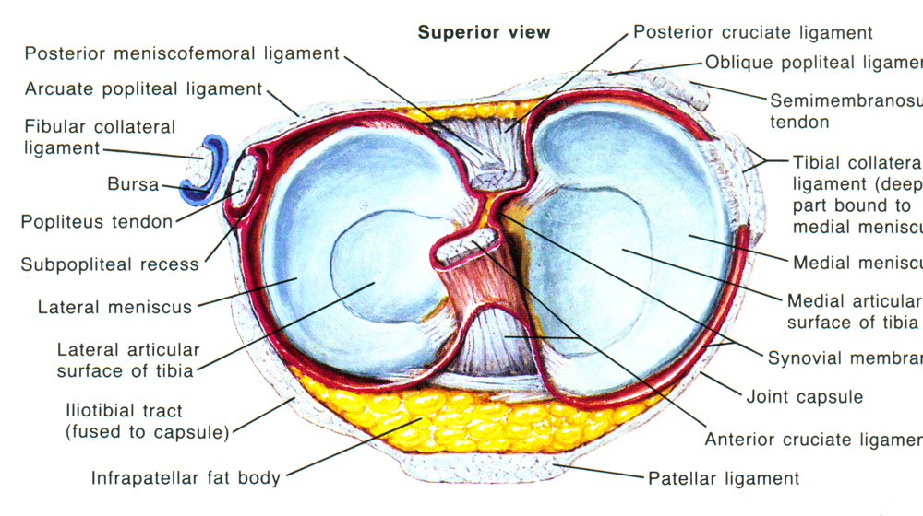
Menisci

Slide 7
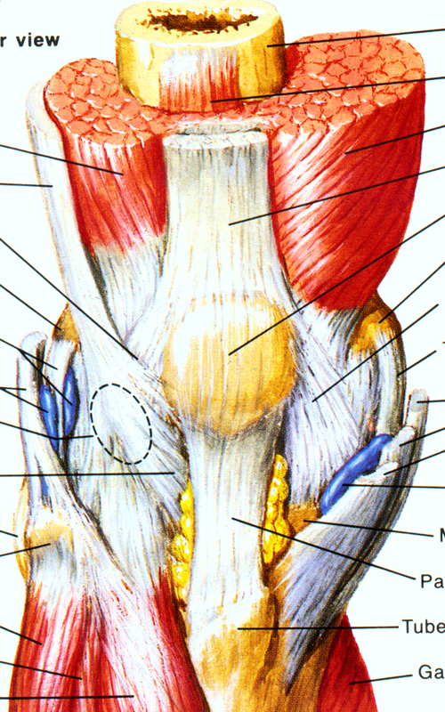
Muscles

Slide 8
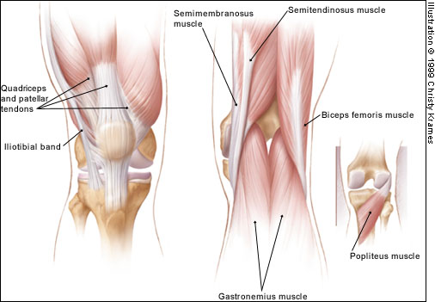
Stability of the knee- muscles

Slide 9
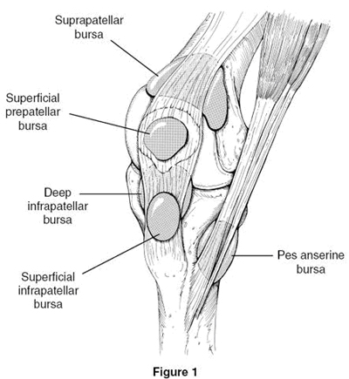
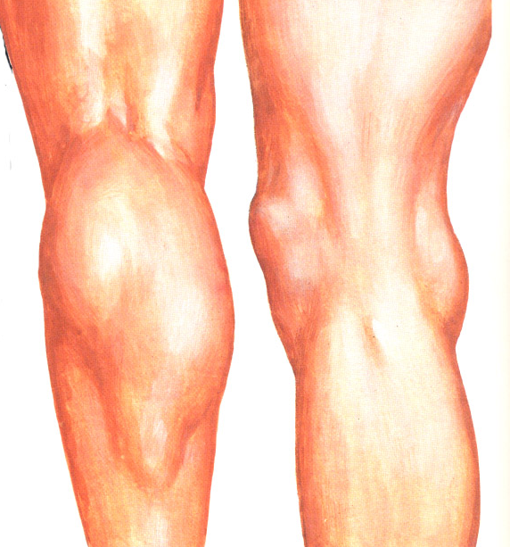
Anatomy- bursae

Slide 10
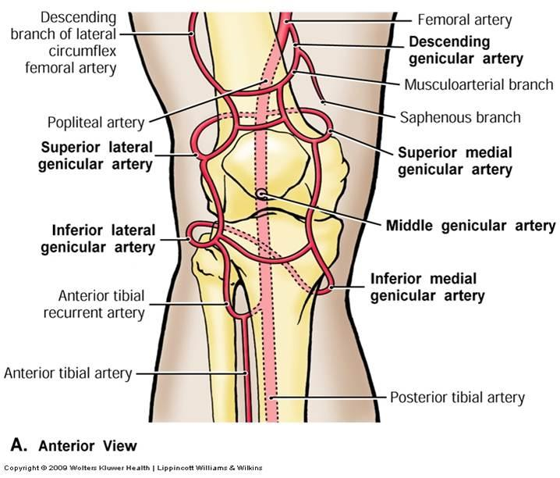
Anatomy- vessels

Slide 11
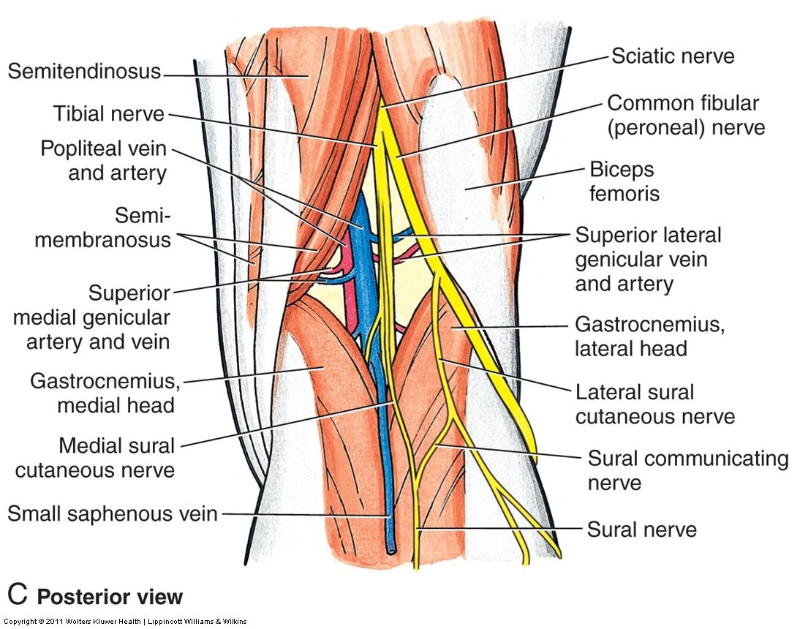
Anatomy- nerves

Slide 12
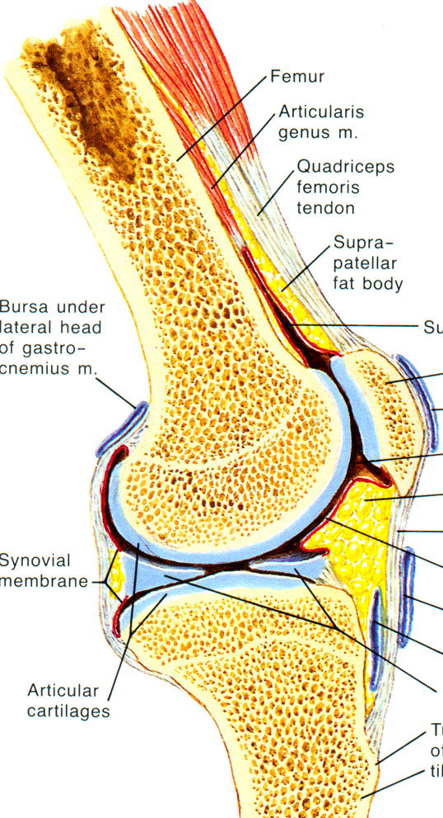
Biomechanics
Level Movement
Sagital flexion/extension
- rolling
- gliding
Transversal ext/ int roration
Frontal adduction/abduction

Slide 13
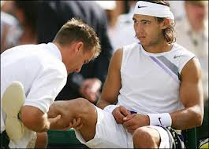
Clinical examination
skin
swelling
alignment
deformity
contracture
active and passive movement
stability
meniscus manevuers
femoropatelar joint

Slide 14
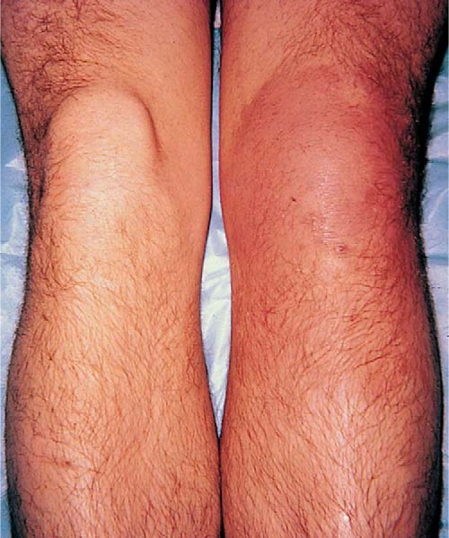
Swelling in the knee region
Effusion
Synovitis
Cysts, ganglion
Tumors
Haematoma

Slide 15
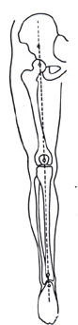
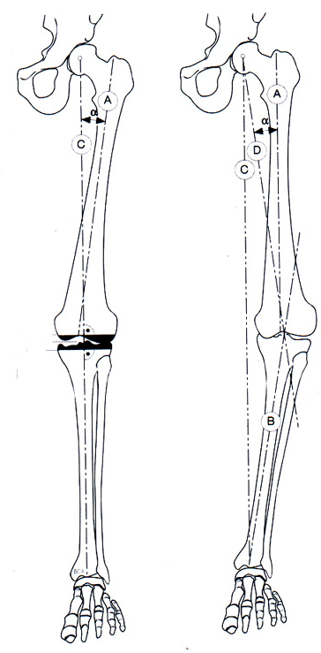
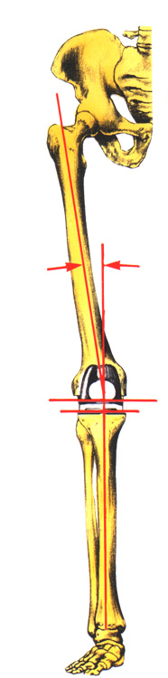
Alignment of lower extremity
Mikulicz line
Mechanical
Anatomical

Slide 16
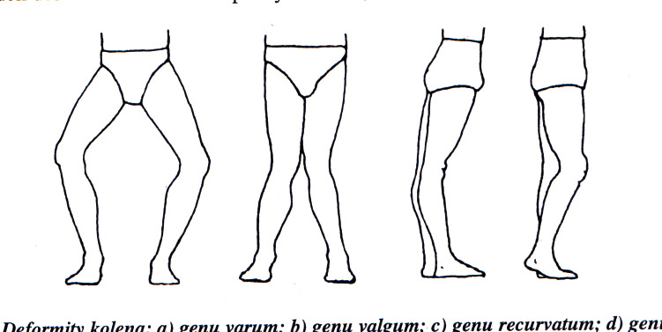
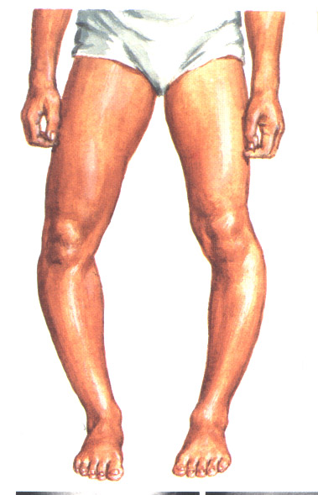
Deformity of the knee joint
M. Blount
Genu varum
M.Blount
rachitis
posttraumatic
O.A.
Genu valgum
rachitis
posttraumatic
R.A.
O.A.
Disorder of the growth plate of proximal tibia

Slide 17
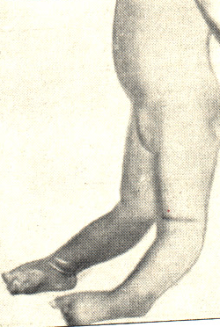
Deformity of the knee joint
Genu recurvatum congenitum
Genu recurvatum
congenital
aplasia of ext. apparatus
laxity of mesenchyme
Genu flectum
cerebral palsy
other neurological disorders
O.A., R.A, post infection

Slide 18
Position of the knee joint
Semiflexion
  antalgic
  extension blockage
    Rupture of meniscus
    Loose body
    Entrapement of synovial plica

Slide 19
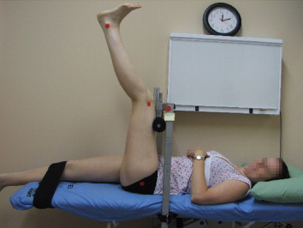
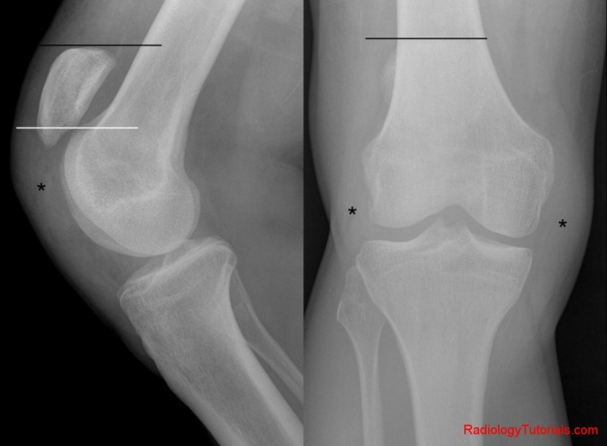
Flexion contracture in cerebral plasy
Contracture of hamstrings (m. semitendinosus, m. semimembranosus, m. gracilis, m. biceps femoris)
Patella alta

Slide 20
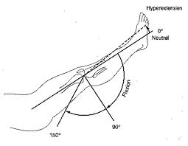
Movement in the knee joint
active, pasive
S extension - 0 - flexion
S 0 - 0 - 140

Slide 21
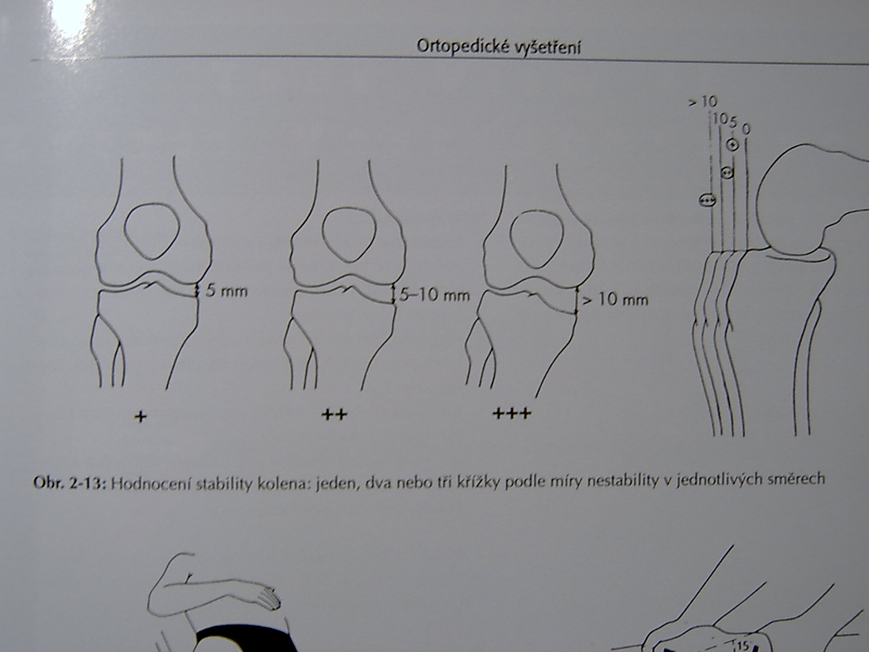
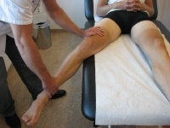
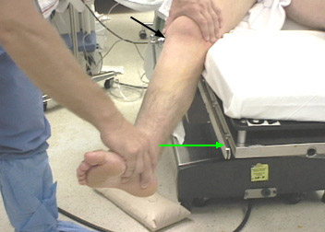
Test for stability
Assesment
Valgus stress test (LCM)
Varus stress test (LCL)

Slide 22
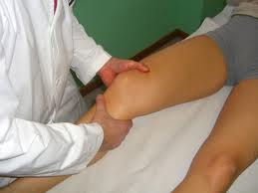
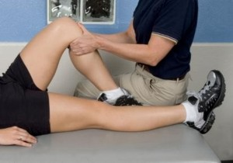
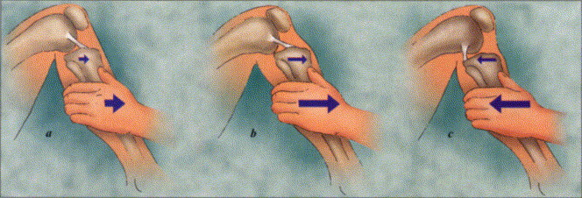
Cruciate ligaments
Lachmann test
Ant. drawer sign , post. drawer sign
normal
ant
post

Slide 23
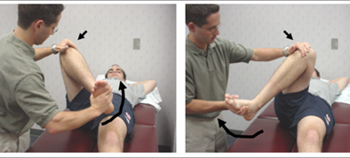
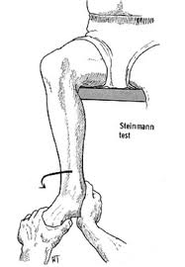
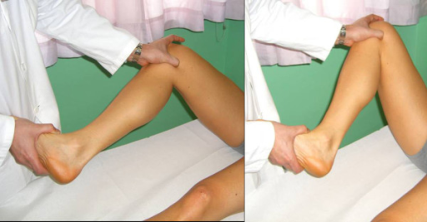
Meniscus manoeuvres
McMurray test
Steinmann test

Slide 24
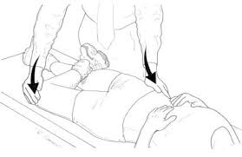

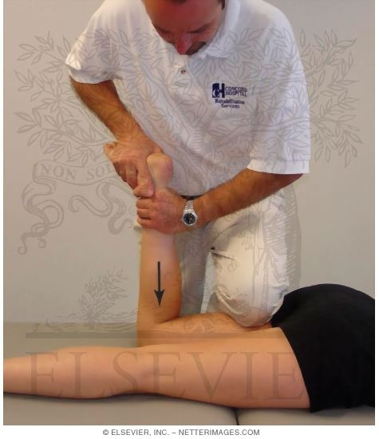
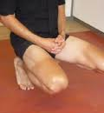
Meniscus manouevres
Payer test
Appley test
Childress test

Slide 25
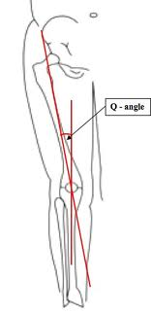
Patella
history- retropatelar pain
kneeling, squatting, down hill gait
giwing away phenomenon
position of the patella
  alta / baja)
  lateral
patelar tracking
stability
Patellar retinacular ligament
Patellar facets, base, apex
FP manoeuvers (Zohlen, grinding)
Q- angle
M 8-10
F 15 ± 5

Slide 26
Imaging methods
X ray, AP, lateral, axial
USG
CT , MRI
Scintigraphy
Artroscopy

Slide 27
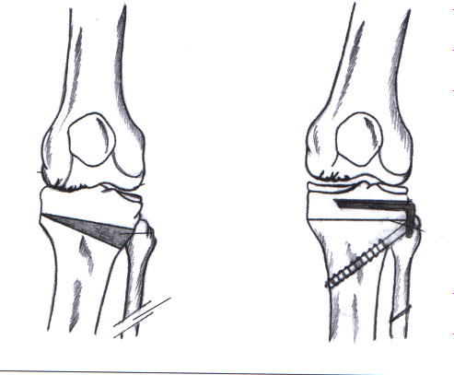
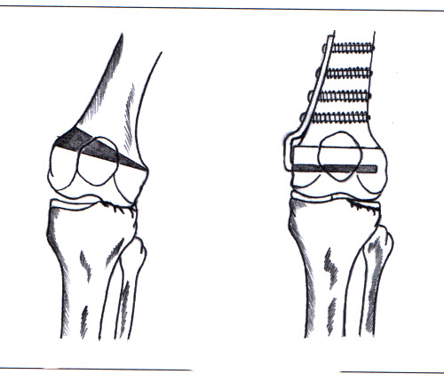
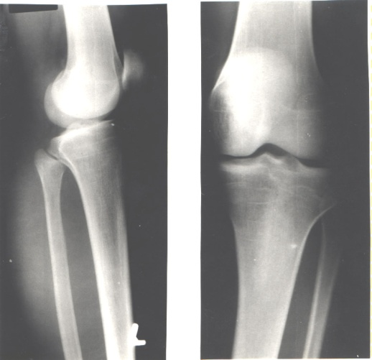
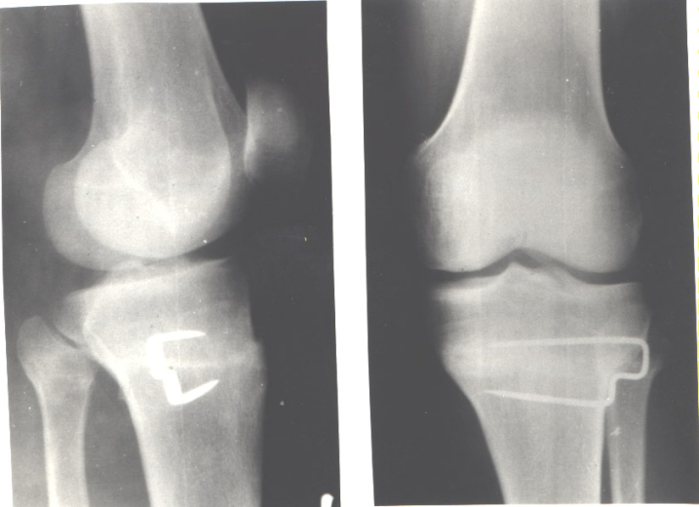
Deformity of the knee joinnt
in children- hemiepiphyseodesis
in adults osteotomy
genu varum /genu valgum
Valgus OT varus OT

Slide 28
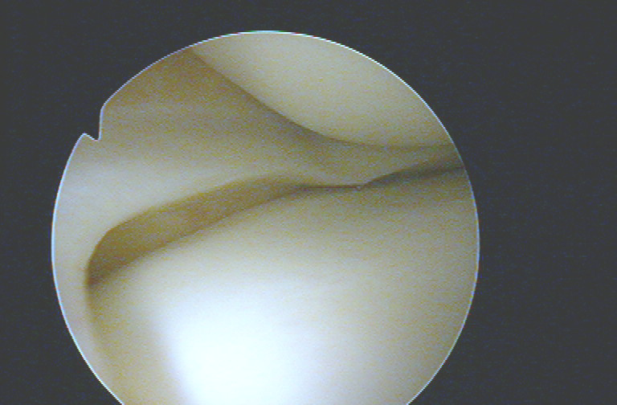
Meniscus
Mechanism of injury
Tests: Mc Murray
Steinmann I
Steinmann II
Appley
Turner
Payer
Childress- squat test

Slide 29
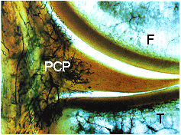
Meniscus
Fibrocartilago
High elasticity
Paracapsular zone
- vessels
Red zone red- white zone white zone

Slide 30
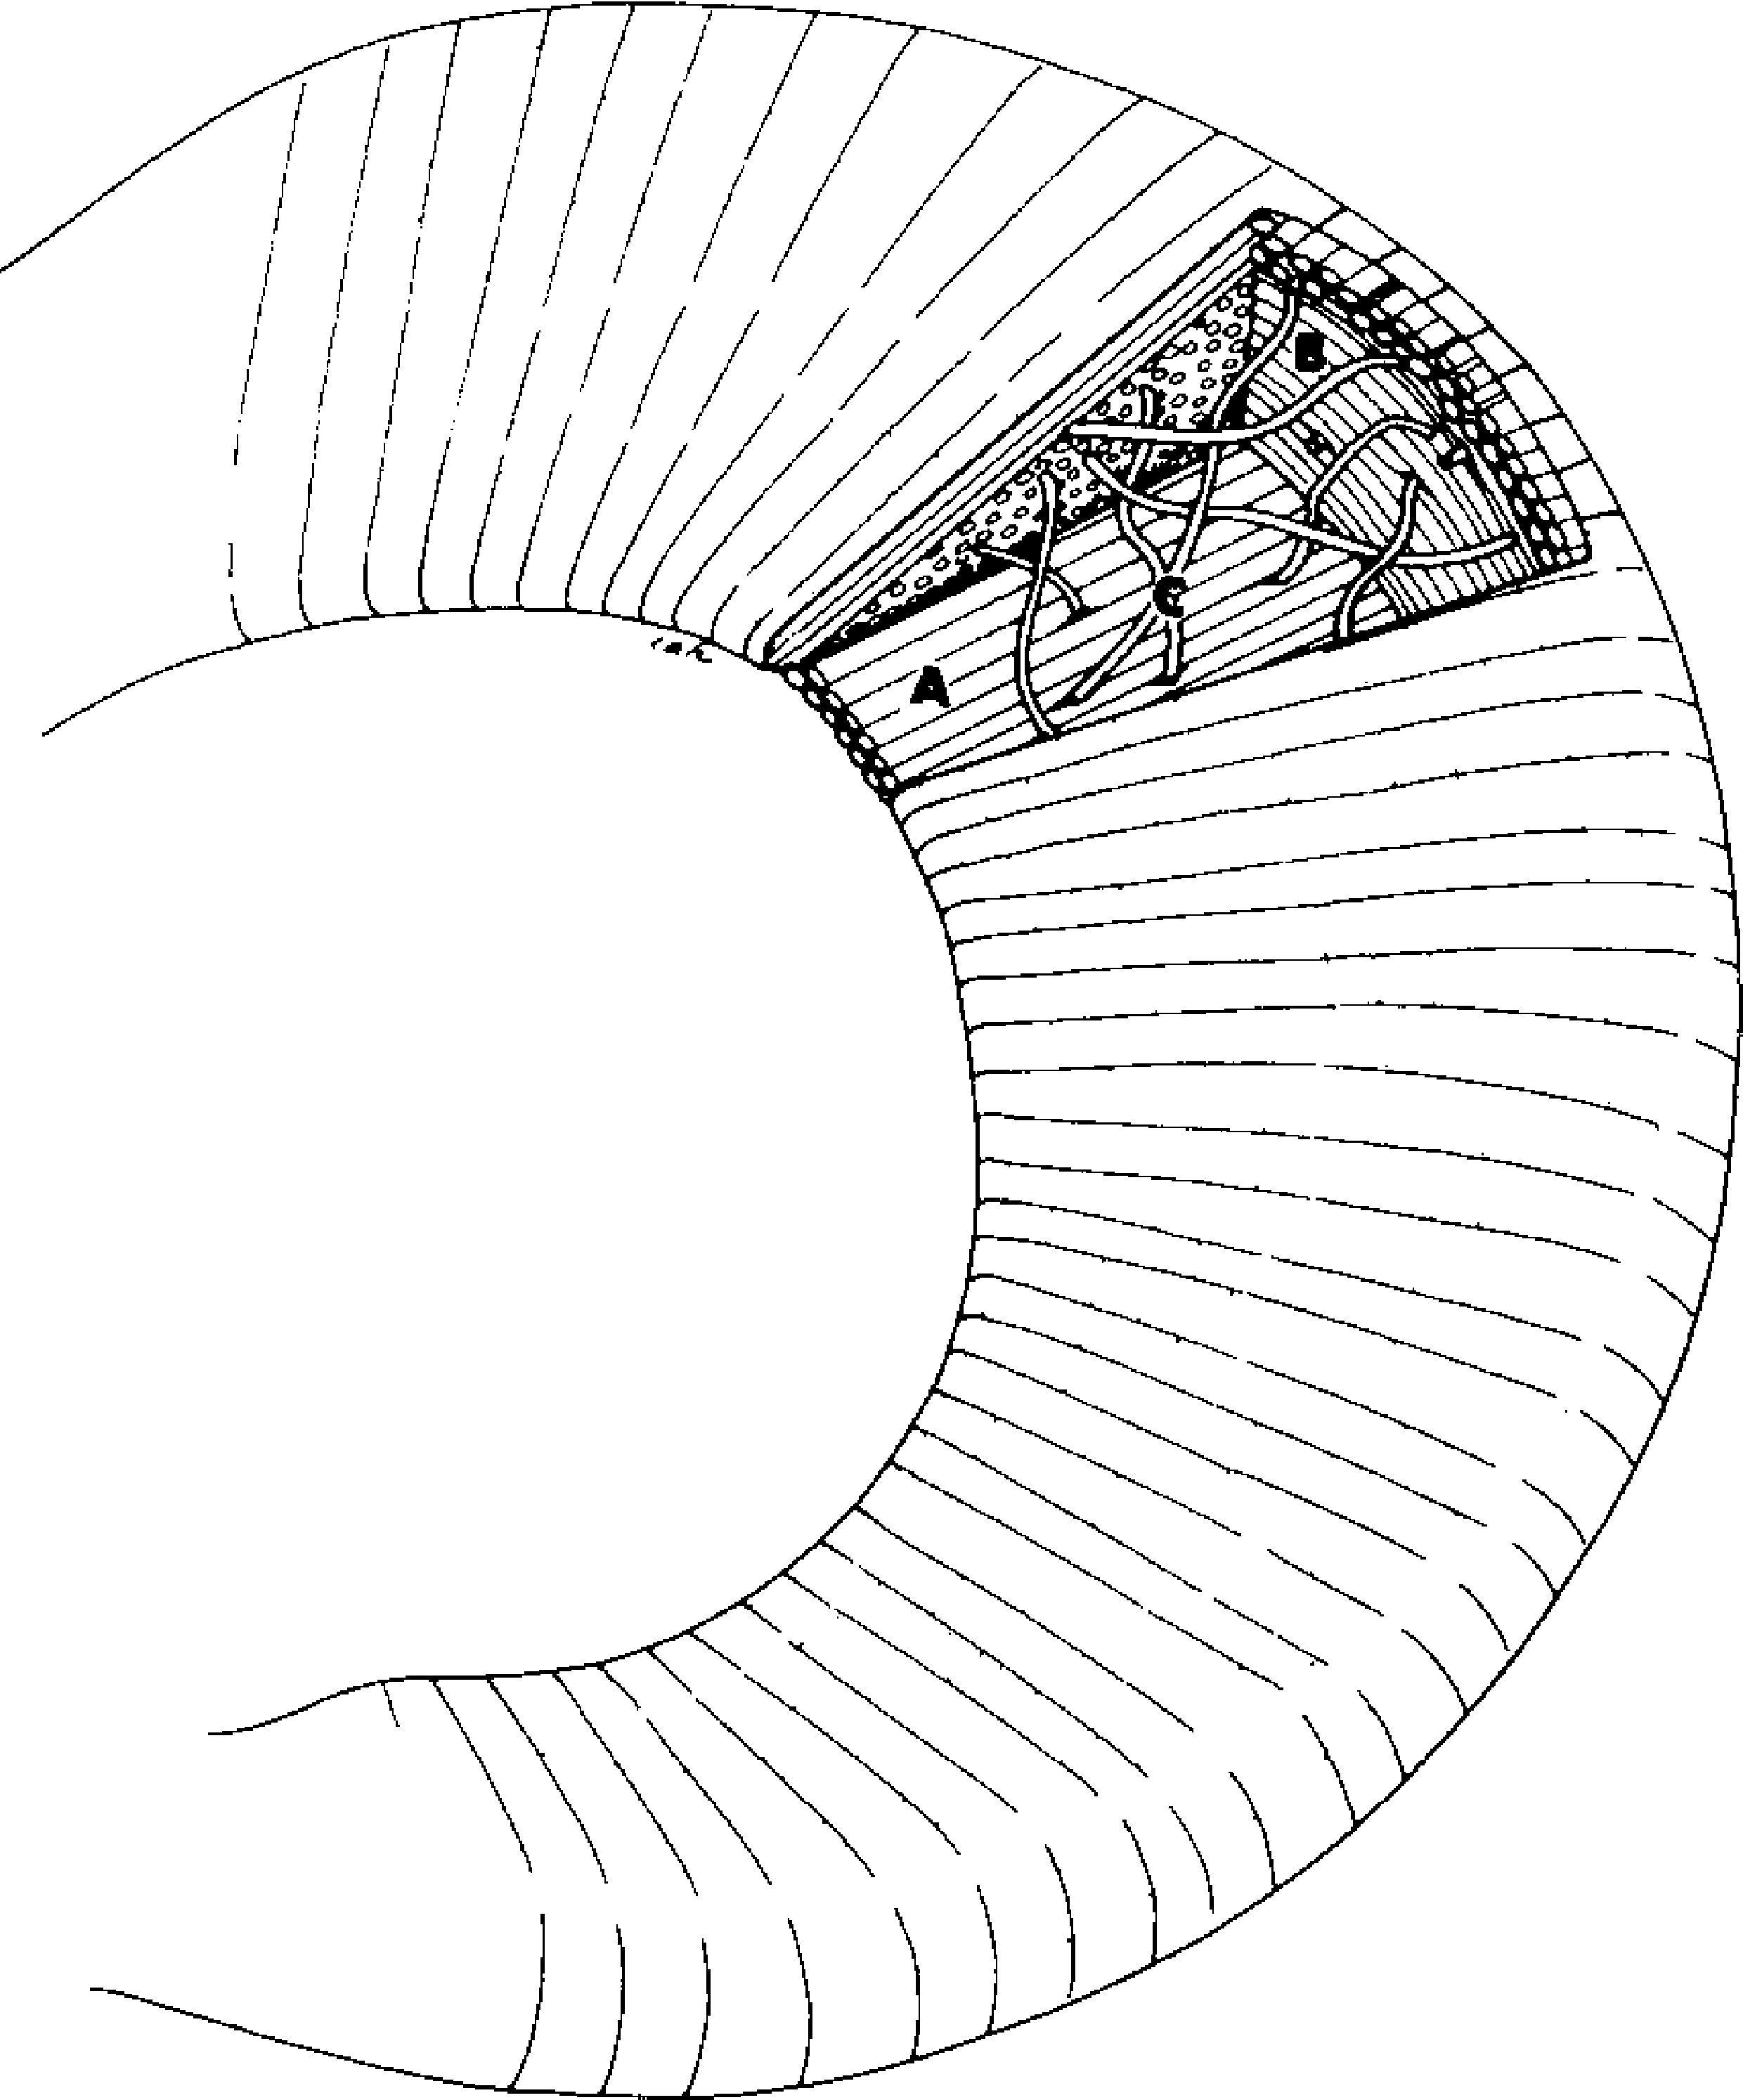
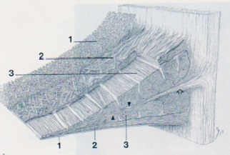
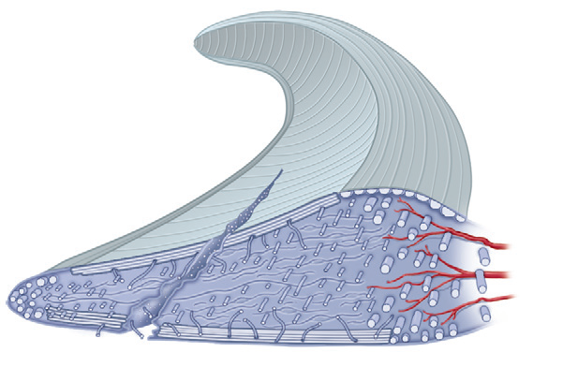
Struktura menisku
Kartilaginózní struktura
Relativně acelulární
- vaskulární zóna – fibroblast-like cells
- avaskulární zóna – chondrocytes-like cells
Kolagen. vlákna v matrix -
-rozložení k přenosu kompresního tlaku + hoop stresu

Slide 31
Functions
Bumper
Stabilisator
More congruency
Distribution of synovial fluid
LM – more mobile
MM – prone for injury

Slide 32

Typy ruptur menisku
Longitudinální
Radiální
Horizontální
Šikmá
Bucket handle
Komplexní

Slide 33
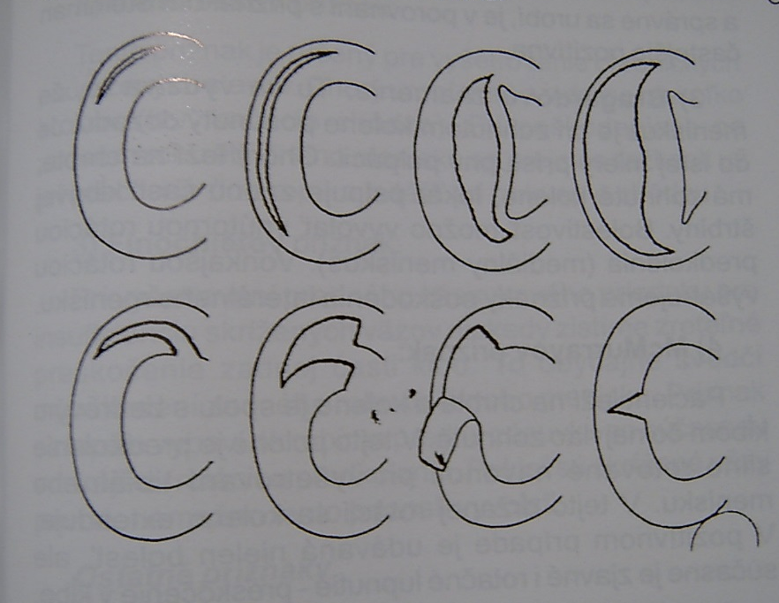
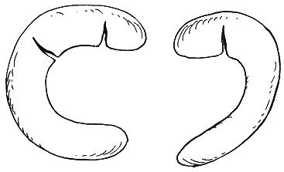

Ruptures of menisci
Longitudinal, horizontal, radial
„bucket handle type“
  Typical blockage
Degenerative lesions
Discoid meniscus

Slide 34



Ruptures of menisci
Longitudinal, horizontal, radial
„bucket handle type“
  Typical blockage
Degenerative lesions
Discoid meniscus

Slide 35

Meniscus treatment
Menisectomy
partial
subtotal
complete

Slide 36

Partial meniscectomy

Slide 37


Subtotal menisectomy

Slide 38



Techniky sutury
Outside – in
Inside – out
All – inside

Slide 39

Excelentní výsl. zhojení u mladých pac.
All – inside – kompresní cirkumferentní steh
po obvodu léze

Slide 40

Radiální ruptura
Rpt. 60 % centrální zóny nemá vlyv na ↑ tlaku
/ kandidát parc. menisektomie /
Rpt 90 % siginifikantně ↑ tlak – sutura
Inside-out, All-inside, transtibiální technika / TT /
Chronická léze – retrakce okrajů – gapping / ↓ TT /
A: Inside-out -horizontální matracový steh B: All-inside knot tying
C: Transtibiální technika

Slide 41


Suture of meniscus- meniscopexis
outside-in
inside-out
all-inside

Slide 42

Ligaments- ACL, PCL

Slide 43

Rupture of ligaments
Sprain
partial rupture
total rupture
Mechanism of injury
Tests of stability
Unhappy trias

Slide 44

Rupture of ACL
Tests of stability
Lachman test
Anterior drawer sign
Pivot-shift test
Lachmann test

Slide 45


Rupture of ACL
Frequent injury

Slide 46

Rupture of ACL
  Debridement
  Physiotherapy
  Limited activity
  Orthesis

Slide 47


Physiotherapy
Orthesis

Slide 48

Indication for reconstruction
1/3 of cases

Slide 49

BTB graft
Bone-Tendon-Bone

Slide 50


BTB graft
Bone-Tendon-Bone
Press fit technique

Slide 51




Hamstrings
(m. semitendinosus + m. gracilis)
Fixation by screws

Slide 52


Technique

Slide 53


ACL plasty- press fit technique

Slide 54






Femoral canal

Slide 55





Tibial canal

Slide 56



Tightening of the graft
Graft in situ

Slide 57

Aftertreatment
6 weeks orthesis
Weight bearing after 6 weeks
Sports activity after 9 months

Slide 58


Rupture of PCL
In dashboard injury
Posterior drawer sign

Slide 59

Chondropathy
Outerbridge. H.K.

Slide 60

Chondropathy
I.
II.
III.
IV.

Slide 61


Chondropathy I. st.
Soft cartilage, chondromalatia

Slide 62


Chondropathy II. st.
Fissures in the cartilage

Slide 63


Chondropathy III. st.
Fibrilation- „ crab meet“

Slide 64


Chondropathy IV. st.
Defects to subchondral bone

Slide 65


Defects of cartilage
Patella
Medial condyle

Slide 66


Shaving and drilling
-
-

Slide 67


Drilling
-

Slide 68


Abrasion chondroplasty
Curretage
Shaver

Slide 69
Microfractures
Perforation of subchondral bone
- slight bleeding
Steadman, J.R., 1999
Multipotent stem cells into
the defecfts
The aim- to create fibrocartilago

Slide 70


Microfractures

Slide 71


ACI – autologous chondrocyte implantation
Transplantation of autologous chondrocytes
into defects of cartilage
Chondrocytes in suspension under periostal layer

Slide 72



Osteochondral autograft transfer- OAT
Mosaic plasty
Hangody, L., 1992
Defects up to 2 - 4 cm²

Slide 73

OAT
4 years after surgery

Slide 74

Hyalografts and chondrografts
Scaffolds- HyaloFast, Chondrotissue…
Biodegradable
Matrix for stem cells from bone marrow
after drilling or from serum
Collagen scaffolds

Slide 75


HyaloFast- scaffold
Polymer of HA
No special fixation
Scaffold serves for maintaining of stem cells from bone marrow
Supports viable cells
Fills the defects of hyaline cartilage

Slide 76


Osteoarthritis

Slide 77

Transchondral fractures
Removal
Subchondral abrasion
Drilling

Slide 78



Osteochondral fractures
Removal
Fixation
Loose body

Slide 79


Osteochondrosis dissecans
Local necrosis in subchondral bone
Mostly on medial femoral condyle
Etiology- trauma, microtraumatisation
vascular

Slide 80






Diagnostics:
X ray, MRI, CT, artroscopy
MRI
RTG
ASC

Slide 81


ASC classification
X ray classification
Negative
radiolucency
Sclerosis
Loose fragment

Slide 82


Therapy
Juvenile form
Adult form
conservative
ASC drilling
  Drilling
  Fixation of the fragment
  debridement, drilling
  Bone grafting
  Mosaic plasty
  Chondrografts

Slide 83


Patella
Chondropathy
Subluxation
Dislocation

Slide 84


Chondropathy of the patella
Clinical symptoms

Slide 85



Chondropathy of the patella
Conservative
In lateral hyperpression
lateral release

Slide 86

Traumatic dislocation of the patella
Always laterally
Conservative treatment
Operative treatment
Types of patella

Slide 87
Recurrent dislocation of the patella
posttraumatic
congenital
habitual
ASK – lateral release + medial
capsuloraphy
Open surgery

Slide 88




Tumors
Osteosarcoma
Ewing sarcoma
Osteoclastoma
Chondrosarcoma
Soft tissue sarcomas
Bone metastases

Slide 89


Pyogenic arthritis of the knee joint
Aspiration- bacteriological exam.
Laboratory tests
X ray, ultrasonography
Therapy
  ASC, lavage, antibiotics
  orthesis
  synovectomy

Slide 90



Other disorders
M. Osgood – Schlatter
Jumper´s knee
Baker´s pseudocyst
Bursitis
Ganglion of meniscus

