Slide 1
Competence
What it takes to practice medical proffession

Slide 2
What is a medical profession
Regulated activities related to treatment of a patient
Administrative regulation for the sake of patient’s protection
Does not relate only to the physicians but almost any profession connected with medicine

Slide 3
Three requirements to practice medical profession
Health capacity
Both physical and mental
Professional competence
Education and Experience
Moral integrity (no criminal history)
Two levels of protection
Medical board or council (Ethical integrity)
State enforcement (Criminal liability)

Slide 4
Health capacity

Slide 5
Health capacity
Health capacity requirements are mainly in place to protect a healthcare professional
Incapacity to work at night
Temporarily incapacities
Pregnancy
Weight-lifting limits
Lack of vaccination

Slide 6
Health capacity for the sake of patient
Two possible approaches
State regulation (negative list)
Competence of employer (provider of medical care)

Slide 7


Slide 8
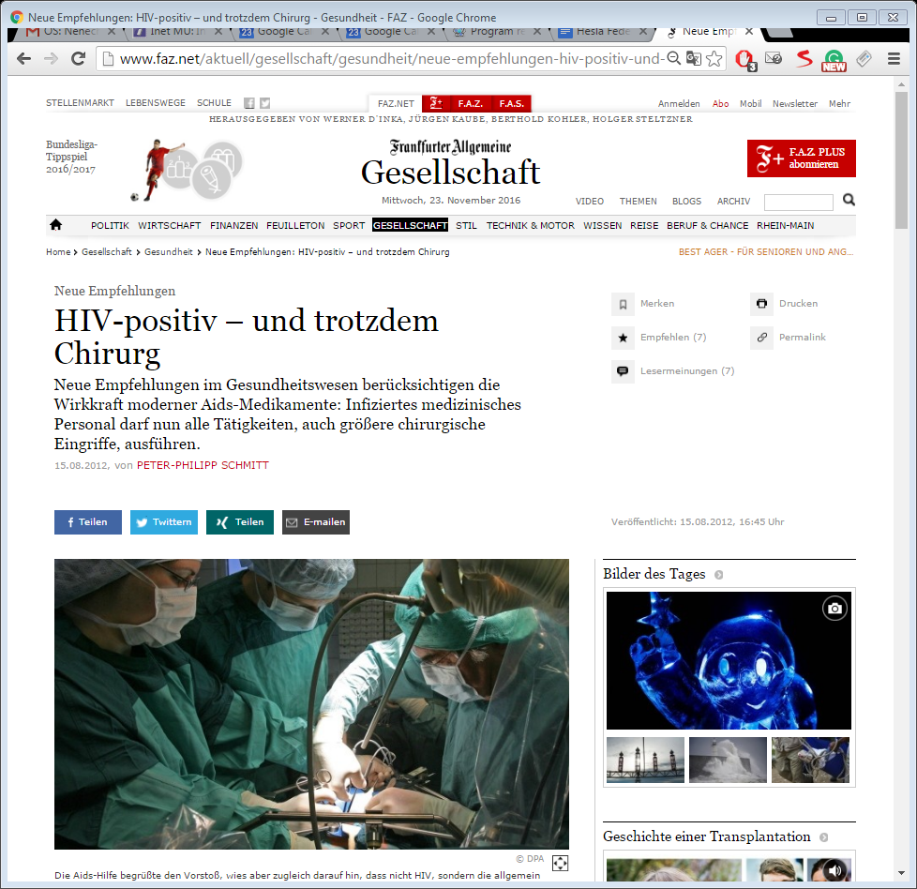

Slide 9
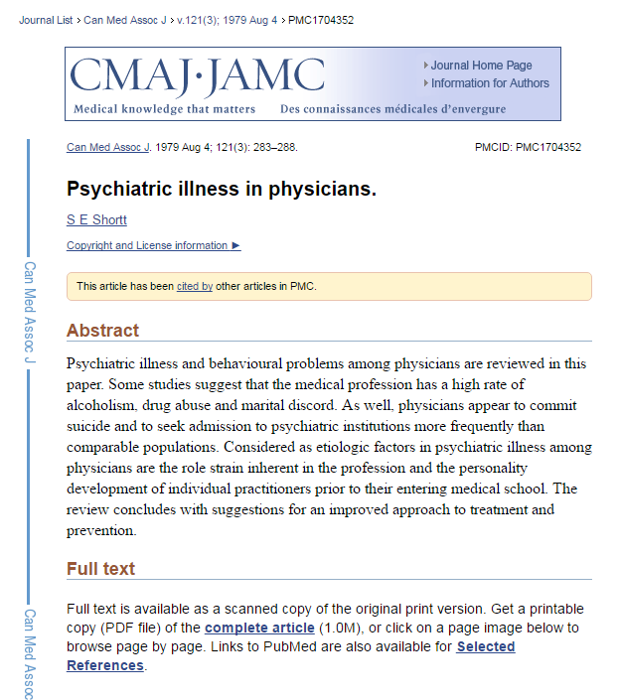
Mental capacity
Czech republic regulates dieseases which are incompatible with work in hospital
Schisopherenia
Dementia
Recidiving manic episodes or depression

Slide 10
Professional Capacity

Slide 11
Professional capacity
To perform profession per se
Education
To perform specialized tasks
Practice

Slide 12
Recognition of professional qualification within the EU
Temporarily mobility
Establishment
Employment ?

Slide 13
Temporarily mobility
Maximum 6 months
Has to be reported

Slide 14


Slide 15
Basic medical Training IN EU
Admission to basic medical training shall be contingent upon possession of a diploma or certificate providing access, for the studies in question, to universities
Basic medical training shall comprise a total of at least six years of study or 5 500 hours of theoretical and practical training provided by, or under the supervision of, a university.

Slide 16
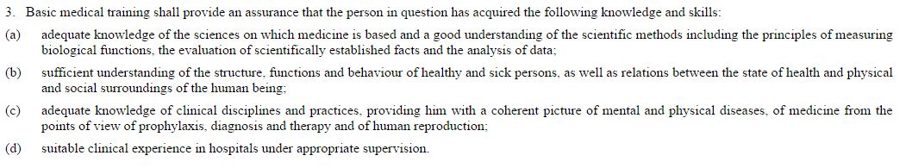

Slide 17
Specialist medical Training (EU)
Admission to specialist medical training shall be contingent upon completion and validation of six years of study
Specialist medical training shall comprise theoretical and practical training at a university or medical teaching hospital or, where appropriate, a medical careestablishment approved for that purpose by the competent authorities or bodies.
Training shall be given on a full-time basis at specific establishments which are recognised by the competent authorities. It shall entail participation in the full range of medical activities of the department where the training is given
http://eur-lex.europa.eu/legal-content/EN/TXT/HTML/?uri=CELEX:32005L0036&from=en

Slide 18
Moral integrity

Slide 19
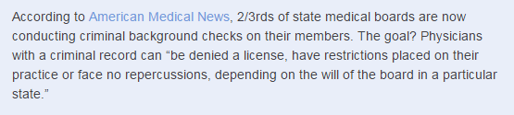
Criminal records
UK
certification from the Disclosure and Barring Service (DBS)
Employer has duty to check, GMC may decide but no automatic ban
USA
Czech republic
Automatic ban if there is inprisonment for more than year

Slide 20
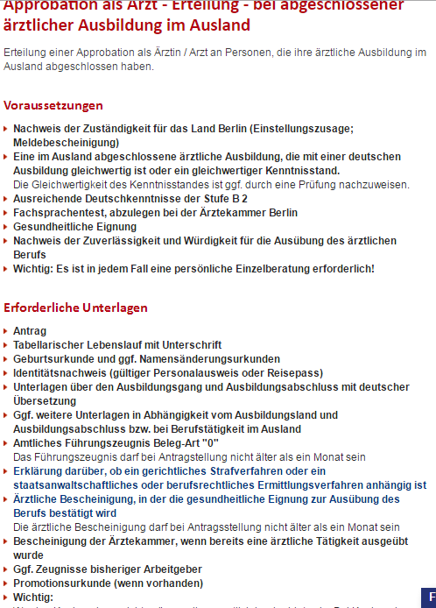

Slide 21
Conflict of interest

Slide 22
Significant policy problem
Antyhing that can create risk, that your actions regarding primary interest (patients well-being) will be influenced by your secondary interest.

Slide 23
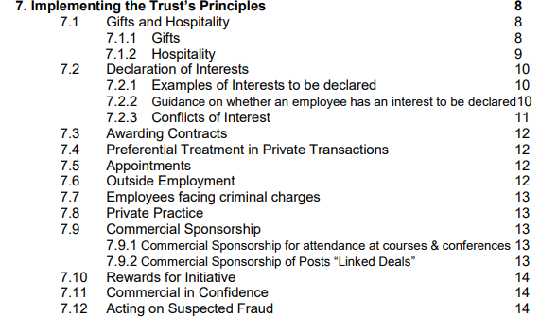
EXAMPLE from the UK: NHS Code of conduct

Slide 24
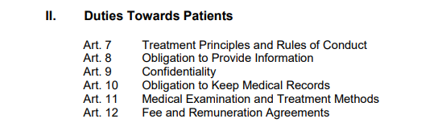
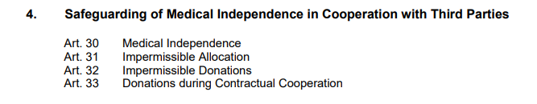
Example Professional Code for Physicians in Germany – Adopted by german medical assembly

Slide 25
Gifts and tokens of gratitude

Slide 26
Gifts and gratitude
Small gifts in the value 5-10 EUROS are usually tolerated
Gifts from patients after the treatment is provided
Commercial merchandise from companies (pens, stickers)
Larger gifts can be considered as compromising „Medical Independence“
Sometimes outright forbidden
Sometimes need to be declared

Slide 27
Examples

Slide 28
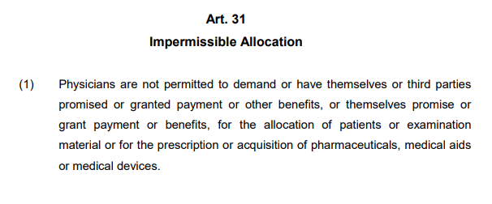
Example – German code of conduct

Slide 29
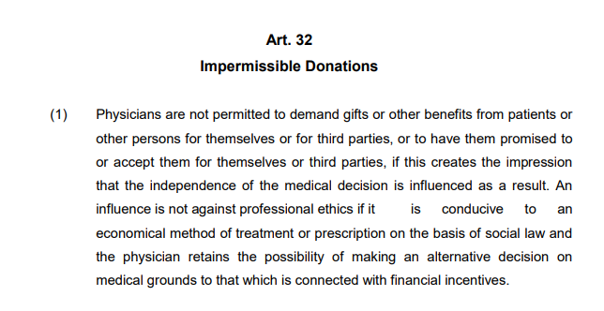
Example – German code of conduct

Slide 30
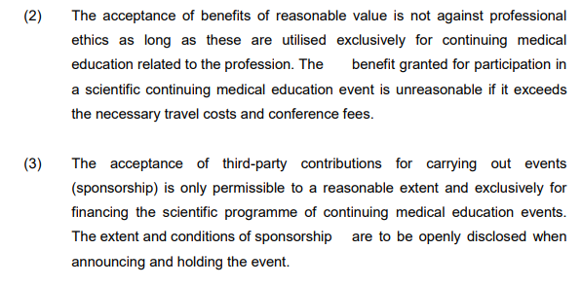
Example – conference events (GER)

Slide 31
Example NHS code of conduct - UK
Gifts should normally be firmly but politely declined. However, articles of low intrinsic value, need not necessarily be refused.
Items of intrinsically small value [less than £5] need not be declared. Diaries; Pens; Calendars; Mugs; Office Stationery; Boxes of chocolates or biscuits.
Gifts with the value of between £5- £25 may be accepted but must be declared.
Bottles of wine or spirits; Books , CDs / DVDs; Decorative objects such as glass tankards, glass crystal, ornaments.
Any other gifts over this value should be politely declined. Under no circumstances should employees accept personal gifts of cash even if this is below the limit of £25.

Slide 32
Invitations to lunches, conferences and events

Slide 33
Invitations to free attendance of conferences and events
Accepted only if it serves education and scientific purpose
Must not compromise your independence
Regulation of pharmaceutical companies
Not so important to physicians
Regulation on the ethical side of physician
See examples
How to organize „promotional“ events

Slide 34
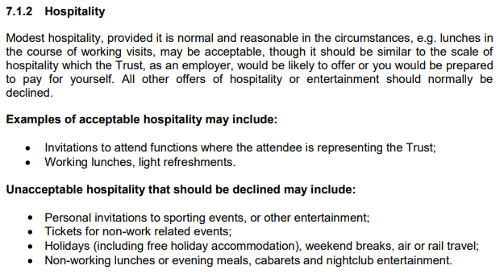
NHS Code

Slide 35
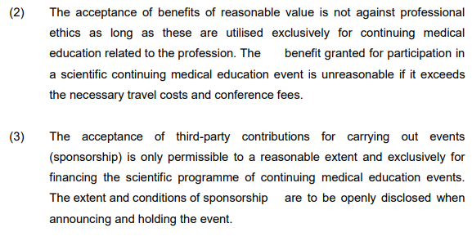
German code of conduct

Slide 36

Employment Law

Slide 37
Employee
Employer
Government
Union

Slide 38
Equal conditions of workers in the EU
Prohibition of discrimination on grounds of nationality between EU Member States
Any discrimination in working conditions between domestic workers and persons coming to work in the territory of a given State from other Member States is considered inadmissible
Gender equality – equal wage for equal work
The right to vocational training under the same conditions as domestic workers
The right to join unions in the country of employment

Slide 39
Labour Contract

Slide 40
Before signature
Employer
Employee

Slide 41
After signature
Employer
Employee

Slide 42
Minimum requirements
Example of Czech Republic
Type of work
Place of work
Day of commencement of work

Slide 43
Duration of the contract
Indefinitely
For a definite period
may be limited – e.g. in the Czech Republic, at most three times in a row with the same employer, then it must be concluded for an indefinite period

Slide 44
Termination of employment
By Employee
  Usually, the reason does not need to be stated
  Notice period
By Employer
  Usually, the reason must be stated – not for employmet „at-will“ (typically some states of U.S.A.)
  For breach of obligations by the employee
  Change of organizational structure/cancellation of job position
  Termination of employer

Slide 45
Rights and obligations under the Labour Code
The employee is required:
Follow the instructions of the employer
Only the work that corresponds the position
In apportioned working time and
To comply with obligations that arise from the employment relationship.
Perform work personally

Slide 46
Obligations of healthcare professional according to HCA
(a) provide healthcare services to which they have a professional or specialist qualification,,
to the extent corresponding to their competence, patient's medical condition
on appropriate professional level
and to act in accordance with ethical principles,
b) immediately provide first aid to everyone
c) fulfill other obligations imposed by HCA or other legislation.

Slide 47
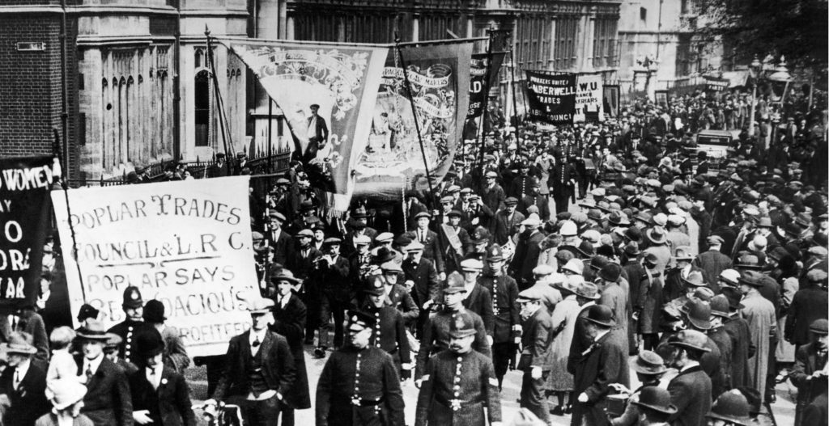
Trade Unions

Slide 48
Union
Legal entity consisting of employees or workers having a common interest
  E.g. all the assembly workers for one employer, or all the workers in a particular industry
Formed for the purpose of collectively negotiating with an employer (or employers) over wages, working hours and other terms and conditions of employment
Often use their organisational strength to advocate for social policies and legislation favorable to their members or to workers in general

Slide 49
The Community Charter of the Fundamental Social Rights of Workers - 1989
Employers and workers of the European Community shall have the right of association in order to constitute professional organisations or trade unions of their choice for the defence of their economic and social interests.
Every employer and every worker shall have the freedom to join or not to join such organisations without any personal or occupational damage being thereby suffered by him.

Slide 50

Salary

Slide 51
Salary
Remuneration for work performed on behalf of an employer
Including such elements as a basic rate, a piecework bonus and other forms of bonus, overtime, etc.

Slide 52
Determining the amount of salary
Contractually agreed
Specified by regulation
internal regulations of the employer
collective agreements
government decree

Slide 53
Minimum wage
Should be in the amount that allows a decent living for workers and their families.
Most EU Member States have a statutory national minimum wage in place, although its level, adjustment mechanisms and coverage vary. Austria, Denmark, Finland, Italy and Sweden have minimum wages set within collective agreements, while Cyprus has statutory rates for different occupations.

Slide 54

Working hours
(DIRECTIVE 2003/88/EC concerning certain aspects of the organisation of working time)

Slide 55
Breaks
Breaks during work hours
No leter than after 6 work hours
Rest hours
11 consecutive hours per 24-hour period
Weekly rest period
minimum uninterrupted rest period of 24 hours plus the 11 hours' daily rest
If objective, technical or work organisation conditions so justify, a minimum rest period of 24 hours may be applied

Slide 56
Maximum weekly working time
The average working time for each seven-day period,
Should not exceed 48 hours including overtime

Slide 57
Annual leave
At least four weeks
Minimum period of paid annual leave may not be replaced by an allowance in lieu, except where the employment relationship is terminated

Slide 58
Nigth work
Night workers whose work involves special hazards or heavy physical or mental strain do not work more than eight hours in any period of 24 hours during which they perform night work.
Health assessment
Obligation of an employer to notify authorities of regular use of night workers

Slide 59
Derogations from Daily rest, Breaks, Weekly rest period and Length of night work
In the case of activities involving the need for continuity of service or production, particularly … treatment and/or care provided by hospitals or similar establishments, including the activities of doctors in training …

Slide 60
Change in working ability

Slide 61
Change in health condition
Temporary incapacity
a short-term change in health that does not allow work
Partial incapacity
health status has been changed in the long term so that it allows to perform work only with certain limitations
Total incapacity
health status has been changed in the long term so that it does not allow to work anymore

Slide 62
Pregnancy
Pregnant worker
  worker who informs her employer of her condition, in accordance with national legislation
DIRECTIVE 92/85/EEC - https://eur-lex.europa.eu/legal-content/EN/TXT/?uri=CELEX:01992L0085-20140325

Slide 63
Pregnancy
Employer shall assess the nature, degree and duration of exposure, in the undertaking and/or establishment concerned
  If the adjustment of her working conditions and/or working hours is not feasible, or cannot reasonably be required on duly substantiated grounds, the employer shall take the necessary measures to move the worker concerned to another job.
  If moving her to another job is not feasible or cannot reasonably be required on duly substantiated grounds, the worker concerned shall be granted leave in accordance with national legislation and/or national practice for the whole of the period necessary to protect her safety or health.

Slide 64
Pregnancy
Workers shall not oblige to perform night work during their pregnancy and for a period following childbirth which shall be determined by the national authority competent for safety and health

Slide 65
Pregnancy
Prohibition of dismissal
  from the beginning of pregnancy to the end of the maternity leave, save in exceptional cases not connected with their condition which are permitted under national legislation, provided that the competent authority has given its consent;

Slide 66
Employee Liability

Slide 67
Assumptions of Liability
Breach of legal obligations
Causality
Damage/violation of a legally protected interest

Slide 68
The obligation of prevention
The employee is obliged to act in such a way as to prevent material damage, non-material damage or unjust enrichment.
If intervention is urgently needed to prevent damage to the employer, the employee is obliged to intervene; employee does not have to do so if it is prevented by an important circumstance or if employee would put himself or other employees at serious risk.

Slide 69
Damages
The employee is usually liable to his employer for the damage he causes
usually associated with a breach of some obligation (remember lege artis, confidentiality etc.)
May be limited
e.g the upper limit of liability in Czech Republic is four and a half times the average monthly wage

Slide 70
Loss
Loss of vested things
an employee is liable for the loss of vested thing, which he has taken over, in its entirety
Loss of entrusted value
an employee is liable for the loss of entrusted values (eg money), which he has taken over, in its entirety

