Slide 1
Cardiac Action Potential and Electrocardiography
Preclinical practice 17. 4. 2024
Mgr. Martin Král
Notes:
Action potential – show different types (neuro, nodal, atrial ventricular…)
What cause that (ionic channels) – voltage gated, selectivity,
Nernst equation
their composition in different tissue
Action potential in nodal cell (how it starts)
Atrial
Ventrícular
Move to the tissue level
spreading through tissue (gap junction)
Diagram srdce
ECG
Leads
Electrical axis in vertical and horizontal layer
a zbytek z praktik
Ukazkové ECG

Slide 2
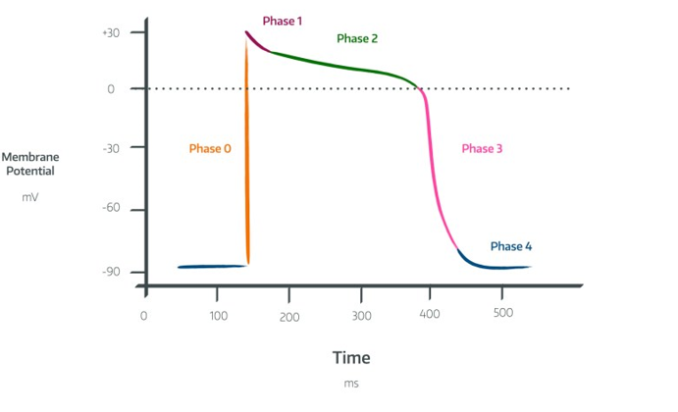
Action potential

Slide 3

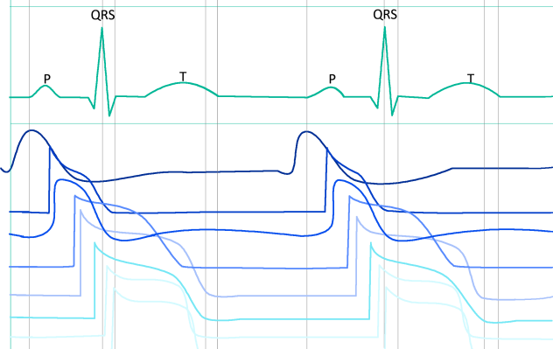
Action potential
Sinoatrial node (SA)
Internodal tracts
SA node
Atrial myocyte
Atrioventricular node (AV)
AV node
His bundle
Tawara branches
His bundle
Purkinje fibers
Ventricular myocyte
Tawara (bundle) branches
Purkinje fibers

Slide 4
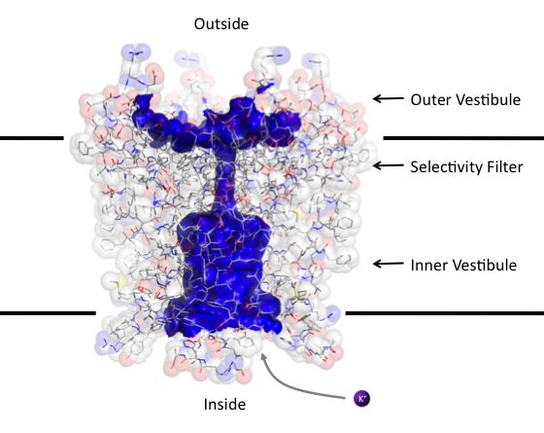
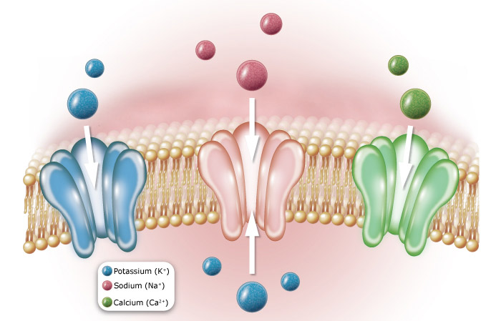
Ion channel

Slide 5

Flow of ions
electrochemical gradient
Nernst eqation
electrochemical equilibrium potential for:
  Na⁺ = +60 mV
  K⁺ = -96 mV
  Ca²⁺ = +134

Slide 6
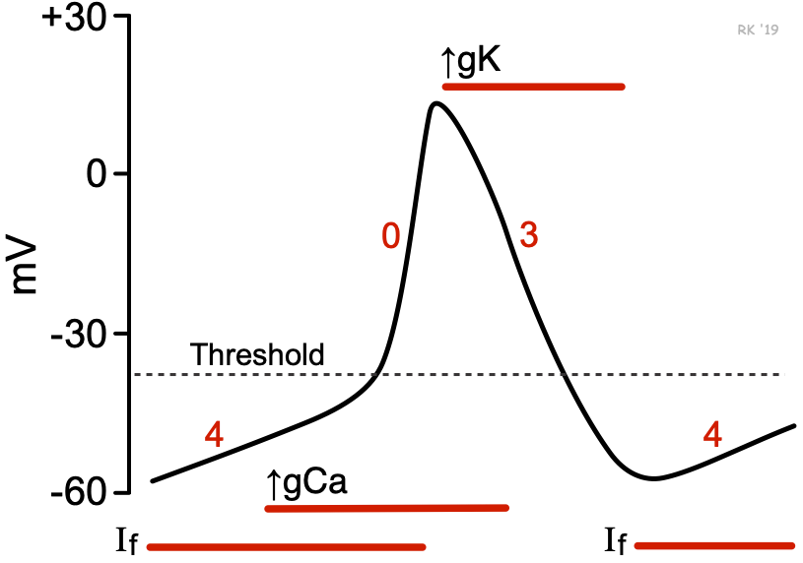
Nodal cell SA
100 AP per minute

Slide 7
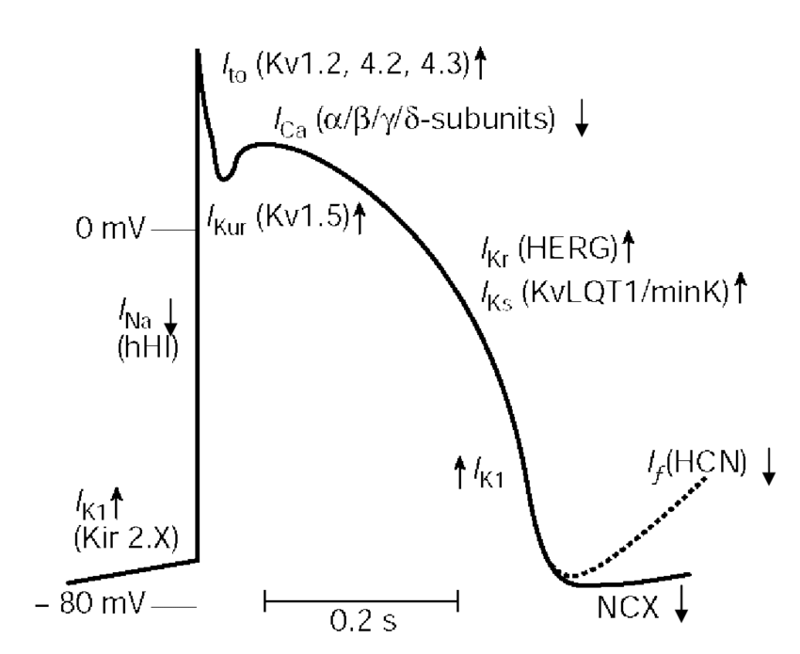
Atrial cell

Slide 8
Ventricular cell

Slide 9
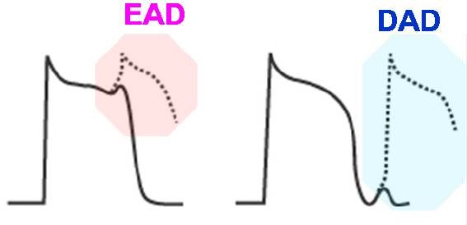
Ventricular cell

Slide 10
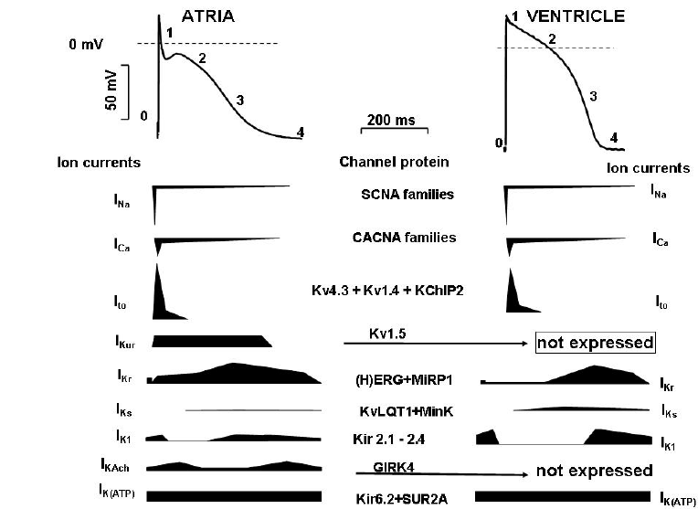
Comparison of atrial and ventricular AP

Slide 11
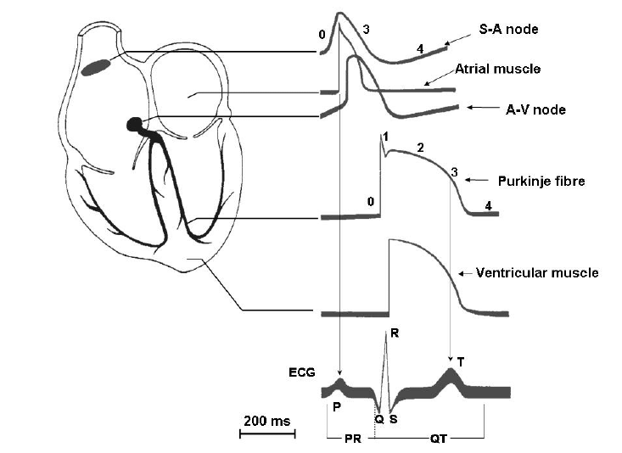
ECG

Slide 12
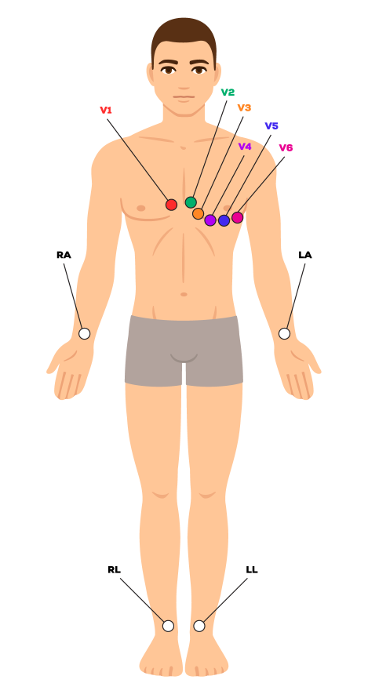
ECG
Definition: recording of the cardiac electrical activity from the surface of the body

Slide 13
Spreading of the signal
Cell to cell by gapjuctions
By conduction system
  Sinoatrial node (SA) – natural frequency 100 bpm (mostly under parasympathetic damping effect), conduction velocity 0.05 m/s
  Internodal tracts – conduction velocity 1 m/s
  Atrioventricular node – natural frequency 40 – 55 bpm, conduction velocity only 0.05 m/s (nodal delay)
  His bundle – conduction velocity 1–1.5 m/s
  Tawara (bundle) branches – conduction velocity 1–1.5 m/s
  Purkinje fibers – conduction velocity 3.5 m/s

Slide 14
ECG
1. Frequency (arrhythmias)
2. Conduction (blocks – SA, AV)
3. Rhythm
4. Ventricular gradient (relationship between depolarization and repolarization)
Notes:
examples - ischemia, hypertrophy, dilatation, cardiomyopathy, inflammations,
changes in electrolytes, drugs…)

Slide 15
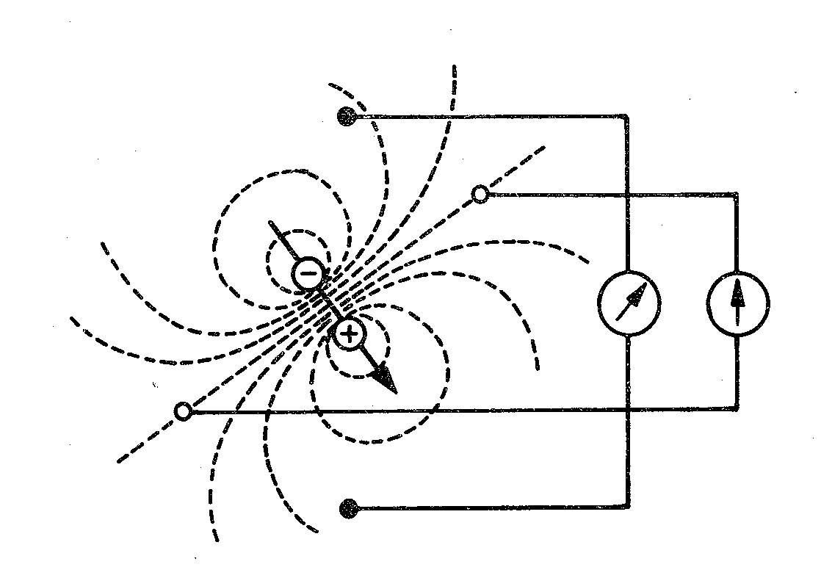
Electric dipole
electrode
Electrode: records electrical potential (Φ)
Electrical lead: a connection between two electrodes
  It records the voltage between the electrodes
  Voltage: difference of el. potentials
  (V= Φ1- Φ2)
Φ2
lead
Φ1

Slide 16
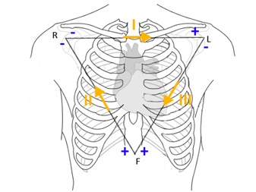
Einthoven’s triangle
(standard, limb, bipolar leads)
Bipolar leads: both electrodes are active (variable electrical potential)
Electrode colors:
R: red, L: yellow, F: green
I
R
L
II
III
F

Slide 17
Goldberger leads
(augmented, limb unipolar leads)
Unipolar leads: one electrode is active (variable electric potential) and the other is inactive (constant electric potential, usually 0 mV)
The active electrode is always positive
R
L
avR
aVL
aVF
F

Slide 18
Wilson‘s central terminal (W)
It is formed by the connection of limb electrodes through resistors
Electrically represents the center of the heart (it is led out or it is calculated)
Inactive electrode (constant potential)
+
+
-
Central terminal
-
Real central terminal
+

Slide 19
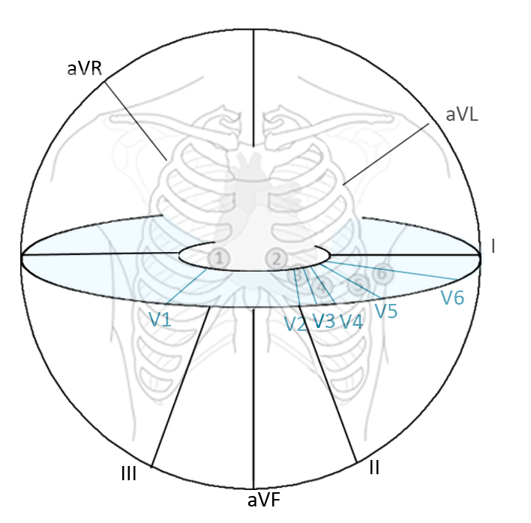
Chest leads
A chest lead: a connection between a chest electrode and the central terminal
Unipolar leads: the chest electrode is active (positive) and the central terminal is inactive (potential = 0 mV)
chest electrode
1
2
3
5
6
4

Slide 20
Leads according to Cabrera
–
I
–
–
R
+
L
–
+
-
+
+
+
–
aVR
aVL
–
aVL
-30°
–
+
-
-
III
II
aVF
I
0°
–
–
+
+
+
aVR
F
+
30°
+
+
II
III
aVF
60°
120°
90°

Slide 21
Analysis of ECG
Heart action
Heart rhythm
Heart rate
Waves, segments and intervals
  P wave
  PQ interval
  QRS complex
  ST segment
  T wave
  QT interval
Electrical heart axis
Ventricular depolarization (QRS)
R
Ventricular repolarization
Atrial depolarization
T
P
Lead II
Q
S

Slide 22
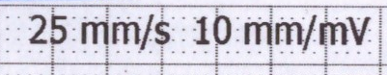
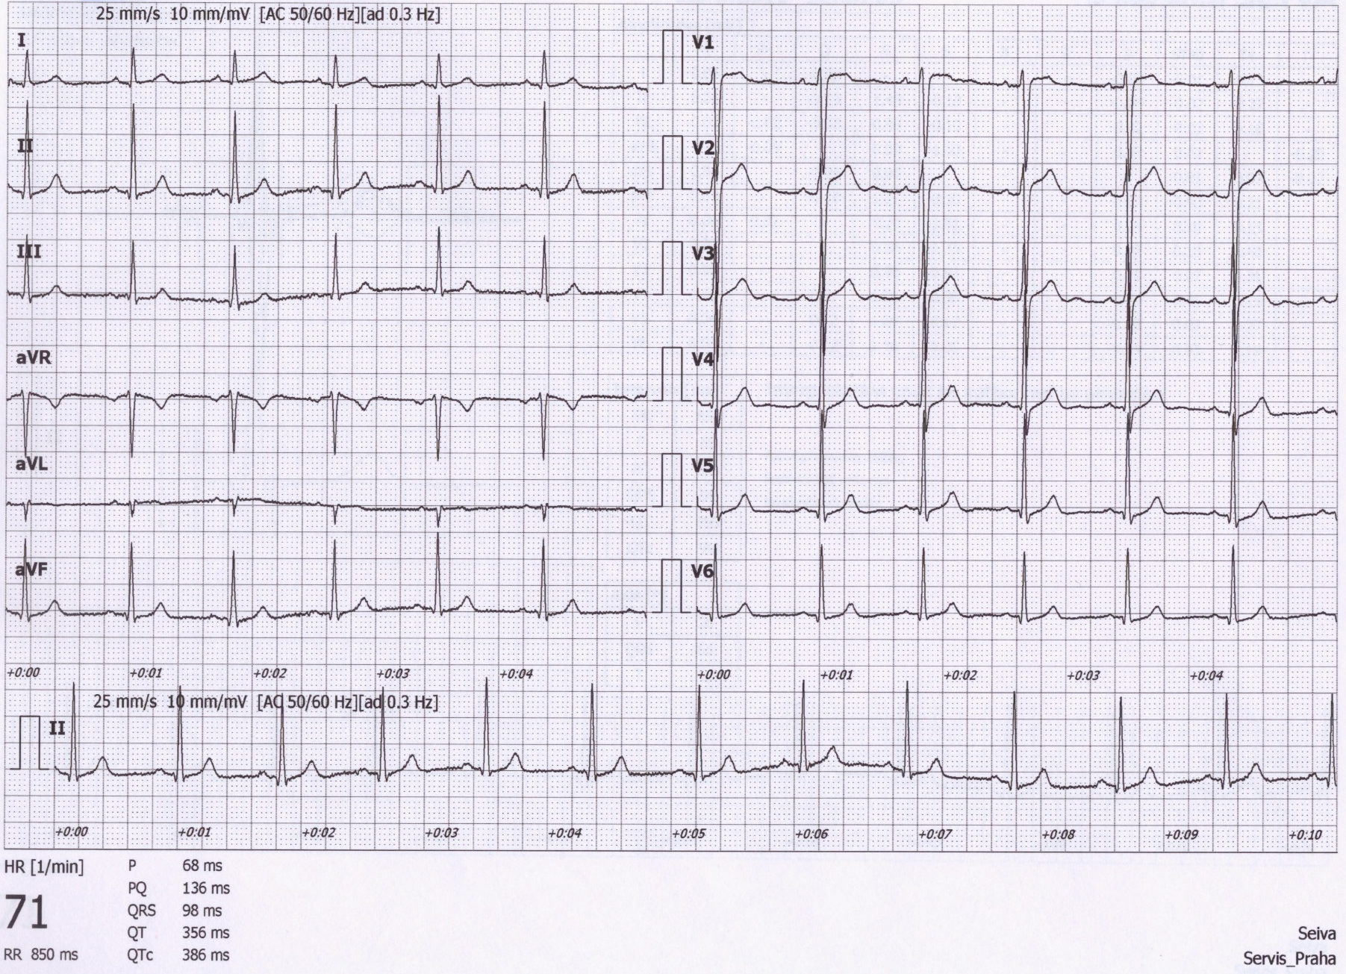
Analysis of ECG
A millimeter grid of paper will help in fast analysis
See the paper speed (here 25 mm/s)
  1 mm = 0,04 s
  5 mm (big square) = 0,2 s

Slide 23
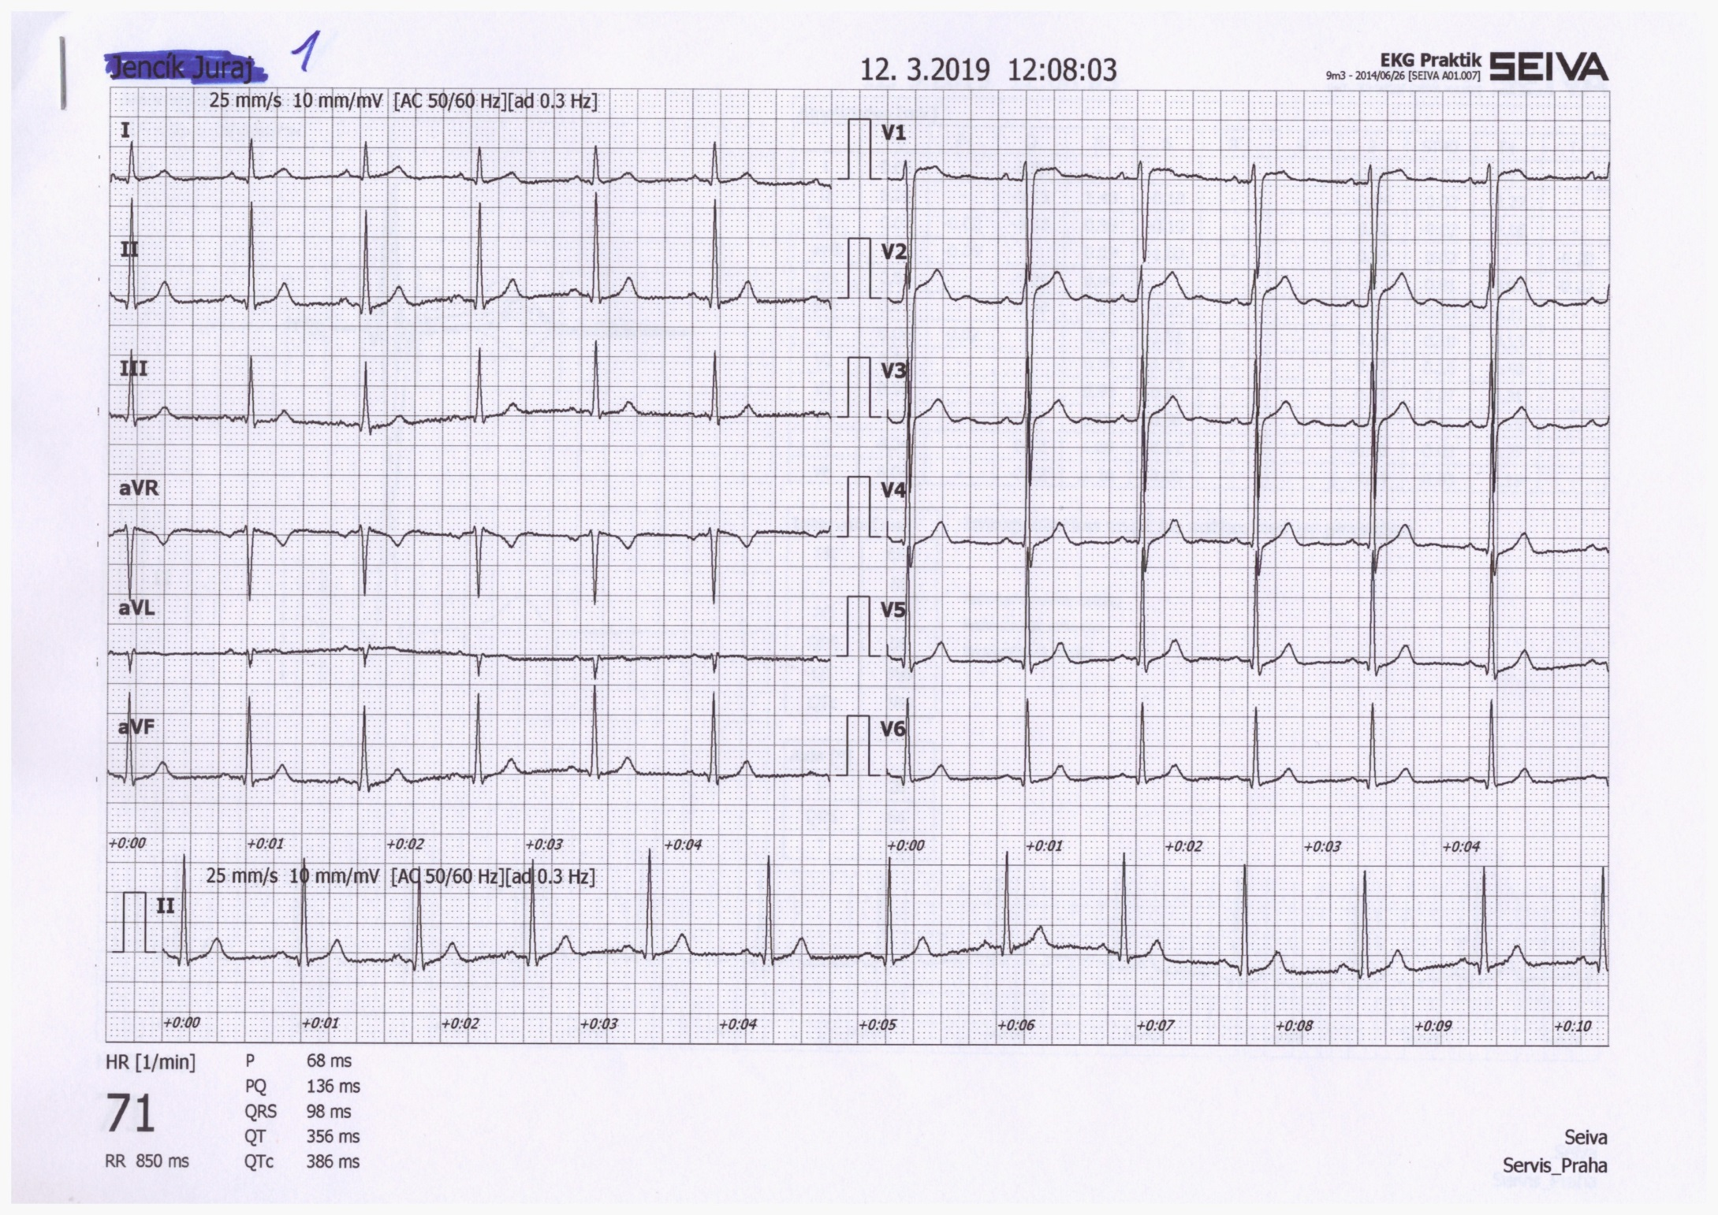
1) Heart action
Regularity of distances between QRS complexes - RR intervals
Regular action: difference < 0,16 s
Irregular action: difference > 0,16 s
  Usually pathological
  Beware of significant sinus respiratory arrhythmia - it is very physiological. If you are unsure, ask the patient to hold their breath during the recording
Note: if one extrasystole is present, but otherwise the action is regular, it is called regular
RR

Slide 24
2) Heart rhythm
Heart rhythm is determined by the source of action potentials that lead to ventricular depolarization
ventricul depolarization is crucial because it determines cardiac output
Sinus rhythm
  AP begins in the SA node
  ECG: P wave (atrial depolarization) precedes QRS complex
Junction rhythm
  AP begins in the AV node or His bundle, and the frequency is usually 40-60 bpm
  P wave does not precede QRS complex, QRS shape is normal (narrow)
  Heart rate is low (40-60 bpm)
  Atrial depolarization can be present in the ECG if the ventricular impulses are transferred to the atria - wave is after QRS and has opposite polarity because it runs in the opposite direction
  Tertial (ventricular) rhythm
  AP begins in other parts of the conduction system, with a frequency of 30-40 bpm
  QRS has a strange shape (wider) because it spreads in a non-standard direction in the ventricles

Slide 25
2) Heart rhythm
Sinus rhythm – P wave precedes each QRS complex – the impulse begins in the SA node, it is followed by the depolarization of the ventricles
Junctional rhythm – normal P waves do not precede QRS – the impulse begins in the AV node or His bundle, low heart rate, but normal QRS shape (the impulse spreads normally in the ventricle)
Atrial depolarization
or
Tertiary (ventriclular) rhythm – there are no P waves bound to QRS, the impulse begins somewhere in the ventricles – a deformed shape of QRS, very low heart rate, for example, 3rd-degree AV block
Atrial repolarization
P – atrial depolarization
3rd-degree AV block – tertiary rhythm in ventricles, faster rhythm in atria determined by the SA node, but the stimulus is not transferred to the ventricles

Slide 26
3) Heart rate (HR)
A frequency of ventricular contractions (it determines cardiac output); on ECG – a frequency of ventricular depolarizations
HR = 1 / RR bpm (beats per minute)
Physiological values: 60-90 bpm at rest
Tachycardia: > 90 bpm at rest
Bradycardia: < 60 bpm

Slide 27
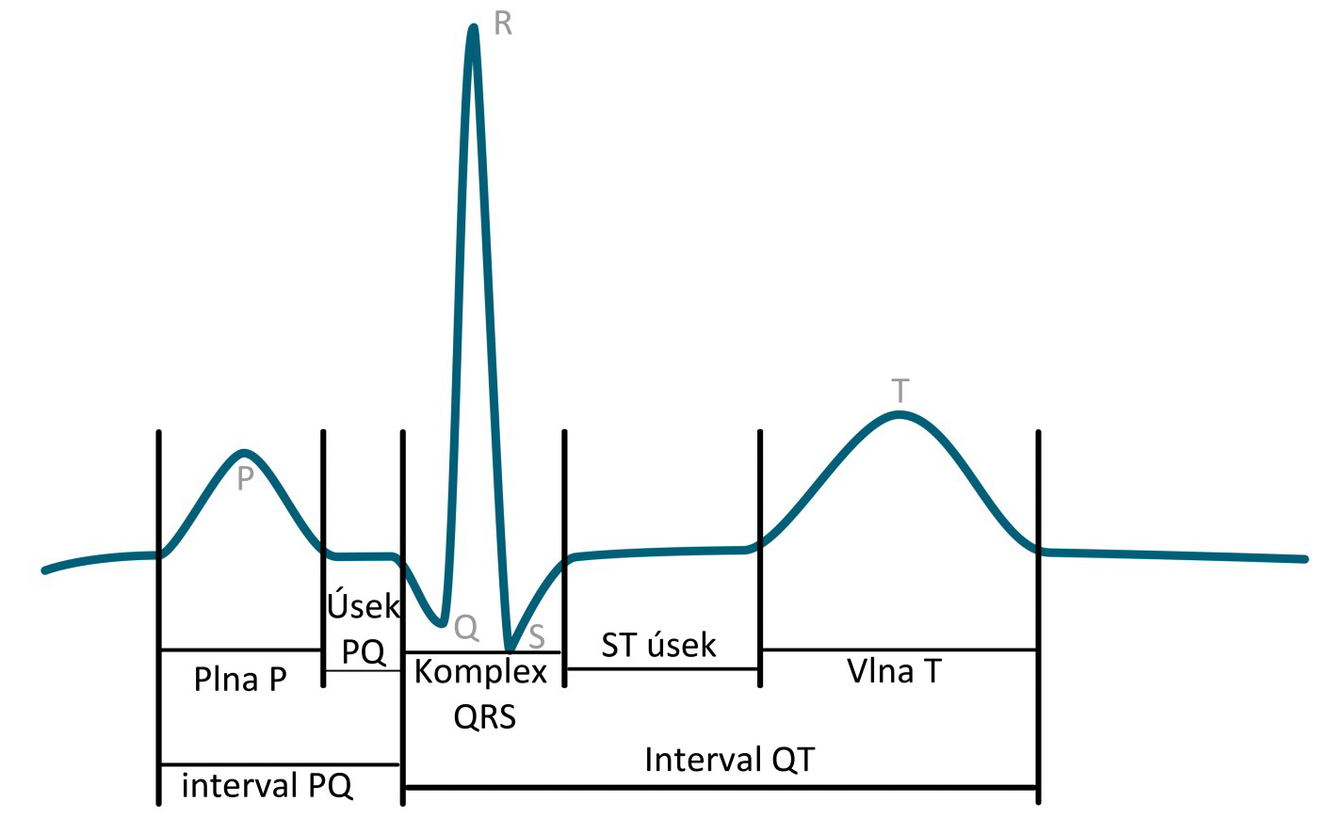
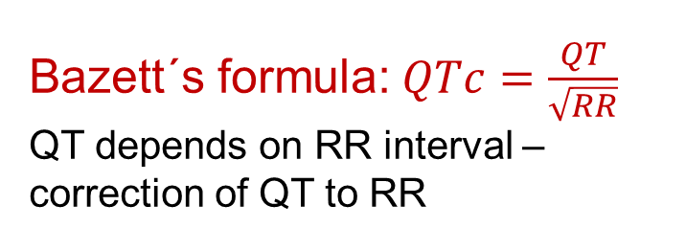
4) Waves, segments, intervals
Name | Norm
P wave | 80 ms
interval PQ (PR) | 120-200 ms
segment PQ (PR) | 50-120 ms
Q | -
complex QRS | 80-100ms
R | -
S | -
segment ST | 80-120 ms
interval QT | < 420ms
wave T | 160 ms
R
T
P
PQ segment
ST segment
Q
S
P wave
QRS complex
T wave
QT interval
Bazett´s formula:$QTc=\frac{QT}{\sqrt{RR}}$
QT depends on RR interval – correction of QT to RR
PQ interval

Slide 28
4) Waves
P wave:
Is it present?
Is it positive/negative, one-peak/two-peak, high (>0,25 mV)/normal/low?
QRS:
  Q: first negative deflection
  R: first positive deflection
  S: negative deflection after positive deflection
Small deflection (less than 0,5 mV) – small letter
Strong deflection (5 mm and more) – capital letter
Second positive deflection (‘)
T wave:
Is positive/negative/bipolar?
Does it have the same polarity as the strongest QRS deflection?
  Yes: concordant (ok), No: discordant (pathology)
Bipolar T:
  Preterminal negative (-/+)
  Terminal negative (+/-)
Examples:
RS
Ventricular depolarization - QRS
R
qRs
rSr‘
Ventricular repolarization
Atrial depolarization
T
P
Lead II
Q
S

Slide 29
5) Electrical heart axis
Electrical heart axis: average direction of the electric heart vector during ventricular depolarization (QRS complex)
El. heart axis
–
–
–
+
Physiological range:
Middle type 0° – 90°
Left type -30° – 0°
Right type 90° – 120°
Pathological range:
Right deviation: > 120 ° (right ventricular hypertrophy, dextrocardia)
Left deviation: < -30° (left ventricular hypertrophy, pregnancy, obesity)
+
aVL
-30°
–
+
I
0°
–
–
aVR
+
30°
+
+
II
vectocardiogram
III
aVF
60°
120°
90°

Slide 30
5) Electrical heart axis
Electrical heart axis: average direction of the electric heart vector during ventricular depolarization (QRS complex)
El. heart axis
–
Physiological range:
Middle type 0° – 90°
Left type -30° – 0°
Right type 90° – 120°
Pathological range:
Right deviation: > 120 ° (right ventricular hypertrophy, dextrocardia)
Left deviation: < -30° (left ventricular hypertrophy, pregnancy, obesity)
+
aVL
-30°
–
+
I
0°
30°
+
vectocardiogram
aVF
I
90°

Slide 31
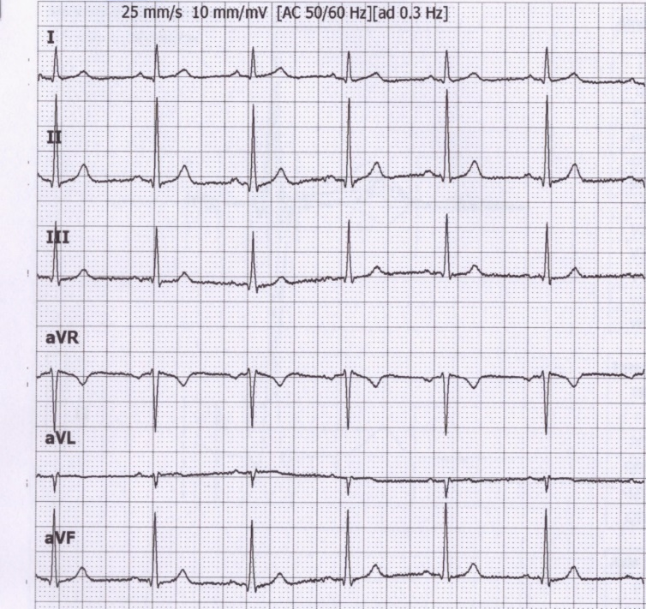
Electrical heart axis – calculation
Because the el. axis is related to ventricular depolarization in the frontal plane, for calculation, we use QRS in limb leads: I, II, III.
Calculate the sum of QRS oscillations in leads I, II, III.
When the oscillation goes downward, it is negative. When the oscillation is upward, it is positive. Use a millimeter grid.
  Lead I: Q_{I}=-1; R_{I}=6; S_{I}=0;
  QRS_{I}=5
  Lead II: Q_{II}=-1; R_{II}=17; S_{II}=-1;
  QRS_{II}=15
  Lead IIII: Q_{III}=0; R_{III}=10; S_{III}=-1;
  QRS_{III}=9

Slide 32
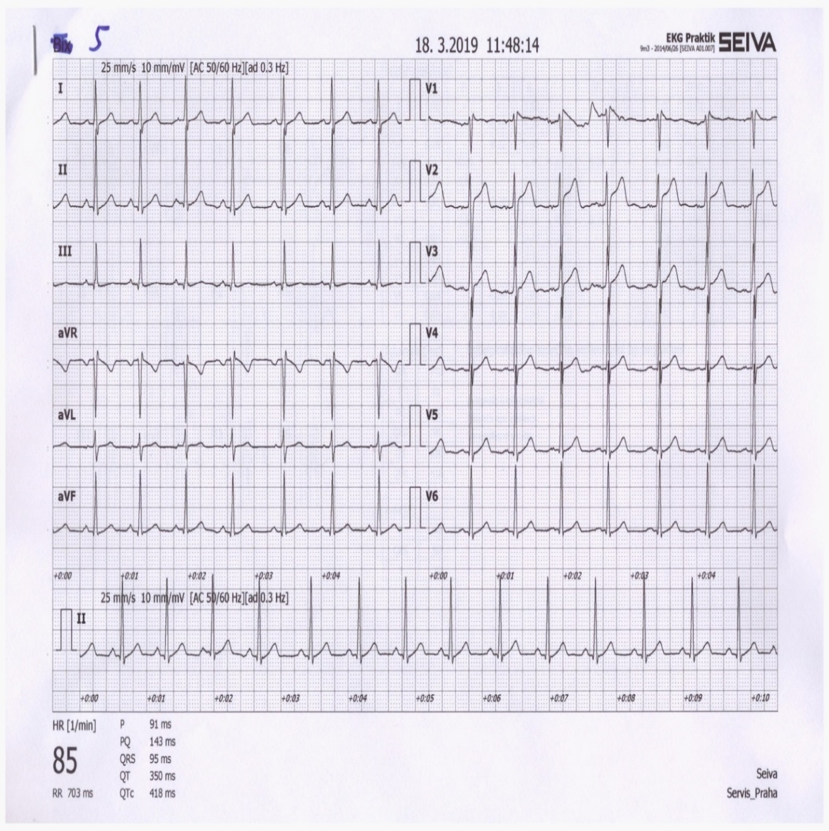
Electrical heart axis – calculation
I
–
0
5
+
-30°
–
–
0°
II
III
0
0
9
30°
15
+
+
120°
60°
90°

Slide 33
Estimation of electrical heart axis
–
–
–
Leads II and aVR
+
+
aVL
-30°
–
+
I
0°
–
–
aVR
+
30°
+
+
II
III
aVF
60°
120°
90°

Slide 34
Estimation of electrical heart axis
Q = -1
R = 6
S = 0
QRS = 5
–
Q = -1
R = 17
S = -1
–
–
QRS = 15
+
+
aVL
-30°
Q = 0
R = 10
S = -1
QRS = 9
–
+
0°
Q = 1
R = -11
S = 0
I
QRS = -10
–
Q = 0
R = -3
S = 0
–
QRS = -3
aVR
30°
+
+
Q = -1
R = 13
S = -1
El. cardiac axis slightly more than 60 °
III
+
II
QRS = 11
aVF
60°
120°
90°
Notes:
perpedicular

Slide 35
Estimation of electrical heart axis
Is deviation of QRS complex positive in I and aVF lead?
Yes
No
Physiological values between -30̊ to 110̊
Is deviation of QRS complex positive in I and negative in aVF lead
Is deviation of QRS complex negative in I and positive in aVF lead
Deviation to the left
Deviation to the right

Slide 36
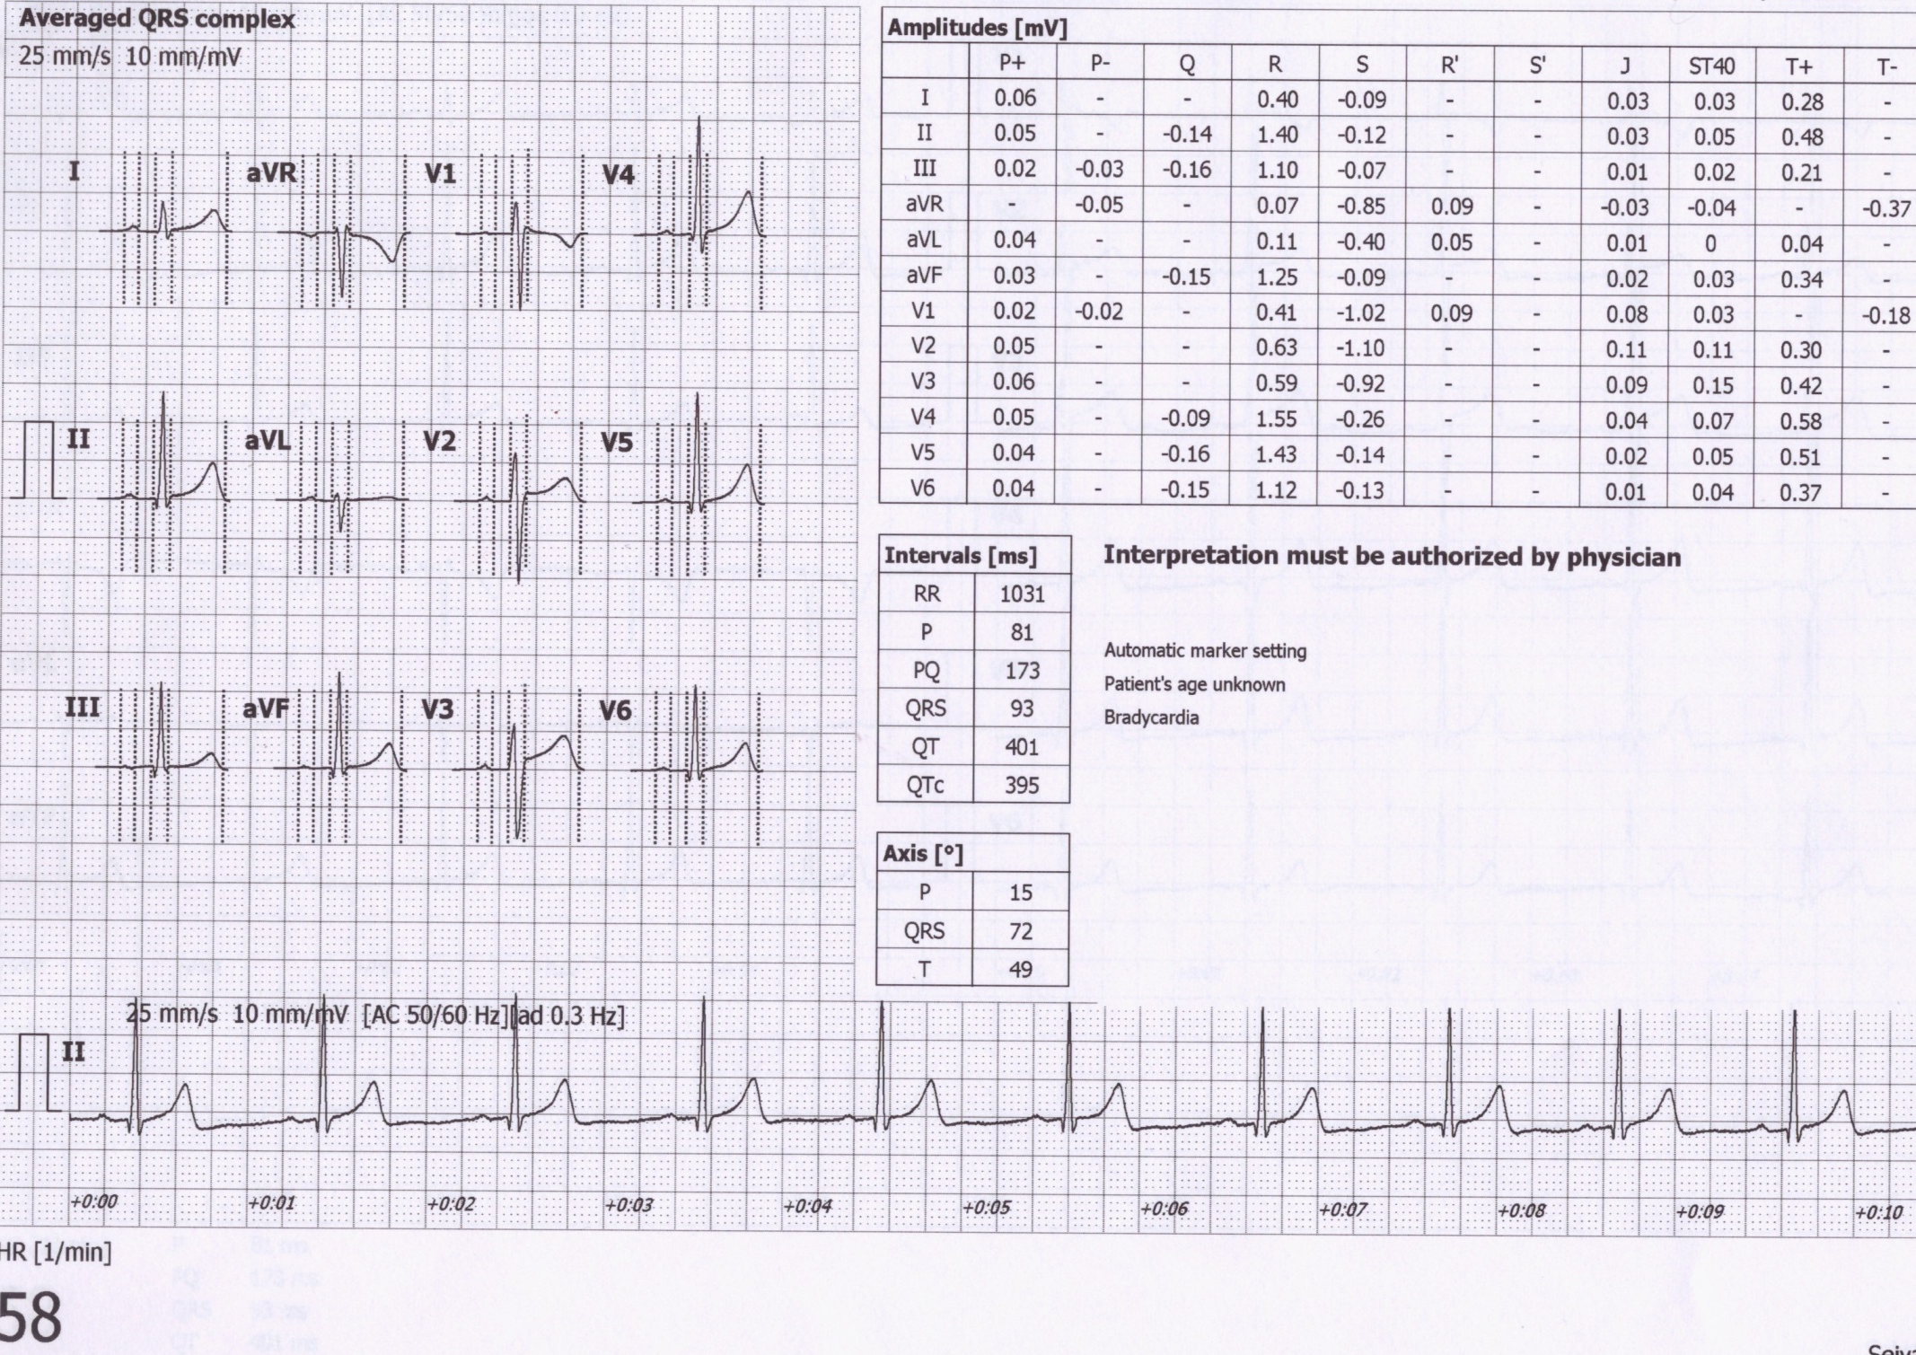
Electric axis calculation by software
Electrical axis for atrial depolarization
72°
Electrical axis for ventricular depolarization
Electrical axis for ventricular repolarization

Slide 37
Estimation of electrical heart axis in Horizontal plane

Slide 38
Thank you for your attention!

