Slide 1
ECHOcardiography

Slide 2
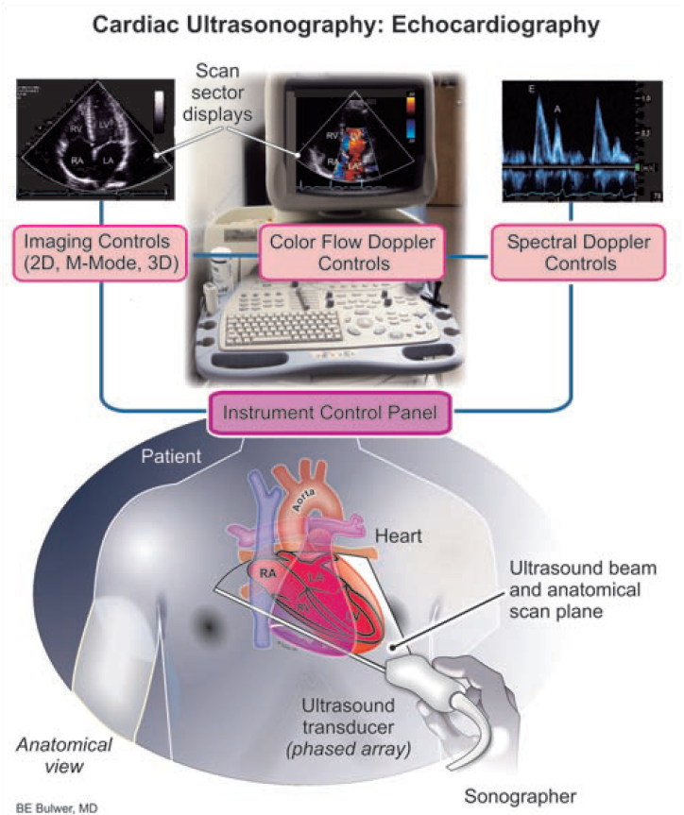
Cardiac trasnoraphy: Echocardioaphy

Slide 3
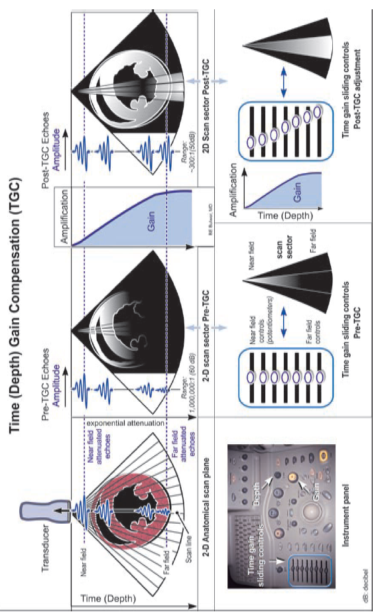
Depth Gain compensation

Slide 4
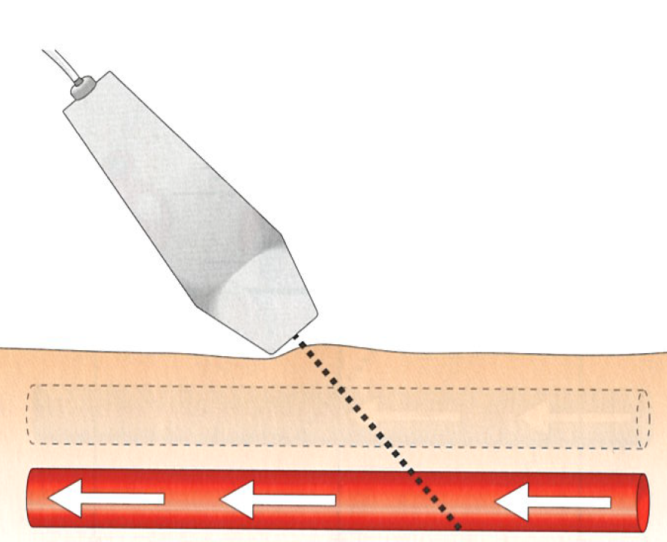
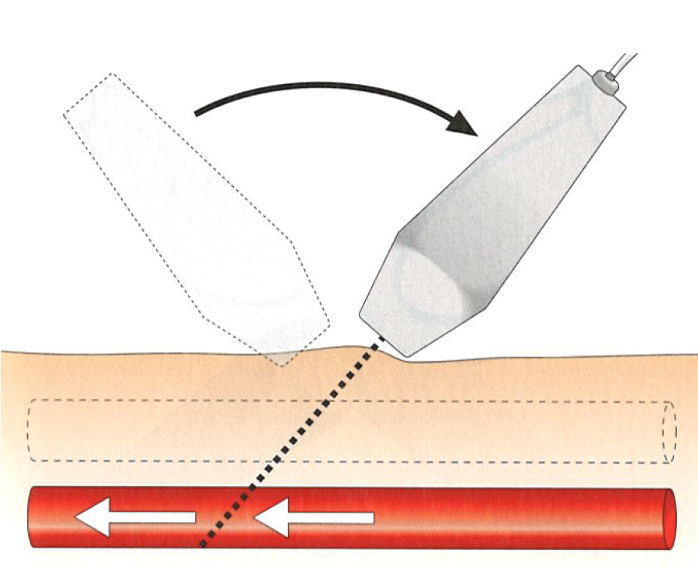

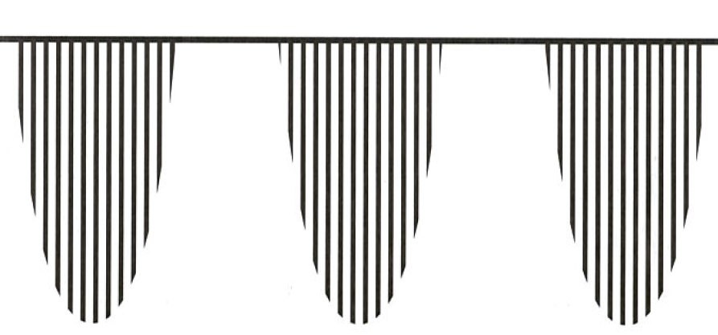
Probe position and slope

Slide 5
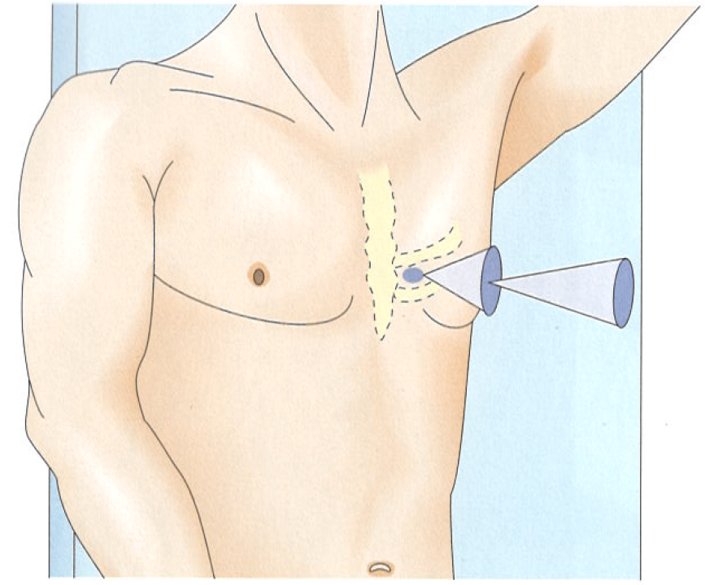
ECHO „windows“ and views. Parasternal window.
Short – axis view
Long – axis view

Slide 6
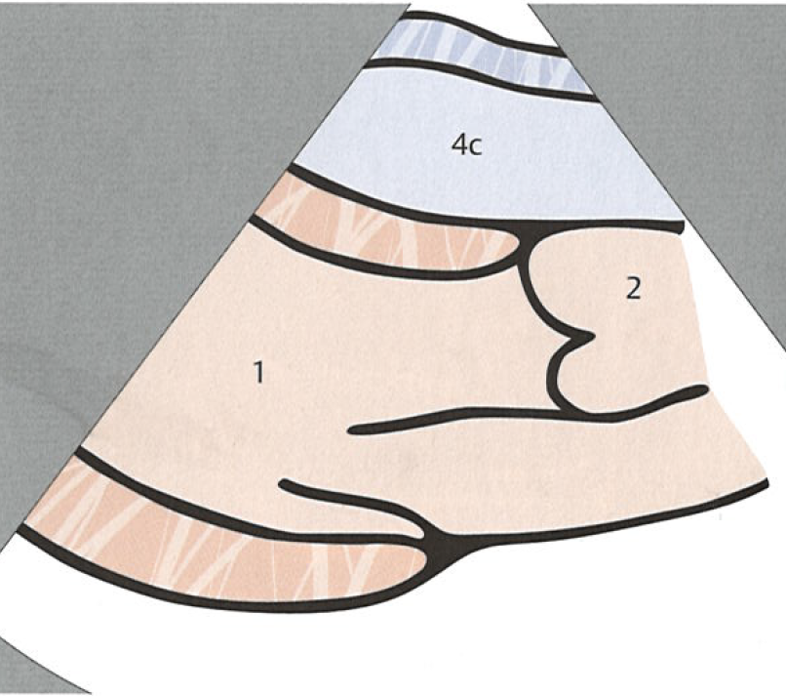
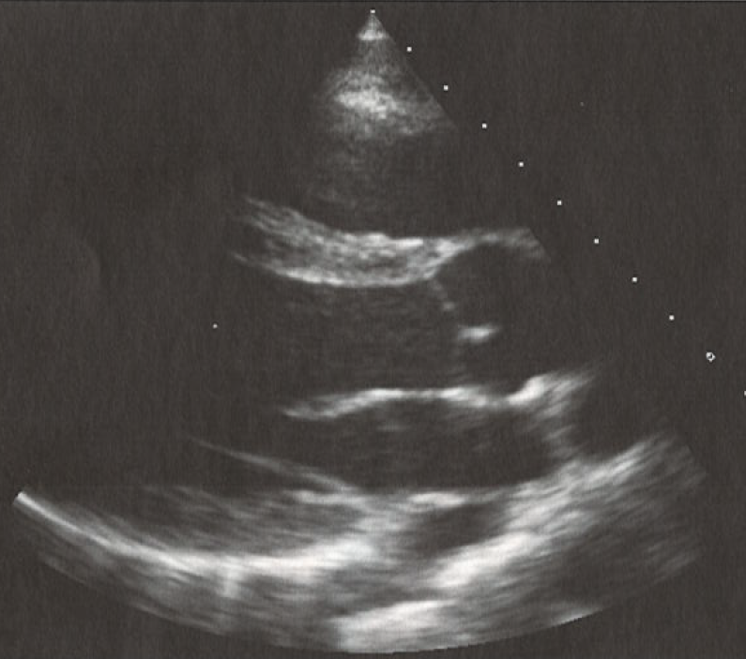
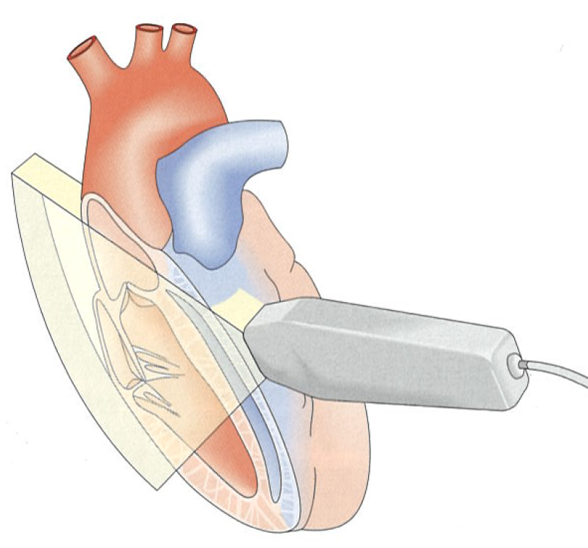
ECHO „windows“ and views. Parasternal window.
Long – axis view
1 – left ventricle
2 – aorta
4c – right ventricle
Estimation of the size of the heart

Slide 7
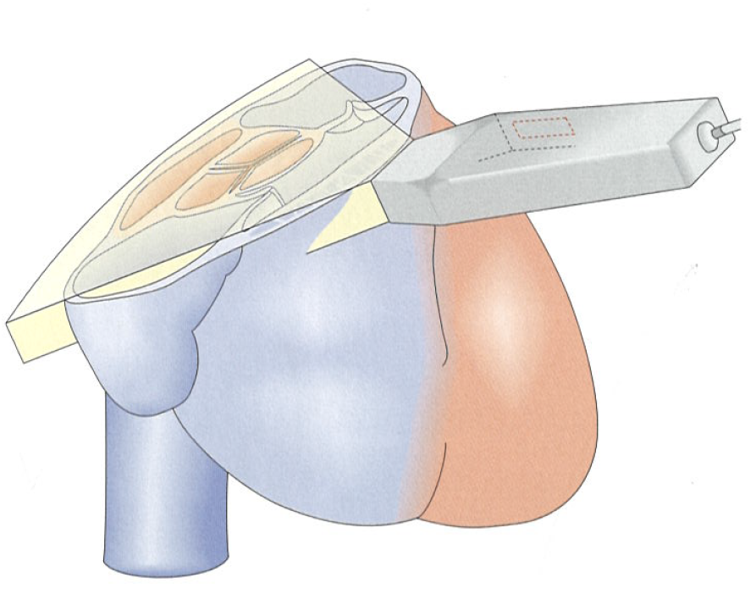
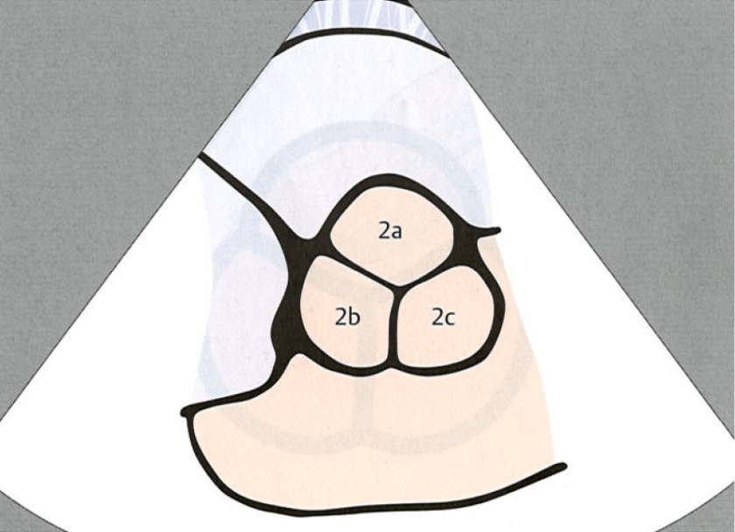
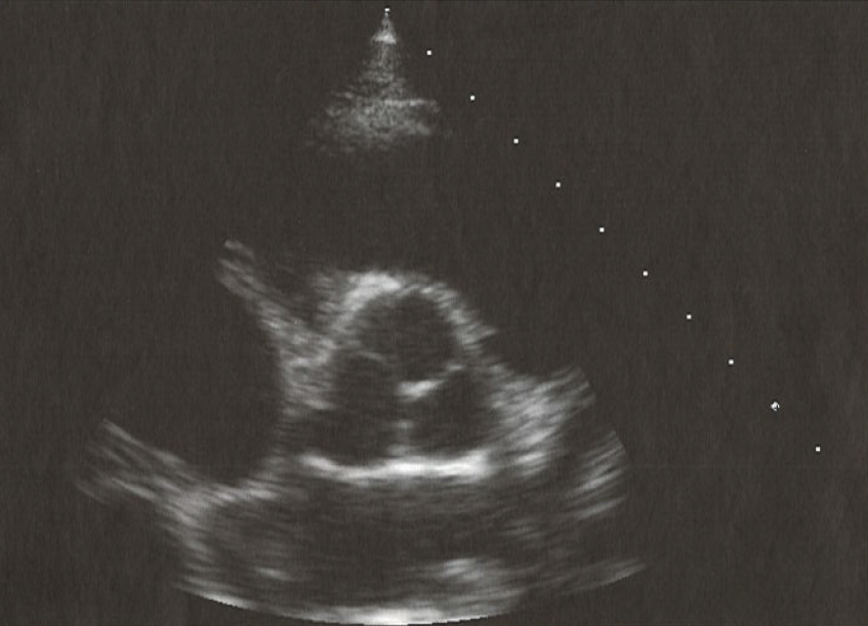
ECHO „windows“ and views. Parasternal window.
Short – axis view (Aortic valve)
2c - left posterior (origin of left coronary)
2b - anterior (origin of the right coronary)
2a - right posterior

Slide 8
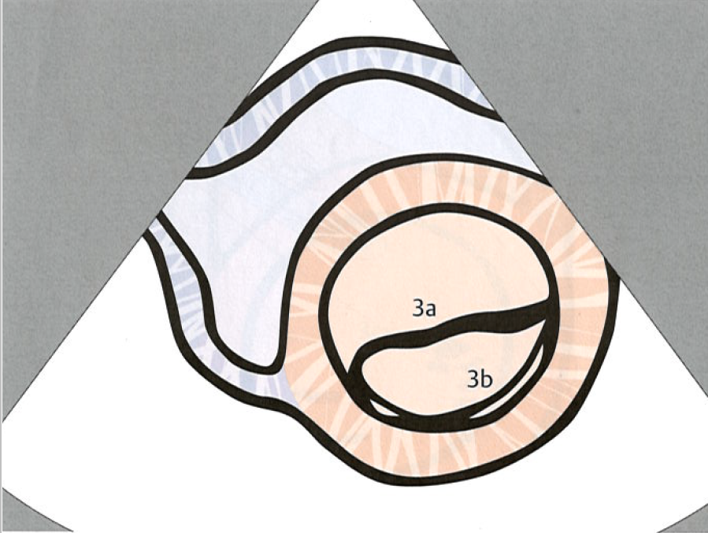
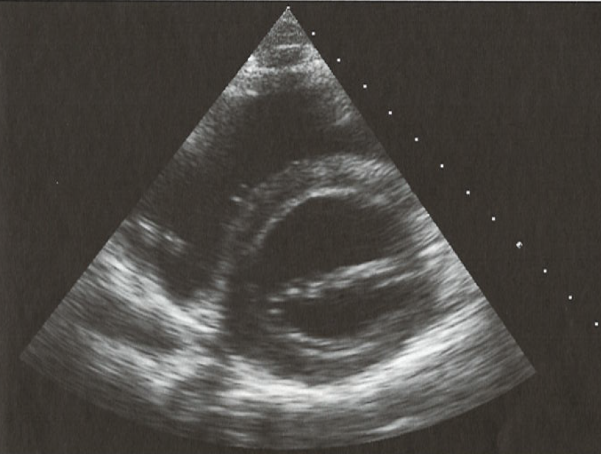
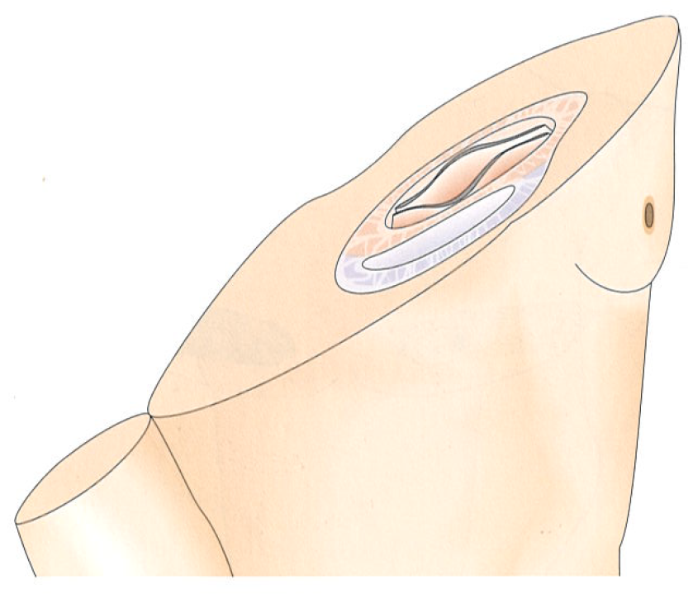
ECHO „windows“ and views. Parasternal window.
Short – axis view (Mitral valve)
anteromedial leaflet
posterolateral leaflet

Slide 9
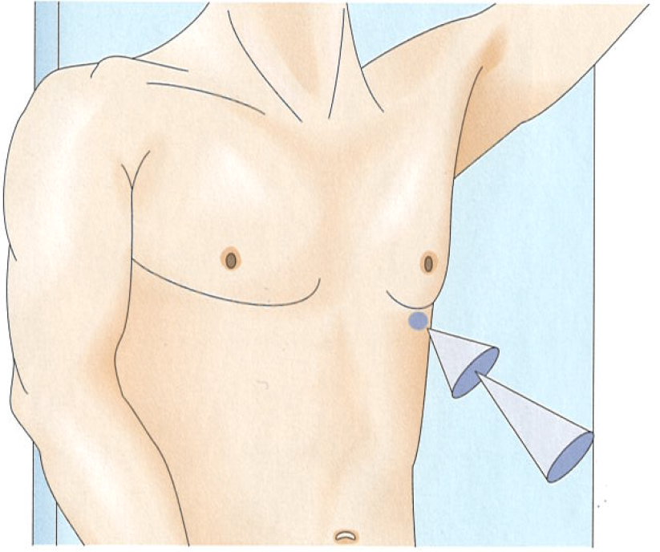
ECHO „windows“ and views. Apical window.
Short – axis view
  2 – chambre view
  3 – chambre view
Long – axis view
  4 – chamber view
  5 – chambre view

Slide 10
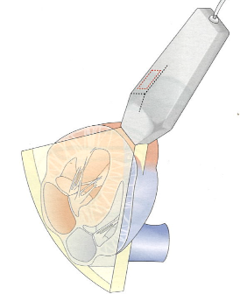
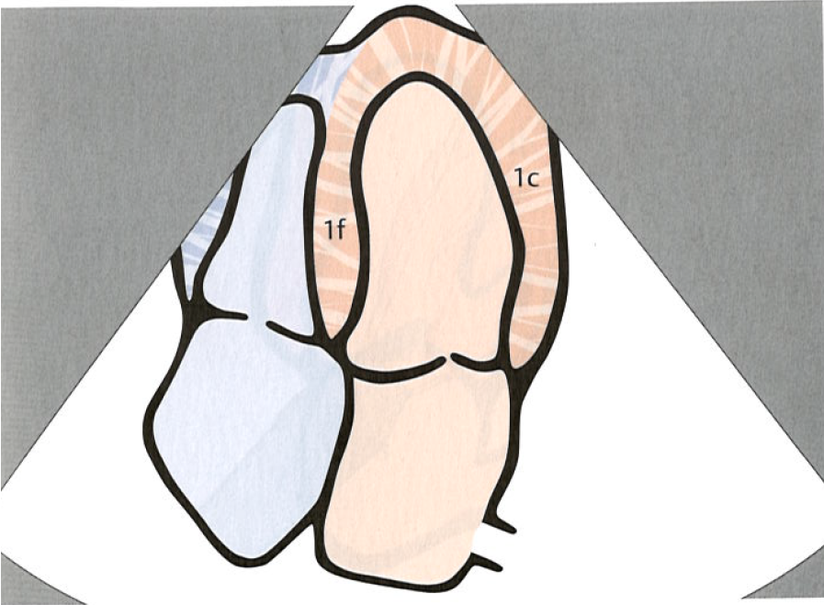
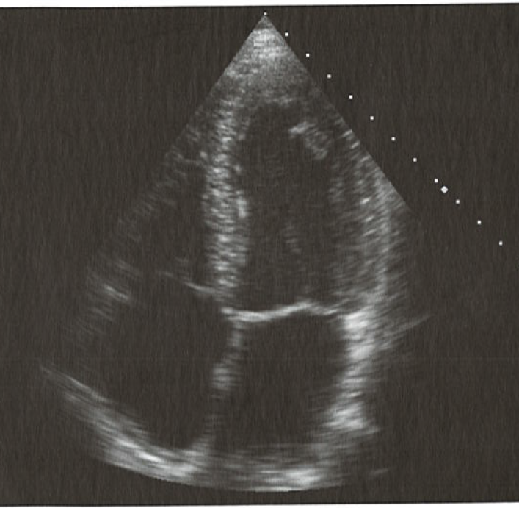
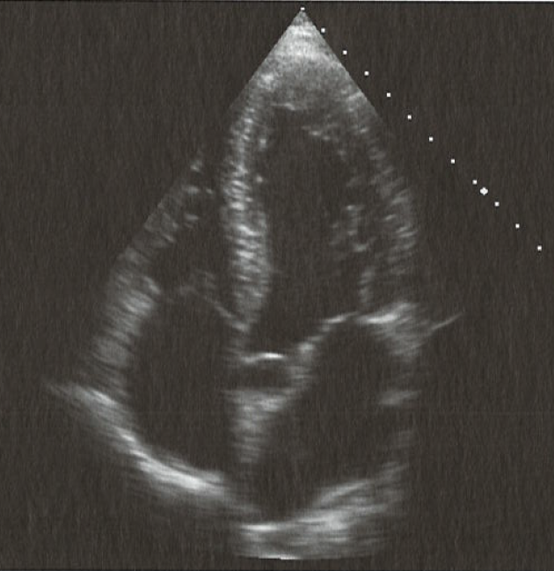
ECHO „windows“ and views. Apical window.
Long – axis view
Evaluation of the systolic and diastolic function of the heart

Slide 11
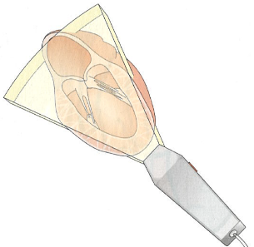
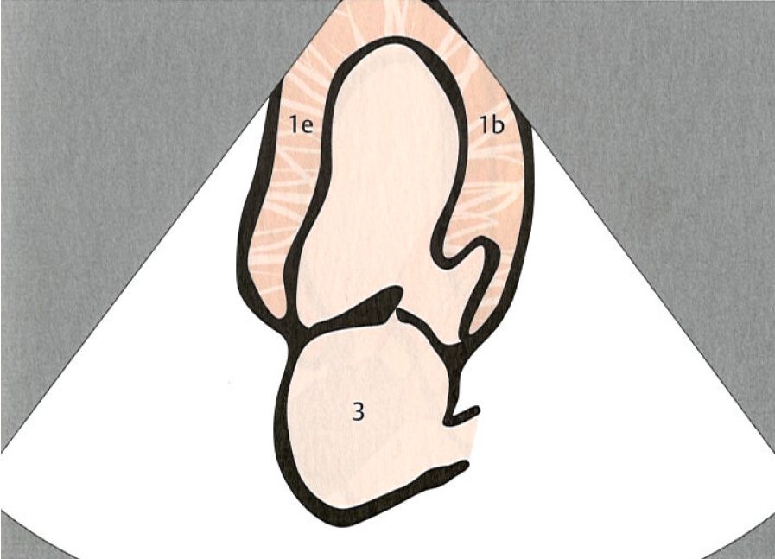
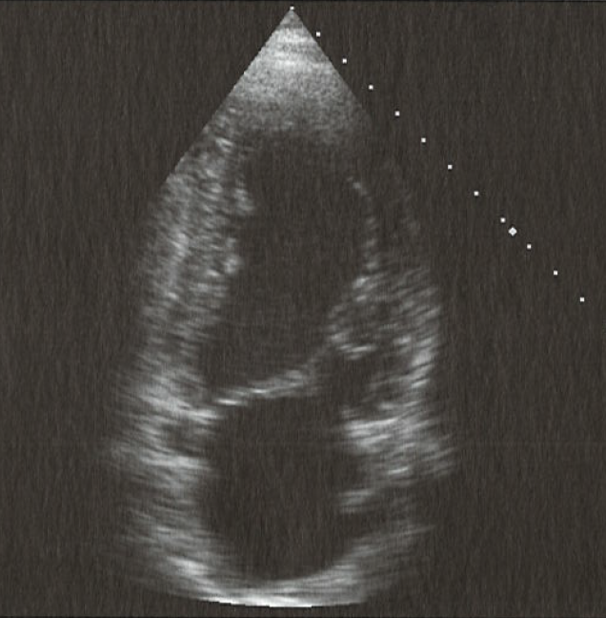
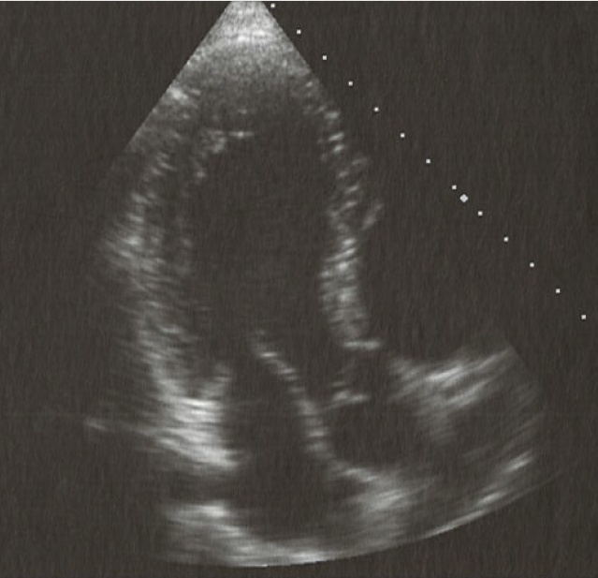
ECHO „windows“ and views. Apical window.
Short – axis view
1b – left ventricular anterior wall
1e – left ventricular posterior wall
3 – left atrium

Slide 12
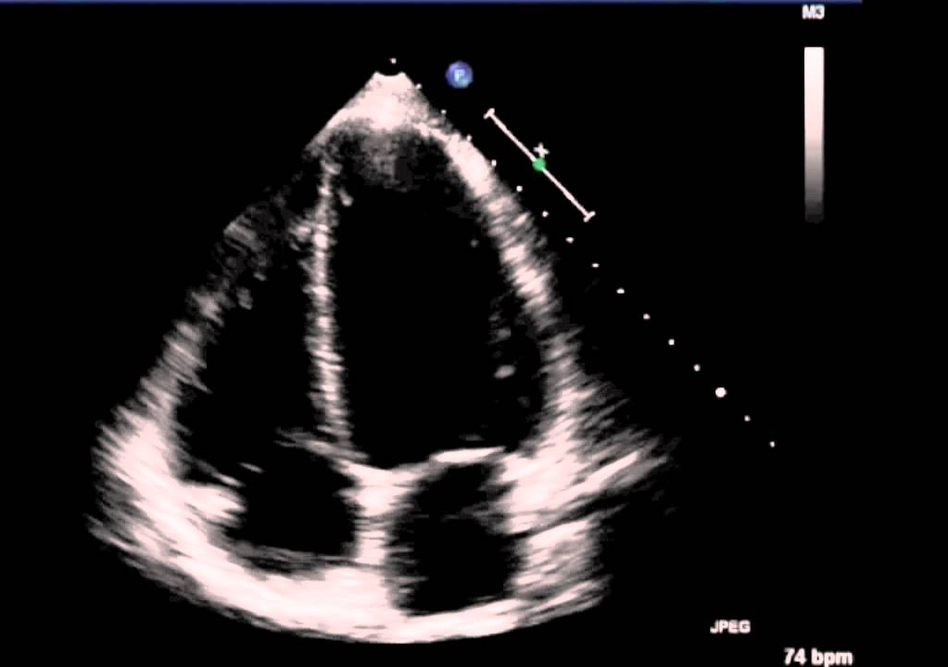
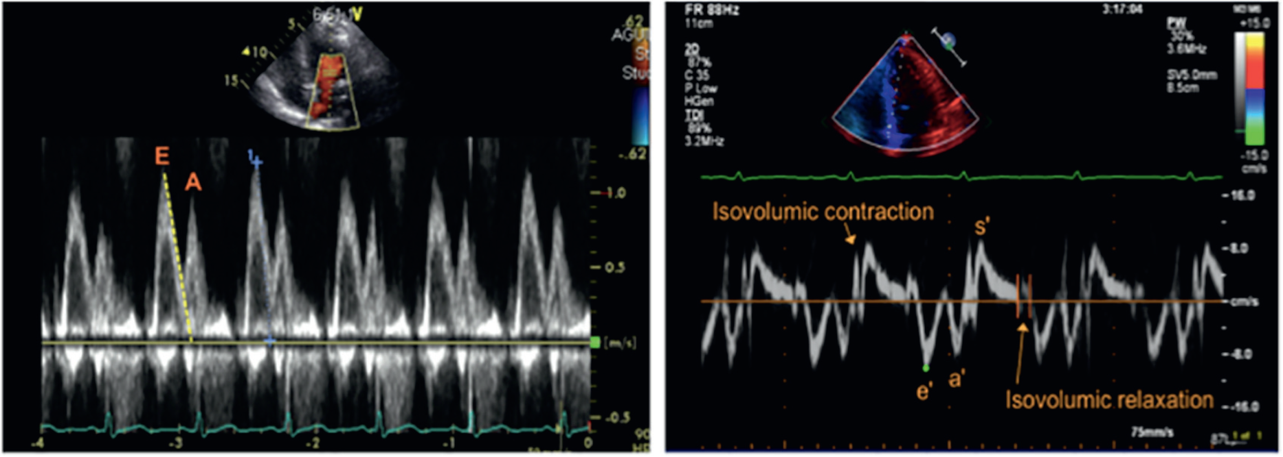
ECHO. Record.

Slide 13
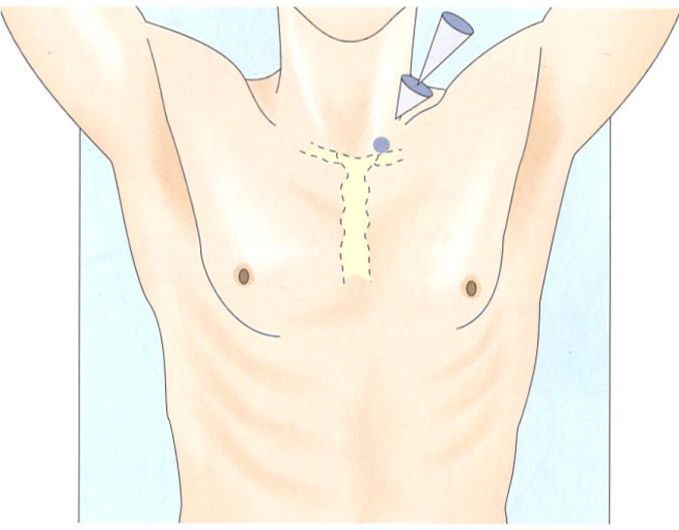
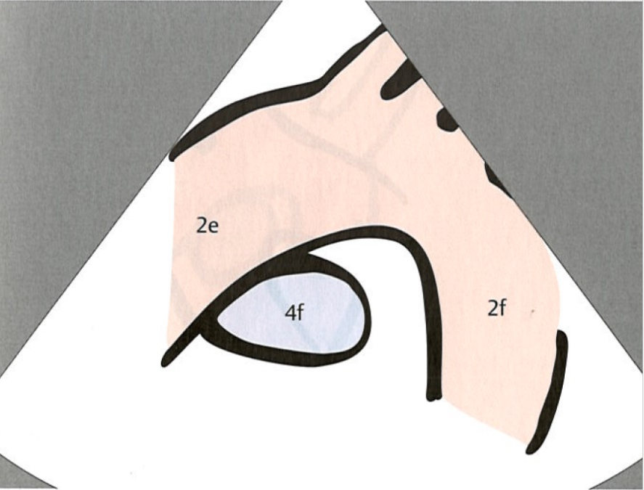
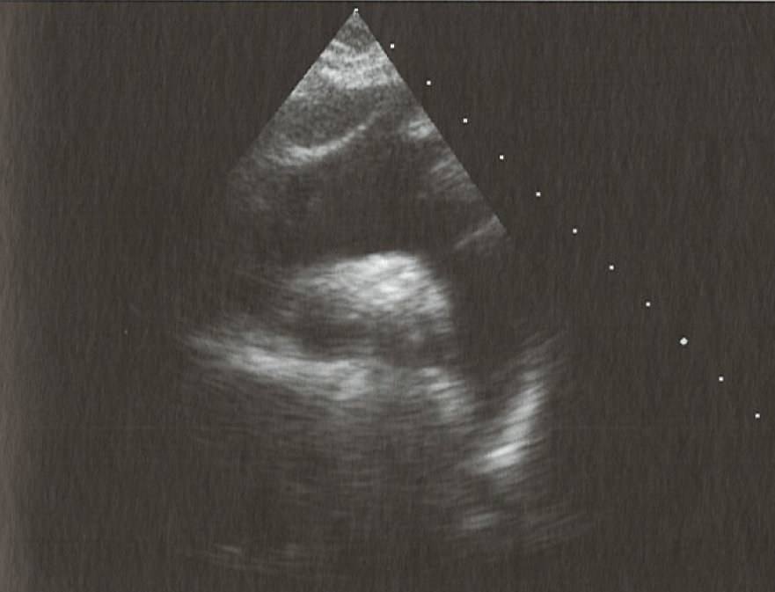
ECHO „windows“ and views. Suprasternal window.
2e – ascendent aorta
2f descendent aorta

Slide 14
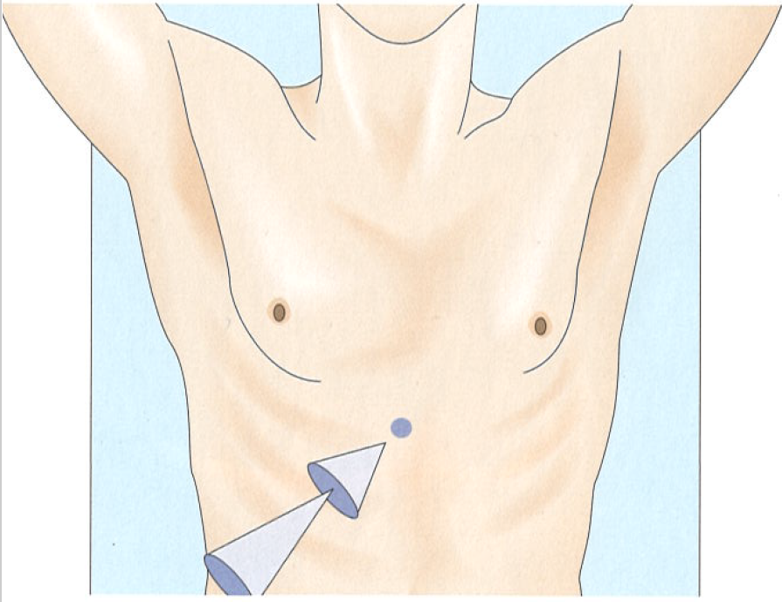
ECHO „windows“ and views. Subcostal window.

