Slide 1
Evaluation of the nutrition state

Slide 2
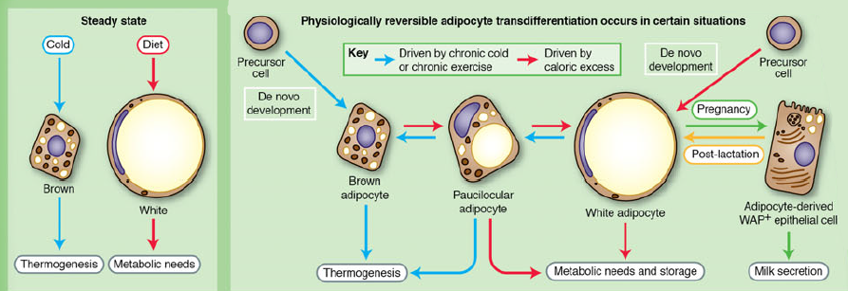
Adipose tissue
White (for storing dietary energy as TAGs)
Brown (for ability to convert chemical energy into heat)
Beige = harbored
Steady state

Slide 3
Fat tissue functions
Thermogenesis
Lactation
Immune responses
Fuel for metabolism

Slide 4
Structure of adipose tissue
Adipocytes
Non-fat cells:
  inflammatory cells (macrophages)
  immune cells
  preadipocytes
  fibroblasts
Connective tissue matrix
Vascular tissue
Neural tissue

Slide 5
Abdominal fat
The abdominal fat is present in two main depots:
Subcutaneous (80% of all body fat)
Intra-abdominal (10–20% of total fat in men and 5–8% in women)

Slide 6
Adipocytes
New smaller adipocytes act as a buffers. They are more insulin-sensitive and have high avidity for FFAs and TGs uptake, preventing their deposition in non-adipose tissue (SCAT)
Large adipocytes are insulinresistant, hyperlipolytic and resistant to anti-lipolytic effect of insulin (VAT)

Slide 7
Clinical and prognostic differences
Metabolic risks
Metabolic syndrome
Vascular risk and cardiovascular events
Prediction of mortality

Slide 8
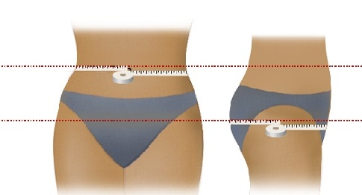
Anthropometric indexes of abdominal adipose tissue mass
WHR
Waist circumference
Abdominal sagittal diameter*
Waist circumference (cm)
Category | Men | Women
Normal value | ≤ 94 | ≤ 80
Necessity to decrease body mass | 95–102 | 81–90
Medical assistance with decreasing of body mass necessary | > 102 | > 90
WHR: for women < 0.80
for men < 1.00

Slide 9
Imaging techniques
Computed tomography (CT)
Magnetic resonance imaging (MRI)
Ultrasound (US)*

Slide 10
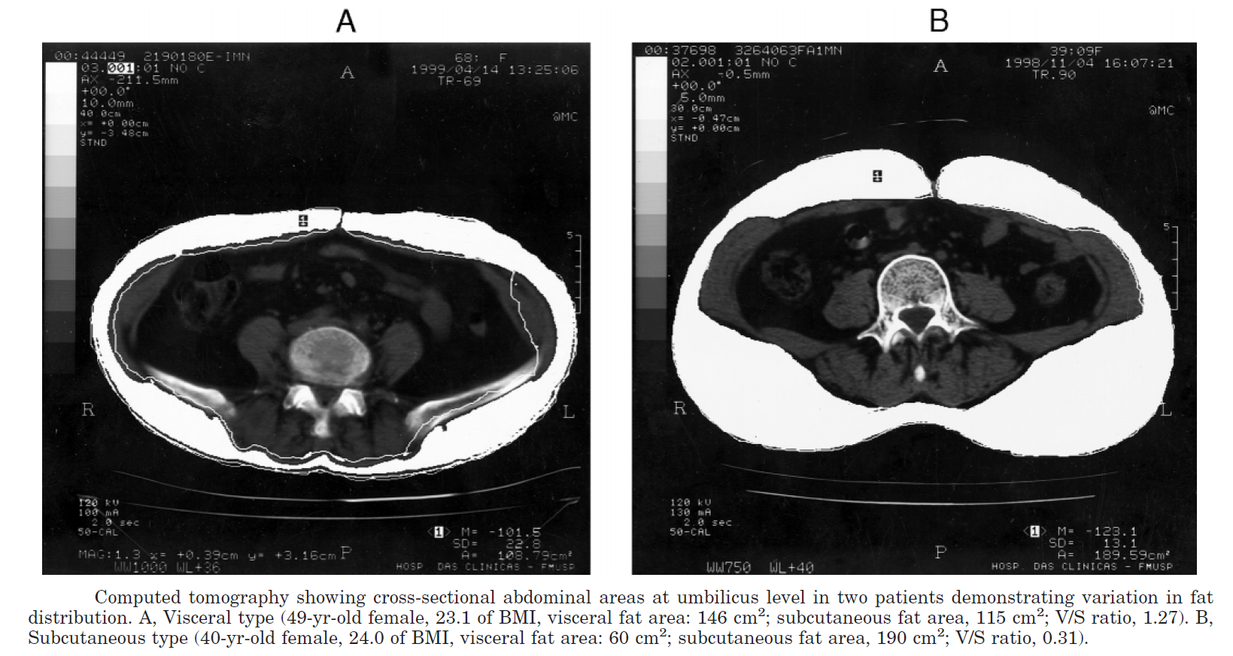
Imaging techniques
Computed tomography (CT)
L4 – L5 region
V/S ratio
V/S≥0.4 (V group)
V/S<0.4 (SC group)
Abdominal sagittal diameter*

Slide 11
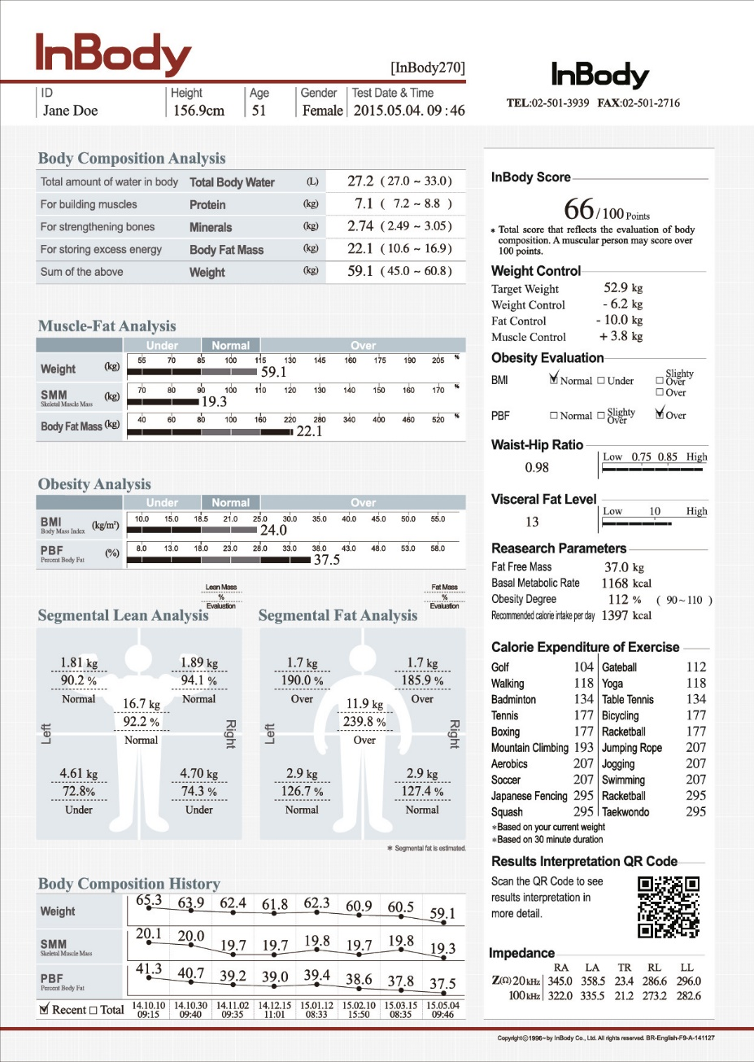
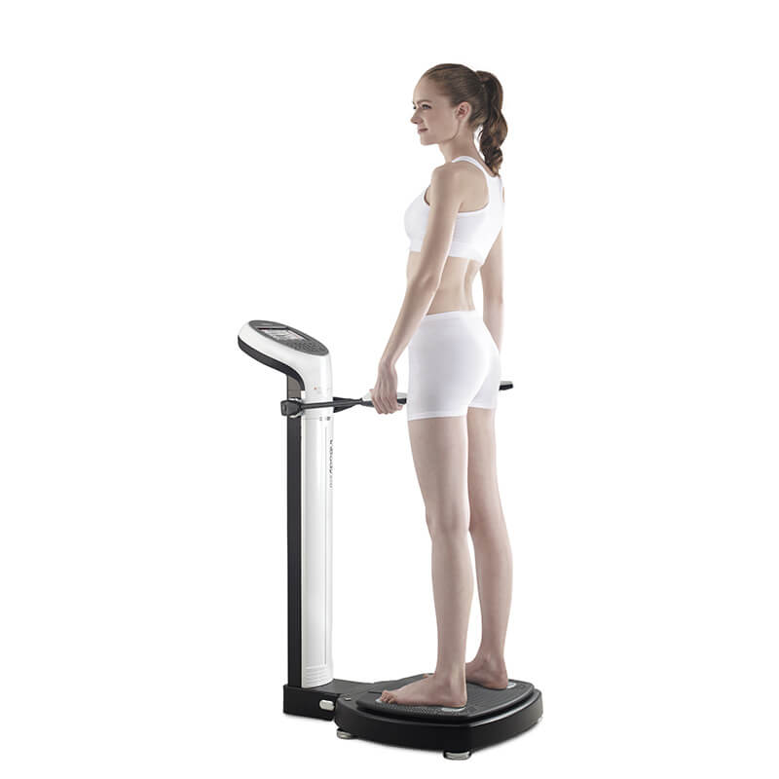
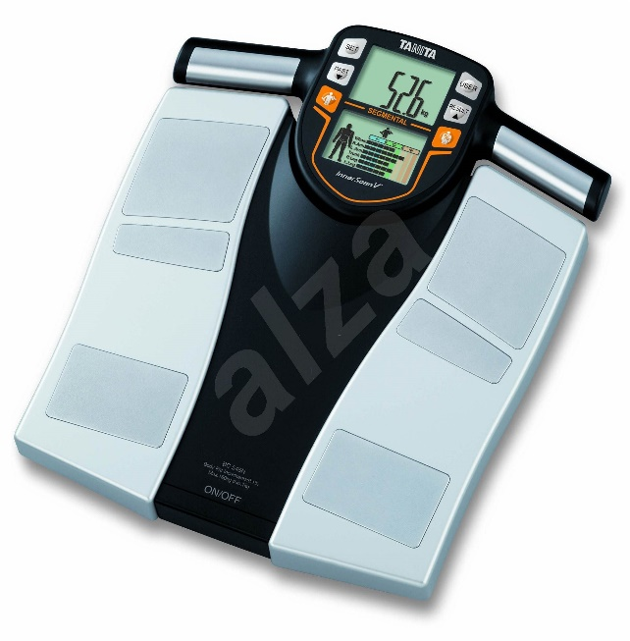
Bioimpedance measuring
Bioimpedance spectroscopy (BIS)
Bioelectrical impedance analysis (BIA)

Slide 12
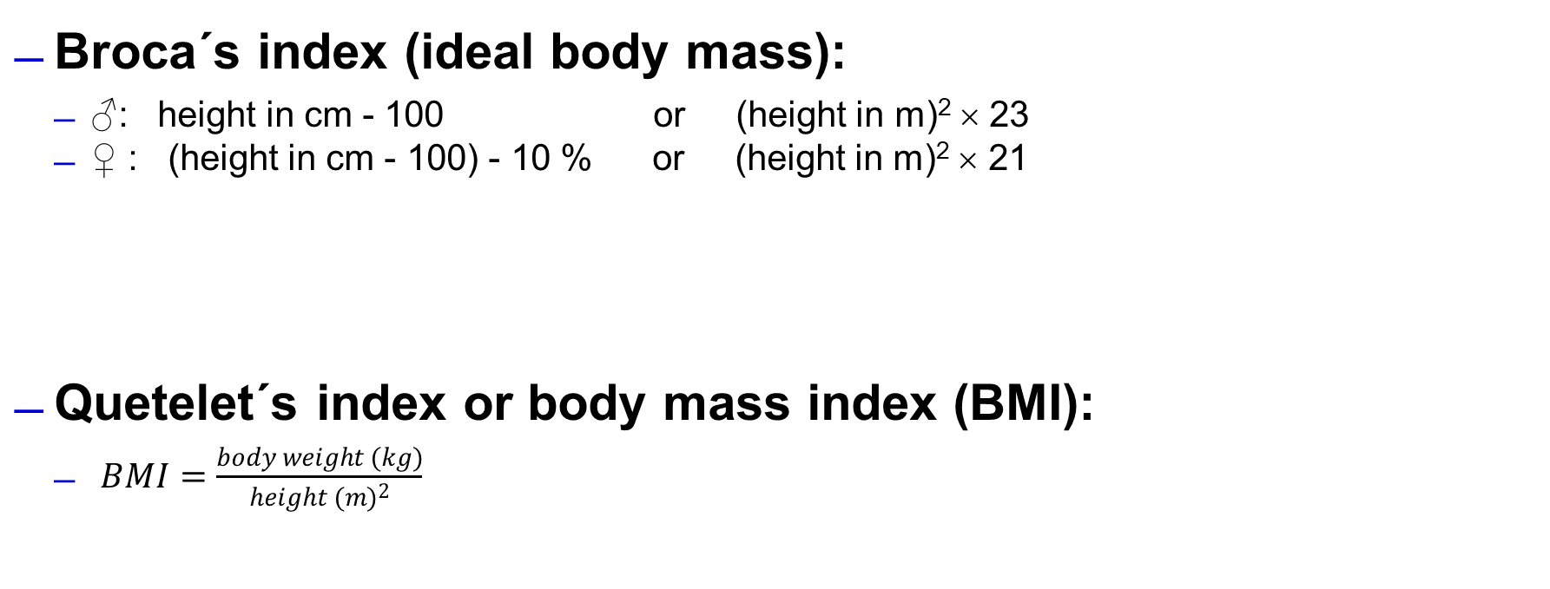
Indexes calculated from anthropometric parameters
Broca´s index (ideal body mass):
  ♂: height in cm - 100 or (height in m)² × 23
  ♀ : (height in cm - 100) - 10 % or (height in m)² × 21
Quetelet´s index or body mass index (BMI):
  $BMI=\frac{body weight (kg)}{{height (m)}^{2}}$
Obesity degree | % ideal body mass
mild | 115–129
moderate | 130–149
severe | 150–199
morbid | > 200
BMI (kg.m⁻²)
Category | Men | Women
Underweight | < 20 | < 19
Healthy | 20–24,9 | 19–23,9
Overweight | 25–29,9 | 24–28,9
Obesity | 30–39,9 | 29–38,9
Morbid obesity | > 40 | > 39

