Slide 1
Differential diagnosis of joint pain
MUDr. Radoslav ROMAN
Rheumatology unit, 2nd Dept. of Internal Medicine
St. Anne´s University Hospital in Brno
Notes:
Dear students, welcome to this lesson. Today’s topic is differential diagnosis of joint pain.

Slide 2
Today’s agenda
Theoretical basics
Clinical cases

Slide 3
Pain in the joint area
is a common finding with a wide differential diagnosis
It can be an initial symptom of a number of joint diseases or soft tissue rheumatic pain syndromes

Slide 4
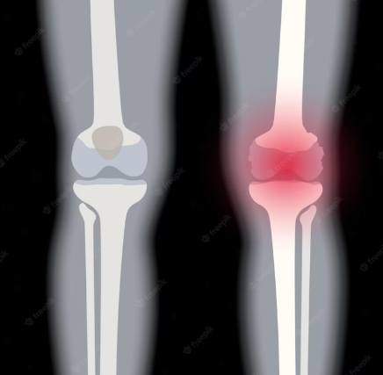
Approach to the patient
1. Articular or extraarticular
4. Number of affected joints
3. Symptoms duration
2. Inflammatory or
Non-inflammatory
6. Age distribution
5. Location of affected joints
Picture: https://www.freepik.com
Notes:
if we want to investigate the cause of joint pain, we need to find answers to the following questions
is pain a symptom of articular or extraarticular disease?
what is the duration of symptoms?
which joints are affected?
how old our patient is? Or what was the age at which the symptoms of the disease began?

Slide 5
1. Articular or Extra-articular pain
  Articular pain:
  deep, diffuse pian
  worsens with active and passive movement
  joint swelling and palpable pain along joint space
  Increased skin temperature
  Skin colour changes are not usually present
  (if present: septic arthritis, crystaline arthritis - gout)

Slide 6
1. Articular or Extra-articular pain
  Extra-articular pain:
  sharp, localized pain
  worsens with active movement (not with passive)
  the patient ussually tells/ shows what kind of movement is causing him pain
  examples:
    Shoulder impigmement syndrome – tendinitis of supraspinatus tendon in subacromial space
    Subacromial bursitis

Slide 7
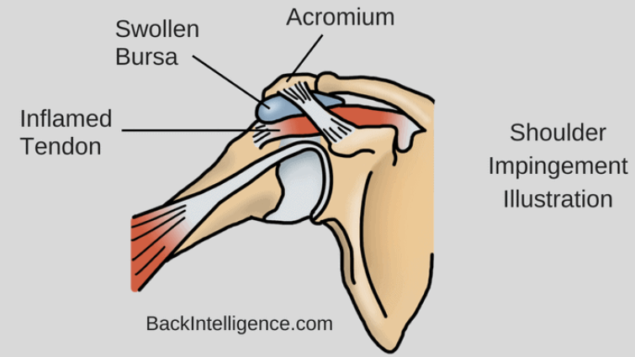
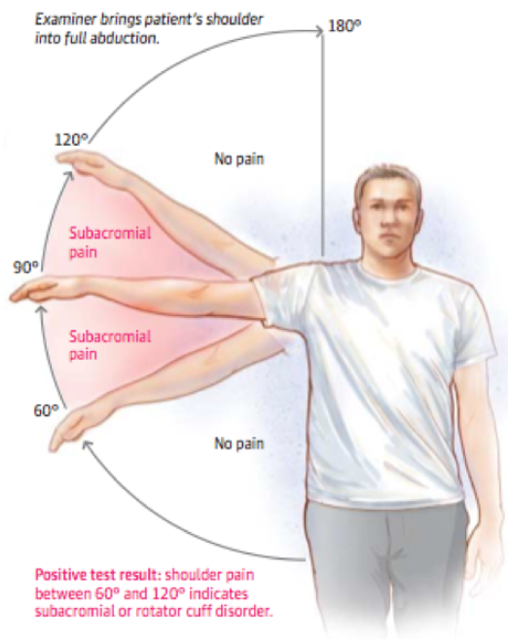
Impigement syndrome/ subacromial bursitis
Pictures: https://backintelligence.com/how-to-fix-shoulder-impingement/
https://pivotalphysio.com/wp-content/uploads/2015/03/sh5.png
Notes:
And here, closer look on subacromial space

Slide 8
2. Inflammatory or non-inflammatory dissease
Symptom | Inflammatory (e.g. rheumatoid artrhritis) | Non-inflammatory (e.g. osteoarthritis)
Morning stiffness | significant, long-term > 60 min | localized, short-term <30 min
Maximum of symptoms | after rest (morning) | after exercise (evening)
General symptoms | present | absent
Local signs of inflammation | present | absent
Symmetry of symptoms | common | occasional
General symptoms: fatigue, fever, anorexia, weight loss
Local signs of inflamation: swelling, increase of skin temperature (skin color changes)
Notes:
The following table shows what are the basic differences between the infl. and non infl. disease
One of the significant differences between I and non-I is the duration of the morning stiffness that lasts more then, or less than
Local signs of inflamation: swelling, increase of skin temperature or skin color changes

Slide 9
3. Duration of symptoms
Acute joint syndrome < 6 weeks
  sudden onset of symptoms
  e.g.: injury, acute gout attack, septic arthritis
Chronic joint syndrome > 6 weeks
  gradual development of symptoms
  e.g.: rheumatoid arthritis, peripheral spondyloarthritis, SLE

Slide 10
4. Number of affected joints
Monoarticular syndrome - involvement of one joint
Oligoarticular syndrome - involvement of 2-4 joints
Polyarticular syndrome - involvement ≥ 5 joints
Note:
small joints: MCP, PIP, DIP, IP joint of thumb, wrist, MTP.
Large joints: shoulder,elbow, hip, knee, ankle

Slide 11
Approach to the patient
1. Articular or extraarticular
4. Number of affected joints
3. Symptoms duration
2. Inflammatory or
Non-inflammatory
6. Age distribution
5. Location of affected joints
Picture: https://www.freepik.com
Notes:
if we want to investigate the cause of joint pain, we need to find answers to the following questions
is pain a symptom of articular or extraarticular disease?
what is the duration of symptoms?
which joints are affected?
how old our patient is? Or what was the age at which the symptoms of the disease began?

Slide 12
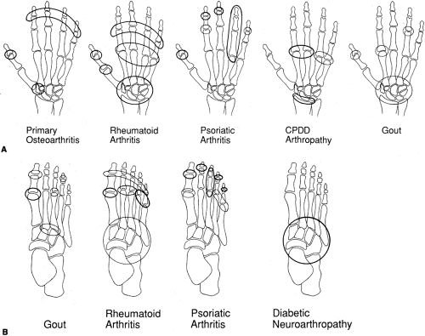
5. Location of affected joints
Notes:
Long standing, poorly controlled gouty arthritis could also affect wrists and small joints of the hand

Slide 13
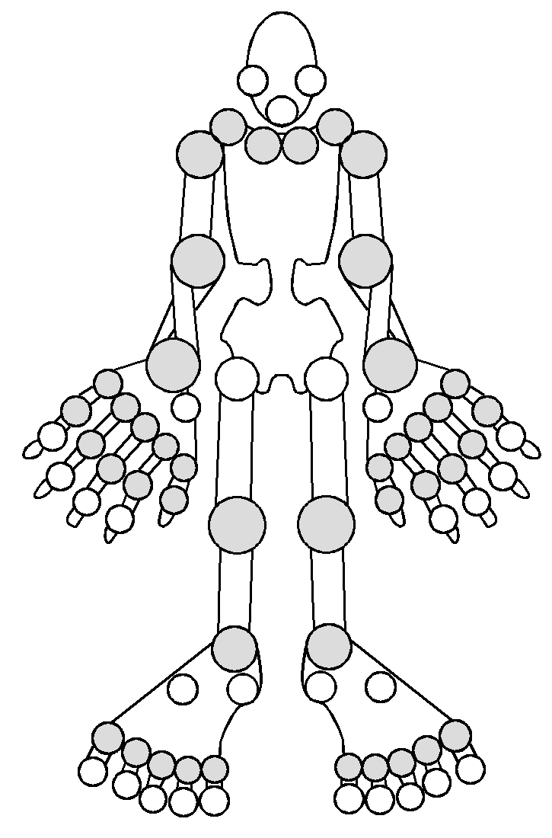
5. Location of affected joints
osteoarthritis rheumatoid arthritis

Slide 14
5. Location of affected joints
psoriatic arthritis ankylosing spondylitis

Slide 15
5. Location of affected joints
gout

Slide 16
6. Age distribution
< 16years 20 – 30 years 30 – 50 years > 50 years
JIA
rheumatic fever
rheumatoid arthritis
SLE
ankylosig spondylitis
reactive arthritis
Infectious arthritis
gout
osteoarthritis
polymyalgia rheumatica

Slide 17
Clinical case #1
50 yo male
Comorbidities: arterial hypertension , DM 2.type
Complain: severe right knee pain of 12-hour duration
No previous pain/surgery/injury
1yr ago: pain + swelling of the base of his great toe → resolved after 5 days with ibuprofen
Clinical examination:
  swelling with moderate effusion
  erythematous warm skin, very tender on palpation

Slide 18
Clinical case #1
Approach:
  articular
  inflammatory
  symptom duration < 6 weeks = ACUTE ARTHRITIS
  # of affected joints: 1 = MONOARTHRITS
  localization: large joint on distal extremity
  Age: 50yo

Slide 19
Monoarthritis
Acute
Inflammatory
Non-inflammatory
Chronic
- Crystal induced arthritis
- septic arthritis
- traumatic
- hemartros
Crystal induced
gout CPDD = calcium-pyrophosphate deposition dissease (pseudogout)
Septic arthritis
staph. aureus, stepto. species, neisseria gonorhoeae, gramnegative,mycotis, etc.

Slide 20
Clinical case #1
Next step?

Slide 21
Clinical case #1
Aspiration of the knee joint to send fluid for:
  synovial fluid analysis – inflammatory type of fluid
  crystal analysis in polarized light microscopy
    needle shaped strongly negatively birefringent crystals
  Cultures - negative

Slide 22
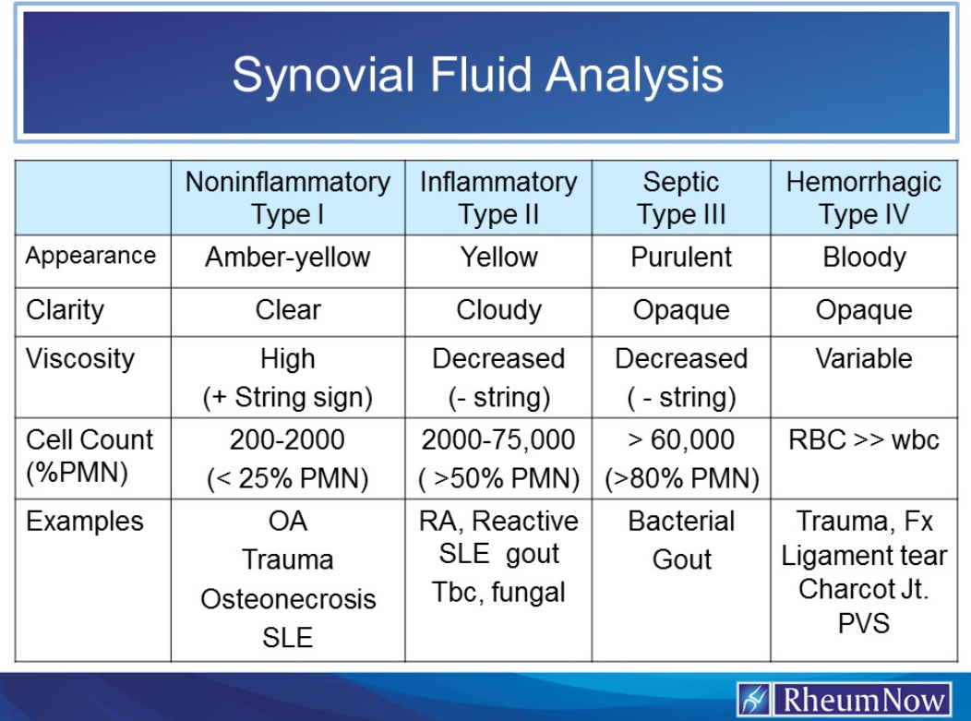
Notes:
According to these 4 characteristics synovial fluid can be devided into noninflammatory, inflammatory, septic or hemorrhagic

Slide 23
Clinical case #1
Diagnosis: acute crystaline arthritis – acute gout
Note: serum uric acid in acute gout attack- may be elevated or normal

Slide 24
Clinical case #2
25 yo male
Comorbidities: none
Complains:
  lower back pain that worsens at night
  morning stiffnes of lower back >45min
  left ankle swelling for 3 months
  history of uveitis
Orthopeadist
  NSA treatment → reduced back pain and ankle pain, swelling did not resolve
  1 intraarticular glukokortikoid injection in the ankle

Slide 25
Clinical case #2
Approach:
  articular
  inflammatory
  symptom duration > 6 weeks = CHRONIC ARTHRITIS
  # of affected joints: 1 = MONOARTHRITS
  localization: large joint on distal extremity
  Age: 25yo
  Other important symptoms: low back pain, history of uveitis

Slide 26
Clinical case #2
Lab: CRP 7.0mg/l, ESR 35/60 mm/hour
Immunology: RF, anti-CCP, anti-MCV negative
HLAB27+

Slide 27
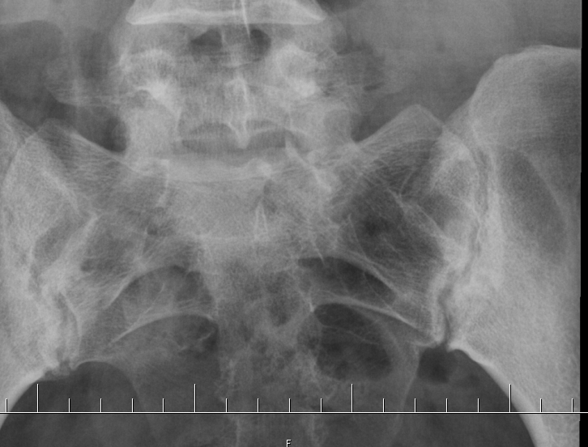
Clinical case #2 X-ray
Diagnosis: axial spondyloarthritis

Slide 28
Monoarthritis
Chronic
Inflammatory
Non-inflammatory
Acute
- TBC, boreliosis, other infectious cause
Osteoarthritis
osteonecrosis
Axial/peripheral spondyloarthritis
monoarthritis as an initial symptom of systemic autoimmune diseases (RA, SLE, JIA, peripheral SpA)

Slide 29
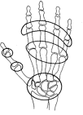
Clinical case #3
32-yo woman with 3-month history of:
  swelling of all MCP and PIP joint of the hand + both wirsts
  morning stiffnes 1 hour
  fatigue

Slide 30
Clinical case #3
Approach:
  articular
  inflammatory
  symptom duration > 6 weeks = CHRONIC ARTHRITIS
  # of affected joints: 18 = POLYARTHRITS
  localization: symmetrical polyarthritis
  Age: 32yo

Slide 31
Clinical case #3
Lab:
  Elevated CRP and ESR
  Pozitive auto-antibodies:
    RF: rheumatoid factor
    anti-CCP: cyclic citrulinated peptides
    anti-MCV: mutated citrulinated vimentin
X-ray hands+ feet
  - normal (no erosive changes)

Slide 32
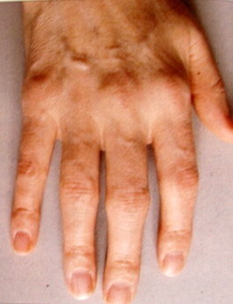
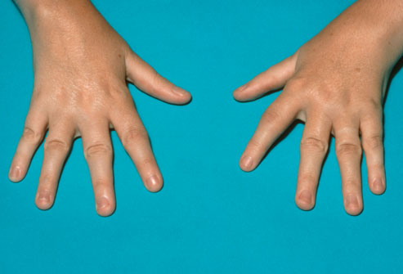
Clinical case #3
Diagnosis: early rheumatoid arthritis
no deformities
no erosion on X-ray

Slide 33
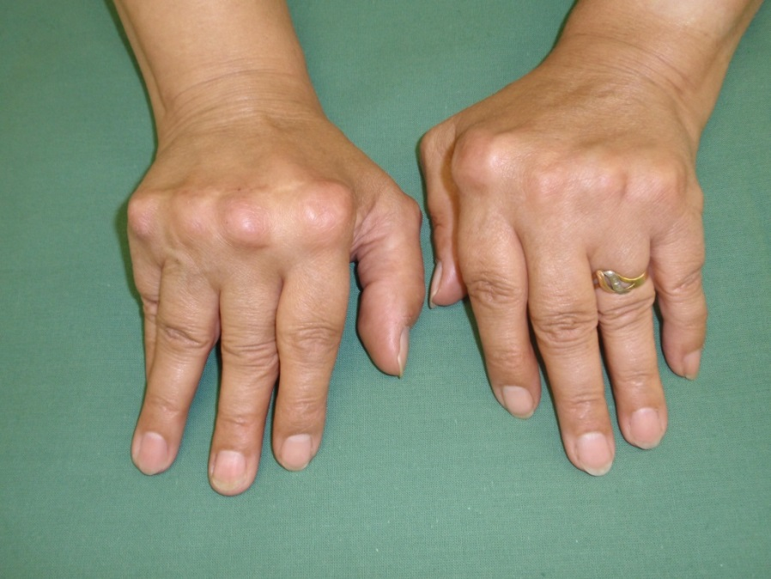
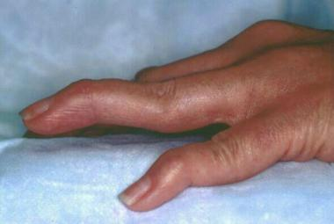
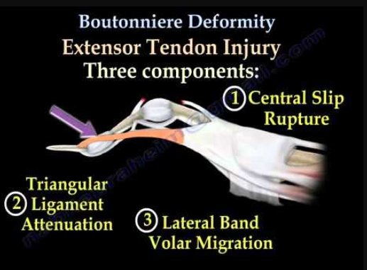
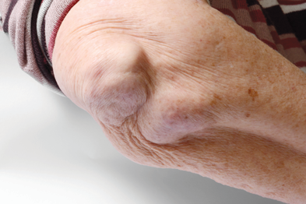
Established rheumatoid arthritis
Ulnar deviation in MCP joints
Swan-neck deformity
Rheumatoid nodule
Notes:
Rheumaoid nodules – subcutaneous nodules typically found over extensor surfaces of the proximal ulna or other pressure points

Slide 34
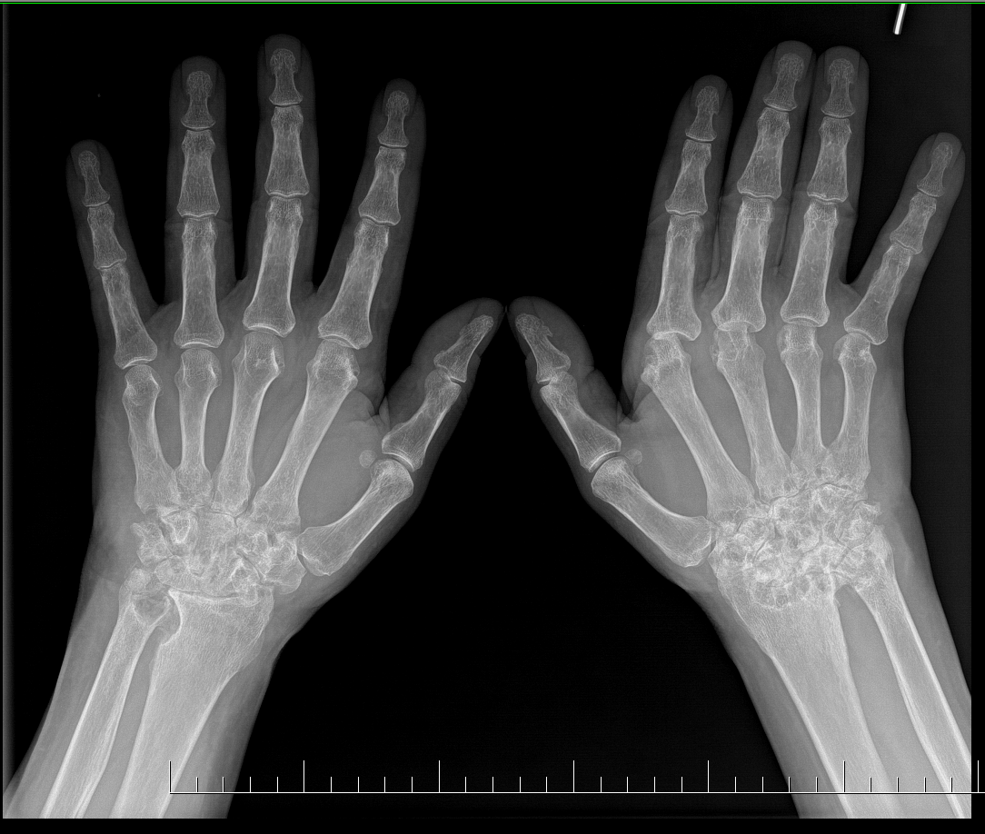
Established rheumatoid artrhitis
X-ray findings:
marginal erosions
MCPs joint space narrowing
severe erosions and destructions of the wrists

Slide 35
Differential diagnosis
Chronic polyarthritis/ polyartralgia
Inflammatory
Non-inflammatory
Rheumatoid arthritis
Psoriatic artrhritis
Sjögren's syndrome
Ostearthritis
Heamochromatosis
Fibromyalgia
Juvenile idiopatic arthritis
Chronic gouty arthritis
Hypermobility syndrome

Slide 36

Thank you for your attention

