Slide 1
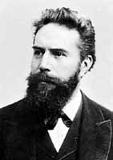
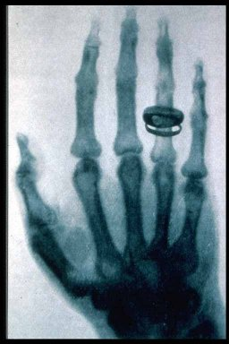
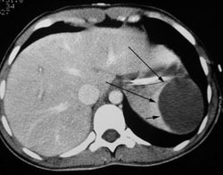
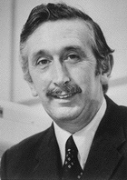
Lectures on Medical Biophysics
Wilhelm Conrad Roentgen
1845 - 1923
Godfrey N. Hounsfield
1919 - 2004
X-ray Imaging (XRI) and CT

Slide 2
X-Ray Imaging
X-ray imaging (XRI) is still one of the most important diagnostic methods used in medicine. It provides mainly morphological (anatomical) information - but may also provide some physiological (functional) information.
Its physical basis is the different attenuation of X-rays in different body tissues.
We have to keep in mind that X-rays may lead to serious health effects (e.g., cancer) for both patients and healthcare professionals (HCP). Thus, strict legal radiation protection safety measures exist to avoid any unnecessary harm to both patients and the HCP. We will deal with them in a special lecture.

Slide 3
Content of the Lecture
Projection XRI devices
Image formation
Projection X-ray devices for special purposes
CT
Radiation dose and health risk

Slide 4
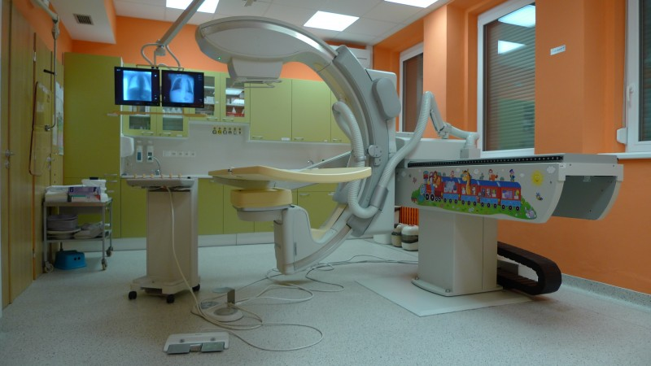
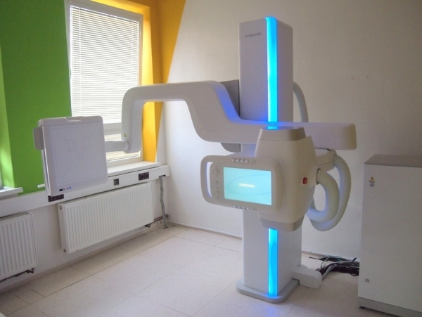
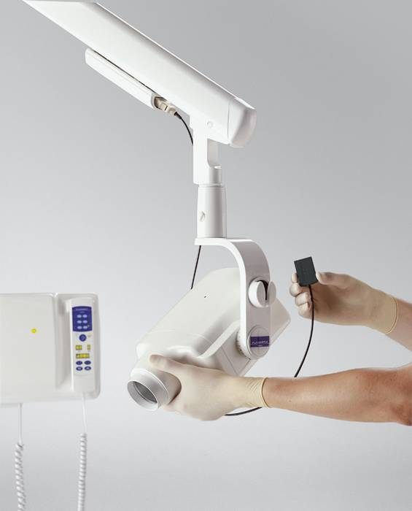
Projection XRI Devices

Slide 5
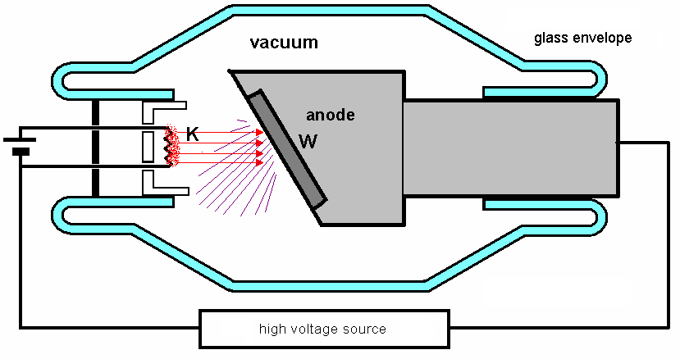
X-Ray Production – Low Power X-Ray Tube used in Dental Units
Scheme of an X-ray tube. K – hot filament cathode, W – tungsten plate.

Slide 6
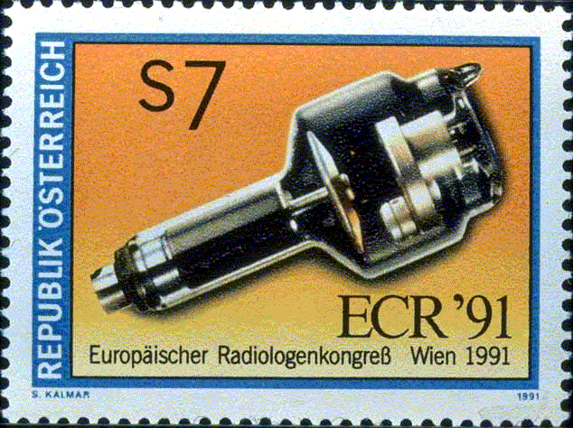
High-Power Rotating Anode Tube

Slide 7
Production of X-rays
An electron with an electric charge e (1.602×10⁻¹⁹ C) in an electrostatic field with potential difference U (voltage, in this case it is the voltage across the anode and the cathode) has potential energy E_{p}:
E_{p} = U·e
In the moment just before impact of the electron onto the anode, its potential energy E_{p} is fully transformed into its kinetic energy E_{K}. Thus:
E_{p} = E_{K} = U·e = ½ m·v²
On impact, the E_{K} is transformed into x-ray photon energy (less than 1%) and heat energy (99%). This heat can damage the tube.

Slide 8
Photon Energy and Tube Voltage
If ALL the kinetic energy of the accelerated electron is transformed into a SINGLE X-ray photon, this photon will have energy:
E = h·f = U·e
This is the maximum energy of the emitted photons. It is directly proportional to the voltage U across the anode and cathode. h is the Planck constant.
Hence if we want to increase the energy of the photons all we must do is to increase the voltage!
The higher the energy of the photons the less they are attenuated by the body - the higher the penetration. This is important when imaging thick body parts or fat patients!
,

Slide 9
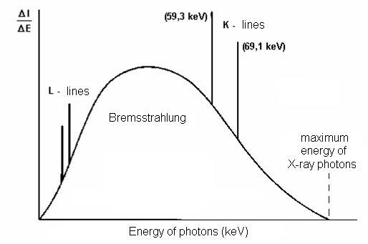
Photon Energy Histogram
Number of photons with certain amount of energy
E

Slide 10
Main Parts of the XRI Device
X-ray tube
Voltage-Current Generator:
  High Voltage Transformer – supplies high voltage (up to 150 kV)
  Rectifier - produces unidirectional tube electron current
  When increasing the magnitude of the electron beam current (by changing the cathode heating) the photon fluence rate (i.e. number of photons per unit area per second) of the X-ray beam increases - however the energy of individual photons does not.
  The energy of the individual photons can be increased by increasing the voltage between the anode and cathode.
Control panel – today most parameters of the device (including voltage and current) are controlled by means of a computer. It is located outside the examination room or behind a shield made of glass containing lead (to protect the radiological assistant).
Main mechanical parts: tube stand, examination table, grid for removing scattered photons (‘Bucky’),
X-ray detector: cassette with radiographic film and adjacent fluorescent screens (in radiography) or image intensifier (both on the way out) or flat panel digital detector (in fluoroscopy or in general).

Slide 11
Passage of X-rays through Patient's Body
X-rays emitted from a small focal area of the anode propagate in all directions. In the tube envelope, some low energy photons are absorbed. Further absorption of these photons occurs in the primary filter, made of aluminium sheet. It absorbs low energy photons which would be absorbed by surface tissues and do not contribute to the image formation (unnecessary patient dose). X-ray beam is delimited by rectangular collimator plates made of lead.
The rays then pass through the body where transmission or absorption or scattering may occur. After that they pass through the grid, which is in front of the detector to remove scattered photons as these would degrade the image.

Slide 12
Image Formation
X-ray image is an analogy of a ‘shadow’ cast by a semitransparent and structured body illuminated by light beam coming form an almost point source. The image is formed due to different attenuation of the beam by the different body tissues and by projection of the structures on a film or an electronic X-ray detector.
The image can be visualised by means of
  Radiographic film / screen and subsequent development (obsolete)
  Digital plate and displaying image on a PC monitor
  Image intensifier and digital CCD camera connected to a monitor (obsolete)

Slide 13
Attenuation of Radiation
A beam of X-rays (any radiation) passes through a substance:
absorption + scattering = attenuation
A small decrease of radiation intensity -dI in a thin substance layer is proportional to its thickness dx, intensity I of radiation falling on the layer, and a specific constant μ:
-dI = I·dx·μ
After rewriting:
dI/I = -dx·μ
After integration:
I = I₀·e^{-μ·x}
I is intensity of radiation passed through the layer of thickness x, I₀ is the intensity of incoming radiation, μ is linear coefficient of attenuation [m⁻¹] depending on kind of radiation, medium and its density.
The mass attenuation coefficient μ/ρ does not depend on the density.
OMG some maths here!
The symbol „d“ comes from differential calculus, we can imagine it as a very small change.

Slide 14
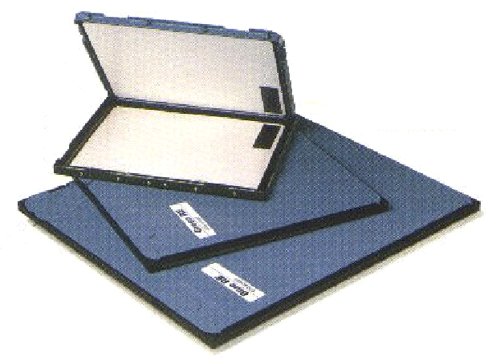
Cassettes for Radiographic Films (becomes history)
FLUORESCENT screens reduce dose of radiation about 50-times

Slide 15


Digital Imaging Plates
Imaging plate consists of an array of very small sensors
„bucky“ – see slide 24
Matrix of amorphous silicon (aSi) photodiode light sensors
Phosphorescent layer of CsI (necessary for patient dose reduction as aSi is not good absorber of X-rays)
electronic signal

Slide 16
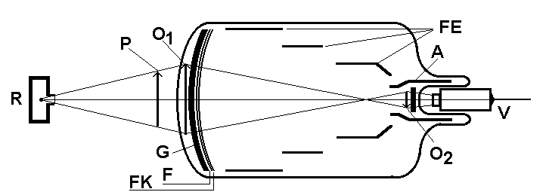
Image Intensifier (obsolete but you can encounter it)
R – X-ray tube, P - patient, O₁ – primary picture on a fluorescent screen, G – glass carrier, F – fluorescent screen, FK - photocathode, FE – focussing electrodes (electron optics), A - anode, O₂ – secondary image on the anodic screen, V – video-camera. Individual parts are not proportionally depicted.

Slide 17
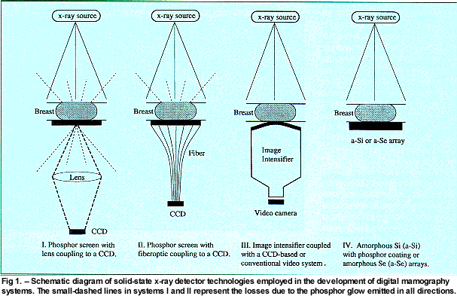
Different Ways how to Obtain DIGITAL Images (mammographic systems)
http://www.moffitt.org/moffittapps/ccj/v5n1/department7.html

Slide 18
Blurring of the Image
No radiograph (an X-ray image) is absolutely sharp. Boundaries between tissues are depicted as a gradual change of gray scale. This non-sharpness (blurring) has several reasons:
Movement blur – accidental, breathing, pulse waves, heart action etc. They can be reduced by shorter exposure times with more intense X-ray radiation.
Geometric blur is caused by finite focal area (focus is not a point). The rays fall on the boundary of differently absorbing media under different angles – blurring of their contours appears
The light emitted by fluorescent screens attached to the film or digital detector does not only illuminate the corresponding part of the film or detector, but also spreads out to surrounding areas.

Slide 19
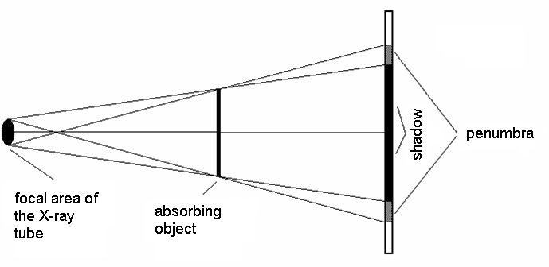
Geometric Blur (‘penumbra’)
Geometric penumbra can be reduced by:
Choosing a small focal spot size (but it increases risk of damage to tube anode by heating)
Decreasing the distance between the patient and the detector
- Increasing the distance between the X-ray tube and the patient

Slide 20
Interactions of X-ray Photons with Matter: ABSORPTION by Photoelectric Effect (PE)
Photon disappears (‘is absorbed’) after hitting an atom and an electron is ejected from electron shell of the atom (typically K-shell). Part of the photon energy h·f is necessary for ionisation. Remaining part of the photon energy changes into kinetic energy (1/2m·v²) of the ejected electron. The electron knocks electrons out of atoms of the body and produces ionization of these atoms. The Einstein equation for photoelectric effect holds:
h·f = E_{b} + 1/2m·v²,
E_{b} is binding (ionisation) energy of the electron (called also work function).
The probability for PE increases with proton number and decreases with increasing photon energy (this is why lead is used for shielding and why higher energy beams are more penetrating).

Slide 21
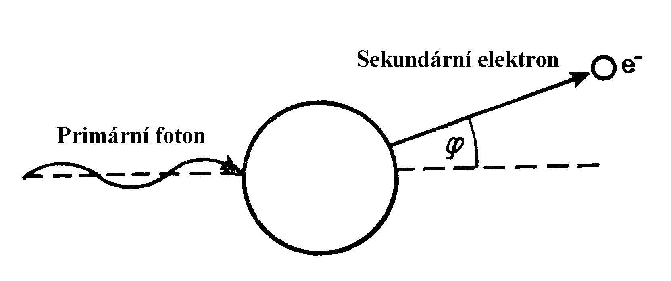
Photoelectric Effect
Secondary electron
Primary photon

Slide 22
Interactions of X-ray Photons with Matter: Compton Scatter (CS)
At higher energies of photons, the photon energy is not fully absorbed – a photon of lower energy appears. The binding energy of the electron E_{b} is negligible in comparison with the photon energy. We can write:
h·f₁ = (E_{b}) + h·f₂ + 1/2m·v²,
where f₁ is frequency of incident photon and f₂ is frequency of the scattered photon.
CS is more probable than PE for primary photon energies 0.5 - 5 MeV and does not depend on the the proton number of interacting atom which explains why images at such energies would be practically useless.

Slide 23
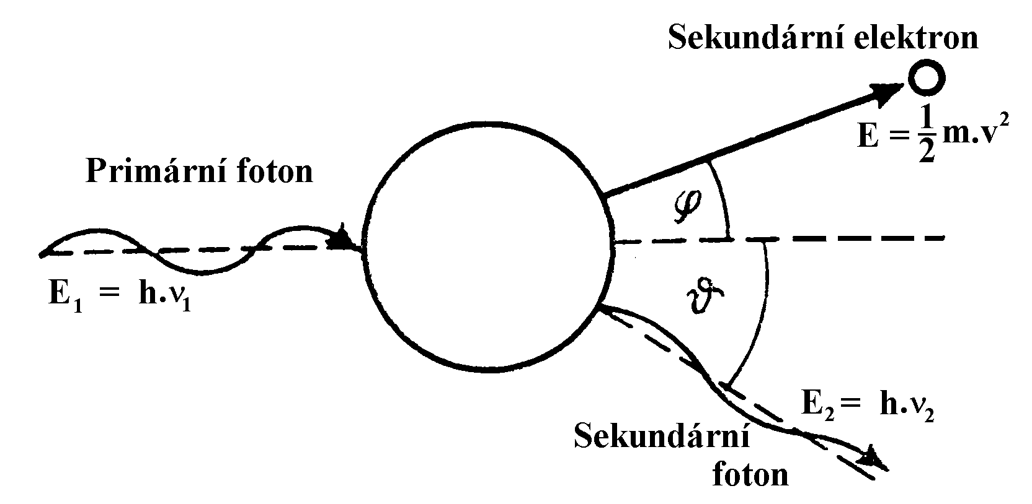
Compton Scatter
Secondary electron
Primary photon
Secondary photon

Slide 24
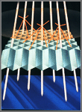
Principle of the Bucky Grid
The Bucky grid stops a substantial part of the scattered rays whilst allowing the useful photons to pass through. However unfortunately grids also absorb part of the useful radiation. Hence a higher number of x-ray photons must be used to produce a good image – this increases the dose of radiation to the patient. Hence for example grids are not used with thin children as the level of scatter is low anyway.
http://www.cwm.co.kr/pro213.htm

Slide 25
Use of the Contrast Agents
The soft tissues only slightly differ in their attenuation. Therefore they cannot be distinguished in a common radiograph. That is the reason for the use of pharmaceuticals called contrast agents.
The attenuation of certain tissues can be increased or lowered. Positive contrast is achieved by substances having a high proton number as the probability of the photoelectric effect is increased. A suspension of barium sulphate, “barium meal”, is used for imaging and functional examination of GIT. In examinations of blood, biliary and urinary vessels etc. compounds with high content of iodine are used.
Hollow inner body organs can be visualised by negative contrast. Air or better CO₂ can be used. The cavities are filled by gas, inflated, so that they can be visualised as structures of very low attenuation (pleural space, peritoneum, brain chambers in the past).

Slide 26
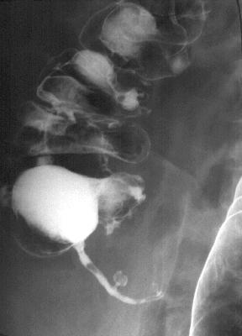
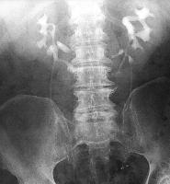
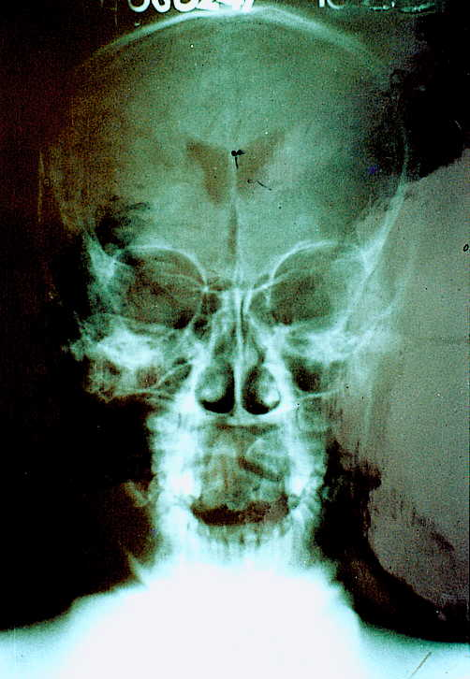
Positive and Negative Contrast
Horseshoe kidney – positive contrast – we can see renal pelvis, calyces and also urethers http://www.uhrad.com/ctarc/ct215a2.jpg
Contrast image of the appendix – diverticulosis – combination with negative contrast http://www.uhrad.com/ctarc/ct199b2.jpg
Pneumoencephalogram – negative contrast of brain chambers – history of medicine
http://anatomy.ym.edu.tw/Nevac/class/neuroanatomy/slide/k42.jpg

Slide 27
Devices for Special Uses - Examples
Dental X-ray devices
Mammographic devices
Angiography (image subtraction systems, formerly image intensifier based; now increasingly digital detector based)

Slide 28
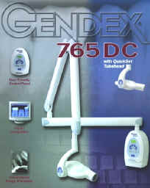
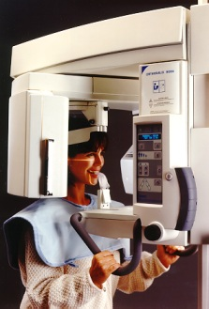
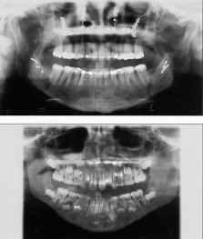

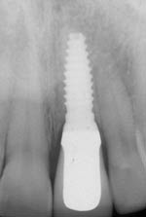
X-ray Devices in Dentistry
http://www.gendexxray.com/765dc.htm
Panoramic screening – orthopantomograpy
very useful in e.g. orthodontics
http://www.gendexxray.com/orthoralix-9000.htm
X-ray image of a dental implant

Slide 29
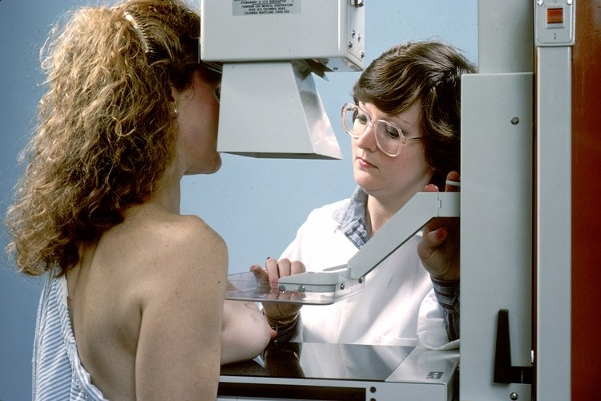
Mammography
Mammography is the process of using low-dose X-rays (usually around 0.7 mSv) to examine the female breast. It is used to look for different types of tumours and cysts. In some countries routine (annual to five-yearly) mammography of older women is encouraged as a screening method to diagnose early breast cancer. It is normal to use low energy (soft) X-rays (molybdenum anode).

Slide 30
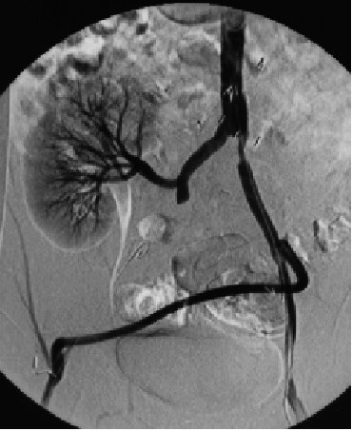
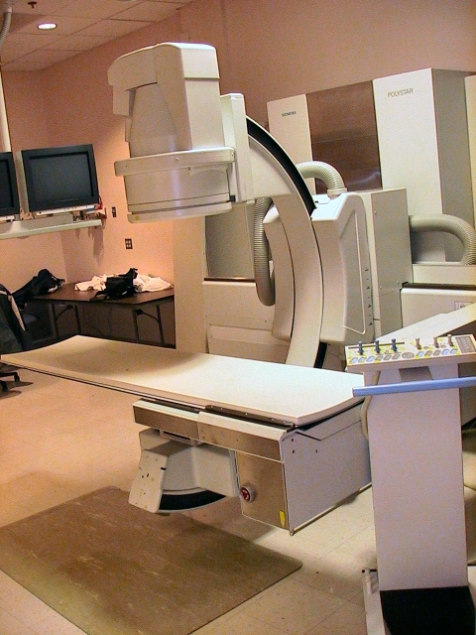
Digital Subtraction Angiography
http://zoot.radiology.wisc.edu/~block/Med_Gallery/ia_dsa.html

Slide 31
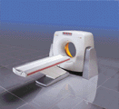
Computerised Tomography - CT
The first patient was examined by this method in London, 1971.
The apparatus was invented by English physicist Hounsfield, (together with American Cormack, Nobel award for medicine, 1979)

Slide 32
Principle of CT
Principle: The CT scanner is a complex instrument for measuring the X-rays attenuation in individual voxels (volume analogies of pixels) in narrow slices of tissues.
Method of measurement: A narrow fan-beam of X-rays is passed through the body and the merging radiation measured by an arc of detectors. This is repeated at different angles till enough information is available to be able to calculate the attenuation coefficient in the patient voxels. A „map“ of attenuation is calculated – a tomogram.

Slide 33
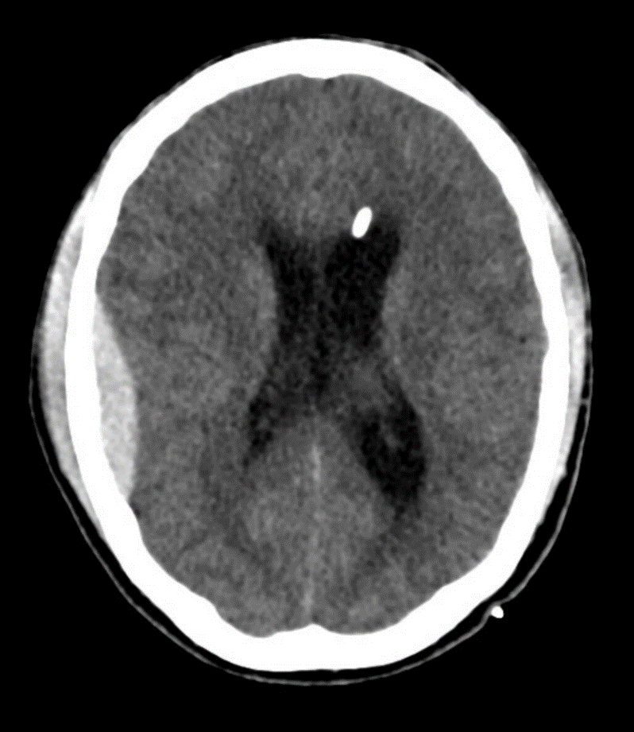
Examples of CT Scans
Extensive subcapsular haematoma of spleen in patient after car accident
http://www.mc.vanderbilt.edu/vumcdept/emergency/apr7xr1a.html
Epidural haematoma right parietal and external chambre drainage left frontal

Slide 34
Advantages of CT over Projection XRI
Much higher contrast than projection XRI - 0.5% difference in attenuation can be resolved because:
  Almost total elimination of effects of scatter
  X-ray measurements are taken from many angles
Thus, we can see and examine different soft tissues.
No overlapping of anatomical structures
Less distortion as measurements are taken from many angles

Slide 35
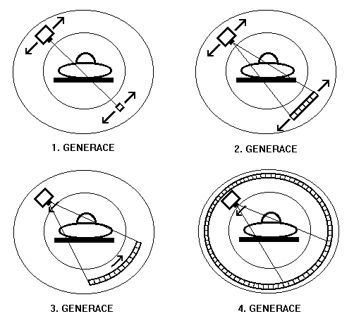
Four Generations of CT
1. Generation
2. Generation
3. Generation
4. Generation

Slide 36
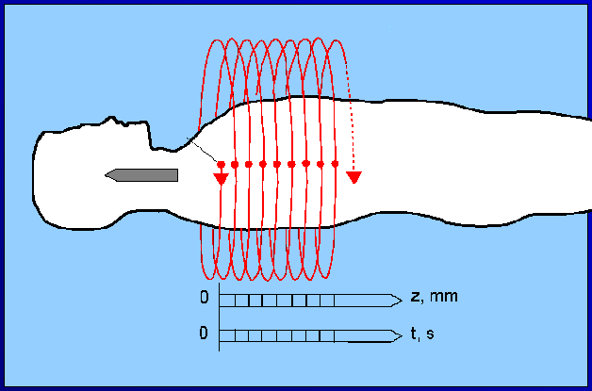
Principle of Spiral (3D) CT
X-ray tube and detectors revolve around the shifting patient

Slide 37
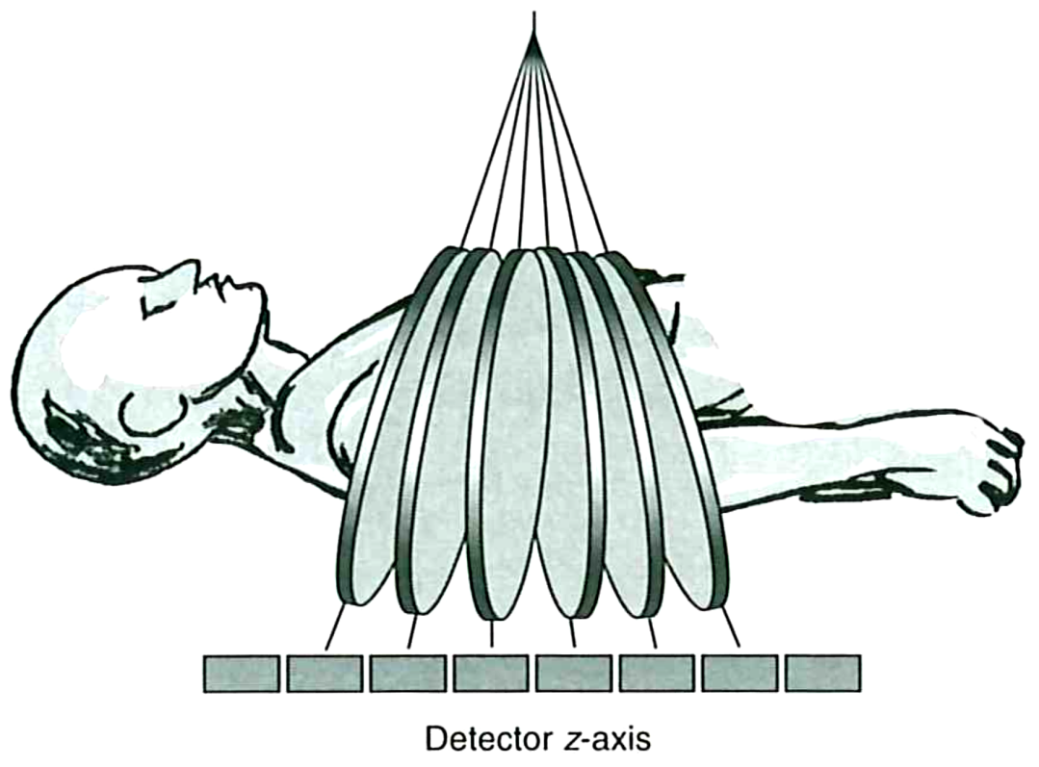
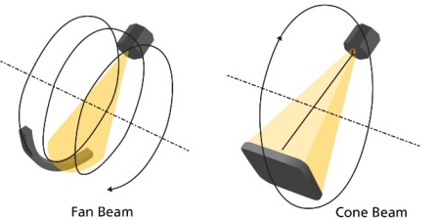
Multislice CT and Cone beam CT
Fast 3D reconstruction is possible

Slide 38
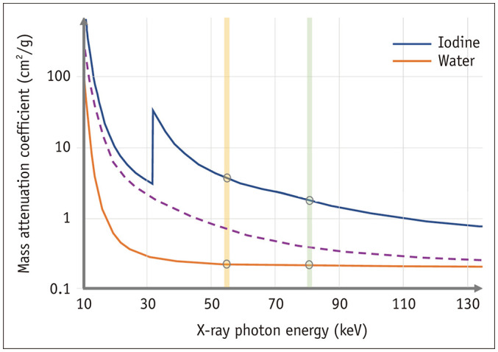
Recent development in the field of CT
In present time, the so-called „dual energy“ systems emerge in practice. They are also called „spectral“ because they produce images by means of at least two different energies of X-rays, which also differ in values of attenuation coefficients. It allows to analyse the atomic composition of depicted tissues.
According to:
So A, Nicolaou S. Spectral Computed Tomography: Fundamental Principles and Recent Developments. Korean J Radiol. 2021 Jan;22(1):86-96. https://doi.org/10.3348/kjr.2020.0144

Slide 39
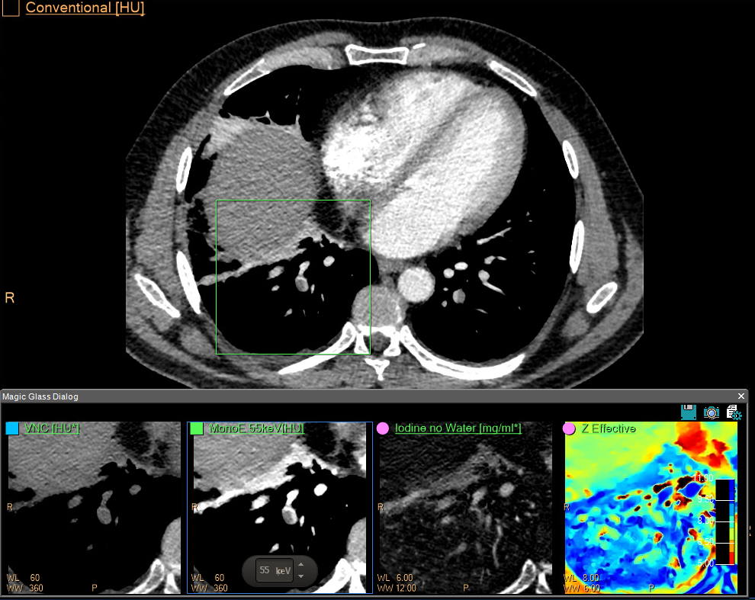
Spectral CT angiography of lungs showing pulmonary emboly
The square sector reconstructions at the bottom of the slide (from left):
1. Virtual native picture
2. Low-energy monoenergetic reconstruction (55 keV, this value is not the maximum photon energy detected!).
3. Map of iodine concentration
4. Map of average proton numbers

Slide 40
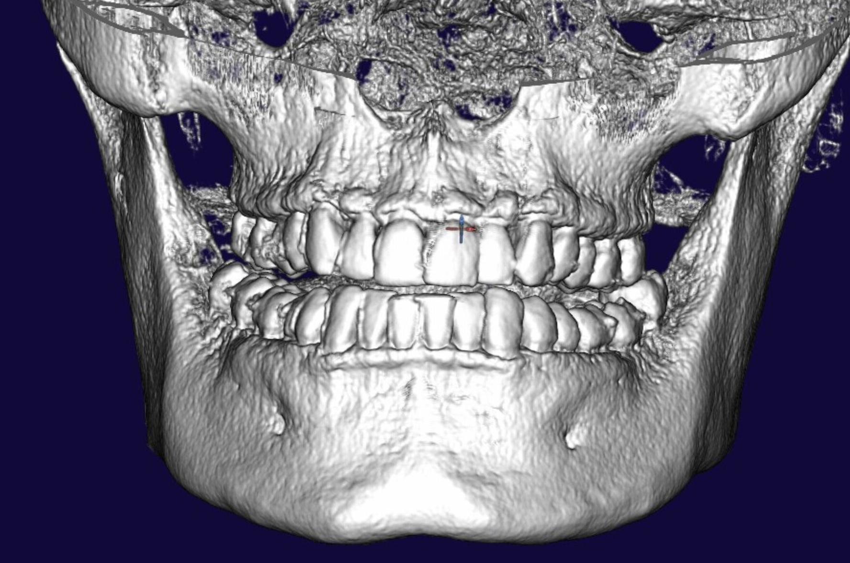
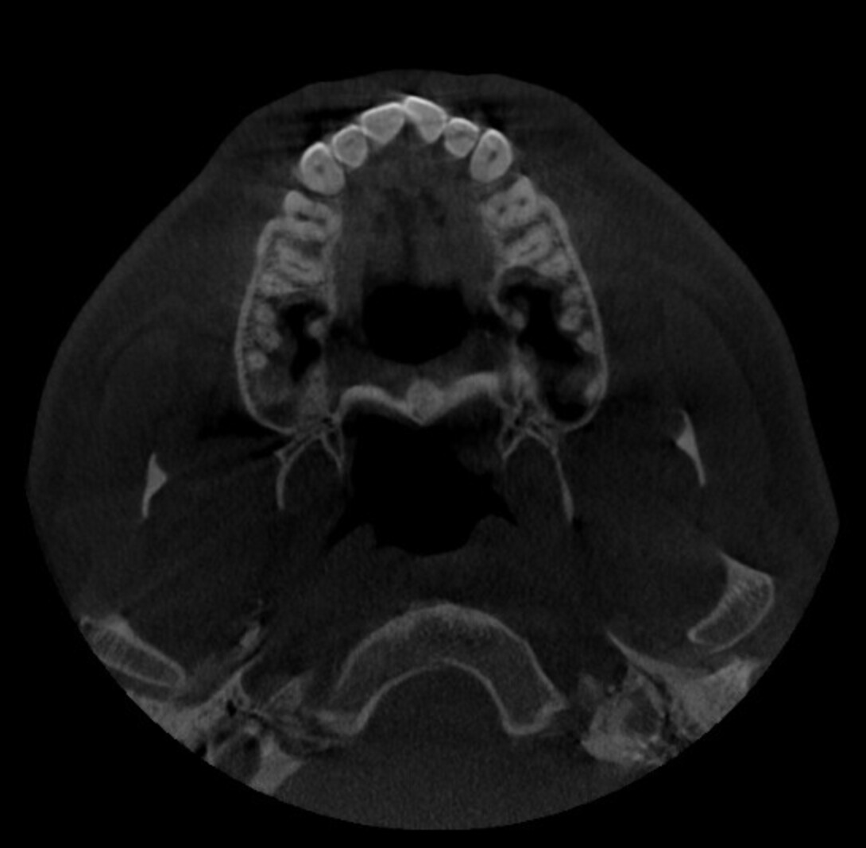
3D CT in dentistry – using modern OPG system
Cone Beam CT (CBCT) - 3D reconstruction ↑
basic axial (= transversal) scan →

Slide 41
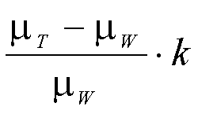
Hounsfield (CT) Units
In order to simplify calculations we use Hounsfield Scale units (HU) for amount of attenuation.
On this simplified scale water is 0 HU, air is -1000 HU, compact bone is about +1000 HU.
A scale of 2000 HU is available for CT examination of body tissues. In most cases, it is senseless to attribute them to all of the grey scale levels (our eye is able to distinguish only about 250 levels of grey). Most of the soft tissue HU values range from 0 to +100. Thus, we use only limited „diagnostic window“ of these units in practice, e.g. from -100 to +100.
W – water
T – tissue
k = 1000
HU =

Slide 42
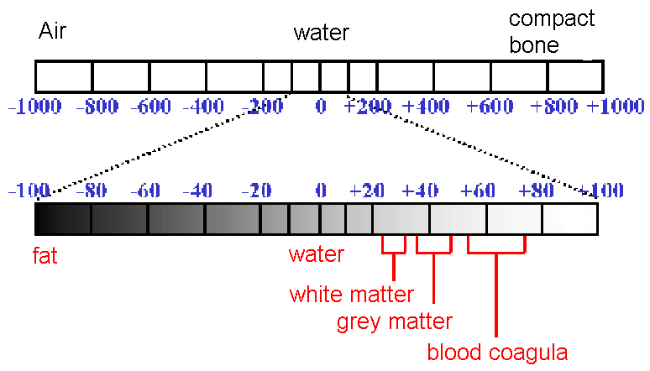
„Diagnostic Window“ of HU
<>
http://www.teaching-biomed.man.ac.uk/student_projects/2000/mmmr7gjw/technique8.htm

Slide 43
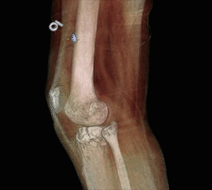
3D CT - Color Coding
https://www.carestream.com/en/us/medical/products/carestream-onsight-3d-extremity-system

Slide 44
Some Typical Doses
From natural sources: 2 mSv per year
Chest X-ray: <1 mSv
Fluoroscopy: 5 mSv
CT Scan: 10 mSv
Medical doses are increasing with ‘better be safe than sorry’ medicine and the ease of use of modern imaging devices (e.g., spiral CT compared to conventional CT).

Slide 45
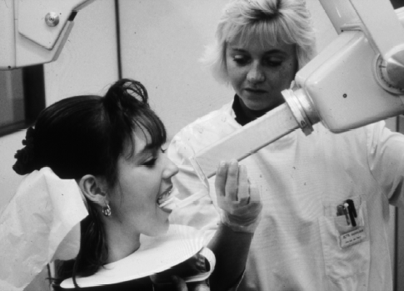
Appendix: Dental Radiography Devices

Slide 46
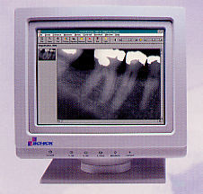
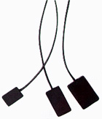
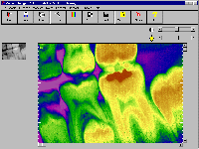
Direct Digital Dental Radiography
Sensor consists of photodiode matrix covered with a scintillator layer. Wireless sensors now available (using bluetooth or wifi).
Notes:
Bluetooth and Wi-Fi are both wireless networking standards that provide connectivity via radio waves. The main difference: Bluetooth's primary use is to replace local cables, while Wi-Fi is largely used to provide wireless, high-speed access to the Internet or a local area network. First developed in 1994, Bluetooth is a low-power, short-range (30 feet) networking specification with moderately fast transmission speeds of 800 kilobits per second. Bluetooth provides a wireless, point-to-point, "personal area network" for PDAs, notebooks, printers, mobile phones, audio components, and other devices. The wireless technology can be used anywhere you have two or more devices that are Bluetooth enabled. For example, you could send files from a notebook to a printer without having to physically connect the two devices with a cable.

Slide 47
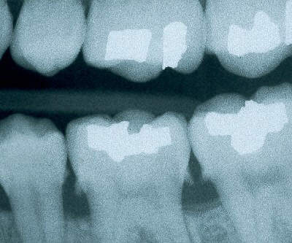
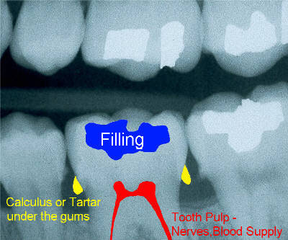
Intra-Oral Image

Slide 48
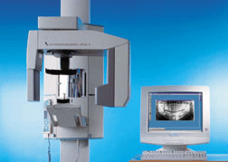
Orthopantomographic (OPG) Unit

Slide 49
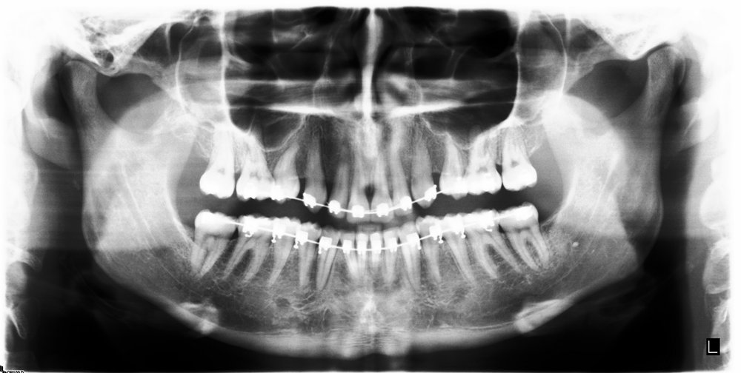
Orthopantomographic (OPG) Image
You can see the so-called braces here. Used in orthodontics.

Slide 50
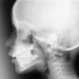
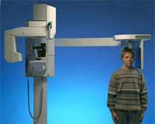
Extraoral Cephalometric Image
Important for assessment of e.g. cranium development and before some orofacial surgery!

Slide 51
Radiation Protection Considerations
Low individual dose but high collective dose technique, particularly since many young patients
Protect eye and thyroid (sometimes latter close to or exposed to direct beam)
As the dose, and therefore the risk to the developing fetus is so low there is no contraindication to radiography of women who are or may be pregnant providing that it is clinically justified. Very Good reference is:
  RP136 European guidelines on radiation protection in dental radiology - The safe use of radiographs in dental practice. 2004. EU publication.

Slide 52
Dose Optimisation for Intraoral
Devices
  Constant power (CP) generator
  filter: 1.5mm Al up to 70kV to reduce skin dose
  Rectangular collimator recommended (if round-end collimator used, beam diameter <60mm at patient end of cone)
  Digital devices need lower dose than film
Protocol
  use 60kV with CP generator
  minimum SSD 200mm (cone should ensure this)
  There is no need to use a lead protective apron (to protect gonads, except in rare cases) even in cases of pregnant patients. However in the case of pregnant patients, the use of a lead apron continues to be used in some states as it may reassure the patient
  Some have suggested using thyroid collar for young patients (in CZ they use it even for adults)

Slide 53

Converting Round Collimators to Rectangular
The UK’s Ionising Radiation (Medical Exposure) Regulations 2000 recommend the use of rectangular collimation to limit the radiation dose a patient receives during routine dental X-rays. DENTSPLY’s Rinn Universal Collimator just clips onto any round-headed long-cone X-ray unit, converting it from round to the recommended rectangular collimation, in one easy step.

Slide 54
Dose Optimisation in OPG
Devices:
  CP (constant power) generators
  Automatic exposure control
  Dead-man type switch
Protocol:
  Proper patient positioning and immobilisation to avoid repeats (e.g., in case of OPG chin rests on plastic support, head held by plastic earpieces, head surrounded by plastic guard)
  Limit field size to area of interest
  Thyroid collar inappropriate as it interferes with the beam in the case of OPG (note however often necessary in the case of cephalometry)

Slide 55

Authors:
Vojtěch Mornstein, Carmel J. Caruana
Content collaboration:
Ivo Hrazdira
Presentation design:
Lucie Mornsteinová
Last revision November 2024

