Slide 1
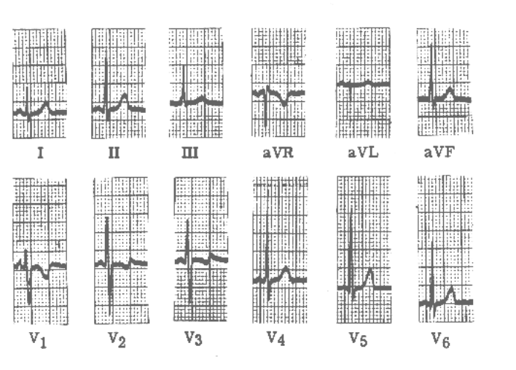
Lectures on Medical Biophysics
Biosignals and their processing, Thermometry

Slide 2
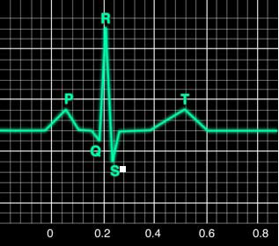
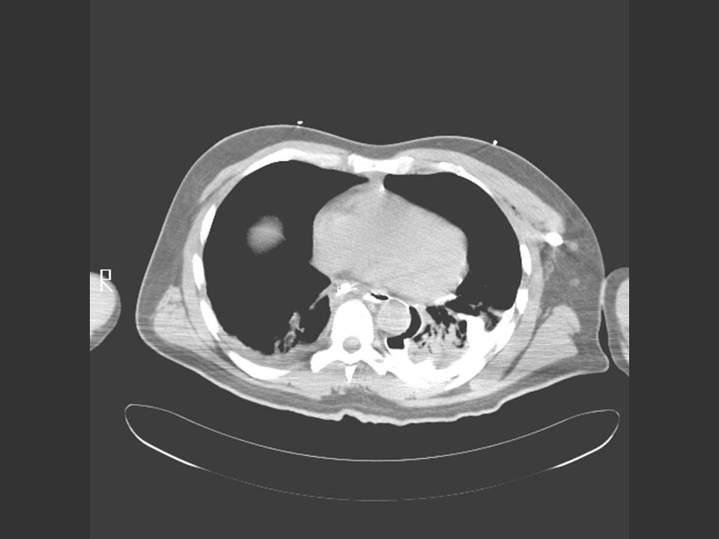
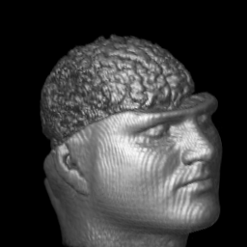
What is a biosignal?
Definition: a biosignal is a human body variable that can be measured and monitored and that can provide information on the health status of the individual. In most cases it is an electric voltage.
Examples:
  EKG (ECG): a V(t) biosignal which provides information on cardiac physiology / pathology
  A US image: small voltage arising in elementary transducer by receiving reflection from tissue interface.
  A CT tomogram: a μ(x, y) biosignal for which the attenuation coefficient value is measured for each patient voxel at the position (x,y) in a slice of patient.
  A 3-D MRI image: a SD (x,y,z) biosignal for which the hydrogen spin density (SD) is measured for each patient voxel at the position (x,y,z) in the patient each.

Slide 3
Types of Biosignals
ACTIVE (body generated) biosignals: the energy source for measurement derives from the patient himself (“internal source”)
    Electrical active biosignals (known as BIOPOTENTIALS) e.g., EKG, EEG, EMG, ERG (electroretinogram) (ERG), EGG (electrogastrogram) etc
    Non-electrical: e.g., temperature, blood pressure
PASSIVE (body modulated) biosignals: the energy source is from outside the patient (“external source) e.g., X-ray in CT
In this lecture we discuss active biosignals only

Slide 4
Origin of Biopotentials
Cells transport ions across their membrane leading to ion concentration differences and therefore charge differences - hence generating a voltage.
Most cell groups in the tissues of the human body do not produce electric voltages synchronously, but randomly. Thus, most tissues have a resultant voltage of zero as the various random voltages cancel out.
When many cells produce voltages synchronously the resultant voltage is high enough to be measurable e.g., EMG - muscle fibre contraction, most cells of the fibre perform the same electric activity synchronously and a measurable electric voltage appears.

Slide 5
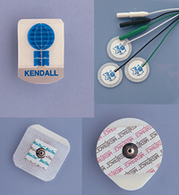
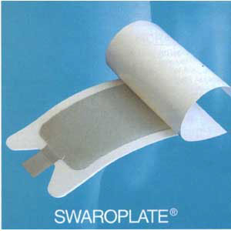
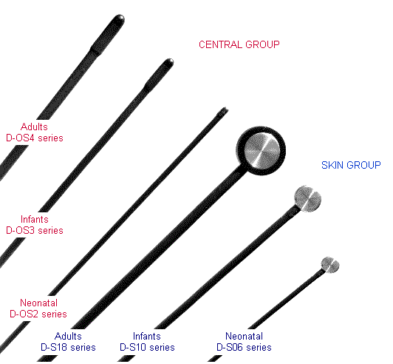
Instruments for Measuring Active Biosignals
Biopotentials: measuring device consists of:
  Electrodes: enable an electrically conductive connection between the examined body part with the measuring system
  Signal processor (amplifier, analogue-digital converter - ADC, electrical filters to remove noise, and unwanted frequencies etc)
  Recorder (also called read-out device, today usually a computer monitor or a chart recorder)
Non-electric active biosignals: electrodes are replaced with appropriate sensors
Two types of disposable ECG electrodes
Medical temperature sensors

Slide 6
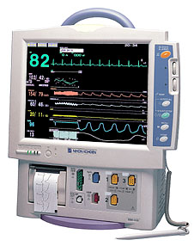
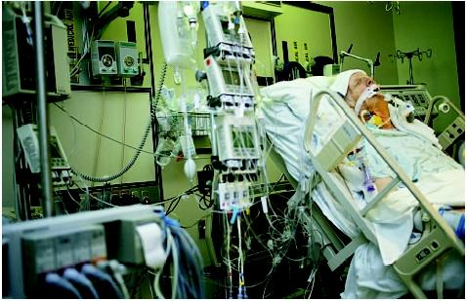
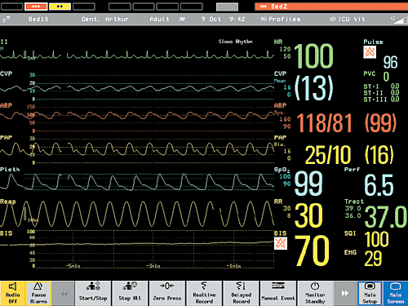
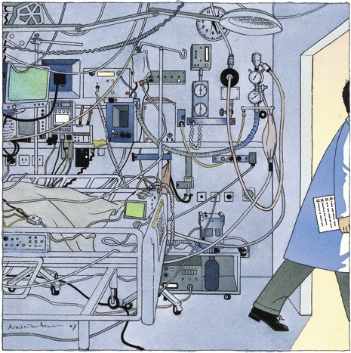
Monitoring Biosignals in an Intensive Care Unit

Slide 7
Electrodes for Biopotentials: contact Voltage Problems
Problem: electrodes produce ‘contact voltages or contact potentials’ when put in contact with body! Polarisable electrodes produce variable contact voltage (via an electrochemical reaction) and hence are not suitable for accurate measurements. Non-polarisable electrodes produce a constant contact potential and hence are used when accurate measurements are required. Electrodes should be made of noble metals (metals which resist corrosion and oxidation).
Non-polarisable electrode: accurate measurements of biopotential. In practice, the silver-silver chloride (Ag-AgCl) electrode is most often used.
Polarisable: the contact voltage varies with movement of patient, humidity (sweating), chemical composition of ambient medium etc.
      Concentration polarisation: the concentration of ions changes around electrodes due to electrochemical processes.
      Chemical polarisation: gases are liberated on the surface of the electrodes.

Slide 8
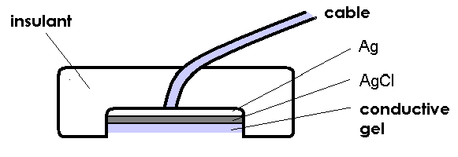
Non-polarisable Ag-AgCl electrode

Slide 9
Electrodes for Biopotentials: Electrode Sizes
Macro or Microelectrodes. Latter used for biosignals from individual cells. Small tip diameter (<0.5 μm) and made of metal (polarisable) or glass (non-polarisable). The glass microelectrode is a capillary with an open end filled with an electrolyte of standard concentration.
Superficial or needle electrodes. Superficial electrodes are metallic plates of different shape and size. Good electric contact is ensured by a conducting gel. Their shape is often dish-like (see the Ag-AgCl electrode in the previous slide). Needle electrodes are used for recording of biopotentials from a small area of tissue. Used mainly for muscle biopotentials or long-term recording of heart or brain potentials.

Slide 10
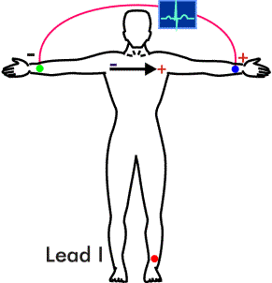
Bipolar and Unipolar Electrode Pairs
Bipolar electrode pair – both are placed in the electrically active region.
Unipolar electrode pair, one electrode has a small area and is placed in the electrically active region. The second electrode (usually with a large area) is placed in an electrically inactive region (this electrode is called ‘indifferent’).
Exclusion: Wilson central terminal used in EKG.
A bipolar ECG electrode pair – depiction of the 1st limb lead – see also next slide

Slide 11
Signal processing: Amplifier
A high-fidelity (HiFi) amplifier is one which amplifies the biosignal without changing its shape (distortion) at different frequencies. The amplifiers of modern medical devices must fulfil this condition.
Gain (amount of amplification) of an amplifier in dB
gain = 20·log(U_{o}/U_{i})
o = output i = input
The user deals only with a correct setting of different filters (to supress some artefacts).

Slide 12
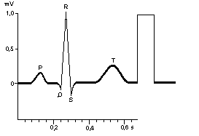
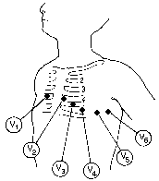
ECG - electrocardiogram
Calibration 1mV voltage impulse
ECG (EKG) is the strongest and most often measured active biopotential.
In Europe 3 electrodes are placed on extremities (2 on arms, 1 on left leg), 6 electrodes are placed on chest. The right leg is used for an electrode which partially removes interfering voltages.
A pair of electrodes between which a voltage is measured, is called a lead. Every lead gives info on different parts of the heart.
The chest leads are formed by chest electrodes and the so-called Wilson central terminal (connected limb electrodes, in principle)
aVR, aVL, aVF – Goldberger or augmented limb leads – see textbook

Slide 13
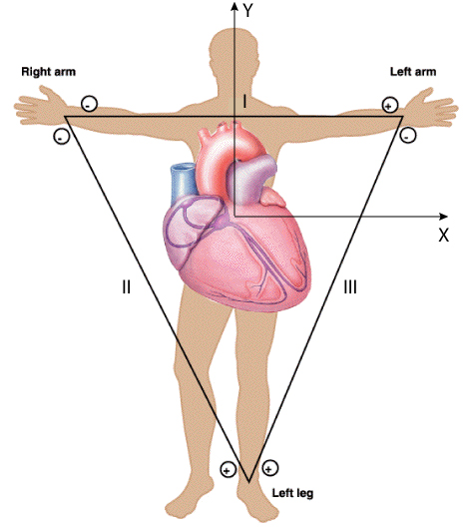
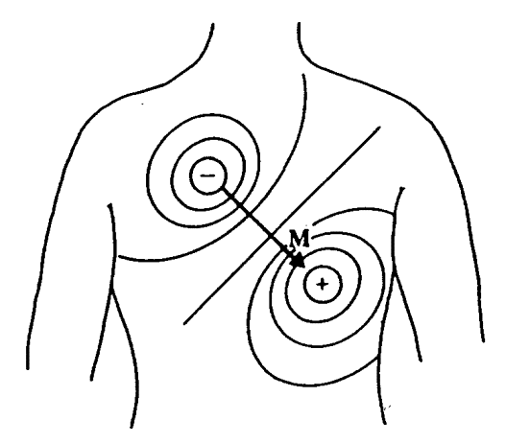
Einthoven triangle
Heart is often modeled as a source of dipole electric field
Placement of triangle vertices (electrodes) can be a problem! Or not?

Slide 14
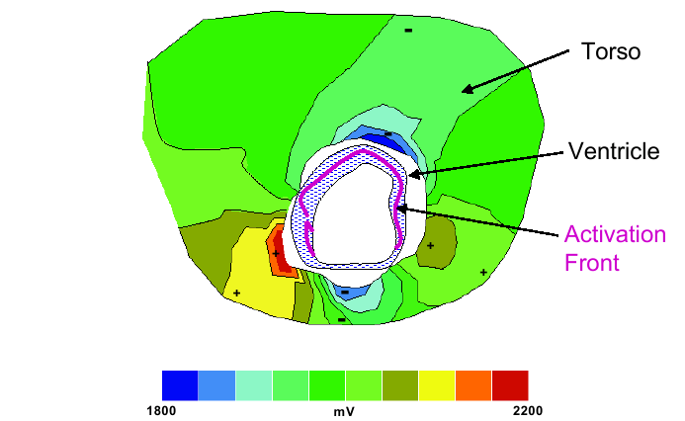
2D and 3D Biopotential images (an example of another way how to record heart activity)
Multiple electrodes placed on the surface of the body allow us to calculate voltage values throughout the torso (V (x,y,z) biosignal). Thus, we can localise problems with stimulus conduction throughout the myocardium.

Slide 15
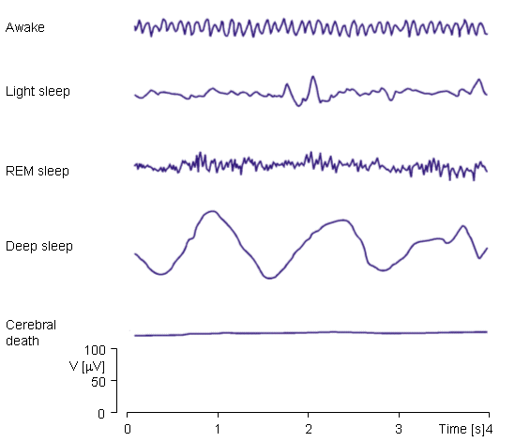
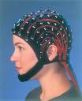
Electroencephalography
- EEG
α−waves: f = 8-13 Hz, amplitude (A) max 50 μV. Body and mind at rest.
β−waves: f = 15 - 30 Hz, A = 5 - 10 μV. Healthy people at full vigilance.
ϑ−waves: f = 4 - 7 Hz, A > 50 μV. Physiological in children, in adults pathological.
δ−waves: f = 1 - 4 Hz, A = 100 μV. Occurs in deep sleep under normal circumstances. In vigilance pathological.
In EEG record, some other patterns of electric activity can appear, characteristic of different brain diseases e.g., spike-wave complexes in epilepsy.
Brain biopotentials can be both spontaneous and evoked. Evoked potentials can be caused by sensory stimuli (vision, audition) or by direct stimulation by e.g. magnetic fields.
Note: The frequencies and amplitudes of individual waves are rather different in various resources! They also depend on the age of the patient.

Slide 16
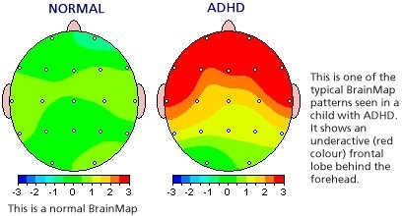
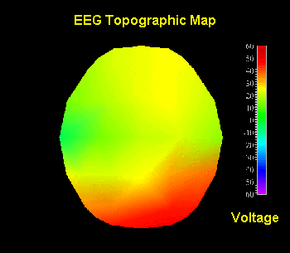
Colour Brain Mapping example: (x,y,z) biosignal
(the colours represent intensity of electric activity of individual parts of the brain)
Attention Deficit Hyperactivity Disorder (ADHD)

Slide 17
Anaesthesia: The EEG and the Bispectral Index (optional)
The Bispectral index monitor is a neurophysiological monitoring device which continually analyses a patient's electroencephalograms during general anesthesia to assess the level of consciousness (too little anesthetic and patient remembers, too much leading to brain damage). The essence of BIS is to take a complex signal (like the EEG), analyze it, and process the result into a single number which can be easily monitored.
The BiS is the bottom trace.

Slide 18
Comments on BiS etc. (optional)
The Bispectral Index is an example of a “descriptive indices”.
These are not real physical quantities. They are calculated from many measured parameters and by searching knowledge databases which contain measurements of many different patients (of various ethnic origins) with different health status. Complete algorithms of calculations and contents of knowledge databases are producer secrets.
The doctor needs only get acquainted with meaning of the respective index and the values which it can have, but it is not necessary to know how it is calculated.
It is usually enough to give some information about the patient for the computer to correctly search in the knowledge databases.
It is almost always necessary to enter age, sex, race, body height and mass.
There are sometimes questions about e.g. length of fingers or toes. Such “strange questions” are frequent in monitoring of the cardiovascular system. However, they can be important. When the answers are omitted, the software can use an incorrect statistical patient model and an incorrect index value will be displayed.

Slide 19
Artefacts
Definition: features of signals not arising from the target tissue
They arise from electromagnetic waves in the environment (e.g., 50Hz electricity supply, mobile phones), patient movement, patient sweating etc.

Slide 20
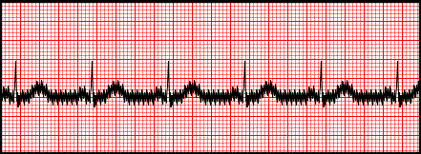
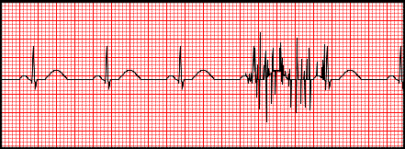
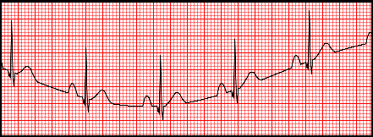
EKG Artefacts
http://mauvila.com/ECG/ecg_artifact.htm
50Hz AC superimposed on the EKG
Muscle tremors
Moving baseline from patient movement, dirty electrodes, loose electrodes

Slide 21
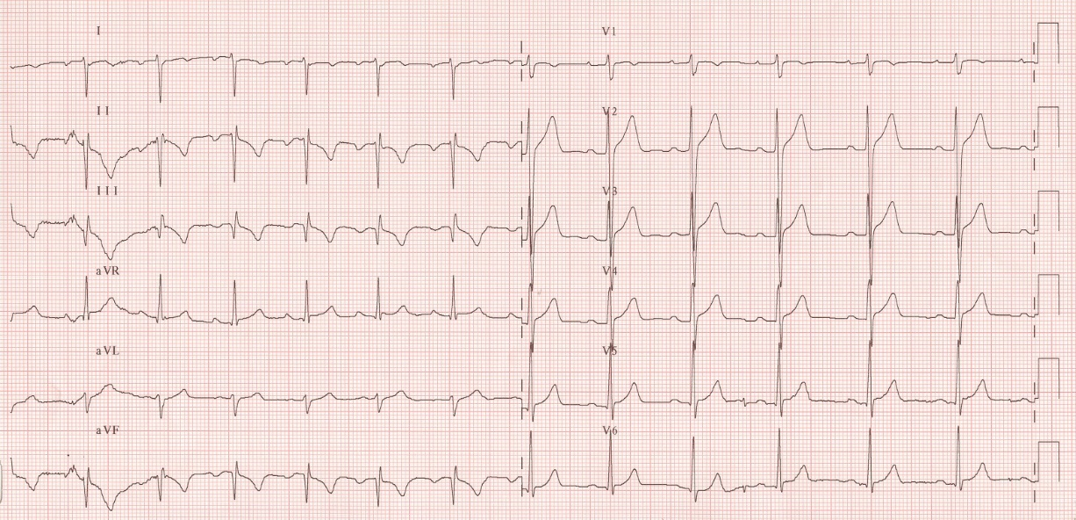
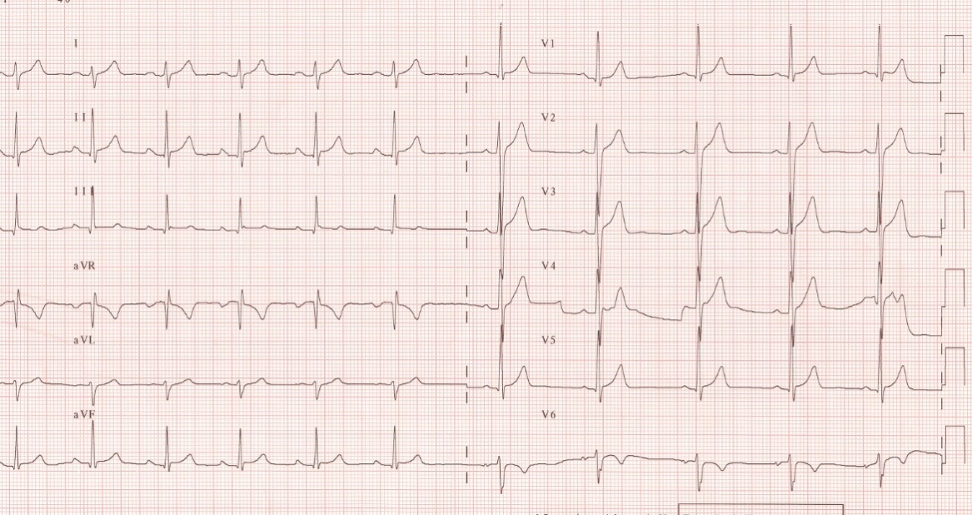
Switched limb leads
Switched chest leads
Doctor must be able to recognise it!!!!!!

Slide 22

Some EEG artefacts
http://www.brown.edu/Departments/Clinical_Neurosciences/louis/artefct.html
Pulse wave artefact: movement of electrode arising from patient pulse under the electrode.
EKG signal artefact: EKG signal also picked up by the EEG electrodes.
Both easily recognized because they are periodic.

Slide 23
Temperature Measurement
“If a part of the human body is warmer or even colder than the surrounding parts, it is necessary to look for the disease focus in this place”
Hippocrates

Slide 24
Main purposes of temperature measurements
monitoring of ill patients
monitoring of physiological reactions
monitoring of hyperthermia treatment
Important specifications of thermometers:
accuracy
response time (determined by heat capacity of the sensor and its conductivity)

Slide 25
Types of Thermometry in diagnostics
1. Point temperature measurement – measurement of temperature at individual points in the body
  Contact
    Dilation thermometers based on expansion (mercury and alcohol thermometers)
    Digital thermometers based on thermistor sensors (resistance of the thermistor changes with temperature)
    Digital thermometers based on thermocouple sensors (voltage produced varies with temperature)
  Contactless (ear tympanic thermometer)
2. Temperature distribution on the surface of the body (thermography)
  Contact (use of sensors placed on skin)
  Contactless – IR camera (another lecture)

Slide 26
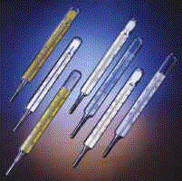
Dilatation thermometers (i.e., based on expansion of some substance)
Mercury-in-glass thermometer gives maximum temperature
Its capillary is narrowed to avoid return of mercury into the reservoir.
Disadvantage: long response time (long time necessary for a stable reading 3 - 5 min.)
Medical high-speed thermometer:
Alcohol filled – the capillary is not narrowed, the temperature must be read during the measurement, response time 1 min.
Today, the toxic mercury is replaced similarly looking Galinstan a special alloy composed of gallium, indium, and tin which melts at −19 °C (−2 °F) and is thus liquid at room temperature.

Slide 27
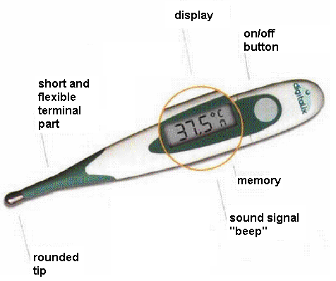
Digital Thermometers

Slide 28
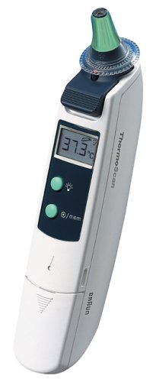
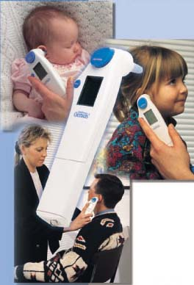
Tympanic (ear) thermometer
Removable hygienic tip
They are based on the measurement of infra-red radiation which is emitted from the ear drum. The temperature reading is obtained only 1 second after attachment of the sensor to the distal end of the acoustic meatus.

Slide 29
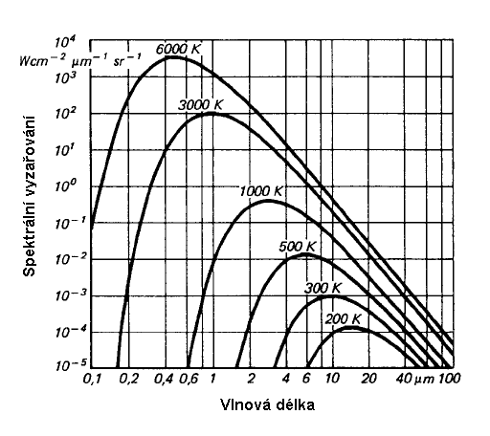
Physical principle of the temperature determination based on measurement of infrared radiation
Stefan-Boltzmann law – dependence of the so-called spectral density of a black body radiation on temperature
Spectral density
Wavelength

Slide 30
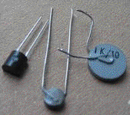

Digital Thermometers: Thermistor sensor based
R – resistance
temperature in Kelvin T
R_{o} – resistance at temperature T_{o}
B – constant

Slide 31
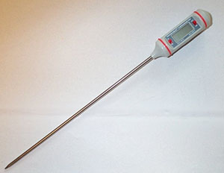
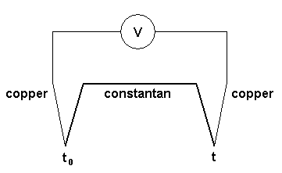
Digital thermometers: Thermocouple sensor based
Digital thermocouple sensor
Thermovoltage U = α(t – t₀)

Slide 32
Authors:
Vojtěch Mornstein,
Jan Dvořák,
Věra Maryšková
Last revision September 2024
Content collaboration and language revision:
Carmel J. Caruana, Ivo Hrazdira

