Slide 1
Cannabis for medical use
Leoš Landa

Slide 2
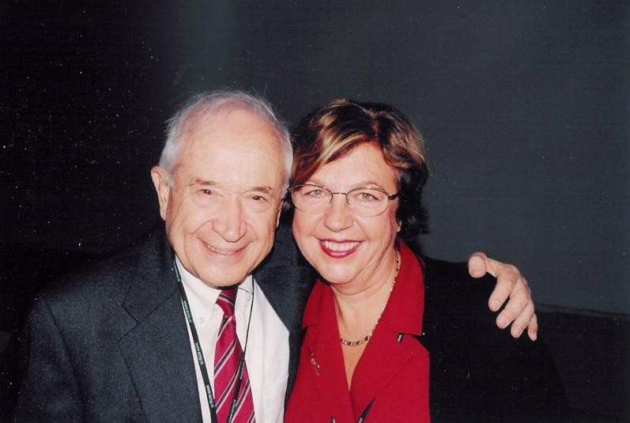
Cannabinoids
Group of 21 carbon terpenophenolic compounds uniquely produced by hemp plants

Slide 3
NEED FOR A CHANGE OF THE ORIGINAL MEANING
Development of synthetic cannabinoids
Discovery of endogenous cannabinoids (endocannabinoids)

Slide 4



Cannabinoids
Phytocannabinoids
= substances contained specifically in hemp
Endocannabinoids
= natural cannabinoids in the body of animals and human beings
Synthetic cannabinoids
= artificially produced

Slide 5
Phytocannabinoids
subclasses according to Elsohly et al. (2005):
cannabigerol type
cannabichromene type
cannabidiol type (CBD)
∆9- trans-tetrahydrocannabinol type (THC)
∆8-trans-tetrahydrocannabinol type
cannabicyclol type
cannabielsoin type
cannabinol type
cannabinodiol type
cannabitriol type
Department of Pharmacology
11) miscellaneous types

Slide 6

Endocannabinoids
https://cs.wikipedia.org/wiki/Soubor:HanDev.jpg
Lumír Hanuš
William Devane

Slide 7
Endocannabinoids
anandamide (N-arachidonoyl-ethanolamine, AEA) (Devane et al. 1992)
name based on the Sanskrit word ‘ananda’ (internal bliss)
2-arachidonoyl-glycerol (2-AG) (Mechoulam et al. 1995) N-arachidonoyl-dopamine (NADA) (Bisogno t al. 2000)
noladin ether (2-arachidonyl-glyceryl ether, 2-AGE) (Hanus et al. 2001) virhodamine (O-arachidonoyl-ethanolamine) (Porter et al. 2002)

Slide 8
Synthetic cannabinoids
Main purpose:
study of distribution and pharmacological properties of cannabinoid receptors
HU-210 (CB₁ a CB₂ receptor agonist) methanandamide (CB₁ receptor agonist) CP 55,940 (CB₁ a CB₂ receptor agonist) WIN 55,212-2 (CB₁ receptor agonist)
JWH 015 (CB₂ receptor agonist)
AM 251 (CB₁ receptor antagonist)

Slide 9

Cannabinoids - mechanism of action (endocannabinoid system)
Cannabinoid receptors
Endocannabinoids
Enzymes (biosyntesis/degradation)

Slide 10
Cannabinoid receptors CB₁ and CB₂
Endocanabinoid system (ECS)
CB₁ receptors - primarily in the CNS
regions of the brain responsible for pain modulation: certain parts of the spinal cord, periaqueductal grey (Grotenhermen 2006)
movement: basal ganglia, cerebellum
memory and learning: hippocampus, cerebral cortex
emotions: amygdala
sensory perception: thalamus (Velasco et al. 2012)
RESPONSIBLE FOR PSYCHOACTIVE EFFECTS
CB₂ receptors - particularly in the periphery
on immune cells, especially B-cells and natural killer cells (Pertwee
1997), also expressed in tonsils or spleen (Galiegue et al. 1995)

Slide 11
Other known cannabinoid receptors:
Endocannabinoid system (ECS)
TRPV1 receptors
transient receptor potential cation channels subfamily V member 1
- also known as the “capsaicin receptor” and “vanilloid receptor (Ross 2003)
GPR18, GPR55, GPR119
(also called putative or non-classical cannabinoid receptors)
- structural similarity to CB₁ and CB₂
(Alexander et al. 2013; Zubrzycki et al. 2014)

Slide 12
Synthesizing enzymes:
Endocannabinoid system (ECS)
phospholipases
Degrading enzymes:
FAAH
(fatty acid amide hydrolase; post-synaptically)
MAGL
(monoacylglycerol lipase; pre-synaptically)
(Pertwee 2005; Muccioli 2010; Battista et al. 2012)

Slide 13
Endocannabinoids
- mechanism of action
NTs bind to their receptors →
activated postsynaptic neurons synthesize endocannabinoid precursors
→ subsequent release of endocannabinoids
(This is generally induced by an increase in the cytosolic
concentration of free Ca²⁺)

Slide 14
Endocannabinoids
- mechanism of action (THC)
Endocannabinoids act as retrograde synaptic
messengers → bind to presynaptic CB₁ cannabinoid receptors
→ inhibition of NTs release: glutamate and GABA (Guzman, 2003).

Slide 15
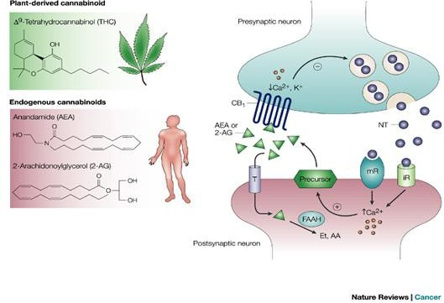
http://30c1be84fhhqj3xa1lmshckme-wpengine.netdna-ssl.com/wp-content/uploads/2015/09/endocannabinoid-natur.jpg

Slide 16
Physiological functions of ECS are very complex:
Endocannabinoid system (ECS)
motor coordination
memory appetite
modulation of pain
neuroprotective effects
maintaining of homeostasis, etc. (Pacher et al., 2006).

Slide 17
Effect of THC on dopamine release
→ dependence potential
THC stimulates neurons in dopamine reward system to release (indirectly)
GABA normally suppresses amount of dopamine released in nucleus accumbens.
GABA is blocked by THC → increase in dopamine release

Slide 18
Effect of THC on dopamine release
→ dependence potential
thebrain.mcgill.ca

Slide 19
Main medical purposes of use
chronic persistent pain – especially in association with cancer,
neuropathic pain, pain associated with glaucoma,
pain associated with degenerative disease of the musculoskeletal system,
spasticity and pain in multiple sclerosis, tremor caused by Parkinson’s disease,
nausea and vomiting particularly following cancer treatment, stimulation of appetite in cancer and HIV patients,
Tourette syndrome
superficial treatment of dermatosis and mucosal lesions

