Slide 1

Antihistaminines

Slide 2
Histamine
- autacoid (local hormone)
- endogenous amine (hydrophilic)
- in tissues is formed from histidine
Location: in granules in mast cells, basophiles (histaminocytes) → bound to heparan sulphate and acidic protein
  in almost all tissues, highest levels in lungs, GIT, skin
Main roles in the body:
  neurotransmitter – CNS
  mediator of allergic/inflammatory reactions – mast cells, basophilles
  regulation of gastric acid release (↑) - stomach

Slide 3
Histamine
is released from mast cells granules by exocytosis (activation of phospholipase C a ↑ Ca²⁺)
Stimuli:
  imunological: antigen + IgE
  physical, chemical or mechanical cell damage
  drugs

Slide 4
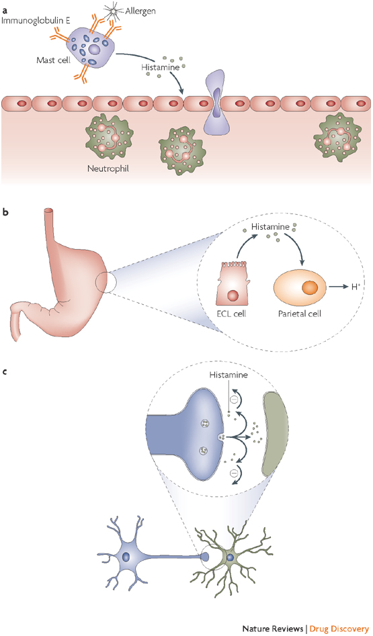
doi:10.1038/nrd2465

Slide 5
Histamine metabolism
L-histidine
histidinde karboxylase
imidazole-N-
methyltransferase
Histamine
diamine oxidase
metylhistamine
MAO
imidazole acetaldehyde
metylhimidazole acetaldehyde
aldehyde dehydrogenase
methylimidazole acid
imidazeacetic acid

Slide 6
Histamine receptors
4 subtypes (H₁ – H₄)
G protein-coupled receptors
their stimulation results in increase in cellular concentration of Ca²⁺ ions

Slide 7
H₁ receptors
postsynaptic, G_{q}-protein ↑ phospholipase C →
↑ IP3 and DAG → ↑ Ca²⁺
Location:
  endothel, smooth muscles (vessels, bronchi, uterus, GIT), peripheral neuron ending, CNS (!!!)
Effects:
  smooth muscle contraction (bronchi, uterus, ileum)
  vasodilatation of minor vessels (↓BP, reddening of skin)
  increase in vessel permeability (swelling)
  irritation of peripheral neuron endings (itching, even pain)
  excitation of CNS

Slide 8
H₂ receptors
postsynaptic, G_{s}-protein ↑ activity of adenylate cyclase → ↑cAMP
Location:
  stomach mucosa, heart, vessels, immune system
Effect:
  in stomach: gastric acid, pepsine, intrinsic factor secretion
  slower and longer vasodilatation
  + inotropic, + chronotropic effect

Slide 9
H₃ receptors
presynaptic, G_{i} protein → inhibition of N-type Ca²⁺ channels → ↓ cellular Ca²⁺
  feedback inhibition of histamine release
heteroreceptors, ↓ release of other neurotransmitters
Location:
  mainly in CNS (but in PNS tissues as well)
Effects:
sedation
  negative chronotropic effect
  bronchoconstriction

Slide 10
H₄ receptors
possibly isoform of H₃
Location:
eosinophiles, basophiles, bone marrow, thymus, intestine, spleen
Effects:
  influencing activity of immune system
  important for chemotaxis

Slide 11
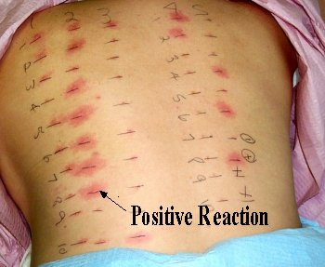
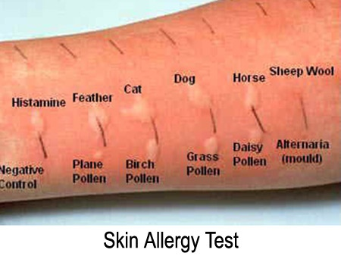
Histamine in clinical practise
limited use (ineffective when given orally)
diagnostics in allergology
histamine analogue → betahistine

Slide 12
Lewis reaction
typical response to intradermal histamine administration:
  skin reddening (vasodilatation of arterioles)
  wheal (capillary permeability)
  flare (redness in the surrounding area due to arteriolar dilatation mediated by axon reflex)
used in allergy testing – positive control
it is used to evaluate the potential antiallergic effect of H1 antihistamines

Slide 13
How to antagonize effects
of histamine?
Treat the symptom
  vasoconstrictiors, sedatives, antacides, tocolytics etc.
Treat the cause
  inhibition of synthesis (glucocorticoids)
  inhibition of release (cromoglycate, nedokromil, β₂-SM, glucocorticoids)
  receptor antagonism:
    - non-specifically, indirectly (epinephrine)
    - specifically, directly (H1, H2, H3 - antihistaminines)

Slide 14
Allergy
has a high incidence, 10-30% (and growing)
genetic factors
various theories about its origin
Mechanism of alergic reaction:
early contact with allergen
allergen binds to IgE antibody
degranulation of cells containing histamine
activation of phospholipase C
  → mobilization of intracellular Ca²⁺
  → mediators are released: HIS, PG, LT, PAF, cytokines

Slide 15
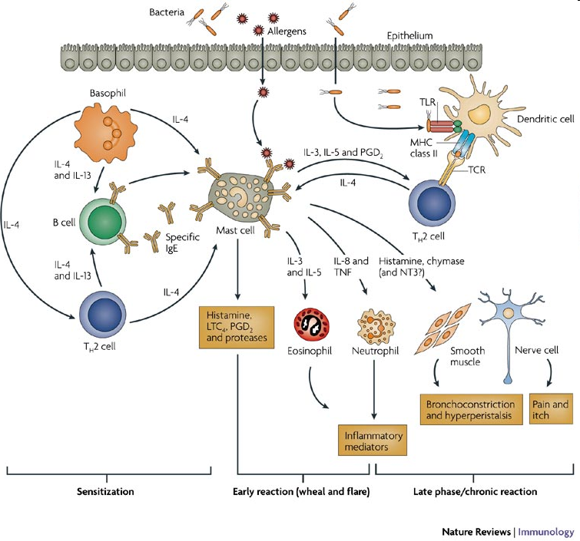
Stephan C. Bischoff. Nature Reviews Immunology 7, 93-104, February 2007

Slide 16
Allergy treatment
always as an addition to taking enviromental control measures and avoiding allergen
H₁- antihistamines
glucocorticoids
mast cells stabilizers
immunotherapy
epinephrine (anaphylactic shock)

Slide 17
H₁ antihistamines
MoA: antagonization of H₁ receptor
they antagonize the allergy symptomes caused by histamine
high selectivity to H₁ rp. → low affinity to H₂ rp.
3 generations
AE:
  antimuskaric, antiserotonergic a antiadrenergic effects of older drugs of this group (sedation, fluctuating blood presure,...)
  block of Na⁺ channels → locally anaesthetic and antipruritic effect

Slide 18
H₁ antihistamines pharmacokinetics
Dosage forms:
  oral, topical, parenteral (i.m., infusion)
easy and quickly absorbed from GIT
distributed evenly in the body
metabolized in liver (some in form of prodrug)
excreted in urine, stool
drugs of I. generation cross the blood-brain barrier → central effects (sedation)
cross the placenta and are distributed into milk!

Slide 19
H₁ antihistamines - I. generation
relatively old drugs
in general lower selectivity to H₁ receptors
they cross the blood-brain barrier
effect lasts approx. 4 - 6 h
rather common adverse effects
dimetinden (Fenistil®)
promethazine
bisulepin (Dithiaden®)
moxastine – for motion sickness (Kinedryl®)
cyproheptadine – treatment of serotonin syndrome
ketotifen

Slide 20
H₁ antihistamines
AE of I. generation
sedative, even hypnotic eff.– driving, heavy mashinery operation (!)
paradoxical reaction (children, elderly) = excitation (sleeplessness, nervousness, tachycardia, tremor, ...)
  indigestion (nausea, vomiting, diarrhea x constipation)
skin symptoms → phototoxicity
anticholinergic effects
increas in appetite (antiserotoninergic effect)
ortostatic hypotension (weak block of α-adrenergic rp.)

Slide 21
H₁ antihistamines
II. and III. generation
low distribution to CNS – minimal sedative effect
better properties – higher selectivity towards rp., less AE
- effect lasts for 12 – 24 hours, given 1 - 2 times a day
II. generation
cetirizine
loratadine
fexofenadine
azelastine
levocabastine
III. generation
levocetirizine
desloratadine
bilastine
rupatadine

Slide 22
Novel H₁ antihistamines
III. generation
bilastine
  high selectivity towards H₁-receptors, antiinflammatory properties
  not metabolized by liver or intestinal wall, low potential for drug-drug interaction
rupatadine
  long-term effect
  dual effect (H₁ antagonist + blocks PAF receptors)

Slide 23
H₁ antihistamines
AE of II. generation
arrythmogenic→ QT interval prolongation (some drugs even withdrawn)
possible sedation when overdosed (cetirizine)
Interactions:
  are metabolised by CYP3A4 → be cautious of inhibitors of this isoform (macrolide ATB, azole antifungals, verapamil, grapefruit juice...)

Slide 24
H₁ antihistamines
Indications I
treatment of symptoms of allergic diseases
  - allergic rhinitis
  - urticaria, drug and food allergy
add-on treatment of anafylactic reactions
pruritus of various ethiology (e.g. itching in allergic and non-allergic dermatitis + insect bites)
tinitus, Meniére‘s disease

Slide 25
H₁ antihistamines
Indications II
migraine
nausea a vomiting
  movement sickness (moxastine, embramine)
  vertigo
prophylactic premedication before some drugs (e.g. monoclonal antibodies)
sleeplessness, when hypnotics are not tolerated
anxiety (hydroxyzine → mild anxiolytic effect)

Slide 26
H₁ antihistamines
Contraindications
- alcohol dependency
- hypersensitiveness to that substance
- serious hypotension
- simultaneous administration of sedative drugs
(I.generation)
- activities which require full attention
(I.generation)
- patients with history of arrythmias
(II. generation)

Slide 27
H₃ antihistamines
betahistine
  MoA: H₃ antagonist, H₁ agonist
  analogue of histamine
  improves microcirculation of the inner ear by vasodilatating capillaries
  indications: tinitus, vertigo, Menière‘s disease

Slide 28
Drugs used in diseases characterized by bronchial obstruction

Slide 29
Bronchial asthma
chronic inflammatory disease of airways
affecting 300 million people all across the globe
prevalence in CZ: 8 %, in children over 10 %
Characteristics:
  bronchial hyper-reactivity
  obstruction (often reversible)
  inflammation
Symptoms:
  shortness of breath (bronchoconstriction, mucous plug, oedema, airway remodeling due to the inflammation)
  difficult and prolonged expiration → wheezing, whistling
  cough (especially at night or in early morning)

Slide 30
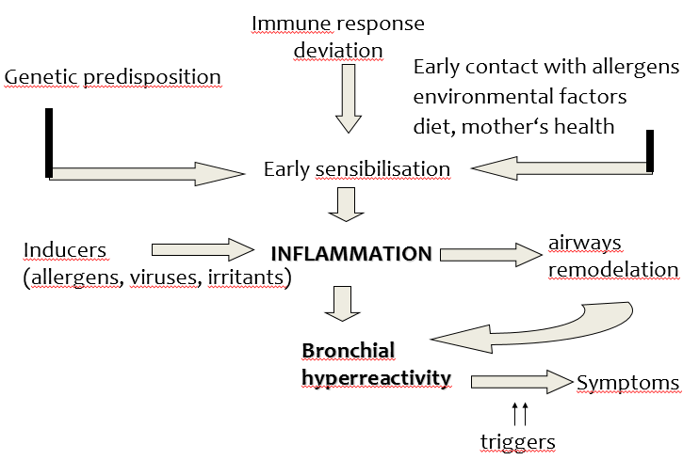
Bronchial asthma
ALERGIC ASTHMA
NON-ALERGIC ASTHMA
allergy not present
excercire-induced, aspirin-sesitive, infectious, work-related, endogenous

Slide 31
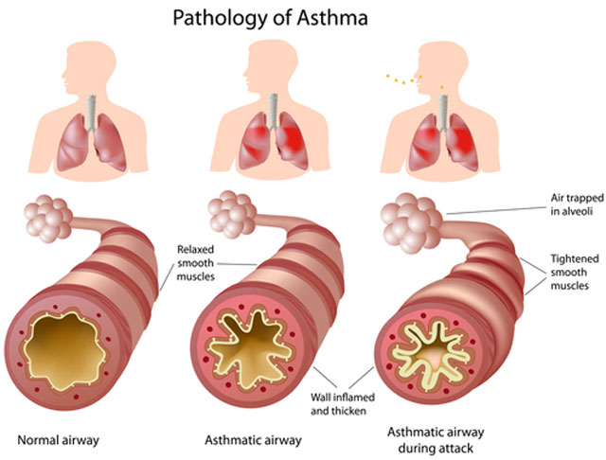
https://www.canstockphoto.com/anatomy-of-asthma-6231875.html

Slide 32
Diagnose
Anamnesis – personal, familiar
Clinical examinations - auscultation, signs of atopy, eosinophilia,
PEF – Peak Expiratory Flow
FEV 1 – Forced Expired Volume
Laboratory tests- eosinophilia, IgE
Allergy testing

Slide 33
Classification with regard
to seriousness
Intermittent – sign up to once a week, night symptoms up to twice a month, pulmonary function normal
Mild persistent– signs no more than once daily, night symptoms up to twice a month, PEF at least 80 %
Moderate persistent– signs once a day and are not permanent, night sign no more than once a week, PEF 60-80 %
Severe persistent– permanent signs, daily, obstruction, PEF ≤ 60 %

Slide 34
Managment of asthma
the disease itself cannot be fully treated, the goal is to keep asthma under control
Goals:
minimalize both acute and chronic symptoms
reduction of exacerbations (lessen SABA administration)
improvement of the quality of life (physical activity)
avoid adverse effects of the treatment

Slide 35
Chronic obstructive pulmonary
disease (COPD)
affecting 600 million people all across the globe
prevalence: 8 %
risk factors: smoking, polluted air, dust and chemical vapors at workplace, genetic predisposition
Characteristics:
  chronic inflammation caused and maintained by long-term exposure to harmful agents (irritating gases and particles)
  poorly reversible, progressing bronchial obstruction
  production of mucus
Symptoms:
  cough (usually whole day, hardly ever only during night)
  expectoration
  shortness of breath

Slide 36
Managment of COPD
we can only slow the progression
reduction of risk factors is necessary (mainly top quit smoking)
Goals:
symptom reduction
improvement in physical condition and overall health state
prevention of complications and exacerbations

Slide 37
Administration
  oral, parenteral (injections, infusions)
  inhalation
  - local administration, high drug concentration at the site
  of action
  - fast onset of the effect
  - minimal penetration to systemic circulation → ↓ risk of side effects

Slide 38
Drugs used in diseases characterized
by bronchial obstruction
BRONCHODILATATORS
- β₂ sympathomimetics
- parasympatholytics
- glucocorticoids
- methylxanthines
- roflumilast (COPD only)
- antileukotrienes
- imunoprofhylactics
- monoclonal antibodies
- noselective sympathomimetics (epinephrine, life-saving medication)
- adjuvant medication (antitussics, drugs facilitating expectoration)
asthma only

Slide 39
β₂ sympathomimetics
MoA: selective β₂ stimulants
  - inhibition of mediator release from mast cells + stimulation of ciliary beat frequency
- diagnostics – post-bronchodilator test (salbutamol)
- mostly inhaled, may be also given orally (mainly in kids)
- not completely selective in their binding to β receptors
long-term use = down-regulation of receptors

Slide 40
β₂ sympathomimetics
Indication: asthma, COPD
AE: nervousness, tremor, cephalgia, palpitation, hypokalemia (mainly when given orally)
CI: hypertension, dysrhythmia, pregnancy

Slide 41
β₂ sympatomimetics
Short-acting = SABA (also rapid-acting = RABA)
  fast onset of effect, which lasts 4 – 6 hours, inhalation
  salbutamol
  fenoterol
Long-acting = LABA
  effect lasts for up to 12 hours, inhaled or administered orally
  salmeterol
  clenbuterol
  formoterol (RABA)
  indakaterol (U-LABA)
  vilanterol (U-LABA)

Slide 42
Parasympatholytics
MoA: competitive antagonism of M receptors
- in a form of inhalation
- can be combined with β₂-sympathomimetics or glucocorticoids
Indication: COPD, asthma
AE: if entering the systemic circulation (low risk, they contain quaternary nitrogen in their structure) – anticholinergic effects
CI: glaucoma, prostate hypertrophy, pregnancy

Slide 43
Parasympatholytics
ipratropium
  - used in asthma as well – in patients resistent to β2 sympathomimetic treatment (approx. 1/6 of patients)
  short acting (SAMA)
aclidinium (LAMA)
tiotropium (U-LAMA)
  glykopyrronium-bromide (U-LAMA)
  umeclidinium (U-LAMA)
COPD
only

Slide 44
Glucocorticoids
MoA: inhibition of phospholipase A2
by lipocortin
Effects I:
  ↓ cytokine, PG a LT secretion
  ↓ lipolytic and proteolytic enzyme secretion
  ↓ endothelial permeability
  block of cell migration
  ↓ bronchial hyperreactivity,

Slide 45
Glucocorticoids
Effects II:
  reduction of edema
  prevention of chronic irreversible changes
  (hypertrophy and hyperplasia of bronchial smooth muscles, subendothelial fibrosis and thickening of mucous basal membrane)
  increase in sensitivity of β₂ adrenergic receptors to β₂-SM

Slide 46
MoA at the cellular level
glucocorticoid + cytoplasma receptor
production of specific mRNA
production of some proteins (lipocortins)

Slide 47
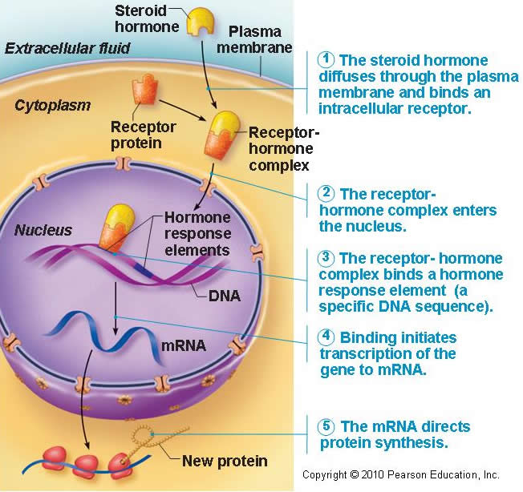
MoA at the cellular level
After entering the cell they bind to specific receptors in cytoplasm causing change of conformation = activation of receptors
Complexes of corticoid + receptor are transported to cell nucleus and bind to DNA elements.
The result is increased transcription of genes either inducing or inhibiting synthesis of other proteins
GLC receptors are present in all tissues!!!
Proteins called lipocortins are able to suppress phospholipase A

Slide 48
Antiinflammatory effect of GC
AA cascade inhibition
glucocorticoids
membrane phospholipids
lipocortin
phospholipase A2
arachidonic acid
Inh. 5-LOX
A-A
NSAIDs
lipooxygenase
PROSTAGLANDINE
PROSTACYCLINES
TROMBOXANES
cyclooxygenase
LEUKOTRIENS
Mobilization of fagocytosis
Changes in vessels permeability
Inflammation
inflammation

Slide 49
Glucocorticoids
given by inhalation
  lower risk of systemic adverse effects
  AE: affected vocal cords – croaky voice, oral candidiasis (thrush)
beclomethasone
budesonide
fluticasone
ciclesonide
mometasone
systemic administration
  orally, via injection – acute conditions, doses are gradually decreased, in severe persistent asthma – if nothing else is effective
prednisone
triamcinolone
hydrocortisone (injection)

Slide 50
Methylxanthines
MoA: phosphodiesterase 1 – 4 inhibitors
adenosine receptors antagonists
sustained-release drug forms
Effects:
– bronchodilatation
– cardiostimulation (+chrono, +inotropic eff. )
– diuretic eff.
– CNS and respiratory center stimulation
– stimulation of hydrochloric acid secretion

Slide 51
Methylxanthines
Effects:
- substrates of CYP450 – be cautious if patient is a smoker!
CI: pregnancy, epilepsy, cardiovascular disease
AE: tachycardia, palpitations, sleeplessness

Slide 52
Methylxanthines
theophylline
  - combination therapy with β₂ SM is convenient
  - becoming obsolent, therapeutic drug monitoring needed
  - variable pharmacokinetics, low therapeutic index
aminophylline
  - a complex of theophylline and ethylendiamine (better solubility)
  - COPD, emphysema

Slide 53
roflumilast
  selective long-acting inhibitor of phosphodiesterase 4
  reduces the inflammation in bronchi in COPD

Slide 54
Antileukotrienes
MoA: antagonism of LT-receptors / inhibition of lipoxygenase
LT receptor antagonists:
  treatment of persisting asthma, allows lowering of glucocorticoid dose
  1-2x a day, orally
montelukast
Inhibitors of LOX:
  need for frequent application
  not registered in CZ (zileuton – USA)

Slide 55
Imunoprophylactics
(mast cells stabilizers)
MoA: stabilisation of mast cell membrane → ↓ Ca²⁺ influx → ↓ degranulation of mast cells and thereby ↓ histamine release
influence on lymphocyte function
prevention of asthma attack, they do not affect already present bronchospasm
Use: as preventive, long-term, maintenance therapy – mild and moderate asthma
when combined with other antiasthmatics, they allow lowering of their dose
CI: pregancy (1. trimester)
nedokromil, ketotifen (H1 antihistamine), cromoglycate

Slide 56
Monoclonal antibodies
Anti-IgE
omalizumab
antibodies against a part of IgE, which binds to mast cells
Indication: severe persistent allergic asthma, which cannot be otherwise controlled
administered subcutaneously in specialized centers only

Slide 57
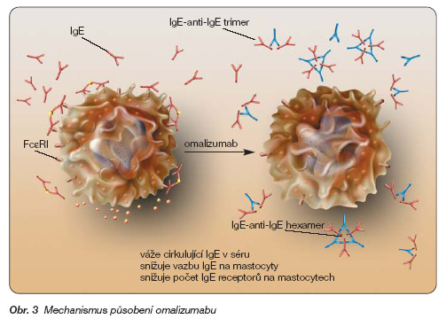
Anti-IgE
omalizumab
http://www.remedia.cz/Okruhy-temat/Respiracni-onemocneni/Omalizumab-terapeuticka-perspektiva-v-lecbe-tezkeho-bronchialniho-astmatu/8-1o-gD.magarticle.aspx

Slide 58
Monoclonal antibodies
Anti-IL-5
mepolizumab, reslizumab
add-on treatment for severe refractory eosinophilic asthma in adult patients

Slide 59
Other options
Bronchial thermoplasty
bronchoskopic procedure, during which a therapeutic radiofrequency energy is delivered to the airway wall, resulting in reduction of smooth mucle cells
Allergen immunotherapy
induces tolerance to the triggering allergen

Slide 60
Devices for inhaled medications
MDI = metered dose inhalers
  drugs as solutions, propellants
BAI = breath-actuated inhalers
DPI = dry powder inhalers
  spinhaler, diskhaler, turbohaler
nebulizers (liquid → aerosol)

Slide 61
Devices for inhaled medications
spacers for children and elderly
patient must be educated how to use their inhaler
→ up to 41 % of patients use incorrect technique
inhalers often combine two drugs (bronchodilator + glucocorticoid or two bronchodilators)

Slide 62
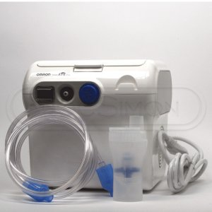
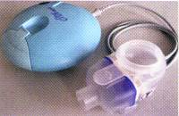
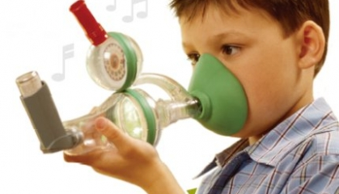

Slide 63
Adjuvant medication in diseases characterized
by bronchial obstruction and
another drugs affecting respiratory system
antitussives
drugs facilitating expectoration
H₁ antihistamines (mainly II. a III. generation)

