Slide 1
Determination of the sensitivity of the respiratory center to hypercapnia
Physiology I – practice
Autumn, weeks 7–9

Slide 2
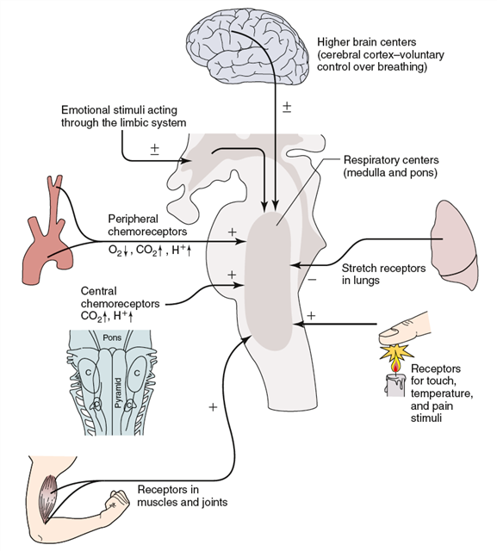
Regulation of breathing
Cerebral cortex
Voluntary breathing, conditioned reflexes
Subcortical structures
Emotions, changes in central temperature, reactions of autonomic nervous system
Respiratory centre
Central chemoreceptors, automatic breathing
Peripheral chemoreceptors
Direct effect of environment
Receptors in lung and airways
Hormones
(epinephrine, steroid hormones)
Receptors in breathing muscles
Baroreceptors
Receptors in skin, muscles, tendons and joints
Nespecific mechanoreceptors

Slide 3
Breathing centres in the medulla
Breathing is an automatic process that takes place unconsciously.
Automaticity of breathing comes from regular (rhythmic) activity of groups of neurons anatomically localized in the medulla and its vicinity. They can be divided into three main groups:
  Dorsal respiratory group – only inspiratory neurons, their axons go to the motoneurons of the inspiratory muscles (diaphragm, external intercostal muscles; their activation = inspiration, during their relaxation = expiration), they participate in inspiration at rest and also during exercise
  Ventral respiratory group – located on the ventrolateral part of the medulla, the upper part: neurons whose axons activate the motoneurons of the primary and accessory inspiratory muscles; the lower part: expiratory neurons with innervation of expiratory muscles. Neurons of this group are active only during forced inhalation and exhalation
  Pontine respiratory group (pneumotaxic centre) – participates in the control of the frequency and depth of breathing; it affects the activity of respiratory neurons in the medulla

Slide 4
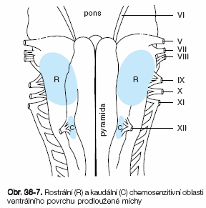
Central chemoreceptors
on the front side of the medulla
CO₂ can cross the hematoencephalic barrier to the cerebrospinal and intercellular fluid
  CO₂ + H₂O → CHO₃⁻ + H⁺
Higher H⁺ concentration of H⁺ in cerebrospinal fluid stimulates central chemoreceptors → increased ventilation
  central chemoreceptor are stimulated also by other types of acidosis (lactate acidosis, ketoacidosis)
  a sudden change of pCO₂ does not have an immediate effect, the changes in ventilation through central chemoreceptors occur after 20-30 s

Slide 5
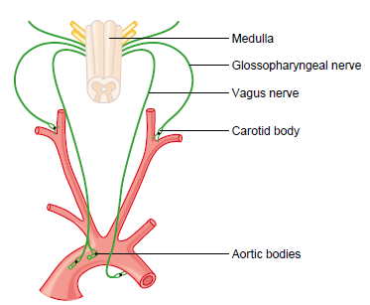
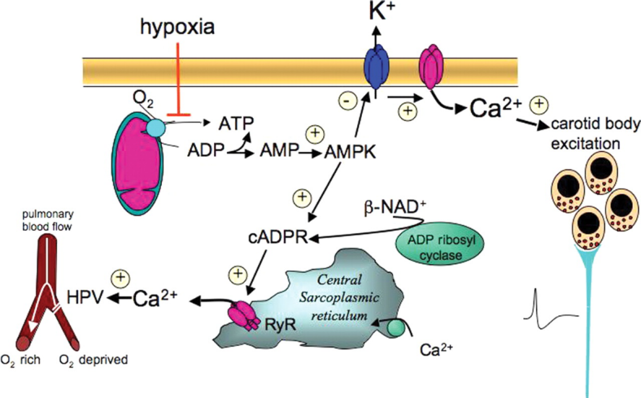
Peripheral chemoreceptors
Located in the aortic and carotid bodies
  glomus caroticum, glomus aorticum
  They convey their sensory information to the medulla via the vagus nerve and glossopharyngeal nerve.
Sensitive to a decrease in arterial pH and pO₂ and an increase in arterial pCO₂
  The most important reaction is to decrease in arterial pO₂, particularly to decrease of O₂ under 10-13 kPa in the arterial blood (caused mainly by a general decrease of pO₂ or impaired flow of the blood)
  Mechanism: decreased pO₂ leads to the decrease of ATP synthesis in mitochondria resulting in membrane depolarization

Slide 6
Hypoxia, hypoxemia (norm. 11-16 kPa)
Hypoxia is a general name for a lack of oxygen in the body or certain tissues.
Hypoxemia is a lack of oxygen in arterial blood.
A complete lack of oxygen is known as anoxia.
The most common types of hypoxia:
  Hypoxic – physiological: stay at higher altitudes, pathological: hypoventilation during lung or neuromuscular diseases, thorax injuries, opioid overdose, …
  Transport (anemic) – reduced transport capacity of blood for oxygen (anemia, blood loss, CO poisoning)
  Ischemic (stagnation) – restricted blood flow to tissues (heart failure, shock, obstruction of an artery)
  Histotoxic – cells are unable to utilize oxygen (cyanide poisoning – disruption of the respiratory chain)

Slide 7
Hypercapnia (norm. 5.3-6.65 kPa)
An increase in the concentration of carbon dioxide in the blood or tissues caused by the retention of CO₂ in the body
  Possible causes: total alveolar hypoventilation – decreased respiration or extension of dead space
  Mild hypercapnia (5-7 kPa) causes stimulation of the respiratory center (therapeutic use: pneumoxid = mixture of oxygen + 2-5% CO₂)
  Hypercapnia around 10 kPa – CO₂ narcosis – respiratory depression (preceded by headache, confusion, disorientation, a feeling of breathlessness)
  Hypercapnia over 12 kPa – significant respiratory depression – coma and death.

Slide 8
The partial pressure of gases (mmHg)
In different parts of the respiratory and circulatory system

Slide 9
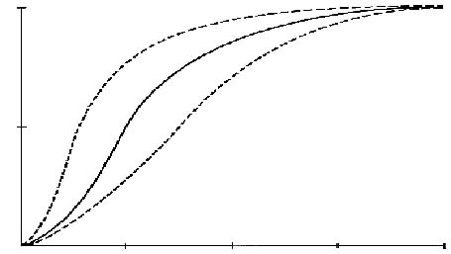
Saturation of hemoglobin with oxygen
100%
↓ temperature
↑ pH
pCO₂
↓ DPG
Percentage of hemoglobin saturated with oxygen
In arterial blood around 95-98%
Hypoxia <85%
50%
↑ temperature
↓ pH
↑ pCO₂
↑ DPG
pO₂ [mmHg]
25
50
75
100

Slide 10
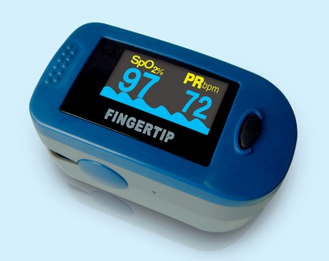
Pulse oximetry
Red
Infrared
Absorption
deoxyhemoglobin
  Is a photometric method of non-invasive measurement of hemoglobin saturation with oxygen in the arterial blood.
  The method is based on the evaluation of the absorption of transmitted light of two different wavelengths after passing through tissues.
  How to get saturation only in the arterial blood: subtract the value between individual heartbeats from the value at the peak of the pulse wave. The component calculated in this way is then equal to the absorption of the variable component, which is the arterial blood (the representation of other tissue is stable).
oxyhemoglobin
600
800
1000
660
920
Wavelenght (nm)
Pulse absorption in the arterial blood
Absorption
Arterial blood – constant
Venous blood
Tissues
Time

Slide 11

Sensitivity of the respiratory centre to hypercapnia
  Aim: to demonstrate the changes in ventilation during induced hypercapnia and to compare the sensitivity of the respiratory centre to hypercapnia in several subjects
  Method: Hypercapnia is induced by re-breathing of air expired into Krogh respirometer with a closed circuit (Krogh respirometer with oxygen, without the soda lime – the CO₂ concentration naturally increases)
  Interpretation: The slope of the curve shows the sensitivity of the respiratory centre to hypercapnia
$$\frac{∆\dot{V}}{∆CO_{2}} \left[l/{min∙\%}\right]$$
ventilation (l/min)
  Clinical note: the sensitivity of the respiratory centre to change of partial pressure of CO₂ is reduced in patients with chronic end-stage lung disease, in patients with heart failure as well as in subjects training breath holding (e.g. divers without oxygen tanks)
Δ V
ΔCO₂
inspCO₂ (%)

