Slide 1
Syndromology
Doc.MUDr.Dagmar Procházková, Ph.D.
Department of Medical Genetics

Slide 2
Syndrome
A combination of several anomalies and malformations, which occurs repeatedly together and creates a characteristic clinical picture – phenotype
No symptom is pathognomonic and none is mandatory for a particular syndrome (but some databases show a percentage for a particular syndrome).
Their occurrence is decided at the time of conception (for phenocopies in early embryonic development)
They do not manifest themselves in the whole spectrum of symptoms at the time of child birth or early infancy
The diagnosis is usually not made during the 1st genetic examination, the child must be monitored and cooperated with other medical disciplines → multidisciplinary approach

Slide 3
Syndrome
The importance of family photography, the symptoms may increase or decrease with age
Syndromological diagnostics places high demands on time, own and literary experience, there are a large number of affections, their population incidence is low, we do not have to see them in our entire professional life
The importance of international cooperation for the diagnosis of rare diseases
The importance of a general practitioner for children and adolescents and a pediatrician or outpatient specialist - they have data from the birth of a child, they know the family and can speed up the diagnosis
Clinical genetics - evaluates the prognosis, can suggest therapeutic and preventive measures, clarifies the genetic causes of the child's disability, makes it easier for parents to accept the diagnosis

Slide 4
Syndrome
Different population frequencies
Klinefelter's syndrome 1: 500
Turner syndrome 1: 2,500
Marfan's syndrome 1:10,000
Alagille syndrome 1:30,000
Xeroderma pigmentosum 1: 2 mil.

Slide 5
Concepts
Small dysmorphic anomalies
Signal symptoms
Genetic heterogeneity
Phenocopy
Molecular heterogeneity

Slide 6
Small dysmorphic anomalies
They are not rare, we observe them at 10 -15% of the population
They occur in isolation
The are clinically insignificant
Usually they are external symptoms - the importance of examination by sight
E.g. protruding ears, disproportion of the length of the fingers, toes, aberrant patterns of flexion palm and finger lines, less common inclination of the eye slits, etc.

Slide 7
Small dysmorphic anomalies
If a child has 2-3 such symptoms, they may be a signal of the presence of one or more malformations of various organ systems as a manifestation of a severe morphogenesis disorder in ontogenesis.
Even normally occurring signs can become anomalies if they persist or manifest at an unusual stage of development, e.g. open large fontanelle in a child over 18 months of age, small stature, disproportionately large head, etc.
Small anomalies are a valuable differential diagnostic guide and are referred to as signaling symptoms

Slide 8
Genetic heterogeneity
The same syndrome can be inherited in an autosomal dominant or recessive inherited form
Different genes affect the same pathogenetic pathway

Slide 9
Phenocopy
Teratogenic embryopathy can mimic the genetic syndrome, i.e. Maternal PKU syndrome
high concentration of phenylalanine in the mother's blood causes microcephaly, congenital heart disease and mental retardation in the offspring

Slide 10
Molecular heterogeneity
Different point mutations in one gene, gene microdeletion, uniparental disomy, mosaic - their consequences can be significantly different for the genetic prognosis of reproduction in the family

Slide 11
An overview of examples of somatoscopically detectable small anomalies and symptoms
They most often focus on the face, ears, hands, feet and genitalia (boys)
Often combined with growth retardation and retardation of psychomotor development

Slide 12
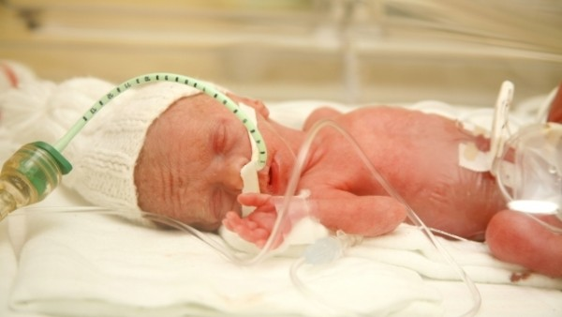
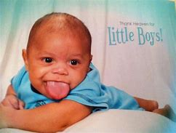
Lower birth weight to gestational age, small for gestational age, intrauterine growth retardation
Higher birth weight to gestational age, huge newborns

Slide 13
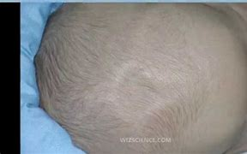
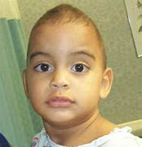
Large fontanelle-late closure after 18 months of age, irregular large fontanelle, wide open large fontanelle
Large fontanelle - premature closure, premature adhesion of e.g. sagittal suture, importance of measuring frontooccipital circumference

Slide 14
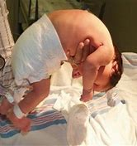
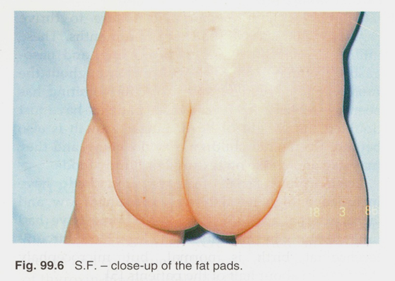
Severe muscle hypotonia, floppy baby
Atypical distribution of fat on the body

Slide 15
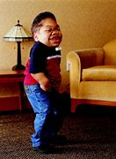

Delayed growth, small growth <3rd percentil for a given age
Accelerated growth, high growth> 97th percentil for a given age

Slide 16
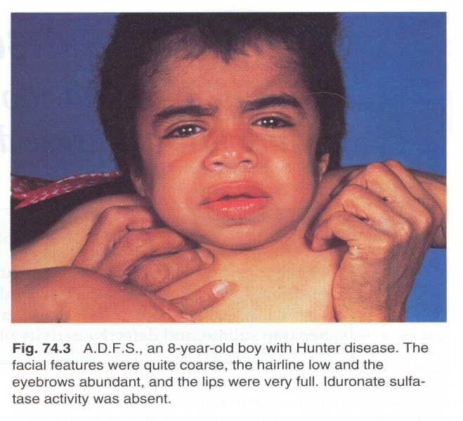

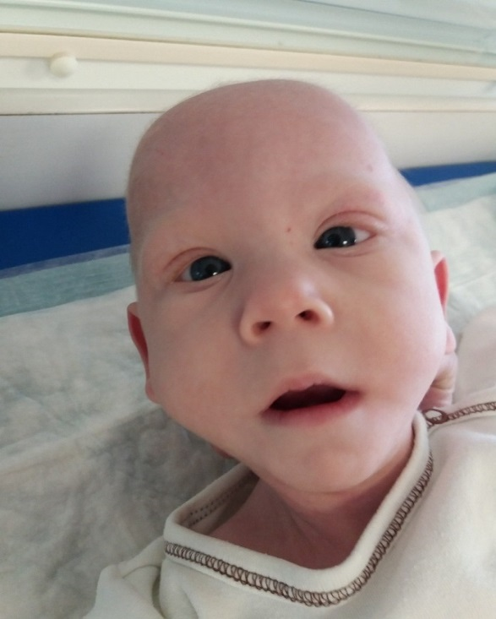
Overweight (BMI 90th - 97th percentil) and obesity (BMI> 97th percentil)
Facial dysmorphia

Slide 17

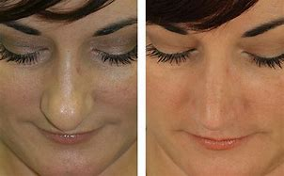
Iris heterochromia
Bulbous nasal tip

Slide 18
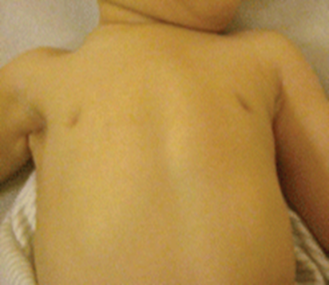
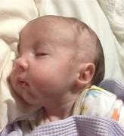
Atypical nipples - inverted
Dysplastic lobes, lower set, rotated and small or large, small chin

Slide 19
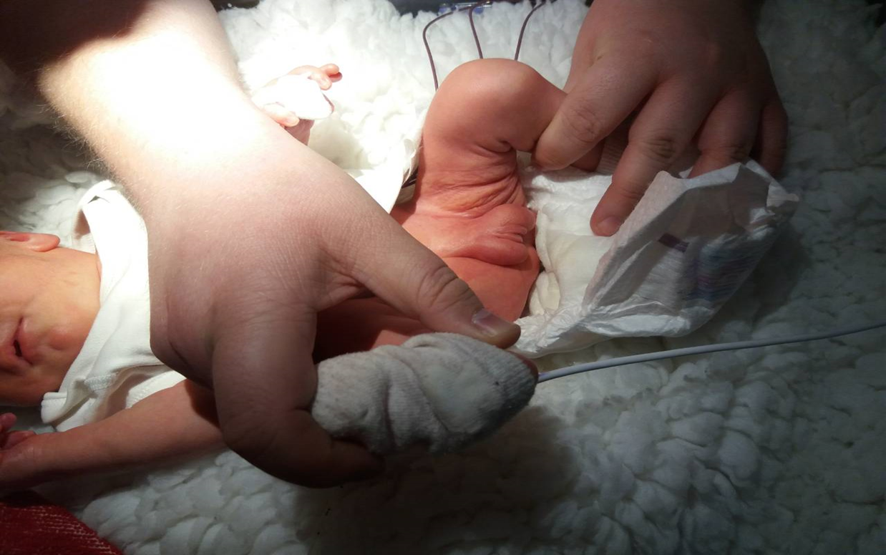
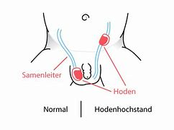
Hypogenitalism, hypogonadism, cryptorchidism, ambiguous genitalia

Slide 20
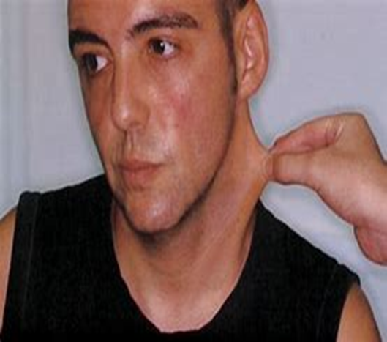
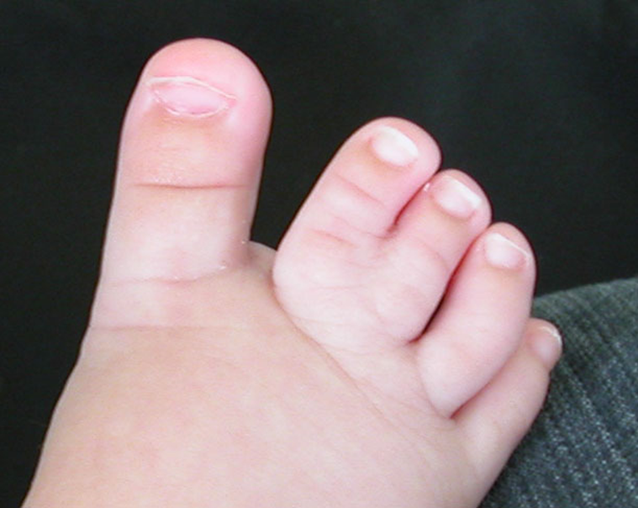
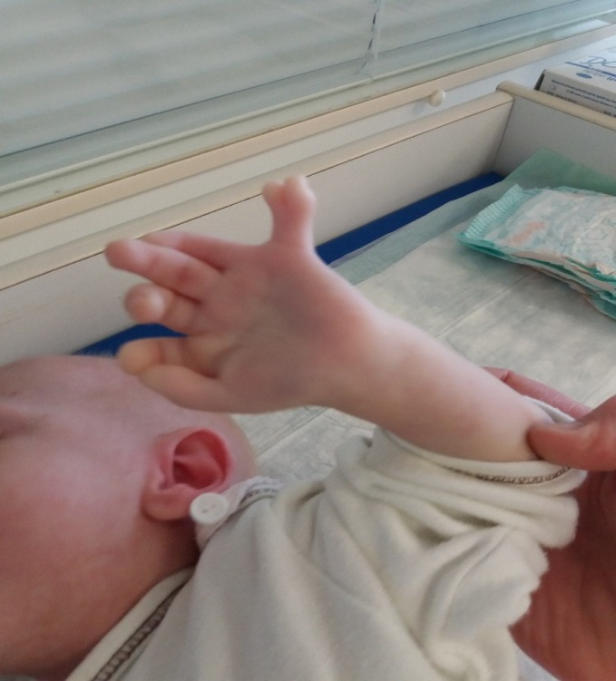
Arachnodactyly, brachydactyly, syndactyly, polydactyly, wide thumbs
Cutis laxa, loose skin

Slide 21
Microdeletion syndrome
I.E. Alagille syndrome (ALGS), Prader-Willi syndrome (PWS), Williams-Beueren syndrome, etc.
Typical facies
Typical occurrence of congenital heart disease
There may be mental disabilities of varying degrees
They usually arise as "de novo" mutations, but also as inherited mutations
Case report of a child with ALGS

Slide 22
Subtelomeric rearrangement
Cause about 7% of mental retardations
Phenotype: facial dysmorphia, dysplastic ears, dermatoglyph anomalies, microcephaly, growth and development retardation
Examination is indicated for dysmorphic features and unexplained developmental disorders

Slide 23
Mosaic affections (approx. 1% of the population)
I.E. Sturge-Weber syndrome, SWS
Early postzygotic chromosomal or gene mutations lead to the development of two or more cell lines with different genetic equipment
There is the development of poor placental function or the development of malformations and anomalies
Presence of affection only in a part of cells - affection has a clinically less severe course compared to the full form, when the affection can be up to lethal

Slide 24
Syndromes of chromosomal instability, immunodeficiency and hypersensitivity to mutagens
I.E. NIJMEGEN BREAKAGE SYNDROME; NBS,
ataxia telangiectasia variant V1
Enzymatic disorders at the DNA level leading to DNA repair failure
It most often affects rapidly dividing cells
High risk of malignancies

Slide 25
Syndromes caused by a trinucleotide repeat expantion
I.E. Fragile X syndrome, FXS;
Caused by a trinucleotide repeat expantion
They depend on the sex of the parent from whom the child inherits the mutation
Presence of premutation in the parent - the presence of an increase in the number of trinucleotide repeats from normal to abnormal numbers

Slide 26
I recommend you look at all the syndromes listed here on the Internet or in a textbook

Slide 27
Case reports (PKU, ALGS, HPP)

