Slide 1
Case report 1
A case of a boy whose teeth had fallen out a bit earlier
Dagmar Procházková

Slide 2
Learning outcomes
the student will be presented with a case report of a child with hypophosphatasia

Slide 3
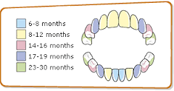
The case of a boy whose teeth fell out at the age of 18 months.
Usually the baby has all baby teeth at 30 months of age.

Slide 4
History
Family history: without interest
The child from the 1st pregnancy, delivery in the 35 th week of pregnancy, birth weight 2060g, birth length 47 cm. Postpartum adaptation in the norm, breastfed for a full month, then artificial nutrition. From the 4 th month of age mixed baby food.
He prospered well, psychomotor development normal.
With verticalization gradually lower limbs pain, development of genua and crura vara, chest with steep ribs with regular administration of vitamin D. At the age of 18 months, the first deciduous teeth (lower incisors and canines) begin to fall out.

Slide 5
Long-term care of a dentist, complete dental prosthesis from 3 years of age, in adulthood gradually permanent teeth replaced by dental prosthesis.
From toddler age in the care of an orthopedist.
X-ray of the wrist and hand in childhood: thin bone structure, in the distal metaphysis of the radius and ulna at the epiphysis oval brightening.
Bone densitometry at the age of 15: in the lumbar spine and in the whole-body scan - osteopenia. At present the finding is improved, in both localities the finding of normal bone density in the tolerated zone to age with an increase in BMD (bone mineral density) in the spine and the hip in general.

Slide 6
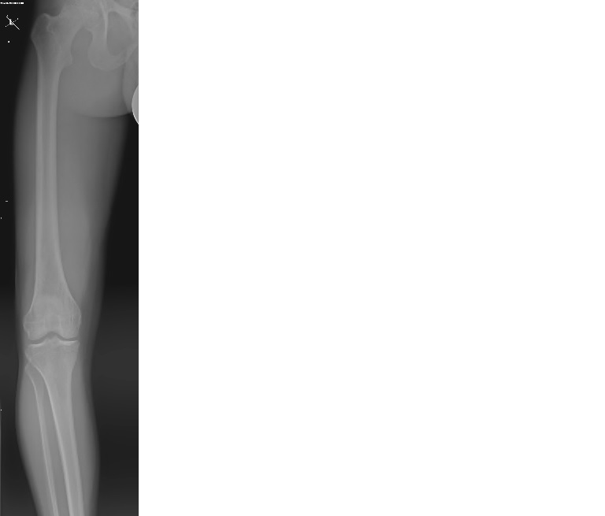
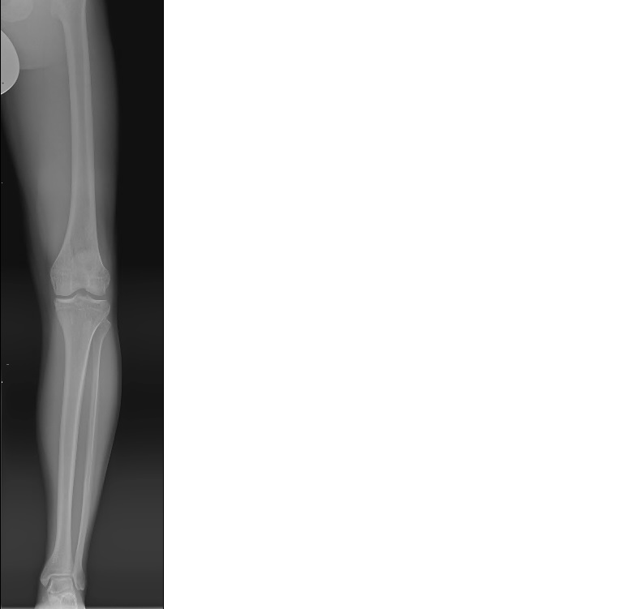
At 19-23 years of age, valgus osteotomy of the lower limbs was performed. However, even after correction, lower limbs pain persists.
Fractures
10/2014 right leg, fracture of the second metatarsus
6/2016 right hand, fracture of the base of the fifth metatarsus
8/2016 left foot, fracture of the diaphysis of the third metatarsus

Slide 7
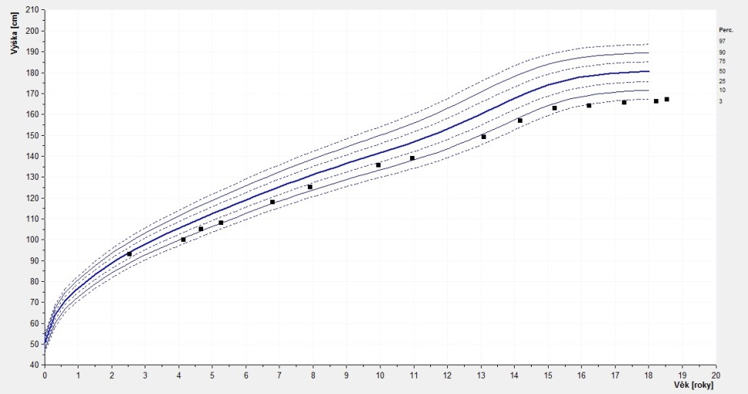
As a child, he thrived on weight well. The height to age gradually decreased below the 3rd percentile. The final height of the figure in adulthood is 166 cm.
In ultrasound of the abdomen without signs of nephrocalcinosis, detected renal cyst 16x11 mm stationary with age.
Renal function has long been normal.

Slide 8
Selected laboratory results
Parameter | Normal value | Results |  |  | Comment
Ca | 2,15-2,6 mmol/l | Repeatedly in the norm
Ca ⁺⁺ | 1-1,4 mmol/l | 1,264 mmol/l
P | 1,1-1,9 mmol/l (children); 0,8-1,45 mmol/l (adults) | In childhood 2,18...2,4 mmol/l; in adulthood 1,52 mmol/l |  |  | Elevated values
ALP | 0,67-2,15 μkat/l | 0,23...0,36...1,45...0,51...1,37...0,69...0,82...1,19 μkat/l |  |  | Fluctuating values
ALP isoforms |  | hepatic 3 % | bone 95 % | intestinal 2 %
25-OH vitamin D | 50-200 nmol/l | 21,5 nmol/l |  |  | Decreased values
Parathyroid hormone | 0,8-7,8 pmol/l | 0,81…0,5…2,7 pmol/l |  |  | Fluctuating values
osteokalcin NMID | 14-46 μg/l | 60…68...169,4 μg/l |  |  | Elevated values
calcitonin | 0-18,2 ng/l | 5,00…2,00 ng/l
Ca in urine/24 hours | 2,4-7,5 mmol/24 hours | 3,6 mmol/24 hours
Ca/creatinine in urine | 0-0,6 | 0,23
P in urine/24 hours | 16-33,5 mmol/24 hours | 33,4 mmol/24 hours
phosphoethanolamine (PEA) in urine | 9-25 mmol/molKr | 104 mmol/molKr |  |  | Elevated values

Slide 9
Laboratory examination in adulthood (General Hospital Prague):
↑ Pyridoxal-5-phosphate (PLP), vitamin B6 in the blood 2121.0 (3.6-18.0) µg/l
↑ Urinary phosphoethanolamine (PEA) 42 (norm up to 10.0) mmol / molKr

Slide 10
DNA diagnostics
In 2016, DNA analysis of the ALPL gene for HPP was performed at the Institute of Biology and Medical Genetics of the 2nd Medical Faculty of Charles University and the Motol University Hospital.
Proband is a composite heterozygote for the c.526G> A, p. (Ala176Thr) / c.2797_802delCCCACT, p. (Ser266_His267del) mutations.
Both variants are termed pathogenic and are the molecular cause of HPP (Taillandier, 2000; Spetchian, 2006).

Slide 11
Hypophosphatasia- HPP
# MIM 241500, 241510, 146300
Rare congenital metabolic disorder caused by a mutation in the ALPL gene, which encodes tissue non-specific alkaline phosphatase (TNSALP)
Low serum TNSALP activity leads to impaired skeletal and dental mineralization
The incidence of severe forms in the European population is about 1: 300,000 live births, milder forms are more common
Heredity in severe forms AR, in lighter forms AD
The clinical manifestation is very wide

Slide 12
Hypophosphatasia - HPP-forms
Distribution based on the severity of clinical symptoms and age of the individual at the time of the first manifestation of the disease:
Perinatal lethal - already intrauterinely as severe skeletal hypomineralization
Prenatal benign - short and markedly curved bones of the lower limbs, improvement in the 3rd trimester of pregnancy
Infantile - in the first 6 months of age, deformities of the chest, ribs, hypercalcaemia, nephrocalcinosis, convulsions, failure to thrive, craniosynostosis, pyridoxine-responsive epilepsy
Pediatric - manifestations after 6 months of age, changes resembling rickets, skeletal deformities, short stature, dentition disorders, failure to thrive, hypotension, myopathy, pain of low extremities

Slide 13
Adult - fractures, pseudofractures, limb pain, osteoarthropathy, chondrocalcinosis
Odontohypophosphatasia-exclusively dental symptoms, premature loss of teeth, increased caries, mildest form

Slide 14
Diagnostics
Diagnosis is based on clinical symptoms typical of individual forms of HPP (HPP can be diagnosed in utero in the perinatal form by ultrasound, possibly X-ray).
Blood calcium levels are usually normal, there may be hypercalcaemia. Blood phosphorus levels tend to be elevated.
Decreased ALP in the blood is typical. In some cases, ALP can reach low or cut-off values even with HPP carriers. Age-specific standards should be used to evaluate blood ALP.
In patients with HPP, concentrations of pyridoxal-5-phosphate in the blood and phosphoethanolamine in urine are high, indicating ALP dysfunction.
Molecular genetic analysis of the ALPL gene confirms the disease.

Slide 15
Hypophosphatasia- HPP
Causal therapy:
Recombinant TNSALP Enzyme Replacement Therapy, Alpha Phosphatase, StrensiqTM, Alexion Pharmaceuticals
Reserved for severe forms of HPP, very expensive
Other options: ????? calcium, vitamin D, bisphosphonates ?????
Not recommended

Slide 16
Take home message
In dentistry, too, we must keep in mind the inherited metabolic disorders

