Slide 1
Law in healthcare 02

Slide 2
Question no. 1
What is the purpose of the law in healthcare?

Slide 3
Social role?
Create trust
Level of organsation in society
Achieve „justice“
Achieve „equality“
Protect the weak
Serve as tool for economic transactions
Protect investment

Slide 4


Two main masses of Law
PUBLIC LAW
  Constitution
  Hierarchy
  Enforcement
  Formal process
PRIVATE LAW
  Individual
  Equality
  Authonomy
  Freedom

Slide 5

The rights and obligations of citizens in health care
(from yesterday)

Slide 6
Patient has rights:
As a citizen
to health protection.
to free health care
right to medical aids under conditions provided by law.
As a policyholder
to choose the health insurance company
to time and the local accessibility and availability of paid services
On medicinal product and foods for special medical purposes
As a patient
"Patients means a natural person, which are provided by the health services"
His rights correspond with obligations of healthcare provider and medical staff
(Charter of Fundamental Rights and Freedoms)

Slide 7
Patients rights (what the group thinks)

Slide 8
Rights of the patient (§28 HCA)
Right on the provision of health services at the appropriate professional level
according to the rules of science and accepted medical practices,
while respecting the individuality of the patient,
with regard to the specific conditions and objective options.
to esteem, treated with dignity, to be treated with courtesy in accordance with the nature of health services,
respect for privacy during the provision of healthcare services
in accordance with the nature of healthcare services,
Related rules for the close persons, medical documentation, etc.

Slide 9
Rights of the patient (§28 HCA)
to choose a provider authorized to provide healthcare services,
to seek consulting services from another provider or healthcare professional, other than that who provides health services;
to be informed about the internal rules of the healthcare facility inpatient or day care

Slide 10
Rights of the patient (§28 HCA)
to be informed in advance about the cost of health services not covered by public health insurance,
to know the names and surnames of healthcare professionals directly involved in the provision of healthcare services
to reject the presence of persons who are not directly involved in the
providing of healthcare services
Including those preparing for the profession of healthcare professional,

Slide 11
Rights of the patient (§28 HCA)
to receive visitors in a medical facility of inpatient or day care,
with regard to their health
in accordance with the internal rules
in a manner which does not infringe the rights of other patients, unless HCA or another law provides otherwise
to receive the pastoral care and spiritual support from spiritual churches and religious communities
on provision of health services in the least restrictive environment while ensuring the quality and safety of healthcare services.

Slide 12
Obligations of the patient (!)
to follow a designed individualized treatment procedure
to follow the internal rules,
to pay the provider cost of health services provided to him with his consent
truthfully inform healthcare professional about the development of health condition, including information on infectious diseases
not to drink alcohol or use other addictive substances during hospitalization and undergo in justified cases examination in order to establish whether or not is the patient under the influence of alcohol or other addictive substances at the discretion of the attending physician

Slide 13
Refusal to provide healthcare services

Slide 14
It is important to distinguish
Rejecting by a Healthcare Professional
Retention of conscience
Rejecting by a Healthcare Provider
rejection of proof of identity
operational reasons
Foreigners from the EU have a special regulation
refusal to provide healthcare services to the patient if the disclosure would be contrary to conscience or religious beliefs of a healthcare professional
exceeding the workload
not insured

Slide 15
Termination of the healthcare (provider)
transfer the patient to another healthcare provider
There are no longer reasons for the provision of healthcare services; does not apply in the case of the registering provider
patient refuse the provision of all healthcare services,
patient severely restricts the rights of other patients
deliberately and systematically fails to comply with the proposed individual medical procedure, if he gave his consent to the provision of health services,
Does not follow internal rulles
does not cooperate;

Slide 16
Informed consent with medical performance; denial of medical care

Slide 17
Distinguish
Informed consent
Information about health condition
Free of will
Informed
notified upon admission to healthcare
Always if it is purposeful
The patient may waive

Slide 18
Information about health condition
about the disease,
the purpose, nature, expected benefits, potential consequences and risks of the proposed health services
other possibilities, their suitability and risks
another needed treatment,
restrictions and recommendations in the way of life with regard to health conditions
options
  To waive the right to be informed about health condition
  identify the persons to whom the information may be given or to impose a ban on reporting on health condition according to § 33.

Slide 19
Retention of health information,
The information would cause serious injury to the patient.
Does not apply if:
a) there is a need for early treatment,
b) risk for the surroundings,
c) patient specifically asks for accurate and truthful information.

Slide 20
Written form of a consent
Consent with hospitalization must be in writing.
Written form of a consent must be where it is required by law or a provider.
Remember HCA, transplantation Act,

Slide 21
Refusal to treatment
Revers
Withdrawal of consent
Previously expressed wishes

Slide 22
REVERS
the patient is informed about his health condition and still refuses treatment
makes a written declaration of refusal
Withdrawal of consent
Patient may withdraw his consent to the provision of healthcare services unless the medical procedure has allready started and its termination may cause a serious injury to the patient.
Record
Written consent and written withdrawal of a consent or its record is a part of medical documentation
It is signed by a patient and healthcare professional
Patient may refuse to sign - healthcare professional and witness

Slide 23
Previously expressed wishes
Patient may express agreement / disagreement in advance in certain cases
Provider takes into account the previously expressed wishes if
it is available
there was a predictable situation which previously expressed wish covers
patient is unable to pronounce a new agreement or disagreement
Previously Expressed wishes will be respected
If it was based on a written notice about the consequences of his decision.
It must be in writing and shall bear an officially verified signature of the patient.
If a written notice of the attending physician is a part of previously expressed wishes.

Slide 24
When it is not necessary to respect the previously expressed wishes?
From the expression occurred such developments on which basis it can be reasonably assumed that the patient would give his consent;
Patient encourages to cause his death,
Its fulfillment could threaten others,
If the provider started a healthcare procedures at the time he did not know previously expressed wishes and interruption of such procedures would lead to an active cause of death.

Slide 25
Underage patient
it is necessary to know his opinion on the planned provision of health services if it is appropriate to his age and maturity.
the importance of his opinion increases in proportion to age and degree of maturity.
The intended health services can be provided to an underage patient on the basis of his consent if the execution of such procedure is appropriate to his mental and moral maturity and corresponds with his age.

Slide 26
Hospitalization and provision of health services without consent
Hospitalization
condition of the patient requires the provision of urgent care and he is unable to give his consent at the same time
Urgent care
case of health services essential to saving lives or preventing serious damage to health.
Based on a court decision
such as protective measures imposed in criminal proceedings

Slide 27
The patient can not give his consent
consent of the person designated by the patient
spouse or registered partner
parents
consent of other legally competent close person

Slide 28
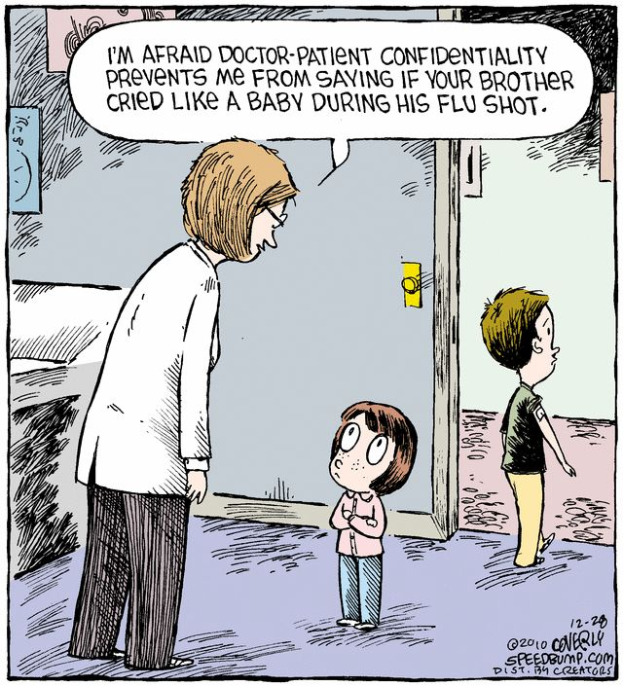
Privacy and confidentiality of medical information

Slide 29
Importance of information and privacy today
Our society as a society of information, more and more people are engaged in processing of information in their profession
Information as a commodity
Some information touches the personal spheres of individuals
Privacy becomes one of the most discussed aspects of human life

Slide 30
The requirement of ethics
Part of the Hippocratic oath
I will respect the privacy of my patients, for their problems are not disclosed to me that the world shall know.
Privacy is part of accentuated patient autonomy in modern bioethics.

Slide 31
Special sensitivity of health information
Many health information are sensitive (sexual life, mental state, alcohol and drug addiction, career and career goals)
Some other information are generally less sensitive, especially if they can not be easily kept secret
They may be sensitive to specific patients (with regard to employment, family, religion, etc.)

Slide 32

The legal concept of privacy

Slide 33
Charter of Fundamental Rights and Freedoms (Art. 10)
Everyone has the right to preserve his dignity, honor, reputation and protect his name.
Everyone has the right to protection against unauthorized intrusion into private and family life.
Everyone has the right to protection against unauthorized gathering, publication or other misuse of his personal data

Slide 34
Privacy
The right not to be part of the public
The right to "personal area"
The right to withhold information about yourselves
The right to decide if and how should be facts from personal privacy revealed to others
United States: Right to be let alone
The right to privacy extends to every individual,
regardless of age or legal capacity

Slide 35
Personality
Life
Expressions of a personal nature
Dignity
Privacy
Honor
The right to live in a favorable environment
Health

Slide 36
Specific regulations in healthcare
The patient has the right during the provision of healthcare services to:
esteem, decent treatment, courtesy and respect for privacy during the provision of health services,
reject the presence of persons who are not directly involved in providing of health services,
know the names of healthcare professionals and students

Slide 37
The rules of the Civil Code
No person shall intervene into the privacy of another, unless…
Legal reason,
Permission
Without permission you cannot:
disrupt Private Spaces of a man,
watch his private life,
capture audio or video recording,
use the images recorded about the private life of a person by a third party,
spread such records of his private life.

Slide 38
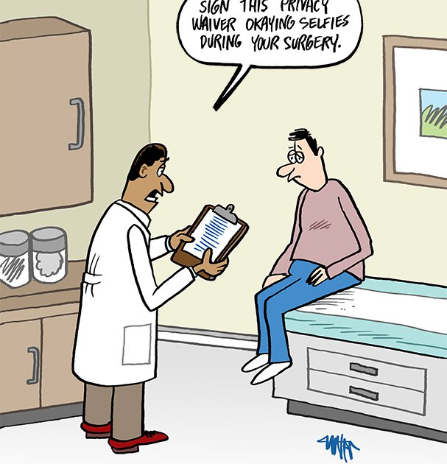
Protection of human appearance
Capture a human appearance by any way, so that it is possible to determine his identity, is possible only with his permission.
Spread human appearance is possible only with his permission.

Slide 39
How to obtain a consent
In Writing
Tacitly
Orally

Slide 40
Confidentiality of a healthcare professional
(Medical secret)

Slide 41
Privacy contra Confidentiality
Privacy
Confidentiality
  Protection from identifying and collecting personal data
  Protection against unauthorized access to information
  Protection from capturing photographs, recordings and records
  Preventing the spread of information to which the medic gained access
  Even if you obtained that information legally

Slide 42
Law on Healthcare Services
The Provider is obliged to maintain confidentiality about all the facts that he has learned in connection with the provision of health services

Slide 43
Who is bound by the obligation of confidentiality?
Health workers and other professionals in connection with the exercise of their profession, including those who are no longer in employment, and information obtained in connection with the former exercise of the profession of healthcare professional
Persons acquiring competence to pursue the profession of healthcare professional (aka students)

Slide 44
“Medical secret”
From the perspective of the law :
Confidentiality of a healthcare professional
Confidentiality of a healthcare provider
Much, MUCH(!) higher standards of confidentiality than other professions
Break only in cases precisely defined by the Law

Slide 45
Confidentiality conceived in very broad terms
All facts with which healthcare professionals meets
  Diagnosis
  Medical procedure
  Information about relatives (family history)
  Any information regarding patient

Slide 46
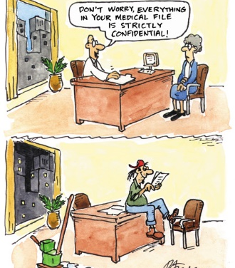
Handling medical documentation

Slide 47
Medical documentation
What do you imagine under it?
Writing doctor into papers?
Is it really just a paperwork?
It would be impossible to cure anyone rationally in practice without medical documentation!
Medical documentation contains a lot of confidential data and therefore deserve special protection and treatment!

Slide 48
The Provider is obliged to keep and store medical records and dispose of them according to this Act and other legal regulations. Health documentation is a set of information:
Patient’s identification data
the sex of the patient
identification data of the healthcare provider
information on the patient's state of health
data from the family, personal and occupational history of the patient, and (if justified) also from social history
data relating to the death of the patient

Slide 49
Maintenance of a medical records
Medical documentation can be kept
In a paper form
In an electronic form
In a combined paper and electronic form

Slide 50
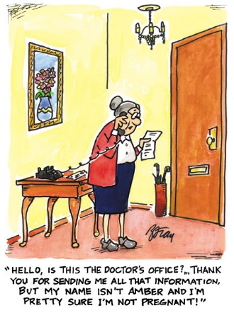
Medical documentation
The law imposes to keep medical records conclusively truthfully and legibly! The information in it must be continuously and promptly updated
Correction of an erroneous entry in the documentation is done by striking out with one line (the entry, even the erroneous one, must remain legible)
It always must be clear who made which notation!

Slide 51
Access to a medical documentation
Healthcare professionals
Patient
Family, relatives, survivors
Students

Slide 52
Healthcare professionals
persons with the legal capacity to practice the medical profession
in direct connection with the provision of health services
to the extent strictly necessary for the pursuit of the profession
to perform tasks under HcAct or other legal regulations
when assessing the correct procedure for providing health services

Slide 53
Patient
In the presence of an employee authorized by the provider
The right to make copies or extracts
The Provider may charge the cost of making copies of the documentation (but cannot make any profit)

Slide 54
Family, relatives, survivors of the deceased
legal representative or guardian (minors), person specified by the patient, legal representative or guardian
persons close to the deceased patient:
information on the state of health of the patient who died and information on the outcome of the autopsy if done, including the right to inspect the medical records kept about the deceased or other medical records relating to his / her state of health and to obtain extracts or copies thereof.
the deceased could forbid this access in advance
Acts on behalf of the patient

Slide 55
Students and a medical documentation
Persons preparing for the profession of a medical professional may inspect the medical documentation to the extent strictly necessary for teaching.
The patient may prohibit access to his medical documentation to students.
NO COPIES AND EXTRACTS (possible only with the express consent of the patient)

Slide 56
Sanctions
The Health Services Act imposes penalties for improper management of medical documentation.
The unauthorized disclosure of the information contained in the medical documentation is always a violation of the mandatory confidentiality

Slide 57
Communication with family members and public authorities

Slide 58
Information requests about the health status of a patient by persons other than the patient
Family members
Public authorities (for example, the Police of Czech Republic, courts, various administrations, etc.)

Slide 59
Family of a patient
Careful! Fully competent patient decides on the disclosure of information about his health condition by himself, even towards the family members of the patient (persons close).
A patient may designate any person (even unrelated) who may receive information about his health and vice versa, without his consent it is not possible to disclose confidential information even to persons close to the patient.
The exception is if the patient's condition requires that these people have to care about the patient, or it is necessary to protect their health.
In a case of a patient who is not fully sui juris, the right to decide on disclosure of information about the health of this patient to third parties has fundamentally his legal representative or guardian (determined by a court).

Slide 60
Disclosure of health information
Information about health of a patient are being given by the attending medical personnel!
Students of medical faculties do not give any information about health of patients to anyone, even family members of the patient!

Slide 61
When is it possible to breach a confidentiality?
Consent of a patient
Providing follow-up services
Communication of data for the purpose of criminal proceedings
Protection of your rights
Fulfilling the duty to thwart or report the offense

Slide 62
How to obtain a consent
Explicit
Oral
In writing
Tacitly

Slide 63
Information on patients' health requested by public authorities
Compulsory confidentiality of healthcare professionals is required by law and has great social significance
Remember the right to privacy
Public authorities, including the police and the courts, can require information about health of a patient only in cases determined by a law.
For an example it is not enough that a policeman comes to the hospital and asks about the patient's health condition (typically at injuries caused by the other person).

Slide 64
Obligation to notify
In certain cases there is the so-called notification obligation when everybody (not only a healthcare professional) has to notify the Police of the Czech Republic upon the fact that a crime of cruelty or wilful grievous bodily harm (a serious injury) was committed.
In certain cases of children patients it is necessary to inform the authority of social and legal protection of children.
Such as underage drinking, abuse of addictive substances, or when there is suspicion that a crime endangering health or life, human dignity or moral development was committed on them.
At the hospital, however, this reporting obligation should be primarily met by the attending healthcare professionals, not students.

Slide 65
Remember!
Not everyone who cares about the health of the patient is entitled to this information!
This also applies to family members of the patient and public authorities.

Slide 66
Conclusion
Students should not be providing information about the health status both to the patient and third parties (family members, public authorities and others).

Slide 67
Sanctions for unauthorized breach of confidentiality

Slide 68
Criminal penalties
Penalties shall be given to who, even if negligently, violates the obligation of secrecy by unlawfully disclosing, communicating or making available to a third party personal data obtained in connection with the exercise of his profession, occupation or function, thereby causing serious harm to the rights or legitimate interests of the person
Up to three years or a ban on activity
If deliberately – up to 8 years

Slide 69
Administrative sanctions
Breach of the Provider's Obligations arising from HcAct
A fine of up to CZK 1,000,000
Breach of the Provider's Obligations under the Personal Data Protection Act
According to GDPR - up to 4% of yearly turnover of a healthcare provider

Slide 70
Private Law Penalties
Labor-law sanctions
Even the immediate termination of employment
Exposure to the risk of bringing a lawsuit
Compensation for non-material damage

Slide 71
Disciplinary sanctions
Every citizen has the possibility to submit complaints to doctors at no cost to the CMC organs, at all times, if he thinks that the physician was acting improperly or acting unethically.
Fine up to CZK 30.000
Exclusion from the Czech Medical Chamber
Actual ban on activity up to 5 years

Slide 72
Thank you for your attention

